Slide 1

Intro to Alma Analytics
September 17, 2024
Michelle Eichelberger, SUNY Library Services

Slide 2
Agenda
Overview
Roles
Access
Account Settings
Navigation
Catalog
Tools
Create Analysis
Objects & Sharing

Slide 3
Why bother with Analytics?
Timing: Now that SUNY is 5 years into Alma, most configuration is working smoothly and there’s breathing room to learn new functionality
Decision Making: Analytics can inform important decisions like collection development, facilities choices, staffing, etc.
Marketing: Reports can be shared with campus administration to highlight the success stories and needs of the library
Overview

Slide 4
SLS Series: 6 more sessions in this series, register here.
Ex Libris Training: SUNY webinars aren’t meant to replace Ex Libris’s Alma Analytics: Become an Expert series, which starts 9/18/24
SUNY Library Services Guides/FAQs:
  Alma Analytics Training Guide
  Alma Analytics FAQs
The best way to learn Analytics is to go in and practice.
Overview, cont.

Slide 5
Key Points
OBI: Analytics is built on Oracle’s Business Intelligence (Enterprise Edition) platform.
Tracking: Analytics keeps a record of all cataloging, circulation, and other Alma activities even if you delete a record, or course, or user, etc.
Timeliness: Data is always a day behind, and sometimes more for areas like Titles
Other Options: Sometimes an advanced Alma search or indication rule is a better way to find information
Notes:
Delete bibs!
Analytics isn’t organized by MARC fields, advanced searches are more efficient to find things like suppressed bibs, active portfolios, etc.

Slide 6
Alma Roles
Analytics Administrator: To manage Alma Analytics configuration including Analytics Objects List, Analytics User Statistics, and Analytics Citation Attribute Types.
Designs Analytics: To design/create/edit/work on any analytics reports, analysis, dashboards etc.
Partial Access Roles: To have these roles available, you must set the support_partial_analytics_designer parameter (Configuration>Analytics>General Configuration>Other Settings) to true.
  Designs Analytics – Fulfillment
  Designs Analytics – Resources
  Designs Analytics – Acquisition
Ex Libris Documentation on Analytics Roles

Slide 7
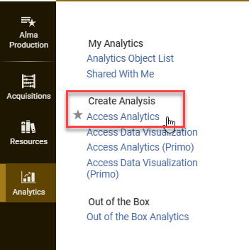
Access Analytics
In Alma, navigate to the Menu bar. Click Analytics>Create Analysis>Access Analytics
If you are not taken directly to the Analytics menu and are given a login screen, close the window and log out of Alma and log back in again.

Slide 8
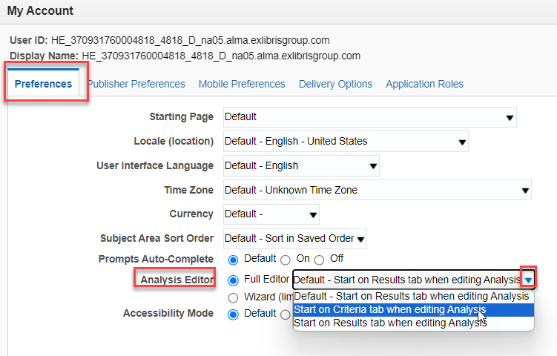

Account Settings
Click on Profile icon in top right to review account settings
Set Starting Page: Choose Home instead of Default
Analysis Editor setting: Start on criteria tab

Slide 9
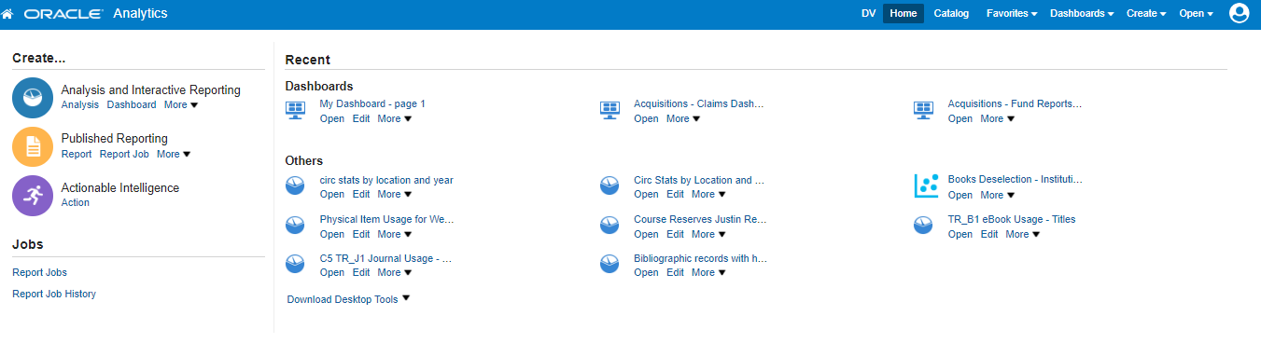
Navigation
Highest Priority Areas:
Home, Catalog, Create

Slide 10
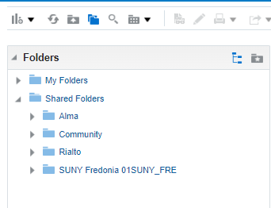
Catalog
My Folders:
Reports that only you can see
Shared Folders:
Alma: Ex Libris Out of the Box Reports
Community: Reports shared by Alma Community Users, including SUNY
Institution Folder: Reports to share with other campus users

Slide 11
Catalog Tips
My Folders and Institution Folder:
Best place to practice creating reports
Can easily add folders, delete reports if you make a mistake
Once you have a working report in your personal folder, can copy it to institution folder to share with colleagues through a widget or email
Alma and Community Folders:
Reports will automatically use your local data
Please do not edit these reports – used by everyone who has access to Alma Analytics
To edit: Copy report and paste into your folder or your Institution Folder
Dashboards: Use “archive” method to copy into your folders

Slide 12
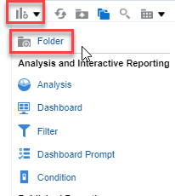
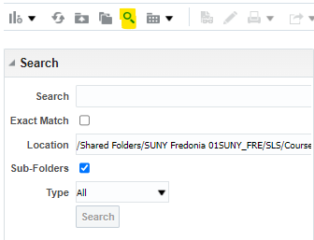
Tools
High Priority Tools:
Add Folder
Search

Slide 13
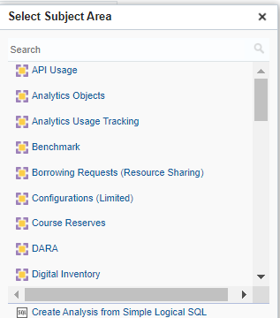
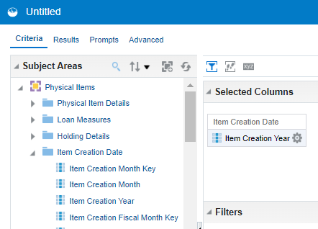
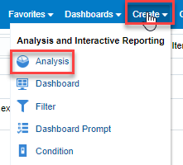
Create Analysis

Slide 14
Create Analysis: Challenges
General:
Steep learning curve
System is complicated – takes a lot of trial and error
Only as good as the data you’ve tracked (withdrawals, etc.)
Subject Areas:
Knowing what’s included in each area
Not always structured in ways you’d expect, e.g. not by MARC fields
Terminology sometimes unclear
Finding a way to combine data
Currency: Some areas updated more frequently than others

Slide 15
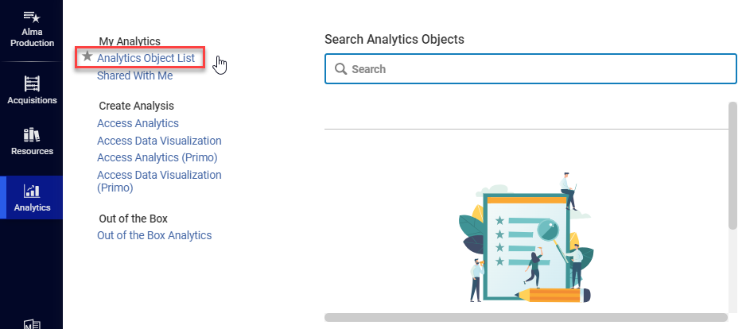
Analytics Objects
Access:
Analytics>My Analytics>Analytics Object List
Purpose:
Quick access to reports
Create widgets
Schedule emailed reports

Slide 16
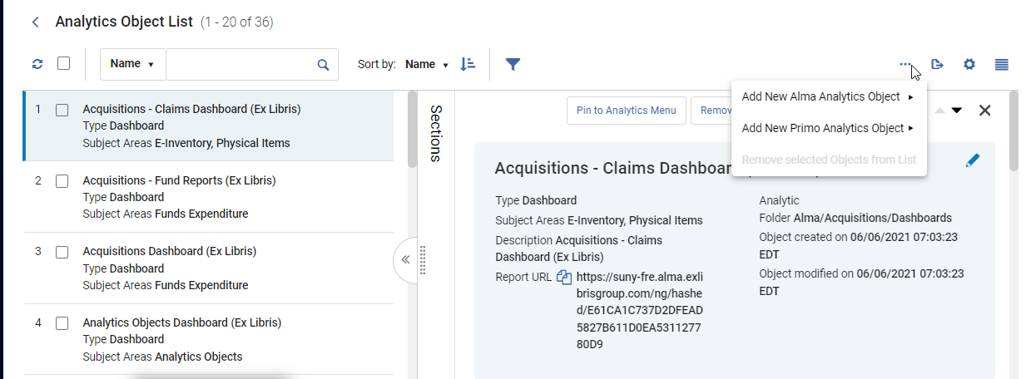
Analytics Objects
https://sunyolis.libguides.com/training-analytics/sharingresults

Slide 17
Live Demo & Discussion

