Slide 1

Fireside Chat
NC Medicaid Updates
Ready, Set, Launch!
Tailored Plans
RCC (Relay Conference Captioning)
Participants can access real-time captioning for this webinar here:
<Enter Link Here>
February 16, 2023

Slide 2

Logistics
for Today’s
Webinar

Slide 3
agenda
01
Tailored Plan Launch Specifics and Path to Success
02
Claims Payment and Processing
03
Responding to Urgent Member Needs
04
Tailored Care Management
05
Q&A
Q&A

Slide 4
Tailored Plan Launch Specifics and Path to Success

Slide 5
Key Reminders for Tailored Plan Launch:
Maintaining Continuity of Care
As a provider, it is important that you are aware of the transition of care protections that impact providers.
The Tailored Plan will honor existing and active prior authorizations on file with NC Medicaid Direct for services covered by the health plan for the first six months after launch (October 31, 2023) or until the end of the authorization period, whichever occurs first.
For the first six months after launch (October 31, 2023), the Tailored Plan will pay claims and authorize services for Medicaid-enrolled out-of-network providers equal to that of in-network providers until end of episode of care or six months, whichever is less (extended transition periods may apply for circumstances covered in N.C. Gen. Stat. § 58-67-88(d), (e), (f), and (g).).
If a beneficiary transitions between health plans after April 1, 2023, a prior authorization authorized by their original health plan will be honored for the life of the authorization by their new health plan

Slide 6
Key Reminders for Tailored Plan Launch:
Maintaining Continuity of Care
In addition to transition of care requirements for Members in an ongoing course of treatment, the Department and Tailored Plans will offer the following flexibilities to support providers to reduce administrative burden during the transition.
Policy Level | Duration | Time Frame
Relax Medical PA requirements | 90 days | 4/1/2023 – 6/30/2023
Relax Pharmacy PA requirements | 90 days | 4/1/2023 – 6/30/2023
Non-Par Providers Paid at Par Rates | 90 days | 4/1/2023 – 6/30/2023
Non-Par Providers Follow In-Network Prior Authorization Rules | 122 additional days | 7/1/2023 – 10/31/2023
Ability to Switch PCP | 213 days | 4/1/2023 – 10/31/2023

Slide 7
Key Reminders for Tailored Plan Launch:
Front Desk Readiness
Make sure staff know the health plans you are contracted with, including Standard Plans, Tailored Plans and the EBCI Tribal Option.
Continually review the NCTracks provider record for each applicable individual provider and organization for accuracy and submit changes using the Manage Change Request (MCR) process.
Know where to submit claims.
For each health plan under contract, be sure enrollment in the Health Plan’s Electronic Funds Transfer program is complete.
Assist beneficiaries with the transition to Tailored Plans
  Verify eligibility, primary care provider and health plan enrollment using the NCTracks Recipient Eligibility Verification/Response or by calling the NCTracks Call Center for more information at 800-688-6696.
  Member ID cards will be provided to each Tailored Plan Member, but are not required to provide service including pharmacies. Members should not be turned away due to the lack of a Member ID card in their possession.
  If you are not the assigned Primary Care Practice for the beneficiary but are in-network for the Tailored Plan, you can render and be paid for Primary Care Services. If the beneficiary would like to have you as their assigned Primary Care Practice, they should call their health plan to have them assigned to you.

Slide 8

Top Reasons to Contract
By contracting with Tailored Plans:
It creates greater choice for Medicaid Beneficiaries.
It creates better access to care for Medicaid Beneficiaries.
Beneficiaries will not have to choose between their medical home and critical specialty care.
In-Network Providers will be paid a higher rate compared to out of network providers (Tailored Plans must cap OON payments at 90% of fee schedule – typically the FFS fee schedule).
NOTE: By contracting, providers avoid or eliminate the risk of getting paid less than the full Medicaid rate.
In-network PCPs will receive additional AMH payments.
NOTE: These payments are not available for OON providers.
Over the past year DHB has worked closely with the Tailored Plans; Tailored Plans understand NC Medicaid better and have improved on early contracting issues.
  NOTE: If your early experience was not great, consider trying again.
Some providers are contracting with all 6 plans, recognizing it is in the best interest of the beneficiaries.

Slide 9
Tailored Plan-Standard Plan Partnering
Tailored Plans are partnering with a Standard Plan to provide an integrated plan with behavioral health and physical health services.
More information on the Tailored Plan-Standard Plan partnering can be found in the Contracting with Tailored Plans fact sheet
Find contact information for contracting with each Tailored Plan
Tailored Plan | Standard Plan Partner* | Leveraging Standard Plan Partner’s PH Network
Alliance | WellCare Health Plan | Not at this time
Eastpointe | WellCare Health Plan | Yes, at least partially
Partners | Carolina Complete Health | Yes, at least partially
Sandhills | AmeriHealth Caritas of NC | Yes, at least partially
Trillium | Carolina Complete Health | Yes, at least partially
Vaya | WellCare Health Plan | Not at this time

Slide 10
Claims Payment and Processing

Slide 11
Paying Claims: The Process Across Plans
 | Alliance | Eastpointe | Partners | Sandhills | Trillium | Vaya
Submit Claims via: | Electronic: Alliance Claim System (ACS) - Alliance Health (alliancehealthplan.org) EDI Payer ID: 23071 Paper: (only with prior approval) 5200 W. Paramount Parkway, Suite 200, Morrisville, NC 27560 | Electronic: Providers – Welcome to Eastpointe.net EDI file 837 : Payer ID 08044 Paper: Eastpointe will only accept paper claims from Out-of-Network providers (OON). Eastpointe Claims Department PO BOX 14552 Lexington, KY 40512 | Electronic: Provider Connect Paper: Electronic submission is preferred, an OON provider may also submit a paper claim by mail. Physical Health: P.O. Box 8002 Farmington, MO 63640-8002 Behavioral Health: 901 S New Hope Road Gastonia, NC 28054 Payer ID: Physical Health - Payer ID 68069 Behavioral Health - Payer ID 13141 | Electronic: Change Healthcare EDI Payer ID 837I, 837P: SHC00 Submit paper, key in portal or 837's all through Change Healthcare | Electronic: BH electronic claims BH-IDD Provider Portal: https://www.ncinno.org/ PH electronic claims: PH Provider Portal: provider.trilliumhealthresources.org EDI: 837I, 837P (BH 56089 or 43071; PH 68069) Paper: Behavioral health and I/D: Trillium Health Resources PO Box 240909 Apple Valley, MN 55124 Physical health: Carolina Complete Health Attn: Claims PO Box 8040 Farmington, MO 63640-8040 | Electronic: Vaya's Provider Portal Login Page - Provider Central at www.vayahealth.com EDI: 837I, 837P: AVS01 Paper: Vaya accepts paper claims for emergency and post-stabilization care Vaya Health, Attn: Claims Processing 200 Ridgefield Ct Suite 218 Asheville, NC 28806
Denials Notified by: | Within 18 calendar days of receiving a clean claim | Within 18 calendar days of receiving a clean claim | Within 18 calendar days of receiving a clean claim | Within 18 calendar days of receiving a clean claim | Within 18 calendar days of receiving a clean claim | Within 18 calendar days of receiving a clean claim
Submit Claims Dispute: | Providers may submit a claims dispute through certified US mail, or through email at Claimsreconsiderations@Alliancehealthplan.org | Provider Appeal Form Mail Eastpointe Director of Grievance and Appeals 450 Country Club Road Lumberton, NC 28360 Email: grievanceappeals@eastpointe.net | https://www.partnersbhm.org/tailoredplan/providers/appeals-submissions/ Mail: Partners Health Management 901 S. New Hope Rd., Gastonia NC 28054 | Provider Appeal Form found in the Provider Support Portal Mail: Provider Network Grievance and Appeals Coordinator 3802 Robert Porcher Way Greensboro, NC 27410 Fax: 910-673-6202 | Provider Direct Portal Mail: Trillium Health Resources Attn: Appeals Department 201 West First Street Greenville, NC 27858 | Electronic: Provider Appeal Form Mail: Vaya Health Attn: Claims Reconsiderations 200 Ridgefield Ct. Suite 218 Asheville, NC 28806 Phone: 1-866-990-9712 or 828-258-3395 ext. 1600 Email: ClaimsReconsideration@vayahealth.com
Dispute Timing: | Submit within 30 days of denial A decision will be made within 30 calendar days of receipt of a complete appeal request | Submit within 30 days of denial Eastpointe will provide a written resolution letter within 30 calendar days of receipt of the grievance/complaint | Submit within 30 days of denial Decision will be made within 30 calendar days of the receipt of the standard appeal request. | Submit within 30 days of denial Decision will be made within 30 days from receipt of the Grievance and/or Appeal. | Submit within 30 days of denial Grievances and complaints are resolved within 30 calendar days of receipt | Submit within 30 days of denial Grievances and complaints are resolved within 30 calendar days of receipt
Prior Auth Services: | Providers will search by procedure code for prior authorization requirements. Details on Prior Authorization Submission Process will be posted here: https://www.alliancehealthplan.org/tp/providers/clinical-resources/ | The provider will use the "Look-up Tool" located on our website. The provider enters the service code and the Tool will report if a PA request is needed (as well as a link to where the PA request can be submitted, if required). https://www.eptestitransact.com/HSP_HT/iTransact/Provider/AuthorizationLookup.aspx | Providers will consult Benefit Grids outlining service codes, service limits, level of care and documentation requirements needed for service authorization requests (SARs) located at: https://providers.partnersbhm.org/benefit-grids | There is a list of services that require prior authorization in the provider handbook and on the website. Right now we use a “master grid,” which tells the PA requirements, but that will be re-worked for TP. https://www.sandhillscenter.org/for-providers/provider-forms | Trillium Health Resources Benefit Plan will include all services and which services need a prior authorization. The Benefit Plan will be available on Trillium's website at www.trilliumhealthresources.org under For Providers, Benefit Plans | Service Definitions | Providers can determine the services that require prior authorization by reviewing Vaya’s authorization guidelines, available at the following link: https://providers.vayahealth.com/authorization-billing/authorization-info/authorization-guidelines/

Slide 12

PA/Claims Processing for Contracted Providers
Service | Primary UM Entity | Initial Prior Authorization | Claims Payment & Processing | Member PA Appeals | 2nd Level Member PA Appeals
BH UM | Alliance | Alliance | Alliance | Alliance (or IRO) | Alliance
Specialty PH UM Complex labs Cardiac imaging Radiation oncology Musculoskeletal/ orthopedics imaging procedures | WellCare | WellCare | Alliance | WellCare | Alliance
Durable Medical Equipment (DME) | Northwood | Northwood | Northwood | Alliance | Alliance

Slide 13
PA/Claims Processing for Contracted Providers
Service | Primary UM Entity | Initial Prior Authorization | Claims Payment & Processing | Member PA Appeals | 2nd Level Member PA Appeals
Vision | Avesis | Avesis | Avesis | Alliance | Alliance
NEMT | ModivCare | ModivCare | ModivCare | Alliance | Alliance
Pharmacy Benefit Management | Navitus | Navitus | Navitus | Alliance | Alliance
Physician Drug Program (PDP) | Alliance | Alliance No PA Required | Alliance | Alliance No PA Required | Alliance No PA Required

Slide 14

Claims Submission
Electronic, Paper, and Direct Entry
  Claims are processed by Eastpointe for physical and behavioral health and state-funded claim
  Electronic claims should be submitted in the standard 837 claim format, Payer ID 08044.
  Paper claims can be submitted to :
  Eastpointe Claims Department
  PO BOX 14552
  Lexington, KY 40512
  For claims requiring documents, forms can be submitted directly to the claims department, through the iTransact portal during claims entry, via secure email to Claimsfunding@eastpointe.net, or faxed to the attention of Eastpointe’s Claims Department at 1-910-272-1299.
  Providers are loaded from the Provider Eligibility Files from NC Tracks, for information on submitting required forms to receive EFT and 835s, providers should contact the Provider Service Line at 1-888-977-2160.

Slide 15
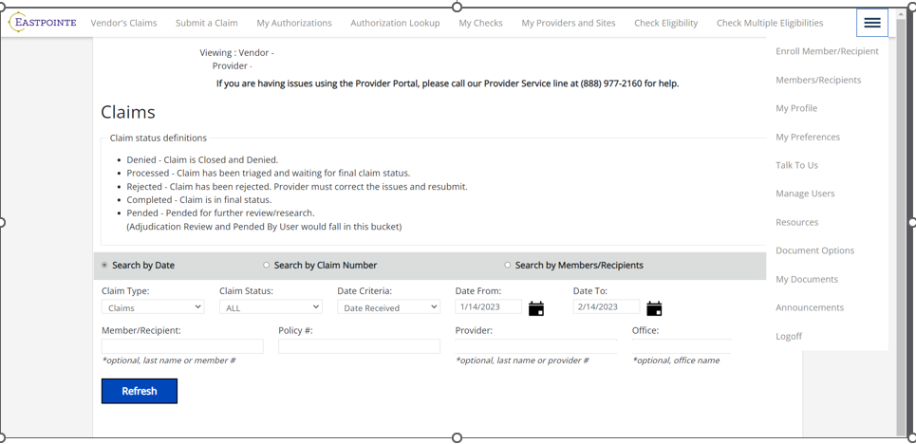
iTransact: Provider portal
Behavioral Health, Physical Health, and State-Funded Claims

Slide 16
  Vision claims
  Eastpointe is partnering with Envolve, Providers can use the Eye Health Manager Portal at https://visionbenefits.envolvehealth.com/logon.aspx to:
  NEMT claims
    Verify member eligibility
    Manage Claims
    Check the status of a claim
    Review past claim submissions
    Reprint EOPs
    View office manual and plan specifications
    View Envolve Vision’s policies and Procedures
Each Transportation Provider will have access to the MTM claims online portal. In the claim’s portal, once the Transportation Providers submits a claim, they will be able to follow it Realtime through the different statuses. Transportation Providers can submit claims, view statuses, appeal denials and search within claims portal 24/7. If a claim is denied, the Transportation Provider will be able to appeal the denial directly in the portal, which also allows the Transportation Provider to submit additional documentation in support of the appeal, if necessary. Claimsanalysis@mtm-inc.net
  Pharmacy claims
Eastpointe’s Pharmacy Benefit Manager (PBM) is Express Scripts. Pharmacy claims should be submitted via the NCPDP HIPAA-approved format. Pharmacy Call Line 1-866-240-9487.

Slide 17
Providers may submit an “Electronic Funds Transfer (EFT) Authorization Agreement for Automatic Deposit" form with official bank letter or voided check
  Form is on our website: https://mco.eastpointe.net/DocumentBrowser/file/CAPFSContracting/Electronic%20Funds%20Transfer%20Form.pdf
Providers must complete an Enrollment Application and send in the EFT Form, W9 Form, and Trading Partner Agreement to networkoperations@eastpointe.net
  Providers must be enrolled and active in NCTracks to be enrolled with Eastpointe

Slide 18
Partners Health Management Claims Submission
Providers may submit claims electronically or by mail.
Electronic Claims Submission
Providers will access Provider Connect for claim submission at:
https://id.partnersbhm.org/
  Alpha+ - Medicaid Tailored Plan Behavioral Health and State Benefit
  Availity - Medicaid Tailored Plan Physical Health
Claims may be submitted via clearinghouse or SFTP as per usual business practice.
  Behavioral Health claims will be submitted to Alpha+
  Physical Health claims will be submitted to Availity
Paper Claims - Electronic submission is preferred; an Out Of Network provider may also submit a paper claim by mail.
Medicaid Tailored Plan Physical Health should be mailed to:
  P.O. Box 8002
  Farmington, MO 63640-8002
Medicaid Tailored Plan Behavioral Health and State Benefit should be mailed to:
  901 S New Hope Road
  Gastonia, NC 28054
Payer ID
Physical Health – Payer ID is 68069
Behavioral Health – Payer ID is 13141

Slide 20
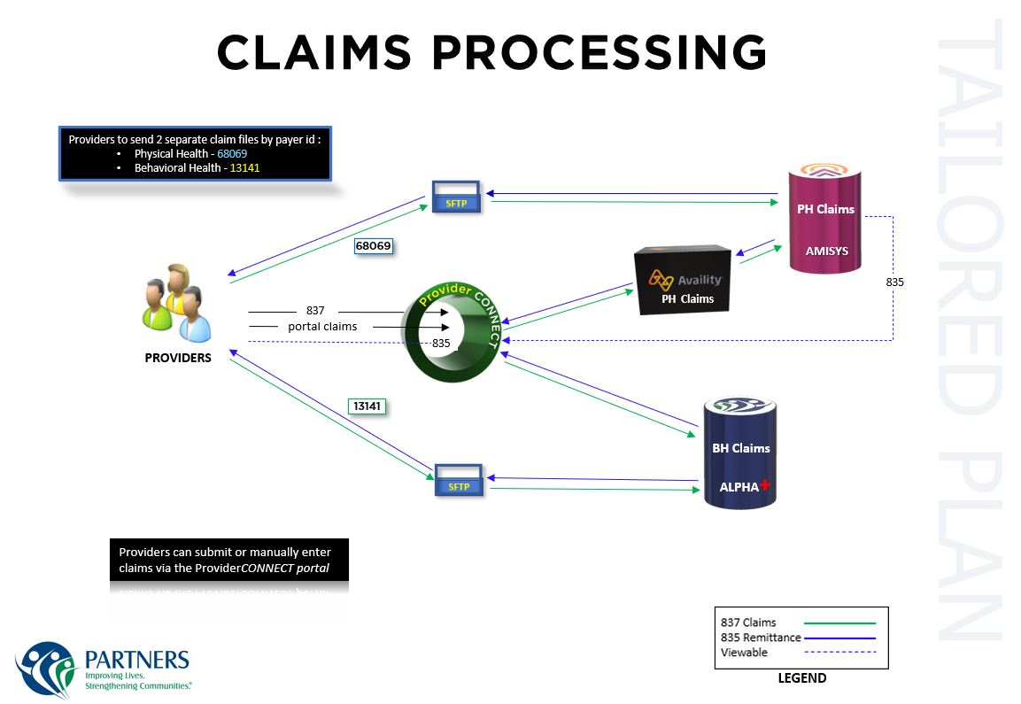

Slide 21
Sandhills Center – Claims Submission
Tailored Plan Providers are contractually required to submit billing electronically
Connection to Change Healthcare (CH), our claims clearinghouse, is required. Provider enrollments are based on TIN
If already established with CH, add Sandhills Center Payer ID SHC00 AND 14816 to your list
Logins for Change Healthcare Portal will be available to download 835s or remittances
  BH Claims will come back on the 835 from SHC00
  PH Claims will come back on 835 from 14816
Beginning April 1, 2023, providers will use Change Healthcare’s “Connect Center“ portal to key in Tailored Plan claims – No fees for providers who register
 | Payor ID: | Remittance Information will include: | EFT Agreement with: | Correspondence (payment, recoup, other) from:
BH Claims | SHC00 | SHC00 | Sandhills Center | Sandhills Center
PH Claims |  | 14816 | AmeriHealth Caritas NC
Providers will need to be registered for both the SHC00 and 14816 Payer ID’s

Slide 22
Sandhills Center – Claims Submission Guidance and Resources
Guidance:
Although not required, providers are encouraged to produce routine billings on at least a weekly or bi-monthly schedule
Sandhills Center will load daily updates into our system via the Provider Eligibility File from NC Tracks, providers are encouraged to review NC Tracks record on a regular basis
Resources:
Detailed instructions are provided in the EDI Companion Guides
  The Companion Guides (a user manual for electronic 837 submissions) gives very specific instructions on what is required to submit claims electronically to Sandhills Center (https://www.sandhillscenter.org/uploads/shc837pcompanionguideversion1.pdf)
Sandhills Center is developing a Claims Submission Guide (available by March 15, 2023)
Sandhills Center will be holding a claims training in March 2023

Slide 23

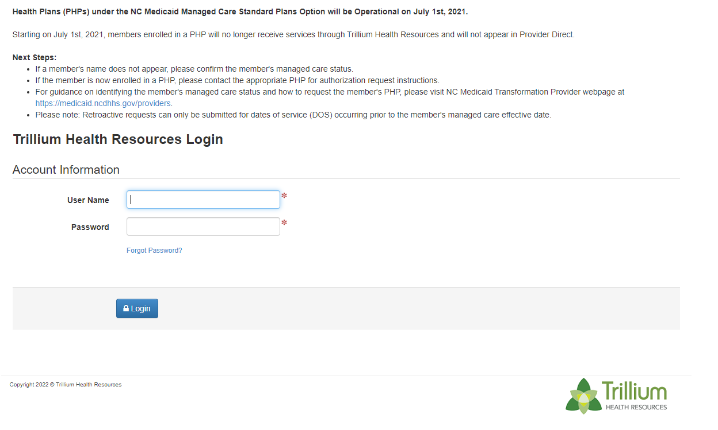
Trillium Health Resources –
Tailored Plan Behavioral Health I/DD and State Funded Claims
Claims for Behavioral Health I/DD fall into three groups:
  Mental Health/Substance Use (MH/SU)
  Traumatic Brain Injury (TBI)
  Intellectual Developmental Disabilities (IDD)
    These include Intermediate Care Facilities for Individuals with Intellectual Disabilities (ICF-IDD), Innovations Waiver services and other home and community-based services.
Billing
  MH/SU/IDD services will be billed with the appropriate primary ICD-10-CM diagnosis code to the highest level of specificity that meets medical necessity in the range of F10-F99
  Exceptions are noted in the Claims Submission Protocol table available in Trillium’s Tailored Plan Provider Manual
Submission
  Claims described here may be submitted to Trillium using HIPAA Standard Electronic Transaction set via one of the following:
    Secure Behavioral Health I/DD web portal
    Secure FTP
    Via claims clearinghouse:
      Change Healthcare (previously Emdeon) via Medical Payer ID 56089
      The SSI Group via Medical Payer ID 43071
Secure Behavioral Health I/DD Portal

Slide 24
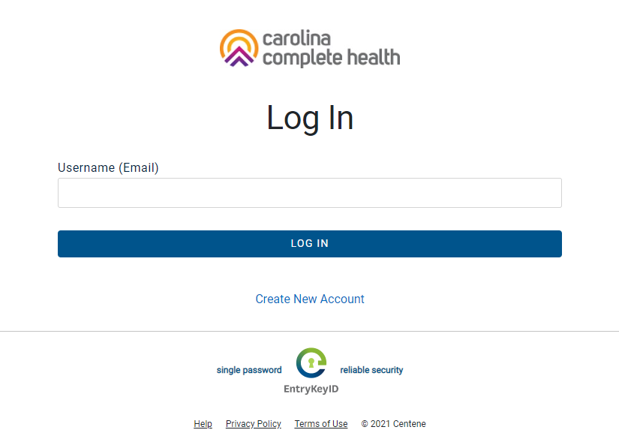
Trillium Health Resources –
Tailored Plan - Physical Health Claims
Claims for Physical Health include:
  Physical health
  Long-Term Services and Supports
    Inclusive of nursing facility, home health, private duty nursing, personal care, and hospice services.
Billing
  Primary medical ICD-10 diagnosis code to the highest level of specificity meeting medical necessity excluding the range of F10-F99
  Exceptions are noted in the Claims Submission Protocol table available in Trillium’s Tailored Plan Provider Manual
Submission
  Physical health claims described here and physician-administered (professional) drug claims may be submitted to Carolina Complete Health (CCH) using HIPAA Standard Electronic Transaction set via one of the following:
    Secure web-based Physical Health Portal
    Secure FTP
    Via claims clearinghouse:
      Availity via Medical Payer ID 68069
Secure Physical Health Portal

Slide 25
Trillium Health Resources –
Tailored Plan - Pharmacy, NEMT and Vision Claims
Pharmacy Claims
  Pharmacy claims for rendered pharmaceuticals or pharmacy services, including outpatient pharmacy, point-of-sale claims may be submitted to PerformRx using the most current NCPDP HIPAA-approved format with Rx BIN Number 019595 and PCN – PRX10811.
Non-Emergent Transportation to Medical Care
  Claims for Non Emergency Medical Transportation (NEMT) and Non Emergent Ambulance Transportation (NEAT) services are processed through Trillium’s contractor Modivcare
  Modivcare responsibilities also include booking of reservations/rides
  Providers can bill electronically through Modivcare’s web portal, by an Automated Transportation Management System (ATMS), or by submitting paper claims.
Vision
  Claims for Vision services are processed through Envolve, a subsidiary of CCH
  Claims may be submitted using HIPAA Standard Electronic Transaction set or via a secure web-based portal linked here.

Slide 26
Trillium Health Resources –
Tailored Plan – Provider Portals & Training Resources
To access the secure provider portals, please visit trillium’s website at www.trilliumhealthresources.org and select “For Providers”
The Behavioral Health I/DD Portal and Physical Health Portal are web-based systems available to Trillium partners upon completion of a Trading Partner Agreement (TPA)
  Both portals provide access to behavioral health and physical health claim entry screens
Billing through these portals is Direct Data Entry (DDE) where an electronic CMS1500 or UB04 form is accessed and billing information is entered and submitted for reimbursement
  Trillium Provider Direct Webinars are available in the secure Behavioral Health IDD - Provider Direct Module to assist with completing CMS1500 and UB04 claim forms
  Secure Physical Health Portal training resources may be found Carolina Complete Health Network’s Education and Training Page.
For Additional Training information on How to Submit Claims to the Provider Portal
  Behavioral Health I/DD Portal
    Trainings available within the Behavioral Health I/DD Secure Provider Portal – Provider Direct
    Trainings available on My Learning Campus from the Trillium’s website
      www.trilliumhealthresources.org
  Physical Health Portal
    Trainings available at Carolina Complete Health Network’s Education and Training Page
      https://network.carolinacompletehealth.com/resources/education-and-training.html

Slide 27
Vaya Health Claims and Payment Processing
More information at www.providers.vayahealth.com

Slide 28
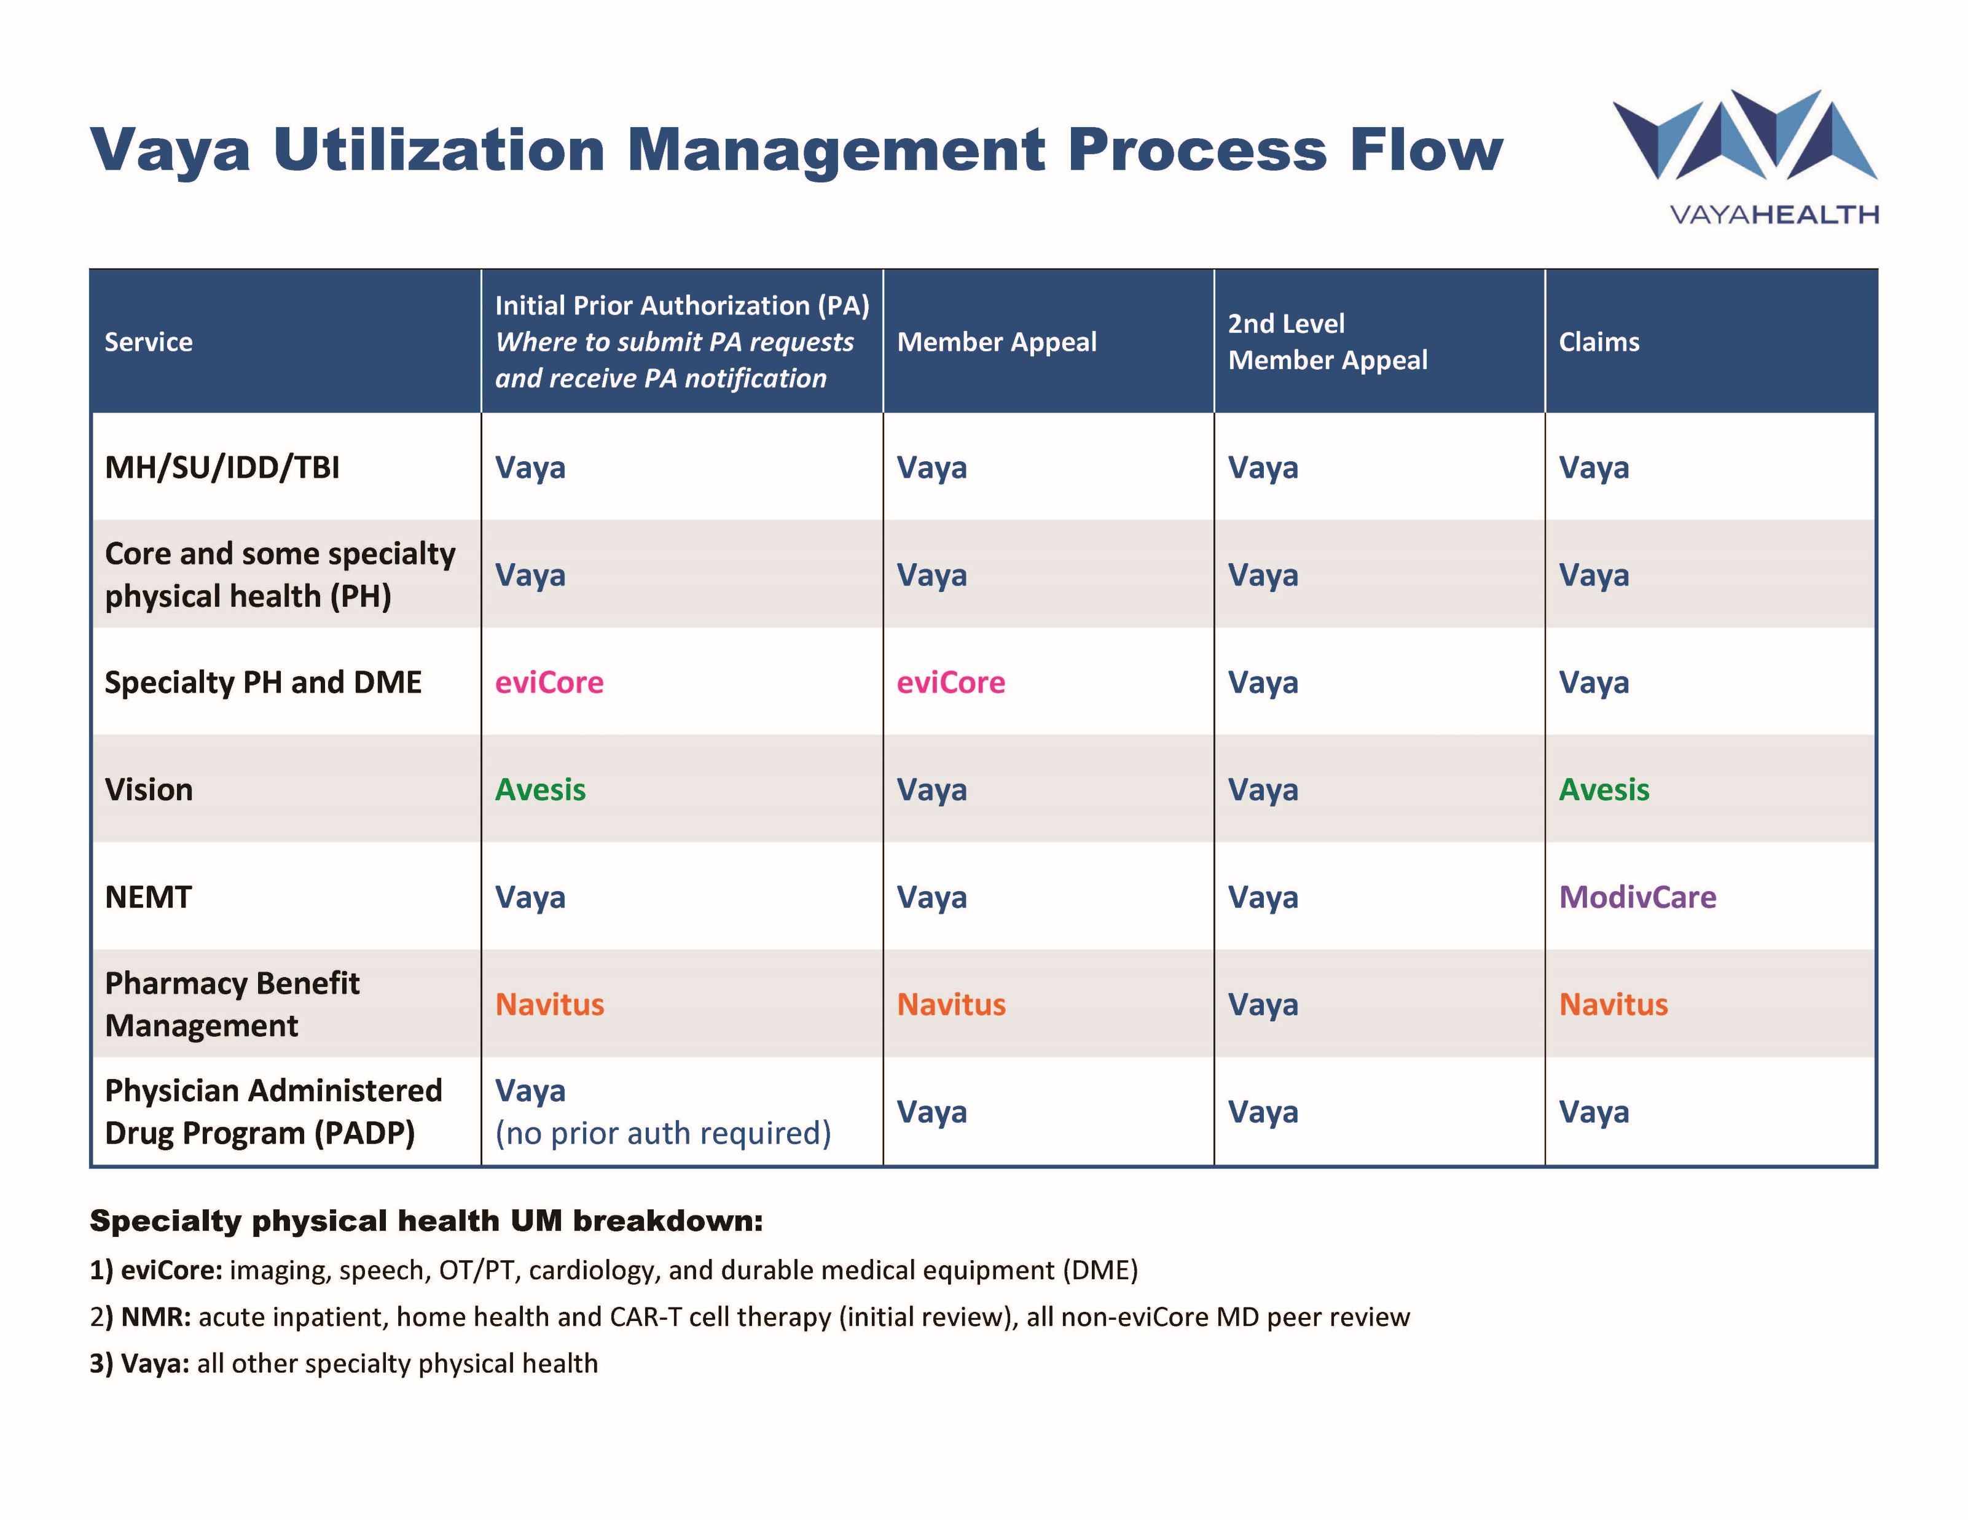
Vaya Health Claims and Payment Processing
Utilization Management Process Flow
More information at www.providers.vayahealth.com

Slide 29
Vaya Health Claims and Payment Processing
Behavioral and Physical Claims
(including physician administered medications (PADP) & durable medical equipment (DME)
Network Providers
  Submit all claims using Vaya’s Provider Portal or HIPAA-compliance 837 Electronic Data Interchange (EDI) file
Out of Network Providers
  Submit emergency and non-emergency service claims using Vaya’s Provider Portal for faster claims adjudication and payment processing
  For paper claims, Vaya will only accept emergency service claims via paper. Paper claims should be submitted to:
  Vaya Health
  Attn: Claims & Reimbursement
  200 Ridgefield Ct. Suite 218
  Asheville, NC 28806
All providers must submit a completed IRS W-9 and Electronic Funds Transfer (EFT) form
For more information or to establish access for electronic claims submission visit Vaya’s Claims Submission website at https://providers.vayahealth.com/authorization-billing/claims/claims-submission/

Slide 30
Vaya Health Claims and Payment Processing
Pharmacy Claims
  Vaya is partnered with Navitus Health Solutions for pharmacy claims
  In-network pharmacies
    Point-of-sale claims routed to Navitus for processing
  Out-of-network pharmacies
    Submit claims for Direct Member Reimbursement to
    Navitus Health Solutions, LLC
    PO Box 999
    Appleton, WI 54912-0999
For more information on claims submission visit Vaya’s Claims Submission website at https://providers.vayahealth.com/authorization-billing/claims/claims-submission/

Slide 31
Vaya Health Claims and Payment Processing
Vision Claims
  Vaya is partnered with Avesis for Medicaid members vision benefits
  Vision claims can be submitted one of three methods
    Avesis Provider Portal accessed through Vaya’s Provider Portal or direct at https://www.avesis.com/Commercial3/Providers/Index.aspx
    Clearinghouse (EDI) vendors include
    Change Healthcare (615-932-3000 or www.changehealthcare.com)
      Trizetto (800-869-1222 or www.trizetto.com)
      Avesis Payer ID AV501
    Paper
      Avesis Third Party Administrators, LLC
      Attn: Eye Care Claims
      PO Box 38300
      Phoenix, AZ 85069-8300
For more information on claims submission visit Vaya’s Claims Submission website at https://providers.vayahealth.com/authorization-billing/claims/claims-submission/

Slide 32
Vaya Health Claims and Payment Processing
Non-emergency Medical Transportation (NEMT) Claims
  Vaya is partnered with Modivcare, LLC for Medicaid NEMT benefits
  NEMT claims are processed through Modivcare’s Transportation Provider Portal
    To establish access and submit claims visit https://www.modivcare.com/login
For more information on claims submission visit Vaya’s Claims Submission website at https://providers.vayahealth.com/authorization-billing/claims/claims-submission/

Slide 33
Responding to Urgent Member Needs

Slide 34
Ombudsman Resources
  Member Resources:
  NC Medicaid Enrollment Broker
  Website ncmedicaidplans.gov
  Call Center 1-833–870–5500 TTY: 711 or RelayNC.com
  (Monday–Friday, 7 a.m. to 8 p.m., Saturday, 7 a.m. to 5 p.m.)
  Tailored Plan webpage ncmedicaidplans.gov/learn/get-answers/tailored-plan-services
    NC Medicaid Behavioral Health I/DD Tailored Plan webpage
    medicaid.ncdhhs.gov/Behavioral-Health-IDD-Tailored-Plans
  NC Medicaid Ombudsman
  Website: ncmedicaidombudsman.org
    Phone: 877-201-3750 (Monday–Friday, 8 a.m. to 5 p.m.)
  Provider Resources:
  Provider Ombudsman
    Email: Medicaid.ProviderOmbudsman@dhhs.nc.gov
    Phone: 866-304-7062

Slide 35
Vaya Health Member Issue Resolution
FOR MEMBERS
24/7 Access via our Behavioral Health Crisis Line at 1-800-849-6127
Seamless transfer to Nursing Triage/Advice Line (via Wellcare) for medical issues or directly at
1-800-290-1623
Member and Recipient Service Line 1-800-962-9003 (Mon-Sat 7a-6p)
FOR PROVIDERS
Provider Support Line 1-866-990-9712
Email provider.info@vayahealth.com
ESCALATION PATH
Access to Chief Medical Officer, Deputy Chief Medical Officer,
Chief Population Health Officer, and Pharmacy Operations for consult and assistance
Member/Recipient and Provider issues identified by the Call Center
will be triaged by the Command Center to ensure follow-up and issue resolution
No wrong door for bringing issues for escalation

Slide 36
Vaya Health Issue Resolution
No Wrong Door for submitting concerns, complaints, or grievances.
Call the Member and Recipient Service Line 1-800-962-9003 (Mon-Sat 7a-6p)
Vaya Call Center can transfer to Nursing Triage/Advice Line for medical issues or members can call them directly at 1-800-290-1623
24/7 Access to Crisis Help via our Behavioral Health Crisis Line at 1-800-849-6127
Providers can call the Provider Support Line at 1-866-990-9712 or email us at provider.info@vayahealth.com
ESCALATION PATH
Vaya works with NC Medicaid Ombudsman to achieve rapid resolution and has a dedicated point of contact for the Ombudsman
Vaya will have a dedicated Command Center for at least 90 days post go-live to ensure follow-up and issue resolution
Call Center and Command Center have direct access to Chief Medical Officer, Deputy CMO,
and Pharmacy Operations for consult and assistance

Slide 37
Vaya Health Member Issue Resolution Scenarios
Pharmacy Urgent Needs
  If a member is out of medication, a 72-hour supply can be issued to cover needs until an appointment can be made with their provider
  Pharmacy Customer Care Line 1-800-540-6083 (live 3/1/23)
    All calls (prescribers, members, pharmacies) handled by PBM Customer Care reps dedicated to work with NC Medicaid
    The PBM has broad authority to allow one time overrides to prevent member harm
    Vaya Pharmacy Operations team has direct access to PBM systems to ensure timely resolution of problems
Accessing out-of-network care
  Call Vaya Member & Recipient Service Line 1-800-962-9003 (Mon-Sat 7a-6p), they will gather information as a first step and will coordinate with medical team, Utilization Management and Provider Network to ensure rapid access to care
  Emergency and post-stabilization care will be reimbursed without prior authorization or contract
Accessing transportation for necessary medical appointments
  MODIVCARE will schedule trips for eligible members utilizing in-network
  transportation providers or out-of-network providers if MODIVCARE’s
  network providers are unavailable
  Family members can also transport members and submit for reimbursement of costs

Slide 38
Member Harm Issue Resolution
Trillium works with the Ombudsman for both member and provider questions and concerns to achieve rapid resolution.
Trillium has one designated point of contact for the Member Ombudsman
Trillium also has a team of staff dedicated to quick resolution of Help Center tickets.
Trillium has a no wrong door policy for accepting grievances. If you have a grievance please call the appropriate service line. Members may call 1-877-685-2415 and providers may call 1-855-250-1539, or use the online portal to submit this. You may also fax or mail your grievance.

Slide 39
Sandhills Center – Supporting Members Through the Transition
The mission of Sandhills Center, BH I/IDD Tailored Plan, is to develop, manage and assure that persons in need have access to quality mental health, developmental disabilities, and substance abuse services.
Sandhills Center is committed to improving your health and well-being. We aim for this goal by helping you get the right treatment that meets all your needs.
Customer Service Agents and Tailored Care Managers can assist you with:
Finding a provider
Making appointments
Arranging transportation
Getting /replacing your insurance card
Changing your PCP
Filing a grievance or complaint
Requesting an appeal
Updating your contact information
Requesting a change of TCM Provider
Questions about your benefits
Call the Sandhills Center Member Service Line at 1-800-256-2452 for assistance.
Our licensed behavioral heath clinicians are available 24/7 to offer support if you feel you are in crisis. Call 1-833-600-2054

Slide 40
Sandhills Center – Supporting Members Through the Transition
Sandhills Center has been working with community providers to educate and support their knowledge of the transition to the BH I/DD Tailored Plan.
Sandhills Center has:
  Delivered Quarterly Provider Forums that are recorded and available on the website
  Met with large groups (CCPN) and hospital systems reviewing expectations
  Distributed Provider Updates via email with contracted providers
  Educated department heads and specialist groups on Tailored Plan implementation
  Coordinated Joint Operating Committees with hospital systems
  Participated in training session for the NC Hospital Association
  Updated website information on Tailored Plan for providers and members
Sandhills Center is committed to ensuring continuity of care. Sandhills Center will continue contracting efforts to ensure a robust network and offer single-case agreements when needed so that our members remain connected to care and our providers are paid without delay.

Slide 41
Sandhills Center – Supporting Members Through the Transition
Non-Emergency Medical Transportation (NEMT)
Pharmacy Benefits
As the NEMT broker, ModivCare confirms that Members are eligible for transport, coordinates reservations, contracts with independent transportation providers, investigates complaints performs quality assurance, and pays providers according to their contracts for the full range of covered transportation services.
Sandhills Center Customer Service Agents work closely with the ModivCare team to ensure timely access to transportation and will coordinate your urgent and routine transportation needs.
Sandhills Center’s pharmacy partner, PerformRx, will assist members to get early refills for vacation supply, lost/stolen supply, leave of absence supply, national disaster supply, delayed mail-order supply, and spilled medication supply.
Sandhills Center has worked with our Pharmacy Benefit Manager (PBM), PerformRx, on a readiness stabilization plan to ensure continuous services with minimal disruption to members, providers and pharmacies participating with Sandhills Center.
Call Member & Recipient Services if you have questions: 1-800-256-2452
(TTY: 1-866-518-6778)

Slide 42
Partners Health Management
PartnersACCESS Call Center
Provider Services Line
877-398-4145
Members and Recipient Line
888-235-4673 (HOPE)
Hours: 7 a.m. to 6 p.m. Monday - Saturday
Behavioral Health Crisis Line
833-353-2093 (24/7/365)
Live answered by licensed clinicians
Command Center Response Approach
Dedicated Member email
Dedicated PCP management email
Proactive strategy
Rapid response
No wrong door access
Continuous communications across departments and with external partners
Weekly community Member Managed Care series
Grievances/Complaints 1-888-235-4673
  grievances@partnersbhm.org

Slide 43
  Proactive engagement and education
  Member Education:
    Tailored Plan benefits
    Tailored Care Management
    Value Added Services and Member Incentives
    How to stay healthy
  Eastpointe uses multiple communications channels to proactively address questions and concerns:
    Email
    Voicemail
    Welcome Packet mailing
    Community meetings and webinars
Notes:
Our message is consistent & continues to emphasizes Eastpointe’s commitment to exceptional care of our members
We recognize there will be opportunities that continue to present as we near launch and we are working hard to ensure there are no disruptions and that includes both service delivery and payment
Working diligently to ensure a healthy amount of information is shared proactively with our members

Slide 44
  Provide multiple ways to efficiently address Members’ and Recipients’ questions and issues
  + Provide accessible, mobile-friendly resources:
    Website (including provider directory)
    Member and Recipient Portal
    Benefits videos
  Multiple support/service lines operational with launch of the Tailored Plan
Notes:
We want to provide multiple communication paths that are seen as accessible for our members

Slide 45
  Member and Recipient educational resources
  Member and Recipient Website: Members and Recipients may find information on how to access services, use Eastpointe benefits, and search the provider directory and drug formulary.
  Provider Directory: Members and Recipients can find local providers or agency locations.
  Benefits Videos: Eastpointe created short educational videos designed to answer questions about Member and Recipient benefits.
  Member and Recipient Portal: Members and Recipients can access their information and manage their benefits, including changing their TCM provider or PCP. They can also request a replacement ID Card, submit complaints/grievances, and view their claims history.

Slide 46
  Member harm resolution
  Eastpointe Ombudsman: Shashonda Alford Ombudsman@eastpointe.net. Eastpointe’s Ombudsman is available to help Members and Recipients with accessing health care and understanding their rights and responsibilities.
  Eastpointe has a no wrong door approach for reporting grievances and complaints. Submission via:
    Member and Recipient Services line at 1-800-913-6109/TTY 711
    Eastpointe website and member portal
    Mail
    Fax

Slide 47
Alliance Provider Support
Call 855-759-9700 Monday-Saturday from 7am to 6pm with questions about authorization, billing, claims, enrollment, ACS or other issues
Subscribe to our Provider Update Feed and follow us on Facebook, Twitter and Instagram
Alliance Member Support
Member and Recipient Services 800-510-9132 Monday-Saturday, 7am to 6pm
Behavioral Health Crisis Line 877-223-4617, 24 hours a day, 7 days a week

Slide 48
Tailored Care Management Insights

Slide 49
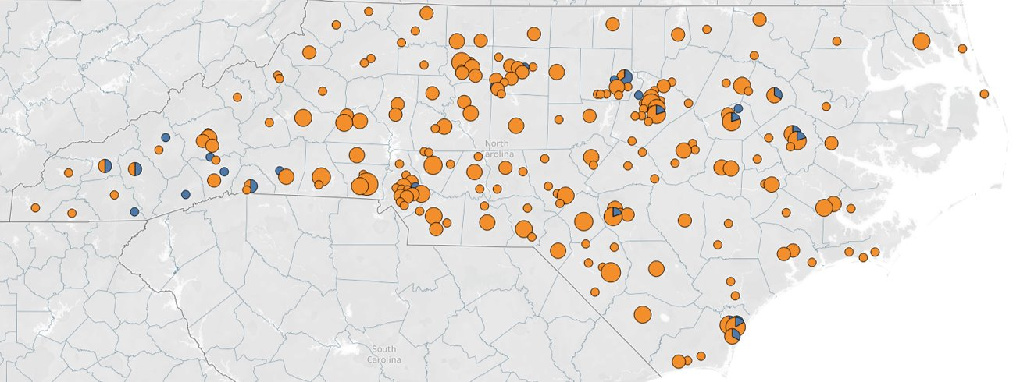
Tailored Care Management
NC Medicaid and LME/MCOs are working closely with TCM providers to ensure a successful start of the service. LMEs are currently contracting with Tailored Care Management providers (CMAs and AMH+s).
AHEC coaches are continuing to provide support to TCM providers and hosting webinar series
NC Medicaid has published a list of certified TCM providers. https://medicaid.ncdhhs.gov/media/11975/download?attachment
LMEs are currently contracting with Tailored Care Management providers (CMAs and AMH+s)
You can find out if your beneficiary is eligible for TCM by checking in NCTracks.
Want to more? https://medicaid.ncdhhs.gov/tailored-care-management
CMA and AMH+ Provider Organizations by Zipcode (as of 2/14)
CMA Providers
Map contains providers who have passed their readiness review and all locations for those providers. Providers may not be contracted with any/all LME/MCOs. If an organization has multiple addresses, each location will appear on the map.
AMH+ Providers

Slide 50
Sandhills Center – Provider Based Care Management
Goal is to help ensure provider success with the delivery of Tailored Care Management.
Several departments work together to provide support and oversite of AMH+ and CMAs. Support can come from Network Management, External Care Management and Information Technology Departments.
Support and education provided has shifted and evolved during the various stages of TCM implementation. Support will continue to evolve as providers shift from implementation to day-to-day care management.

Slide 51
Sandhills Center – Provider Based Care Management
Interactions and work with Provider Based Care Management Agencies can range from:
  Monthly TCM provider meetings
  Providing training and technical assistance
  Education regarding Capacity Building Funds
  Oversite and monitoring
  Support with determining agency panel sizes
  Responding to questions regarding Tailored Care Management assignments
  Data integration and support

Slide 52
Sandhills Center - Situations and Solutions
Situation: Acuity tier information was not immediately available to providers for the initial TCM Assignment and providers at times need additional member information.
Solution: Sandhills Center provided TCM agencies with an “additional information” file. The additional information file had information about authorized services, diagnostic categories and several other fields. Ongoing and on an as needed basis, if a provider has questions regarding a member's diagnostic information, Sandhills Center will research and provide available information.

Slide 53
Vaya Health - Tailored Care Management (TCM)
Vaya has 25 contracted TCM providers operating across Vaya’s 31 counties, with 18 more anticipated by July 1, 2023
To support a successful implementation, Vaya is providing technical assistance and training to TCM providers by:
  Assigning a dedicated Provider Network Contract Manager
  Hosting bi-monthly technical assistance calls
  Facilitating monthly AMH+/CMA Learning Community sessions
  Offering technical assistance from a dedicated TCM team within Vaya’s Quality Management department

Slide 54
Care Management
Each provider has an assigned Alliance Practice Transformation who will be a single point of contact for questions and technical assistance
Continue monthly TCM learning collaboratives which provide a mix of training, technical assistance and Q&A time
Continue monthly supervisor collaborative as an avenue to discuss implementation issues and ongoing challenges
Continued technical assistance to care management entities using Alliance platform

Slide 55
Insights to Tailored Care Management
The model is an opt out model but is treated more like an opt in model because we are asking for the member to consent on the front end- we think engagement will improve with clarity about the approaches providers use to engage members.
Trillium has assigned Tailored CM consultants to every Tailored CM provider entity to assist 1:1 with navigation and management of issues that providers encounter.
Trillium has designated Claims specialist focused on Tailored CM to assist with billing issues.
Trillium holds a monthly touch base meeting with all Tailored CM entities to identify issues and barriers and work toward resolutions.
Trillium offers 1:1 meetings with the entire Trillium Implementation team as needed for providers.
Trillium is scheduled to launch Value-Added Services for member engagement March 1, 2023 to support providers by offering incentives for member engagement in Tailored plan and Medicaid Direct Tailored CM programs.
  $30 gift card for completing Care Needs Screening within first 30 days of enrollment with Trillium.
  $50 gift care for completing Comprehensive Care Management Assessment within 60 days of enrollment with Trillium.
  CONTACT US: Provider Support Service Line: 1-855-250-1539

Slide 56
  Eastpointe is committed to supporting this new health home model to promote better outcomes for our members
  Began monthly TCM meeting with Round 1 and 2 TCM providers in Feb. 2022; now includes Round 3 providers
  Hired Practice Transformation Specialists to work exclusively with TCM providers
  Unique Distribution of Community Capacity Funds:
    Linked funds to TCM staff hired and local service capacity offered. We understood funding needed to offset unbillable time staff would have for agency certification, training, and initial member outreach.
      So far over 13 providers have received $3.6 million
    Eastpointe exceeded the first-year threshold to have 30% of members served by providers

Slide 57
  Offer free use of our Care Management software
    Providers who use our CM platform receive training and sit on advisory group providing input on enhancements
    We currently have 9 providers using our CM Platform
    Use of this technology solution eliminates separate PRL reporting
  Biweekly individual meetings with our contracted TCM providers began in December 2022 after soft launch; more individualized approach to check in and facilitate broad discussions and provider-specific solutions
  Shifted file configuration in January to populate more member phone numbers on the BAF as a solution to more than 85% being missing on 834 from state
  Ad hoc reports, ticketing, and meetings with state analytics team to mitigate issues with auto-assignment process and new eligibility file
  Extensive work and collaboration with providers and state on panel size and member assignments to maximize provider referrals based on staff capability

Slide 58
Partners Health Management TCM Insights
Partners currently contracts with 32 Tailored Care Management Providers.
We remain committed to supporting our TCM network.
  To promote open and frequent communication with our TCM network, we host bi-weekly virtual collaboratives.
  We have also implemented a team of Clinical Support Specialists to act as designated liaisons specifically for Tailored Care Management for our TCM providers.
    Initially, these liaisons have focused on trouble shooting issues, fielding questions, gathering panel data, etc.
    Long term, this team will support the successful provision of external TCM by sharing performance data, staffing clinically complex cases, and troubleshooting issues as they arise.
We continue to work daily on ensuring our TCM providers are receiving the required data and are submitting claims successfully.

Slide 59
Medicaid Reminders

Slide 60

Public Health Emergency (PHE) & Continuous Coverage Unwinding
The 2023 Consolidated Appropriations Act (Omnibus Bill) delinked the continuous coverage requirement from the Federal Public Health Emergency
NC Medicaid will begin redeterminations (Continuous Coverage Unwinding) on April 1, 2023
  Beneficiaries who lose coverage due to redetermination will lose coverage on July 1, 2023
The federal Public Health Emergency will end on May 11, 2023
DHB Continuous Coverage Unwinding priorities:
  Beneficiary communications focus on 2 key messages
    Update your address via county DSS or create an enhanced ePASS account
    Check your mail
  CMS reporting starts in February 2023

Slide 61
NC Health Choice Move to Medicaid - Overview
Per Session Law 2022-74 (HB 103), effective April 1, 2023
~47,000 children (aged 6 – 18) enrolled in NC Health Choice will move to Medicaid
Provides access to more services for NC Health Choice beneficiaries, including:
Enhanced behavioral health services
Early Periodic Screening, Diagnosis and Treatment (EPSDT) services and well-child visits
Non-emergency transportation
No copayments or enrollment fees
Beneficiaries will be mailed a notice by March 2023 informing them of the change
Beneficiaries’ Medicaid ID (Recipient ID) will NOT change​
The move will NOT impact beneficiaries’ health plan enrollment

Slide 62

NC Health Choice Move to Medicaid – Provider Impacts
Providers currently enrolled only with NC Health Choice will update to terminated status in NC Tracks as of 4/1/2023, unless they choose to enroll with Medicaid
Communications from NC Medicaid and Health Plans forthcoming with information on claims processing timeline and Prior Authorizations related to NC Health Choice move to Medicaid
As of April 1, 2023, no beneficiaries will be enrolled with NC Health Choice but may present with an NC Health Choice ID card while they await their replacement Medicaid ID card
Providers must confirm Medicaid eligibility via the Recipient Eligibility Verification function of NCTracks.

Slide 63

Provider Reverification – Voluntary Program Began January 2023
Provider reverifications are suspended during the PHE, since March 2020
When PHE ends on May 11, 2023, provider reverifications will begin again
Failure to reverify in NCTracks will result in suspension and possible termination
DHB has begun a voluntary submission of reverification applications which includes:
    Optional submission of reverification application IF provider was due for reverification during the PHE
      A special NCTracks notification will be sent to Office Administration of eligible providers
      NPI will display in the Reverification section of the NCTracks Status and Management page
    Under voluntary process, there is no adverse action for failing to submit reverification application
      If the reverification application is submitted, any requested credentialing activities must be completed
    Allows providers to complete reverification before it becomes required at the end of the PHE and take advantage of the NC Application Fee waiver (expires June 30, 2023)
    Time-limited opportunity during the first quarter of 2023 only

Slide 64

QUESTIONS?
64

Slide 65
APPENDIX

Slide 66
Alliance Slides

Slide 67
PA/Claims Processing for Contracted Providers
Service | Primary UM Entity | Initial Prior Authorization | Claims Payment & Processing | Member PA Appeals | 2nd Level Member PA Appeals
BH UM | Alliance | Alliance | Alliance | Alliance (or IRO) | Alliance
Specialty PH UM Complex labs Cardiac imaging Radiation oncology Musculoskeletal/ orthopedics imaging procedures | WellCare | WellCare | Alliance | WellCare | Alliance
Durable Medical Equipment (DME) | Northwood | Northwood | Northwood | Alliance | Alliance

Slide 68
PA/Claims Processing for Contracted Providers
Service | Primary UM Entity | Initial Prior Authorization | Claims Payment & Processing | Member PA Appeals | 2nd Level Member PA Appeals
Vision | Avesis | Avesis | Avesis | Alliance | Alliance
NEMT | ModivCare | ModivCare | ModivCare | Alliance | Alliance
Pharmacy Benefit Management | Navitus | Navitus | Navitus | Alliance | Alliance
Physician Drug Program (PDP) | Alliance | Alliance No PA Required | Alliance | Alliance No PA Required | Alliance No PA Required

Slide 69
Alliance Provider Support
Call 855-759-9700 Monday-Saturday from 7am to 6pm with questions about authorization, billing, claims, enrollment, ACS or other issues
Subscribe to our Provider Update Feed and follow us on Facebook, Twitter and Instagram
Alliance Member Support
Member and Recipient Services 800-510-9132 Monday-Saturday, 7am to 6pm
Behavioral Health Crisis Line 877-223-4617, 24 hours a day, 7 days a week

Slide 70
Care Management
Each provider has an assigned Alliance Practice Transformation who will be a single point of contact for questions and technical assistance
Continue monthly TCM learning collaboratives which provide a mix of training, technical assistance and Q&A time
Continue monthly supervisor collaborative as an avenue to discuss implementation issues and ongoing challenges
Continued technical assistance to care management entities using Alliance platform

Slide 71
Alliance Appendix – Additional Resources
Please click to download appendix of additional resources for your reference

Slide 72
Eastpointe Slides

Slide 73
Claims Submission
Electronic, Paper, and Direct Entry
  Claims are processed by Eastpointe for physical and behavioral health and state-funded claim
  Electronic claims should be submitted in the standard 837 claim format, Payer ID 08044.
  Paper claims can be submitted to :
  Eastpointe Claims Department
  PO BOX 14552
  Lexington, KY 40512
  For claims requiring documents, forms can be submitted directly to the claims department, through the iTransact portal during claims entry, via secure email to Claimsfunding@eastpointe.net, or faxed to the attention of Eastpointe’s Claims Department at 1-910-272-1299.
  Providers are loaded from the Provider Eligibility Files from NC Tracks, for information on submitting required forms to receive EFT and 835s, providers should contact the Provider Service Line at 1-888-977-2160.

Slide 74
iTransact: Provider portal
Behavioral Health, Physical Health, and State-Funded Claims

Slide 75
  Vision claims
  Eastpointe is partnering with Envolve, Providers can use the Eye Health Manager Portal at https://visionbenefits.envolvehealth.com/logon.aspx to:
  NEMT claims
    Verify member eligibility
    Manage Claims
    Check the status of a claim
    Review past claim submissions
    Reprint EOPs
    View office manual and plan specifications
    View Envolve Vision’s policies and Procedures
Each Transportation Provider will have access to the MTM claims online portal. In the claim’s portal, once the Transportation Providers submits a claim, they will be able to follow it Realtime through the different statuses. Transportation Providers can submit claims, view statuses, appeal denials and search within claims portal 24/7. If a claim is denied, the Transportation Provider will be able to appeal the denial directly in the portal, which also allows the Transportation Provider to submit additional documentation in support of the appeal, if necessary. Claimsanalysis@mtm-inc.net
  Pharmacy claims
Eastpointe’s Pharmacy Benefit Manager (PBM) is Express Scripts. Pharmacy claims should be submitted via the NCPDP HIPAA-approved format. Pharmacy Call Line 1-866-240-9487.

Slide 76
Providers may submit an “Electronic Funds Transfer (EFT) Authorization Agreement for Automatic Deposit" form with official bank letter or voided check
  Form is on our website: https://mco.eastpointe.net/DocumentBrowser/file/CAPFSContracting/Electronic%20Funds%20Transfer%20Form.pdf
Providers must complete an Enrollment Application and send in the EFT Form, W9 Form, and Trading Partner Agreement to networkoperations@eastpointe.net
  Providers must be enrolled and active in NCTracks to be enrolled with Eastpointe

Slide 77
  Proactive engagement and education
  Member Education:
    Tailored Plan benefits
    Tailored Care Management
    Value Added Services and Member Incentives
    How to stay healthy
  Eastpointe uses multiple communications channels to proactively address questions and concerns:
    Email
    Voicemail
    Welcome Packet mailing
    Community meetings and webinars
Notes:
Our message is consistent & continues to emphasizes Eastpointe’s commitment to exceptional care of our members
We recognize there will be opportunities that continue to present as we near launch and we are working hard to ensure there are no disruptions and that includes both service delivery and payment
Working diligently to ensure a healthy amount of information is shared proactively with our members

Slide 78
  Provide multiple ways to efficiently address Members’ and Recipients’ questions and issues
  + Provide accessible, mobile-friendly resources:
    Website (including provider directory)
    Member and Recipient Portal
    Benefits videos
  Multiple support/service lines operational with launch of the Tailored Plan
Notes:
We want to provide multiple communication paths that are seen as accessible for our members

Slide 79
  Member and Recipient educational resources
  Member and Recipient Website: Members and Recipients may find information on how to access services, use Eastpointe benefits, and search the provider directory and drug formulary.
  Provider Directory: Members and Recipients can find local providers or agency locations.
  Benefits Videos: Eastpointe created short educational videos designed to answer questions about Member and Recipient benefits.
  Member and Recipient Portal: Members and Recipients can access their information and manage their benefits, including changing their TCM provider or PCP. They can also request a replacement ID Card, submit complaints/grievances, and view their claims history.

Slide 80
  Member harm resolution
  Eastpointe Ombudsman: Shashonda Alford Ombudsman@eastpointe.net. Eastpointe’s Ombudsman is available to help Members and Recipients with accessing health care and understanding their rights and responsibilities.
  Eastpointe has a no wrong door approach for reporting grievances and complaints. Submission via:
    Member and Recipient Services line at 1-800-913-6109/TTY 711
    Eastpointe website and member portal
    Mail
    Fax

Slide 81
  Eastpointe is committed to supporting this new health home model to promote better outcomes for our members
  Began monthly TCM meeting with Round 1 and 2 TCM providers in Feb. 2022; now includes Round 3 providers
  Hired Practice Transformation Specialists to work exclusively with TCM providers
  Unique Distribution of Community Capacity Funds:
    Linked funds to TCM staff hired and local service capacity offered. We understood funding needed to offset unbillable time staff would have for agency certification, training, and initial member outreach.
      So far over 13 providers have received $3.6 million
    Eastpointe exceeded the first-year threshold to have 30% of members served by providers

Slide 82
  Offer free use of our Care Management software
    Providers who use our CM platform receive training and sit on advisory group providing input on enhancements
    We currently have 9 providers using our CM Platform
    Use of this technology solution eliminates separate PRL reporting
  Biweekly individual meetings with our contracted TCM providers began in December 2022 after soft launch; more individualized approach to check in and facilitate broad discussions and provider-specific solutions
  Shifted file configuration in January to populate more member phone numbers on the BAF as a solution to more than 85% being missing on 834 from state
  Ad hoc reports, ticketing, and meetings with state analytics team to mitigate issues with auto-assignment process and new eligibility file
  Extensive work and collaboration with providers and state on panel size and member assignments to maximize provider referrals based on staff capability

Slide 83
  Provider resources
  Provider Service Line: 1-888-977-2160
  Open 7am-6pm, Monday through Saturday
  Having your agency Tax ID available will facilitate validation of contract and/or eligibility
  You can also submit questions via the Network Operations email at networkoperations@eastpointe.net
  Visit the Eastpointe Provider page for additional claims submission information including:

Slide 84
  Provider resources (cont.)
Each contracted provider in our provider network is assigned a Provider Relations Account Representative (PRAR) to be the first point of contact for any questions and to provide technical assistance on our processes. A letter of introduction is sent to each provider who is joining our network from your assigned PRAR providing their phone number and email address. Please feel free to reach out to your assigned PRAR with any questions.
If your staff are unsure who is the assigned PRAR you can go to our website, www.eastpointe.net. From there, click on:
Provider, then
Information, Manuals and Forms, then
Manuals and Forms
On this page, you will see the Provider Relations Account Representative Provider Assignment List.

Slide 85
  Member-related service lines
  Member and Recipient Services:1-800-913-6109/TTY 711 (Monday-Saturday 7am-6pm). Members can call for information on supports and resources, to find a provider, to make a complaint, or speak with their care manager.
  Behavioral Health Crisis Line: 1-866-218-1328 (24/7/365). Members may call if they have thoughts of hurting themselves or others, emotional or mental pain, or distress. If they need to speak with someone who will listen and help.
  Nurse Line (Medicaid Only): 1-866-248-9512 (24/7/365). Members may call to ask questions if they have concerns about their health or medications or for advice on when to go to their provider.
  Non-Emergency Medical Transportation: Tailored Plan Members can access transportation by calling MTM (NEMT Vendor) at 1-866-201-5623, accessing the MTM Portal Link: https://www.mtm-inc.net/mtm-link/, or calling Member and Recipient Services.

Slide 86
Partners Slides

Slide 87
Partners Health Management Claims Submission
Providers may submit claims electronically or by mail.
Electronic Claims Submission
Providers will access Provider Connect for claim submission at:
https://id.partnersbhm.org/
Alpha+ - Medicaid Tailored Plan Behavioral Health and State Benefit
Availity - Medicaid Tailored Plan Physical Health
Claims may be submitted via clearinghouse or SFTP as per usual business practice.
Behavioral Health claims will be submitted to Alpha+
Physical Health claims will be submitted to Availity
Paper Claims - Electronic submission is preferred; an Out Of Network provider may also submit a paper claim by mail.
Medicaid Tailored Plan Physical Health should be mailed to:
P.O. Box 8002
Farmington, MO 63640-8002
Medicaid Tailored Plan Behavioral Health and State Benefit should be mailed to:
901 S New Hope Road
Gastonia, NC 28054
Payer ID
Physical Health – Payer ID is 68069
Behavioral Health – Payer ID is 13141

Slide 90
Partners Health Management
PartnersACCESS Call Center
Provider Services Line
877-398-4145
Members and Recipient Line
888-235-4673 (HOPE)
Hours: 7 a.m. to 6 p.m. Monday - Saturday
Behavioral Health Crisis Line
833-353-2093 (24/7/365)
Live answered by licensed clinicians
Command Center Response Approach
Dedicated Member email
Dedicated PCP management email
Proactive strategy
Rapid response
No wrong door access
Continuous communications across departments and with external partners
Weekly community Member Managed Care series
Grievances/Complaints 1-888-235-4673
  grievances@partnersbhm.org

Slide 91
Partners Health Management TCM Insights
Partners currently contracts with 32 Tailored Care Management Providers.
We remain committed to supporting our TCM network.
  To promote open and frequent communication with our TCM network, we host bi-weekly virtual collaboratives.
  We have also implemented a team of Clinical Support Specialists to act as designated liaisons specifically for Tailored Care Management for our TCM providers.
    Initially, these liaisons have focused on trouble shooting issues, fielding questions, gathering panel data, etc.
    Long term, this team will support the successful provision of external TCM by sharing performance data, staffing clinically complex cases, and troubleshooting issues as they arise.
We continue to work daily on ensuring our TCM providers are receiving the required data and are submitting claims successfully.

Slide 92
Sandhills Slides

Slide 93
Sandhills Center – Claims Submission
Tailored Plan Providers are contractually required to submit billing electronically
Connection to Change Healthcare (CH), our claims clearinghouse, is required. Provider enrollments are based on TIN
If already established with CH, add Sandhills Center Payer ID SHC00 AND 14816 to your list
Logins for Change Healthcare Portal will be available to download 835s or remittances
  BH Claims will come back on the 835 from SHC00
  PH Claims will come back on 835 from 14816
Beginning April 1, 2023, providers will use Change Healthcare’s “Connect Center“ portal to key in Tailored Plan claims – No fees for providers who register
 | Payor ID: | Remittance Information will include: | EFT Agreement with: | Correspondence (payment, recoup, other) from:
BH Claims | SHC00 | SHC00 | Sandhills Center | Sandhills Center
PH Claims |  | 14816 | AmeriHealth Caritas NC
Providers will need to be registered for both the SHC00 and 14816 Payer ID’s

Slide 94
Sandhills Center – Claims Submission Guidance and Resources
Guidance:
Although not required, providers are encouraged to produce routine billings on at least a weekly or bi-monthly schedule
Sandhills Center will load daily updates into our system via the Provider Eligibility File from NC Tracks, providers are encouraged to review NC Tracks record on a regular basis
Resources:
Detailed instructions are provided in the EDI Companion Guides
  The Companion Guides (a user manual for electronic 837 submissions) gives very specific instructions on what is required to submit claims electronically to Sandhills Center (https://www.sandhillscenter.org/uploads/shc837pcompanionguideversion1.pdf)
Sandhills Center is developing a Claims Submission Guide (available by March 15, 2023)
Sandhills Center will be holding a claims training in March 2023

Slide 95
Sandhills Center – Supporting Members Through the Transition
The mission of Sandhills Center, BH I/IDD Tailored Plan, is to develop, manage and assure that persons in need have access to quality mental health, developmental disabilities, and substance abuse services.
Sandhills Center is committed to improving your health and well-being. We aim for this goal by helping you get the right treatment that meets all your needs.
Customer Service Agents and Tailored Care Managers can assist you with:
Finding a provider
Making appointments
Arranging transportation
Getting /replacing your insurance card
Changing your PCP
Filing a grievance or complaint
Requesting an appeal
Updating your contact information
Requesting a change of TCM Provider
Questions about your benefits
Call the Sandhills Center Member Service Line at 1-800-256-2452 for assistance.
Our licensed behavioral heath clinicians are available 24/7 to offer support if you feel you are in crisis. Call 1-833-600-2054

Slide 96
Sandhills Center – Supporting Members Through the Transition
Sandhills Center has been working with community providers to educate and support their knowledge of the transition to the BH I/DD Tailored Plan.
Sandhills Center has:
  Delivered Quarterly Provider Forums that are recorded and available on the website
  Met with large groups (CCPN) and hospital systems reviewing expectations
  Distributed Provider Updates via email with contracted providers
  Educated department heads and specialist groups on Tailored Plan implementation
  Coordinated Joint Operating Committees with hospital systems
  Participated in training session for the NC Hospital Association
  Updated website information on Tailored Plan for providers and members
Sandhills Center is committed to ensuring continuity of care. Sandhills Center will continue contracting efforts to ensure a robust network and offer single-case agreements when needed so that our members remain connected to care and our providers are paid without delay.

Slide 97
Sandhills Center – Supporting Members Through the Transition
Non-Emergency Medical Transportation (NEMT)
Pharmacy Benefits
As the NEMT broker, ModivCare confirms that Members are eligible for transport, coordinates reservations, contracts with independent transportation providers, investigates complaints performs quality assurance, and pays providers according to their contracts for the full range of covered transportation services.
Sandhills Center Customer Service Agents work closely with the ModivCare team to ensure timely access to transportation and will coordinate your urgent and routine transportation needs.
Sandhills Center’s pharmacy partner, PerformRx, will assist members to get early refills for vacation supply, lost/stolen supply, leave of absence supply, national disaster supply, delayed mail-order supply, and spilled medication supply.
Sandhills Center has worked with our Pharmacy Benefit Manager (PBM), PerformRx, on a readiness stabilization plan to ensure continuous services with minimal disruption to members, providers and pharmacies participating with Sandhills Center.
Call Member & Recipient Services if you have questions: 1-800-256-2452
(TTY: 1-866-518-6778)

Slide 98
Sandhills Center – Provider Based Care Management
Goal is to help ensure provider success with the delivery of Tailored Care Management.
Several departments work together to provide support and oversite of AMH+ and CMAs. Support can come from Network Management, External Care Management and Information Technology Departments.
Support and education provided has shifted and evolved during the various stages of TCM implementation. Support will continue to evolve as providers shift from implementation to day-to-day care management.

Slide 99
Sandhills Center – Provider Based Care Management
Interactions and work with Provider Based Care Management Agencies can range from:
  Monthly TCM provider meetings
  Providing training and technical assistance
  Education regarding Capacity Building Funds
  Oversite and monitoring
  Support with determining agency panel sizes
  Responding to questions regarding Tailored Care Management assignments
  Data integration and support

Slide 100
Sandhills Center - Situations and Solutions
Situation: Acuity tier information was not immediately available to providers for the initial TCM Assignment and providers at times need additional member information.
Solution: Sandhills Center provided TCM agencies with an “additional information” file. The additional information file had information about authorized services, diagnostic categories and several other fields. Ongoing and on an as needed basis, if a provider has questions regarding a member's diagnostic information, Sandhills Center will research and provide available information.

Slide 101


CONTACT US!
Should you have questions or concerns during this transition, please reach out to Sandhills Center staff for assistance!
Provider Help Desk:
1-855-777-4652
Provider Support Portal
https://support.sandhillscenter.org/support/login
Quick Reference Guide

Slide 102
Trillium Slides

Slide 103
Trillium Health Resources –
Tailored Plan Behavioral Health I/DD and State Funded Claims
Claims for Behavioral Health I/DD fall into three groups:
  Mental Health/Substance Use (MH/SU)
  Traumatic Brain Injury (TBI)
  Intellectual Developmental Disabilities (IDD)
    These include Intermediate Care Facilities for Individuals with Intellectual Disabilities (ICF-IDD), Innovations Waiver services and other home and community-based services.
Billing
  MH/SU/IDD services will be billed with the appropriate primary ICD-10-CM diagnosis code to the highest level of specificity that meets medical necessity in the range of F10-F99
  Exceptions are noted in the Claims Submission Protocol table available in Trillium’s Tailored Plan Provider Manual
Submission
  Claims described here may be submitted to Trillium using HIPAA Standard Electronic Transaction set via one of the following:
    Secure Behavioral Health I/DD web portal
    Secure FTP
    Via claims clearinghouse:
      Change Healthcare (previously Emdeon) via Medical Payer ID 56089
      The SSI Group via Medical Payer ID 43071
Secure Behavioral Health I/DD Portal

Slide 104
Trillium Health Resources –
Tailored Plan - Physical Health Claims
Claims for Physical Health include:
  Physical health
  Long-Term Services and Supports
    Inclusive of nursing facility, home health, private duty nursing, personal care, and hospice services.
Billing
  Primary medical ICD-10 diagnosis code to the highest level of specificity meeting medical necessity excluding the range of F10-F99
  Exceptions are noted in the Claims Submission Protocol table available in Trillium’s Tailored Plan Provider Manual
Submission
  Physical health claims described here and physician-administered (professional) drug claims may be submitted to Carolina Complete Health (CCH) using HIPAA Standard Electronic Transaction set via one of the following:
    Secure web-based Physical Health Portal
    Secure FTP
    Via claims clearinghouse:
      Availity via Medical Payer ID 68069
Secure Physical Health Portal

Slide 105
Trillium Health Resources –
Tailored Plan - Pharmacy, NEMT and Vision Claims
Pharmacy Claims
  Pharmacy claims for rendered pharmaceuticals or pharmacy services, including outpatient pharmacy, point-of-sale claims may be submitted to PerformRx using the most current NCPDP HIPAA-approved format with Rx BIN Number 019595 and PCN – PRX10811.
Non-Emergent Transportation to Medical Care
  Claims for Non Emergency Medical Transportation (NEMT) and Non Emergent Ambulance Transportation (NEAT) services are processed through Trillium’s contractor Modivcare
  Modivcare responsibilities also include booking of reservations/rides
  Providers can bill electronically through Modivcare’s web portal, by an Automated Transportation Management System (ATMS), or by submitting paper claims.
Vision
  Claims for Vision services are processed through Envolve, a subsidiary of CCH
  Claims may be submitted using HIPAA Standard Electronic Transaction set or via a secure web-based portal linked here.

Slide 106
Trillium Health Resources –
Tailored Plan – Provider Portals & Training Resources
To access the secure provider portals, please visit trillium’s website at www.trilliumhealthresources.org and select “For Providers”
The Behavioral Health I/DD Portal and Physical Health Portal are web-based systems available to Trillium partners upon completion of a Trading Partner Agreement (TPA)
  Both portals provide access to behavioral health and physical health claim entry screens
Billing through these portals is Direct Data Entry (DDE) where an electronic CMS1500 or UB04 form is accessed and billing information is entered and submitted for reimbursement
  Trillium Provider Direct Webinars are available in the secure Behavioral Health IDD - Provider Direct Module to assist with completing CMS1500 and UB04 claim forms
  Secure Physical Health Portal training resources may be found Carolina Complete Health Network’s Education and Training Page.
For Additional Training information on How to Submit Claims to the Provider Portal
  Behavioral Health I/DD Portal
    Trainings available within the Behavioral Health I/DD Secure Provider Portal – Provider Direct
    Trainings available on My Learning Campus from the Trillium’s website
      www.trilliumhealthresources.org
  Physical Health Portal
    Trainings available at Carolina Complete Health Network’s Education and Training Page
      https://network.carolinacompletehealth.com/resources/education-and-training.html

Slide 107
Member Harm Issue Resolution
Trillium works with the Ombudsman for both member and provider questions and concerns to achieve rapid resolution.
Trillium has one designated point of contact for the Member Ombudsman
Trillium also has a team of staff dedicated to quick resolution of Help Center tickets.
Trillium has a no wrong door policy for accepting grievances. If you have a grievance please call the appropriate service line. Members may call 1-877-685-2415 and providers may call 1-855-250-1539, or use the online portal to submit this. You may also fax or mail your grievance.

Slide 108
Insights to Tailored Care Management
The model is an opt out model but is treated more like an opt in model because we are asking for the member to consent on the front end- we think engagement will improve with clarity about the approaches providers use to engage members.
Trillium has assigned Tailored CM consultants to every Tailored CM provider entity to assist 1:1 with navigation and management of issues that providers encounter.
Trillium has designated Claims specialist focused on Tailored CM to assist with billing issues.
Trillium holds a monthly touch base meeting with all Tailored CM entities to identify issues and barriers and work toward resolutions.
Trillium offers 1:1 meetings with the entire Trillium Implementation team as needed for providers.
Trillium is scheduled to launch Value-Added Services for member engagement March 1, 2023 to support providers by offering incentives for member engagement in Tailored plan and Medicaid Direct Tailored CM programs.
  $30 gift card for completing Care Needs Screening within first 30 days of enrollment with Trillium.
  $50 gift care for completing Comprehensive Care Management Assessment within 60 days of enrollment with Trillium.
  CONTACT US: Provider Support Service Line: 1-855-250-1539

Slide 109
Vaya Slides

Slide 110
Vaya Health Claims and Payment Processing
More information at www.providers.vayahealth.com

Slide 111
Vaya Health Claims and Payment Processing
Utilization Management Process Flow
More information at www.providers.vayahealth.com

Slide 112
Vaya Health Claims and Payment Processing
Behavioral and Physical Claims
(including physician administered medications (PADP) & durable medical equipment (DME)
Network Providers
  Submit all claims using Vaya’s Provider Portal or HIPAA-compliance 837 Electronic Data Interchange (EDI) file
Out of Network Providers
  Submit emergency and non-emergency service claims using Vaya’s Provider Portal for faster claims adjudication and payment processing
  For paper claims, Vaya will only accept emergency service claims via paper. Paper claims should be submitted to:
  Vaya Health
  Attn: Claims & Reimbursement
  200 Ridgefield Ct. Suite 218
  Asheville, NC 28806
All providers must submit a completed IRS W-9 and Electronic Funds Transfer (EFT) form
For more information or to establish access for electronic claims submission visit Vaya’s Claims Submission website at https://providers.vayahealth.com/authorization-billing/claims/claims-submission/

Slide 113
Vaya Health Claims and Payment Processing
Pharmacy Claims
  Vaya is partnered with Navitus Health Solutions for pharmacy claims
  In-network pharmacies
    Point-of-sale claims routed to Navitus for processing
  Out-of-network pharmacies
    Submit claims for Direct Member Reimbursement to
    Navitus Health Solutions, LLC
    PO Box 999
    Appleton, WI 54912-0999
For more information on claims submission visit Vaya’s Claims Submission website at https://providers.vayahealth.com/authorization-billing/claims/claims-submission/

Slide 114
Vaya Health Claims and Payment Processing
Vision Claims
  Vaya is partnered with Avesis for Medicaid members vision benefits
  Vision claims can be submitted one of three methods
    Avesis Provider Portal accessed through Vaya’s Provider Portal or direct at https://www.avesis.com/Commercial3/Providers/Index.aspx
    Clearinghouse (EDI) vendors include
    Change Healthcare (615-932-3000 or www.changehealthcare.com)
      Trizetto (800-869-1222 or www.trizetto.com)
      Avesis Payer ID AV501
    Paper
      Avesis Third Party Administrators, LLC
      Attn: Eye Care Claims
      PO Box 38300
      Phoenix, AZ 85069-8300
For more information on claims submission visit Vaya’s Claims Submission website at https://providers.vayahealth.com/authorization-billing/claims/claims-submission/

Slide 115
Vaya Health Claims and Payment Processing
Non-emergency Medical Transportation (NEMT) Claims
  Vaya is partnered with Modivcare, LLC for Medicaid NEMT benefits
  NEMT claims are processed through Modivcare’s Transportation Provider Portal
    To establish access and submit claims visit https://www.modivcare.com/login
For more information on claims submission visit Vaya’s Claims Submission website at https://providers.vayahealth.com/authorization-billing/claims/claims-submission/

Slide 116
Vaya Health Member Issue Resolution
FOR MEMBERS
24/7 Access via our Behavioral Health Crisis Line at 1-800-849-6127
Seamless transfer to Nursing Triage/Advice Line (via Wellcare) for medical issues or directly at
1-800-290-1623
Member and Recipient Service Line 1-800-962-9003 (Mon-Sat 7a-6p)
FOR PROVIDERS
Provider Support Line 1-866-990-9712
Email provider.info@vayahealth.com
ESCALATION PATH
Access to Chief Medical Officer, Deputy Chief Medical Officer,
Chief Population Health Officer, and Pharmacy Operations for consult and assistance
Member/Recipient and Provider issues identified by the Call Center
will be triaged by the Command Center to ensure follow-up and issue resolution
No wrong door for bringing issues for escalation

Slide 117
Vaya Health Issue Resolution
No Wrong Door for submitting concerns, complaints, or grievances.
Call the Member and Recipient Service Line 1-800-962-9003 (Mon-Sat 7a-6p)
Vaya Call Center can transfer to Nursing Triage/Advice Line for medical issues or members can call them directly at 1-800-290-1623
24/7 Access to Crisis Help via our Behavioral Health Crisis Line at 1-800-849-6127
Providers can call the Provider Support Line at 1-866-990-9712 or email us at provider.info@vayahealth.com
ESCALATION PATH
Vaya works with NC Medicaid Ombudsman to achieve rapid resolution and has a dedicated point of contact for the Ombudsman
Vaya will have a dedicated Command Center for at least 90 days post go-live to ensure follow-up and issue resolution
Call Center and Command Center have direct access to Chief Medical Officer, Deputy CMO,
and Pharmacy Operations for consult and assistance

Slide 118
Vaya Health Member Issue Resolution Scenarios
Pharmacy Urgent Needs
  If a member is out of medication, a 72-hour supply can be issued to cover needs until an appointment can be made with their provider
  Pharmacy Customer Care Line 1-800-540-6083 (live 3/1/23)
    All calls (prescribers, members, pharmacies) handled by PBM Customer Care reps dedicated to work with NC Medicaid
    The PBM has broad authority to allow one time overrides to prevent member harm
    Vaya Pharmacy Operations team has direct access to PBM systems to ensure timely resolution of problems
Accessing out-of-network care
  Call Vaya Member & Recipient Service Line 1-800-962-9003 (Mon-Sat 7a-6p), they will gather information as a first step and will coordinate with medical team, Utilization Management and Provider Network to ensure rapid access to care
  Emergency and post-stabilization care will be reimbursed without prior authorization or contract
Accessing transportation for necessary medical appointments
  MODIVCARE will schedule trips for eligible members utilizing in-network
  transportation providers or out-of-network providers if MODIVCARE’s
  network providers are unavailable
  Family members can also transport members and submit for reimbursement of costs

Slide 119
Vaya Health - Tailored Care Management (TCM)
Vaya has 25 contracted TCM providers operating across Vaya’s 31 counties
To support a successful implementation, Vaya is providing technical assistance and training to TCM providers by
  Assigning a dedicated Provider Network Contract Manager
  Hosting bi-monthly technical assistance calls
  Facilitating monthly AMH+/CMA Learning Community sessions
  Offering technical assistance from a dedicated TCM team within Vaya’s Quality Management department

