Slide 1
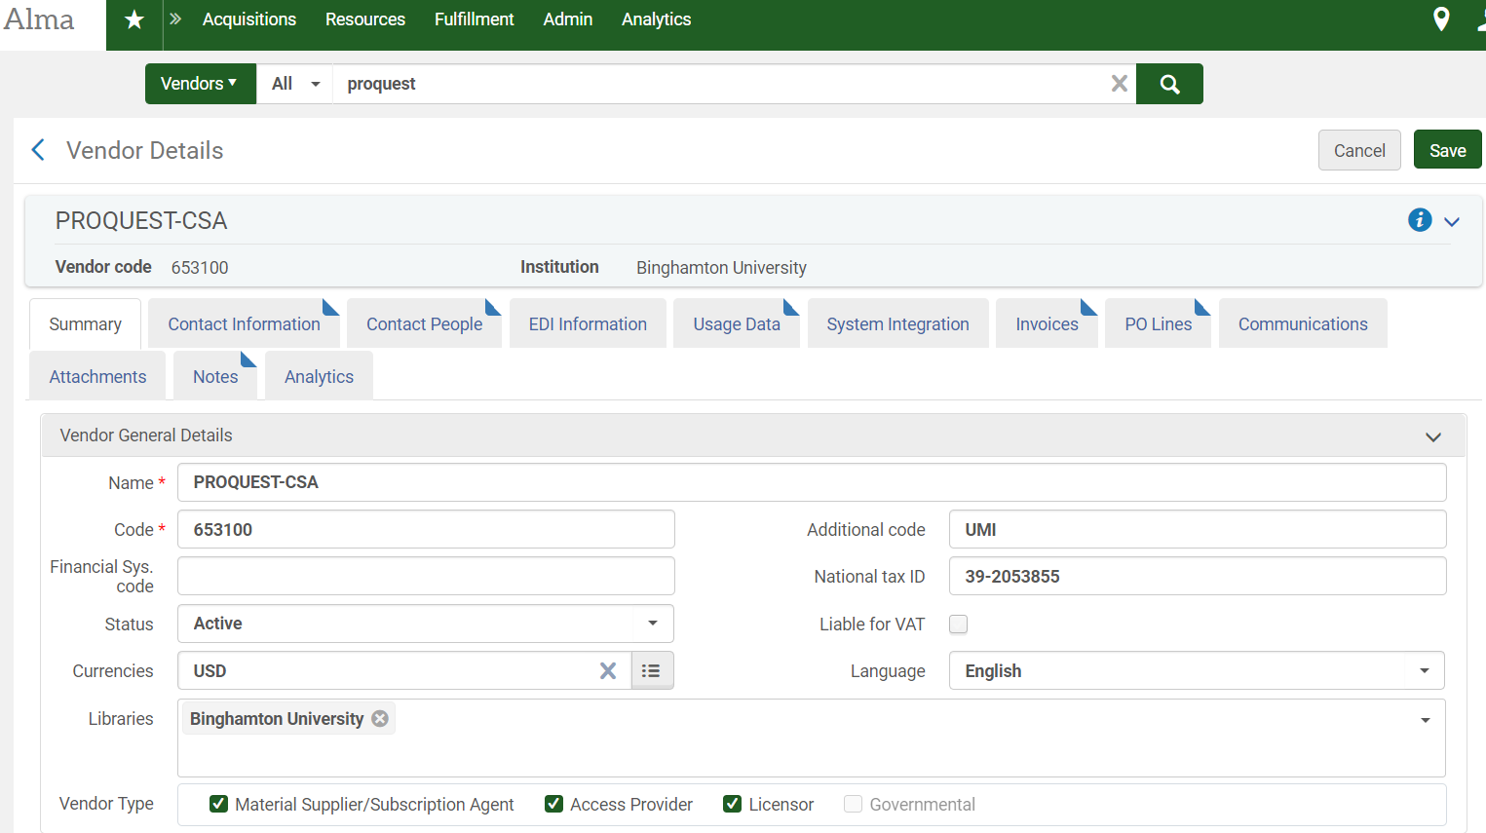
Prior to uploading usage reports /creating SUSHI accounts, check the Usage Data tab in the vendor entry
Search by vendor name to retrieve relevant entry
Select Usage tab in entry to upload/ delete files & create SUSHI accounts
Access Provider must be selected as a Vendor Type in Vendor General Details entry
Notes:
Before uploading usage reports or creating SUSHI accounts for a vendor, make sure the relevant vendor entry has the Access Provider box checked under Vendor Type in vendor general details

Slide 2
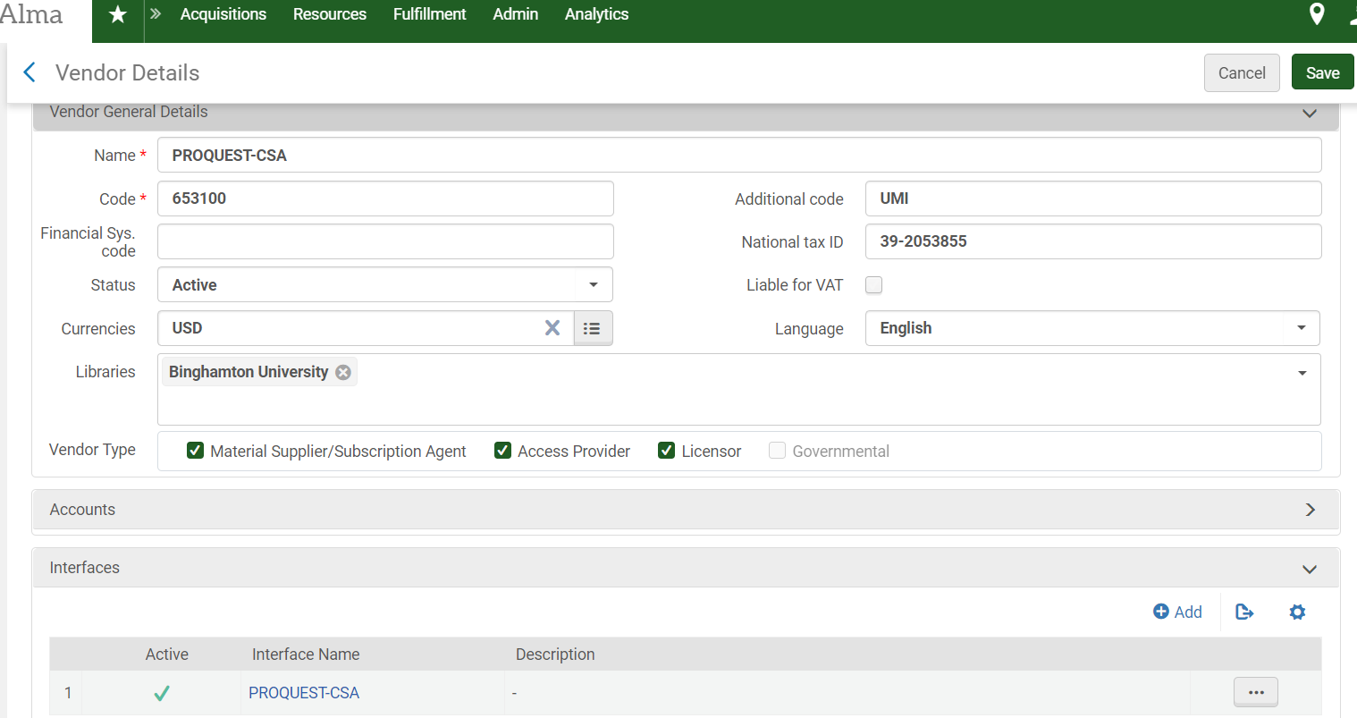
Be sure to add the appropriate interface
Notes:
In order to run analytics, you will need to add the appropriate interface. Scroll down within the vendor details summary and click on the “Add Interface” icon

Slide 3
Enter Vendor Interface Details
Notes:
Only 1 required field to create an interface.

Slide 4
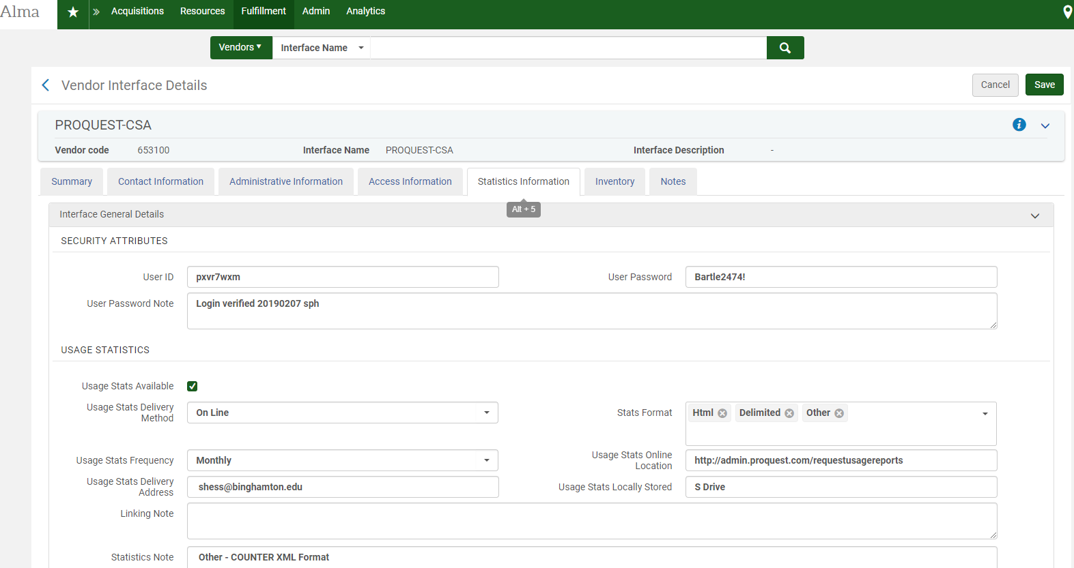
Enter Statistics Information
Notes:
Once the interface is created, you can add additional details re: contact, administrative, access, statistics, inventory, and notes.

Slide 5
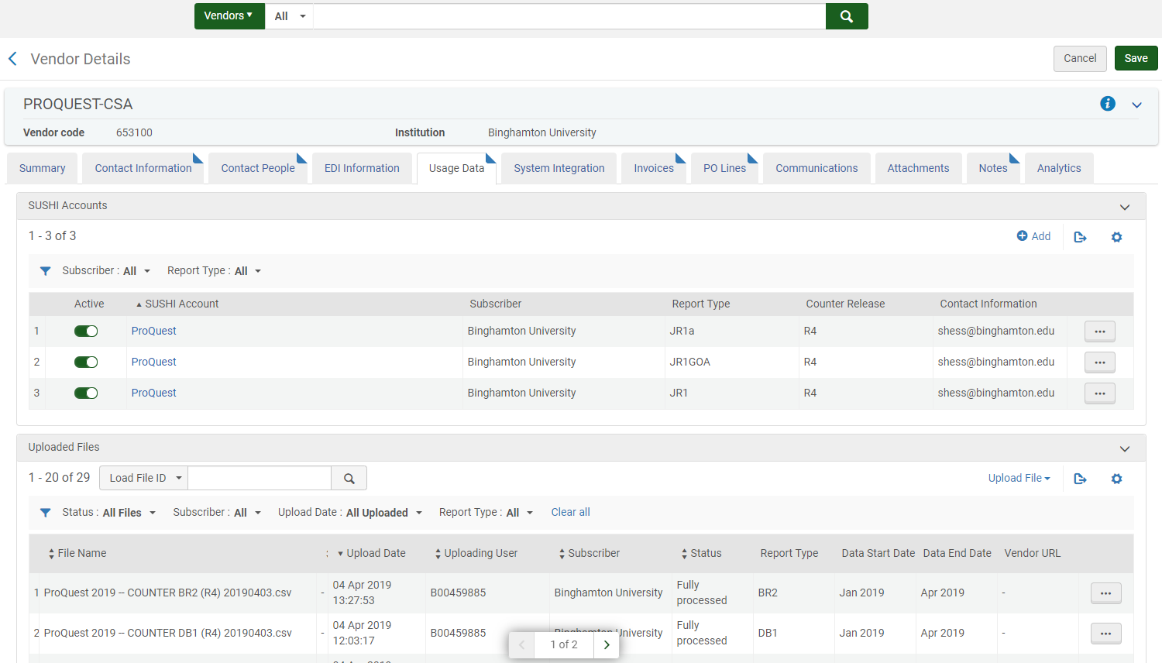
Example: Usage Data tab details
Notes:
Example of Usage Data tab details

Slide 6
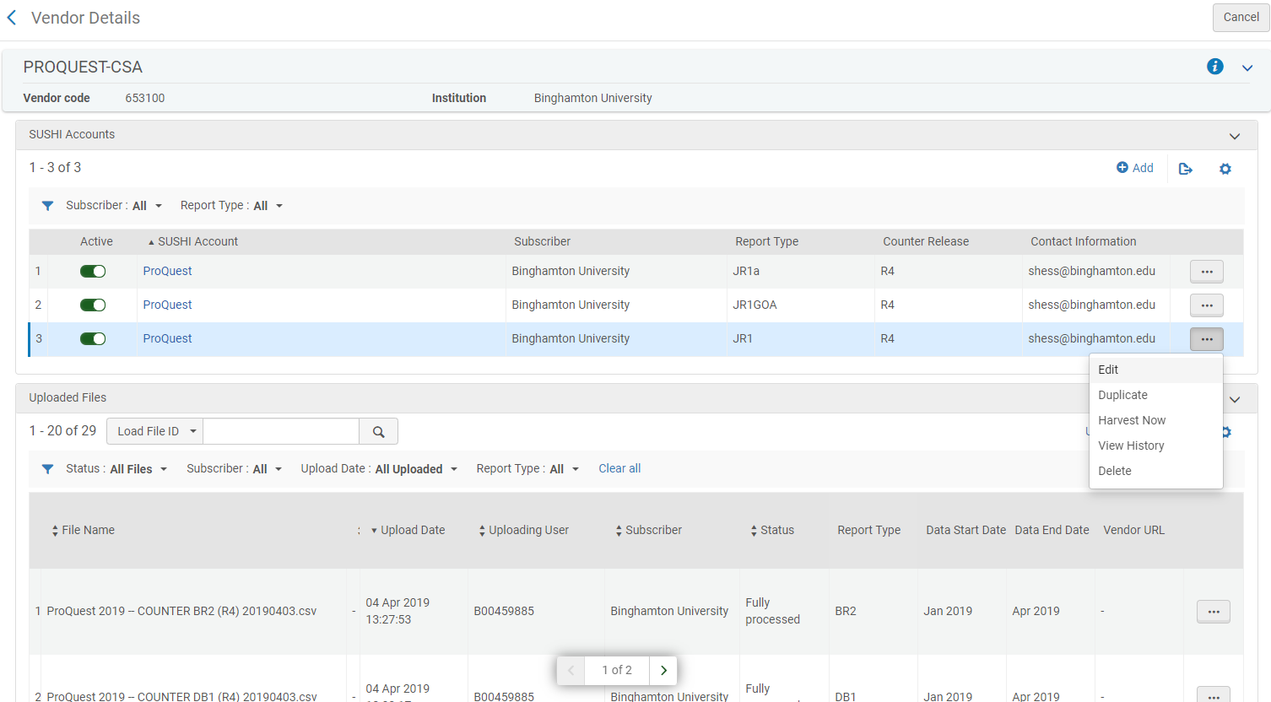
Adding SUSHI Accounts
Notes:
Can create one SUSHI account and then duplicate; Can test but full SUSHI functionality is not yet available in the test/ production environment

Slide 7
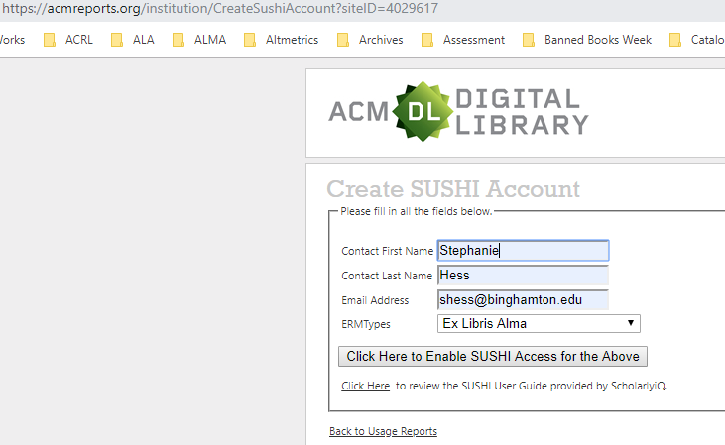
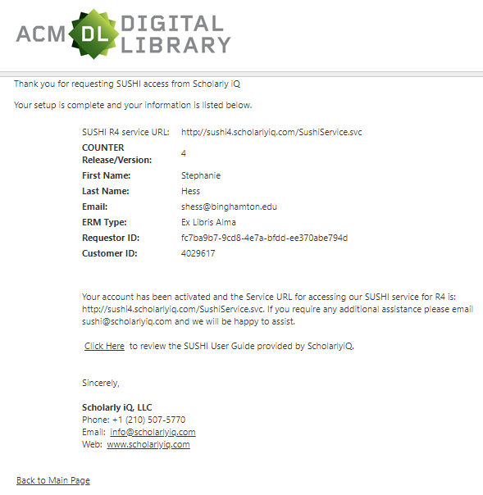
Create SUSHI account in vendor admin portal
Notes:
Can create one SUSHI account and then duplicate; Can test but full SUSHI functionality is not yet available in the test/ production environment

Slide 8
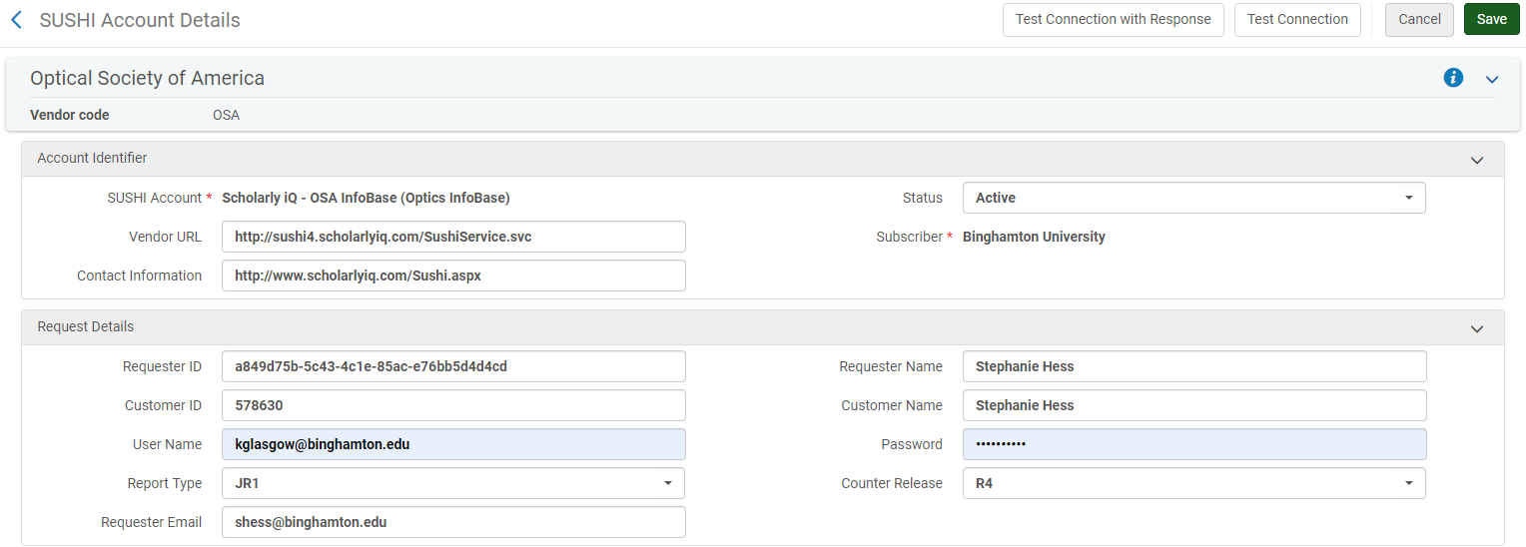
Enter SUSHI account details in Usage tab of vendor entry in Alma
Notes:
Can create one SUSHI account and then duplicate; Can test but full SUSHI functionality is not yet available for all reports

Slide 9
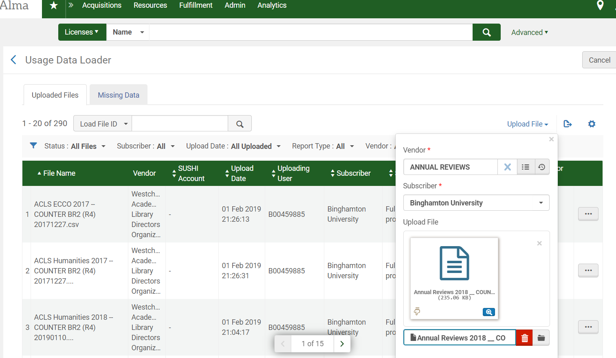
Uploading Usage Reports – Alma is not yet R5 compliant!

Slide 10
COUNTER @ https://www.projectcounter.org/
Notes:
Counting Online Usage of NeTworked Electronic Resources (COUNTER) ; Still using COUNTER Code of Practice Release 4 (R5 was implement ted in Jan. 2019); Alma is not yet accepting R5 format; Must use R4 for now; Check compliance registries for more information regarding which content providers are currently compliant and/ or being audited
BEGIN DEMO

