Slide 1
Unit 3
Understanding the work
Work Group Lead Toolkit 2020/21

Slide 2
What exactly is the work?

Slide 3
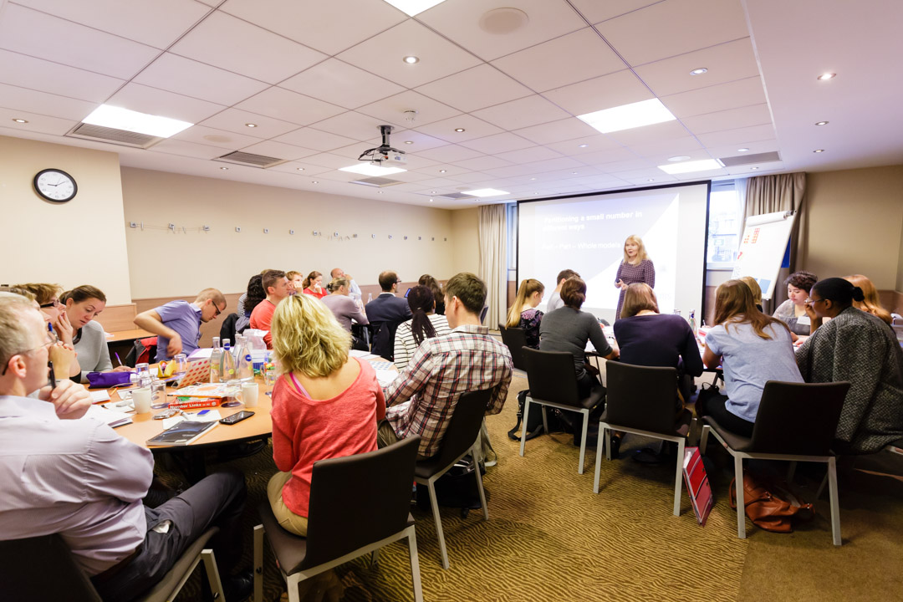

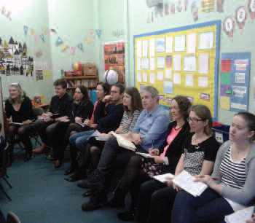
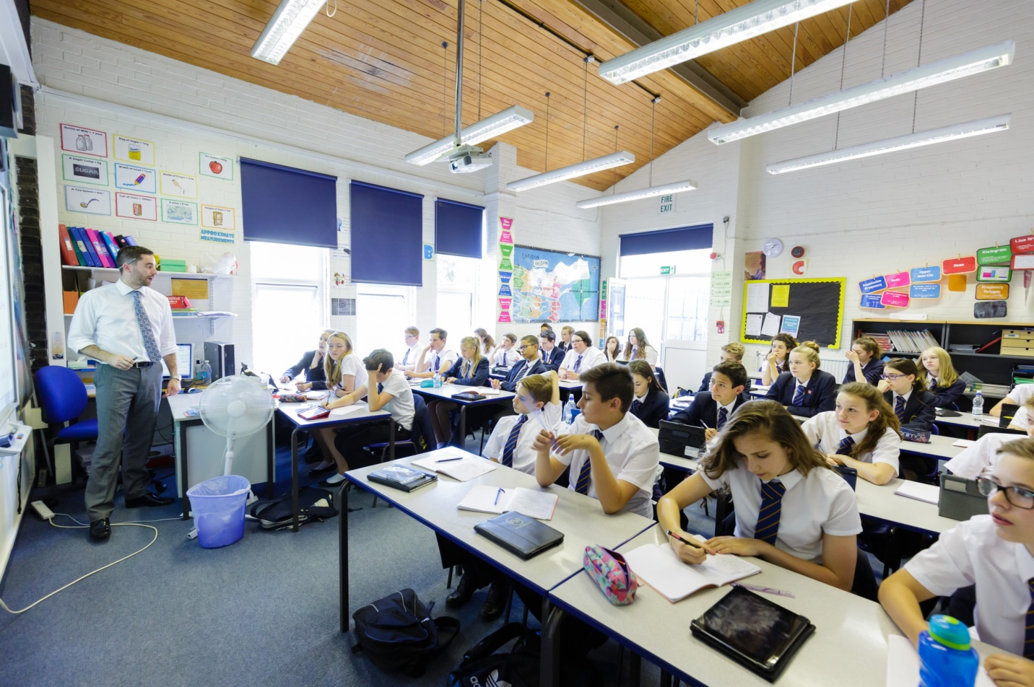
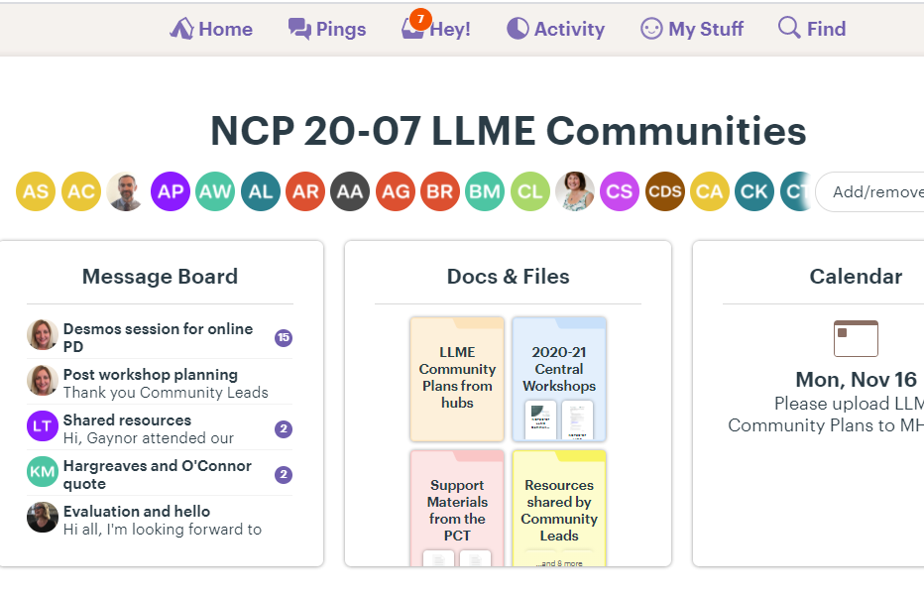

Multi-faceted work

Slide 4
Work 1 – Workshop for lead participants outside school

Slide 5
Work 2 – Observing learning in Work Group Lead’s classroom

Slide 6
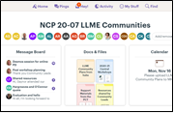
Work 3 – Online collaboration between Work Group participants

Slide 7
Work 4 – Working individually planning and assessing

Slide 8

Work 5 – Trying out a new approach in the classroom

Slide 9
Work 6 – Meeting as a team to discuss impact of new approach

Slide 10
Multi-faceted work
Combination of different forms of work
Within and outside school
Takes place over time

Slide 11
Questioning the work
Haven’t teachers got enough work to do? (current versus extra)
Where has the CPD gone? (learning versus work)
Who decides what work gets done? (teachers versus leaders)

Slide 12
Taking it further
Suggestions for reading, watching, listening
Read the Charlie’s Angles article “Raising the status of professional development”
Suggestions for discussion with others
What forms of teachers’ professional work are really supportive of their ongoing professional learning?

