Slide 1
Success Metrics:
Benchmarking usage and adoption of Alma
Claudia Balby (Ex Libris) for SUNY libraries | February 8, 2024

Slide 2
The blurb
The agenda
“Would you like to make the most of Alma in your library? Then come join OLIS and Ex Libris in a discussion of employing usage and adoption data to discover where your library is already utilizing Alma to the max, and where there may be opportunities to use it differently.
An Ex Libris representative from the Customer Success team will explain how the vendor tracks and analyzes usage and adoption of Alma functionality through nine metrics across three functional areas.
Interested SUNY libraries will be able to request their free Alma usage and adoption report with the metrics.
Libraries will also learn about optionally joining the global Alma benchmarking community to generate performance reports on your own in the Benchmark area of Alma Analytics.
OLIS will discuss follow-up initiatives including a member survey, a functional checklist, and site visits.”
Why analyze usage and adoption of software?
Ex Libris tracks usage and adoption
Key areas and metrics in Alma for Ex Libris Customer Success
Self-service benchmarking in Alma
OLIS follow-up initiatives

Slide 3
Presenter
Delivering the Signature Success Program to SUNY since July 2022
What it is:
High-touch, post-implementation attention to key customers for the entire customer lifecycle
Goals:
Promote your satisfaction with our products
Support you in value realization
Help you streamline efforts and activities
Claudia Balby, PhD
Strategic Customer Success Manager
20+ years’ experience with Ex Libris
Software training, implementation, consulting in North America & Latin America markets
Currently Success Manager for key accounts in North America
Claudia.Balby@clarivate.com

Slide 4
Why analyze usage and adoption of software?
Usage
Library point of view
Vendor point of view
How frequently or for what purposes the software is used
The manner in which the software is being consumed
Maximize return on investment
Reveal opportunities to:
streamline workflows
close knowledge gaps (staff and users)
offer new services based on specific features
If benchmarked (compared) to other libraries:
acquire context for planning and evaluation
Deliver on promises
Reveal opportunities to:
improve features, documentation, training
develop new features
Retain customers
Adoption
How fully utilized the software is
Extent to which the user has integrated the software into their workflow, and is able to leverage it to achieve their desired outcomes

Slide 5
ExL tracks usage and adoption
Internal process builds a data warehouse for internal use
What
Benchmarking by SIZE
Benchmarking by REGION
ETL (Extract, Transform, Load) job runs monthly on all data centers housing products Alma, Primo, Leganto, Esploro, Rialto, Rapido
Pre-built Dashboards & Ad-hoc Queries available to internal users
Per Users (# of staff users)
XS - between 0 and 14
S - between 15 and 49
M - between 50 and 99
L - between 100 and 299
XL – 300 and above
Per Inventory (# of BIB records)
XS- between 0 and 199999
S - between 200000 and 499999
M - between 500000 and 1499999
L - between 1500000 and 4999999
XL – 5000000 and above
Geographical region where ExL keeps a data center
AP – Asia Pacific (excludes China)
CA - Canada
CN - China
EU - Europe
NA - Americas (includes LATAM)
Why
To see how various product features are & are not being used
To help determine which areas and features may need additional training, marketing, and development
To assess risk

Slide 6
Key areas and metrics in Alma for Ex Libris Customer Success
What the library is doing to…
Automate
Integrate
Analyze
Save time by…
Replacing manual workflows with automated jobs
Streamline operations + make Alma an integral part of the local IT ecosystem by…
Integrating with third-party systems (used by the library or by other departments in the university)
Make data-informed decisions by…
Reporting on operations
Using reported evidence to set or correct course

Slide 7
Area: Automate
Metrics: Community Zone, Auto holdings, Import Profiles
Community Zone
Percentage of electronic collections linked to the CZ
Why this metric matters:
The higher the percentage, the more a library saves time & resources by not needing to create original metadata
Auto holdings
Seven import profile options that can create holdings for e-resources automatically from vendor-supplied data*
Why this metric matters:
The more profiles in use, the more a library saves time & resources by not needing to create holdings manually
* Elsevier, Ovid, ProQuest Ebook Central,Springer, Wiley, Taylor & Francis, and Project Muse
Import profiles
Load of third-party records
Why this metric matters:
Import Profiles can automate operations in multiple areas, running manually or automatically on a schedule
The more scheduled import profiles, the less the library staff is spending time in repetitive tasks
Scheduling profiles indicates a library trusts the process enough to have it automated and check the report afterwards

Slide 8
Area: Integrate
Metrics: APIs, Cloud Apps, Financial Systems
APIs*
Number of API executions
Why this metric matters:
APIs enable integration between Alma and 3rd-party systems/applications, allowing staff to do work in fewer interfaces, and/or eliminating double data entry
APIs support end-to-end workflows that replace manual processes, and other time savers – helping a library do more with less
The more APIs in use, the more Alma is an integral part of the university’s IT ecosystem
Libraries usually depend on IT to integrate ExL-supplied APIs into other systems. Therefore, API use may indicate there is good support from IT and no resistance from IT to integrating Alma with other university applications
* Use of ExL-supplied application program interfaces to pass data in real time from/to Alma and third-party systems
Cloud Apps*
Number of Distinct Cloud Apps in Use & Number of Users that use Cloud Apps
Why this metric matters:
Cloud Apps and APIs have similar advantages in enabling a library to do more with less
ExL provides infrastructure for library and IT staff to create Cloud Apps in the ExL Cloud and publish them for the community to use. Thus, a library can benefit from Cloud Apps even if it doesn’t have local development capabilities
The more Cloud Apps in use, the more the customer is extending Alma capabilities to suit their needs
* Utilization of customer-developed (as opposed to ExL-developed) apps running inside ExL products to add new features beyond core ExL functionality, to integrate with other systems, or to provide shortcuts and efficiencies for institution-specific workflows
Financial Systems
Y or N if the customer has integrated Alma with the institution’s financial system
Why this metric matters:
Integrations enable staff to do work in fewer interfaces, and/or eliminate double data entry
Financial systems are mission-critical to universities. When Alma is integrated to them, it becomes a part of the university’s IT ecosystem where it matters most
Libraries usually depend on Finance to authorize/accept that the integration is pursued (buy-in), and on IT to deploy it. Therefore, Finance integration may indicate there is good support to the library from IT and Finance

Slide 9
Area: Analyze
Metrics: Reports, Widgets, COUNTER & SUSHI
Reports*
Percentage Of Users Using Scheduled Reports
Why this metric matters:
The more staff users are scheduling reports, the less they are wasting time having to manually run them
* Use of reports provided out-of-the-box, and development of new reports by the library
Widgets*
Percentage Of Users Using Widgets
Why this metric matters:
It looks at the use of Widgets to display Analytics that are relevant to the staff user’s context (their role and the current Alma status)
Widgets put data in front of staff that they can use to make decisions without having to look for the data – so they help a library save time and effort
* Small panes of information or actions that are relevant to the connected staff user’s role and the current Alma status; this metric looks at the use of widgets to display Analytics reports
COUNTER & SUSHI*
Loading of COUNTER reports to Alma – automatically via SUSHI, or manually
Why this metric matters:
COUNTER reports contain statistics about usage of e-resources. Once they are loaded to Alma, a library can use Analytics to perform cost per use analyses that guide decisions such as renewing or cancelling a subscription
The more COUNTER reports are being loaded automatically via SUSHI, the less time and effort a library is spending to make data-based decisions about subscriptions
* Use of functionality that loads files with e-resource usage statistics into Alma. Files are generated by the publishers the library does business with, following specific industry standards

Slide 10
Self-service Benchmarking in Alma - 1
Opt-in feature to populate the Benchmark subject area of Alma Analytics
How many opt-ins? Where?
What is it?
Why do it?
Comparing your library to similar libraries on Key Performance Indicators (KPIs) for:
Inventory
Acquisitions
Fulfillment
requests and loans
Resource Sharing
borrowing & lending requests
Usage
through COUNTER reports
Discover areas for process improvement (if any)
Example business questions:
What is the average time of my institution from when an order is sent until the eResource is activated compared to other institutions?
What is the average time for a physical item hold request to be processed compared to other institutions?
What is the percent of loans that were returned late compared to other institutions?
57.6% of live Alma institutions*
Notes:
NA 678 -- EU 410 -- AP 81 -- CA 52 -- CN 5

Slide 11
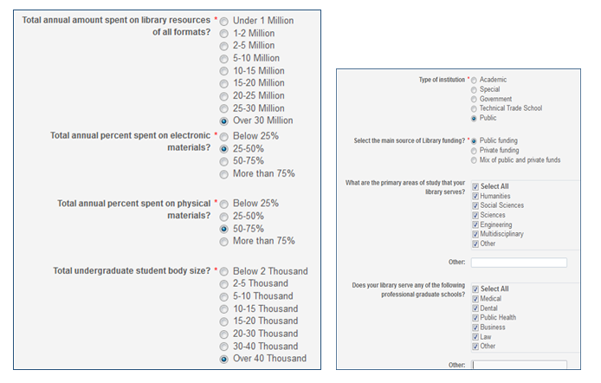
Self-service Benchmarking in Alma - 2
How to opt in
Complete Profile at
Configuration > General > General Configuration > Data Sharing Profile
What happens after you opt in
Data are anonymized!! -- details here
Populating your Benchmark subject area may take up to a month
Your institution is benchmarked against others of the same SIZE and REGION (same criteria as per slide 5)
Other options allow filtering the benchmarking pool per criteria from the Profile, such as:
Institution type
Consortium member Y/N
Main source of library funding
Total annual amount spent on all materials
Total size of undergraduate student body
KPI Year and Month

Slide 12
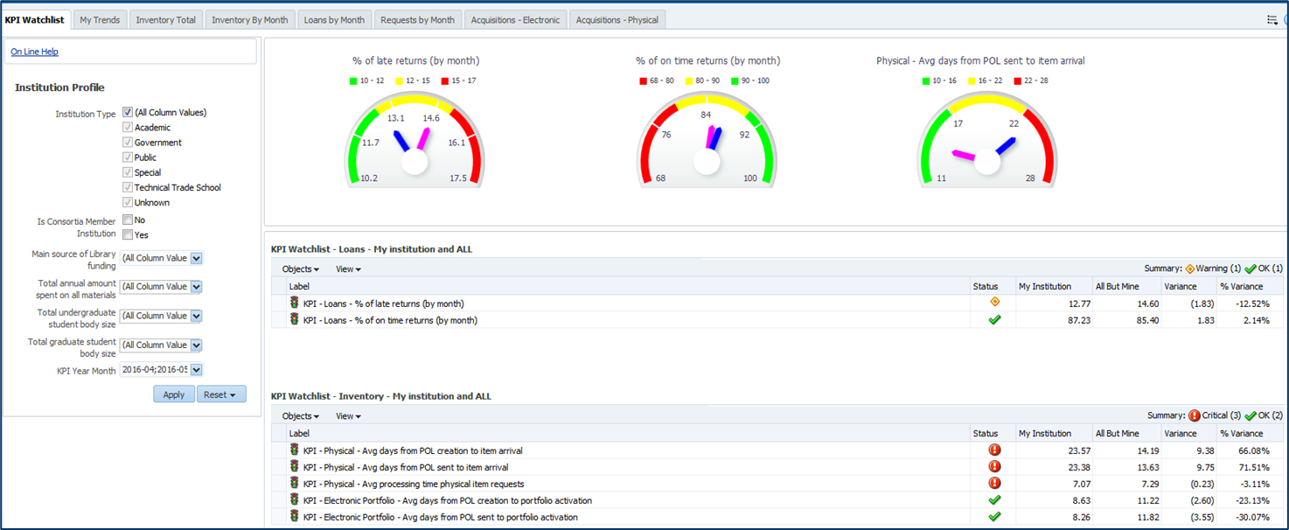
Self-service Benchmarking in Alma - 3
KPI dashboard from documentation
Notes:
The gauges quickly inform the user where his institution (blue dial) stands in comparison to other institutions (pink dial)
When the dial is near the green this is good. When the dial is near the red this is a warning
Inventory total: The dotted line is the average. The blue bar is “my institution”. The pink bars are all other institutions.

Slide 13
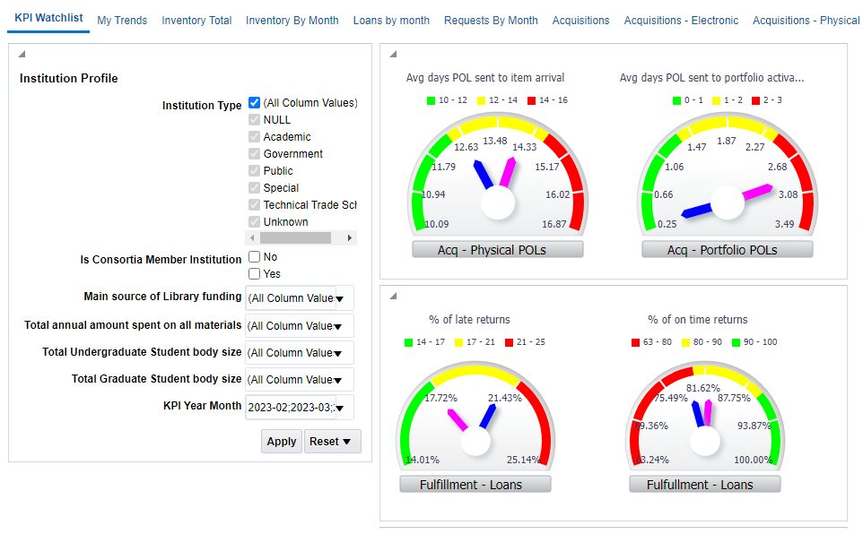
Self-service Benchmarking in Alma - 4
Part of the KPI dashboard from Broome Community College*
* Also opted in: Stony Brook and Buffalo
Notes:
Blue= me. Pink= others.
Filters allow closer matching with me
When the dial is near the green this is good. When the dial is near the red this is a warning
Judging from reported data, Broome is a relatively recent opt-in

Slide 14
Self-service Benchmarking in Alma - 5
Documentation
Best Practice Toolkit
FAQ
Data Sharing Profile (from Alma Online Help)
Benchmark (from Alma Online Help)
Overview Presentation (link will download file to your computer)

Slide 15
OLIS Follow-up initiatives
For any interested SUNY institution: Ex Libris will provide a free, one-time report with the usage and adoption metrics discussed in slides 7-9:
Automate: Community Zone, Auto holdings, Import Profiles
Integrate: APIs, Cloud Apps, Financial Systems
Analyze: Reports, Widgets, COUNTER & SUSHI
Data for the latest available month compared to same month a year ago
Your institution will be compared to others of the same SIZE and REGION as per slide 5
Does not require that you opt-in to Benchmark Analytics
Your report will be shared with OLIS staff, but not with other SUNY institutions
Are you interested? OLIS staff will collect names and forward to Ex Libris

Slide 16
Questions

Slide 17
Claudia Balby
Claudia.Balby@clarivate.com
+1 773-230-2426

