Slide 1
Better Together
Family Café:
Managing Screen Time
in a Technology World
Notes:
Trainer Note: Introduce yourself and welcome participants to the cafe.

Slide 2
Let's get ready!
Rename yourself if your screen does NOT say your name.
Move the mouse over your picture until you see 3 little dots in the top right corner.
Click on the dots and then click on “Rename” and type your first and last name.
Please be actively engaged during our time together
Participating in the chat box, discussing topics, contributing to the conversation
1
4
2
Type the following information in the chat box:
First and last name
Tell us the name of the ECE Program your child attends
5
Please stay muted unless you have a question or comment.
Please turn on your video at this time.
If two of you are watching together, we must be able to see both of you throughout the training.
If you get kicked off during the training due to a technology issue, please log back in using the same link in your confirmation email.
3
6
Notes:
Trainer Note: Omit this slide if you are hosting the cafe in person.

Slide 3
Welcome!
What is something you enjoy doing as a family?
Notes:
What is something you enjoy doing as a family?
Trainer Note: Share your own response to start the conversation.
Thank you all for sharing! Now, let’s find out a little more about our topic for this session.

Slide 4
Objectives
To understand how the Four Building Blocks of HOPE (Healthy Outcomes from Positive Experiences) support the development of the child and family
To discover the benefits of a family media plan
To consider alternate activities to reduce passive screen time
Notes:
Objectives for this Cafe:
To understand how the Four Building Blocks of HOPE (Healthy Outcomes from Positive Experiences) support the development of the child and family
To discover the benefits of a family media plan
To consider alternate activities to reduce passive screen time
We’re going to start by discussing the Four Building Blocks of HOPE.

Slide 5
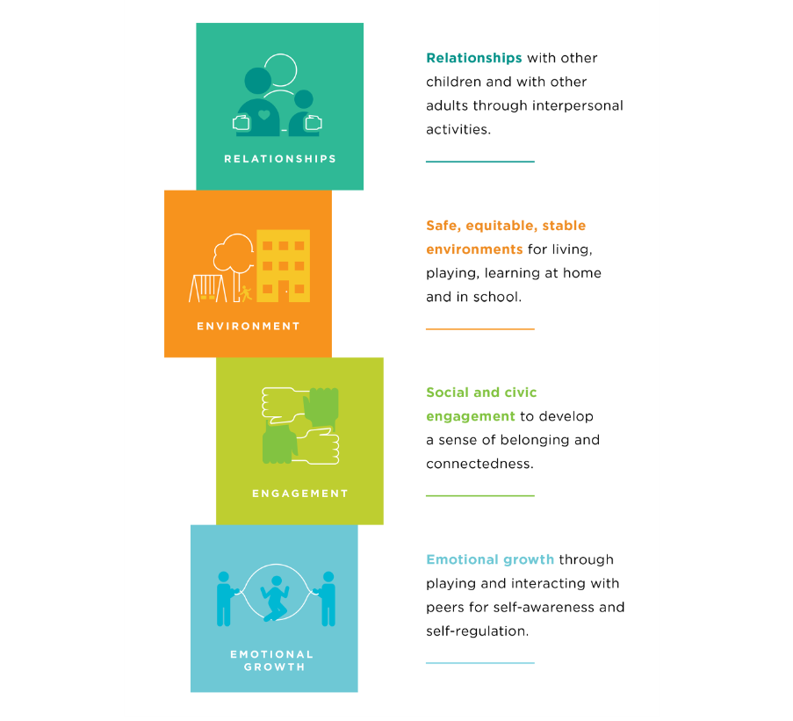
The Four Building Blocks of HOPE
Sege and Browne. Responding to ACEs with HOPE: Health Outcomes from Positive Experiences. Academic Pediatrics 2017; 17:S79-S85
Notes:
Just as ACEs (Adverse Childhood Experiences) are organized into categories or domains, we see that PCEs (positive childhood experiences) can be organized into the Four Building Blocks. HOPE (Healthy Outcomes from Positive Experiences) centers around key Positive Childhood Experiences (PCEs) that buffer against the negative lifelong health effects caused by Adverse Childhood Experiences. These Building Blocks are essential for healthy development - even in the absence of ACES.
Research shows that positive experiences promote children’s long-term health and well-being. They allow children to form strong relationships and meaningful connections, cultivate positive self-image and self-worth, provide a sense of belonging, and build skills to cope with stress in healthy ways.
Now we will look deeper into each of the Four Building Blocks: Relationships, Environment, Engagement, and Emotional Growth.
Background Information:
Information about HOPE & the Mission- Spreading-HOPE_FINAL_2.2.2021.pdf (positiveexperience.org)

Slide 6
The Four Building Blocks of HOPE: Relationships
Sege and Browne. Responding to ACEs with HOPE: Health Outcomes from Positive Experiences. Academic Pediatrics 2017; 17:S79-S85
Notes:
Being in nurturing, supportive relationships are critical for children to develop into healthy, resilient adults.
Having key foundational relationships: parents/caregivers who respond to a child’s needs and have warm, responsive interactions.
Having adults outside of the family that take a genuine interest in a child and support their growth and development.
Having healthy, close, and positive relationships with peers.
Trainer Note:
Below is more information regarding this HOPE Building Block. It provides more relatable context. However, if you have already covered the HOPE Building Blocks with the group you are working with in a previous session, please use your discretion in reviewing the information.
For child care providers: Individuals that recall having these types of relationships during childhood experience significantly lower rates of depression and poor mental and physical health during adulthood. When working with families, especially vulnerable families affected by trauma, it is important to ask about the types of positive relationships a parent may recall from their childhood. This information can then be celebrated and used to help create opportunities for their children to experience the types of relationships encompassed by this Building Block of HOPE.
For parents/families: Individuals that recall having these types of relationships during childhood experience significantly lower rates of depression and poor mental and physical health during adulthood. We encourage you to think about these types of positive relationships from your own childhood. Reflecting on this yourself can then be used to help create opportunities for your own children to experience these types of relationships encompassed by this Building Block of HOPE.
As you think about the positive relationships in your life - what characteristics have they had?
Maybe the relationships have been trusting, nurturing, supporting, etc.
The next Building Block we will discuss is Environment.

Slide 7
The Four Building Blocks of HOPE: Environment
Sege and Browne. Responding to ACEs with HOPE: Health Outcomes from Positive Experiences. Academic Pediatrics 2017; 17:S79-S85
Notes:
Children who live, learn, and play in safe, stable, and equitable environments are less likely to experience poor mental and physical health as adults. So what do we mean by safe, stable, and equitable environments?
A safe, stable environment, secure in meeting a child’s basic needs, including adequate food, shelter, and healthcare.
A school or home where children feel emotionally safe
A stable school environment where children feel valued and receive high-quality education.
A community environment to play and interact with other children safely and equitably.
Trainer Note:
Below is more information regarding this HOPE Building Block. It provides more relatable context. However, if you have already covered the HOPE Building Blocks with the group you are working with in a previous session, please use your discretion in reviewing the information.
For providers: It is crucial to ask caregivers about the types of environments their children are experiencing. Celebrate the positive and work with families to help ensure their child has the opportunity to live, learn and play in safe and nurturing environments.
For parents/families: It’s important to think about the type of environment your children are experiencing. Celebrate the positive and work to ensure your child has the opportunity to live, learn, and play in safe and nurturing environments.
Think about your child's environment - what positive things does your child experience in their environments?
Do they have friends in their neighborhood they like to play with? Do you have a garden where they can enjoy learning outside?
Now let’s talk about the Engagement Building Block.

Slide 8
The Four Building Blocks of HOPE: Engagement
Sege and Browne. Responding to ACEs with HOPE: Health Outcomes from Positive Experiences. Academic Pediatrics 2017; 17:S79-S85
Notes:
Children need opportunities for social engagement and to develop a sense of connectedness. Developing a connection to and sense of belonging in a community, as well as a sense that you matter to your community, describes the essence of the third of the Four Building Blocks of HOPE. What are some examples of social and community engagement?
Being involved in projects, peer-mentoring, or community service through one’s school or religious organization.
Partaking in family cultural traditions.
Participating in organized music, art, or sports.
Trainer Note:
Below is more information regarding this HOPE Building Block. It provides more relatable context. However, if you have already covered the HOPE Building Blocks with the group you are working with in a previous session, please use your discretion in reviewing the information.
Children need to feel connected to their communities, loved, and appreciated. Having this type of engagement (involvement in social institutions and environments, awareness of cultural customs and traditions, and a cultivated “sense of mattering” and belonging) helps children develop into secure and resilient adults.
Have any of you experienced positive benefits or had good experiences being part of a community group or friend group that you would be comfortable sharing?
Trainer Note: Add a personal story or experience here if participants don’t feel comfortable sharing.
Now let’s move on to discuss the last Building Block- Emotional Growth.

Slide 9
The Four Building Blocks of HOPE: Emotional Growth
Sege and Browne. Responding to ACEs with HOPE: Health Outcomes from Positive Experiences. Academic Pediatrics 2017; 17:S79-S85
Notes:
The final Building Block of HOPE Emotional Growth: through playing and interacting with peers for self-awareness and self-regulation.
Children need opportunities for social and emotional development. What do we mean by social and emotional development?
Developing a sense of emotional and behavioral self-regulation
Having the ability to respond to challenges in a productive manner
Developing key socially and culturally appropriate communication and interpersonal skills
Children need to have ample opportunity to develop their sense of social and self-awareness, learn how to self-regulate emotions and behaviors, and acquire skills needed to respond functionally and productively to challenges.
Trainer Note: (emphasize this point)- Opportunities to develop these skills arise during child-centered play. Children need the support of adults to name and understand make meaning of their emotions. Whether a child needs help developing these skills or they naturally pick up on them, these skills are critical for children to be able to become resilient, emotionally healthy adults.
Trainer note:
Examples of what play and social emotional development looks like-
Play pretend with baby dolls with your child. This helps develop empathy as young as 18 months. Narrating what you’re doing by responding to the baby “crying” and naming their feelings. “Oh the baby must be sad”. Then give the doll to your child and encourage them to do the same.
Playing dress up and imitating housework activities to help them develop a sense of independence.
Practice taking turns. Grab a race car, and give a car to the child. Use cues such as “my turn, your turn, I love the way you’re being patient as you are waiting for your turn”. You can even practice this skill with an infant by playing games such as peek a boo and cooing back and forth.

Slide 10
Why HOPE?
Positive experiences help children grow into resilient, healthy adults, and they can help lessen the effects of adversity.
HOPE aims to evolve our understanding and support
of these key experiences.
Notes:
By promoting the HOPE Building Blocks, we aim to support resiliency for our families. We want to encourage positive experiences and the Building Blocks to help children grow into resilient, healthy adults, and to help lessen the effects of adversity.

Slide 11
Partner Activity
What was one of your favorite shows to watch when you were young? Why did you like to watch it?
Notes:
Ten minute activity: Four minutes in groups or breakout rooms, six minutes to debrief upon return
Trainer Note:
Pose question to participants: What was one of your favorite shows to watch when you were young? Why did you like to watch it?
Send participants to groups or breakout rooms in groups of two-three. Allow four minutes total, approximately two minutes for each partner to share.
Debrief: We invite anyone to share your own thoughts or share something from your partner, whatever you are most comfortable with.
Trainer note:
If no one speaks up during debrief, trainer can share example first. Example: When I was young, every Sunday we knew we would get together as a family and watch a Disney show and have a treat. It was a special time for us. I loved all Disney movies but especially Bedknobs and Broomsticks. The memories made while watching those Disney movies is what I cherish.
Thank you all for participating in our partner activity! When we were children we did not have as much access to screens as children have today. As caregivers, we have to be much more intentional about their screen time exposure and think about how we can create memories like the ones we all shared.
We will now begin discussing how we can manage screen time.

Slide 12
American Academy of Pediatrics Recommendations
Recommendations
Report Card
Younger than 18 months- avoid screen time
18-24 months- some supervised, high-quality screen time
Ages 2-5 years- limit to 1 hour per day
Ages 6 and older- consistently limit screen time
66% of preschoolers exceed recommendations
Preschoolers are exposed to 4.1 hours of screen time a day on weekdays
90% of screen time is viewed at home
Notes:
Screen time displaces opportunities for other activities that encourage healthy development such as reading, physical activity, and imaginative play. Also, since children’s young minds are not fully developed, young children do not learn from media interactions the same way they learn from their interactions with other people.
These recommendations from the American Academy of Pediatrics apply to a child’s full day. (This includes their time in child care and with their families.)
For children younger than 18 months, avoid use of screen media other than video-chatting.
Parents of children 18 to 24 months of age who want to introduce digital media should choose high-quality programming, and watch it with their children to help them understand what they're seeing.
For children ages 2 to 5 years, limit screen use to 1 hour per day of high-quality programs. This includes the time spent watching at child care. Parents should co-view media with children to help them understand what they are seeing and apply it to the world around them.
For children ages 6 and older, place consistent limits on the time spent using media, and the types of media, and make sure media does not take the place of adequate sleep, physical activity and other behaviors essential to health.
With these recommendations in mind, let’s look at what the research says about screen time use for children.
Overall, 66% of preschoolers exceed the recommended 2 hours of screen time a day.
On average, preschoolers are exposed to 4.1 hours of screen time a day on weekdays.
90% of screen time is viewed at home.
While screen time use is high for most children, there are actions you can take to reduce the use of screens, which we will be discussing today.

Slide 13
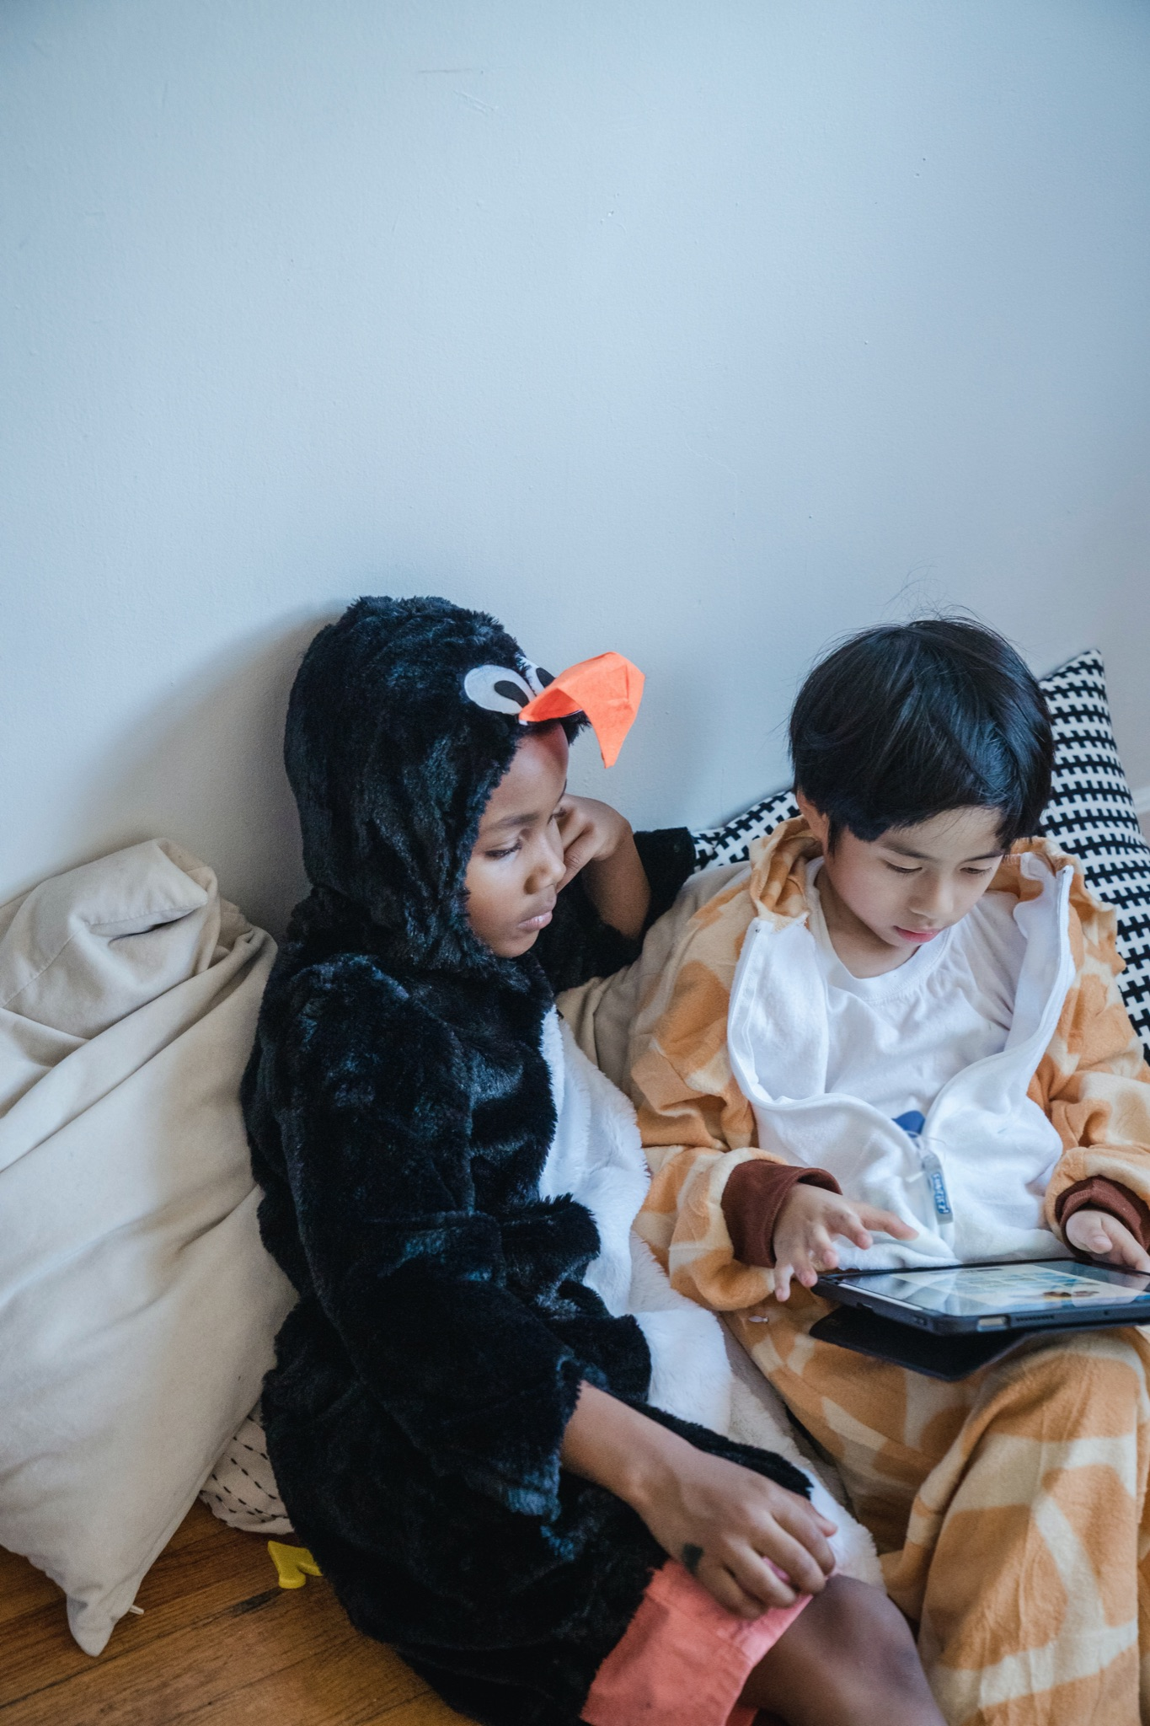
What is Screen Time?
What foods are served across a variety of food groups.
TV, DVDs, videos
Computer time
Smart phone, tablets
Video games
Virtual reality headsets
Classroom curriculums
Any apps
Passive/Active viewing
Notes:
What is Screen Time?
TV, DVDs, videos
Computer time
Smart phone, tablets
Video games
Virtual reality headsets
Classroom curriculums that are technology-based
Any apps
Passive/Active viewing
Passive: Watching a device or a screen with no/minimal activity by the child. Examples: watching a TV show, movies, videos.
Active: Watching a device or screen with conversation with an adult about what is happening, movement can be involved, creative thinking and connection. This type of screen interaction reaps the most benefits.
There are things that are appropriate for screen time:
Personal conversations (FaceTime, Skype, etc.), remote learning
Therapy appointments
Augmented technology for children with special needs
Technology is everywhere around us, so we want to share some tips to consider.

Slide 14
Tips to Consider About Screen Time
Don’t feel pressured to introduce technology early
Monitor children’s screen time
Turn off TVs and other devices when not in use
Keep bedrooms, mealtimes, and parent-child playtimes screen free
Avoid exposure to screens 1 hour before bedtime
Avoid using screens as a way to calm/occupy your children
Create screen free time in the home
Information from healthychildren.org
Notes:
Here are some tips for families and caregivers to consider about screen time:
Do not feel pressured to introduce technology early. Media interfaces are intuitive and children can learn quickly.
Monitor children's media. For example, know what apps are used or downloaded. Test apps before your child uses them, play together, and ask your child what he or she thinks about the app. Don’t rely solely on parental controls, especially as children are getting older.
Turn off TVs and other devices when not in use. Background media can distract from parent-child interaction and child play, which are both very important in child language and social-emotional development.
Keep bedrooms, mealtimes, and parent-child playtimes screen free and unplugged for children and parents. Turn off phones or set "do not disturb" during these times.
Avoid exposure to devices or screens 1 hour before bedtime. Remove devices from bedrooms before bed.
Avoid using the screens as the only way to calm/occupy your children. Although media may be used to soothe children, such as during a medical procedure or airplane flight, using media as a strategy to calm could lead to problems with a child's own ability to managing emotions. Ask your child's doctor for help if needed.
Create Screen Free Time in the Home. As part of the daily routine, make devices (e.g., televisions, phones, computers, games or other electronics) off limits at specific times. Dinnertime and before bedtime are important ones, but more extended breaks from technology each day are desirable, especially for families with very young children. You can also limit digital distractions by creating tech-free rooms/zones in the house, such as the kitchen table. If you're sitting around the table texting while eating, you are not connecting. Teach your child to connect by connecting.
The development of speech and language skills is strongly linked to thinking ability, social relationships, reading and writing, and school success. In the first three years of life, 80% of a child's brain development occurs. This development is fed through consistent verbal and nonverbal interactions between parents and children, so it is important to keep the focus on quality time and not on technology whenever you can. Does this mean that we need to put down our smartphones completely? Of course not; but nothing takes the place of face-to-face interaction when it comes to our children's learning and speech and language development—not even technology. (Parents of Young Children: Put Down Your Smartphones - HealthyChildren.org)
When creating tech free time in the home, we encourage you to replace that time with another fun activity to engage your child in. We will talk about some of those activities.
Background Information & Sources:
Healthy Digital Media Use Habits for Babies, Toddlers & Preschoolers - HealthyChildren.org
Parents of Young Children: Put Down Your Smartphones - HealthyChildren.org

Slide 15
Creative Ideas to Replace Screen Time
Surprise them
Puzzle time
Get crafty
Act our stories or skits
Play music
Enlist their help
Rotate toys
Get physical
Provide nothing
Notes:
We know that many adults use screen time with children to get a quick break to do other tasks. Changing screen time habits takes time – just like creating any new habit does. Over time, children will get used to screen time limitations and their own imaginations and independence will grow to fill the time.
Creative ideas to replace screen time:
Surprise them: Put together a bag or box containing activities that children don’t always have access to. Some examples may be cooking utensils they get to use while cooking dinner, playdough activities, trinkets or action figures they are interested in, etc. (Supporting Relationship & Environment Building Blocks)
Puzzle time: Provide puzzles that children can do independently.
Get crafty: Make greeting cards for upcoming holidays or birthdays. (Supporting Relationship & Engagement Building Blocks)
Act out stories or skits: Provide a variety of costumes or dress-up clothes and let children pretend and/or perform. (Supporting Engagement Building Block)
Play music: Play music and encourage children to make up their own dances. Add ribbons and instruments for more movement. (Supporting Emotional Growth Building Block)
Enlist their help: Allow children to help with developmentally appropriate tasks. Examples: snack or meal prep, simple household tasks (Engagement Building Block)
Rotate toys. Set up different toy bins and rotate them out frequently. This helps to prevent burnout from playing with the same toys every day.
Get physical: Go outside. Nature is the best play companion. (Supporting Environment & Engagement Building Blocks)
Provide nothing. Let THEM create their fun! Boredom can spark the best creativity.
It is important to remember that every family is unique. The best way to get started with setting screen time boundaries is to create a plan for media use.
Trainer Note: The majority of these ideas came from Better Together: Reducing Screen Time training materials.

Slide 16
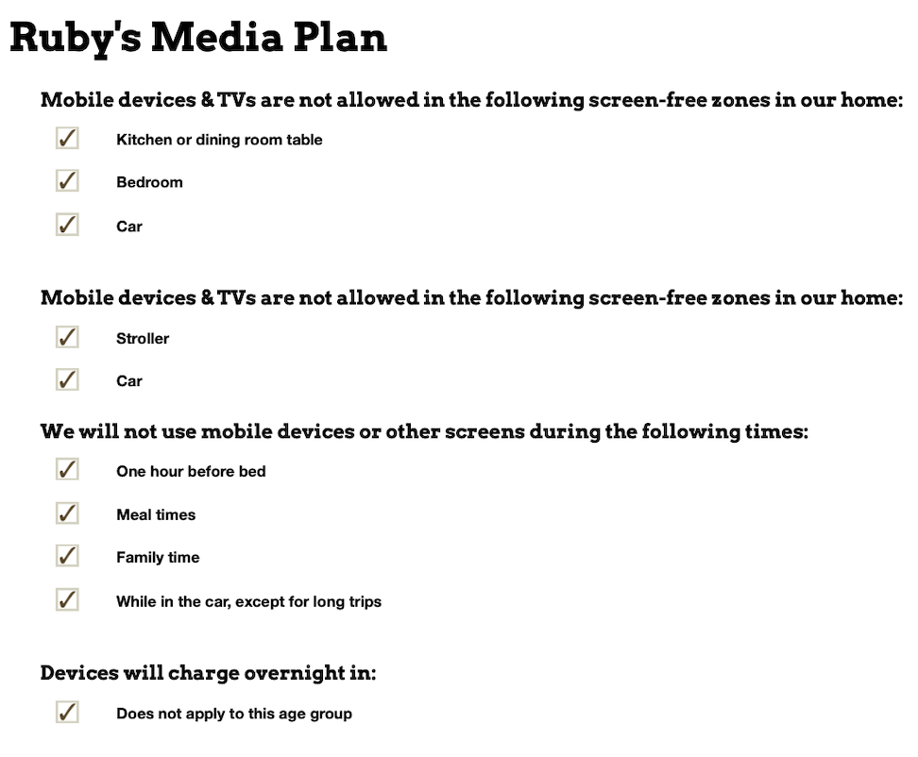
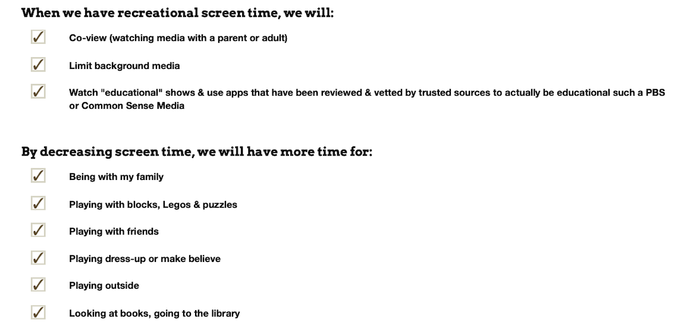
Creating a Family Media Use Plan
Notes:
Trainer Note:
Prior to the training, have your own account set up with Healthy Children.org. Create a Family Media Plan so you can briefly demonstrate the Plan during the Cafe. AAP Media Plan (healthychildren.org)
By creating a Family Media Use Plan, it allows the opportunity:
to support using media thoughtfully and appropriately for your family.
for the family to work together to work towards a common goal.
for everyone to model the importance of healthy media habits.
Examples:
Put phone or devices away when spending time as a family
No phone or screens during mealtimes
Avoid use of screens to fall asleep or right before bedtime
Trainer Note: Remember that there are individual needs of families, including assistive technology. Encourage participants to develop a plan that meets their specific needs.
Let’s now set the stage for conversation before we discuss together how we can manage screen time for our families.

Slide 17
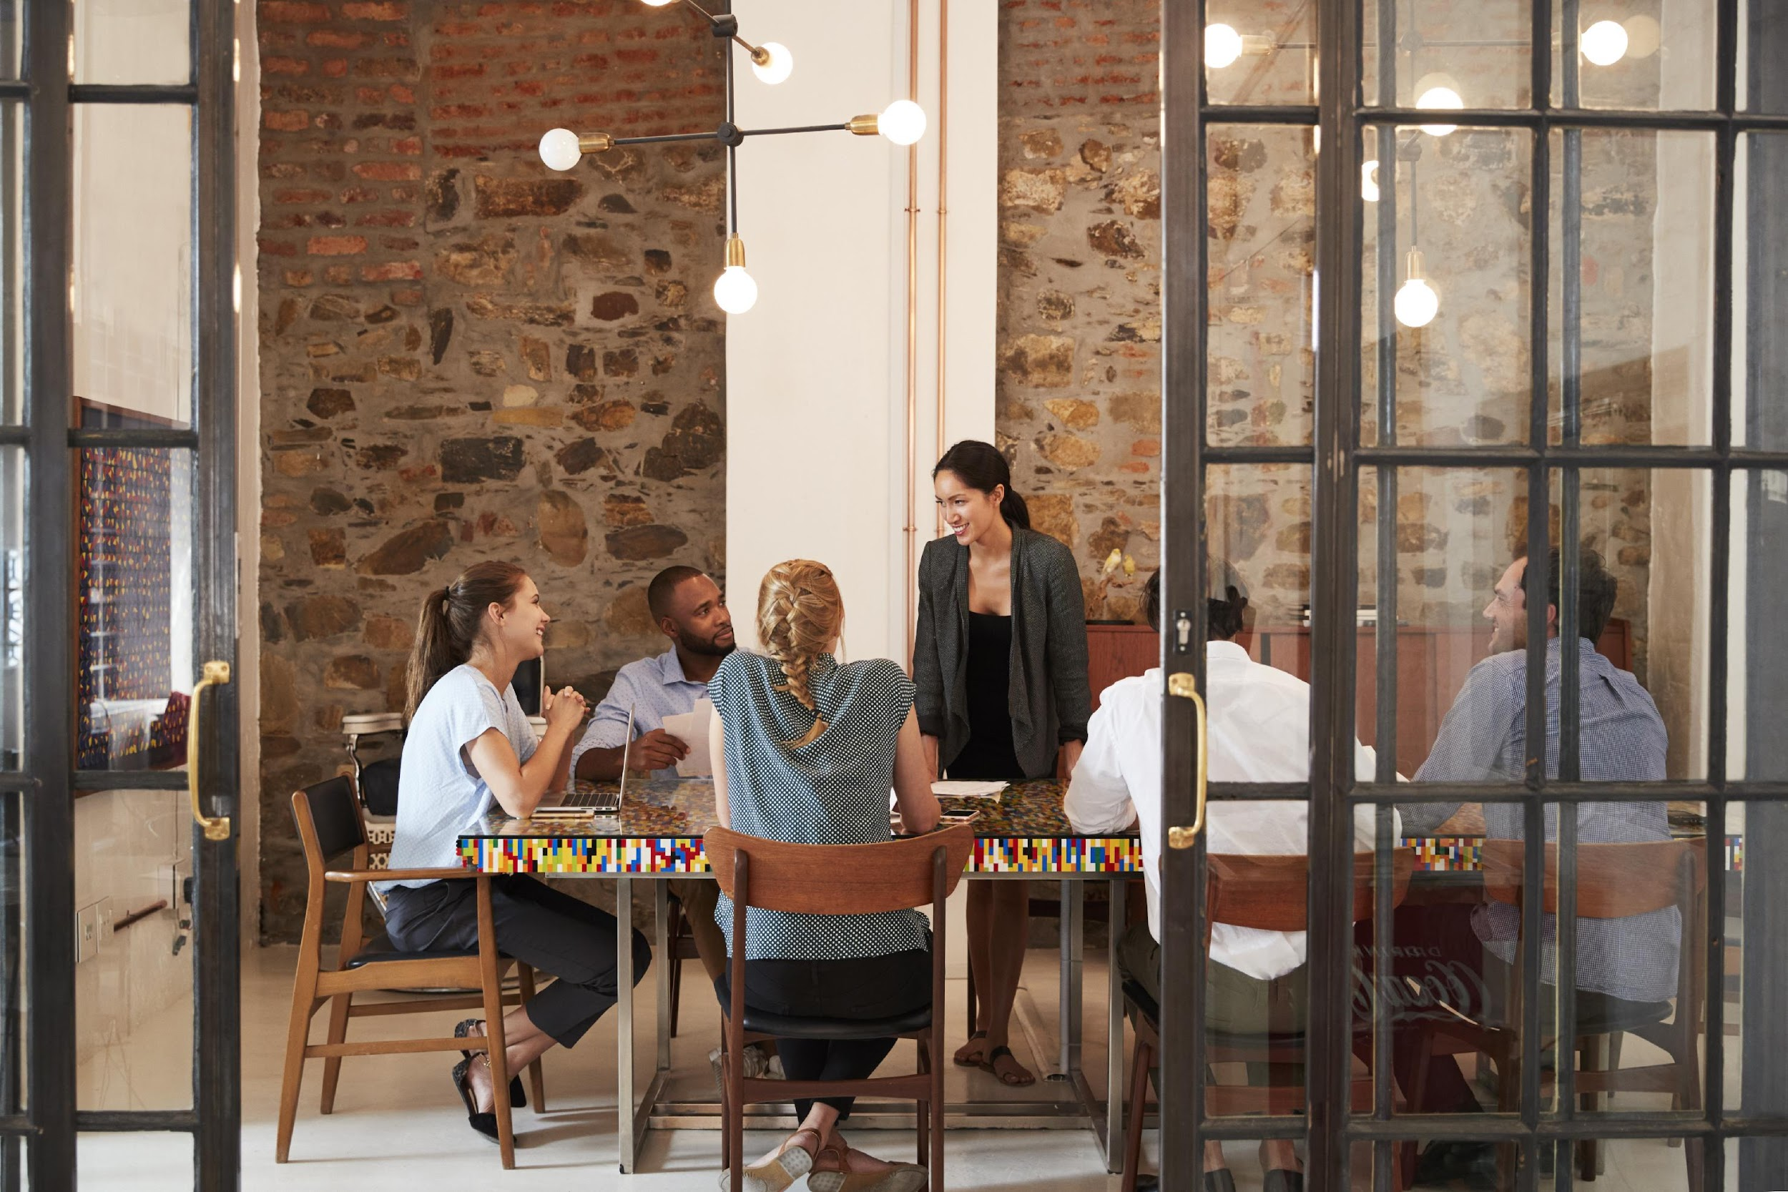
Creating an Emotionally Safe Environment
Active listening
Judgement free zone/safe place
Confidentiality
All responses welcome!
Notes:
Before we move into the discussion, we want to make sure we are setting a space for a positive environment and experience for all who are participating today. This will help set the stage for our conversations.
Active listening- truly listening to everyone sharing and being present
Judgement free zone/safe place- This is a judgement free zone in order to help create a safe place.
Confidentiality-What happens in the café, stays in the café!
All responses welcome! We encourage everyone to be open in sharing their thoughts and experiences. That's what makes a cafe so special!
Any questions? Alright, let’s dive into the Cafe questions.

Slide 18
Cafe Questions
Managing Screen Time in a Technology World
Notes:
Trainer Note: Based on the number of participants, divide into groups of up to five people. Breakout rooms will be used for each of the cafe questions. Small group discussions should last for eight-ten minutes.
If the Cafe is in person, refer to the Better Together Family Cafe Toolkit for facilitation instructions.
At this time, give a brief explanation of how the cafe portion works to the participants.
Sample Script (This will vary based on several factors: in person/virtual, large group/small group, etc):
We are about to move into the cafe questions. During this time, you will have about eight minutes with your group to discuss each question. This is an opportunity to connect and collaborate with each other. After each cafe question, we will come back together to debrief our discussion with the whole group.

Slide 19
#1
What are some ways that you have created positive connection time without screens?
Notes:
Question 1: What are some ways that you have created positive connection time without screens?

Slide 20
#2
What are possible benefits of reducing screen time for your family?
Notes:
Question 2: What are possible benefits of reducing screen time for your family?

Slide 21
What are some strategies you could add to your family media plan? What are some things that are important to you?
#3
Notes:
Question 3: What are some strategies you could add to your family media plan? What are some things that are important to you?

Slide 22
Reflection
How do you feel after listening to the responses from the other participants?
How did you feel sharing your own thoughts and experiences?
What is one thing you will take away from today?
Notes:
Trainer Note: It is important to ask each reflection question individually and allow wait time for responses.

Slide 23
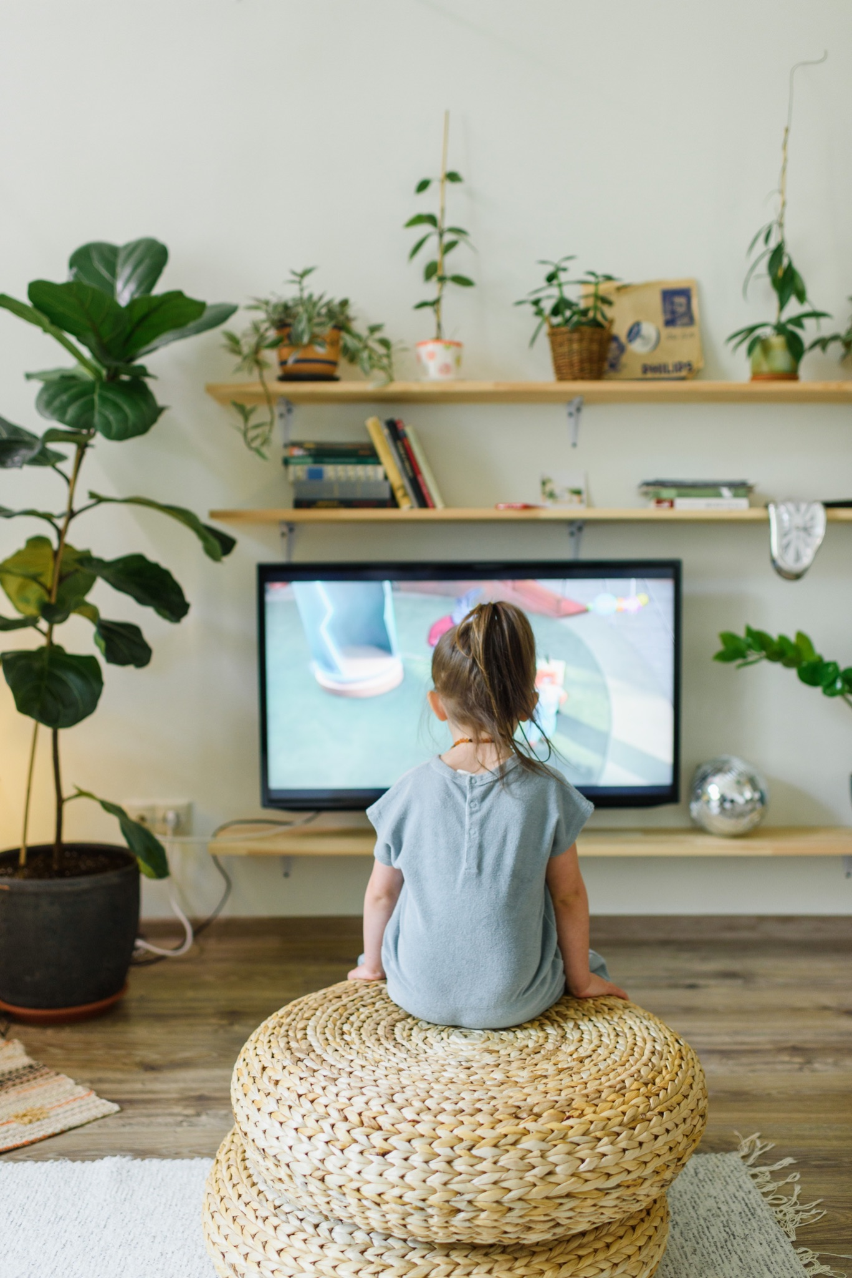
Note to Self
In the next 30 days, will you commit to developing your family's media plan?
Set a date!
Which strategies will you include?
AAP Media Plan (healthychildren.org)
Notes:
The purpose of the note to self is to leave you with an action plan in creating a positive experience for your family. We really encourage you to take the time to complete your Note to Self.
You've had a chance to think about what you want to add to your family's media plan. Now is the time to commit to making it! In the next 30 days, will you commit to developing your family's media plan? Set a date! Which strategies will you include?
AAP Media Plan (healthychildren.org)

Slide 24
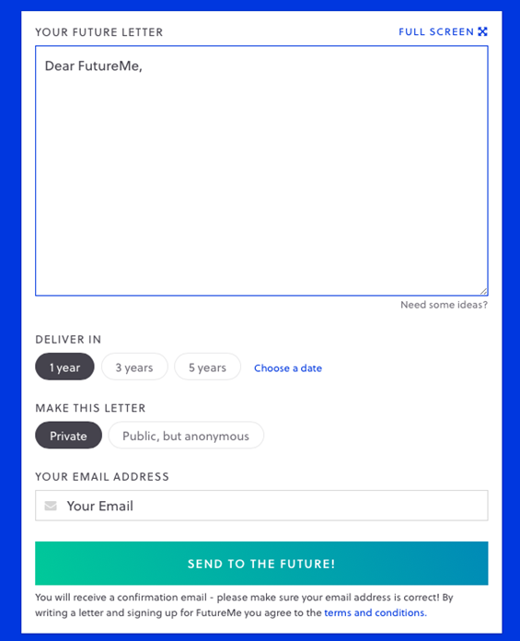
Futureme.org
Type response after reflecting on the
“Note to Self”
Click ‘Choose a Date”
Enter the date two weeks from today
Make this letter private
Type in your email address
Click “Send to the Future!”
Notes:
Trainer Note: Only use this slide if you are hosting the cafe virtually. If you are hosting in person, please refer to the Better Together Family Cafe Toolkit for more details.
Futureme.org is a website we suggest using for the Note to Self. Type in your response, click “Choose a Date” and enter the date two weeks from today. Keep the letter private. Type in your email address. Click “Send to the Future!” On your selected date, your note to self will arrive in your email to serve as a reminder of the positive experience you wanted to create for your family.
Background Information:
https://www.futureme.org is a website participants can use, especially virtually, to send the note to self. The link and information should be included in the follow up email if the cafe is done virtually.

Slide 25
Questions?
Notes:
Trainer Note: This slide can be used to discuss any questions, evaluations, next steps, etc.

Slide 26
THANK YOU!
Notes:
Type your notes

