Slide 1
Screen Time
Learning Collaborative
Insert Trainer Name(s)
© 2023 The Nemours Foundation
Notes:
Italicized text = notes to the trainers to assist you in leading the Sessions.
Non-italicized text = script/talking points.
(Text in parenthesis) = notes for virtual implementation.
We want ECE Providers to engage in the materials and learn from each other. You are encouraged to incorporate personal stories about ECE programs making improvements and/or using an Assessment Tool to support changes in healthy eating and physical activity. You may also add additional interactive activities to all Sessions.
Additionally, this series of Sessions can be implemented in several ways, timeframes, and formats. Trainers should review the Implementation Toolkit for further guidance about constructing these Sessions to meet the needs of the participating ECE programs. Trainers should take time to revise these PowerPoints and their overall Learning Collaborative plan to determine the best layout of the intended Learning Collaborative program.
All of the resources presented throughout the Learning Collaborative can be found in the Resource Guide. When you see the notebook icon in the top right corner of the screen, the resource shown on the screen can be found in the Resource Guide.
The Resource Guide can be found at https://public.3.basecamp.com/p/Xj1WBY5rhXD46RQqyoW1Ji1q
For any other assistance, please email:
Nemours Children’s Health: info@healthykidshealthyfuture.org

Slide 2
Screen Time
Learning Collaborative
Orientation
Insert Trainer Name
Insert Date of Presentation
© 2023 The Nemours Foundation
Notes:
Italicized text = notes to the trainer to assist you in leading the Sessions.
Non-italicized text = script/talking points.
(Text in parenthesis) = notes for virtual implementation.
You are encouraged to incorporate personal stories about early care and education (ECE) programs making improvements and/or using assessment tools to support changes in healthy eating and physical activity.
It is good to see you (all) today. We will be working together over the next few months. We’ll spend time learning about how ECE programs can support the health of children today and into their future. Your fellow ECE providers in this Learning Collaborative and I (as your trainer) are here to support you as we all learn, try new ideas, and work to improve practices.
All of the resources presented throughout the Learning Collaborative can be found in the Resource Guide. We will provide this to you (electronically or as a printed copy). When you see the notebook icon in the top right corner of the screen, the resource shown on the screen can be found in the Resource Guide.
The Resource Guide can be found here:
https://public.3.basecamp.com/p/Xj1WBY5rhXD46RQqyoW1Ji1q

Slide 3
Today’s Agenda
Introductions & Icebreaker
Setting the Foundation for Healthy Habits
Learning Collaborative
Program Assessment Introduction
Next Steps
Notes:
Here is a quick snapshot of how we will spend our time together today.
Welcome participants to the Orientation Session.
Read aloud the agenda items. Please remind participants that they can follow along with the slides during Sessions.
We are going to start with Introductions.

Slide 4
Orientation Session
Icebreaker and
Virtual Meeting Basics
Notes:
If your Sessions are in-person, remove Virtual Meeting Basics from the slide and only do an Icebreaker here.
(Please stop sharing your screen to encourage discussion and to see faces. This slide is a space holder for you to do introductions and cover the functions of your virtual platform. Ask everyone to turn on their video and practice muting and unmuting themselves. Remind people to change the name on their screen if it isn’t the name they use and if two people are in the same room that they both need to be seen in the video.)
During our time together we will share our thoughts and experiences as we learn and implement new ideas into our programs. Let’s take a few minutes to get to know our support network…The trainers should introduce themselves here. Then have all participants introduce themselves including their name, ECE program and role. (For virtual meetings, you may do this by chat which also gives a way to log attendance. If so, be sure to let participants know this is how you capture their attendance.)
Additionally, have each person answer the Icebreaker Question. Suggested questions for this Session: What is your favorite outdoor activity? OR What is a healthy habit from your own life? People may respond with items such as Drink water, exercise, get lots of sleep. (Place this question in the chat box so all can see.)
(You will now move on to cover the basic functions of our virtual platform. Trainers will need to create a poll in advance and then share for everyone to respond. Change the practice steps below to cover the functions in the platform you are using for your Sessions.
Since 2020, we have been using our computers for virtual learning more than ever before. Some of you may be more familiar with virtual meetings or trainings than others. We want to take a few minutes to practice the functions of this platform to help everyone get a bit more familiar.
First, I am going to mute everyone and then ask people to unmute themselves. We want a lot of conversation during our time together, but we also know that background noise is distracting. We will ask people to mute and unmute themselves as they want to share.
Next, we already introduced ourselves in chat. Did anyone have trouble with typing in the chat? If so, please unmute yourself and let us know.
Next, let’s practice the reactions. Instruct the group where to find reactions. If this platform is new to you, please click yes. If you are already experienced say no. We may use this yes and no to get quick responses throughout our program.
You can also raise your hand there if you have a question or just unmute yourself and share. We purposefully have small groups for our Sessions so we can all talk together.
Lastly, we will be using the polling function throughout the Session so we created a quick poll (create this in advance with a question of your choice) so we can all practice. I’ll share the poll now. Once everyone answers, share the responses and then close the poll so it doesn’t stay on the participants’ screen.
We will all continue to get comfortable in this type of meeting, ask questions and laugh when mistakes happen. As with everything in this Learning Collaborative we are learning together.)

Slide 5
Establishing Group Norms
What group norms would we like to set for our Learning Collaborative?
Notes:
Trainers, please use this time to establish group norms for your Learning Collaborative. Be sure to write down the agreed upon group norms for this Session group. As this group continues to meet, you should share the group norms in the chat box as a reminder.
Take time to hear suggestions from your group. A few suggestions are listed below. Your group norms will be different for in-person and virtual settings. Having around 5 group norms is a good goal.
Be on time.
Respect other members of the Learning Collaborative at all times.
Speak 1 at a time without interrupting.
If something is unclear, ask.
Imagine the other person’s point of view.
Assume good intentions. Listen with respect.
Everyone has something to share. Be sure to share while also making space for others to share.
Share stories and tips with one another. Stories and experiences shared here are confidential.
Accept that each individual participating in the Session will be managing different circumstances in their environment.
Assume technological glitches will happen.
Adhere to agreements on using cameras and muting when possible.

Slide 6
Learning Objectives
After today’s Session, you will be able to…
Describe how children’s eating and physical activity habits influence their overall development
Explain why early care and education (ECE) is an important place to use best practices in health, nutrition and physical activity for children
Understand how this Learning Collaborative can help you achieve best practices that promote opportunities for children, families, and staff to reduce screen time and the ways to implement and identify opportunities to change within your program
Familiarize yourself with the Assessment Tool and understand how its program assessment and quality improvement process will support your ECE program.
Notes:
Review the Learning Objectives and ask if there are any questions.

Slide 7
Success Story from a Previous Participant
“We changed our policy on screen time and no longer allow screen use and have gotten rid of all of our TVs in the center. I think it is important to educate parents on the importance of not using screens and being able to back up my belief by not having screens in our center.”
Director, Kingdom Kids Preschool and Play Center, Arizona
Notes:
ECE program directors most respect the perspective of their peers. You may want to share this quote from a center director from Arizona that participated in a previous Learning Collaborative.
Possible ice breaker: How do you feel about this quote from a director who has previously been through this program.

Slide 8
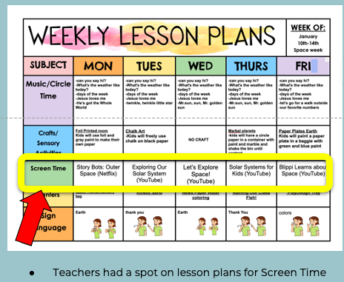
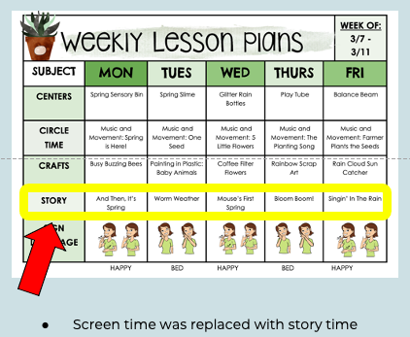
Success Story from a Previous Participant
Kingdom Kids Preschool and Play Center, Arizona
A small change with a big impact
Notes:
ECE program directors most respect the perspective of their peers. You may want to share this example of a change to a weekly lesson plan from a center director from Arizona that participated in a previous Learning Collaborative.
Possible ice breaker: How do you feel about adjustments made to the weekly schedule by a center that has previously been through this program?

Slide 9
Setting the Foundation for Healthy Habits
Notes:
Let’s get started with our discussion for today.
These slides are your first opportunity to have discussion amongst participants. You want to create an environment where people feel comfortable participating. (People have varying comfort in sharing their ideas – take advantage of the opportunities for chat and verbal communication during virtual Sessions).

Slide 10

Supporting Child Development
Information shared during this Learning Collaborative impacts ALL developmental domains of child development:
Physical Development
Cognitive Development
Social and Emotional Development
Communication and Language Development
Sensory Development
Notes:
While this Learning Collaborative focuses on screen time practices, it is important to understand their broader impact.
As ECE providers, you work hard every day to set children up for success. You are expected to…
make sure that they are physically healthy and growing to their optimal potential.
prepare children for school, making sure they have certain knowledge and skills, and the ability to solve problems (cognitive development);
teach children how to get along with others and manage their emotions (social and emotional development);
help children learn how to read and communicate (language development, literacy, and communication); and
teach them an appreciation for their senses – sight, smell, taste, feel, sound (sensory development, approaches to play and learning).
Ask: How many of you recognize the concepts of developmental domains and “the whole child approach to education”? What does this mean to you?
When you plan your day, you want to include activities that incorporate all domains into children’s learning to support their overall development and health.
More information about Developmental Domains can be found at: https://www.naeyc.org/resources/position-statements/dap/principles
More information about this Whole Child Approach to Education can be found at: http://www.wholechildeducation.org/take-action/making-the-case. Place these links in the chat for people to copy and check out after the Session.

Slide 11

All Domains are Essential and Inter-connected
Notes:
All of the domains are essential and inter-connected. Let’s take a closer look at how you impact the health and physical development of young children.
Take a moment and estimate how long do most of your children spend at child care in a day? And how many of their meals do they eat at child care? How much activity do they get?
With that information, why do you think it is important to support children’s health and physical development at child care?
Use the information below to frame the conversation in a way that is impactful to participants.
ECE programs—that’s you—play such an important role in shaping children’s health…
ECE programs are a “home away from home” for many children.
Over 60% of children in the US are in child care, and most of them are in child care full time (30+ hours a week).
As a result, most of the meals and snacks children eat are with you at child care.
Similarly, most of the physical activity they get, especially in winter when days are so short, comes from the time they spend with you.
So what you do today has an immediate impact on children’s eating and activity.
At the same time, you are shaping children’s future. You have such a powerful influence on the children during a very impressionable age. You will help shape their development of food preferences and physical skills, which in turn have a lasting impact on their eating and physical activity habits. You influence children’s knowledge, attitudes and healthy habits. Children want to do what you do– you have a chance to practice healthy habits for yourself as children watch and copy– creating healthier futures for them.
You are also a valuable source of education for families and a great partner in raising healthy children. You are in the unique position to impact children and their families.
One of the hard things about working with young children is that they aren’t likely to remember your influence. Yet we know you make a difference!

Slide 12

Healthy Eating and Child Development
Physical
Sensory
Social and Emotional
Cognitive
Language, Literacy, and Communication
Notes:
Let’s take a few minutes to explore how everyday opportunities around eating impact all aspects of development… Envision yourself sitting around a table with children and sharing a healthy meal together. How do you think that helps them develop across domains?
Encourage ECE providers to share their thoughts. ECE provider responses can be supplemented with the information below.
Physical Development - The nutritious meals that you are providing to children helps them develop and grow, maintain a healthy weight, and reduce their risk for chronic disease. Using their hands and later eating utensils allows children to develop their fine motor skills.
Cognitive Development - If children are hungry or not well nourished, they may not be able to concentrate on learning activities. Eating nutritious meals and snacks allows them to concentrate and do better academically.
Language Development, Literacy, and Communication - Talking with children during meal and snack time and encouraging group conversations with peers allows them to practice their communication and language skills.
Social and Emotional Development is impacted as children practice manners, conversation skills, and learn about each other’s preferences.
Sensory Development (approaches to play and learning) - Nutritious meals allow children to see, touch and feel, smell, and try new healthy foods. Meals are natural opportunities to talk with children about these different senses and support their sensory development.

Slide 13

Physical Activity and Child Development
Physical
Sensory
Social and Emotional
Cognitive
Language, Literacy, and Communication
Notes:
Now, let’s consider physical activity. Again, take a moment to envision children at your center engaged in cooperative play time. How do you think that helps them develop in their domains?
Encourage ECE providers to share their thoughts. ECE provider responses can be supplemented with the information below.
Physical Development - The time you provide for free and cooperative play helps children maintain a healthy weight, have a healthy heart, build strong muscles and bone, and reduce their risk for chronic disease.
Cognitive Development - Activity breaks, free and cooperative play time, helps get “the wiggles out”, expend energy, and allows children to better concentrate. Integrating academic learning into play/physical activity also gives children with different learning styles new ways to engage with the subject matter.
Language Development, Literacy, and Communication – As children play and interact, there are opportunities for new conversations which increase children’s receptive and expressive language.
Social and Emotional Development – Child-led play is also a great chance for children to negotiate social relationships and practices problem-solving skills.
Sensory Development (approaches to play and learning) - When children play outdoors and explore the natural world, this helps them smell, touch, see, feel, and hear different things (ex. birds, insects, trees and leaves, water, changing seasons).
We’ve gone through just two specific examples of natural opportunities in child care to support children’s healthy eating and physical activity. I am sure that you can think of many more. It is important to take advantage of these opportunities because well-nourished and physically active children are better prepared to succeed in school, become healthy adults, and lead health, active lives. Supporting children’s health and development benefits not only children but their families too.
Through our Learning Collaborative we will take a close look at those everyday opportunities to support children’s screen time viewing habits and overall development.

Slide 14
Benefits of Healthy Habits
Helps children develop positive relationship with body and food
Improved mental wellbeing, increased self-esteem, and lower rates of depression
Reduces risk of:
  Heart disease
  High blood pressure (hypertension)
  High cholesterol
Notes:
As child care providers, you have some control over the environment where children learn, play, and grow. Providing an optimal environment may not prevent the development of health conditions for all people, but the benefits of offering a variety of foods and lots of opportunity for children to move does have a positive impact on their overall health and well-being.
Children are showing early signs of heart disease (e.g., 15% with high blood pressure, 20% with high cholesterol). Heart disease is the leading cause of death in the US.
Signs of pre-diabetes are also on the rise (e.g., 1 in 5 adolescents).
Health habits reduce the risk of heart disease and other chronic conditions: eating a variety of nutritious foods and moving your body regularly has health benefits for children and adults of all sizes and abilities, including reducing the risk of conditions like heart disease, high cholesterol, or high blood pressure.
Healthy habits help children develop a positive relationship with their body and food: Over time, children that develop a positive relationship with food and their body are less likely to be depressed, have low self-esteem, and overall may have improved mental-well being.
Sources:
https://www.cdc.gov/bloodpressure/youth.htm#:~:text=Using%20the%20updated%202017%20American,common%20in%20youth%20with%20obesity.
https://www.cdc.gov/heartdisease/facts.htm (HD as leading cause of death in the US)
https://diabetes.org/diabetes/prediabetes/adolescents-prediabetes-health-risk#:~:text=One%20report%20in%20JAMA%20Pediatrics,more%20likely%20to%20have%20prediabetes.
https://nrckids.org/CFOC/Database/4
U.S. Department of Health and Human Services, U.S. Department of Agriculture. 2010. Dietary guidelines for Americans, 2010. 7th ed. Washington, DC: U.S. Government Printing Office. http://www.health.gov/dietaryguidelines/dga2010/DietaryGuidelines2010.pdf

Slide 15

Discussion
Consider…
What do you think is impacting children’s ability to develop healthy habits related to nutrition and physical activity?
What do you see in your community?
Notes:
If there are multiple trainers leading the Learning Collaborative, it may be beneficial to split participants into 2 TA groups, especially if there are many participants. If there is only 1 trainer leading the Learning Collaborative, there is no need to split participants into groups, and you should disregard the information on breakout rooms below.
(For virtual Learning Collaboratives with multiple trainers, put the questions on this slide in the chat after entering the breakout rooms for participants to use as a guide.)
Engage the group in the discussion.
Here’s my list of changes in our society and environment, some of which you named and some of which may be new.
Higher caloric foods
Larger portion sizes
Consumption of soda & sweetened beverages
More meals away from home
Growth of food industry and advertising
Differences in food marketing
Less time for meal preparation
Differences in food access
Less physical activity
Lack of walkable communities
Automobile travel
Safety in communities
Watching more TV and using devices
More labor assisting devices in the workplace
Less time for leisure and recreational activities
This Learning Collaborative will explore ways to find balance through screen time practices. More specifically, we will learn ways to create positive ECE environments to support and overcome barriers that might be in the way of building healthy habits.
When finished with this activity, bring the groups back together. Each trainer can share one takeaway from their group’s discussion.

Slide 16

Physical Activity Break
Notes:
Just like for the children in our care, being active is important to us as adults. In many of our Sessions, we will take physical activity breaks – we know that active breaks keeps your brain more engaged today and helps you be healthier overall. These breaks are for you and perhaps ideas that you can take home to your classroom.
Wiggles Activity
We are going to start by standing up. If you can, start marching in place. If you are more comfortable you can do this activity standing still or sitting down.
Have participants stand up and start by marching on the spot.
As I introduce each body part, you are going to move/wiggle that body. You also need to keep moving all of the body parts that were already named and keep on marching!
We’re going to start with our fingers and work our way down the body.
• begin to wiggle your fingers
• then your fingers and wrists
• then your fingers, wrists and forearms
• then your fingers, wrists, forearms and elbows
• then your fingers, wrists, forearms, elbows and shoulders
• then your fingers, wrists, forearms, elbows, shoulders and rib cage
• then your fingers, wrists, forearms, elbows, shoulders, rib cage and hips
• then your fingers, wrists, forearms, elbows, shoulders, rib cage, hips and knees
• then your fingers, wrists, forearms, elbows, shoulders, rib cage, hips, knees and head
Are you still marching?
Now, let’s end with three deep breaths before we sit back down. Ready, breathe through your nose and out through your mouth.
Source: Adapted with permission from the North Carolina Department of Public Instruction (www.ncpe4me.com). https://www.winnipeginmotion.ca/docs/Energizers_final_low.pdf

Slide 17
Learning Collaborative

Slide 18
Learning Collaboratives
Focus on quality ECE and children’s health as the foundation for life-long success
Health promotion and optimal child development made possible by the power of ECE providers
Notes:
As ECE providers, you have the power to change this story by providing a healthy environment in your ECE program. Your efforts will have a lasting influence on children’s development and health.
Often ECE programs focus on preparing children for the next step, elementary school, but you are preparing children for so much more including children’s long-term health.

Slide 19
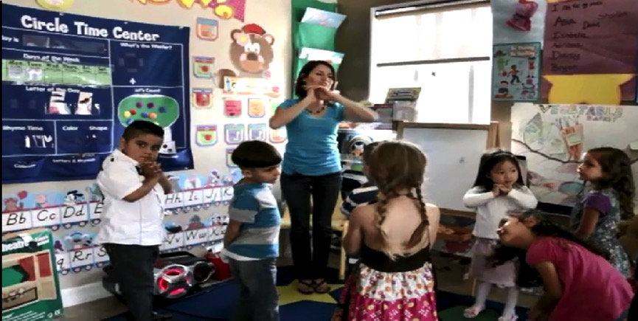
Video Making Health Easier:
Healthy Changes Start in Preschool
Notes:
Here’s a video that demonstrates how your work influences children in the classroom, their families, and their habits. This video demonstrates a Los Angeles teacher’s efforts in promoting healthy habits in her classroom.
Click on the photo (hyperlink) to start the video. If the hyperlink does not work, use this link: https://www.youtube.com/watch?v=JhoTY0FrG3c.
(Share the audio from your computer. Confirm that everyone can see and hear the video before you continue.)
Ask: What stood out to you from this video? Do you see ways to connect all components of a child’s life and learning together?

Slide 20
The Learning Collaborative Model
Community of learners that implement changes to promote health and wellness in ECE programs
Share ideas on what works and implement change with support from other learners and trainers
Proven ideas and resources to support program change to adopt best practices
Notes:
The Learning Collaborative Model creates a community of learners and a network among the Leadership Teams to share ideas and provide mutual support in implementing healthy change.
A Learning Collaborative is a powerful way to support ECE programs as they improve their practices and policies. Leadership Teams come together over a period of time to learn about new ideas, go back and test them out, then come back and share their experiences and strategize ways to make them even better.
The Nemours Children’s Health Learning Collaborative Curriculum serves as the foundation for our Learning Collaborative, promoting positive changes in healthy eating, breastfeeding support, physical activity, and screen time. Development of this curriculum was guided by:
Standards from “Preventing Childhood Obesity in Early Care and Education Programs”, which are part of Caring for Our Children
CACFP requirements and best practices
Wellness Workbook policies and best practices
Through the Learning Collaborative, you gain access to high-quality resources and practical advice that will help you become leaders/champions of change for your ECE program, while nurture collaboration with ECE program staff to implement best practices successfully. You will also learn strategies to engage your families as partners in children’s health, development, and well-being, maximizing the long-term impact of your efforts.

Slide 21
Leadership Team Model
ECE Programs
Self-Defined
Leadership Team
Owner/
Director
Other Staff member
Lead
Teacher
Notes:
Our Learning Collaborative includes _____ (# of ECE programs). Each of you have selected a Leadership Team. This team is usually made up of 3 people – one owner/director, one lead teacher, and one other staff member. Your team will attend this Orientation and a series of Sessions. Your whole Leadership Team is expected to attend each Session. We want you to learn together so you can together bring new ideas to your ECE program. You are the ambassadors leading your whole program to change.

Slide 22
Learning Collaborative Timeline
Orientation
Session 1: Learning Collaborative Orientation
Session 2: Program Assessment Orientation
Session 5: Implementing Screen Time Best Practices
Session 6: Celebrating Success
& Continuing the Process of Healthy Change
OR
Action Period
LS 3&4
LS
5&6
Action Period
Action Period
Session 3 Screen Time Overview
Session 4: Best Practices
Notes:
The script and timeline are only examples. Please revise the script and the chart in the slide to reflect the components of your Learning Collaborative structure.
This is a brief overview of how our Sessions will roll out over the next #__ months. Here we are today at the Orientation. We will then continue with several other Sessions. The following Learning Sessions are broken into one-hour Sessions, done as a group.
Group Sessions are active: We will dig deep into specific topics and explore resources together. We’ll use practical strategies that you can take back to your ECE programs to make change happen. Each Session covers different topic areas.
At each Session we will also have time to practice what we are talking about and taking activity breaks so we can remember that children need active adults leading the way. We’ll end each meeting talking about the next action steps you can take to make change in your ECE program.
Best Practice Sessions are an opportunity to learn the Caring for Our Children best practices related to screen time. From these you will choose your ECE program goals.

Slide 23
Action Periods
Orientation
Session 1: Learning Collaborative Orientation
Session 2: Program Assessment Orientation
Session 5: Implementing Screen Time Best Practices
Session 6: Celebrating Success
& Continuing the Process of Healthy Change
OR
Action Period
LS
3&4
LS
5&6
Action Period
Action Period
Session 3 Screen Time Overview
Session 4: Best Practices
Notes:
In between Sessions are Action Periods.
During Actions Periods, your Leadership Team will have specific tasks to complete. These tasks make sure that you are putting what your teams have learned into action program-wide. The Action Periods also make sure you are prepared for the next Session. For example, your first Action Period starts after the Assessment Tool orientation. The tasks for that Action Period are:
Share what you have learned about this Learning Collaborative with your staff.
Complete registration for your ECE program on the assessment tool, if applicable.
Complete your program assessment on Screen Time.
We will cover the details of Assessment during the Assessment orientation.
In a minute we will look at the calendar with greater detail. Your trainer will be connecting with you regularly to help keep you moving and motivated. Are there any questions at this point?

Slide 24

Creating Your Storyboard
Capture your ECE program’s journey
Work with staff to create a Storyboard that shows your process and accomplishments
Possible things to include:
  What change(s) were made
  Who was involved or provided help
  What challenges you overcame
  How children reacted to the change(s)
  What policies were updated
  How will you sustain the change(s)
Notes:
Refer to the Toolkit for more suggestions on Storyboards.
One other aspect of Learning Collaborative is that Leadership Teams work with their ECE programs to create a Storyboard that captures your experience in the Learning Collaborative and the progress made in your program throughout. ECE programs may choose to use a variety of ways to express their story of change. Your Storyboard could be a bulletin board in your program, a newsletter you share with families and staff, posts to your Facebook page about the changes you are making at your program or a PowerPoint to share with your trainer. Be creative – what we want to see is all of the great work you are doing.
Your Storyboard might include:
Photos of the process, including before, during and after the change(s);
Stories from teachers, staff, families and children;
Assessments, observations and reflections;
Documents including lesson plans or menus that demonstrate changes; and/or
Children’s artwork that describe the healthy changes in the program.
Remember to capture your changes on your Learning Collaborative Storyboard. We want to all learn from your challenges and successes!

Slide 25
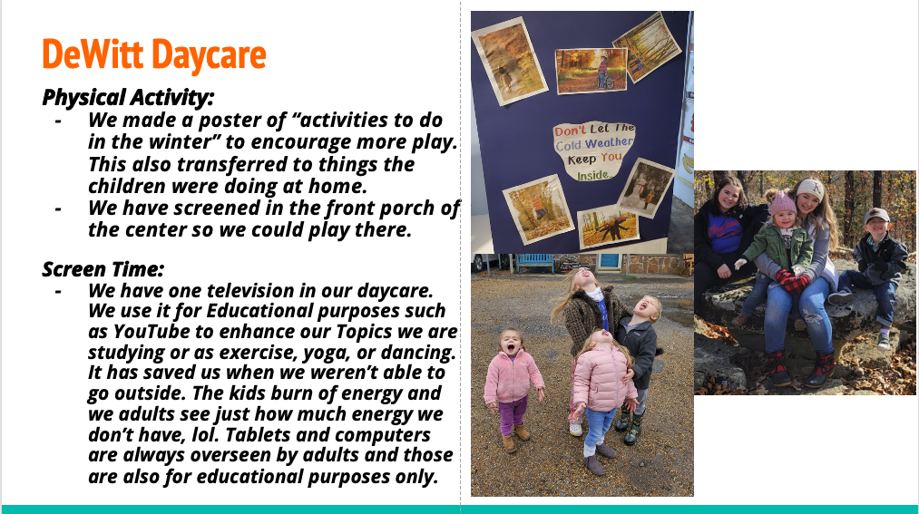
Sample PowerPoint Storyboard
Notes:
Leadership Teams add to their Storyboards over time. You will share your Storyboard with others during the last Session so that we can celebrate successes together. Sharing your Storyboard is a great way to reflect on your journey alongside those who have travelled with you.
You can replace the example on this slide with another example Storyboard from your state.

Slide 26
Trainer Notes:
Wellness Workbook is a free assessment tool to support improvements to ECE program policies, practices, and environments. If your state uses a different program assessment tool (Go NAPSACC or another program assessment tool), update the following slides and complete an orientation on the program assessment tool of your choosing.

Slide 27
Wellness Workbook
Introduction
Notes:
Wellness Workbook is a free program assessment tool to support improvements to ECE program policies, practices, and environments. If your state uses a different assessment tool (paper Go NAPSACC assessments or another program assessment tool), update the following slides and complete an orientation on the assessment tool of your choosing.

Slide 28
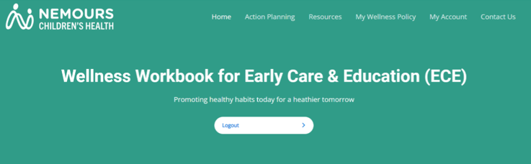
Wellness Workbook
Support improvements to ECE environments that foster healthy eating, physical activity, and overall development in children
Notes:
The Wellness Workbook is a program assessment tool based on the High Impact Obesity Prevention Standards to help ECE programs understand where they may already be meeting these standards and where they could improve. Wellness Workbook was designed to help ECE programs make improvements to their environments that foster the adoption of healthy eating and physical activity habits in children.
Development of the Wellness Workbook was a collaborative effort between researchers, public health professionals, technical assistance consultants, and ECE providers (like you).
It offers easy-to-use interactive online tools to help your ECE program meet the nutrition and physical activity best practices that matter to you.
Wellness Workbook is free to child care providers.
Within the Learning Collaborative it is going to provide you with information on your ECE program, your current strengths and places to grow. Along with the knowledge you are gaining in the Sessions, it will help you decide next steps.

Slide 29
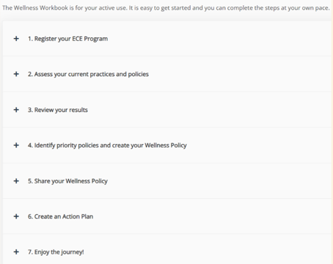
Wellness Workbook
PURPOSE
The Wellness Workbook guides users through an intentional program assessment process to inform the development of a custom Wellness Policy.
Notes:
The purpose of the Wellness Workbook is to guide users through an intentional program assessment process to inform the development of a custom Wellness Policy.

Slide 30
Screen Time
SECTIONS
Screen Time Program Assessment
Wellness Policy
EXAMPLE BEST PRACTICES
“Children under 18 months and younger old are not exposed to screen time.”
“Providers encourage families to limit screen time at home to no more than one to two hours daily.”
Notes:
Let’s take a closer look at examples of Screen Time best practices found in the Wellness Workbook program assessment.
There are many opportunities in ECE programs to support the development of healthy and active children.
The first section focuses on screen time standards. This includes the availability of children to be exposed to screens throughout the normal course of the day at the ECE program and the practices of the adults that influence children. For Screen Time, this includes adult/child interactions. For example: “Children under 18 months and younger old are not exposed to screen time.”
“Education & Professional Development” and “Policy” best practices are included in every module and speak to the educational opportunities offered to children, staff and families and the development of written policies that help solidify and sustain these practices once adopted.
Ask ECE providers to reflect on best practices:
Do either of these best practices surprise you?
Do you think changes in any of these sections (ex: screen time standards, professional development, etc.) would make a big impact in your ECE program?
Each module includes an opportunity to improve your ECE program’s policies. We want to make sure staff and families know the expectations of your ECE program and that these changes are permanent.

Slide 31
Next Steps
Notes:
If trainers are combining multiple Sessions, you should review and update the Next Steps slides at the end of each Session to ensure accuracy and to reduce repetitive tasks.

Slide 32
Action Period Tasks
Complete Assessment Orientation
Review the Orientation Key Learnings handout to share with staff after Assessment Orientation
Notes:
If trainers are combining multiple Sessions, you should review and update the “Action Period Tasks” slides at the end of each Session to ensure accuracy and to reduce repetitive tasks.

Slide 33

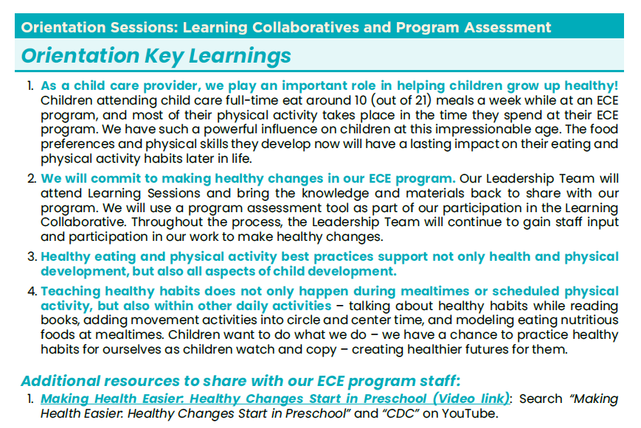
Key Learnings Handout
Notes:
After the Wellness Workbook Orientation, you will find a time to share information from today’s Orientation with ECE program staff.
In your Resource Guide, you will find a handout with key learnings from today. Sharing copies of this handout is a quick and easy way to keep staff up-to-date about the Learning Collaborative activities. Trainers can email the Key Learnings handout which may make it easier for them to share with their staff and view video links.
We strongly recommend that you also arrange time to meet with staff.
Trainers can find the Key Learnings handout in the Resource Guide. The Resource Guide and all Key Learnings handouts can be found on the Healthy Kids Healthy Future website.

Slide 34
Key Dates
First technical assistance “visit”:
Upcoming Session dates:
  Session 2: Program Assessment Orientation
  Session ___:
  Session ___:
Notes:
You all have a copy of this blank slide in your participant materials. Let’s take a look at this and fill in the dates for our upcoming Sessions.
Use this slide if implementing as individual 1-hour Sessions. If combining multiple Sessions, you can delete/hide this slide and include this information at the end of the final Session.
Review the timeline. Share dates for the Sessions so participants can fill in the dates on the slide. Be sure to provide a list of actions for each program to complete before and after each Session. The goal is to ensure participants know when they need to complete each action item.

Slide 35
Trainer Contact Information
Trainer Name
  Email:
  Phone:
Notes:
Be sure to provide your contact information. Add additional trainer’s contact information if more than one trainer is leading the Learning Collaborative.

Slide 36
Questions
Notes:
Any questions?

Slide 37
Trainer Reminders
Before the Program Assessment Orientation, trainers should:
Prepare the Program Assessment Orientation PowerPoint for your ECE programs based on their level of experience using the chosen assessment tool.
Ensure all programs have a digital or print copy of the Resource Guide.
Notes:
This “Trainer Reminder” slide gives you, the trainer, reminders for the Action Periods and next steps for you in facilitating the Learning Collaborative. They are hidden in the PowerPoint. They are not intended to be shared with ECE providers. Do not include them in any printed versions of the slides you provide to ECE providers.
During this Action Period, trainers should:
Prepare the Program Assessment Orientation PowerPoint for your ECE programs based on their level of experience using the chosen tool.
Ensure all programs have a digital or print copy of the Resource Guide.

Slide 38
Wellness Workbook
Notes:
The Wellness Workbook for Early Care and Education (ECE) is a free program assessment tool to support improvements to ECE policies, practices, and environments. This is a self-assessment, and ECE providers should work with the leadership and staff of a program to complete the assessments. If your state uses a different assessment tool (e.g., the paper Go NAPSACC self-assessments or another state-specific assessment tool), update the following slides, and complete an orientation on the assessment tool of your choosing.
In preparation, we recommend the following:
Complete the Screen Time program assessment. Select responses so that all but 1-2 best practices are being met. So, you can use this completed assessment as an example.
Trainers will help ECE programs create Wellness Workbook accounts either during this orientation or during the first TA visit, if necessary.

Slide 39
Wellness Workbook
Support improvements to ECE environments that foster healthy eating, physical activity, and overall development in children
Notes:
The Wellness Workbook is a program assessment tool based on the High Impact Obesity Prevention Standards to help ECE programs understand where they may already be meeting these standards and where they could improve. Wellness Workbook was designed to help ECE programs make improvements to their environments that foster the adoption of healthy eating and physical activity habits in children.
Development of the Wellness Workbook was a collaborative effort between researchers, public health professionals, technical assistance consultants, and ECE providers (like you).
It offers easy-to-use interactive online tools to help your ECE program meet the nutrition and physical activity best practices that matter to you.
Wellness Workbook is free to child care providers.
Within the Learning Collaborative it is going to provide you with information on your ECE program, your current strengths and places to grow. Along with the knowledge you are gaining in the Sessions, it will help you decide next steps.

Slide 40
Wellness Workbook
PURPOSE
The Wellness Workbook guides users through an intentional program assessment process to inform the development of a custom Wellness Policy.
Notes:
The Wellness Workbook guides users through an intentional program assessment process to inform the development of a custom Wellness Policy.

Slide 41
Getting Started
The Wellness Workbook is live at www.workbook.healthykidshealthyfuture.org
There are 2 types of User accounts:
  1) Center – for ECE program staff
  2) Partner – for trainers supporting ECE program staff
User guides and short videos are available to help navigate the website

Slide 42
How to Register
To request a Wellness Workbook log-in, email workbook@healthykidshealthyfuture.org.
You will receive your log-in information within 2 business days.

Slide 43
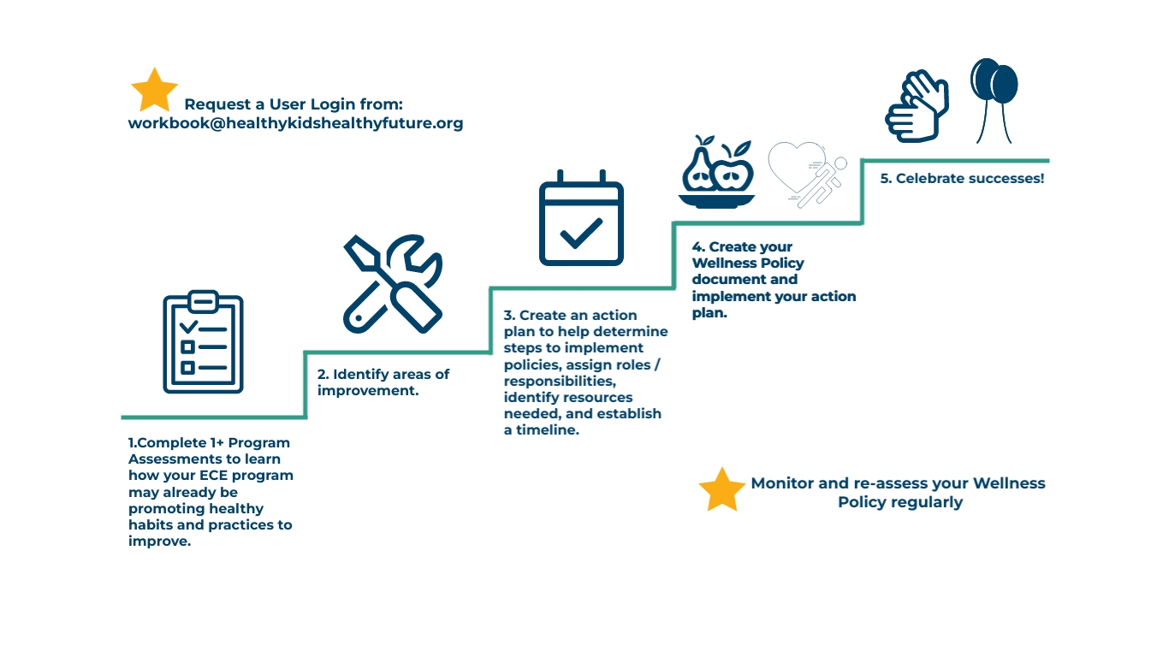
Steps for using Wellness Workbook

Slide 44
Program Assessments Overview
The Wellness Workbook includes an Introduction section that provides an overview of “Why Does an Early Childhood Program Need a Wellness Policy?”
The homepage includes access to the ECE Registration module and 5 program assessments.
The only required section is the ECE registration module.
Users can complete as many program assessments as they like and can complete them multiple times, as desired.
Notes:
You may share the following video with ECE providers after completing the Wellness Workbook Orientation.
Wellness Workbook: Completing a program level assessment – This video walks users through completing a program assessment, viewing and saving results. Total time: 8 minutes https://www.loom.com/share/20c4b157b481432680b62469b1eec0ae

Slide 45
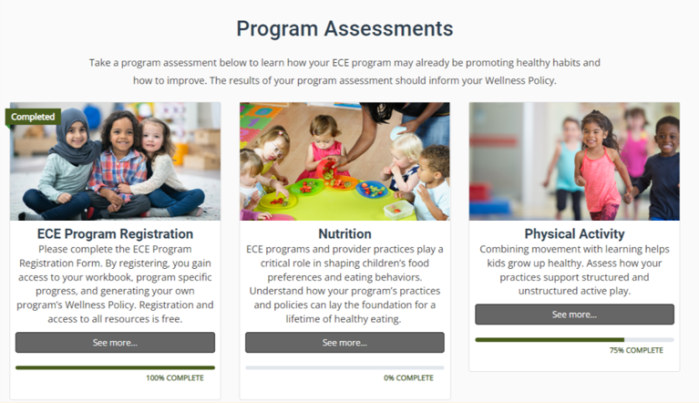
Program Assessments

Slide 46
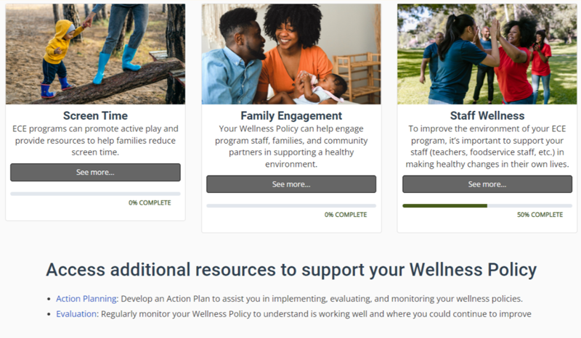
Program Assessments

Slide 47
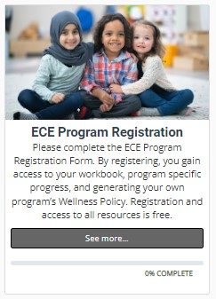
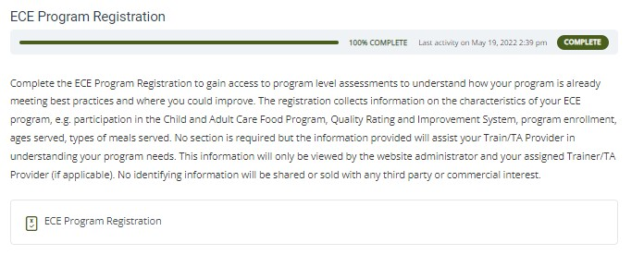
ECE Program Registration
First, you must complete the "ECE Program Registration."
Click the "See more" button on the homepage.
Click "ECE Program Registration" and complete all questions.
Click "Finish Assessment".

Slide 48
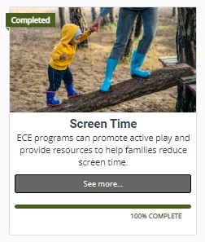
Screen Time Program Assessment
Screen Time Program Assessment – 1 assessment
Assessments have 4-12 questions and can be completed in 10 minutes or less.

Slide 49
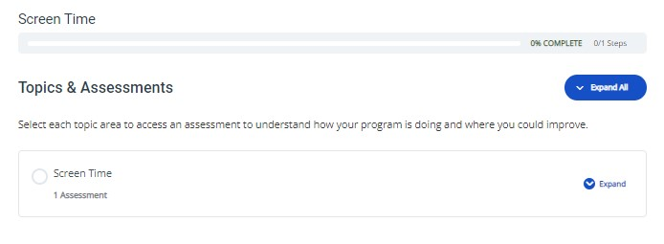
How to Complete a Program Assessment
Click the “See More” button under “Screen Time”
View the 1 topic area for “Screen Time”
Click “Expand All” to see the assessment

Slide 50
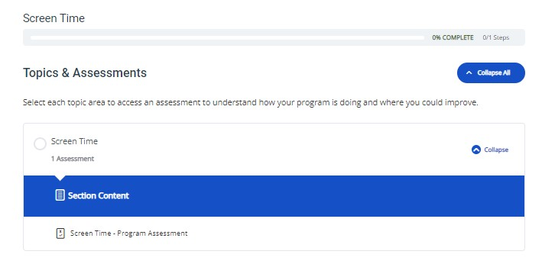
Complete Screen Time Program Assessment
Click “Screen Time Program Assessment” to begin answering the program assessment questions.

Slide 51
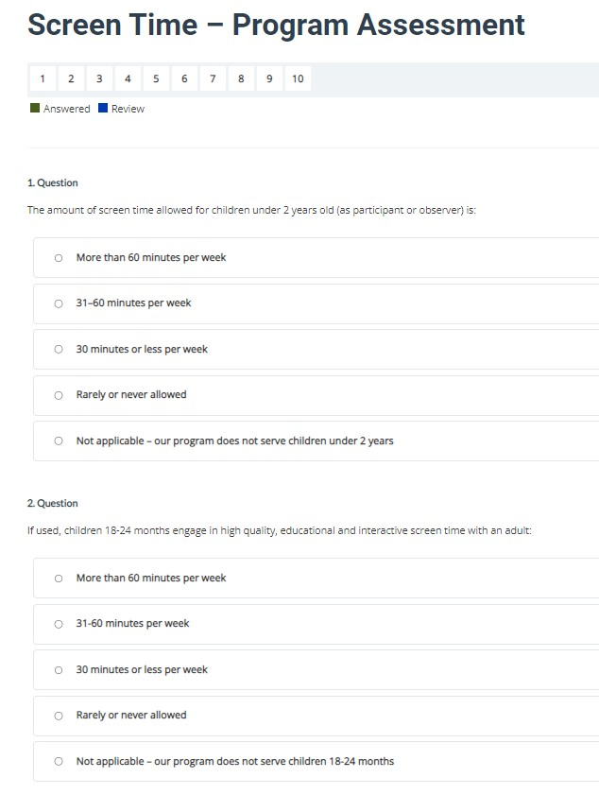
Respond to All Assessment Questions
Respond honestly to assess your program’s current practices.
Be sure to answer all questions.
After completing all questions, click “Next” on the bottom right of the page.

Slide 52
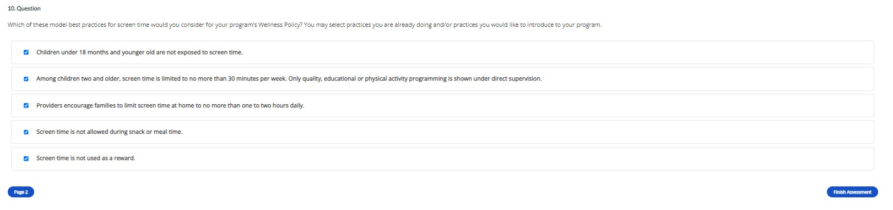
Model Best Practice Options
At the end of the Assessment, there’s a prompt to select multiple best practices for your program’s Wellness Policy. You can select practices you are already doing and/or practices you would like to introduce to your program.
Click “Finish Assessment.”

Slide 53
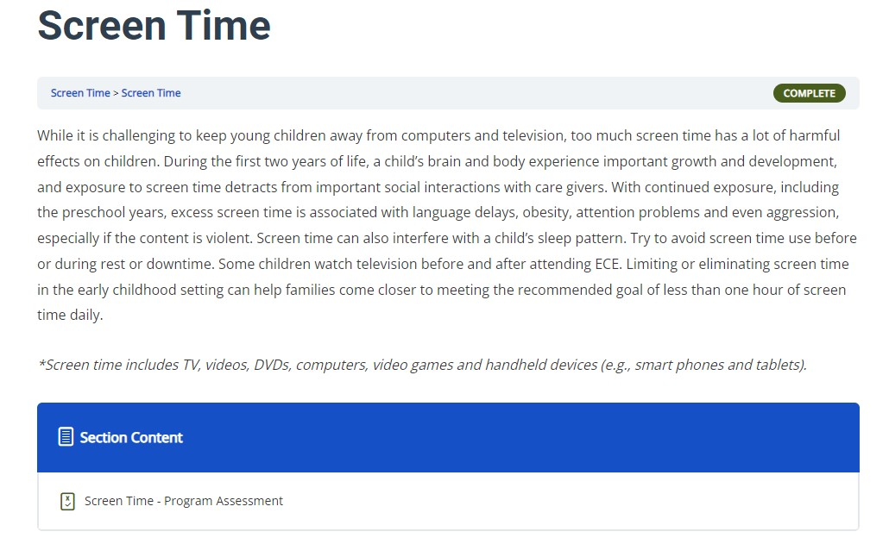
Mark Complete
Section will show green “Complete” icon on top right corner.

Slide 54
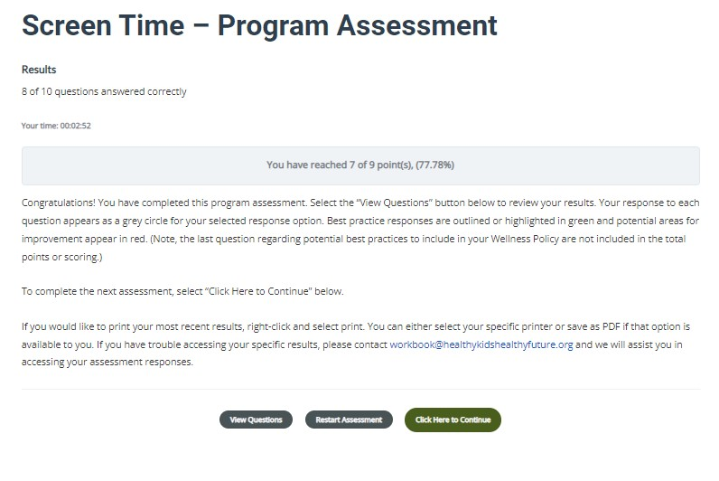
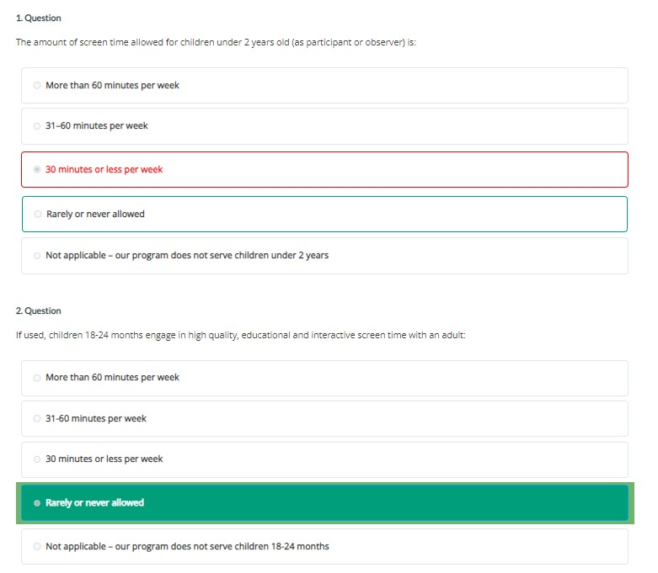
View Screen Time Results
Click “View Questions” to see your responses.
Your responses will appear below the “View Questions” button.

Slide 55
Are you meeting best practices?
Best practice responses are outlined in green.
Areas where the best practice is not being met is outlined in red.
Notes:
Best practice responses are highlighted in green.
Areas where the best practice is not being met is highlighted in red.
In the image, you can see that the response for Question 1 does not meet the best practice standard.
For Question 2, your program is also not meeting the best practice.

Slide 56
How do you know if all assessments have been completed?
Bar at the top of the Screen Time module will say “100% COMPLETE.”
Screen Time tab on the Wellness Workbook homepage will show a “Completed” flag on the top left corner.

Slide 57

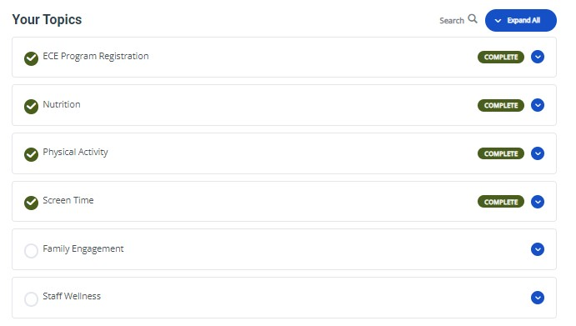
Program Assessment Results
To see your program assessment results, click “My Account” on the top bar.
You can see all topics that have been completed under this page.

Slide 58
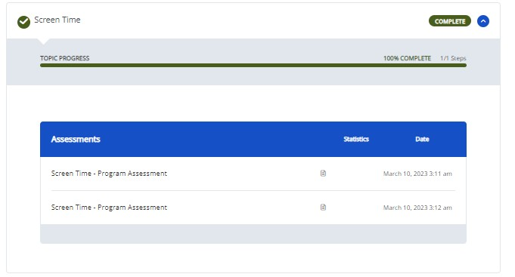
Select Screen Time
Click the arrow beside Screen Time.
You can see the assessment that has been completed.
Click the Notebook icon to view assessment results

Slide 59
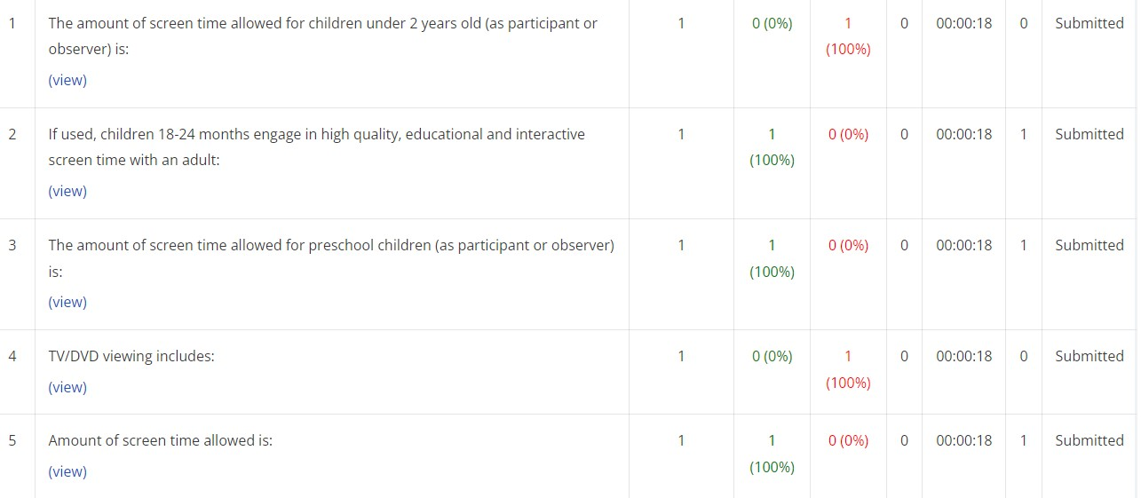
Click View under each Question

Slide 60
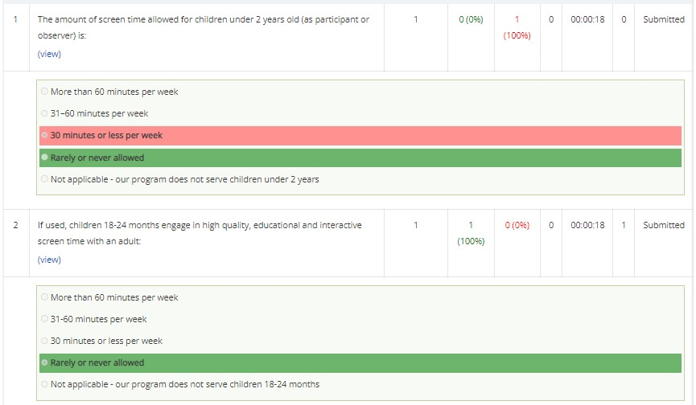
Program Assessment Results
Notes:
If you review your results online, you can easily see which options are the best practice. The best practice option will always be highlighted in green. This page will show you which best practices your ECE program has met, and others your program has not met.
The Wellness Workbook best practices align with the CDC’s 47 High Impact Obesity Prevention Standards, Caring for Our Children, 4th edition, and the Child and Adult Care Food Program standards and meal patterns. For your Leadership Team, this means you can trust the best practices no matter which one you choose. They will all lead you in the right direction of improving children’s health.
We are now going to discuss your experience with the Orientation Action Period.

Slide 61

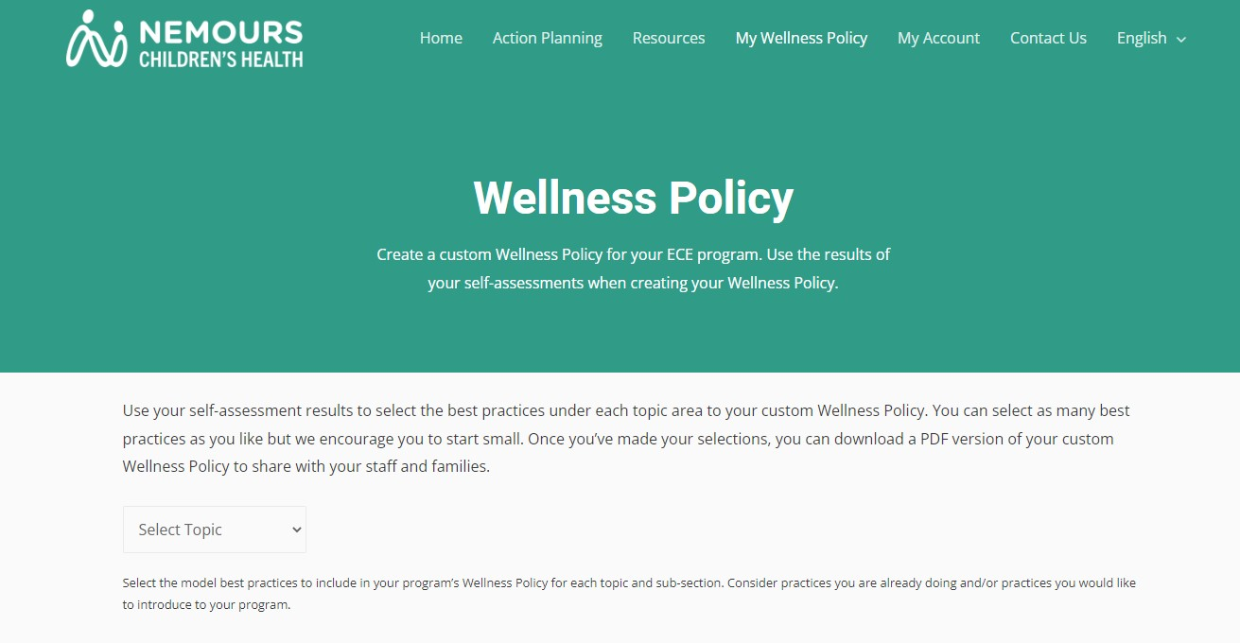
Selecting Wellness Policies
After completing a program assessment, ECE programs can create Wellness Policies to share with staff and families.
On the homepage, click “My Wellness Policy.”
On the “Wellness Policy” Page select your topic area of choice.
Notes:
What are the Components of a Wellness Policy?
Your program’s Wellness Policy should be informed by the results of your self-assessments. This helps you focus your time, energy, and resources on the areas where you are not yet meeting best practices. The self-assessments will also highlight the best practices you are already meeting. These practices should be celebrated and included in your program’s Wellness Policy, so everyone knows how your ECE program supports healthy habits.
Your Wellness Policy should include goals and standards that address:
nutritional practices (how infants and children will be fed at your program) and education
physical activity practices and education, including screen time
other program-based activities, including those that promote staff wellness
Your Wellness Policy should also include a few statements about how you will plan on revisit your Wellness Policy on a regular basis to ensure it is effective and meeting the needs of your staff, children, and families.

Slide 62
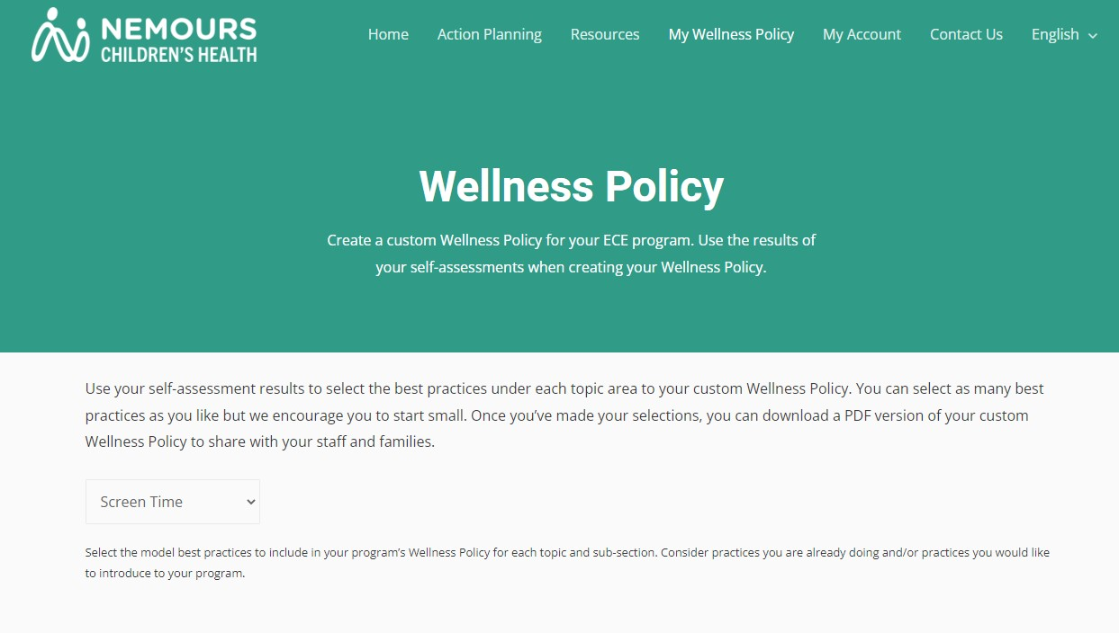
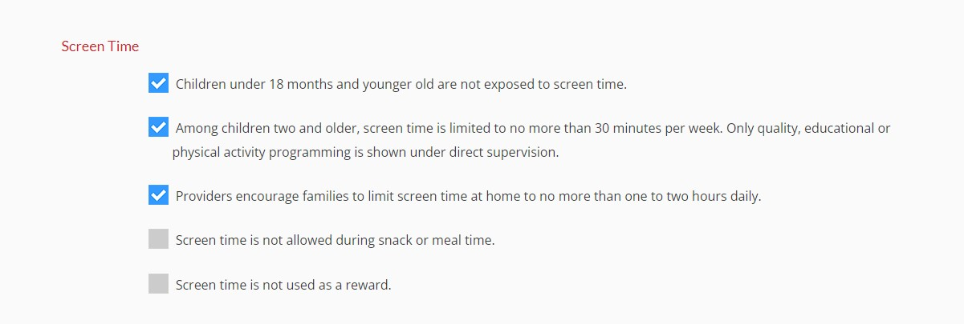
Selecting Screen Time Wellness Policies
After selecting “Screen Time” on the Wellness Policy Page, you will be directed to the “Screen Time” Wellness Policy options.
Select the check box beside each policy your program is committed to upholding.

Slide 63

Download Your Wellness Policies
After selecting your Wellness Policies, scroll down to the bottom of the page and click “Download PDF.”

Slide 64
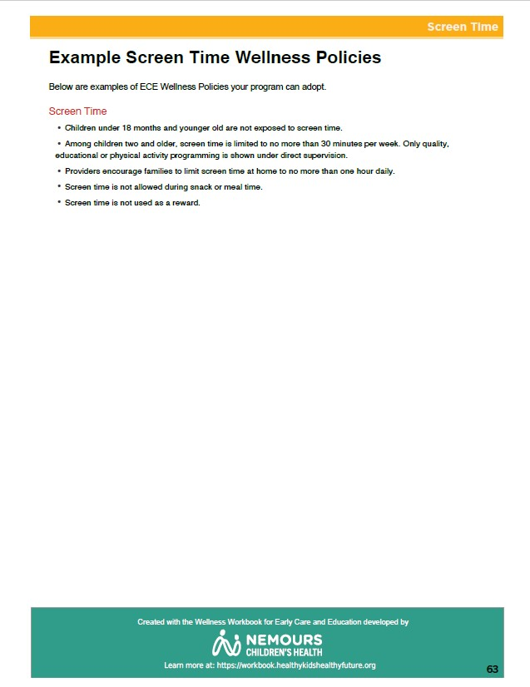
Wellness Policies
A PDF of the Wellness Policies you selected will automatically download to your computer or device.
The Wellness Policies can be easily added to Staff and Family Handbooks.

Slide 65
Next Steps
Notes:
Add the following slides to the end of the Wellness Workbook orientation so that Leadership Team members know their Action Period tasks to complete after the Wellness Workbook Orientation.
Trainers should review and update the “Action Period Tasks” slides at the end of each Session to ensure accuracy, align tasks with Learning Collaborative timeline, and reduce repetitive tasks.

Slide 66
Action Period Tasks
During this Action Period your team will:
Meet with your trainer to receive technical assistance (TA).
Complete registration for the assessment tool, if applicable.
Complete the Screen Time program assessment.
Share Key Learnings Handout and other information with program staff, teachers, and families.
Notes:
Trainers should review and update the “Action Period Tasks” slides at the end of each Session to ensure accuracy, align tasks with Learning Collaborative timeline, and reduce repetitive tasks. Remind participants about actions ECE programs should complete before and after each Learning Session. The goal is to ensure participants know when they need to complete each action item.
Over the next few days, we (the trainers) will check-in with each of your teams by phone and/or email to schedule a time for our first TA visit.
The Leadership Team will:
Receive technical assistance from your trainer.
If you haven’t already, register for the chosen assessment tool, if applicable. You will do this with your trainer at your first TA visit.
Before the next Session, your Leadership Team should complete the Screen Time program assessment. Because this is a program-wide assessment, we encourage your teams to reach out to other staff to get their input. You will complete one program assessment for your ECE program.
Let teachers, staff and families know that your ECE program is taking part in the Nemours Children’s Health Learning Collaboratives by sharing the Key Learnings Handout.
Any questions?

Slide 67
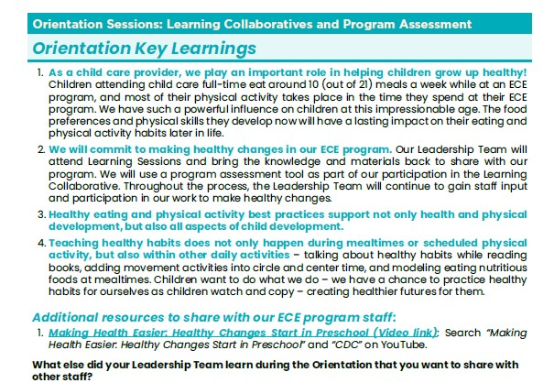
Key Learnings Handout
Notes:
Find a time to share information from today’s Orientation with ECE program staff.
In your Resource Guide, you will find a handout with key learnings from today. Sharing copies of this handout is a quick and easy way to keep staff up-to-date about the Learning Collaborative activities. Trainers can email the Key Learnings handout which may make it easier for them to share with their staff and view video links.
We strongly recommend that you also arrange time to meet with staff.
Trainers can find the Key Learnings handout in the Resource Guide. https://public.3.basecamp.com/p/Xj1WBY5rhXD46RQqyoW1Ji1q

Slide 68
Key Dates
Next technical assistance “visit”:
Upcoming Session dates:
Session ___:
  Session ___:
  Session ___:
Notes:
You all have a copy of this blank slide in your participant materials. Let’s take a look at this and fill in the dates for our upcoming Sessions.
Review the timeline. Share dates for the Sessions so participants can fill in the dates on the slide. Be sure to provide a list of actions for each program to complete before and after each Session. The goal is to ensure participants know when they need to complete each action item.

Slide 69
Questions
Notes:
Any questions?
Share your appreciation and excitement for working together during the Learning Collaborative. Remind Leadership Team members that they can reach out with any questions.

Slide 70
Trainer Reminders
During this Action Period, trainers should:
Meet with ECE programs to provide TA.
Ensure all ECE programs have registered on the program assessment tool and know how to log-in.
Ensure all ECE programs have completed the Screen Time program assessment before the next Session.
Provide additional support to any ECE programs that are not very comfortable with technology.
Share Orientation Key Learnings handout and any other requested resources with participants.
Remind participants to review their Screen Time program assessment results.
Notes:
This “Trainer Reminder” slide gives you, the trainer, reminders for the Action Periods and next steps for you in facilitating the Learning Collaborative. They are hidden in the PowerPoint. They are not intended to be shared with ECE providers. Do not include them in any printed versions of the slides you provide to ECE providers.
During this Action Period, trainers should:
Meet with ECE programs to provide TA.
Ensure all ECE programs have registered on the program assessment tool and know how to log-in.
Ensure all ECE programs have completed the Screen Time program assessment before the next Session.
Provide additional support to any ECE programs that are not very comfortable with technology.
Share Orientation Key Learnings handout and any other requested resources with participants.
Remind participants to review their Screen Time program assessment results.
As a reminder, you may share the following video with ECE providers after completing the Wellness Workbook Orientation. This tutorial walks users through the process of completing a program assessment, viewing, and saving results. Total time: 8 minutes https://www.loom.com/share/20c4b157b481432680b62469b1eec0ae

Slide 71
Screen Time
Overview
© 2023 The Nemours Foundation
Notes:
Welcome participants to the Screen Time Session.
Leadership Team members will review their Screen Time program assessments during this Session. Trainers can download the results of their programs’ program assessments from their Wellness Workbook trainer account. For virtual Sessions, we encourage you to email these results to participants to have available during the Session. For in-person Sessions, we encourage you to print one copy per Leadership Team and provide them in the Session for the Leadership Team to share.

Slide 72
Today’s Agenda
Icebreaker + Group Norms Review
Learning Objectives
Reflection
Importance of Managing Screen Time
Identifying Goals and Planning for Change
Next Steps
Notes:
Here is a quick snapshot of how we will spend our time together today.
Read aloud the agenda items.
Please remind participants that they can follow along with the slides during the Session.
Share the Group Norms (Create an additional slide to add to your presentation or share on a Flip Chart or in Chat) These are the Group Norms you created in the Orientation Session with this group. Ask anyone if they have any questions or additions.
In our Orientation Session we created Group Norms to help guide our discussions. I will review them briefly now. If you have any additions or questions, please share those with the group.
We are going to start with an Ice Breaker.

Slide 73
Icebreaker
Notes:
Icebreakers are important to connect participants.
Suggested Ice Breaker Question: What was one of your activities as a child that had nothing to do with a screen?
Have all participants introduce themselves including their name, ECE program and role along with answering the icebreaker question.
(Stop screen sharing during the icebreaker so participants can see each other. Additionally, trainers can use this time to check attendance by having participants type their name and ECE program in the chat)

Slide 74
Learning Objectives
After this Session, you will be able to…
Describe best practices for screen time for infants, toddlers, and preschoolers
Understand the importance of managing screen time
Use your Screen Time program assessment results to identify ways to improve Screen Time practices in your ECE program
Notes:
Here are the learning objectives for the Screen Time Session. ​
Ask for a volunteer to read through the learning objectives. If no one feels comfortable doing so, one of the trainers should read through the objectives. ​

Slide 75
Reflection
Notes:
Before we dive into new content today, let’s take a moment to reflect on the past couple of weeks since our initial Orientation Meeting.

Slide 76
Orientation Action Period
Orientation
Session 1: Learning Collaborative Orientation
Session 2: Program Assessment Orientation
Session 5: Implementing Screen Time Best Practices
Session 6: Celebrating Success
& Continuing the Process of Healthy Change
OR
Action Period
LS
3/4
LS
5/6
Action Period
Action Period
Session 3 Screen Time Overview
Session 4: Best Practices
Notes:
At our Orientation Session, we talked about the project and what we would be doing with the Learning Collaboratives over the next few months. We also began looking at the Assessment Tool and some of the Provider Tools, specifically the program assessment .
Your first Action Period began immediately afterwards. You had a few tasks to work through since the Orientation. Let’s check in to see how those are coming along.

Slide 77
Orientation Action Period
During this Action Period your team:
Met with your trainer to register for your Assessment Tool account, if applicable.
Completed the Screen Time program assessment.
Informed staff about your ECE program’s participation in the Learning Collaboratives.
Shared the Orientation Key Learnings with teachers and staff.
Notes:
Remember, the Action Period tasks from the Orientation Session? These tasks were designed to encourage discussion and idea sharing between members of your Leadership Teams and staff back at your ECE program in order to support program-wide changes. These tasks also help prepare your team for the upcoming Sessions. Hopefully, you spent some time talking with your staff about your participation in the Learning Collaborative and what you learned at the Orientation Meeting. You should also have registered for an assessment tool account, if applicable, and completed the Screen Time program assessment.

Slide 78
Program Assessment Results
To see your program assessment results, click “My Account” on the top bar.
You can see all topics that have been completed under this page.
Notes:
Review the process for how ECE providers can check their program assessment results on the Wellness Workbook.

Slide 79
Select Screen Time
Click the arrow beside Screen Time
You can see that all assessments have been completed.
Click the Notebook icons to view assessment results

Slide 80
Click View under each Question

Slide 81
Program Assessment Results
Notes:
If you review your results online, you can easily see which options are the best practice. The best practice option will always be highlighted in green. This page will show you which best practices your ECE program has met, and others your program has not met.
There are two examples of how this will look on the screen.
Question 1 shows that the best practice was not met since the option chosen is highlighted in red. The best practice is highlighted in green.
Questions 2 is an example of a best practice that is being met since the option chosen is highlighted in green.
The Wellness Workbook best practices align with the CDC’s 47 High Impact Obesity Prevention Standards, Caring for Our Children, 4th edition, and the Child and Adult Care Food Program standards and meal patterns. For your Leadership Team, this means you can trust the best practices no matter which one you choose. They will all lead you in the right direction of improving children’s health.
We are now going to discuss your experience with the Orientation Action Period.

Slide 82
TA Group Discussion
Consider…
How did your team share information about the Learning Collaborative with staff?
What did you learn about your program from your Screen Time program assessment?
  Are there any best practices you don’t understand?
  Which practices do you struggle with?
  Are there any practices you are already working to improve?
Notes:
If there are multiple trainers leading the Learning Collaborative, it may be beneficial to split participants into 2 TA groups, especially if there are many participants. If there is only 1 trainer leading the Learning Collaborative, there is no need to split participants into groups, and you should disregard the information on breakout rooms below.
(For virtual Learning Collaboratives with multiple trainers, put the questions on this slide in the chat after entering the breakout rooms for participants to use as a guide.)
Lead the discussion. Participants should have their program assessment results for reflection (emailed to them by their trainer prior to this Session).
Facilitate a brief group discussion about the Orientation Action Period Tasks.
How have things been going since the Orientation?
Were you able to complete all tasks?
How did your team share information about the Learning Collaborative with staff? Did you share the Orientation Key Learnings handout? What was the response from staff? Anything you want to do differently in the future?
What did you think about the As tools? Any questions?
Have participants look at their program assessment results and encourage reflection. While Leadership Teams were encouraged to complete the program assessment as a team, some may have designated the task to a single person. Sharing results will ensure that all team members understand their results. Trainers should have emailed (virtual) or provided (in-person) a copy of the ECE program’s program assessment for this discussion.
What did you learn from the program assessment?
Where is your ECE program doing well?
What areas need improvement?
Were there any questions that you didn’t understand?
Throughout the Screen Time Learning Collaborative, we’ll take a closer look at each of the best practices. I wanted to make sure that you had your results on hand so you can take notes about things you are interested in working on.
When finished with this activity, bring the groups back together. Each trainer can share one takeaway from their group’s discussion.
The Screen Time Learning Collaborative will focus on how ECE programs can provide opportunities that support the development of healthy screen time habits in children.
We’ll discuss a variety of best practices in Screen Time. Later in the Learning Collaborative, you’ll have a chance to select goals for improvement. You will also learn about the additional tools available to guide you through the action planning process and locate resources needed to put that plan into action. You will continue to use these tools throughout the project.

Slide 83
Importance of Managing
Screen Time
Notes:
Hopefully, the Screen Time program assessment got you thinking about the variety of ways that ECE programs can support healthy management of screen time for young children. During this portion of our Session, we will discuss what are different types of screen that we encounter in our daily lives, what are the recommendations about managing screen time for young children, and what are some of the concerns about too much exposure to screens.

Slide 84
Screen Time Recommendations
The American Academy of Pediatrics (AAP) recommends:
Infants and toddlers, birth – 18 months: avoid screen time other than video-chatting with family and friends
Toddlers, 18 – 24 months: some screen time, but only when with a parent or caregiver
Preschoolers: Limiting screen time to 1-2 hours of quality, educational programming per day
Notes:
The American Academy of Pediatrics recommends that:
Infants and toddlers, birth - 18 months avoid screen time other than video-chatting with family and friends
Toddlers, 18 – 24 months: some screen time, but only when with a parent or caregiver
Preschoolers: Limiting screen time to 1-2 hours of quality, educational programming per day
Screen time displaces opportunities for other activities that encourage healthy development such as reading, physical activity, and imaginative play. Also, since children’s young minds are not fully developed young children do not learn from media interactions the same way they learn from their interactions with caregivers.
These recommendations apply to a child’s full day. Their time in child care and with their families.
Source:
https://publications.aap.org/pediatrics/article/138/5/e20162591/60503/Media-and-Young-Minds?autologincheck=redirected

Slide 85
Screen Time Report Card
Some studies indicate that >80% of preschoolers exceed the recommended 2 hours of screen time a day
On average, preschoolers are exposed to 4.1 hours of screen time a day on weekdays
  90% of screen time is viewed at home
  Children attending home based child care watch the most screen time
Notes:
With these recommendations in mind, let’s look at actual screen time use for children. Overall, 66% of preschoolers participate in more than 2 hours of screen time each day. Research shows that preschoolers are exposed to an average of 4.1 hours of screen time on weekdays. This is more than double the recommendation.
Generally, children who attend child care centers view a little less than the average. Children in home based child care viewed the most screen time, more than children in child care centers or children who do not attend child care anywhere.
While screen time use is high for children, there are actions you can take to reduce the use of screens in your ECE program.
Sources:
https://jamanetwork.com/journals/jamapediatrics/fullarticle/2755656?guestAccessKey=7efc2069-d6e3-41b9-94ae-920053ee288f&utm_source=For_The_Media&utm_medium=referral&utm_campaign=ftm_links&utm_content=tfl&utm_term=112519
https://pubmed.ncbi.nlm.nih.gov/20980020/#:~:text=On%20average%2C%20children%20in%20this,Head%20Start%20(4.2%20hours)

Slide 86
What is Screen Time?
Allow
Personal Conversations
  Remote Learning
  Separated Families
Therapy Appointments
Teacher Reading a Story from a Tablet
Augmented Technology for children with special needs
Limit
TV, DVDs, videos
Computer time
Smart phone, tablets
Video games
Virtual reality headsets
Classroom Curriculums
Notes:
Screen time is not just watching television. It also includes watching videos and DVDs, playing on computers, tablets, video games, handheld devices and classroom curriculums that include a video component.
For the purposes of this Learning Collaborative, Skyping or doing FaceTime with family members (such as a parent serving in the military overseas, or a child in foster care having visitation with their parent) is NOT considered screen time. Additionally, a child having virtual speech therapy, or a teacher reading a story from a tablet rather than a hard copy of a book does not count as screen time. During this time of virtual learning due to COVID-19, communicating with classmates who are learning at home or with a remote teacher also doesn’t count as screen time for our purposes.
Screen time is an activity with less personal connection which often gets in the way of children interacting with their environment, peers and teachers. For the purposes of this training, screen time refers to all items in the limit category.

Slide 87
What are the concerns about screen time?
Screen Time decreases the opportunity for child development.
  For children 8-16 months, every hour of viewing is associated with 6-8 fewer words learned
  More hours of viewing at age 3 can lead to decreased cognitive test scores at age 6
  Less likely to be at a healthy weight
Children learn best through engaging in physical activity, educational activities and social interaction with peers and teachers.
Notes:
There are many reasons to limit screen time for children. While watching television might be an enjoyable activity for children and occupies their time so you can complete other tasks, children are often unable to apply the educational content viewed on screen to their learning. Screen time is a sedentary activity that often does very little to stimulate the brain. Children learn by doing. It gets in the way of exploring, playing, and social interaction. In young children, TV viewing beyond recommendations has been linked with cognitive and speech delays, aggressive behavior, and a decrease in academic performance, and less likely to be at a healthy weight.
For children 8-16 months, every hour of TV viewing is associated with 6-8 fewer words learned. More hours of viewing can lead to decreased cognitive test scores at age six. And screen time may also lead to more aggressive and violent behavior because young children cannot tell the difference between fantasy and reality on television and can become desensitized to violence.
Instead of using screens, children should be engaging in physical activity, educational activity, and interacting socially with their community, families, teachers and peers. When children spend less time in front of a screen and more time interacting with their peers and the adults around them, they learn valuable social skills.
Sources:
https://pubmed.ncbi.nlm.nih.gov/17889070/
https://jamanetwork.com/journals/jamapediatrics/fullarticle/486070
https://www.ncbi.nlm.nih.gov/pmc/articles/PMC5769928/

Slide 88
Identifying Goals and
Planning for Change
Notes:
Explain to participants that making healthy changes is a process. Areas of improvement are identified and then steps should be taken to continue to make changes to the ECE program. This segment reviews self-assessment results, starts identifying goals, and begins action planning needed to create change in the inner most rings of the Social Ecological Model.

Slide 89

How do you develop an action plan?
Do a program assessment
Develop goals
Identify challenges
  Resources needed
  Estimate costs
Develop action steps
Identify a completion date
Share responsibility
Notes:
Action plans support the change process.
An action plan is like a mapped-out road trip.
The goal of a plan is like the destination of a road trip. Where do you want to go? What change do you want to make?
The action steps in the plan are like the directions to reach the destination.
Self-assessments help you understand where you can improve your program or practices. The areas to improve could be goals. You might select a goal that builds on current strengths.
As you work on the action plan think about challenges you may face. Consider materials, and any costs to implement the steps. Using resources that are currently available can make goals more attainable.
Action steps support children, staff, and families in reaching the goal and should also address changes to the environment that are needed. For example, you might identify needing a water station outdoors to support longer period of outdoor play.
A timeline helps keep the action plan moving toward completion. Setting completion dates supports accountability for completing each step of the plan.
Responsibilities to complete action steps should be shared among program staff in order to support buy-in and ensure implementation takes place.

Slide 90


Goals and Action Steps
Goals
Action Steps
A broad desired outcome
The planned implementation of the goal and objective
Toddlers will participate in at least 60 minutes of physical activity every day
Create an activity ring of physical activities that teachers can do indoors and outdoors
Notes:
Trainer notes: Use the content on the slide to help participants distinguish between goals and action steps.
Goals are like the destination of a trip.
Action steps are like the directions needed to reach that destination.
Without the directions or action steps, it can be challenging or impossible to reach the goal.

Slide 91

How do you identify goals?
Review the best practices for physical activity
Think about which best practices you currently have in place and why you would like to improve your physical activity practices
Use your program assessment results to identify your strengths and areas of improvement
Identify a goal you would like to work on in your program
Notes:
Trainer notes:
Refer participants to their program assessment results.
They will use their results to develop their action plan.

Slide 92

SMART GOALS
Specific ⎯ exactly what you would like to achieve
Measurable ⎯ a way to determine if the goal has been reached
Attainable ⎯ reasonable to achieve it in a specific timeframe
Relevant ⎯ aligned with program objectives
Time-bound ⎯ with a completion date
Notes:
Setting goals is a necessary step to make changes to a program or a practice. A goal sets a broad target for what you need to accomplish.
S.M.A.R.T. is an acronym used to support the development of a goal statement.
Specific: Goals should clearly state what you want to achieve. They should be specific and clearly written. Goals should define the who, what, when, and where of the desired outcome.
Measurable: Goals should contain a metric that measures the progress and completion of the goal. They might be measured by dates, the number of tasks completed or environmental changes.
Attainable: Setting goals that are attainable increases staff motivation. Reaching a goal may require developing new skills and knowledge, a shift in attitude, and possibly changes to the environment. Think about your goal based on what you currently have (for example, resources, staffing).
Relevant: Goals that align with your program’s philosophy or beliefs make sense. Goals that fit into families’ demands and interests might also be a good fit for programs. For goals to be meaningful to staff, make sure it fits into a larger picture of the program’s objectives.
Time-bound: Goals should have a target date for completion. Deadlines support recognition of progress and accountability.

Slide 93

How do you create a SMART goal?
How can we make this goal statement stronger?
Children will be physically active in my program
Specific
Measurable
Attainable
Relevant
Time-bound
Notes:
Trainer notes:
Facilitate a discussion. Ask participants to use the goal on the slide and their knowledge of goal-setting to create a stronger goal.
The goal statement on the slide is vague and undefined. Using the SMART acronym, lead the group in a brainstorming activity to develop a stronger goal statement.
Facilitation suggestions:
Go letter by letter through the S.M.A.R.T. acronym.
Using a whiteboard, ask participants to add wording to make the goal S.M.A.R.T.
If virtual, use the chat. Use breakout groups and task each group to develop a S.M.A.R.T. goal statement. When break out ends, ask each group to share their statement.
Example:
By August 15, all lead teachers will develop a daily schedule for their classroom that includes 2 structured physical activities and 2 outdoor play periods. Activities will reflect children’s interests and abilities.
Specific - 2 structured physical activities daily and 2 outdoor play periods
Measurable - The schedules will list the specific activities to be implemented and the outdoor times
Attainable - Teachers have 4 weeks to plan for this goal. We will discuss this at our staff meeting this week with opportunities for brainstorming activities.
Relevant –Teachers create daily schedules, and this goal aligns with our program philosophy and parent expectations.
Time-bound -Completion date is August 15.

Slide 94
What are action steps?
Action steps are specific activities that you will carry out to meet your goal
Action steps should
Connect to the goal
Be clear and specific
Answer the question, How?
Notes:
Action steps are the specific activities that will be carried out to meet the goal.
They are the ‘how’ the goal will be reached.

Slide 95

What are action steps?
Think about the change process
What steps will support the changes in your program?
What resources are needed?
What challenges may arise?
Notes:
You develop your action steps based on your goal.
Developing a strong, clear goal supports understanding and developing actionable items.

Slide 96

How do you develop action steps?
Goal:
Toddlers will participate in 60 minutes of physical activity every day during outdoor play, indoor play and transitions
Action steps:
Develop an activity ring with quick physical activities to use during transitions
Include 2 structured physical activities in daily lesson plans
Create an activity box with portable equipment to use during indoor and outdoor play
Notes:
Trainer notes:
On the slide is a sample goal and action steps.
Read through the goal and steps.
Ask participants to brainstorm more action steps that would support this goal.
Encourage them to think about their specific program and how they could reach this goal in their setting.

Slide 97
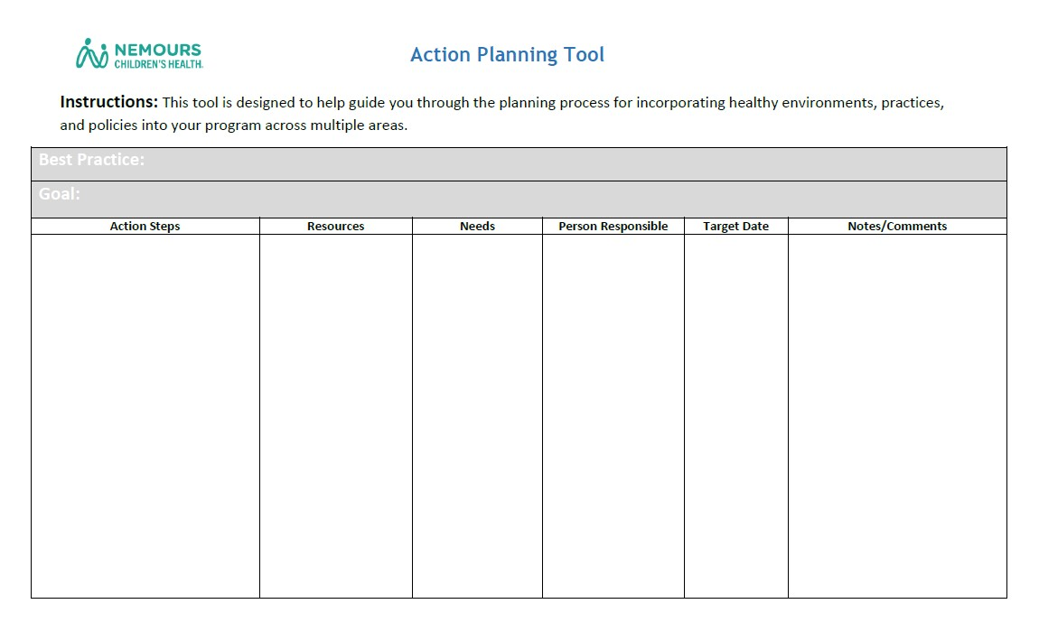
Action Planning Tool
Notes:
Now that we've learned about establishing "SMART" Goals and Action Steps, let's turn our attention towards the Action Planning Tool. We will use this document to plan out goals and action steps for our program that we will work to implement throughout the remainder of the Learning Collaborative. We will review each part of the Action Planning Tool, review the Social Ecological Model, and discuss an example action plan as we prepare to write our own. During this Action Period, you will develop two action plans for your program. Also, you should review your Physical Activity program assessment results to determine areas where improvements can be made. Your Leadership Team should focus your program's action plans on best practices that are not being met already.
Trainers should discuss each area of the Action Planning Tool and suggest that action steps should incorporate each level of the Social Ecological Model found on the next slide.
You can find the fillable Action Planning Tool here: https://public.3.basecamp.com/p/dCxffyJkNNbhi1cq452sccrN

Slide 98
Social Ecological Model:
Many Systems Influence a Child
ECE Program Policies
ECE Program Environment
ECE Program Staff
Family
Child
Notes:
As you start reviewing the action plan steps, you will notice that adopting best practices requires a program-wide effort. To maximize change and its impact, the action plan steps will encourage your Leadership Team to engage multiple levels of the Social Ecological Model, shown in this image. The Social Ecological Model outlines the many systems that can influence a child. As shown through this graphic, each color represents a different system that ultimately has an impact on the child, shown in red. The yellow “Family” ring and the light and dark green “ECE Program Staff” and “ECE Program Environment” rings are closest to the red “Child” ring and therefore have the greatest influence. Even ECE Program Policies, shown in light blue, have an impact.
When you create your Action Plans, you will notice that you need to involve multiple levels of the model. For example, to have portable play equipment available to children indoors – you need to provide the equipment and perhaps rearrange your classrooms (dark green, ECE Program Environment); you also need staff ready to encourage the positive use of this equipment (light green – ECE Program Staff). You may later change your policies so new families and staff know this is expected at your program. And certainly, you are going to want to inform families of the exciting new activities in your program.
All levels will work together, and this is outlined in the steps of the action plans. At the same time, look at where you fall on the model – the light green ring for ECE program staff. You are the closest and strongest influence on the child, other than the child’s family and have the opportunity to impact families who have life-long influence on children. You are the key to making this all successful.
​

Slide 99
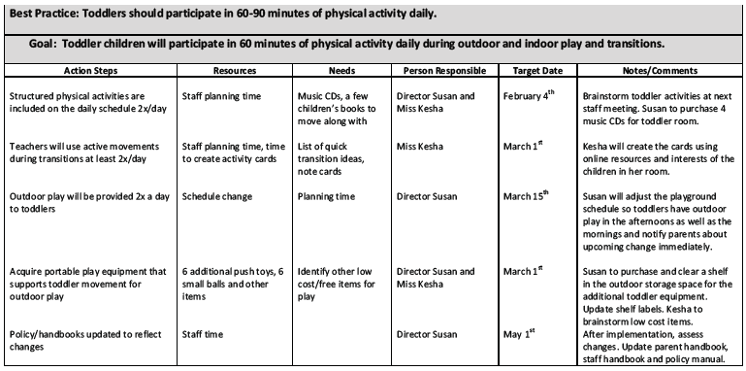
Example Action Plan
Notes:
Trainer notes:
Encourage participants to pull out this handout as you review the sample action plan.
Highlight the action steps listed.
Ask them to think about how the action steps align with the best practice and goal.
Discuss other action steps they might list to accomplish the goal.

Slide 100

Resources – 5 Healthy Goals
Healthykidshealthyfuture.org
Notes:
HealthyKidsHealthyFuture.org has many resources to help you reach your goals.

Slide 101
Brainstorm the Possibilities
Brainstorm the possibilities: What best practices do you want to work on?
Notes:
Have participants look at their Screen Time program assessment results. Ask each person to share one best practice goal that they feel would be helpful for their program to consider. (Virtual meetings, people may prefer to share by chat.)
Several people mentioned these best practices: share a few that you heard more often. As we move on to planning, you can reach out to other ECE programs working on the same goals to get new ideas and support.
Ask a few participants to share why they chose that goal and why it is important to them.

Slide 102

Physical Activity Break
Notes:
Just like for the children in our care, being active is important to us as adults. In many of our Sessions, we will take physical activity breaks – we know that active breaks keeps your brain more engaged today and helps you be healthier overall. These breaks are for you and perhaps ideas that you can take home to your classroom.
Stir the pot
Have kids visualize they are standing in front of an enormous cauldron. Inside the cauldron is an ooey-gooey pot of caramel. Take hold of a large stirrer and plunge it to the bottom of the pot. Slowly begin to stir in a clockwise direction. Have them use their whole body to help get a full range of motion in their wrists and shoulders. Instruct them to throw their hips into the action. After a minute or two, reverse the direction.
From: We are teachers; https://www.weareteachers.com/brain-breaks-for-kids/

Slide 103
Next Steps
Notes:
Trainers should review and update the “Action Period Tasks” slides at the end of each Session to ensure accuracy, align tasks with Learning Collaborative timeline, and reduce repetitive tasks.

Slide 104
Action Period Tasks
Ensure your program’s Screen Time program assessment has been completed.
With your Leadership Team, start thinking of potential Goals and action plan topics for your ECE program.
Notes:
Trainers should review and update the “Action Period Tasks” slides at the end of each Session to ensure accuracy, align tasks with Learning Collaborative timeline, and reduce repetitive tasks.
- Ensure your program’s Screen Time program assessment has been completed.
- With your Leadership Team, start thinking of potential Goals and action plan topics for your program.

Slide 105
Key Dates
Next technical assistance “visit”:
Upcoming Session dates:
Session ___:
  Session ___:
  Session ___:
Notes:
You all have a copy of this blank slide in your participant materials. Let’s take a look at this and fill in the dates for our upcoming Sessions.
Review the timeline. Share dates for the Sessions so participants can fill in the dates on the slide. Be sure to provide a list of actions for each program to complete before and after each Session. The goal is to ensure participants know when they need to complete each action item.

Slide 106
Questions
Notes:
Any questions?
Share your appreciation for their participation during the Sessions. Remind Leadership Team members that they can reach out with any questions.

Slide 107
Trainer Reminders
After Session 3, trainers should:
Share any helpful resources.
Review the Best Practice Session slides and add any discussion questions or activities to make the Session more interactive.
Notes:
This “Trainer Reminder” slide gives you, the trainer, reminders for the Action Periods and next steps for you in facilitating the Learning Collaborative. They are hidden in the PowerPoint. They are not intended to be shared with ECE providers. Do not include them in any printed versions of the slides you provide to ECE providers.
After Session 3, trainers should:
Share any helpful resources
Review the Best Practice Session slides and add any discussion questions or activities to make the Session more interactive.

Slide 108
Screen Time
Best Practices
© 2023 The Nemours Foundation
Notes:
Welcome to the Screen Time Best Practices Session. In this Session, we will discuss best practices for Screen Time for infants, toddlers, and preschoolers.

Slide 109
Today’s Agenda
Icebreaker
Screen Time Standards
  Availability
  Daily Practices
Education and Professional Development
Policy
Next Steps
Notes:
Here is a quick snapshot of how we will spend our time together today. Please follow along with the slides. Today we will cover:
Screen Time Standards, including:
Availability and
Daily Practices.
Education and Professional Development
Policy and
Next Steps

Slide 110
Icebreaker
Notes:
Icebreakers are important to connect participants.
Suggested Ice Breaker Question: What is the most significant change in the world due to the increase prevalence of screens from when you were a child until today?
Have all participants introduce themselves including their name, ECE program and role along with answering the icebreaker question.
(Stop screen sharing during the icebreaker so participants can see each other. Additionally, trainers can use this time to check attendance by having participants type their name and ECE program in the chat)

Slide 111
Availability
Notes:
We covered the basics of screen time in our last Session, let’s turn our attention to the availability of screen time in your classrooms.

Slide 112
Availability
For children under 2 year of age, screen time/digital media should not be used.
Limit total media time for children 2 years and older to not more than 30 minutes once a week; limit screen time with televisions, DVDs and computers
For children ages 2 to 5 years, total exposure (in early care and education AND at home combined) to digital media should be limited to 1 hour per day of high-quality programming
Notes:
Caring for Our Children Standard: 2.2.0.3
For the purposes of this standard “screen time/digital media” refers to media content viewed on cell/mobile phone, tablet, computer, television (TV), video, film, and DVD. It does not include video-chatting with family.
When it comes to availability of screen time, Caring for Our Children best practices recommend:
For children under 2 years of age, no screen time is allowed.
Total media time should be limited for children 2 years and older to not more than 30 minutes once a week.
For children ages 2-5, total exposure to digital media should be limited to 1 hour per day of high-quality programming.
This 1 hour per day of high-quality programming includes screen time across all settings (in early care and education settings AND at home)
While companies sell videos developed specifically for infants that some families and ECE providers use, we now know that babies and even toddlers (up to two years old) shouldn’t get any screen time at all. Children under two years old are in a critical period for brain development and activities that are active, social, and engage a child’s senses – such as touching, exploring, and playing. Are more beneficial than watching television. ECE providers should implement the best practice of eliminating all screen time for children less than two.
As we already discussed, preschool aged children, on average, watch about 4 hours of screen time. While the majority of it is being watched at home, in ECE programs, preschool children still watch, on average, about 25 minutes of screen time each day for close to 2 ½ hours/week. It is best to minimize screen time in ECE programs to no more than 30 minutes per week. Some programs may choose not to have any screen time children.
By not having screens in sight or easily accessible, staff are less tempted to turn them on and children are less likely to ask for screen time.

Slide 113
Availability cont.
For children of all ages, digital media and devices should not be used during meal or snack time, or during nap/rest times and in bed
Notes:
Caring for Our Children Standard: 2.2.0.3
Digital media and devices should not be used during meal or snack time, or during nap/rest times and in bed.

Slide 114
Type
This applies to children age 2+
When offered, digital media should be free of advertising and brand placement
Use screen media only for educational purposes or physical activity
Notes:
Caring for Our Children Standard: 2.2.0.3
ECE programs should ensure that any screen media used is free of advertising and brand placement.
This is why Caring for Our Children best practices recommend:
When offered, digital media should be free of advertising and brand placement.
The High Impact Obesity Standards for screen time recommends that screen media should only be used for educational purposes or physical activity.
Children are bombarded with advertising for high-calorie and non-nutritious foods and drinks through screen media. Advertising influences the food consumption of young children, and for every one-hour increase in TV viewing per day, children drink more sugar-sweetened beverages, eat more fast food, and consume more calories overall. Be sure to review all media prior to sharing with children (over age 2 only) to make sure it is free of all advertising and branding.

Slide 115
Daily Practices
Notes:
Let’s turn our attention to screen time use in your daily practices.

Slide 116
Daily Practices: Rewards
Screen time is never used as a reward.
Notes:
Wellness Workbook Policy Statement (WW PS ST4) recommend:
Screen time is never used as a reward.
Using screen time as a reward may actually give screen time more importance and make children want it more. Research shows that using screens as a reward is associated with higher use of screens.
Moving away from punishments and rewards is ideal. We want children to learn from all experiences. If you want to celebrate special events or class accomplishments, keep the celebrations healthy and interactive, such as a dance party or having snack outside. Most children are rewarded by fun time with the adults in their lives – child care providers included! Intentional time you spend playing with children or sitting by them at lunch or snack may be the most special reward to them!

Slide 117
Make the Most of Screen Time: Plan Ahead
Intentional screen time practices that support children’s learning and development:
  Plan ahead. Choose media in advance to align with learning goals.
  Preview and evaluate the media selection. Does it further the learning? Is it commercial free?
  Plan activities that transition the screen time experience to a hands-on, real-world activity.
  Establish rules and routines for screen time use. Inform the children of these rules. Be consistent.
  Place technology in areas with where they are less distracting to children engaged in other activities.
Notes:
Rather than using screen time as a reward, the limited classroom screen time should be intentional and support children’s learning and development in the classroom.
This includes the following steps:
First, plan ahead. Intentional media selection is all about ensuring that the screen time enhances your learning objectives. Determine how the media will help you achieve your goals for the classroom and the children. Screen Time shouldn’t be spur of the moment – but rather planned and chosen carefully. Use screen time as an opportunity to enhance children’s understanding of the topic that is being covered.
Second, preview and evaluate the media selection. Review the media prior to showing it to the children. This will allow you to determine the appropriateness of the activity, prepare you to talk about the material with the children and develop the next activities. It also gives you a chance to guarantee that it is commercial-free.
Third, select media that will help children make connections with their peers and community. Allow children to explore the learning outside of the screen time. For example, if the topic of “farming” is being discussed, watching a video about the animals and crops on a farm is a good way to enhance the learning experience. Next, you might want to read a book on the work of farmers or arrange a field trip to a nearby farm or farmers market.
Next, be consistent in your screen time use. For example, if your program allows preschoolers to use devices for a certain amount of time each week, create system for tracking this and be consistent. Children appreciate and will learn to follow consistent, clear rules.
Also, if only some children are using technology then place this in an area where other children aren’t tempted to join in. Watching someone else play a video game is still screen time!

Slide 118
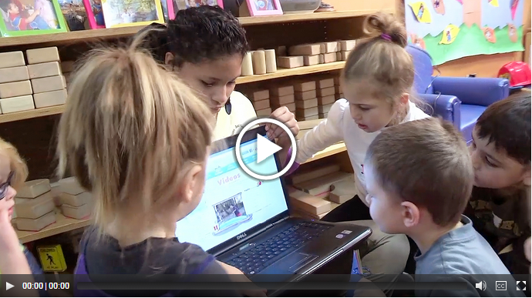
Select Media with Intention
Notes:
As we just discussed, you should always review media in advance and make sure it is free of advertising or branding. In a moment you will watch this video about selecting media with intention. The ECE provider applies many best practices before showing media to her students. As you watch, pay attention to how this provider:
Thinks about what she wants her children to learn,
Reviews and evaluates the media or technology on her own first,
Selects media that helps to extend children’s learning beyond the classroom, and
Uses media to engage in a thoughtful and intentional way.
Return to this slide and continue with the recorded training once you finish watching the video.
http://resourcesforearlylearning.org/educators/module/20/8/26/

Slide 119
Daily Practices: Interaction
Screentime should be viewed with an adult who can help them apply what they are learning to the world around them.
Notes:
Caring for Our Children Standard: 2.2.0.3
As you saw in the video, being intentional in screen time use is important, as is how you interact with children during screen time.
Caring for Our Children best practices recommend:
When screen time is offered, it should be viewed with an adult who can help children apply what they are learning to the world around them

Slide 120
Make the Most of Screen Time
When offering screen time:
Watch with children
Talk about what you are watching
Help the child connect what they are watching to their world
Choose strategies for including screen time that support children’s healthy development.
Make sure screen time doesn’t:
  Take the place of physical and/or interactive activities
  Present developmentally inappropriate content
  Contain commercials or other advertisements
Notes:
During screen time you should:
Actively engage with what children are seeing. If you watch a video with music, you can encourage children to dance and sing along.
Pause the video to ask questions about what the children see, think, feel or wonder. If you are reading a story on a tablet, you can pause to ask children about the characters, the setting, or the plot.
Ask children about ways they might apply what they saw to the real world. You could start by asking: What did you see? What do you think happened? How did they do that? What did we learn that we did not know before? And/or, What do you still have questions about?
After watching a video, you can choose follow-up activities that connect what children viewed or learned.
When using screen time, it should always support children’s learning and development. Ensure that screen time:
Does not take the place of physical and/or interactive activities. We want children to learn through doing – whether that’s building, pretend play or being outdoors.
Is developmentally inappropriate. Even good videos aren’t helpful if children don’t understand them, or they can’t relate them to their lives; and
Does not contain commercials or other advertisements. Children may not remember the ads they see but they enter their minds – exposing children to products, ideas, and messages that may not be developmentally appropriate and in some cases could be harmful.

Slide 121
Screen Time during Meals and Snacks
Screen time should not be utilized during meal or snack time. Instead, meal and snack time can support development in many domains.
Health and Physical Development:
  Modeling appropriate eating behaviors and habits
  Encouraging children to try new foods
  Talking about hunger and fullness cues
  Supporting the development of children’s gross and fine motor skills (e.g., using personal and serving utensils)
Notes:
Keeping screens off during meals and snacks is a Caring for Our Children best practice. Time during meals should be spent modeling appropriate eating behaviors and habits, encouraging children to try new foods, assisting children in the recognition of their hunger and fullness cues, and supporting the development of children’s gross and fine motor skills as they learn to feed and serve themselves.

Slide 122
Screen Time during Meals and Snacks
Social Emotional Development:
  Socialization with peers
  Passing foods, practicing manners
  Talking about likes and dislikes – each person is unique!
Language and Cognitive Development:
  Conversation – expressive and receptive language
  Talking about foods – their textures, tastes and nutrition
  Exposure to new concepts and ideas on all topics
Sensory Development:
  Smells, touch, and taste of varied foods
Notes:
Additionally, as we discussed at the beginning of the Learning Collaborative in the Orientation Meeting, all domains of development are interconnected. Times eating together are opportunities to develop all domains of development including – social emotional, language and cognitive, and sensory development. Some examples are here on the slide. Social emotional development is enhanced by children talking with their peers, learning about each other’s unique likes and dislikes, while learning table manners. Language and cognitive development are strengthened whenever children partake in the give and take of conversation, share new ideas about food or whatever else is on their minds. And sensory development evolves as children smell, touch and taste new and varied foods.
Just like play is most beneficial when it is interactive so are mealtimes.

Slide 123
Physical Activity Break
Notes:
Just like for the children in our care, being active is important to us as adults. In many of our Sessions, we will take physical activity breaks – we know that active breaks keeps your brain more engaged today and helps you be healthier overall. These breaks are for you and perhaps ideas that you can take home to your classroom.
The Mirror Game
The leader acts out a motion such as brushing their teeth, waving their arms in the air, or bowing. The rest of the group must imitate the leader’s actions as if they are looking into a mirror. After five or six actions, change who is the leader and have the new leader act out their motions.

Slide 124
Education & Professional Development
Notes:
Deciding on the changes you want in your ECE program is the first step. The next step is supporting your staff, families and children to understand the topics and new expectations. This can be done through education, information sharing, and offering assistance if a concept is difficult to implement. Let’s review the best practices for Education and Professional Development in screen time.

Slide 125
Education for Staff
If applicable, early childhood providers receive professional development on screen time two or more times per year on a variety of topics:
  The recommended amount, types, and use of screen time in child care
  Effectively teaching children about screen time
Notes:
If applicable, early childhood providers receive professional development on screen time two or more times per year on a variety of topics:
The recommended amount, types, and use of screen time in child care
Effectively teaching children about screen time

Slide 126
Education for Families
Families are offered education on screen time at least 2 times per year, as their children reach developmental milestones, and upon request.
  On a variety of topics related to screen time recommendations and how families can follow them at home.
  Providers encourage families to limit screen time at home to no more than one hour daily. (American Academy of Pediatrics)
Notes:
Families should be offered education on screen time at least 2 times per year, as their children reach developmental milestones and upon request. Family education should be on a variety of topics related to screen time recommendations and how families can follow them at home. Providers should encourage families to limit screen time at home to no more than one hour daily based on the American Academy of Pediatrics recommendation.

Slide 127
Education for Families cont.
Prospective families are informed of screen time policies and practices.
Materials are written in a language and at a level the families can understand.
Notes:
Prospective families are informed of screen time policies and practices.
Materials are written in a language and at a level the families can understand.

Slide 128
Bringing it Home
Education opportunities can include special programs, newsletters, or information sheets.
Topics to include when educating families may include:
Many families are not familiar with current screen time recommendations for children.
Families have the greatest control of screen time use.
Children look to the caregivers in their lives as role models – family members and child care providers are modeling the use of screen time.
Notes:
Educate families on how to reduce screen time or teach media literacy education* two times per year or more. *Education opportunities can include special programs, newsletters, or information sheets.
Topics to include consider when educating families may include:
Many families are not familiar with current screen time recommendations for children. And since most screen use is happening at home, this is an important place to begin conversations about screen time. Facilities should encourage families to limit screen time at home to no more than one to two hours daily.
Families often view television screen time as an educational resource and are not concerned with how much their child watches. Many families count only the time spent watching television—but screen time also includes time spent playing on or with a computer, cell phone, tablet, or video game. Adults also may not realize that when they use screens in front of their children their children are absorbing the content which is often not developmentally appropriate.
It is important to educate families about screen time, but also to partner with them on ideas as to how to change their children’s screen time habits.

Slide 129
Creative Ideas to Replace Screen Time
Surprise them: Put together a bag or box containing activities that children don’t always have access to.
Puzzle time: Have easy puzzles available that children can do alone.
Get crafty: Make greeting cards for upcoming holidays or birthdays.
Act out stories or skits: Hand out a variety of costume pieces and have children dress up.
Play music: Have children make up their own dances. Add ribbons and instruments for more movement.
Enlist their help: Involve children in the task. For meals and snacks, have them help prepare and clean-up.
Notes:
We know that many adults use screen time with children to get a quick break to do other tasks. Changing screen time habits takes time – just like creating any new habit does. Over time, children will get used to screen time not being an easy option and their own imaginations and independence will grow to fill the time. In the short run, here are a few ideas for when you need just a few moments:
Start by having a few activities or toys that are just for these moments. Children will be more engaged in a toy they don’t see all the time and may look forward to the surprise. Puzzles can be a great quiet activity for these times.
Similarly, you can have art materials that are only available at these times – stickers or hole punchers that make different designs. You can ask children to make cards for an upcoming birthday.
Provide dress up clothing or play music and ask children to create a dance or a skit to perform for you after you finish the task.
And whenever possible, ask the children to help you with the task. Perhaps they can help set the table or clean-up.

Slide 130
Policy
Notes:
Policies help make the changes you implement in your program permanent by setting them to paper and sharing them with staff and families.

Slide 131
Screen Time Policies
The facility’s policies should include policies on screen time that include a variety of topics:
  The amount and type of screen time at child care programs
  Reducing screen time and increasing physical activity
  Appropriate supervision and use of screen time
  Not using screen time as a reward
Variety of
Topics
Notes:
A policy helps set clear expectations and lets families know gently, but firmly, what your ECE program does to limit screen time for children.
On this slide we see topics that should be included in your screen time policy.
Ideally, your policy includes all of the things that we have discussed today. However, it is important for your policy to reflect your actual practice.
A policy is only effective if it is used and enforced.
A written policy can be a helpful last step after making program changes. Once you have introduced a best practice and it starts to take hold, revise your written policy to make sure that the changes are sustained.
All written guidelines should be consistent. Your policy should be reflected in your Family Handbooks and Staff Manuals and reviewed and/or updated annually.

Slide 132

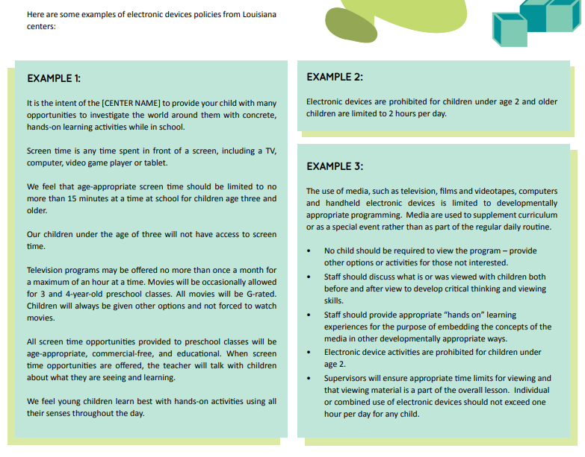
Sample Screen Time Program Policy
Notes:
There are guides and resources for developing appropriate screen time policies from several state and national organizations. One example is the “Louisiana Screen Time Regulations Toolkit for Early Childhood Education Centers.” You find a copy in the Resource Guide.
https://wellaheadla.com/prevention/early-childhood-education/reduce-screen-time/

Slide 133
Selecting Wellness Policies
After completing a program assessment, ECE programs can create Wellness Policies to share with staff and families.
On the homepage, click “My Wellness Policy.”
On the “Wellness Policy” Page select your topic area of choice.

Slide 134
Selecting Screen Time Wellness Policies
After selecting “Screen Time” on the Wellness Policy Page, you will be directed to the “Screen Time” Wellness Policy options.
Select the check box beside each policy your program is committed to upholding.

Slide 135
Download Your Wellness Policies
After selecting your Wellness Policies, scroll down to the bottom of the page and click “Download PDF.”

Slide 136
Wellness Policies
A PDF of the Wellness Policies you selected will automatically download to your computer or device.
The Wellness Policies can be easily added to Staff and Family Handbooks.

Slide 137
Next Steps
Notes:
Trainers should review and update the “Action Period Tasks” slides at the end of each Session to ensure accuracy, align tasks with Learning Collaborative timeline, and reduce repetitive tasks.

Slide 138
Action Period Tasks
Create 3 action plans with your Leadership Team.
Begin working through steps of action plans.
  Check the Healthy Kids Healthy Futures tools & resources library for resources
Reach out to your trainer for help as needed
Add successes to your program’s Storyboard.
Notes:
Trainers should review and update the “Action Period Tasks” slides at the end of each Session to ensure accuracy, align tasks with Learning Collaborative timeline, and reduce repetitive tasks.
You have now completed Screen Time Best Practice Session. We also encourage you to review the content in your participant materials.
Thank you for your participation. We’ll see you soon at the next Session.

Slide 139
Key Dates
Next technical assistance “visit”:
Upcoming Session dates:
Session ___:
  Session ___:
  Session ___:
Notes:
You all have a copy of this blank slide in your participant materials. Let’s take a look at this and fill in the dates for our upcoming Sessions.
Review the timeline. Share dates for the Sessions so participants can fill in the dates on the slide. Be sure to provide a list of actions for each program to complete before and after each Session. The goal is to ensure participants know when they need to complete each action item.

Slide 140
Questions
Notes:
Any questions?

Slide 141
Trainer Reminders
After the Best Practices Session, trainers should:
Meet with ECE programs to provide TA.
Review program assessment results with ECE programs.
Provide support to help ECE programs create 3 action plans.
Notes:
This “Trainer Reminder” slide gives you reminders for the Action Periods and next steps for you in facilitating the Learning Collaborative. They are hidden in the PowerPoint. They are not intended to be shared with ECE providers. Do not include them in any printed versions of the slides you provide to ECE providers.
After Best Practices Session, trainers should:
Meet with ECE programs to provide TA.
Review program assessment results with ECE programs.
Provide support to help ECE programs create 3 action plans.

Slide 142
Implementing Screen Time Best Practices
Notes:
Welcome participants to Implementing Screen Time Best Practices Session. In this Session, we will discuss the significance of managing Screen Time and Overcoming Common Challenges.

Slide 143
Today’s Agenda
Ice Breaker + Physical Activity Break
Learning Objectives
Reflection
Significance of Managing Screen Time in ECE
Overcoming Common Challenges
Notes:
Here is a quick snapshot of how we will spend our time together today.
Read aloud the agenda items. Please remind participants that they should follow along with the PowerPoint slides during the Session.
Share the Group Norms. (Create an additional slide to add to your presentation or share on a Flip Chart or in Chat) These are the Group Norms you created in the Orientation Meeting with this group. Ask anyone if they have any questions or additions.
We are going to start with an Icebreaker.

Slide 144
Icebreaker + Physical Activity Break
Notes:
Icebreakers are important to connect participants. Additionally, trainers will use the chat to check attendance. All participants must introduce themselves.
In chat, have all participants introduce themselves including their name, ECE program and role.
Suggested Ice Breaker: Time to get active with our bodies and our brains. Let’s go on a screen media scavenger hunt!
If participants are joining from their homes: Ask them to walk around their home and count the number of devices they see.
If participants are joining from their ECE programs: Ask them to walk through their classrooms (if possible) and count how many screen time devices they see for children and among staff.
Give participants a couple of minutes to complete the activity and then return to the screen to share what they found.
Reflect on this activity. Ask participants:
If they were surprised by the number of devices they found.
If they counted at home, who uses the devices the counted? For what are they used?
Remember that cell phones count as screen devices!

Slide 145
Learning Objectives
At the end of the Implementing Screen Time Best Practices Session, you will be able to:
Describe best practices for screen time.
Understand the benefits of reducing screen time and the ways to implement and identify opportunities to change within your program.
Use your Screen Time program assessment results to identify ways to improve Screen Time practices in your ECE program.
Notes:
Here are the learning objectives for the Implementing Screen Time Best Practices Session. ​
Ask for a volunteer to read through the learning objectives. If no one feels comfortable doing so, one of the trainers should read through the objectives. ​

Slide 146
Reflection
Notes:
Before we dive into new content today, let’s take a moment to reflect on the progress you all have made since the start of this Learning Collaborative.

Slide 147
Action Periods
Orientation
Session 1: Learning Collaborative Orientation
Session 2: Assessment Orientation
Session 5: Implementing Screen Time Best Practices
Session 6: Celebrating Success
& Sustaining Healthy Changes
OR
Action Period
LS
3&4
LS
5&6
Action Period
Action Period
Session 3 Screen Time Overview
Session 4: Best Practices
Notes:
At our Orientation Session, we talked about the project and what we would be doing with the Learning Collaboratives over the next few months. We also began looking at Wellness Workbook and some of the Provider Tools, specifically the program assessment.​
​
Your first Action Period began immediately afterwards. You had a few tasks to work through since the Orientation. Let’s check in to see how those are coming along.​

Slide 148
Significance of Screen Time
Notes:
Hopefully, the Screen Time program assessment got you thinking about the practices in ECE programs regarding screen time for children birth to five. During this portion of our Session, we will discuss the significance of screen time for adults and children. Additionally, we will discuss how ECE providers and programs play a role in promoting healthier screen time habits including teaching children and adults to be less dependent on screen time and more intentional of their use.

Slide 149

Screen-Free Engagement and Child Development
Physical
Sensory
Social and Emotional
Cognitive
Language, Literacy, and Communication
Notes:
This slides includes animation.
Picture children seated and watching a movie. Then picture children participating in activities like building with blocks, playing outside or creating a story in dramatic play. Think about the differences in how the children are engaging with their environment, one another and their caregivers. How is this affecting the child’s development across domains? What does the screen-free time do to enhance the children’s development compared to a screen-filled activity?
Pause for a moment to let participants share their ideas on this scenario. Then click to reveal additional information. Use the talking points below to elaborate.
Physical Development: When children are not using screens, they are less likely to be sedentary. Children who are up and moving are using their bodies to stay active while developing their gross motor skills.
Cognitive Development: We know that learning through play is the most effective way that children learn! Children use the repetition of their play, their experiences and their imagination to make connections in their learning.
Language Development, Literacy and Communication: When children are interacting with others they have conversations that grow, developing new vocabulary that is immediately put to use in the conversation. This allows these words to have more meaning. Receptive and expressive language skills develop best through personal interactions.
Social and Emotional Development: When children are engaged with their environment and each other, they are provided opportunities to develop self-regulation skills including impulse control and managing emotions. During play, children negotiate rules, problem solve, take turns and help others. These skills take practice and the more the better!
Sensory Development: When children move through space, they use all of their senses -- sight, sound, smell, taste, and touch. (ex. Screens give them sound and sight only – and these are coming from one artificial device.). Screen-free play allows them to subconsciously incorporate all of their experiences into their learning.
As you can see, ECE programs’ support of reducing or eliminating screen time not only impacts the health and physical development of children but also their development in all domains.

Slide 150
Large Group Discussion: Staff Wellness and Screen Time
How does screen time influence your life?
What might be the benefits of reducing?
How can you reduce your own screen time?
Notes:
Facilitate a large group discussion about the staff wellness and screen time.
There are many ways that you and your staff can cut down on your personal screen time use:
Log your personal screen time and set goals to cut down!
Turn your phone off from time to time to take mental breaks
Turn off screens during mealtimes
Focus on other activities
Find different ways to unwind (e.g., listening to music)
Take up a new, active hobby.
Plan screen-free activities with family and/or friends

Slide 151
Physical Activity Break
Notes:
Before we move on, let’s take a quick moment to do some yoga and stretching from our chairs. Yoga can help adults reduce stress and anxiety and build strength and we can even do it from our chairs! Today we are going to do three poses:
Cow stretch,
Cat stretch, and
Side angle
Take a look at the three chair yoga poses shown here or feel free to choose alternate chair yoga poses: https://www.mondaycampaigns.org/move-it-monday/3-chair-yoga-poses-fitness-levels-Monday.
This is a short physical activity break, but chair yoga can be done in only a few minutes.

Slide 152
Engaging with Families
Notes:
Now that you have done more to educate your staff and children, you may want to engage with families on the topic of screen time.

Slide 153
Large Group Discussion: Engaging Families
How do you currently engage your families in discussions about screen time? Do you talk with families about the value of limiting screen time?
What tips can you share with families struggling to reduce screen time with their young children?
Notes:
In our previous Learning Sessions, we talked about why it is important to build partnerships with families. Just like partnerships with families are important in child nutrition, breastfeeding and physical activity, it is important with screen time as well.
Promote a large group discussion around provider’s family engagement strategies. Use chat to gather ideas. Deepen the discussion by asking providers to consider how they can engage families around reducing screen time. Encourage participants to take notes of suggestions shared during this discussion.
There are many ways to work with families to reduce screen time at home. Here are some examples to share to start the conversation:
Talk with the family about the active play their child enjoys while in care. This can serve to start a conversation with families around physical activity at home.
Your child may be used to watching TV, so establishing some “media rules” may take time, but it will work. This doesn’t mean you can never watch TV again! Setting limits will help children learn to be less dependent on media and more intentional with screen time. It will also give you more opportunities to spend quality time together. Children will find something fun to do if you make it easy and support them with ideas. Try these to start: put special toys or materials that they enjoy on a shelf or cupboard in your kitchen: blocks, board books or a craft box with safe items for them to use (crayons, markers, stickers, tape, and blank paper).
Establish screen free times – perhaps mealtimes or an hour before bed.
They can “work” in the kitchen with you while you make dinner.
Encourage “family talk” during meals. Turn off the TV during dinner and enjoy each other.
Move the TV’s and other screen devices out of bedrooms and to a central location where screen time can be enjoyed together and monitored.
Have one specific time during the day with age-appropriate, educational programming, during which TV viewing is okay for your two-year-old. An even better approach is to steer them to activities that do not involve screen time. If you do allow your children to watch television, always watch the program with them so you can talk about it together and ensure they know how to use it appropriately.
Encourage families to consider their own screen time use and how this impacts and influences their children. Wait to watch adult-only shows until after your children have gone to bed.
Make a weekly screen time plan. Choose the specific shows they will watch that week and when. Mark them on a calendar so that children know when they will have screen time.
Create a quiet corner. Have picture books available and easy puzzles so they can entertain themselves.
Create a safe area for supervised physical activity where your toddler can walk, run, and play and use push or pull toys. Always provide close supervision for toddlers.

Slide 154



Resources for Families
Notes:
As we just discussed, you can assist families with discovering ways to reduce screen time at home.
Have participants turn to the Reducing Screen Time Resource section of their Resource Guide. Here they will find the resources shown on this slide:
Why is Limiting Screen Time Important? – This resources provides families an overview of the importance of reducing screen time at home and how they can serve as a role model for their children. https://idph.iowa.gov/Portals/1/Files/HCCI/factsheet_parents.pdf
Turn Off the TV, Turn On the Play – this is available in English and Spanish and provides families an overview of what can be done at home to reduce screen time. https://idph.iowa.gov/Portals/1/Files/HCCI/brochure_parents_sp.pdf

Slide 155
Overcoming
Common Challenges
Notes:
In this section, we will discuss challenges and solutions to meeting the best practices for screen time.
There are many solutions presented for each of the challenges. You do not need to discuss ALL of the potential challenges. Choose two common challenges to discuss with the group. Solicit potential solutions from participants before sharing proposed solutions listed on the slides, engaging in a discussion around each of the common challenges. Use this time to highlight key solutions. You can also refer back to these solutions during your TA visits/discussions.

Slide 156
Challenge: Screen time is used as a distraction
Screen time keeps children distracted while performing necessary tasks, like setting up for lunch or cleaning.
Solution #1: When cooking and cleaning, have children assist you.
Solution #2: Provide self-directed activities.
Solution #3: Use nap time to complete tasks.
Notes:
This slide includes animation. Solutions are initially hidden to encourage group discussion. Facilitate a group share in which participants offer their own suggestions before clicking to show the provided suggestions.
Solution #1: When cooking and cleaning, have children assist you
Children can learn to set the table, put away their dirty dishes, and wipe the table off with water. This can be a classroom helper chore for a few children each day.
Other children can play in the dramatic play center. Here they can prepare a pretend meal for each other or dolls.
Solution #2: Provide self-directed activities
Save some unique materials for just these times. This will keep them special and be more likely to keep children engaged. For example, you may have puzzles that are special for these times or extra art materials such as stickers to add to your art center. You will need to rotate these activities from time to time. You can provide encouraging comments as they continue with their activities.
Good activities for this time include:
Art -- Provide crayons, markers, stickers, blank paper, construction paper, and children’s scissors.
Story time – each child can have their own book. Or you can offer group story time using audiobooks.
Puzzles – children can work individually or in groups of 2 based upon their age or skill level.
Dance Party- you can put on the children’s favorite songs. You can sing with them and encourage them to dance.
Solution #3: Use nap time to complete tasks
Take advantage of nap time to complete cleaning, paperwork, or attend to your personal needs and responsibilities.
NOTE: All required supervision ratios must be maintained during nap time, and you must be able to easily see children in the nap area while completing tasks.

Slide 157
Challenge: Child preferences for screen-based activities
Preschoolers ask to watch television and do other screen-based activities.
Solution #1: Cover or hide screens so they are out of sight.
Solution #2: Set a consistent time for limited, age appropriate, education programming
Solution #3: Enthusiastically promote and participate in alternate activities
Solution #4: Role model screen-free behaviors
Notes:
This slide includes animation. Solutions are initially hidden to encourage group discussion. Facilitate a group share in which participants offer their own suggestions before clicking to show the provided suggestions.
Solution #1: Cover or hide screens so they are out of sight
Out of sight, out of mind has some truth in this circumstance. Children are less likely to ask for screen time when it is no longer in plain view.
Solution #2: Set a consistent time for limited, age appropriate, education programming
Children like routines. They provide safety and consistency. If screen time comes at the same time each day or week, then children will get used to this routine and are less likely to request screen time at other times.
You can slowly reduce the amount of time on the schedule for screen time. If you started with screen time for an hour a day before lunch you can slowly reduce this time down to the time you want.
Solution #3: Enthusiastically promote and participate in alternate activities
Children need long blocks of free play to be creative in their play.
Provide children with various materials that allow them to play freely. Art, puzzles, books, dramatic play, blocks, music and movement, sensory tables, etc. are all good activities to place in a child care classroom.
Play with the children. Adults are always role modeling for children. If you show interest in an activity the children will too.
Solution #4: Role model screen-free behaviors
Put your phone or tablet away! The less you use screens the less children see these as an option.
If your program requires to log things into an app, consider if you can do this in blocks so the screens aren’t always in sight or perhaps you can update at naptime.

Slide 158
Challenge: Families are not aware of the importance of limiting screen time
Families may not be aware of the effects of screen time on child development and may be asking your program to offer more screen-based activities.
Solution #1: Educate families on the importance of active play for children’s development. Share your program’s policy on screen time.
Solution #2: Post information about screen time in various formats to reach many families
Solution #3: Encourage families to practice screen-free mealtimes or participate in a 'screen-free week’ at home.
Solution #4: Encourage interaction between family members, children and teachers at pick-up and drop-off..
Notes:
This slide includes animation. Solutions are initially hidden to encourage group discussion. Facilitate a group share in which participants offer their own suggestions before clicking to show the provided suggestions.
Solution #1: Educate families on the importance of active play on children’s development. Share your program’s policy on screen time.
Provide families with current screen time recommendations for infants, toddlers and preschool children.
Share information about child development and how children learn the most through active, engaged play with materials, peers and adults.
Include your ECE program’s screen time policy in your family handbook. This way families know from the beginning your policy on screen time and why.
Solution #2: Post information about screen time in various formats to reach many families
Use newsletters, email, social media, bulletin boards, program apps, parent/teacher conferences, etc. to engage families in conversations about screen time, children’s developmental needs and ways to reduce screen time at home. Partner with families to assist in the challenges of changing habits.
Provide an overview of what television ratings mean and the influence that violence in TV programs and other screen time programming can have on children.
Solution #3: Encourage parents to practice screen-free mealtimes or participate in a ‘screen-free week’ at home
Check out the family letter on screen time in your Resource Guide. This letter is part of the Screen-Time Reductions Toolkit for Child Care Providers.
May 1-7, 2023 is Screen Free Week. Providers and families can check out the website for more information about this week and find additional resources: https://www.screenfree.org/pledge/
Solution #4: Encourage interaction between family members, children and teachers at pick-up and drop-off
Children want to share their school with their family members. Take this time to talk about the child’s day and to share activities from the classroom.
Talking on the phone at pick-up and drop-off make it difficult for teachers to form a relationship with family members.
Discourage families from handing their phone to a child to entertain them during this time.

Slide 159
Brainstorm the Possibilities
Brainstorm the possibilities: What best practice do you want to work on?
Notes:
Have participants look at their Screen Time program assessment results. Ask each person to type in chat one best practice goal that they feel would be helpful for their program to consider.
Some of the most common best practices chosen are: (read from the chat those chosen). As we move on to planning, you can reach out to other ECE programs working on the same goal to get new ideas and support. After today’s live discussion, you will be asked to select one Screen Time goal to work on with your Leadership Team.

Slide 160
Next Steps
Storyboards:
  Prepare your Storyboard to share your successes from your participation in the Learning Collaborative.
Screen Time Action Period Tasks:
  Share the Screen Time Key Learnings with teachers and staff.
  Continue to work on your action plans for the screen time goals that you have chosen for your program.
  Meet with your trainer to receive technical assistance (TA)
Notes:
Remind participants of the tasks they need to complete before the next Session.
Prepare your Storyboard to share your successes from your Learning Collaborative Participation.
Share the Screen Time Key Learnings with teachers and staff.
Work with teachers, staff and families to work on your action plans for the screen time goals that you have chosen for your program..

Slide 161
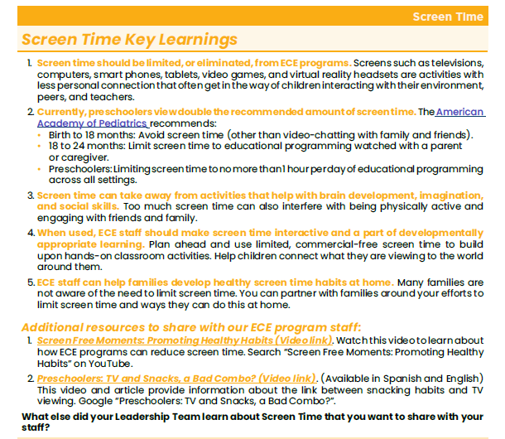
Key Learnings Handout
Notes:
Find a time to share information about this Screen Time Learning Collaborative with your ECE program staff. ​
In your Resource Guide, you will find a handout with key learnings. Sharing copies of this handout is a quick and easy way to keep staff up-to-date about the Learning Collaborative activities. Trainers can email the Key Learnings handout which may make it easier for them to share with their staff and view video links. ​
We strongly recommend that you also arrange time to meet with staff. ​
Trainers can find the Key Learnings handout in the Resource Guide.

Slide 162
Finalizing Your Storyboard
Capture your ECE program’s journey
Your program’s Storyboard should show your process and accomplishments
Possible things to include:
  What change(s) were made
  Who was involved or provided help
  What challenges you overcame
  How children reacted to the change(s)
  What policies were updated
  How will you sustain the change(s)
Notes:
Your Leadership Team should be working with their ECE programs to create a Storyboard that captures their experience and the progress made in your program throughout the Learning Collaborative. ECE programs may choose to use a variety of ways to express their story of change. Your Storyboard could be a bulletin board in your program, a newsletter you share with families and staff, posts to your Facebook page about the changes you are making at your program or a PowerPoint to share with your trainer. Be creative – what we want to see is all of the great work you are doing.
Your Storyboard might include:
Photos of the process, including before, during, and after the change(s);
Stories from teachers, staff, families and children;
Assessments, observations and reflections;
Documents including lesson plans or menus that demonstrate changes; and/or
Children’s artwork that describe the healthy changes in the program.
Remember to capture your changes on your Storyboard. We want to all learn from your challenges and successes!

Slide 163
Sample PowerPoint Storyboard
Notes:
Leadership Teams add to their Storyboards over time. You will share your Storyboard with others during the last Session so that we can celebrate successes together. Sharing your Storyboard is a great way to reflect on your journey alongside those who have travelled with you.
You can replace the example on this slide with another example Storyboard from your state.

Slide 164
Key Dates
Technical assistance “visit”:
Upcoming Session:
  Session 6:
Notes:
You all have a copy of this blank slide in your participant materials. Let’s take a look at this and fill in the dates for our upcoming Sessions.
Review the timeline. Share dates for the Sessions so participants can fill in the dates on the slide. Be sure to share a list of actions for ECE programs to complete before and after each piece of the Learning Collaborative. The goal is to ensure participants know when they need to complete each action item.

Slide 165
Questions
Notes:
Ask participants if there are any remaining questions . Thank everyone for their participation.

Slide 166
Trainer Reminders
After Session 5, trainers should:
Provide support to help ECE programs reach their Goals.
Help ECE programs finish preparing their Storyboards.
Collect all PowerPoint or computer-based Storyboards so that the trainer can present them during Session 6. (Leadership Team Members will describe.)
Email Leadership Team Members the Screen Time Key Learnings Handout to share with teachers, staff and families.
Notes:
This “Trainer Reminder” slide gives you reminders for the Action Periods and next steps for you in facilitating the Learning Collaborative. They are hidden in the PowerPoint. They are not intended to be shared with ECE providers. Do not include them in any printed versions of the slides you provide to ECE providers.
After Session 5, trainers should:
Provide support to help ECE programs reach their Goals.
Help ECE programs finish preparing their Storyboards. Additional information is in the Learning Collaborative Toolkit.
Collect all PowerPoint or computer-based Storyboards so that the trainer can present them during Session 6. (Leadership Team Members will describe.)
Email Leadership Team Members the Screen Time Key Learnings Handout to share with teachers, staff and families.

Slide 167
Celebrating Success and Continuing the Process of Change
© 2023 The Nemours Foundation
Notes:
Welcome participants to the Celebrating Success and Continuing the Process of Change Session.

Slide 168
Today’s Agenda
Icebreaker
Learning Objectives
Reflection
Storyboards
Healthy Changes
Next Steps
Notes:
Here is a quick snapshot of how we will spend our time together today.
Read aloud the agenda items.
Please remind participants that they can follow along with the slides during the Sessions.
We are going to start with an Icebreaker.

Slide 169
Icebreaker
What have you enjoyed the most about this Learning Collaborative?
Notes:
Icebreakers are important to connect participants.
Have all participants introduce themselves including their name, ECE program and role.
Suggested Ice Breaker Question: What have you enjoyed the most about this Learning Collaborative?
(Stop screen sharing during the icebreaker so participants can see each other. Additionally, trainers can use this time to check attendance by having participants type their name and ECE program in the chat)

Slide 170
Learning Objectives
At the end of the Celebrating Success and Continuing the Process of Change Session, you will be able to:
Use Storyboards to learn what other ECE programs are most proud of accomplishing as a result of the Learning Collaborative
Be able to identify local organizations/agencies that support early childhood providers
Develop a plan for sustaining the new strategies from the Learning Collaborative
Notes:
Here are the learning objectives for the Celebrating Success and Continuing the Process of Change Session. ​
Ask for a volunteer to read through the learning objectives. If no one feels comfortable doing so, one of the trainers should read through the objectives. ​

Slide 171
Reflection
Notes:
Before we dive into new content today, let’s take a moment to reflect on the progress you all have made during the Screen Time Learning Collaborative.

Slide 172
Presenting Storyboards
Notes:
Please ask programs to share their Storyboards in whatever format you and your trainers/project coordinator have determined. Ideally, programs will be able to share at least the one change they are most proud of along with photos of this change. As the trainer, set a time limit for each presentation (including questions from other participants) to guarantee coverage of all the material.
This is a great opportunity for programs to share their success stories and ideas with other participants. While programs are sharing, you may want to suggest that participants write down any tips/ideas they learn from others that may help them reach their own future goals.

Slide 173
Questions
Notes:
Ask participants if they have any questions for the other Learning Collaborative participants.

Slide 174
Continuing the Process of Change
Notes:
Our Learning Collaborative might end after today, but that should not hold you back from continuing on your journey to make beneficial healthy changes in your ECE program. Let’s talk about how you can continue the process of change that you started.
Throughout remainder of this Session we are going to use the Healthy Changes Handout from your Resource Guide. This will allow us to reflect on the work you have done and next steps for continuing making healthy changes in your child care program.
The Healthy Changes Handout can be found here:
https://public.3.basecamp.com/p/xripK3pHY2DVW87qCzQgC4bh

Slide 175
Healthy Changes Handout
Step 1: Complete program assessment
  What changes are you most proud of from participating in the Learning Collaborative?
  What helped you implement those changes successfully?
Notes:
(Stop sharing your screen to allow work on the Healthy Changes Handout and discussion. Copy the questions in the chat for anyone who does not have their Resource Guide available.)
We are now going to take a moment to return to our Healthy Changes Handout in your Resource Guide. Let’s look at Step 1 Complete program assessment
What changes are you most proud of from participating in the Learning Collaborative?
What helped you implement those changes successfully?
For Step 1 and as everyone just shared their Storyboards, please write and share with us the change you are most proud of. This might be what’s highlighted on your Storyboard or another change you have seen in your program.
Give people a few minutes to write down their thoughts. After people are done, ask them to share what they think will help their program make the changes they have made permanent and what they are interested in working on next.

Slide 176
Healthy Changes Handout
Step 2: Plan
  What does my ECE program need to do to make these changes permanent?
  What other best practices do I still want to implement?
Step 3: Take Action
    What can I do in the future to continue on our journey to create healthy child care? List potential action steps for your ECE program.
Notes:
(Stop sharing your screen to allow work on the Healthy Changes Handout and discussion. Copy the questions in the chat for anyone who does not have their Resource Guide available. )
We are now going to take a moment to return to our Healthy Changes Handout in your Resource Guide. Let’s look at Step 2: Plan
What does my ECE program need to do to make these changes permanent?
What other best practices do I still want to implement?
Give people a few minutes to write down their thoughts. After people are done, ask them to share what they think will help their program make the changes they have made permanent and what they are interested in working on next.
We will now move on your handout to Step 3: Take Action
As the Learning Collaborative ends, what can I do in the future to continue on our journey to create healthy child care? List potential action steps for your ECE program
Give people a few minutes to write down their thoughts. After people are done, ask them to share potential next action steps for their program.

Slide 177
National, State, and Local Support
Notes:
You are not alone as you continue to make positive changes in your program. Let’s touch on some of the many potential resources that exist to support ECE providers in our state.

Slide 178
Potential Resources/Support
Organization | What is it? | How can it help?
WIC (Women Infants & Children) | Supports breastfeeding, provides financial support to purchase nutritious foods, plus education and counseling to families. | Resource for families and referrals to other health and social services if needed. Contact WIC office.
SNAP-Ed/SNAP (Supplemental Nutrition Assistance Program-Education) | Educates and encourages participants to make healthy food choices and additional resources. SNAP provides financial support to qualifying families. | Offers tools and resources to distribute to families. Contact local SNAP-Ed agency.
CACFP (Child & Adult Food Care Program) | Provides partial reimbursement for meals and offers trainings on healthy eating. | Reimbursement for healthy meals and support for breastfeeding. Contact state agency or a sponsor organization.
Cooperative Extension | For individuals with limited resources in acquiring the skills for healthy eating including gardening and budgeting. | Offers workshops and tools to educate families. Contact local cooperative extension service office.
CCR&R (Child Care Resource & Referral) | Works to ensure that all families have access to affordable child care and assistance to locate them. | Increase enrollment, provide staff training and assist in developing a business plan. Contact local CCR&R.
QRIS (Quality Rating Improvement System) | Uses a rating scale to assess level of quality. | Increase the quality of your program and market your program to families. Contact state agency (if applicable).
Notes:
Use this slide to highlight various potential resources/supports to help ECE programs to meet their action plan goals. Some organizations/programs include the:
WIC (Women, Infants, and Children)
SNAP-Ed/SNAP (Supplemental Nutrition Assistance Program-Education)
Child and Adult Care Food Program (CACFP)
Cooperative Extension
Child Care Resource and Referral (CC R&R)
Quality Rating and Improvement System (QRIS)
If you have the contact information for organizations listed here, be sure to share that with participants. You could also create a handout of the national and local resources to share with participants.

Slide 179
Potential Local Support and Initiatives
Organization | What is it? | How to get involved:
Ex: Child Care Health Consultants
Ex: Farm to ECE Learning Collaborative
Ex: SPARK
Ex: Oral Health Initiative
Ex: Local Health Department
Notes:
Use this slide to highlight various local supports and initiatives to support child care providers so they can continue on their healthy journey.
Trainers/State leads: edit/add rows for local agencies that are relevant to your state. If you have the contact information for organizations listed here or other local organizations, be sure to share that with participants.

Slide 180
Healthy Changes Handout
Step 4: Review Available Resources
  How can I learn more to help me implement the goals I want to reach?
  Who are the people/programs that can help me reach those goals?
Step 5: Keep Moving Forward
  What will my role be in sustaining the positive changes?
  What else can my ECE program do to stay on this journey?
Notes:
(Stop sharing your screen to allow work on the Healthy Changes Handout and discussion. Copy the questions in the chat for anyone who does not have their Resource Guide available.)
We are now going to take a moment to return to our Healthy Changes Handout in your Resource Guide. We will now look at Steps 4: Review Available Resources. Here you will consider where you can go for support and assistance in reaching these potential goals. You should discuss this with others on your Leadership Team but for now write down your thoughts.
Step 4: Review Available Resources
How can I learn more to help me implement the goals I want to reach?
Who are the people/programs that can help me reach those goals?
Give people a few minutes to write down their thoughts. After people are done, ask them to share where they think they can get more support for their learning and work.
We will now move onto Step 5: Keep Moving Forward. Each step builds on the one before. We really want to create a habit of positive change.
Step 5: Keep it Up
What will my role be in sustaining the positive changes?
What else can my ECE program do to stay on this journey?
Give people a few minutes to write down their thoughts. After people are done, ask them to share their thoughts on how to stay on this journey.
We want your journey to continue and for all of your successes to be celebrated along the way!

Slide 181
Next Steps
Notes:
Trainers should review and update the “Action Period Tasks” slides at the end of each Session to ensure accuracy, align tasks with the Learning Collaborative timeline, and reduce repetitive tasks.

Slide 182
Final Action Period
Orientation
Session 1: Learning Collaborative Orientation
Session 2: Program Assessment Orientation
Session 5: Implementing Screen Time Best Practices
Session 6: Celebrating Success
& Continuing the Process of Healthy Change
OR
Action Period
LS
3&4
LS
5&6
Action Period
Action Period
Session 3 Screen Time Overview
Session 4: Best Practices
Notes:
After this Session, there is one final Action Period. During this Action Period, we will focus on Sustaining Healthy Changes and considering what additional changes can be made that will positively impact the health and wellness of the children in your program.

Slide 183
Key Learnings Handout
Notes:
If you haven’t done so already, now is a good time to share all that you have learned with ECE program staff.
In your Resource Guide, you will find a handout with key learnings from this Learning Collaborative. Sharing copies of this handout is a quick and easy way to keep staff up-to-date about the Learning Collaborative activities. Trainers can email the Key Learnings handout which may make it easier for them to share with their staff and view video links.
We strongly recommend that you also arrange time to meet with staff.

Slide 184
Action Period Tasks
During this Action Period your team will:
Work to reach all of your remaining goals with the help of the Healthy Kids, Healthy Future website and other resources.
With your Leadership Team, discuss and complete Healthy Changes Handout
Complete second Screen Time program assessment on Wellness Workbook.
Meet with your trainer to discuss your second program assessment and the completion of your action plans.
Notes:
Trainers should review and update the “Action Period Tasks” slides at the end of each Session to ensure accuracy, align tasks with Learning Collaborative timeline, and reduce repetitive tasks.
Remind participants of the tasks they are asked to complete after the Celebrating Success Session ends today.
We have now covered best practices in Screen Time, along with how to implement positive changes in your ECE programs. You had the chance to share your successes and see what others in our collaborative have accomplished over the last several months together.
Remember, the impact of this Learning Collaborative will be larger and last longer the more you involve your whole staff. The Healthy Changes Handout that you started today can help guide you in this process. Just as you did on previous goals, you can also get staff input on making an ongoing plan for sustaining change. When you leave today, we hope you will continue to involve your staff as you make changes in your program.

Slide 185
Key Dates
Final technical assistance “visit”:
Notes:
Review dates for any final Action Period tasks and TA visits.

Slide 186
Questions
Notes:
Any questions?

Slide 187

Congratulations!
Notes:
Thank you for taking this journey to improve the health of the children in your ECE program and their families. Your commitment to your children, your staff and their families should be celebrated!

Slide 188
Thank you!
Trainer Name
Email
Phone
Notes:
Be sure to insert your contact information.
Thank you for taking this journey to improve the health of the children in your ECE program and their families. Your commitment to your children, your staff and their families is to be commended.

Slide 189
Trainer Reminders
After Session 6, trainers should:
Meet with ECE programs to provide TA.
Provide support to help ECE programs reach their Goals and brainstorm any support needed for final implementation of action plans.
Offer support as programs complete the 2nd Screen Time program assessment.
Talk with ECE programs about the Healthy Changes Handout and any additional action plans they would like to select.
Notes:
This “Trainer Reminder” slide gives you reminders for the Action Periods and next steps for you in facilitating the Learning Collaborative. They are hidden in the PowerPoint. They are not intended to be shared with ECE providers. Do not include them in any printed versions of the slides you provide to ECE providers.
After Session 6, trainers should:
Meet with ECE programs to provide TA.
Provide support to help ECE programs implement their action plans and brainstorm any support needed for final implementation of action plans
Offer support as programs complete the 2nd Screen Time program assessment
Talk with ECE programs about the Healthy Changes Handout and any additional action plans they would like to select

