Slide 1

Shared LSP Project Update
October 31, 2019
www.suny.edu

Slide 2

First, Happy Halloween…
Consider wearing an Alma tiara as you trick or treat.
www.suny.edu

Slide 3
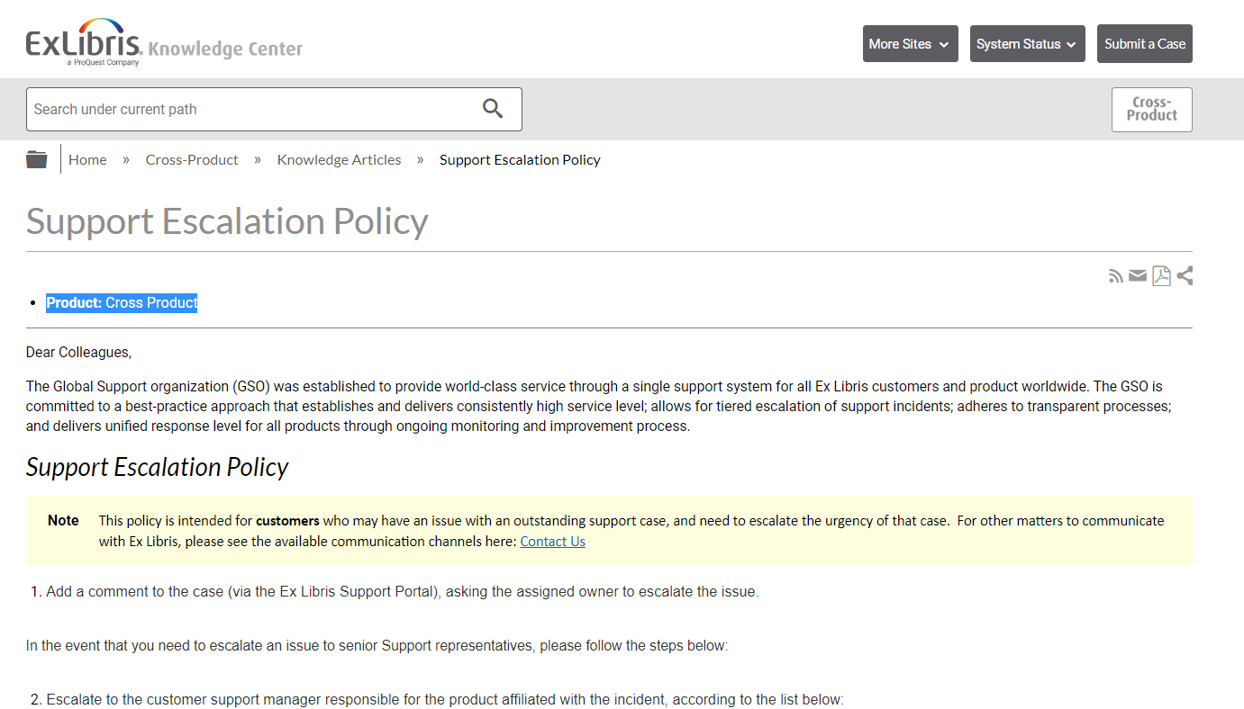
Support Update
SLSS/SLC met with:
  ExLibris support managers.
  Content Operations Administrators
SUNY escalated many cases gone stale in transition from implementation team.
Many linking cases escalated.
  Please treat linking cases as high priority moving forward.
Please don’t hesitate to escalate.
Continuing targeted discussions on Primo VE issues.
  November 5th: next meeting with Primo VE Product Managers
https://knowledge.exlibrisgroup.com/Cross_Product/Knowledge_Articles/Escalation_Policy
www.suny.edu

Slide 4
The Future of Institutional Leads + Contacts
Although we’re done with implementation, we’ll continue with institutional leads and the communication channels associated with this concept.
SLSS will be reaching out next week to ensure that your listed institutional lead is still accurate:
  https://slcny.libguides.com/overview/institutional_leads
We will be adding primary contacts for cataloging/resource management, and also for resource sharing.
  Adding functional area contacts as we’re struggling with communication not being distributed by institutional lead, and non-responsiveness for around 50% of institutions.
www.suny.edu

Slide 5

New SUNY Shared Library Services Staff
Jennifer Smathers working ½ time release time as SLSS Support Coordinator.
She will be working with Extended Support Campuses to manage projects and the overall support relationship.
www.suny.edu

Slide 6
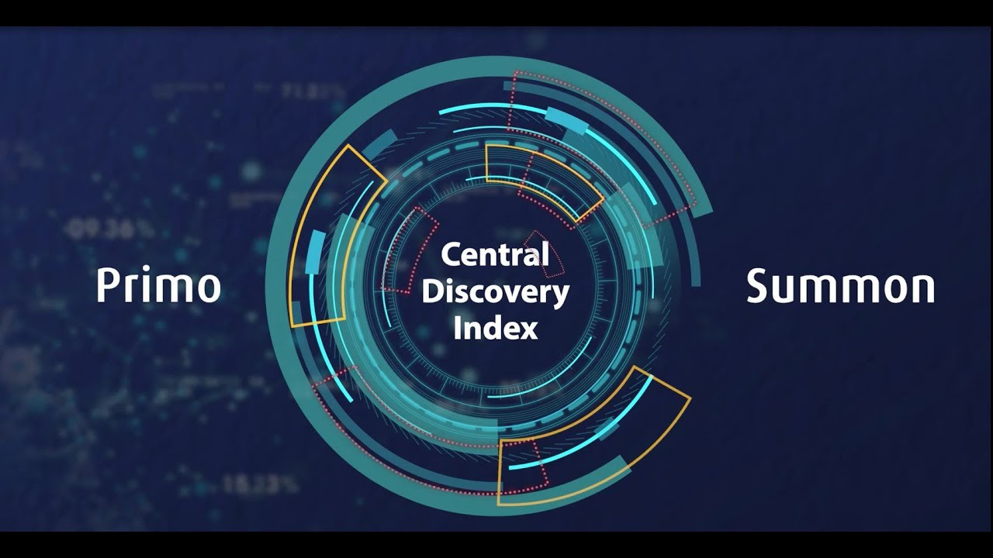
Central Discovery Index
Coming soon!
SUNY part of early adopter group
Will replace the PCI
E-Resource activation for full-text and search can happen at the same time
Will improve "held" publishing timing from 7-10 days to 24-48 hours
Improved EBSCO content indexing, alternative coverage no longer needed
Go live will take place during winter break
CDI Task Force will test Nov 15 – Dec 15 and will present findings on SUNY HQ Basecamp
https://public.3.basecamp.com/p/CgtraNKCano4RDphVDdfQD7U
Ex Libris YouTube https://www.youtube.com/watch?v=9k-JZdtSuo8
www.suny.edu

Slide 7


API Based Ordering Task Force
The API Based Ordering Task force will be charged with evaluating and testing the functionality and viability of using API based ordering such as Gobi and Oasis within the SUNY Network Zone environment. Specifically, the task force will analyze Ex Libris’ New Order API and related configuration such as configuration of integration profiles for ordering new physical bibliographic records in a Network Zone environment. The API Based Ordering Task Force will analyze criteria for adding records to the SUNY Network Zone, and analyze how functionality available for ordering via API matches with requirements for adding records to the NZ. If adding records to the NZ via API ordering is not possible, the Task Force will create recommendations for how to handle linking of records added to the IZ.
Membership:
  Maggie McGee, SLSS, Chair
  Jason Parker, Buffalo
  Kate Jones, Oswego
  Noah Roth, Broome Community College
  Marla Gruner, Ulster CC
  Marian Stern, Binghamton University
www.suny.edu

Slide 8

November Primo VE Updates
Release Notes
You should be getting the release by the end of the coming weekend.
Journal Search: you'll now be able to browse your journals by category
Primo VE Analytics Widget on Alma Dashboard
Improved patron tools: selecting and managing records
Accessibility improvements: includes Dragon voice integration improvements, better accessibility coding. See Primo Accessiblity Roadmap for more info.
https://pixabay.com/illustrations/turkey-animal-bird-farm-wild-1424732/
www.suny.edu

Slide 9

Café Alma Reminder
Starting Thursday, October 3rd, the former weekly Ex Libris
Q&A meeting became Café Alma Open Mic Thursdays!
November is Fulfillment month. Come stuff yourself silly with tasty tips, passing of the conversational gravy, and community questions to whet your appetite for knowledge.
October 31 | Fulfillment - Circulation
November 7 | Fulfillment - Patron Records
November 14 | Fulfillment - Fines and Fees
November 21 | Fulfillment - Open Call
Visit Café Alma online for sign up info, session links, presenter and host guidelines, and other details.
www.suny.edu

Slide 10
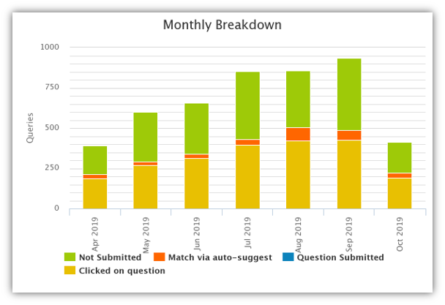
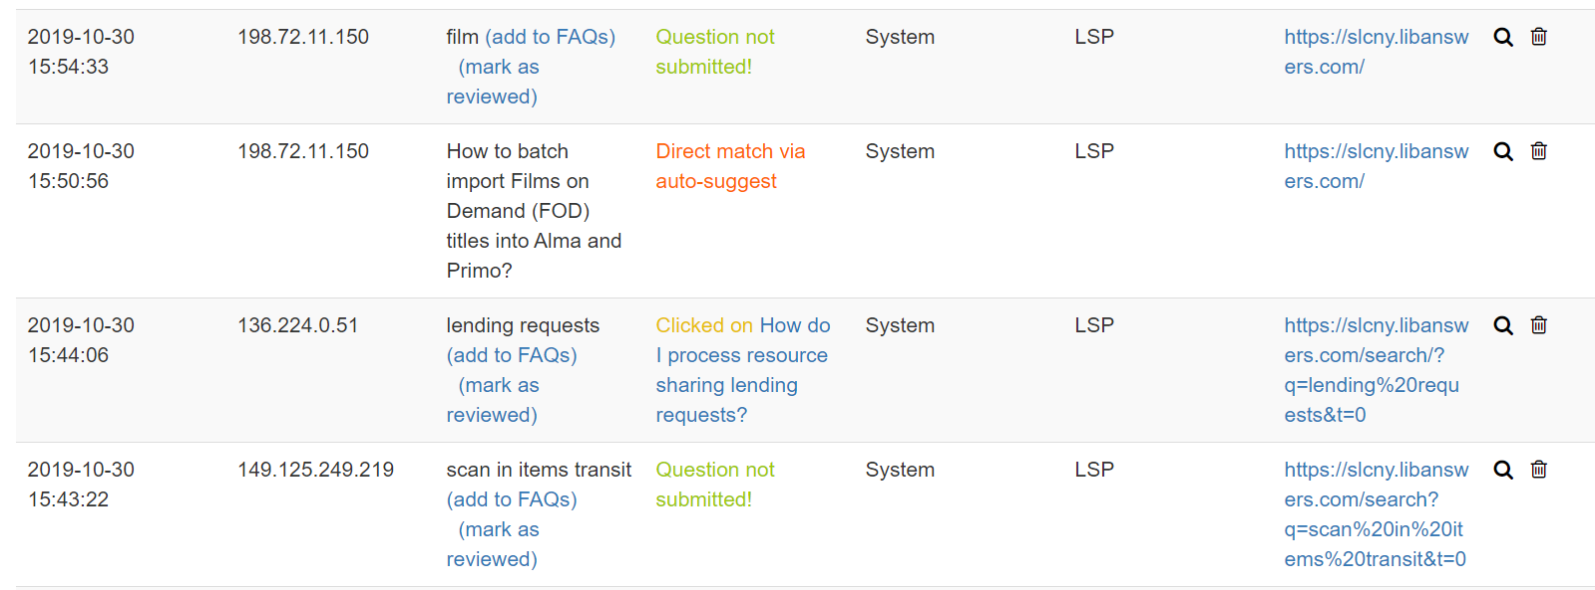
Statistics
Gathering monthly LibAnswers & FAQs statistics, posting on SUNY Shared LSP Overview LibGuide
Will use data to help identify areas where there is great interest – opportunities to create more FAQs
Query spy gives us search words and shows us if patron clicked on an answer or gave up
www.suny.edu

Slide 11

Resource Sharing Update
Timothy Jackson
www.suny.edu

Slide 12
October Resource Sharing Volumes
Top 10 Borrowers |  | Top 10 Lenders
Campus | Volume | Campus | Volume
1. University at Buffalo | 814 | 1. University at Albany | 257
2. University at Albany | 183 | 2. Binghamton University | 234
3. Binghamton University | 175 | 3. University at Buffalo | 131
4. SUNY Geneseo | 168 | 4. SUNY Oswego | 92
5. SUNY Purchase | 119 | 5. SUNY New Paltz | 88
6. SUNY New Paltz | 85 | 6. The College at Brockport | 86
7. The College at Brockport | 52 | 7. Buffalo State College | 82
8. Fashion Institute of Technology | 47 | 8. Erie Community College | 77
9. SUNY Oswego | 39 | 9. SUNY Oneonta | 76
10. SUNY Fredonia | 28 | 10. SUNY Plattsburgh | 64

Slide 13
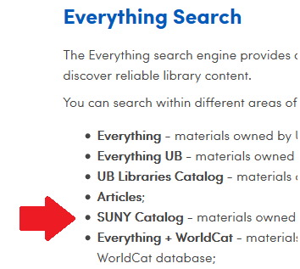
October Resource Sharing Volume Takeaways
The University at Buffalo is by far the biggest borrower in SUNY because they're the only SUNY library to include the SUNY scope in their Everything search
Primo configuration can have a huge impact on resource sharing request volumes!
Customized rota management at Buffalo has helped spread their requests out more evenly
  Binghamton no longer lending far more than other SUNYs
  Buff State and Erie CC also lending less
  No negative impact on turnaround time
www.suny.edu

Slide 14
Resource Sharing Turnaround Time Statistics
Average Borrowing Turnaround Time: 4.3 days
Takeaways:
  Turnaround times are pretty good!
  Separate East and West rotas may not be necessary for upstate libraries
  Separate East and West rotas are necessary for NYC libraries
  One size fits all approach to rota management may not work
 | East | West | NYC | Overall
East | 4.6 | 5.1 | 5.4 | 4.8
West | 4.0 | 3.9 | 5.2 | 4.0
NYC | 6.8 | 8.4 | 4.6 | 6.5
www.suny.edu

Slide 15
Resource Sharing Fill Rate Statistics
Fill rate statistics by month:
Takeaways:
  Fill rates are lower than expected
  Vast majority of unfilled requests truly cannot be filled within SUNY
  Working with Ex Libris to improve results of Alma's locate process
Month | Fill Rate
July | 38.3%
August | 50.2%
September | 54.0%
October | 56.1%
www.suny.edu

Slide 16


November Alma Release
New method for exporting unfilled resource sharing requests to ILLiad
Uses an API, not ILLiad's email import feature
Should solve the =09 issue
Requests from users without ILLiad accounts cannot be exported
Training session on new export method scheduled for November 5
www.suny.edu

Slide 17
Lost & Damaged Resource Sharing Items
Lost and damaged resource sharing items being reconciled annually by SLSS staff
$90 standard replacement fee for all items plus SUNY processing fee.
SLC dues adjusted accordingly
Access Services and Resource Sharing working group developing policies & workflows for lost and damaged items
www.suny.edu

Slide 18
Network Zone
Maggie McGee
www.suny.edu

Slide 19
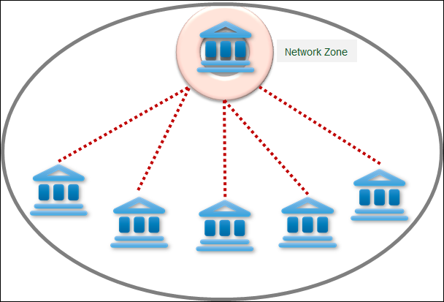
Identifying Records That Are Not Used In The NZ
Currently there are 1,654,926 NZ bib records that are not being used
NZ bib records that are not being used will be deleted from the NZ starting at the end of the fall 2019 semester
From this point on, bib records not being used in the NZ will be identified and deleted on a monthly basis
www.suny.edu

Slide 20
Training Update
Jennifer Koerber
www.suny.edu

Slide 21
Recent Trainings
"Identifying the Correct Bibliographic Record when Ordering in Alma's Network Zone" (Resource Management/Acquisitions)
"Item Policies Demystified" (Fulfillment/Resource Management)
"SIS Loading and Troubleshooting" (User Management)
"Resource Sharing – Lending Deflections" (Fulfillment)
"Sets and Jobs" (all areas)
"Submitting a Good Support Ticket" (all areas)
www.suny.edu
Notes:
Good attendance and engagement for all sessions. A successful switch to registration-based training, which makes it easier to communicate with and count participants.

Slide 22
Upcoming Trainings
"A New Method for Exporting Unfilled Resources Sharing Requests from Alma to ILLiad" - Nov 5, webinar, https://slcny.libcal.com/event/5976632
"Analytics Basics Training" – full-day session, in person in Syracuse (full) and Middletown (Nov 7, spaces available), https://public.3.basecamp.com/p/gNNKD9eSbqkeBizRMM6GCJV2
Monitoring Resource Sharing Request Lists & Active Notes (2 sessions, TBD)
LHR Publishing Profiles and "Sharing with Network" Functionality in the MD Editor (1 session each, TBD)
These and more will be available for registration on https://slcny.libcal.com/calendar/training/
www.suny.edu
Notes:
As trainings are scheduled, we'll add them to the training calendar, which is where all registration information, pre-requisites or pre-work, and webinar information will be.

Slide 23
Looking Ahead
Watch Basecamp for December training announcements
In the November Update:
  You asked, we're answering: a single place to find all Alma/Primo VE training materials, on LibGuides.
  More "Alma/Primo VE basics" webinars and videos
  A preliminary outline of trainings to be available through Q1 of 2020
www.suny.edu

Slide 24

Volunteer Needed to Chair Improvements Task Force
Need chair for Alma and Primo Enhancements and Improvements Coordination Task Force.
Details about TF is at:
  https://public.3.basecamp.com/p/gqTdzb5FBp2FjCBL268qM7Gk
Contact Shannon if interested (shannon.pritting@suny.edu)
www.suny.edu

Slide 25


Questions or Discussion?
www.suny.edu

