Slide 1
Unit 0 Understanding a Maths Hub Work Group
Work Group Lead Toolkit 2020/21

Slide 2
What is a Work Group?

Slide 3
A definition
In a Maths Hub Work Group, schools work together in a structured way over a sustained period with the support of an expert Work Group Lead to achieve shared outcomes
In a Maths Hub Work Group, schools work together in a structured way over a sustained period with the support of an expert Work Group Lead to achieve shared outcomes.

Slide 4
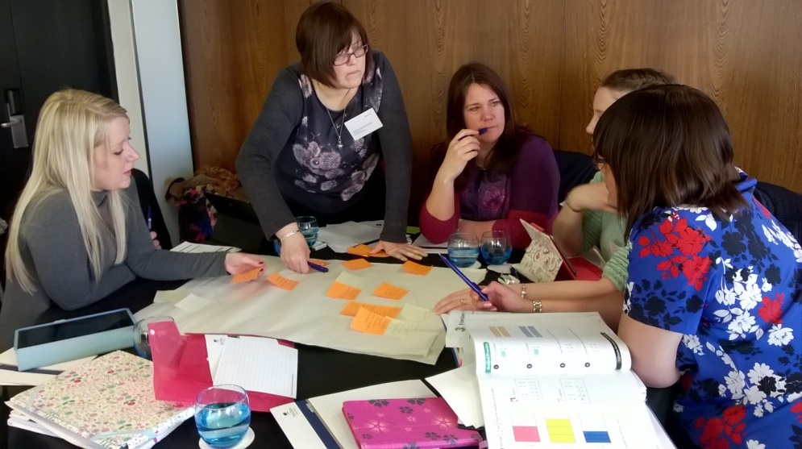
Work Group on a slide
Participants
Outcomes
Work

Slide 5
Understanding the key ideas
Unit 1 Understanding the participants
Unit 2 Understanding the outcomes
Unit 3 Understanding the work

Slide 6
The role of the Work Group Lead
Unit 4 Designing the Work Group
Unit 5
Leading the Work Group
Unit 6
Evaluating the Work Group
Unit 7
Working with others
Unit 8
The Work Group plan
Unit 9
The Work Group report

Slide 7
Toolkit overview
Units 1 to 9 (slides and narration)
Suggestions for further reading, watching, listening
Suggestions for discussion with others
Key documents: Toolkit overview; Work Group plan template; Work Group report template

