Slide 1

COVID 19 Response in SUNY Libraries
May 15, 2020
www.suny.edu

Slide 2

OLIS Update
Mark McBride, Library Sr. Strategist
www.suny.edu

Slide 3
4-week Planning Committees
Resource Sharing | Tim Jackson/Shannon Pritting
Professional Development | Jennifer Smathers
Partnerships | Shannon Pritting/Mark McBride
Course Reserves | Mike Daly
Physical spaces | Jennifer Smathers
Library Instruction/Course Support | Mike Daly
Shared Collection Management | Esta Tovstiadi
Scholarly Communication | Maureen Zajkowski/Wendi Ackerman
www.suny.edu

Slide 4
Identified Problems Being Analyzed
Professional Development:
How to best support librarians who are in the APT/Continuing Appointment process right now?
Which Professional Development Opportunities (PDOs) are worth our time Right Now?
How to foster cross-campus networking?
Ongoing need for library profession to develop leadership / support management
www.suny.edu
Notes:
To volunteer email Connie Perrin

Slide 5
Identified Problems Being Analyzed
Partnerships
3 areas to focus our energies
Tighter alignment with SUNY procurement to help with coordinated purchasing for campus libraries
Extend opportunities for professional development and seek organizations outside of SUNY to help with delivering
Identify opportunities where there could be tighter alignment with other SUNY specific organizations, such as SUNY Online etc.
www.suny.edu
Notes:
To volunteer email Connie Perrin

Slide 6
Identified Problems Being Analyzed
Physical Spaces:
How to keep people safe?
Staff
Students
Public
How to safely handle the logistics of returns?
Barriers to accessibility and safe practice built into our buildings?
Shared offices
Entrances near work areas
Installation of safety aids (i.e. sneeze guards) even possible?
www.suny.edu
Notes:
To volunteer email Connie Perrin

Slide 7
Identified Problems Being Analyzed
Virtual Library Services:
We offer chat (or) virtual ref desk (or) online research consults, but they're underutilized
We don't offer live chat; rely on email or CMS
Use of chat has grown; how do we keep up?
No common chat service/vendor/platform across SUNY
Scheduled instruction sessions still expected by faculty – both synchronous and asynchronous; rush to create materials
Some course assignments/student expectations not revised by faculty
www.suny.edu
Notes:
To volunteer email Connie Perrin

Slide 8
Identified Problems Being Analyzed
Resource Sharing:
Need to focus on reopening resource sharing and access services during transition period from closed to opening.
RS is being managed in multiple systems: is there an opportunity to leverage systems better, and reduce the amount of technology infrastructure?
Staff sizes will be static or shrinking, even as services are expanded. Is there a need for centralization/regionalization and sharing of staff?
Need to begin working on lending of resource types beyond articles and chapters such as e-books and streaming video.
RS is a community: how do we facilitate training and prof. Dev. Of staff? How do we monitor and help when campuses/departments are struggling and help them?
www.suny.edu
Notes:
To volunteer email Connie Perrin

Slide 9
Identified Problem Being Analyzed
Course Reserves: Textbook Reserves
Course reserves are a dynamic and multi-faceted collection.
Narrowing the scope of our investigation to textbook reserves present these problems:
  Textbook reserves are a proxy to the larger issue of textbook affordability for students
  Publishers are quickly shifting to digitally-walled course content and faculty are requiring those resources
  Many campuses still rely on bookstores as a revenue stream, leading to an increasing number of inclusive access programs which theoretically secure annual revenues
www.suny.edu
Notes:
To volunteer email Connie Perrin

Slide 10
Identified Problems Being Analyzed
Library Instruction / Course Support:
There is both a lack of available current best practices and a redundancy of available tools (paid for and free) for creating flexible (videos, modules, customized tutorials, etc.) library instruction content
A long-standing hurdle of effectively communicating to faculty and students the availability of library instruction / supports has been magnified by COVID-19
Varying degrees of library/librarian access to and presence in campus LMS
www.suny.edu
Notes:
To volunteer email Connie Perrin

Slide 11
Identified Problems Being Analyzed
Shared Collection Management:
Procurement process for licensing e-resources; difficult and time consuming to purchase anything. Difficult to pay bills for currently subscribed resources. Process could be in place for 1 - 1.5 yrs
Potential library budget cuts. Not having the budget to support new needs brought about by online instruction
How do we support new needs and explore new collections opportunities in this environment?
Lack of collaborative collection development.
Confusion about SUNY print collection policies - last copy policy? Rule of 3 policy?
No mechanism in place for easily sharing print collection in current environment
Access to campus print collection, safety of circulation staff
Archives and special collections - how much moves online? What does that mean for physical archives.
www.suny.edu
Notes:
To volunteer email Connie Perrin

Slide 12
Identified Problems Being Analyzed
Scholarly Communications:
How to provide best practices for workflows and metadata in support of managing collections?
What would it take to migrate from a local repository to SOAR?
Is it possible to promote the benefits of open access within the context of a SUNY-wide initiative to help address challenges of obtaining content?
What approach to take to address faculty questions related to licensing, ownership, copyright, and negotiating with publishers?
www.suny.edu
Notes:
To volunteer email Connie Perrin

Slide 13
SLSS Update
Shannon Pritting, Director of SUNY Library Shared Services
www.suny.edu

Slide 14
Reminder: Helping Libraries as Part of Baseline Services
In response to what we heard from campuses in virtual site visits, most libraries are doing well with Alma/Primo.
But—they'd like a little help here and there with things they may be struggling with. Or, maybe you want a report or two developed to meet your needs.
SLSS will provide up to 5 hours per year of consulting with campuses if you're struggling with something, with no need for an extended agreement.
Just reach out if you need help. If you can send it to libanswers: info@slcny.libanswers.com, that would be helpful
This is in addition to our integration and other configuration work we have been and continue to do such as:
  OCLC integration
  GOBI/Oasis API integration
  SIS
  Science Direct change
  Shared Reports
www.suny.edu

Slide 15

New Training Opportunities – Acquisitions
May 28, 2020 – Webinar (1 hour)
Review and Revisit Alma Acquisitions
June 23, 24, 25, 29 - (8) hour course
CPD fee - $100
Using or upgrading to full acquisitions:
Registration Open Now:
https://sunycpd.eventsair.com/fla-alma/fla-info
www.suny.edu

Slide 16
Accessibility/EIT
Working with Nazely Kurkjian to determine what is best for central efforts.
Met yesterday with Library Accessibility Alliance/Big Ten Academic Alliance to review their approach
  https://www.btaa.org/library/accessibility/reports
Will reach out for volunteers for working groups in near future when an initial structure is established.
www.suny.edu

Slide 17
Shared Collections Update
Esta Tovstiadi, Shared Collections Coordinator
www.suny.edu

Slide 18

Presentations on Making Cuts in Collections
Thursday, May 21, 2020, 10 am – 11 am. Strategies for managing e-resource cancellations and renewals
  https://slcny.libcal.com/event/6706344
Tuesday, May 26, 2020, 9 am – 10 am. Using Alma's Overlap Analysis tool to evaluate e-collections for renewal or cancellation
  https://slcny.libcal.com/event/6706641
Thursday, May 28, 2020, 10 am – 11 am. Strategies for managing library resource renewals and cancellations. With Tim Arnold, Director at JCC; Alana Nuth, Head of Coll. Mgmt. At Geneseo.
  https://slcny.libcal.com/event/6705157
www.suny.edu

Slide 19
Want Some Help in Reviewing What to Cut?
SLSS is offering a service to assist you with identifying cuts in your collections.
Send us a request via libanswers (info@slcny.libanswers.com), and we'll work with you to help make the best decisions on resources that can be cancelled to meet demands for budget cuts.
Will need administrative logins (for usage data), a spreadsheet or other information about resources, target percentage for cuts, and any other relevant information.
We'll do as many of these consults as we can.
Please give us at least 3-4 days advance notice before any deadlines/meetings you have.
www.suny.edu

Slide 20
Resource Sharing Update
Timothy Jackson, SUNY Library Shared Services
www.suny.edu

Slide 21
Libraries Accepting Returns from All SUNY Users
List of libraries accepting returns from all SUNY users
  https://slcny.libanswers.com/faq/302298
  Being updated daily
No libraries currently accepting returns from all SUNY users at a circulation desk
29 libraries currently accepting returns from all SUNY users in their book drops
  How often drops are checked varies from daily to once every two weeks
  Book quarantine periods also vary widely
www.suny.edu

Slide 22
Libraries Accepting Returns from All SUNY Users
Information gathered from responses to "SUNY Libraries Accepting Returns from Users" survey
  https://slcny.libwizard.com/f/returns
Still waiting from responses from some libraries
Other libraries have multiple people responding, so please coordinate responses
Provide a new response any time you have new information to share
Please be as specific as you can
  What day(s) of the week are your book drops being checked?
  Are books being quarantined before or after they're checked in?
www.suny.edu

Slide 23
Libraries Accepting Returns from All SUNY Users
Many users returning items will expect those items to be removed from their user records regardless of where they were returned
SLSS developing workflow to make this happen
  Simple form for reporting returns
  SLSS staff will update user records accordingly
User record update workflow will be entirely manual, so potential for workload to become impractical
  Approximately 175,000 items currently checked out to users throughout SUNY
Please do what you can to encourage users to hold on to materials!
www.suny.edu

Slide 24
A Few Other Things...
OCLC list of libraries lending and accepting returns
  Survey: oc.lc/mailform
  Responses: oc.lc/mailstatus
  Please respond if you haven't
Ex Libris Powerpoint on creating a "Quarantine Library"
  https://knowledge.exlibrisgroup.com/@api/deki/files/82726/How_to_cause_returned_items_to_remain_in_quarantine_for_a_specified_time_period_before_returning_to_permanent_location.pptx?revision=2
  How to configure a workflow where returned items will go to a quarantine location for a specific time period before transiting to the permanent location
  SLSS can help if you'd like to implement this
www.suny.edu

Slide 25
SLC Update
Jennifer Smathers, SLC Consortial Engagement Coordinator
www.suny.edu

Slide 26


SLC Spring 2020 Virtual Meeting
June 8-10
No Registration Fee
Open to All SLC
Breakout Rooms
Afternoon Schedule
Virtually Social Events
www.suny.edu
Notes:
Decorative image from https://www.pxfuel.com/en/free-photo-xnwek

Slide 27

SLC Board Election Results
2 year term
Jill Locascio
Associate Librarian – Digital and Technical Services, Harold Kohn Vision Science Library, Optometry
3 year terms
Christine Faraday
Chairperson A. Holly Patterson Library, Nassau
Alana Nuth
Head of Collection Management, Milne Library, Geneseo
Election Results
soon
How Can You
Get Involved with SLC?
LSP Advisory Committee
Task Forces
www.suny.edu
Notes:
https://forms.gle/zFdapsQC6JuQfoX16
If the announcement gets emailed out by KF before the update, then I can announce the winners and will remove the solid blue box (JS)

Slide 28
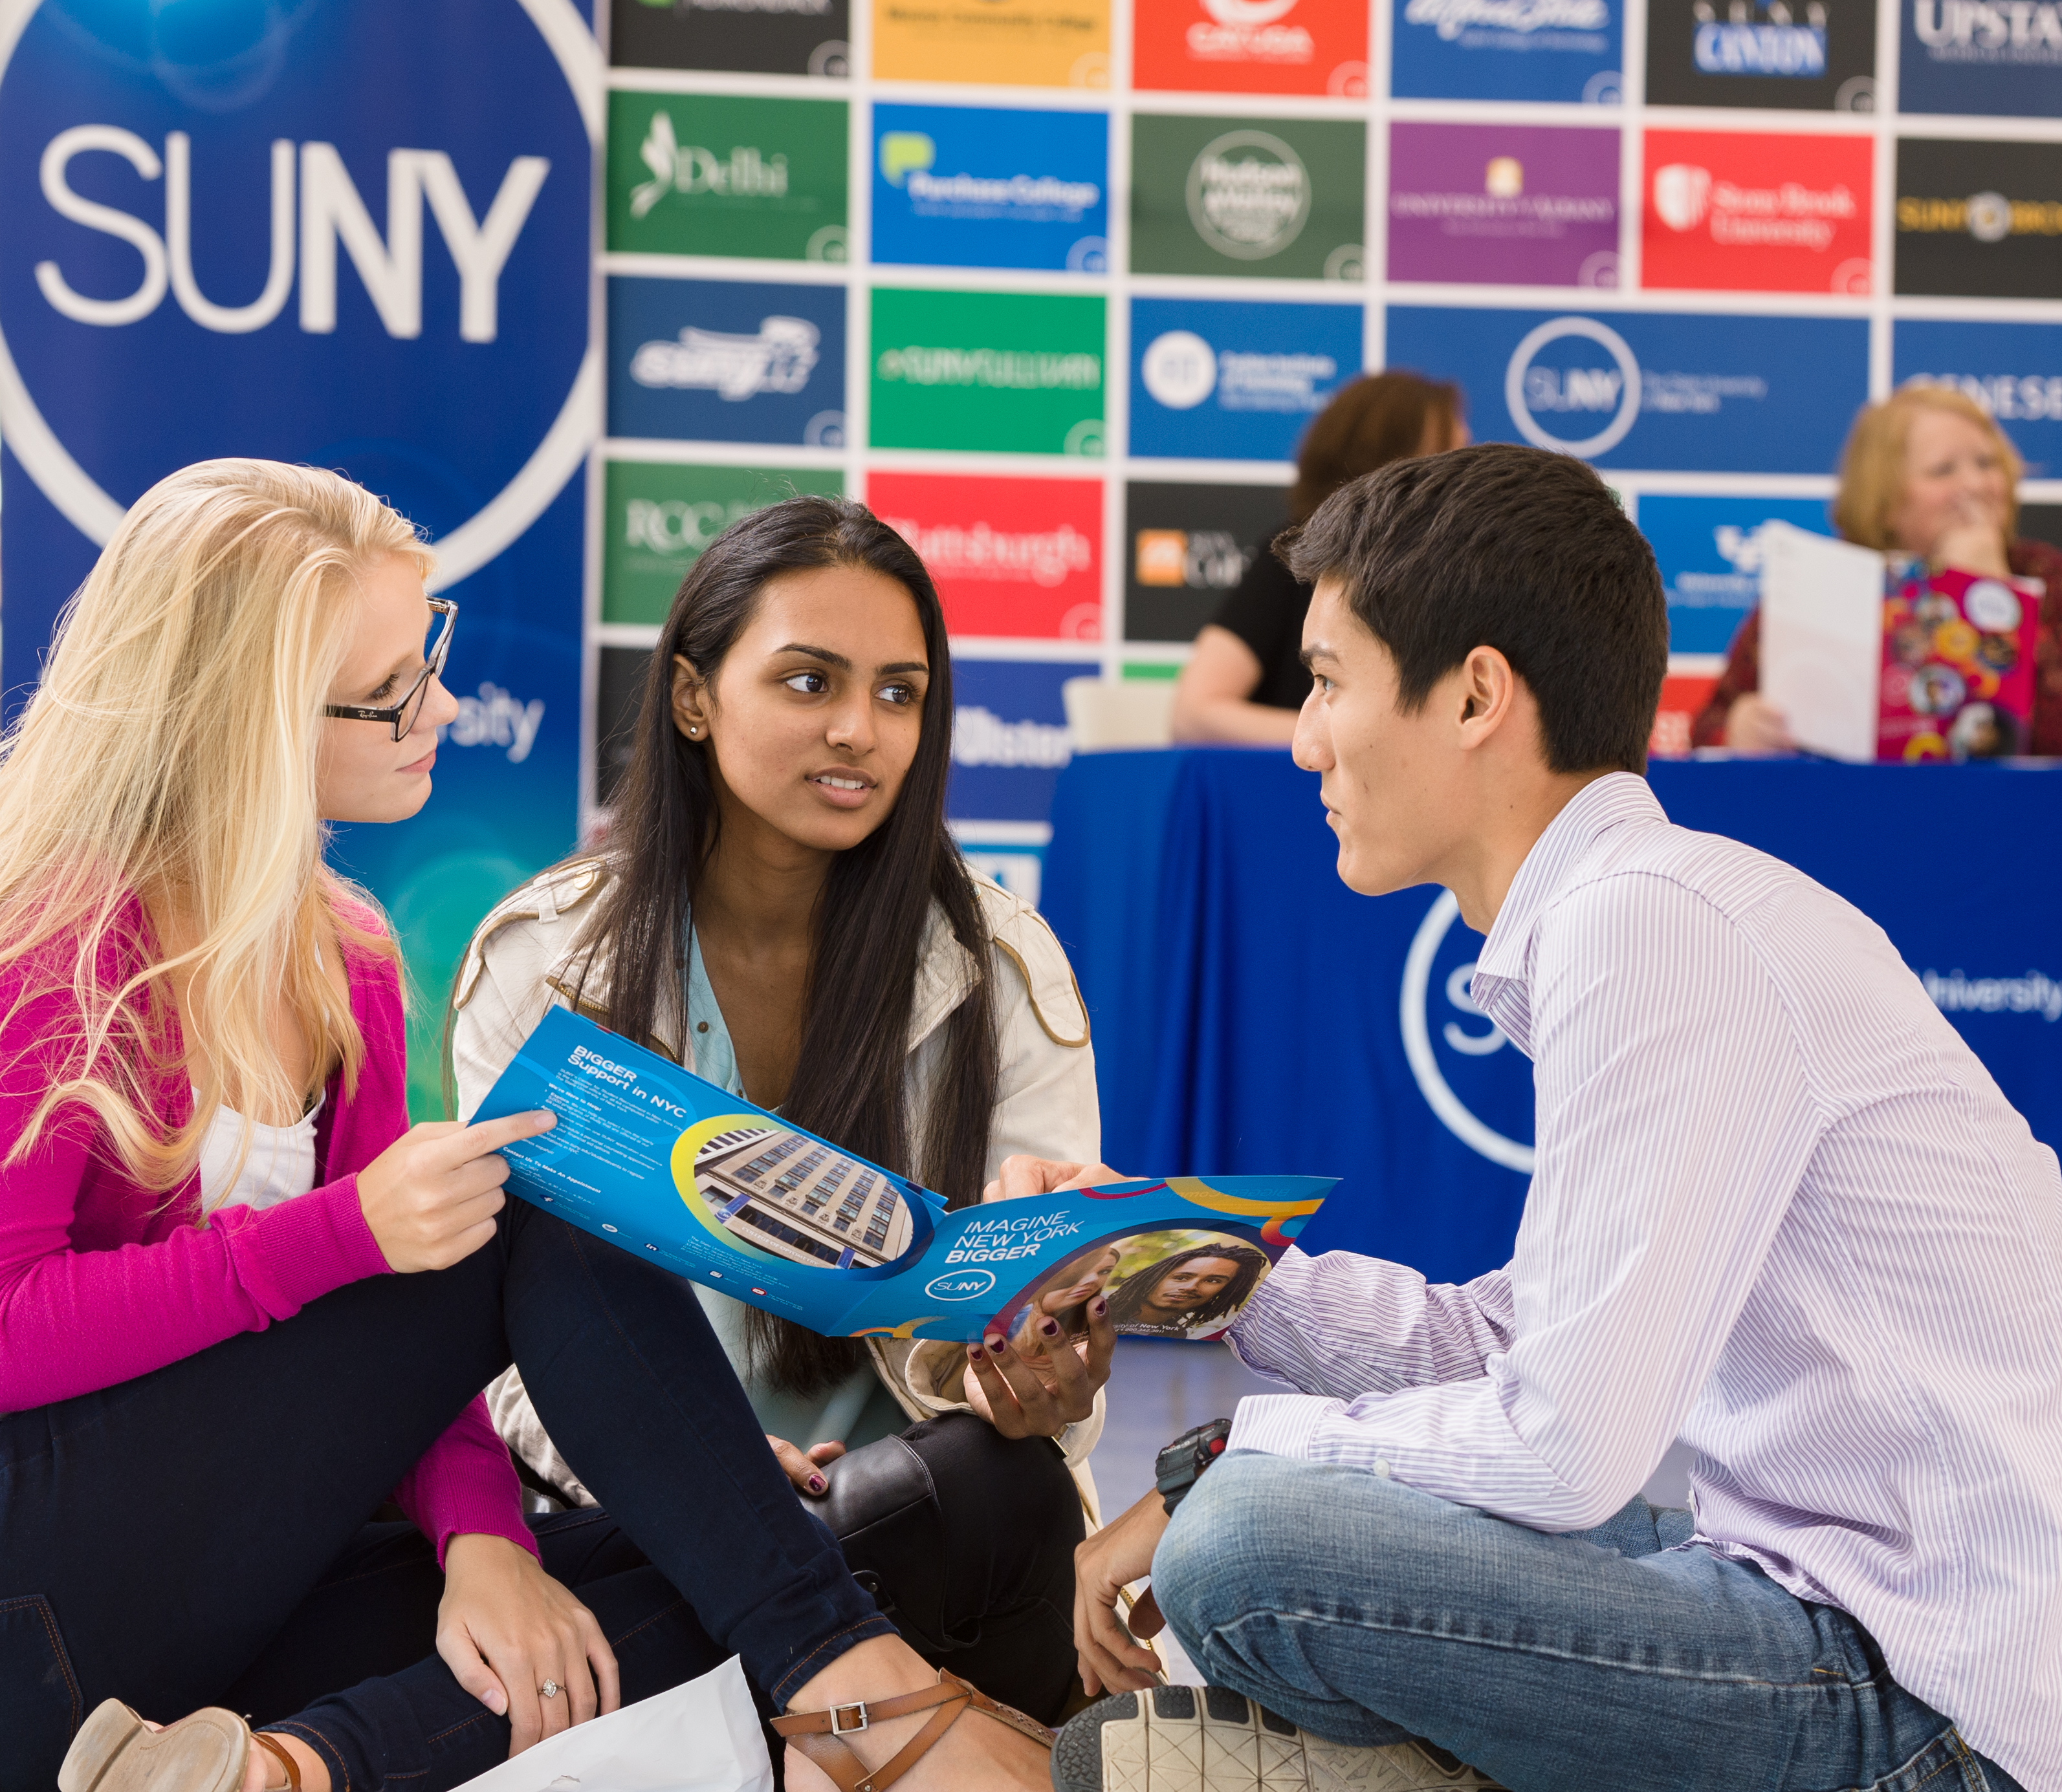

Questions?
How are Things Going at your Campus?
www.suny.edu

