Slide 1
Alma Analytics: Physical Collections October 1, 2024

Slide 2
SUNY Alma Analytics series: 1. Intro to Alma Analytics (see recording) 2. Resource sharing (see recording) 3. Physical collections (TODAY!) 4. Acquisitions: October 8 5. Fulfillment: October 15 6. Sharing reports: October 24 7. eResources: October 29

Slide 3
Agenda
Collection management/weeding
Routine maintenance for physical collections

Slide 4
Subject areas: Physical Items, Titles
Built-in tools from ExLibris
[Shared Folders/Alma/Inventory]
Physical Item Usage for Weeding
Physical Items Committed to Retain
Physical Items dashboard
[Shared Folders/Alma/Titles]
Title Level Overlap Analysis dashboard
Creating your own analysis
Collection management/ weeding
Notes:
Physical Items refreshes overnight
Titles refreshes after 30 days

Slide 5
SUNY Last Copy: report from the NZ that can be combined with your institution’s IZ data
https://sunyolis.libanswers.com/faq/372808
Collection management/ weeding
Notes:
You can request a Last Copy report from SLS

Slide 6
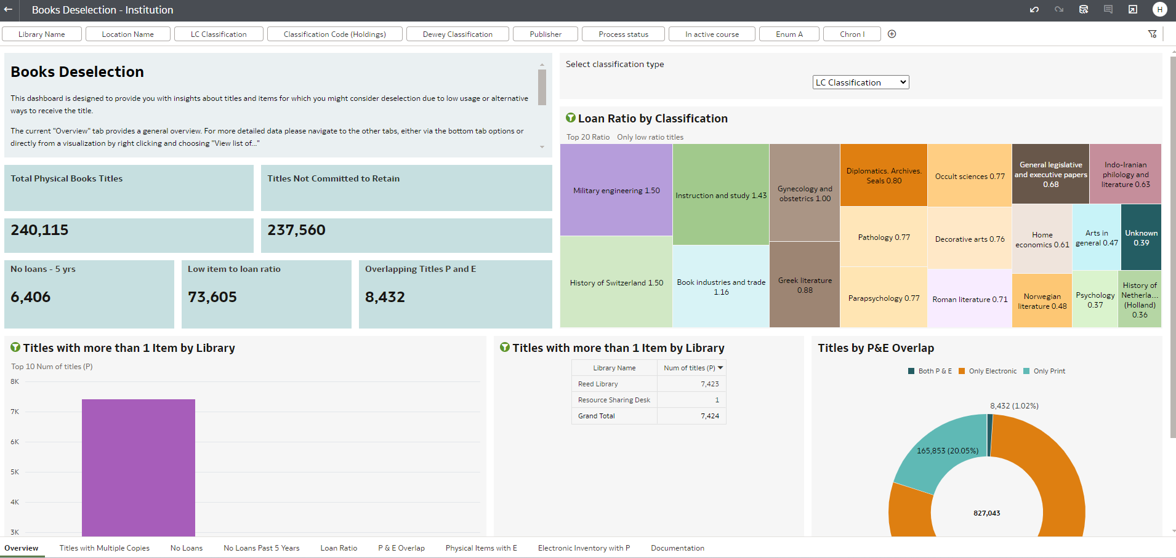
Notes:
This tool is a Data Visualization Workbook that can give you a big picture visual of your physical collection.

Slide 7
[Shared Folders/Alma/Titles/Reports]
Bibliographic records with holdings record and no items
Bibliographic records with no inventory of any type
Routine maintenance
Notes:
Next, we’ll look at some reports that you may want to use to check on the general health of your collection and look for items that may have fallen through the cracks or that could use improvements.
ExLibris has some handy out-of-the-box reports that can help you identify materials that haven’t been completed and are missing some or all of their inventory. These reports are Bibliographic records with holdings record and no items, and Bibliographic records with no inventory of any type. One thing to remember about these reports is that they are using the Titles subject area, which is only refreshed monthly. You may find records on these lists that have been addressed more recently.

Slide 8
[Shared Folders/Community/ Reports/Consortia/SUNY/ Resource Management/]
Duplicate Barcodes in IZ
Duplicate Holdings Report for the Same Location
Physical and Electronic Inventory on the Same Bib Record
Browse Shelf List Report with Prompt
Routine maintenance
Notes:
These reports have been developed by staff members at SLS and are available to all Alma users through the SUNY consortia folder. Like any shared report, if you want to alter these reports, please save a copy in your institution’s Alma folder and don’t edit these in the consortia folder.

Slide 9
Creating your own reports
Looking for poor quality bibliographic records
Recovering withdrawn items using “wdn”
Routine maintenance

Slide 10
Questions?

