Slide 1
5/17 SUNY Library Services Platform Project Update
Shannon Pritting,
SUNY Shared Library Services

Slide 2
Let’s keep one thing in mind.
Be nice to each other. That means everyone involved. We’re all trying, and we’re all human.

Slide 3
Review of SUNY Libraries Shared Services Staffing
Tim Jackson: Resource Sharing and Fulfillment Program Manager.
Maggie McGee: Network Zone Coordinator.
Gail Pawlowski: Sr. Alma Support Specialist.
Shannon Pritting: SLSS Director.
Michelle Eichelberger: E-Resource and Discovery Program Manager.
Additional Support and Special Projects librarian beginning in Fall.
Additional staff positions will be forthcoming.
Kristy Lee continues in Project Manager role through 12/2019.
Heidi Webb Project Manager contract ends July 1, 2019.
6 staff working on (mostly) short-term release time agreements until go-live to provide direct support to campuses.

Slide 4
Banner-Alma Integration Update
Banner patch/SICAS application now available to all SICAS member campuses.
SUNY will support Alma integration when you have an XML file to test.
We’re happy to set up a meeting with you if desired.
SICAS will support the Banner application.
Please use their Service Now portal to submit requests/issues.
Current version of application only tested at one institution, so it’s likely your IT will need to work through some issues or clarify documentation.

Slide 5
Primo Update: NZ and Speed

Slide 6
Primo Speed and Responsiveness
ExLibris is working on improving responsiveness, but we’ll need to focus on specific areas.
Speed enhancements testing didn’t provide evidence of significant improvements.
SUNY is working to escalate this issue to continue to improve performance.

Slide 7
Network Zone/SUNY Catalog Testing
Intent is to have the SUNY catalog contain your e-resources and the physical resources of all of SUNY.
QA environment released to us weeks ago indicates that Primo NZ search will work as intended.
QA environment tested is early preview of June Primo VE release.

Slide 8
Go-Live Checklist
First session to review the checklist will be May 20th from 11-12.
Checklist intended to be taken and used/revised/edited by campuses to meet their own needs.
Checklist links back to documentation and further information about tasks.
Will have second session on checklist June 6th from 10-11.
We are working to make this as comprehensive as possible, but campuses should review their own needs as well.

Slide 9
Walk-In Borrowing and Fulfillment Network

Slide 10
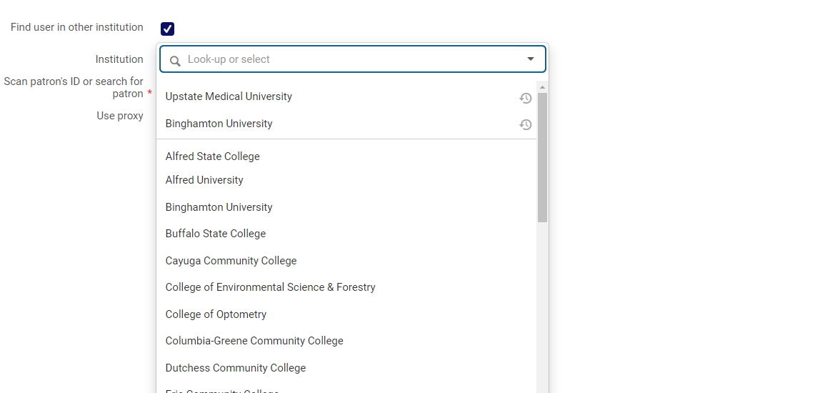
Status Thus Far
51 Campuses configured for “Walk-In Borrowing.”
This means that if a patron from one of the 51 campuses comes into your library, and they’re an active user from another campus, you’ll be able to pull in their user record.
Patron will then become a user in the other library with specified privileges.
ASRS group will be sending survey soon to review possible standard loan periods and fines/fees/TOUs.

Slide 11
OCLC Publishing From Alma
Currently setting up profiles for you in Alma.
27 campuses asked SUNY to do this.
Deadline to request that SUNY do this for you has passed.
We’ve responded to all campuses who requested this set up.
Working on configuration now.

Slide 12
Key Dates Coming Soon For Cutover
May 10th: All migration forms/files were due to ExLibris.
Link Resolver Form, Aleph to Alma Migration Form, 360 Link files
If you didn’t submit anything, we did this for you. For about 20 campuses, we uploaded your LR form, and updated Science Direct, and did a quick review of the form.
Today/May 17th: OCLC Master Record Query Submitted
May 24th: Last day for PLIF loads
Group 1 and 2 specific dates coming in late May-Early June.

Slide 13
Migration: the Network Zone
Key Dates:
May 17th: OCLC Master Record Query Submitted.
June 12th: SUNY Network Zone Live as first group goes live.
July 2nd: We can begin automated updates of Network Zone.
What this Means for Campuses:
If you continue OCLC cataloging after May 17th, your IZ and the NZ will be a little out of sync and you’ll have some non-matches.
There is a linking job that IZs can run, but this job is tricky, and should be run with caution.
During July and August, we’ll be working to get the NZ and IZs as synced up as we can.
But, our meetings with other consortia indicate that the NZ will be a constant work in progress, and we’ll never have a “perfect” bibliographic database.

Slide 14
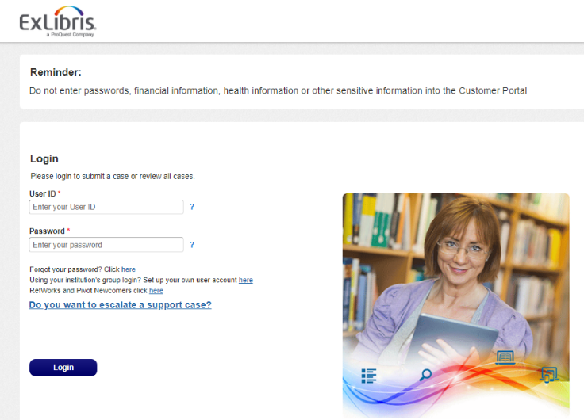
Transitioning Interactions During Cutover
ExLibris will still have Basecamp presence, and will review Basecamp, but if questions are not easily/quickly answered, you’ll be asked to submit a SF case.
Focus will be on successful migration, so more general questions may take longer to be answered.
As we move past go-live, the focus will be more and more on Salesforce cases.

Slide 15
Support from SUNY through go-live process
Continue topic based webinars as much as possible, but we won’t be able to do more focused topic courses.
Helping manage relationship with Exlibris—which can include helping escalate if you let us know.
Facilitating communication about delivery of environments, acceptance of environments, or tracking issues from migration.

Slide 16
Support from SUNY Libraries Shared Services (SLSS) After Go-Live
Campuses will go directly to support via Salesforce unless your campus is engaged in a move toward extended support.
Questions/Issues should go through libanswers (info@slcny.libanswers.com) until SLSS transitions to new ticketing system at end of year.
SLSS will provide general support and point libraries to FAQs or documentation with how to resolve their question/issue.
Issues related to NZ level configuration or functionality will be reviewed and resolved if possible.

Slide 17
Limitations on SLSS Support Beyond Go-Live
Will focus on providing campuses with assistance through pointers to FAQs and responses that campuses can adopt.
Campus visits and individual meetings to train staff are not possible unless arrangements are made.
SLSS staff performing extended configuration, workflows, set up, and customization of Alma and Primo will require an extended support agreement.
Staff training beyond scheduled all-group webinars will require an extended support agreement.

Slide 18
If your campus knows that you want more extensive support.
Contact Shannon (shannon.pritting@suny.edu) to:
Begin discussion about extended support, which will include discussing costs associated with extended support.
Identify what extended support is needed, and identify whether the support needed is something that SLSS can assist with.

Slide 19
Resource Sharing Roll Out Planning
Working with ASRS to develop plan for roll out of resource sharing across SUNY.
Likely will not have all campuses go live immediately on lending and borrowing.
Proposal being reviewed by LSP Task Force next week.

Slide 20
Resource Sharing Walk Through Sessions
ASRS members working on scheduling multiple small group sessions in late May-early June timeframe to get staff more comfortable with resource sharing workflows.
Model developed based on other large consortia going live in a similar method as SUNY.

Slide 21
LSP Advisory Board Vacancies: Deadline May 20th
Volunteers Needed for LSP Advisory Board (which will replace current LSP Task Force)
https://forms.gle/Cd3fdeDvYdUhJVC38
3 Volunteers Needed for 2-Year Terms beginning in June 2019

Slide 22
Questions

