Slide 1
SUNY Alma Overview
Shannon Pritting
SUNY Libraries Shared Services

Slide 2
I feel empty: when is a database not a database?
Alma terminology takes some getting used to.
Basic terminology that has tripped us all up the most:
Database: a resource that cannot contain full text or titles. So, usually an “abstracting and indexing” database such as MLA Intl. Bibliography.
Portfolio: at its most basic, a journal title, ebook, or online content and its associated holdings and full-text services.
Collection: Can contain portfolios and services, so means it can be full-text.

Slide 3
What you can do and see in Alma is set through roles.
Everything besides searching in Alma requires a role of some type.
Roles can be added one by one or in bulk.
Profiles are a good way to add roles in bulk.
Because the architecture of Alma is complex, many roles must be “scoped,” meaning you have to tell Alma where this role should be applied.
If it’s not toggled on, and then saved, it won’t work.
Any changes require a log out and log in to take effect.

Slide 4
User Roles can be viewed in User Details

Slide 5
Demo of User Roles and Profiles

Slide 6
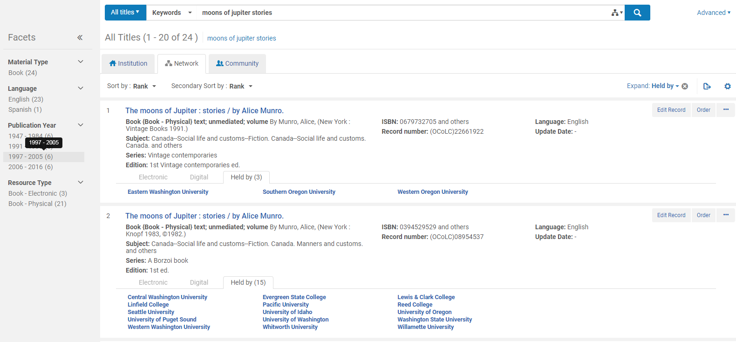
Understanding the Zones
Community Zone
(Alma Knowledge Base)
Network Zone
(consortium)
Institutional Zone

Slide 7
Community Zone (CZ)
The Community Zone is the global knowledgebase of electronic resources that ExLibris maintains, allowing all Alma subscribers to link their local holdings to this resource. Collections linked to the CZ automatically receive updates from the CZ, reducing the need for campuses to locally manage collections.

Slide 8
Network Zone (NZ)
The Network Zone is the central consortial infrastructure for SUNY. The major component of the Network Zone is the shared bibliographic database of all SUNY physical materials (books, DVDs, CDs, etc.). Other centralized management such as configuration for resource sharing is housed in the NZ.
Think: SUNY-wide services (kind of like public libraries)

Slide 9
Institution Zone (IZ)
The Alma institution is the basic level of data and workflow management in Alma.
Very little resource management will be only in your Institution Zone, with most linked to CZ and NZ.

Slide 10
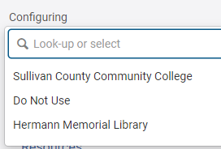
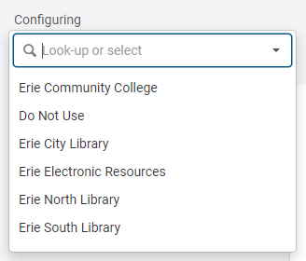
Your Alma Environment Has Multiple Levels Too
All SUNY environments have at least one institution, and at least one library. Many have a single institution and multiple libraries.
Configurations, settings, and user roles can be at the institution or library level.
Alma also has a campus organizational level, but only one SUNY is using campuses.

Slide 11
Library
The Alma library is comprised of one or more physical locations, each of which is normally housed in a single building or in several buildings in close physical proximity. A library may have several locations within it, such as the circulation desk and digital archiving. Each Alma Institution can have multiple Alma libraries.

Slide 12
How did we build the Network Zone?
OCLC Master Records imported from OCLC Collection Manager Query Collection.
Filtered by physical resources to exclude e-resources.
5.9 million bib records.
High match rate for almost all campuses, which means that most of your IZ bib records were linked to the NZ bib records.
Local fields (if they migrated) in the IZ, and only OCLC Master Record fields in the NZ.
SUNY will be updating NZ records with Master record updates, that everyone will benefit from.

Slide 13
How SUNY’s Resource Environment is structured.
For physical materials, the bibliographic record is in the Network Zone, and cannot be edited except for in OCLC.
Institutions can edit local fields for institution specific information.
Almost all e-resources will be connected to the Community Zone in one form or another.

Slide 14
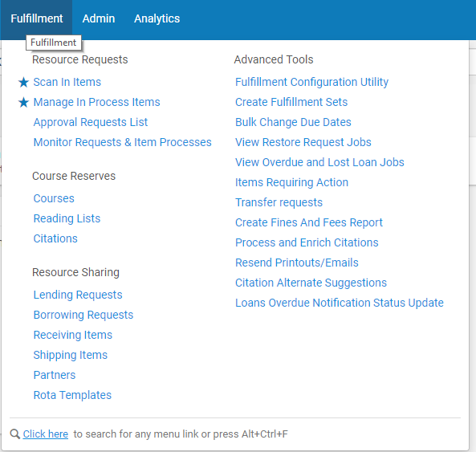
Finding Your Way Around Alma takes some practice
Alma contains a lot of different paths to workflows and tasks, but once you figure out where you’re going to do most of your work, it’s not too hard to find your way around the interface.

Slide 15
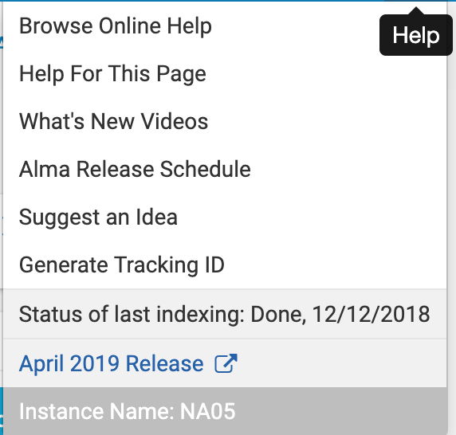
Alma Menu

Slide 16
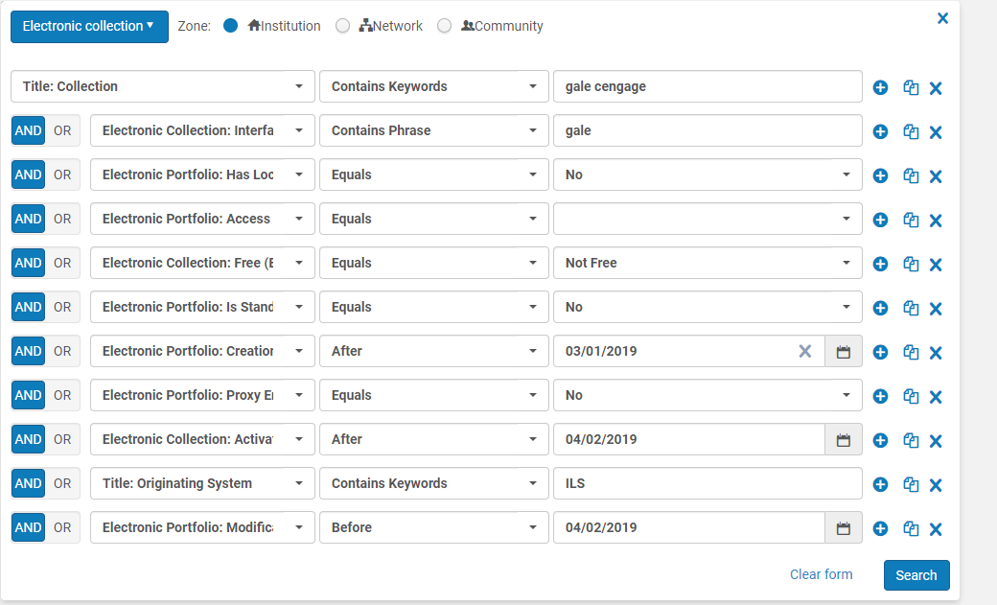
Searching in Alma is Powerful, but also complex
If you aren’t getting any results, it’s likely that the search needs to be refined.
If you can’t search for something directly from Alma, you can likely use analytics.
Available indexes are context sensitive

Slide 17
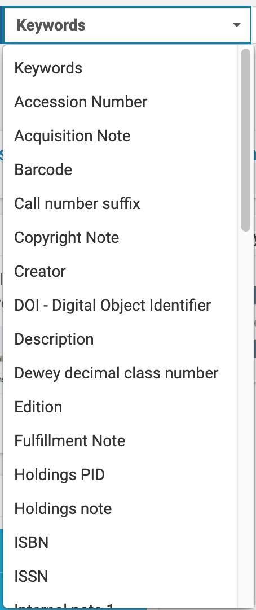
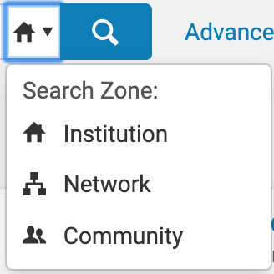
Basic Searching

Slide 18
Demo of Searching in Alma

Slide 19
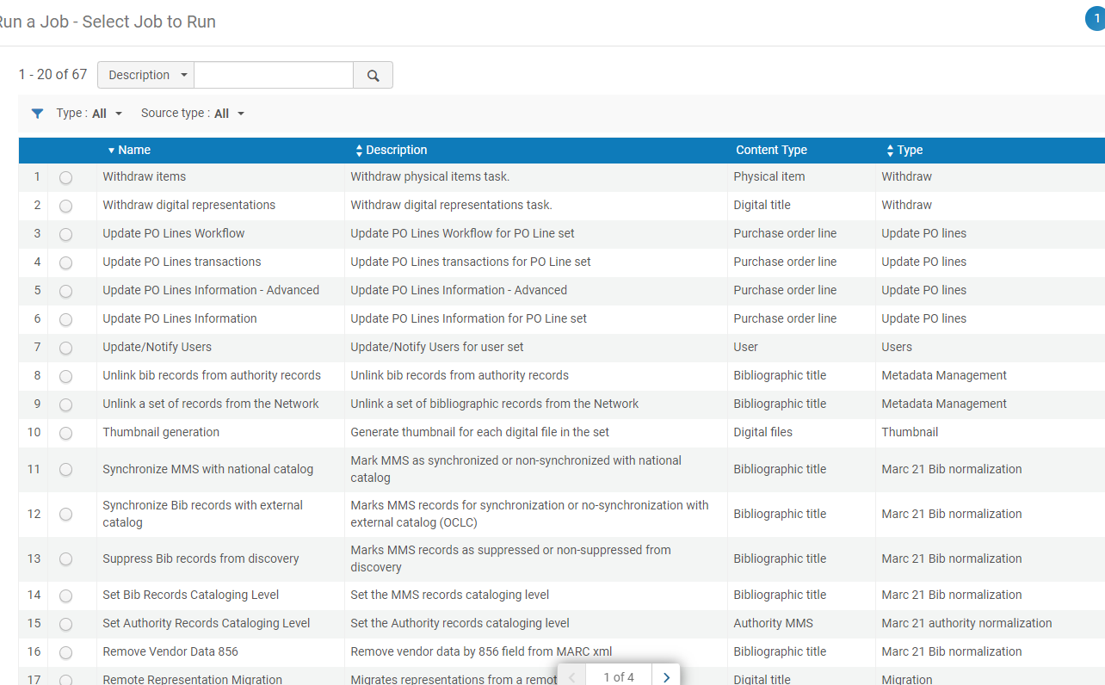
Alma Runs on Jobs
Most activities in Alma are created through jobs.
Jobs can be:
Scheduled
Run manually
Reviewing what jobs are available is a good way to see what you can update in Alma in bulk.
Jobs require an input, which in Alma is called a Set.

Slide 20
Alma is highly configurable, which is sometimes great, sometimes frustrating.
You usually need an “administrator” role to change or view most configuration.
There are endless areas of configuration, so if something isn’t working how you want it to in Alma, you can probably configure things differently.
Alma’s configuration is pretty simple to use, with most done through buttons, sliders, dropdowns, and inputs.

Slide 21
Demo of Alma Configuration

Slide 22
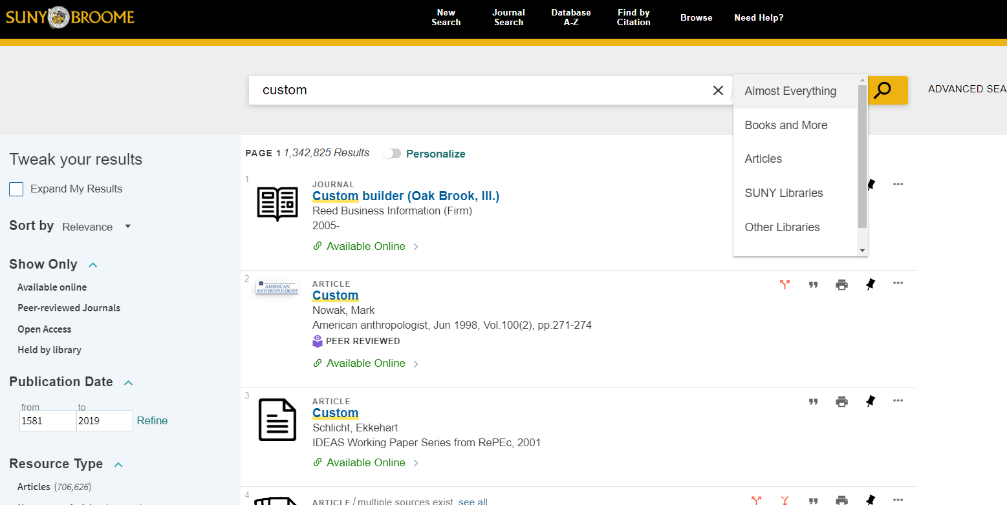
Primo VE: Where Alma Meets our Users
Like Alma, Primo VE is highly configurable.
But, this also means that you probably won’t like Primo “out of the box.”
Primo VE and Alma are tightly connected so that you can configure discovery in one place.
Link to URLs of all SUNY Primo Environments: https://slcny.libguides.com/discoverywg/suny_primo_urls

Slide 23
Where do Primo Search Results come from?
Primo Search Results
PCI (Article Level)
Alma IZ/NZ bib records
Alma holdings determine what you have
Alma
Alma specific bib records such as your physical material provide some search result content.
Primo Central Index (PCI)
Article level metadata comes through PCI activations.

Slide 24
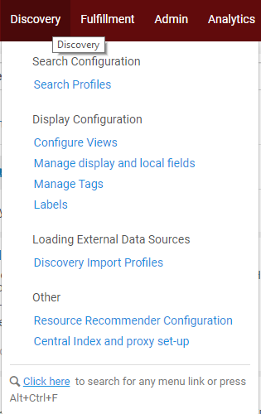
What in Primo is configured/determined in Alma.
Availability of an item, either in full text for e-resources, or to circulate for p- resources.
What services are displayed to a user, such as ILL, RS, or Hold Request links.
Content that is being search (scopes) can be configured, and blended if desired.
Basically any part of the Primo interface can be customized (via labels), as well as how search results and facets are displayed.

Slide 25
Demo of Primo VE Basics

Slide 26
Alma runs on orders.
Only about 30% of SUNYs were using acquisitions in Aleph.
Alma was built to have the easiest workflows for most resources by starting and ending with an order.
As Alma is flexible, there are lots of ways to configure Alma “acquisitions,” but almost all campuses will be using ordering and receiving of some sort.
Depending on how your Library staff is configured, this may mean departments are working together much more closely.

Slide 27
Questions

