Slide 1

Welcome to (add institution name)
Notes:
Welcome learners to your Go Visit final session at (add name of the institution) of the Think and Go Higher Programme, well done on getting this far.
Explain that we will start with introductions and then explain more about this session and how it fits with the previous 5 sessions they’ve done.

Slide 2
Technology Research Challenge

Slide 3




Who are we?
OO Name
Go Higher West Yorkshire Outreach Officer
Institution Name
OO Name
Go Higher West Yorkshire Outreach Officer
Institution Name
Notes:
OO – Introduce yourself and your institution, as well as what course you studied at university.
Note: Slides 1-8 are introductory slides, which should be completed within the first 15 minutes of the session

Slide 4
Who are we?
SA Name
Course
Institution Name
SA Name
Course
Institution Name
SA Name
Course
Institution Name
Notes:
SA – Introduce yourself, the institution you study at and your course.

Slide 5





What is Think and Go Higher?
Session 1: Go Connect
Connecting knowledge
Making justifications
Explaining your decisions
Session 4: Go Collaborate
Working as a team
Using critical thinking and debating skills in a group setting.
Session 5: Go Present
Do’s and don’ts of presenting
Top 5 presenting tips
Practicing presentation skills
Session 2: Go Analyse
Critical thinking
Asking interrogating questions
Session 3: Go Debate
Do’s and don’ts of debating
Forming an argument
Practicing your debating skills
Session 6: Go Visit
Experience Higher Education
Take on the Technology Research Challenge
Use skills from the last 5 sessions
Notes:
Outline the project in weeks, the objectives of each session and the campus visit at the end.
Take time to speak about why these skills we will cover will be useful and highlight various slides will have top tips included on them.
Highlight each session and how all the sessions will build up to the campus visit (session 6).
Encourage the use of the SA each session.
Bullet points on the slides provide detail for each session, go through these in order.
Mention that there is a prize at the end of this session for the winning group (£10 voucher per student in winning group)

Slide 6

Your Challenge…
You will be divided into one of these two groups:
A Tech Company
(For Technology)
A Children’s Charity
(Against Technology)
Or
Using the skills you have learned in the sessions so far, you will present your argument either for or against technology to a group of judges.
The group with the most convincing, organised and well supported argument will win funding for their organisation
Notes:
Explain the task to students.
Students will be placed into groups (these can be anything from a pair to a group of four depending on the total number of students in the session) and will be assigned an organisation; the tech company (for technology) or the children’s charity (against technology).
Students will have the opportunity to research technology using a range of sources, to gather evidence for their argument. They will then have the opportunity to present their argument at the end of the session, for the opportunity to receive funding from the government (£10 voucher per person).

Slide 7
What skills do you need to succeed?
What skills have you practiced over the last 5 sessions and how will they help you to succeed in this task?
Session 1: Go Connect
Connecting knowledge
Making justifications
Explaining your decisions
Session 2: Go Analyse
Critical thinking
Asking interrogating questions
Session 3: Go Debate
Do’s and don’ts of debating
Forming an argument
Practicing your debating skills
Session 4: Go Collaborate
Working as a team
Using critical thinking and debating skills in a group setting.
Session 5: Go Present
Do’s and don’ts of presenting
Top 5 presenting tips
Practicing presentation skills
Session 6: Go Visit
Experience Higher Education
Take on the Technology Research Challenge
Use skills from the last 5 sessions
Spend a few minutes discussing this with the people on your table.
Notes:
Ask students to identify how the skills they have practiced in sessions 1-5 will be able to help them in this challenge.
Give students a few minutes to discuss on their tables.
After the time is up, ask students to feed back by giving one point per session.

Slide 8
How we decide on a winner…
You will be more successful at this challenge if:
You connect information and justify your decisions using logic and reasoning.
You analyse the sources in detail and use critical thinking to make your point.
You use PEEL as the structure for your presentation.
You collaborate well with others, treating each other with respect and putting forward ideas.
You present your argument clearly and confidently, using the correct body language and tone of voice.
Notes:
Share the success criteria with students, explaining how each point relates to one of sessions 1-5.
Explain that this is what students will be marked on to decide on a winning group.

Slide 9



How will you prepare for this challenge?
Select appropriate sources
Think critically to form your opinion
Build your argument
Research
Analyse
Debate
Notes:
Explain that the session will be split into three main sections.
Section 1 – Understanding how to research and use sources as evidence
Section 2 – A recap of critical thinking and how to use this when choosing and using sources.
Section 3 – Using these skills (and the skills from sessions 1-5) to prepare and structure your argument, ready to present to the judges.

Slide 10

Section 1: Research

Slide 11
Analysing Sources: Primary vs Secondary
Primary Source:
A First-hand account of an event or topic.
The most direct evidence of a time or event - they were created by people or things that were there at the time or event.
Haven’t been modified by interpretation, offer original thought or new information.
Secondary Source:
Usually use primary sources and offer interpretation, analysis, or commentary.
Often present primary source information with the addition of hindsight or historical perspective.
Common examples include criticisms, histories, and magazine, journal, or newspaper articles written after the fact.
Notes:
Explain that students will be using sources as evidence for their research. They need to be able to identify and assess these sources, ensuring they are credible and usable in their work.
Explain to students what the differences are between primary and secondary sources.
Ask them which sources they think would be more reliable?
Answer: It depends on the situation or the way in which the source is being used. Primary sources are more credible as evidence, but secondary sources show how your work relates to existing research.

Slide 12
Analysing Sources: Primary Vs Secondary
Primary | Secondary
Photographs, audio recordings, video recordings, films, speeches Tik Tok video Letters and diaries Published books, newspapers, and magazine clippings at the time of the event Government publications | Biographical works Articles from magazines, journals, and newspapers written after the event Movie and book reviews Textbooks Works of criticism and interpretation
Notes:
Give some examples of both kinds of sources

Slide 13






Spot the Sources: Primary Vs Secondary
Can you figure out which of these are primary sources and which are secondary sources?
Interviews with teachers about technology in the classroom
A podcast on tech conspiracy theories
A student survey to find out what tech they own
A scientific journal article about the effect of blue light on sleep
A blog written by a university student about how they use tech to help them study
An e-sport competition review commenting on the latest technological developments in gaming
An experiment on the effectiveness of blue light glasses
A leading tech company’s tik tok which shows their latest sales figures
Notes:
Give students 3-5 minutes to identify the primary and secondary sources on the page.
Students should write down their answers on flip chart paper.
At the end of the time, share the answers with students.

Slide 14


Spot the Sources: Primary Vs Secondary
Can you figure out which of these are primary sources and which are secondary sources?
Interviews with teachers about technology in the classroom
A podcast on tech conspiracy theories
A student survey to find out what tech they own
A scientific journal article about the effect of blue light on sleep
A blog written by a university student about how they use tech to help them study
An e-sport competition review commenting on the latest technological developments in gaming
An experiment on the effectiveness of blue light glasses
A leading tech company’s tik tok which shows their latest sales figures
Notes:
Primary sources

Slide 15
Spot the Sources: Primary Vs Secondary
Can you figure out which of these are primary sources and which are secondary sources?
Interviews with teachers about technology in the classroom
A podcast on tech conspiracy theories
A student survey to find out what tech they own
A scientific journal article about the effect of blue light on sleep
A blog written by a university student about how they use tech to help them study
An e-sport competition review commenting on the latest technological developments in gaming
An experiment on the effectiveness of blue light glasses
A leading tech company’s tik tok which shows their latest sales figures
Notes:
Secondary sources

Slide 16
Selecting Sources - Bias
When analysing sources, you should always look for bias.
Bias is a disproportionate weight in favour of or against an idea or thing, usually in a way that is closed-minded, prejudicial, or unfair.
When looking at sources of text, you could find bias, depending on factors such as who wrote it, their political, religious ideas, or the reason the source was written.
For example, many TV and radio stations, newspapers and political parties are politically motivated, depending on who owns/finances them and what their interests are.
Notes:
Explain what bias is.
Explain that it can be hard to identify in a source, but key things to look for are who wrote it, where they are from, when it was written and the language used.

Slide 17

Notes:
Show students the video to explain what bias is.

Slide 18

Working With…
Newspapers
Most newspapers have an obvious political bias so always try to determine this before you begin.
Be aware of how the source uses language or pictures (often together) to influence the reader.
Notes:
Explain how you might find bias in this type of source
Use real world examples if you feel this would be useful.

Slide 19

Working With…
Academic Journals
Peer reviewed academic journals are often the most ‘reliable’ form of source as they are held to higher standards of research.
Good source for quotations but be sure to understand complex academic language fully before using it in your own work.
Notes:
Explain how you might find bias in this type of source
Use real world examples if you feel this would be useful.

Slide 20

Working With…
Government Sources
Government sources are an excellent place to find data to support your argument.
Data doesn’t tell the whole story so it should always be supported by other research lead analysis.
Notes:
Explain how you might find bias in this type of source
Use real world examples if you feel this would be useful.

Slide 21

Working With…
Internet Sources
There is a huge amount of information available on the Internet so always approach these sources with a critical mind.
Sites like Wikipedia are an excellent starting point for research into a subject area, but they should always be verified and supported by peer reviewed information.
Notes:
Explain how you might find bias in this type of source
Use real world examples if you feel this would be useful.

Slide 22

Working With…
Social Media
Social media can be a great tool to understand trends or current opinions.
However, not everything on social media is true or as it seems. Be careful to fact check and verify this information before using it. If you don’t know why someone should be trusted – don’t trust them!
Notes:
Explain how you might find bias in this type of source
Use real world examples if you feel this would be useful.

Slide 23





Analysing Sources: Think CRAP
Currency
Relevance
Accuracy
Purpose
Notes:
Introduce students to C.R.A.A.P, a process for analysing sources and identifying potential bias.
Currency: Is this information current? Is it the most up to date research on my topic that I can access?
Relevance: Is this relevant to my project? Just because something is relevant to the research topic doesn’t mean it is relevant to your research project. If you are researching diabetes in children in the UK, then a children's book on diabetes is not necessarily relevant, however if your research is on how we explain complex medical conditions to children then a children's book on diabetes could be relevant.
Accuracy: How accurate is the information? Does it match up with everything else you've read on the topic?
Purpose: Why was the research completed? What was the purpose of it? Who funded the research and why?
You can keep track of you sources with a simple source evaluation table, an example of which is on the next slide (and in the student’s booklets).

Slide 24
Analysing Sources: Think CRAP
Source | Current | Relevant | Accuracy | Purpose
Notes:
Currency: Is this information current? Is it the most up to date research on my topic that I can access?
Relevance: Is this relevant to my project? Just because something is relevant to the research topic doesn’t mean it is relevant to your research project. If you are researching diabetes in children in the UK, then a children’s book on diabetes is not necessarily relevant, however if your research is on how we explain complex medical conditions to children then a children’s book on diabetes could be relevant.
Accuracy: How accurate is the information? Does it match up with everything else you've read on the topic?
Purpose: Why was the research completed? What was the purpose of it? Who funded the research and why?
You can keep track of you sources with a simple source evaluation table, an example of which is on the next slide.

Slide 25
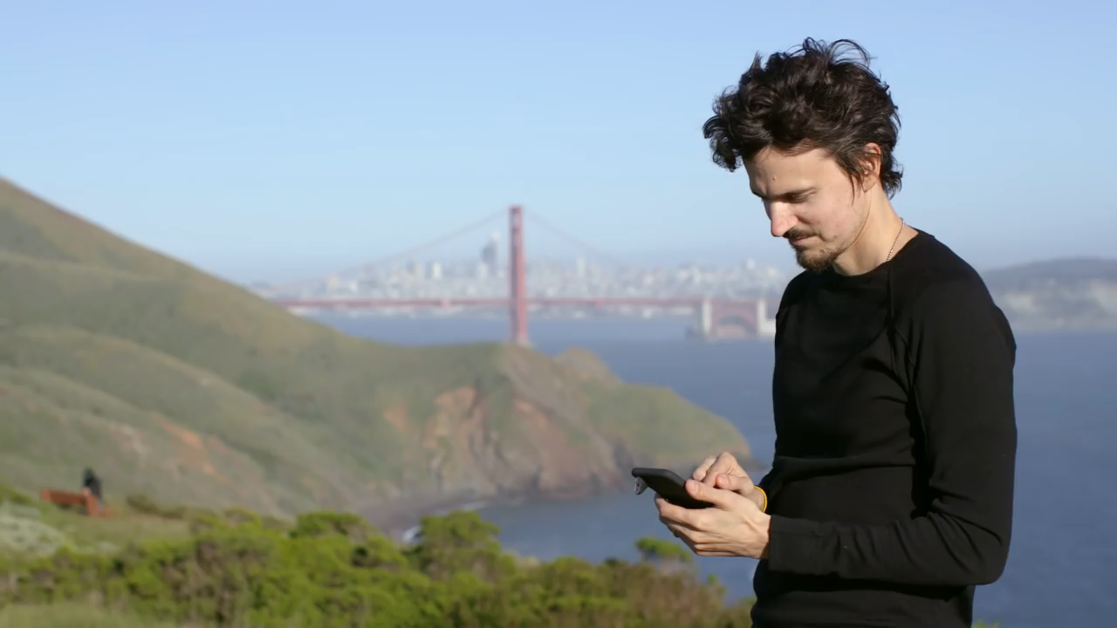
Practice your CRAP
Can you identify…
The source
When it was made/published?
How relevant it is?
How accurate is it?
What is the video’s purpose?
Notes:
Share this source with students, asking them to fill in their C.R.A.A.P table as they watch it.

Slide 26

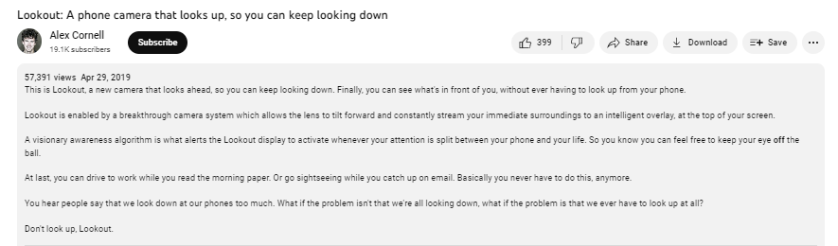
Can you identify:
The source
When is was made/published?
How relevant it is?
How accurate is it?
What is the video’s purpose?
Notes:
Now share this slide, which will help them fill the other spaces on their table.
Ask students to feed back to the group about what they found.

Slide 27
Section 2: Analyse

Slide 28
What is Critical Thinking?
Discuss this in your groups and write your answer on the flip chart paper (2 mins)
Notes:
Give students two minutes to come up with a definition for critical thinking.
At the end of the two minutes, ask them to feed back to the group.

Slide 29
Critical Thinking is…
The objective analysis and evaluation of an issue to form a judgement.
Critical thinking doesn't just mean thinking a lot about something. It is a deliberate process of applying logic and reasoning to our thinking.
Critical thinking means not accepting everything we read, see, and hear as an indisputable fact.
Notes:
Share this definition of critical thinking with them.
This is a very basic definition of critical thinking; but when we break it down we can really understand more about what it means to be a critical thinker.
Objectivity is momentarily removing yourself and your own biases from what you might be asked to think about. This can be quite challenging because we all have biases, some of them we don't even realise we have, and it can be hard to remove ourselves from them but with practice we can learn to do this. Analysis is something that we have to do all of the time in academic writing- it’s the skill of dissecting work, and spotting patterns in sets of data that we’re all familiar with. Even if you don't work with data or in mathematical or scientific subject you will still have analysed something at some point, you might be studying history, or English, or religion, all of these subjects while have required some sort of analysis at some point.
Evaluation is the act of weighing up factors and comparing them with others, evaluation looks to the future, and doesn’t always answer the research question in its entirety, but proposes areas in which your research might go if you studied that subject further.
The judgment is your opportunity to add yourself back into the critical thinking, this is really important because it's when you add your voice, and get to show what you've learnt, by evaluating the objective analysis in relation to what you might already know. Critical thinking isn't just an academic skill; it is a life skill.

Slide 30
Critical Thinking is…
Critical thinking is a key skill in preparing for and during debates and presentations.
We use it to look at evidence that we find, and that the other side presents, to form a judgement and back up our opinion.
Notes:
Share this slide with students, explaining how critical thinking will be important in this task. .

Slide 31






Critical Thinking Skills
Analysis
Communication
Creativity
Open
Mindedness
Problem Solving
Hint! You’ve already started practicing critical thinking in Go Analyse!
Notes:
Critical thinkers must analyse the information presented to them and establish how useful or meaningful it is to their research.
Critical thinkers must be able to communicate their research in a clear and concise way.
Critical thinkers are creative researchers, they see problems or areas that need investigated and look for the solutions.
Critical thinkers are open minded, they do not approach their research with bias or pre-conceived ideas.
Critical thinkers are problem solvers.

Slide 32


Developing your skills – How do we do it?
Asking Critical Questions
Analysing Sources
Notes:
The development of these skills will allow students to become critical thinkers who are open to new ideas and confident in their ability to think critically about the work of others.

Slide 33
Asking critical (interrogating) questions
Descriptive
Analytical
Evaluative
Asks: Who? What? When? Where?
Asks: So, What? What Next?
Asks: How? Why? What If?
Notes:
Explain that there are three types of critical questions.
Descriptive – Asks for basic facts and information about the source/topic/event.
Analytical – Asks for further detail, using logic and reasoning to understand more about the source/topic/event.
Evaluative – Asks what the impact of the source/topic/event is or how it compares to something else.

Slide 34

Asking critical (interrogating) questions
Descriptive
Who said it?
What did they say?
Where did they say it?
When was it written?
What is the aim of the article?
What is this problem about?
Who does it involve or affect?
When and where is this happening?

Slide 35
Asking critical (interrogating) questions
Analytical
Why did they say it?
How was the research conducted?
Why are these theories discussed?
What are the alternative methods and theories?
What are the contributing factors to the problem?
How might one factor impact another?
What if one factor is removed or altered?

Slide 36
Asking critical (interrogating) questions
Evaluative
What do I think about this?
How is this relevant to my assignment?
How does this compare to other research I have read?
What's next?
What is the impact this will have? What are the next steps this research should take?
Why is this research worth investing our time, effort, and potentially money in?

Slide 37
Interrogating Questions
Practice your critical questions
Try to produce one of each of the following for the source you have been given:
  One descriptive question
  One analytical question
  One evaluative question
Notes:
Hand out a source (either per pair or individually)

Slide 38
Section 3: Debate

Slide 39
Your Challenge
You will be divided into one of these two groups:
A Tech Company
(For Technology)
A Children’s Charity
(Against Technology)
Or
Using the skills you have learned in the sessions so far, you will present your argument either for or against technology to a group of judges.
The group with the most convincing, organised and well supported argument will win funding for their organisation
Notes:
Recap the slides from earlier, explaining what students will be researching and preparing for the next part of the activity.
Put students into groups (2-4 per group) and assign each group an organisation, either the tech company (for technology) or the children’s charity (against technology).

Slide 40
How we decide on a winner…
You will be more successful at this challenge if:
You connect information and justify your decisions using logic and reasoning.
You analyse the sources in detail and use critical thinking to make your point.
You use PEEL as the structure for your presentation.
You collaborate well with others, treating each other with respect and putting forward ideas.
You present your argument clearly and confidently, using the correct body language and tone of voice.
Notes:
Recap the success criteria with students, explaining how each point relates to one of sessions 1-5.
Explain that this is what students will be marked on to decide on a winning group.

Slide 41




Remember to PEEL
Each debate point you make should be PEEL structured:
Point
Evidence
Explain
Link
Your point can either be a new point to answer a question or can be a counterpoint to the opposing team.
If you think they used bias or unreliable evidence, you can use the PEEL structure to argue against them!
Hint! –
Notes:
Reintroduce students to PEEL, reminding them that they will need to use this as a structure for each point they make in their presentation.

Slide 42

Challenge Time!
Is digital technology making children’s lives better?
  Look at the different sources.
  Think critically about them to answer the question.
  Remember to include evidence to support your answer.
  Present your argument at the end using a PEEL structure!
Good Luck!
Tech Company: YES!
Children’s Charity: NO!
Notes:
Give students time to look at each source and start preparing their presentation.
Students can use their CRAAP tables to decide whether or not a source is worth using.
Once students have read through the sources and picked out key pieces of information, they should start writing their PEEL statements and structuring their presentation.

Slide 43
Challenge: Top Tips
Be open to finding new ideas and new information.
Ask critical questions when you are researching.
Use the CRAP method when analysing sources.
Use PEEL to structure your presentation
Notes:
It may be useful to share these top tips with students, to help them prepare for the presentation.

Slide 44

Presentation Time!
Notes:
Presentation time (approximately 5-6 mins per group)

Slide 45
And the winners are…

Slide 46
Thank You!

Slide 47


