Slide 1
Unit 8
The Work Group / Programme / Community plans
LLME Toolkit
(Revised October 2022)

Slide 2
What is expected in a plan?
Work Group | With the primary aim of supporting school – or department-wide development in their own setting, participant teachers will develop their own expertise as classroom practitioners. Both objectives – personal learning and school or department development – are supported by the collaboration among other members of the Work Group, guided by the Work Group Lead.
Programme | Teachers participating in a programme join a cohort of colleagues from other schools on a series of sessions – more akin to a training course – where the central objectives are individual professional learning and practice development. Sessions are led by a local Cohort Lead, who concentrates on progress being made by individuals as well as facilitating experience-sharing and discussion amongst participants. The materials used on the programmes are developed centrally by the NCETM.
Community | Professional learning communities are looser in structure, with fewer fixed meeting times, but more frequent, informal communications among members in their own time. There’s also an expectation that participants will continue to work and learn together beyond one academic year. All communities have a Community Lead who steers discussions and conversations, offering expert input and individual support where appropriate

Slide 3
Key features of the plan
Plan and report template
Summary information
Reach and school profiles
Outcomes (and evidence)
Schedule

Slide 4
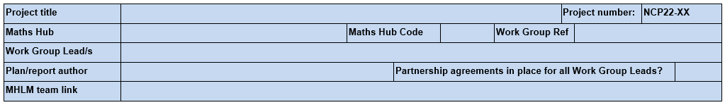
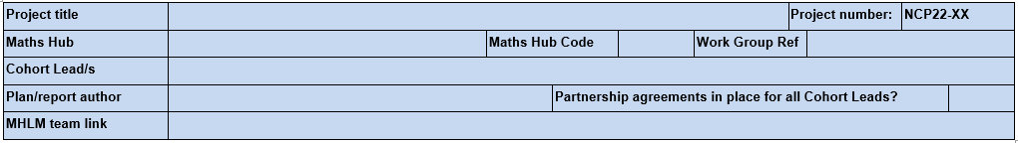
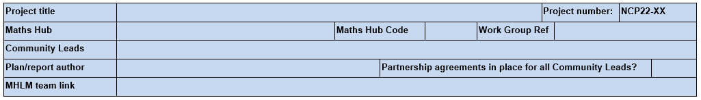
Summary information
Work Group
Programme
Community

Slide 5
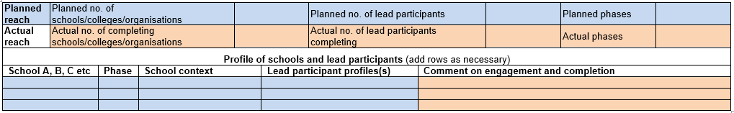
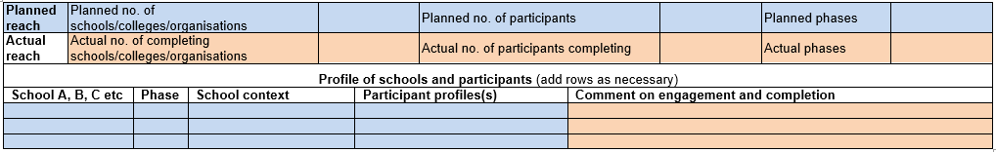
Reach and school profiles
Work Group
Programme
Community

Slide 6
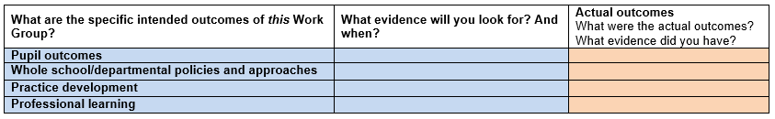
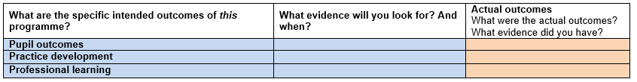

Outcomes (and evidence)
Work Group
Programme
Community

Slide 7
Schedule
2021/22
2022/23

Slide 8
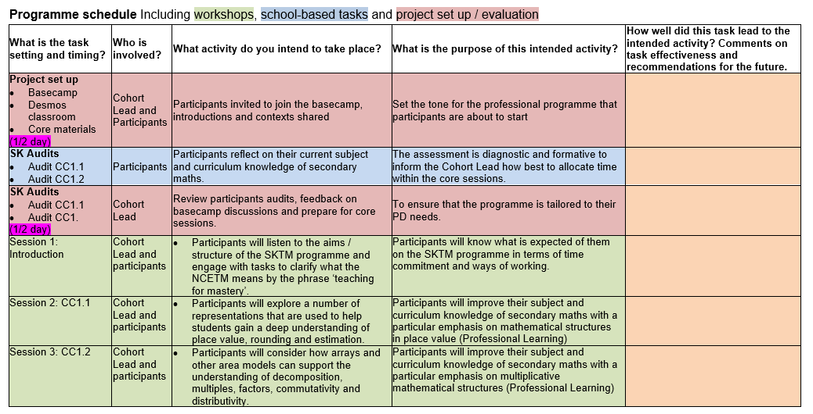
NCP22-30 Programme plan example

Slide 9
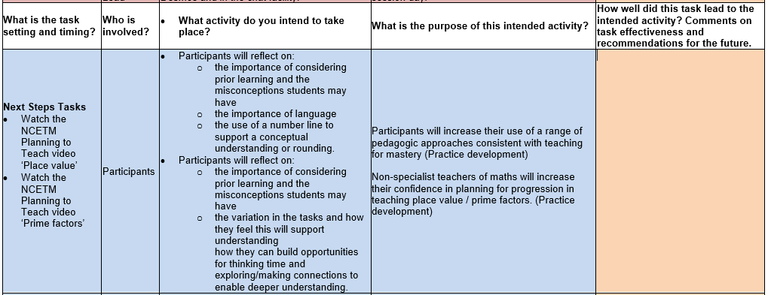
NCP22-30 Programme plan example

Slide 10
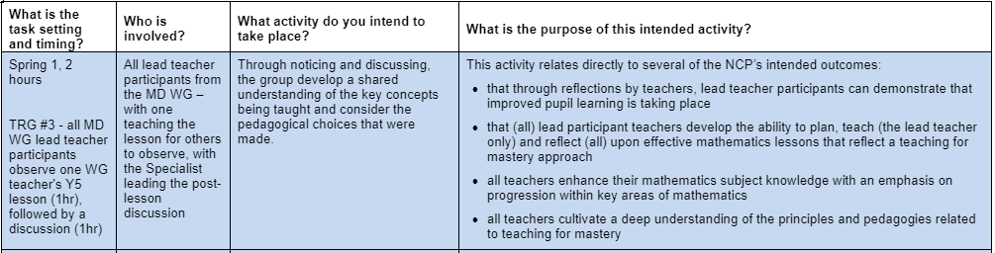
NCP22-09 Work Group plan example

Slide 11
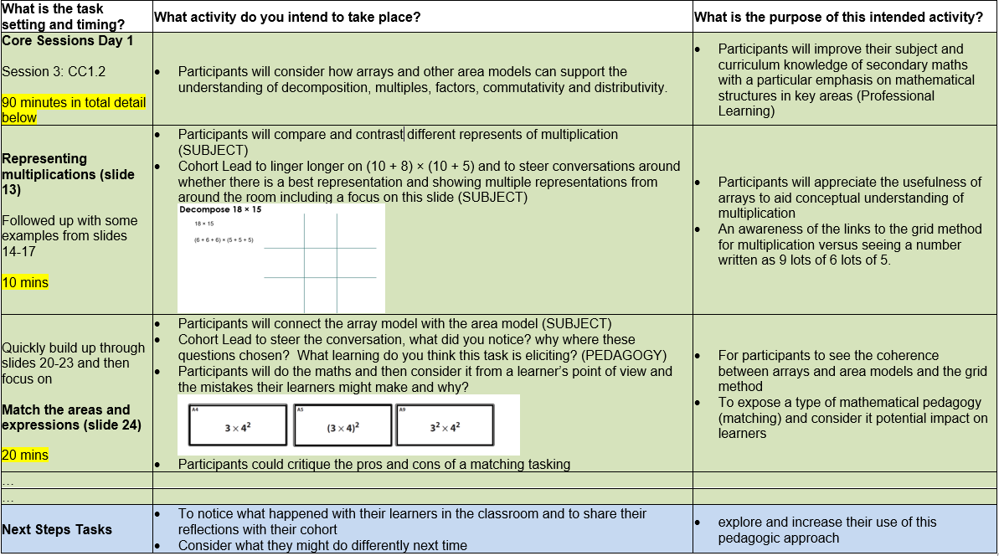
NCP22-30 Programme Session plan example

Slide 12
Advice, feedback and agreement
Exemplar plans
Feedback from project team and community members
LLME community colleagues
MHLM team link – key point of agreement
Hub submission date: 07/12/22

Slide 13
Taking it further
Suggestions for reading, watching, listening
Read the relevant Work Group / Community / Programme Plan and Report Template 2022/23
Suggestions for discussion with others
How do you go about writing your plan?
How much do you do at the start and how much do you adapt it during the year?

