Slide 1

Emergency
Closing
Procedures
March 16, 2020
www.suny.edu

Slide 2
Agenda
COVID-19 Response Overview
RS and Fulfillment Policy Changes
Adjusting your library calendar
Turning off resource sharing in Alma and OCLC
Hiding ILLiad links in Primo
Disabling on shelf requesting
Disabling recalls
Changing loan/renewal periods and due dates
Updating hold expiry dates
Waiving fines
www.suny.edu

Slide 3
COVID-19 Response Overview
FAQ for Emergency Closing Procedures
  https://slcny.libanswers.com/faq/286209
FAQ will be expanded and updated in the coming days and weeks
COVID 19 Related Closures and Service Interruptions Survey
  https://slcny.libwizard.com/f/COVID19
  Please complete survey as best you can
  You may respond again if things change at your campus
www.suny.edu

Slide 4
Temporary Policies for Resource Sharing and Fulfillment In Response to COVID Pandemic
Highlight of Changes:
  Lending RS loan periods are now 16 weeks with 3 renewals for all item types and user groups
  Automatic renewals are now permitted for resource sharing items
  Open SUNY users (i.e. walk-in borrowers) now have resource sharing requesting privileges (any lost item charges will be assessed to the user's home library)
  Non-reserve recalls will be permitted for items given an expanded loan period due to these policy changes once the policy changes are no longer in effect
  All items borrowed from a SUNY library or through a SUNY library via resource sharing may be returned to any SUNY library (users will not be assessed lost item charges for items lost in transit)
www.suny.edu

Slide 5
Important Note on Temporary Policies
We understand that local policies and circumstances may not allow libraries to have external visitors to your library.
Or, your library may close.
As we realize that the situation is evolving, and it may be multiple months before students return to home campuses, the policy is intended to provide some continuity of services.
But, the health and safety of staff and your community is the most important consideration.
www.suny.edu

Slide 6
Temporary Policies for Resource Sharing and Fulfillment In Response to COVID Pandemic
Policy and procedures changes will be in effect until July 31, 2020
Full policy and procedure details can be found here:
  https://slcny.libguides.com/ld.php?content_id=52873224
SLSS staff will be making the configuration changes needed to implement these policy changes as soon as possible
  We will communicate via Basecamp when these changes are made.
  SLSS staff will be responsible for removing config. changes when policies change/when appropriate
Thank you to the Access Services and Resource Sharing Working Group and the SLC Board for drafting and approving these changes
www.suny.edu

Slide 7
Calendar Maintenance: A Quick Review
Roles needed to manage calendars
General System Administrator
Fulfillment Administrator (library only)*
Three Types of Hours in Alma
Standard opening hours – regular hours during terms
Events – used to force the end of a loan period on a specific date, such as end of term.**
Exceptions – change the standard opening hours temporarily
www.suny.edu
Notes:
*Upon request, ExLibris will enable the following roles to configure calendar information for libraries:
Circulation Desk Manager, Circulation Desk Operator, Circulation Desk Operator Limited, Requests Operator.
**Events are often set at the institution level because that way they are inherited by all libraries.

Slide 8
Important to Remember
Standard opening hours (SOH) remain in effect, and exceptions overlay them for each day
For example, if your SOH are Monday – Thursday from 8am to 12:30am, and your spring break hours will be 9am to 5pm, you need to add two or three exceptions for each day:
Monday, Closed from 08:00 to 09:00
Monday, Closed from 17:00 to 23:59
Tuesday, Closed from 00:00 to 00:30
Tuesday, Closed from 08:00 to 09:00
Tuesday, Closed from 17:00 to 23:59
Wednesday, Closed from 00:00 to 00:30
And so on….
www.suny.edu

Slide 9
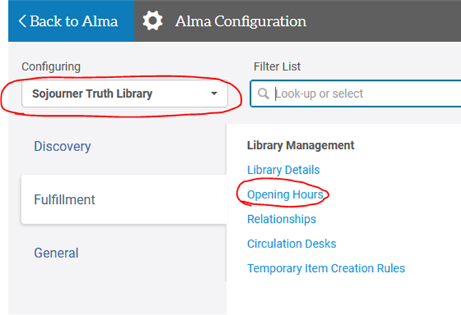
Adding Exceptions to SOH Manually
For minor (short-term) changes, you can manually add exceptions.
Go to Configuration
Select library
Select Fulfillment
Click Opening Hours
www.suny.edu

Slide 10
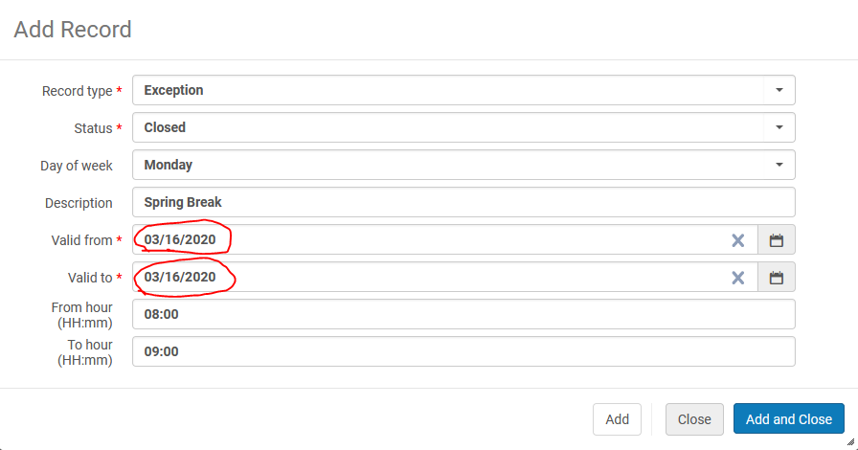
Adding Exceptions to SOH Manually
Click Add Record and
fill in the fields. This is
the first exception
for our example.
Note that it covers
8am-9am on one day, because the library is opening one hour later.
www.suny.edu

Slide 11
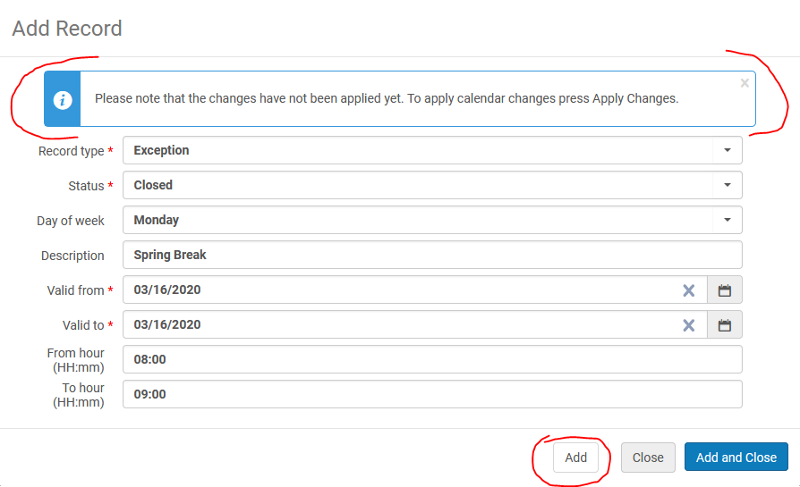
Adding Exceptions to SOH Manually
To add the next exception, simply click Add. You will be warned to Apply the Changes, but otherwise the fields will remain the same and you can edit them for your next exception – the same day from 17:00 to 23:59.
www.suny.edu

Slide 12
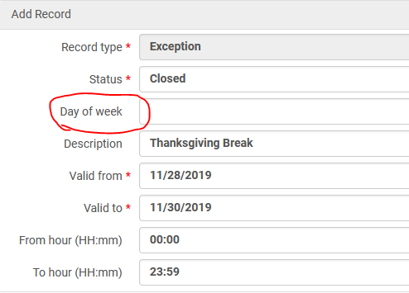
Adding Exceptions to SOH Manually
If your library will be closed completely for a period of days or weeks, you can add one exception to cover that by adding the date range and keeping the Day of week blank.
www.suny.edu

Slide 13
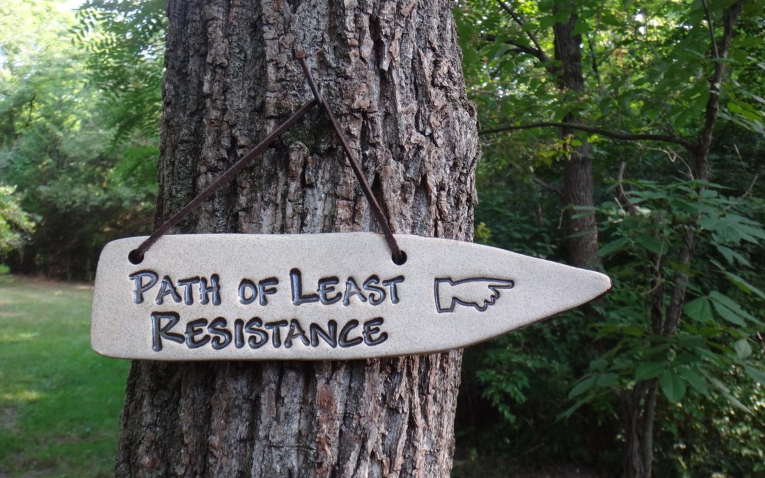
An Easier Way!
Manual exceptions are fine for quick changes, but adding two or three exceptions for every day can get tedious fast. Luckily, thanks to awesome people who voted in Idea Exchange, there is an easier way.*
www.suny.edu
Notes:
*I recommend having at least one full day of exceptions configured before taking this path.

Slide 14
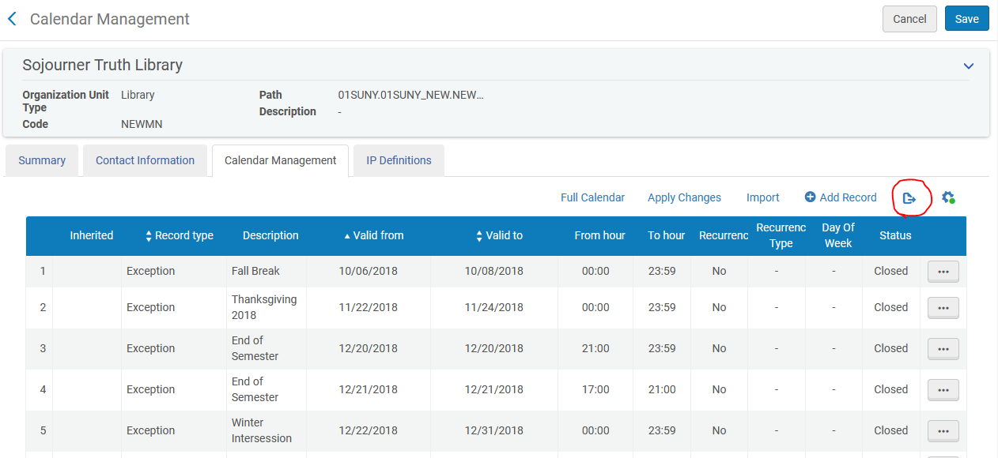
Export to Excel
www.suny.edu

Slide 15
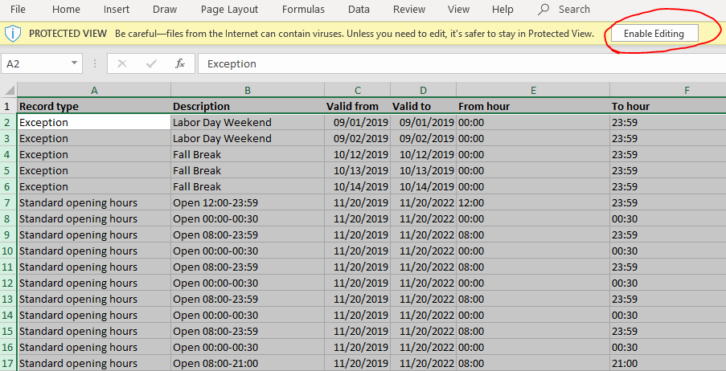
Edit in Excel
www.suny.edu

Slide 16
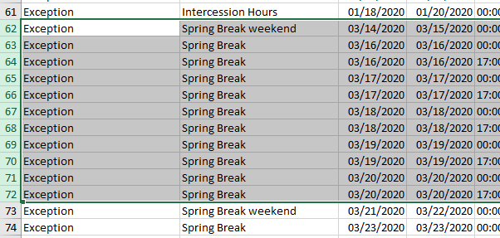
Edit in Excel
Just copy+paste previous entries and change the dates. I always keep a string of entries in there so I can do this. It also helps to remind me of the pattern.
www.suny.edu

Slide 17
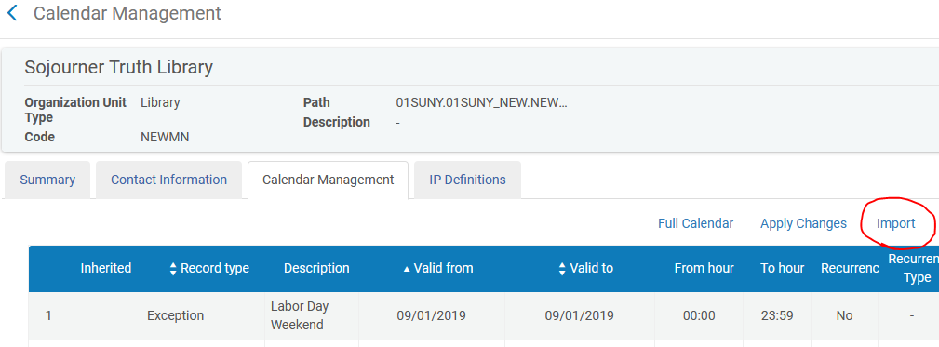
Save the File and Import It into Alma*
www.suny.edu
Notes:
*This will entirely overwrite what was there previously.
For more detailed information on calendars in Alma, please see this ExLibris documentation.

Slide 18
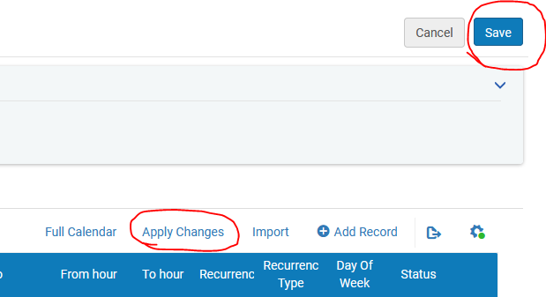
Don't forget to Apply Changes and Save
www.suny.edu

Slide 19
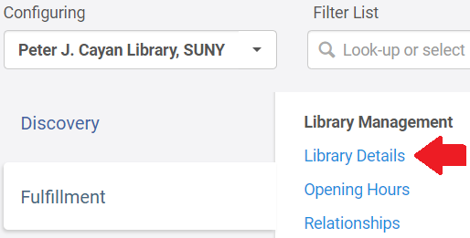
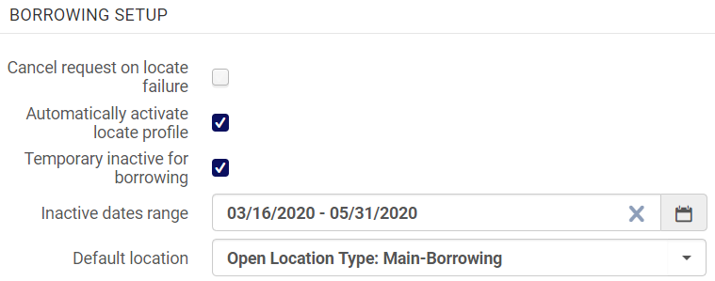
Turning Off Resource Sharing in Alma
Borrowing and Lending can be turned off in your Resource Sharing Library's Library Details
  Most campuses use their main library as their RS library
Borrowing and lending must be turned off separately
You can select a closure date range or turn off indefinitely by simply checking the inactive box
Turning off borrowing hides the Alma RS request link in Primo (will not hide ILLiad links)
Please let me know if you turn off your borrowing and/or lending
Rotas will be adjusted if necessary
FAQ: http://slcny.libanswers.com/faq/266453
www.suny.edu

Slide 20
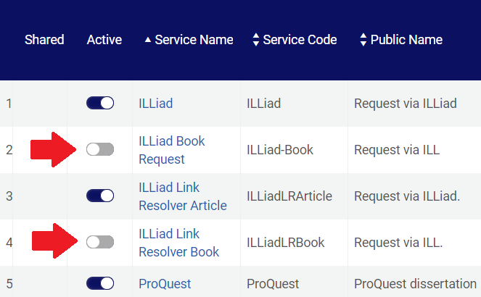
Turning Off Resource Sharing in ILLiad/OCLC
ILLiad/OCLC lending must be turned off in the OCLC Policies Directory
  https://help.oclc.org/Resource_Sharing/WorldShare_Interlibrary_Loan/Troubleshooting/How_to_become_a_NonSupplier_in_the_ILL_Policies_Directory
If you need to turn off the ILLiad request link in Primo, you can deactivate the ILLiad General Electronic Service you configured in Alma
FAQ: https://slcny.libanswers.com/faq/286215
www.suny.edu

Slide 21

Empire Library Delivery
I have been in touch with Maria DeGaetano from Empire Library Delivery
They currently have no plans to suspend services
If your library is closing or you ar unable to accept deliveries, please be sure to notify ELD
https://www.esln.org/services/empire-library-delivery/
www.suny.edu

Slide 22


Document Delivery in ILLiad
You may need to expand electronic delivery services in light of COVID-19
ILLiad's document delivery module can be used to deliver electronic copies of locally held materials
IDS Logic can help identify borrowing requests for locally held materials
Webinar on Friday, March 20
  https://slcny.libcal.com/event/6609780
www.suny.edu

Slide 23
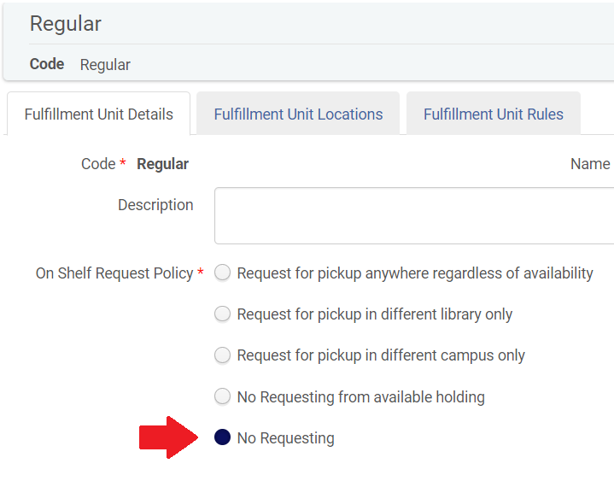
Disabling On Shelf Requesting
On shelf requesting can be disables in your Fulfillment Unit Details settings
Switch On Shelf Request Policy to "No Requesting"
Must be done separately for each Fulfillment Unit
Will hide the Hold Request link for on shelf items in Primo
Will not hide Hold Request link for unavailable items
FAQ: https://slcny.libanswers.com/faq/286214
www.suny.edu

Slide 24
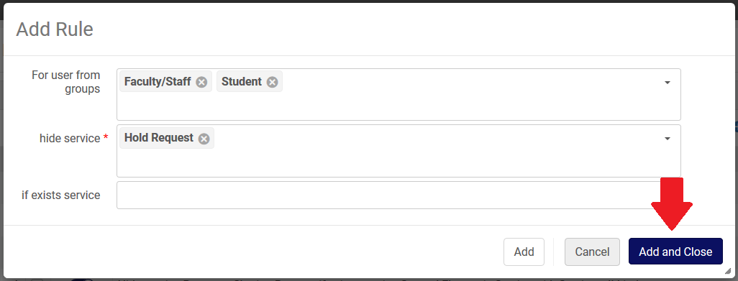
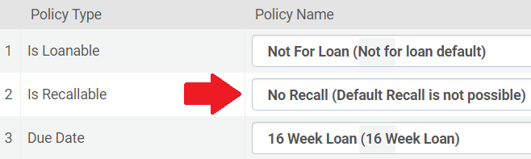
Disabling Recalls
If you do not allow on shelf requesting, the easiest way to disable recalls is to use a Display Logic Rule to hide the Hold Request link in Primo
If you want to still allow for on shelf requesting, you will need to edit your Loan TOUs to turn off recalls
FAQ: https://slcny.libanswers.com/faq/290277
www.suny.edu

Slide 25
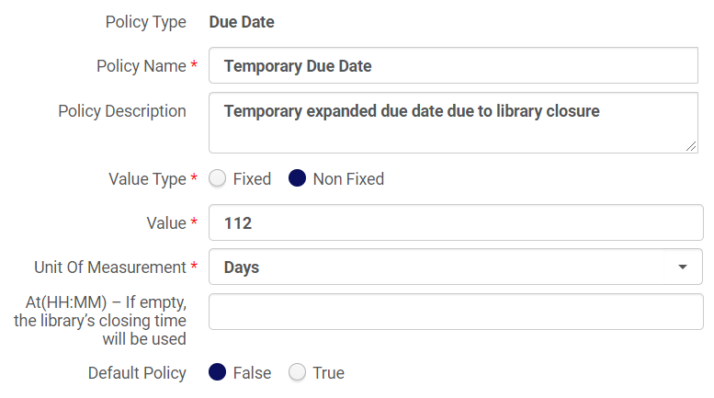
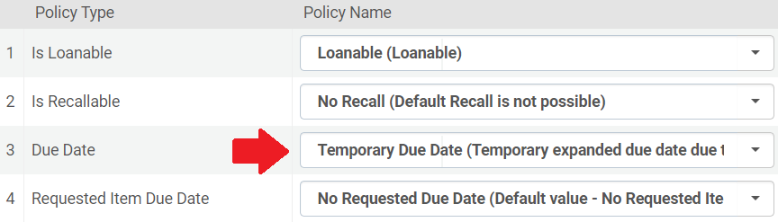
Changing Loan & Renewal Periods
To change your loan and renewal periods, you will need to do three things:
  Create new Due Date and Maximum Renewal Period policies
  Create new Loan Terms of Use
  Create new Fulfillment Unit Loan Rules to apply the new TOUs you've created
We recommend you create new policies, TOUs, and loan rules instead of editing existing ones (it will be easier to roll back changes that way)
All configuration should be done at the Institution level
FAQ: https://slcny.libanswers.com/faq/290281
www.suny.edu

Slide 26
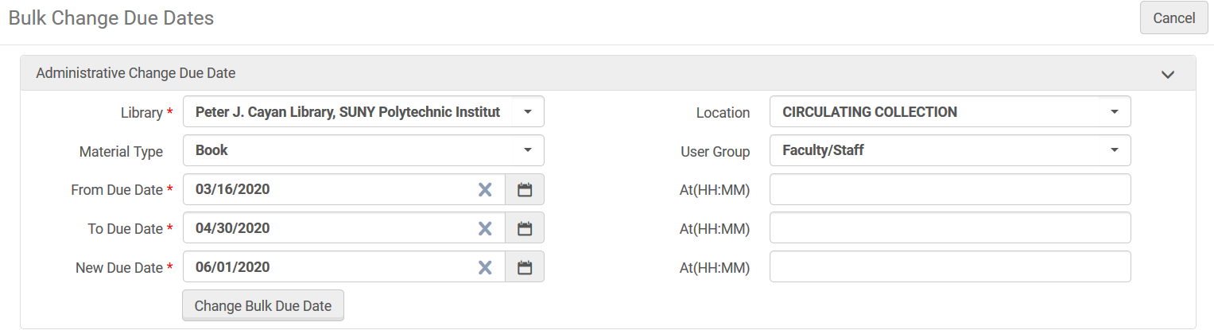
Updating Due Dates
Changing your Loan periods will not automatically change the due dates for items that are already checked out
Some due dates may be automatically adjusted when you change your calendar
You can use the Bulk Change Due Dates job to adjust due dates
FAQ: https://slcny.libanswers.com/faq/290281
www.suny.edu

Slide 27
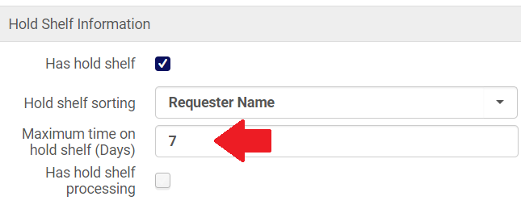
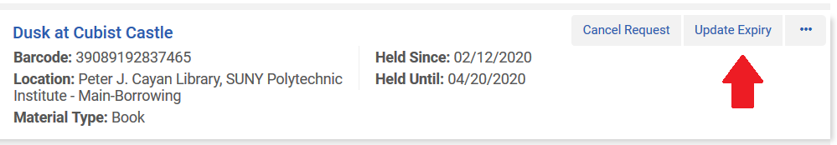
Updating Hold Expiry Dates
You can change your hold shelf period by editing your circulation desks that have hold shelves
Updating your hold shelf period will not update the hold expiry dates for items already on hold
Hold expiry dates may be changed by using the Active Hold Shelf
Expired holds aren’t automatically deleted, and users can still check out expired holds, so this doesn't need to be a top priority
Users can see hold expiry dates in Primo, so they should be updated to prevent questions or confusion
FAQs: https://slcny.libanswers.com/faq/290338 and https://slcny.libanswers.com/faq/281639
www.suny.edu

Slide 28
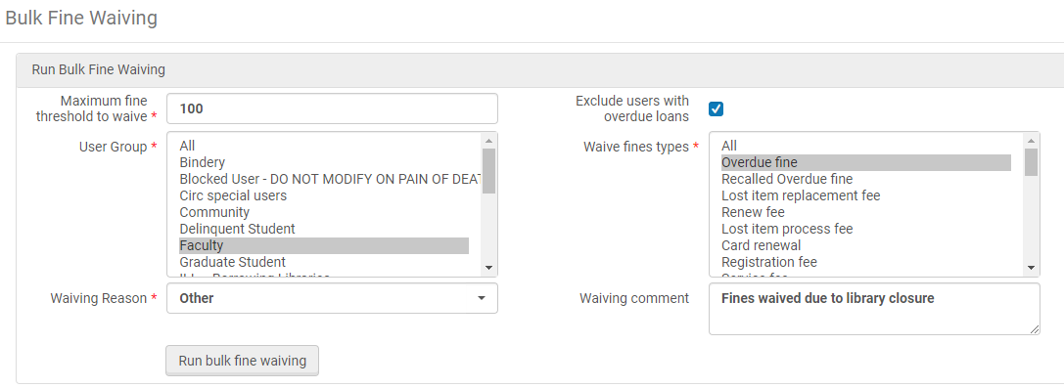
Waiving Fines
Fines can be waived on an individual basis in the user's record
Fines can be waived in bulk by running the Bulk Fine Waive job
FAQ: https://slcny.libanswers.com/faq/262380
www.suny.edu

Slide 29
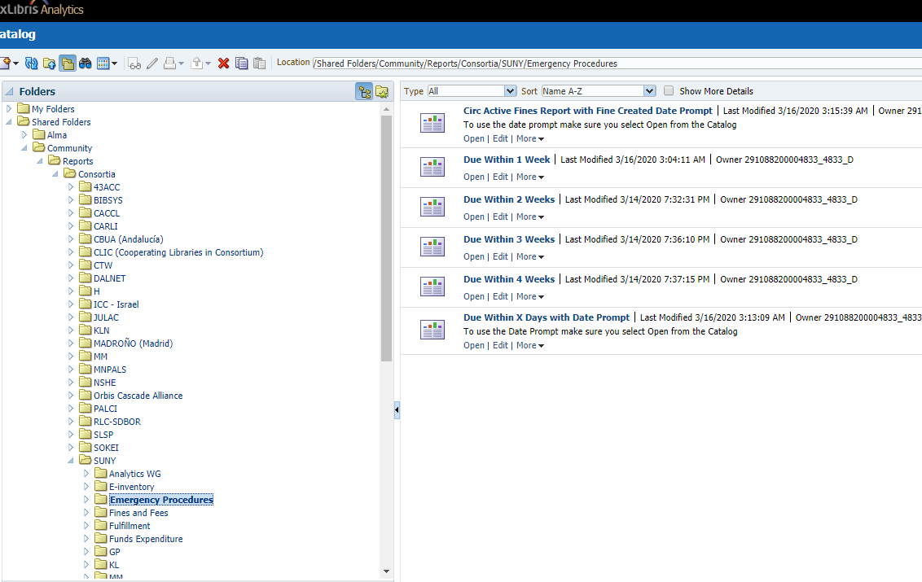
Analytics Reports that May Be Helpful
Gail has created some reports and put them in the shared reports folder that will help you identify how many items are checked out, due dates, etc.
If there are any other reports that you think would be helpful, please let us know.
Community-->Reports-->Consortia-->SUNY-->Emergency Procedures
www.suny.edu

Slide 30
We're Here to Help
If you're struggling with making changes needed in Alma to address COVID 19 response, we can help (regardless of support contract)
Please use our ticketing system and not our individual email addresses:
  http://slcny.libanswers.com/ or info@slcny.libanswers.com
If possible, try to be specific in what you need changed, rather than an open request for help.
www.suny.edu

Slide 31


Questions or Discussion?
www.suny.edu

