Slide 1
HIV health services: Prioritization and integration towards achieving 90-90-90
A public health program approach by the Family Planning Association of Trinidad and Tobago (FPATT)
Presented By:
Mrs. Angelie Chotalal
Clinic Coordinator
Family Planning Association Of Trinidad And Tobago
79 Oxford Street, Port Of Spain. Trinidad And Tobago
mail.fpatt@gmail.com | 1.868.623.5169

Slide 2
About FPATT
More than 60 years experience working to advance the sexual and reproductive health and rights landscape of Trinidad and Tobago
Comprehensive package of clinical sexual and reproductive health services, offered through 5 Service Delivery Points: 3 Static Clinics, Mobile Unit, Outreach Services
Networks and partnerships with government, corporate, technical and community sectors
Accredited member of the International Planned Parenthood Federation (IPPF)
Notes:
In 2017 we had more than 5000 unique clients and delivered more than 100,000 SRH services

Slide 3
FPATT’S INTEGRATED PACKAGE OF SERVICES
1.
3.
6.
COUNSELLING
SAFE ABORTION CARE
GYNAECOLOGY
A: Sex and Sexuality
A: Pre & Post-abortion counselling
A: Cervical cancer screening – Pap smear
B: Relationship Counselling
B: Options counseling
C: Gender based Violence
B: Manual breast examination
Referral to Medical Practitioner
2.
C: SRH specialist doctor part time
CONTRACEPTION
Post abortion contraceptive counseling
A: Counselling
D: Pregnancy testing
4.
STIs
B: Hormonal
A: Rapid testing for Chlamydia
7.
UROLOGY
C: Non Hormonal
B: Rapid testing for Gonorrhea
A: screening via DRE
HIV
D: Natural
5.
B: Urologist available part time.
E: At least one long-acting and reversible contractive intrauterine device system OR implants
A: Pre- and/or post-test counselling
6.
GENDER-BASED VIOLENCE
B: HIV rapid tests as per MOH
A: Screening for gender-based violence.
C: Referral system to MOH for HIV positive clients
B: Referral mechanism for clinical, psychosocial and protection services.
F: At least one emergency contraceptive method
D: Psychosexual support
D: PNs/ PEs

Slide 4
FPATT’s history addressing HIV
VCT service provider since 2003 (15 years)
Comprehensive Service Delivery Model
HIV and AIDS does not exist in isolation, it is part of our overall sexual and reproductive health
Linkage to care not a new concept
FPATT forged and maintained public and private sector relationships, some of which predates many current agencies.
From the onset we recognized the importance of leveraging existing and new relationships to ensure comprehensive support for HIV positive persons.
Evaluated by WHO during their VCT evaluation survey, FPATT was recognized as an efficient and effective service provider with the seamless capacity for HIV service integration.

Slide 5
FPATT’S CURRENT HIV SERVICES PROCESS
START
HIV negative result
PNEs and PEs conduct prevention activities to encourage uptake of HIV tests
PEs continue prevention activities and repeat HIV-VCT in 6-months
Client wants an HIV test
PNEs accompany client for HIV test at FPATT
Positive client identified
Seek verification
HIV positive result
Navigate to treatment site (MRF)
Previous enrolment in treatment site confirmed
(i.e. LTFU)
PN to ensure:
Enrolment into treatment site
All medical tests are completed
All appointments are attended
Provided psycho-social support where needed
Client refuses HIV test
Unconfirmed
HIV+ result
Positive KP needs
group support
Navigate to FPA evening clinic
PEs continue prevention activities
Peer-to-peer support
One on one conversations
Positive client needs group support
FPA SUPPORT GROUP

Slide 6
HIV testing 2006 - 1st QTR 2018

Slide 7
17
25
9
12
12
9
6
5
3
6
7
3
3
Notes:
Red numbers are HIV positive cases identified.

Slide 8
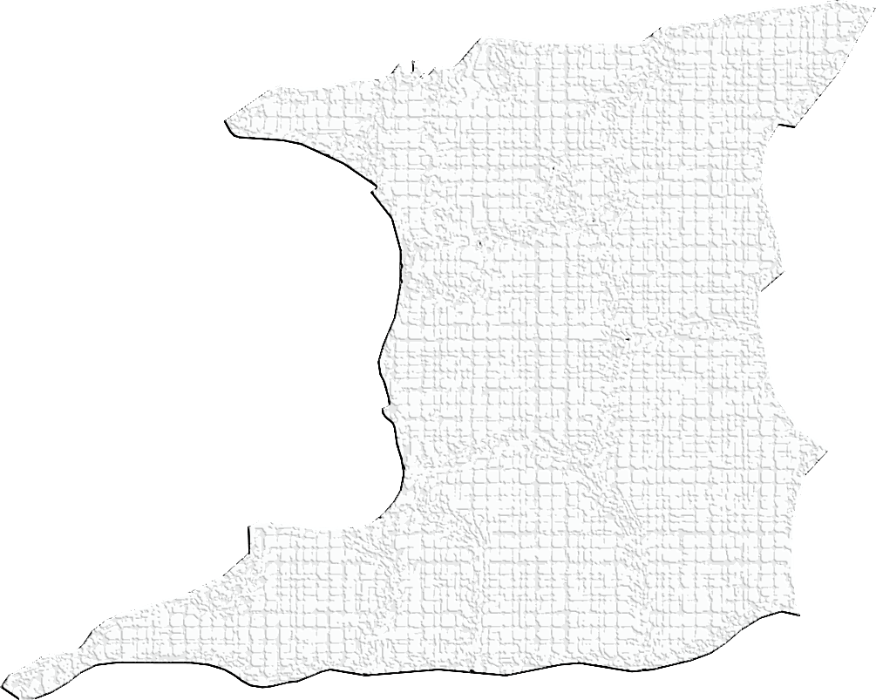
Client Demographics: Area of Residence
HIV Tests by Area of Residence (n=631)
Tobago
28
Diego Martin
118
The South-East and most of the South-West areas of the country are underserved by FPATT.
San Juan/
Laventille
108
Tunapuna/Piarco
113
Port of Spain
95
Arima
33
Sangre Grande
15
Chaguanas
45
Couva/Tabaquite/Talparo
30
Not Stated
16
San Fernando
18
Mayaro/Rio Claro
0
Point Fortin
3
Princes Town
5
Siparia
3
Penal/Debe
1

Slide 9
Males account for 30% and females account for 70% of all persons tested
Male positivity rate is 1.7% among all males tested
Female positivity rate is 0.6% among all females tested

Slide 10
Key Populations: Reach, Test, Navigate (90 – 90 – 90)
FSW
Reach | 883
HIV Test | 149
HIV Positive | 0
Navigate to Care | 4
MSM
Reach | 916
HIV Test | 105
HIV Positive | 3
Navigate to Care | 40
Transgender
Reach | 304
HIV Test | 12
HIV Positive | 3
Navigate to Care | 18
* Time frame: December 2016 to June 2017

Slide 11
Challenges
Increasing restricted donor funds
Challenges within public sector, bottlenecks some areas of continuum of treatment and care services
Few capacity development opportunities to increase cadre of HIV testers
Public Health Sector competition (we need to see each other as partners not competitors)
KPs are increasingly clandestine our ME systems need to better capture their reality

Slide 12
Strengths
Integrated service provision
Existing networks and partnerships with government, corporate, technical and community sectors
Quality service provision.
Existing KP clientele and leaders.
Support from governing body - IPPF

Slide 13
Opportunities
Integrated and comprehensive approaches to HIV service delivery
Scale up of peer navigation services which lead to increased adherence
FPATT is well positioned to provide PrEP and become a HIV treatment facility
Scale up of services for KP since they recognize FPATT as a trusted service provider
Scale up of services for KP since they recognize FPATT as a trusted service provider

Slide 14
Successes
Longstanding relationship between partners
ACTION:
Regular communication to address instant changes/occurrences.
RESULT:
Continued collaborative partnership
1
HIV test opportunities outside of static clinic:
ACTION:
HIV testing available at KP events
RESULT:
Higher HIV test uptake
2
PN collaboration with Oasis Drop In Centre
ACTION:
Implementation of EPOA. Clients referred to PN for HIV tests
RESULT:
Access to another KP – drug users
3

Slide 15
strategies for successful KP testing
FUNDING
Project
MOH
TESTING SITE
Night Clinics
Locales
Bars-Caliente, Bruce, Session Kaleidoscope
Spanish Harlem
EXTRA MILE
Transport
Food
Support
NAVIGATION
PNEs
PNs

