Slide 1
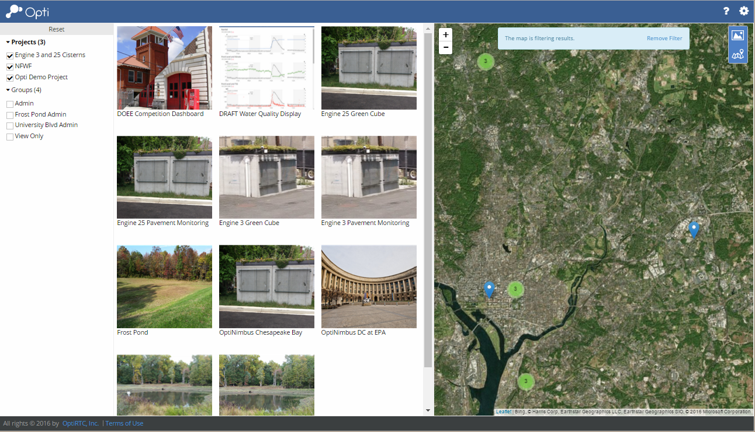
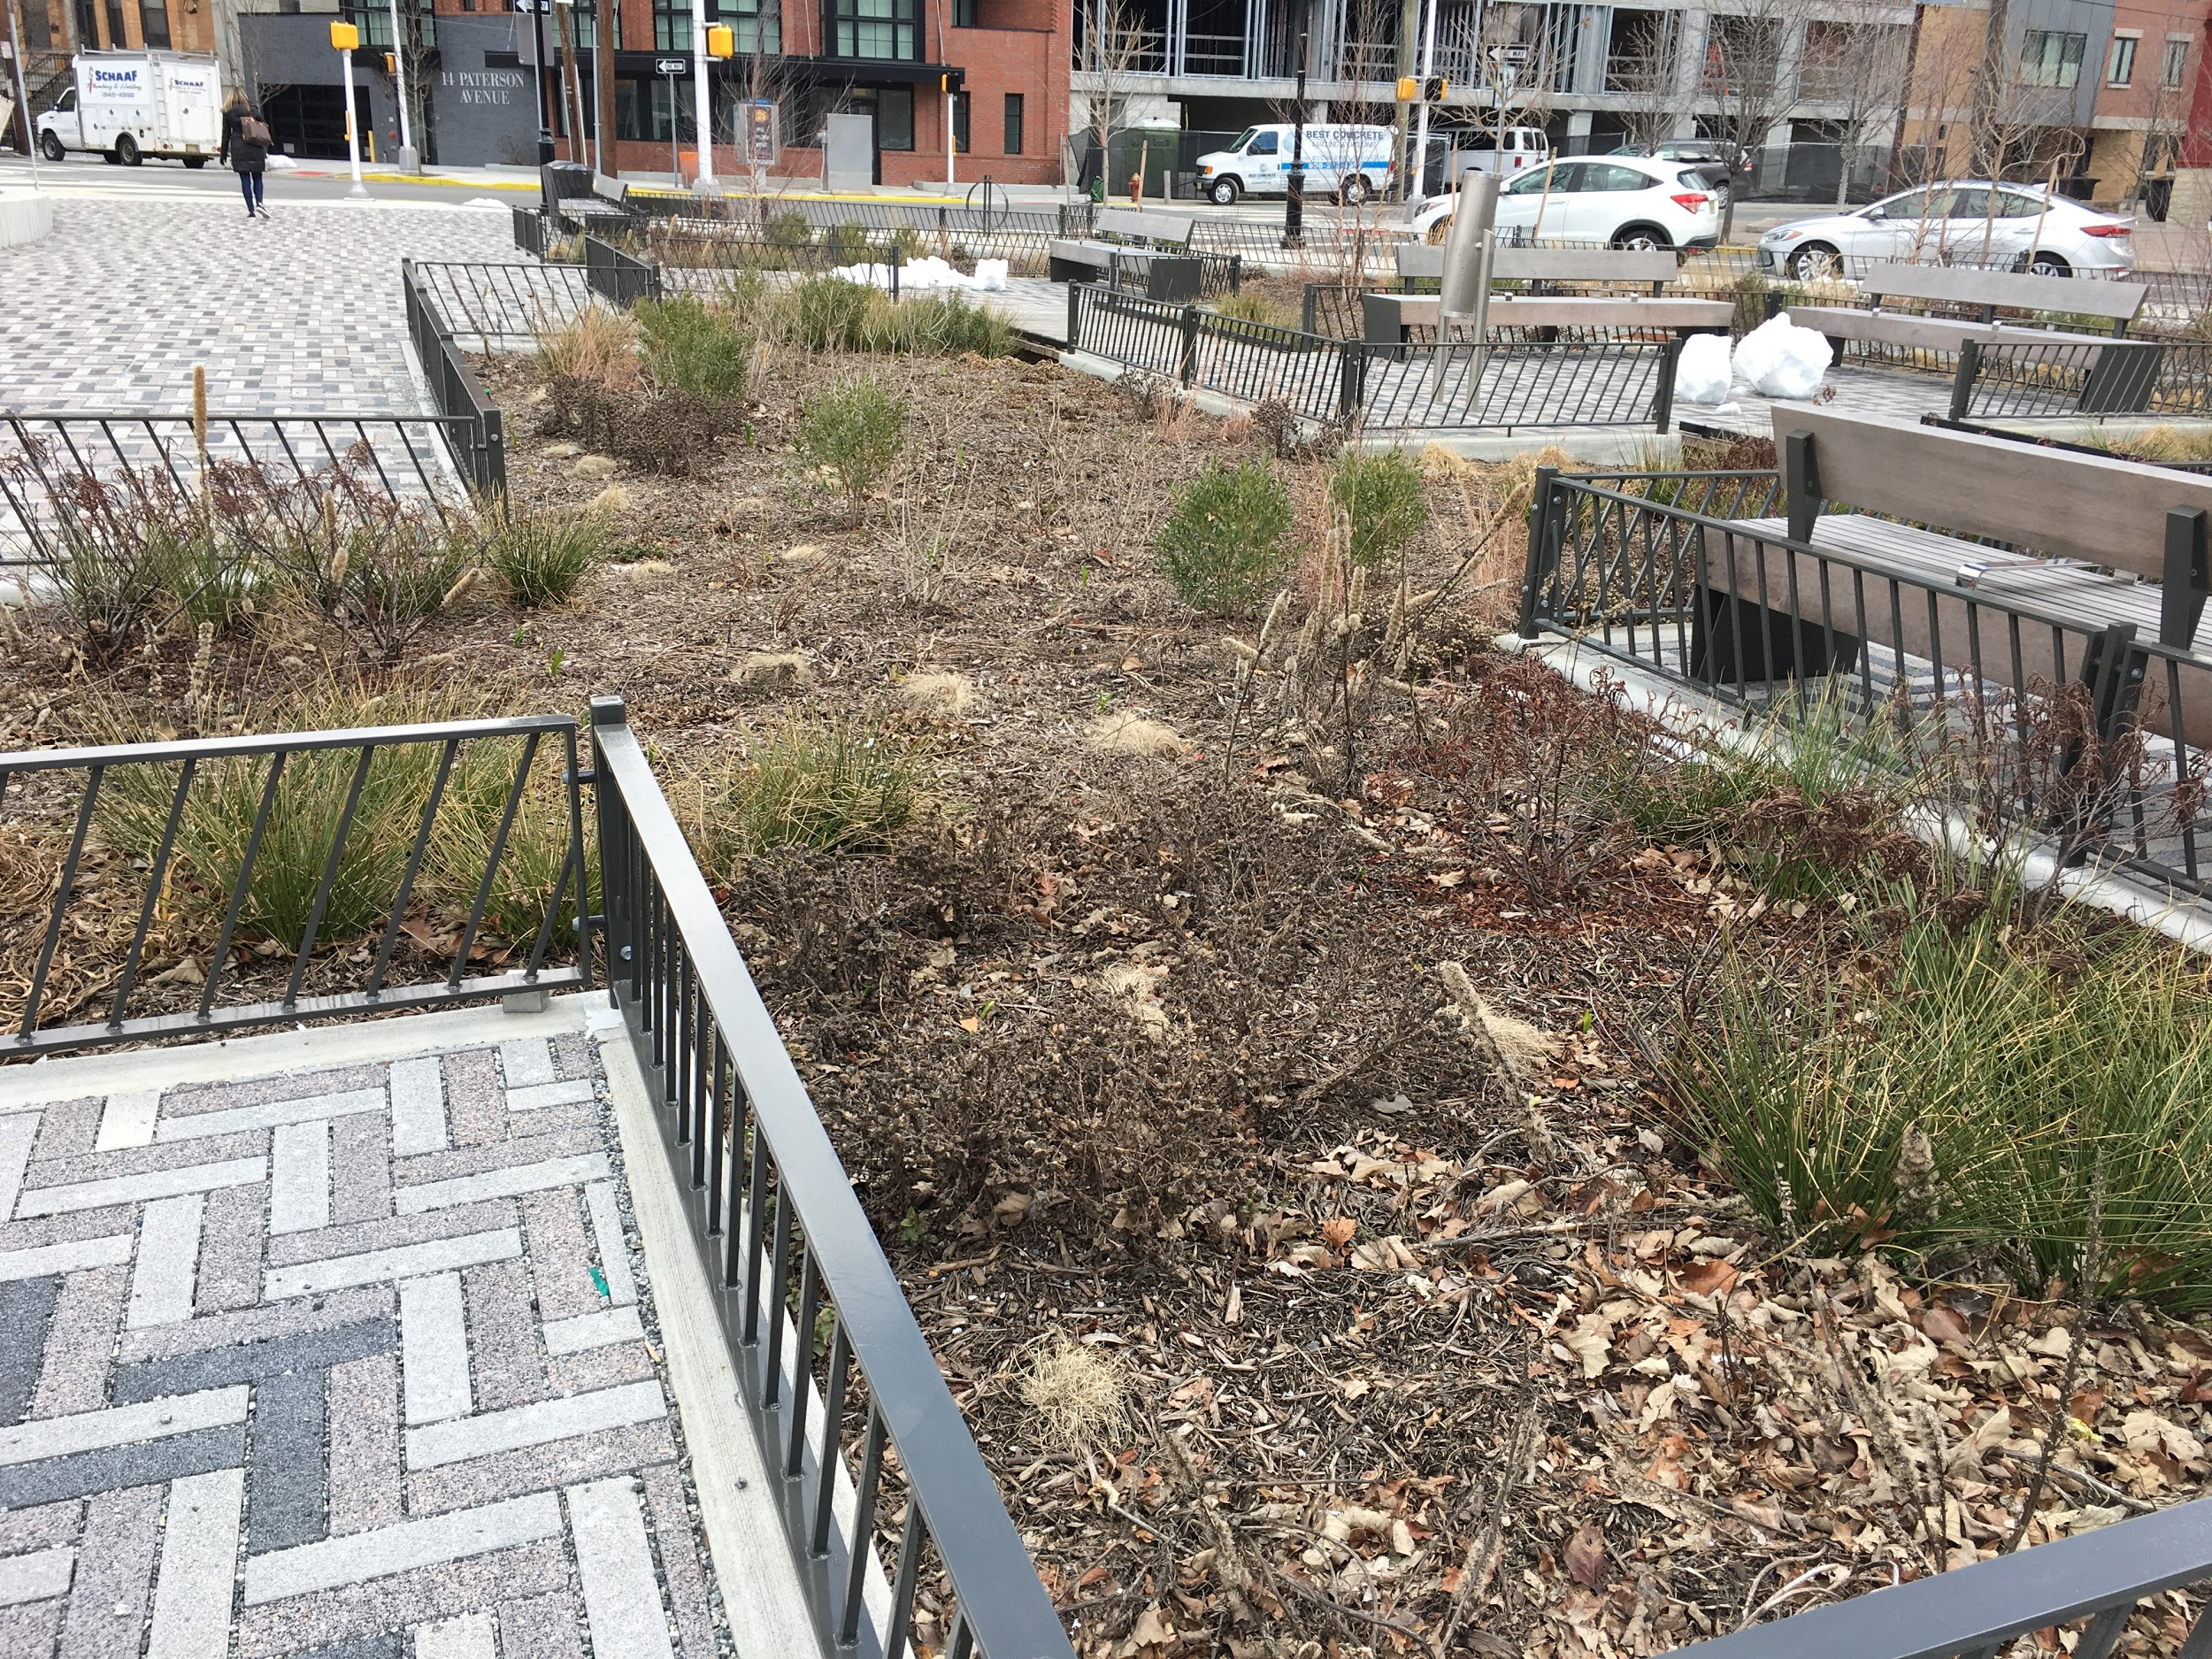
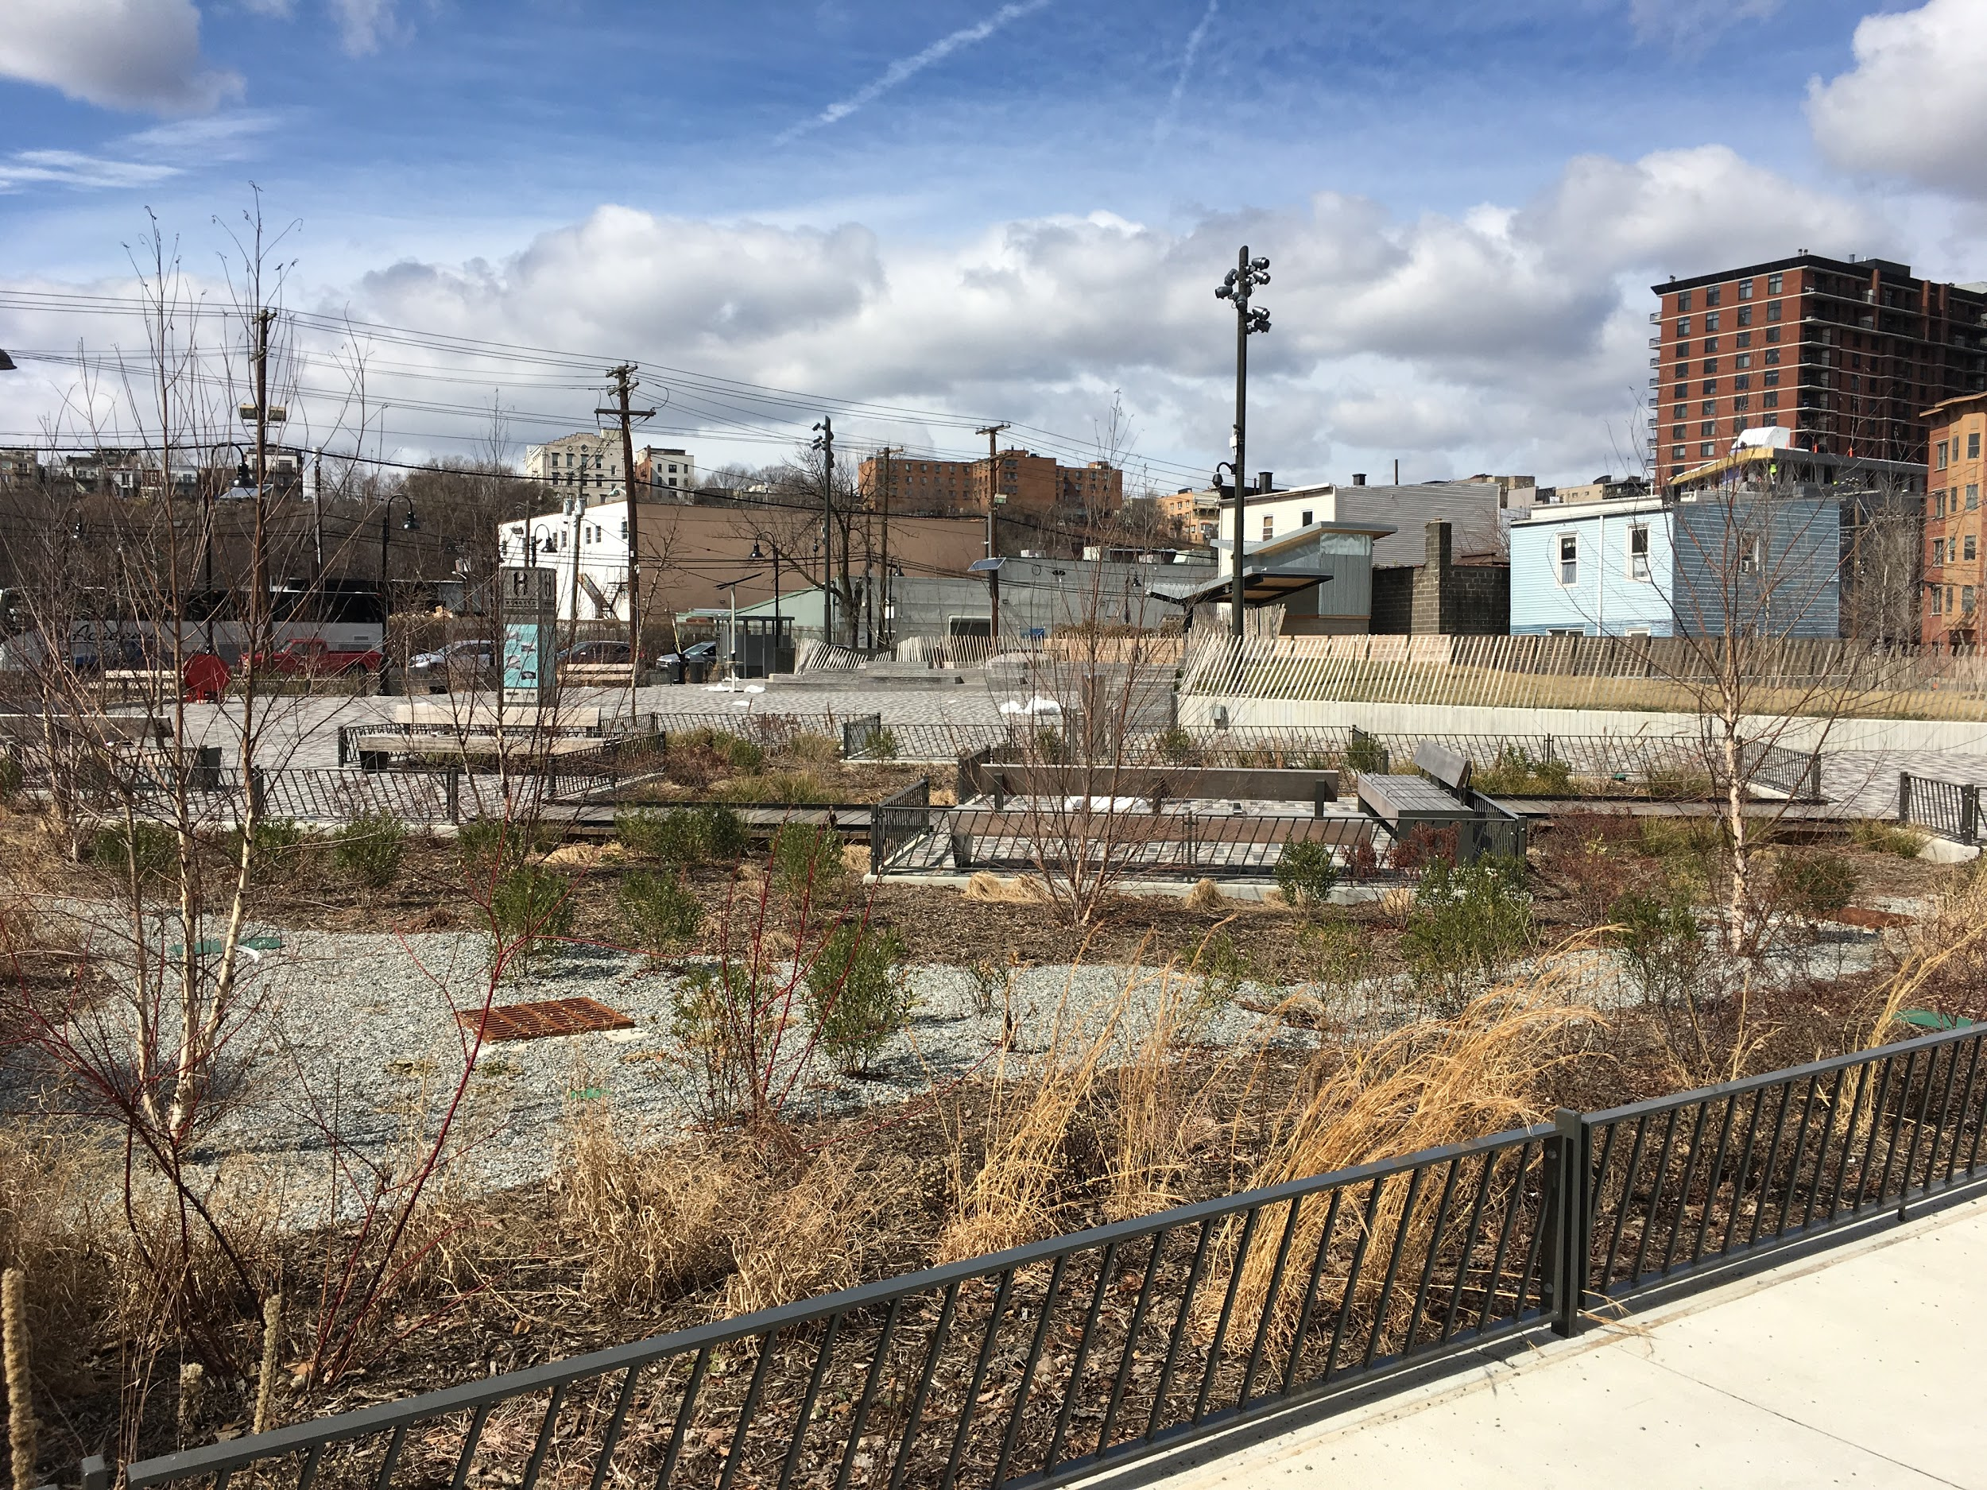
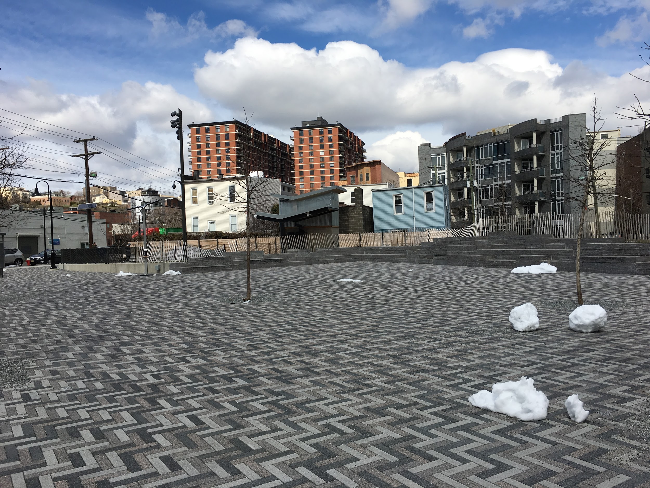
INNOVATIVE APPROACHES FOR PEAK FLOW REDUCTION IN NORTH HUDSON’S COMBINED SEWER NETWORK
Mott MacDonald, Iselin, NJ
Kevin Wynn, PE
Karen Karvazy, PE
CSO Permittee Network Meeting
April 19, 2019
Notes:
KK

Slide 2
Presentation Outline
NHSA Background
Stormwater Management Tool
Use of Automated Valves
Program Observations
The Path Ahead

Slide 3
Background
North Hudson Sewerage Authority
City of Hoboken
Weehawken,
West New York,
Union City
Notes:
North Hudson Sewerage Authority owns and operates the sewerage system for four municipalities. Across is Hudson River and New York City.

Slide 4
Background - Topography

Slide 5
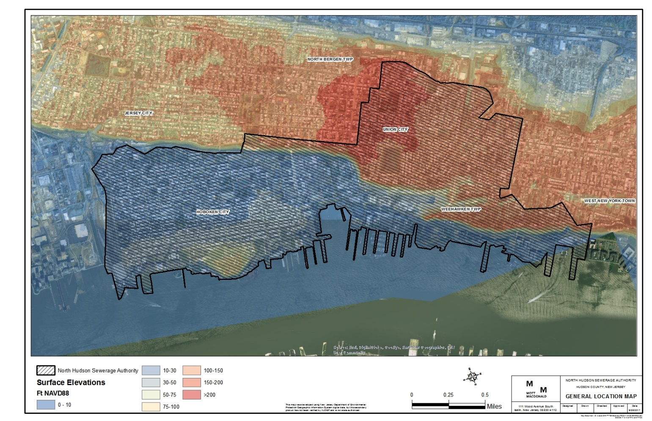
Background
Notes:
Need to make more clear municipality names (Hoboken, West New York,
Need to note

Slide 6
Background
Authority Sewer Connection Review Process
Any change in development is reviewed by the Authority
Review of stormwater management report
Review of Engineering Plans
Redevelopment
Impervious Coverage
Notes:
Give an I dea of something else which is in the NHSAs favor which is stormwater discharge control from new sites.

Slide 7
North Hudson Sewerage Authority Stormwater Control
NHSA Stormwater Control Design Guidelines: 2000-2017:
Loosely planned guidelines , development requirements of the New Jersey Administrative Code:
“Design stormwater management measures so that the post-construction peak runoff rates for the 2,10 and 100-year storm events are 50, 75 and 80 percent, respectively, of the pre-construction peak runoff rates.”
Applications to NHSA showed large variability in modeling method, calculations in existing Impervious Area.
What does this do for meeting the Authority’s Long Term Control Goals?
c
Notes:
Submittal of a Stormwater Report – Show Existing Conditions Proposed Conditions Choose modelling method between modified rational, rational, etc.
Good for design of large scale stormwater controls.
Need a process to address smaller events (Return Period<=2year).
NHSA targeting to address <1 acre sites that do not trigger the State stormwater requirements.
Plan is to reduce hydraulic load on ageing and undersized sewer system.
Small and more frequent events lead to CSO overflows.

Slide 8
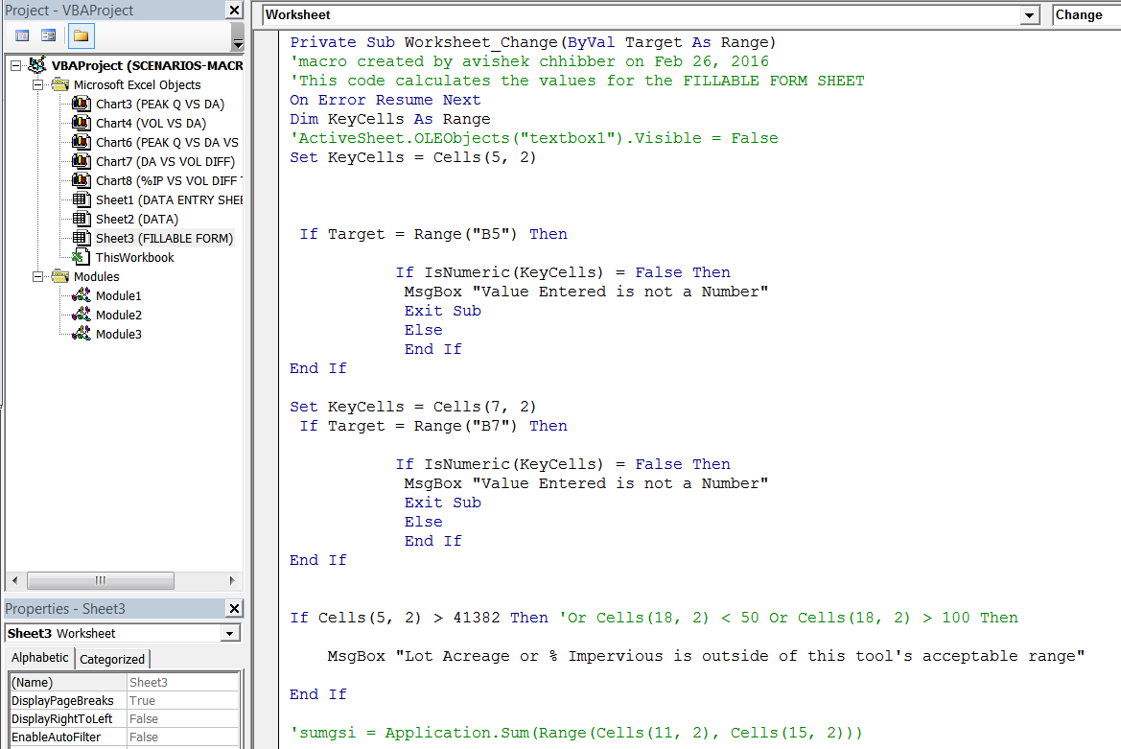
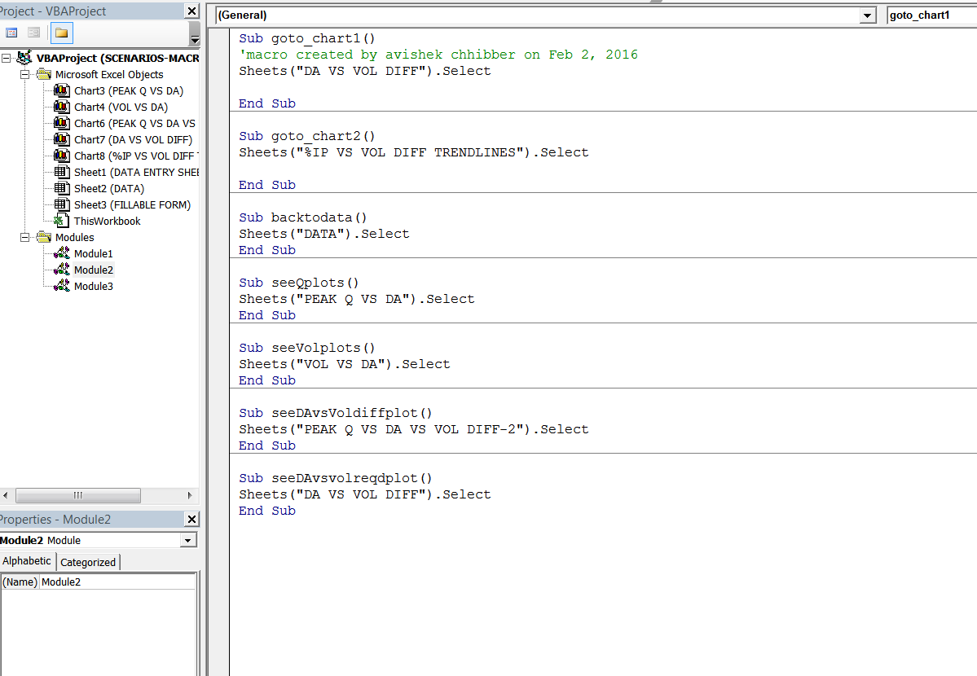
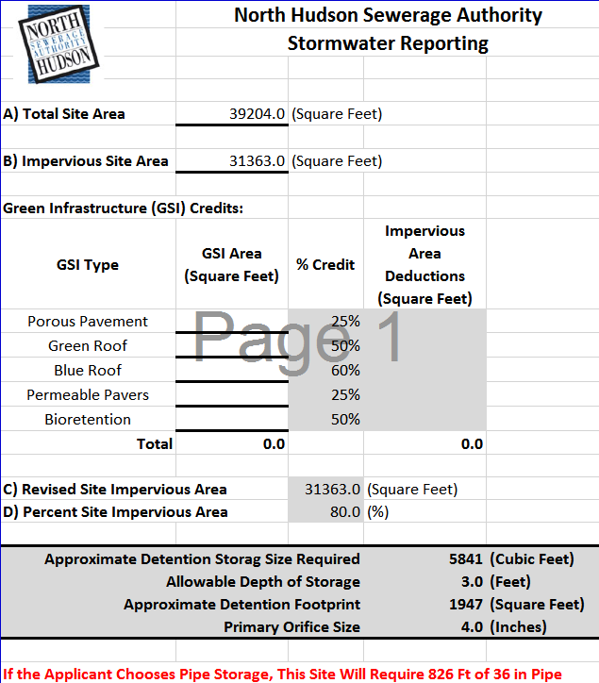
The Tool
Background optimizer algorithms – Microsoft Visual Basic for Applications (VBA IDE) platform.
Object Oriented Programming – “objects” in Excel.
Available as part of MS Office Suite (Word, Excel, Access etc.).
Worksheet – Excel functions.
VBA Script

Slide 9
The Tool
c
Interpretation
TR-55, Woods in Good Condition
Trees and Rocks
Impervious Area: Run-off Curve Numbers for Urban Areas: 98
Reduce to run-off curve number of Wooded Conditions: 70
Basis: 2-year , 24-hour storm (3.3 inches)

Slide 10
The Tool
Notes:
David – I don’t know if I can use this slide – this is a video. really only want to see the part that shows the reporting tool
So – that would be the end of the story – except there were issues now in with the implementation . Leads us to the use of automated controls within the collection system

Slide 11
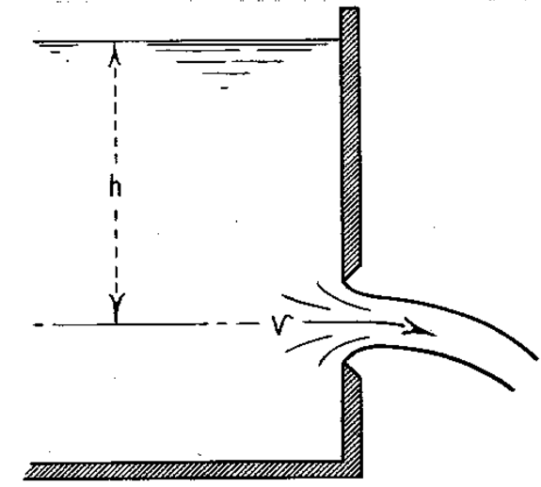
Program Implementation
Program Challenges
Small sites (under 0.3 acres) require a minimum orifice size to prevent clogging, but allows too much flow for peak shaving.
Limits to passively controlled systems – only use gravity, but need certain size orifice, but cannot hold back flow in system.
Program Assists
3 of 4 Municipalities have passed the Inspection Program.
Allows Inspections on Private Property
Corrective actions for failure to maintain system

Slide 12
Use of Automated Control Valves
All Sites > 10,000 square feet are required to install automated valves to control stormwater.
OPTI Valves – real time control
Mission Communications – NHSA Operated Valves
New requirements for Owner-Authority Access Agreements
Reviewed During the Sewer Connection Application Phase
Recorded with Hudson County Property records

Slide 13
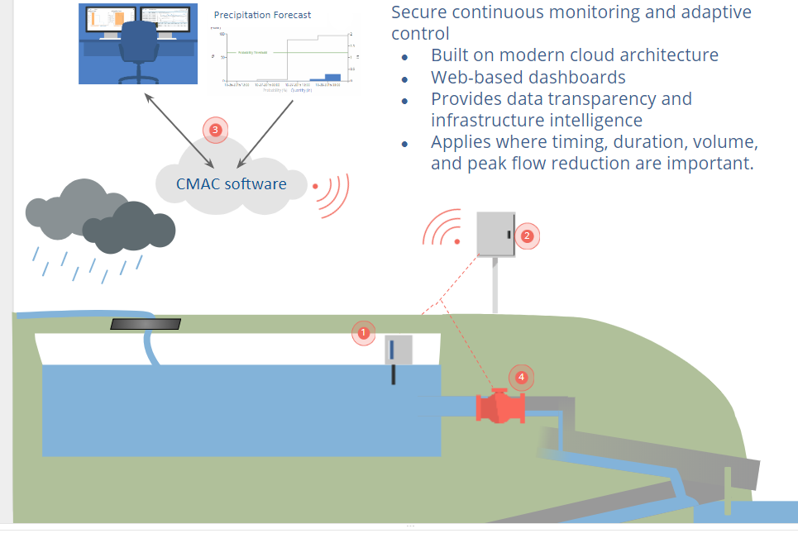
CMAC Technology
CMAC Technology
Secure continuous monitoring and adaptive control
Built on modern cloud architecture
Web-based dashboards
Provides data transparency and infrastructure intelligence
Applies where timing, duration, volume, and peak flow reduction are important.
Notes:
MS:

Slide 14
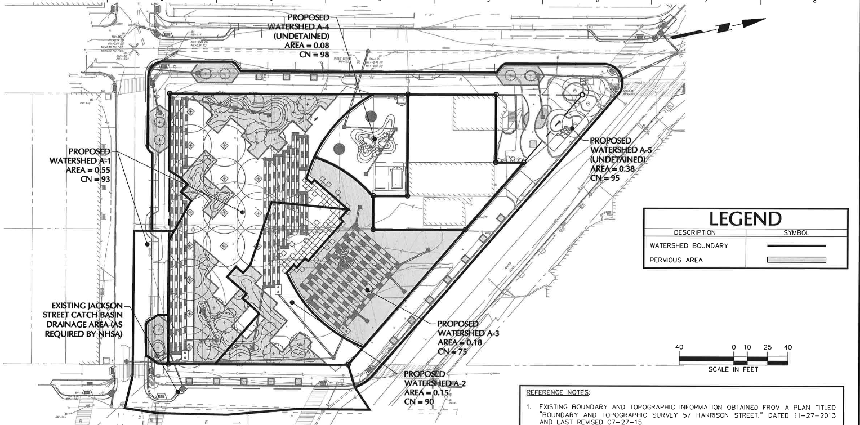
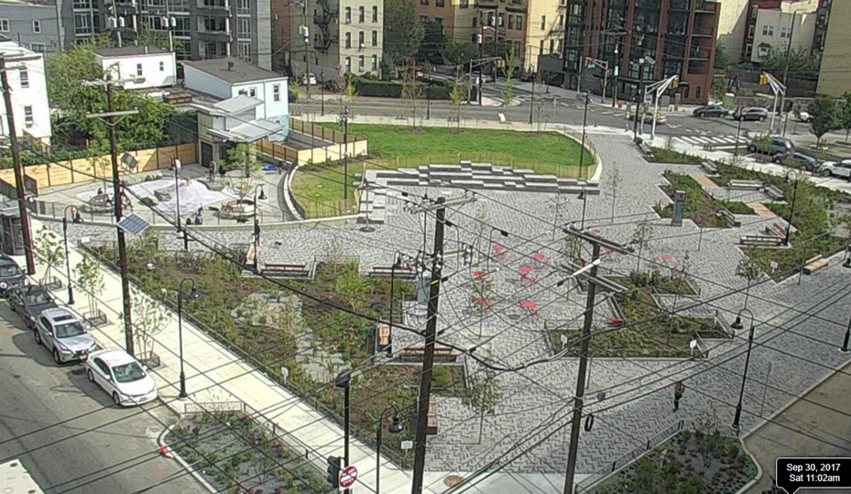
Projects – Southwest Park
Southwest Park, Hoboken, NJ
67,000 gal total capture
0.88 acre watershed
Can retain half of volume to release in dry weather
Notes:
MS:

Slide 15
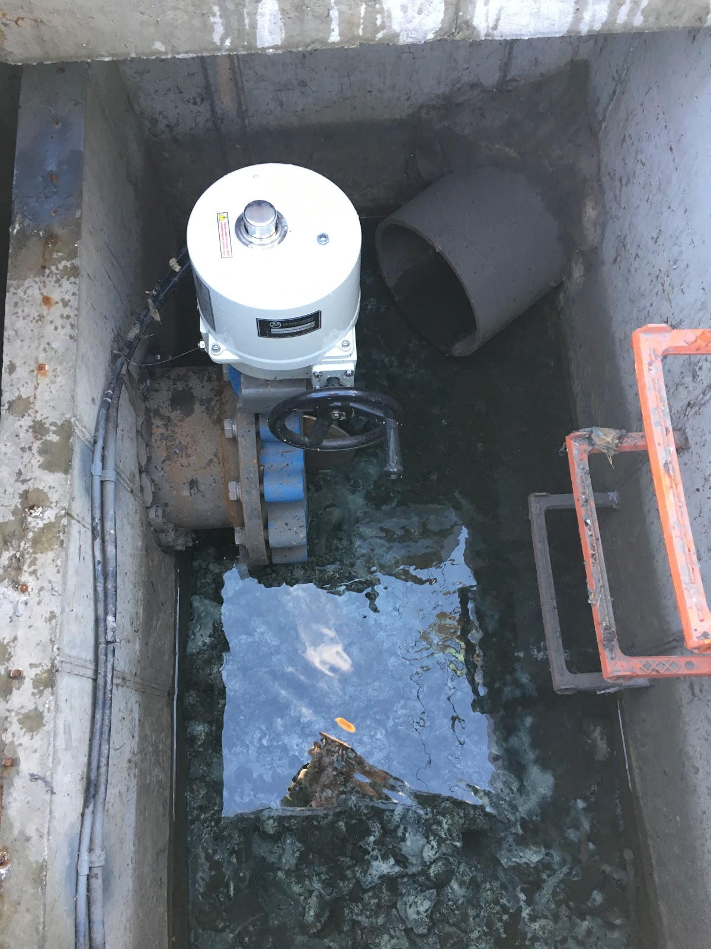
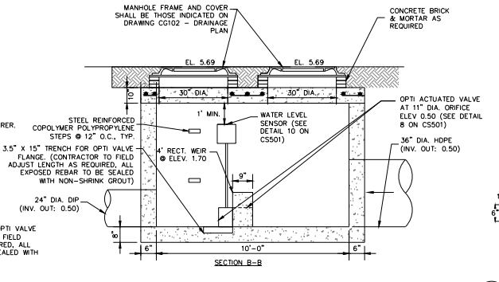
Projects – Southwest Park
Southwest Park, Hoboken, NJ
Notes:
MS

Slide 16
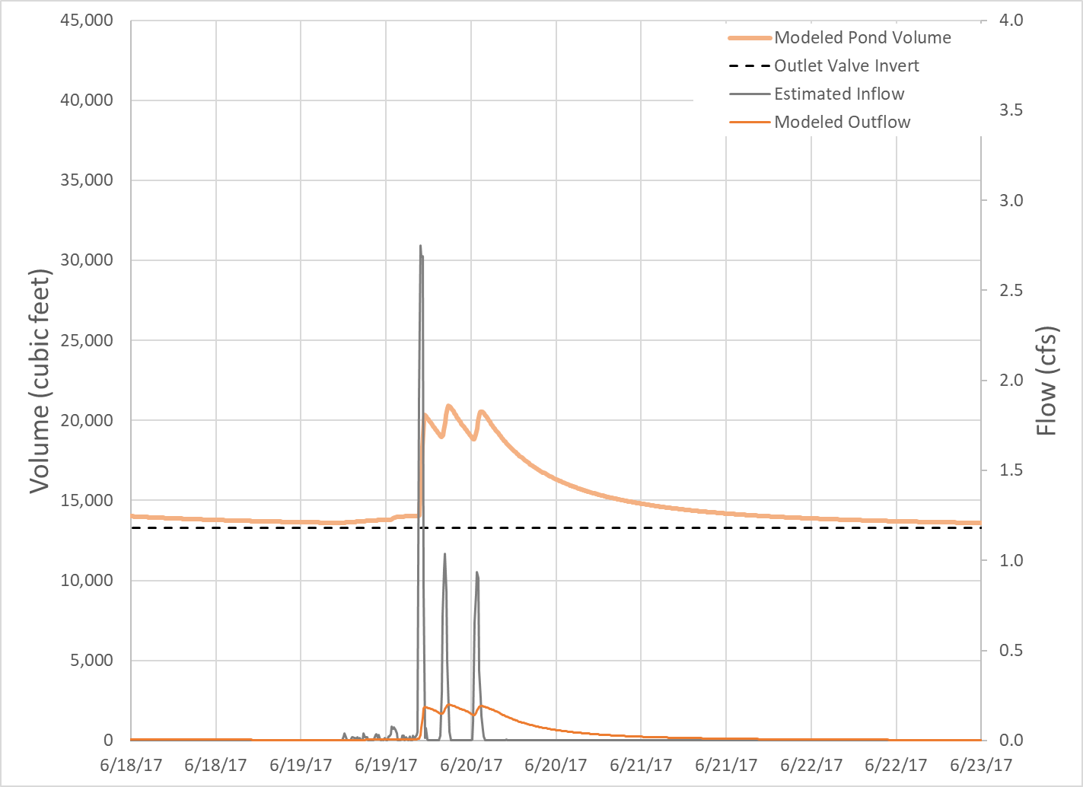
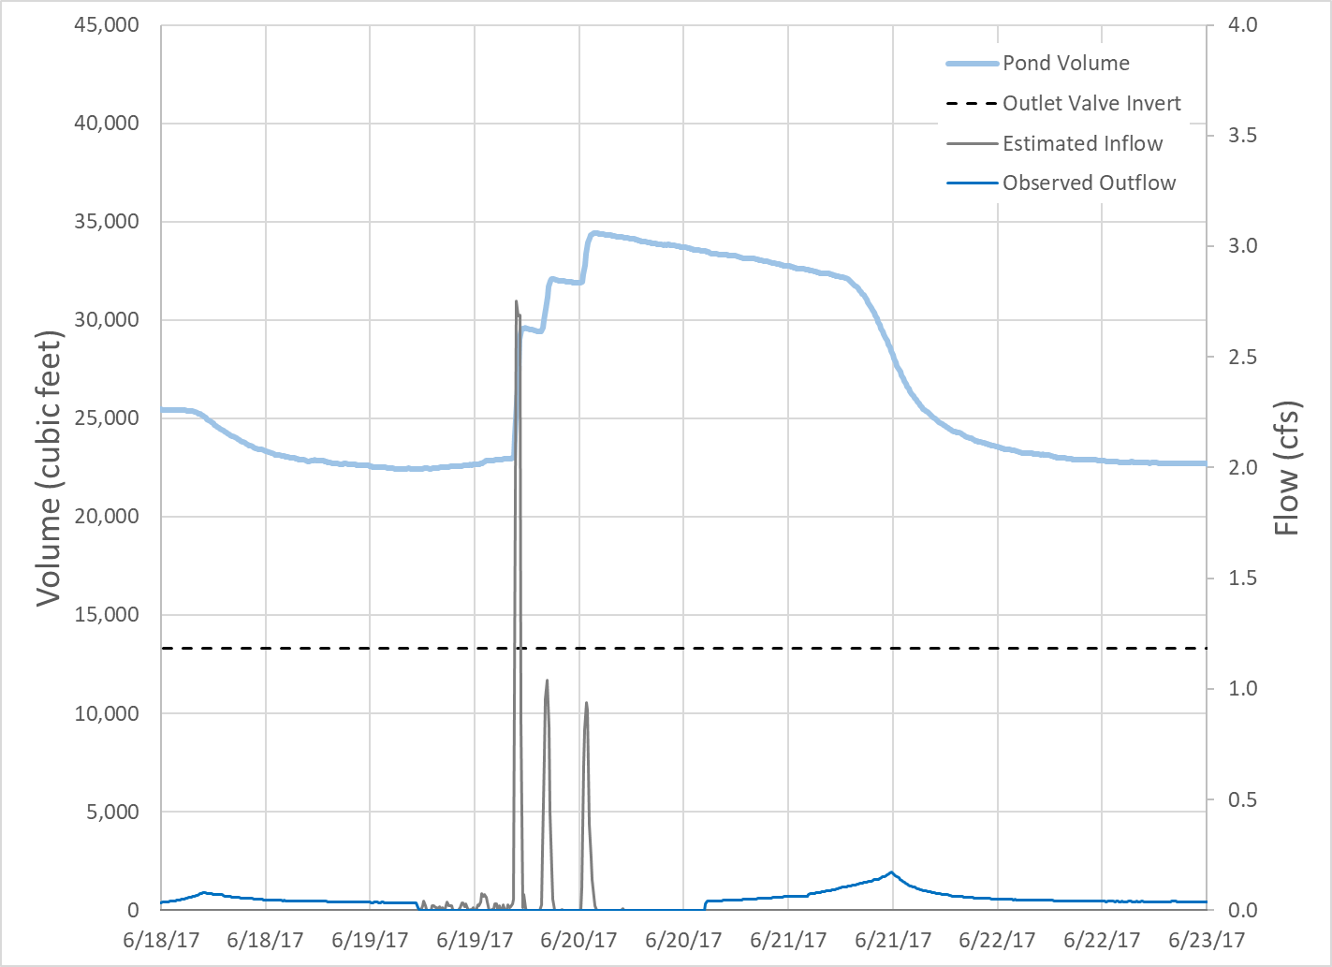
CMAC Technology
Simulated Passive System
Observed CMAC System
CMAC Technology
SIMULATED PASSIVE SYSTEM
OBSERVED OPTI SYSTEM
Sim
Notes:
MS

Slide 17
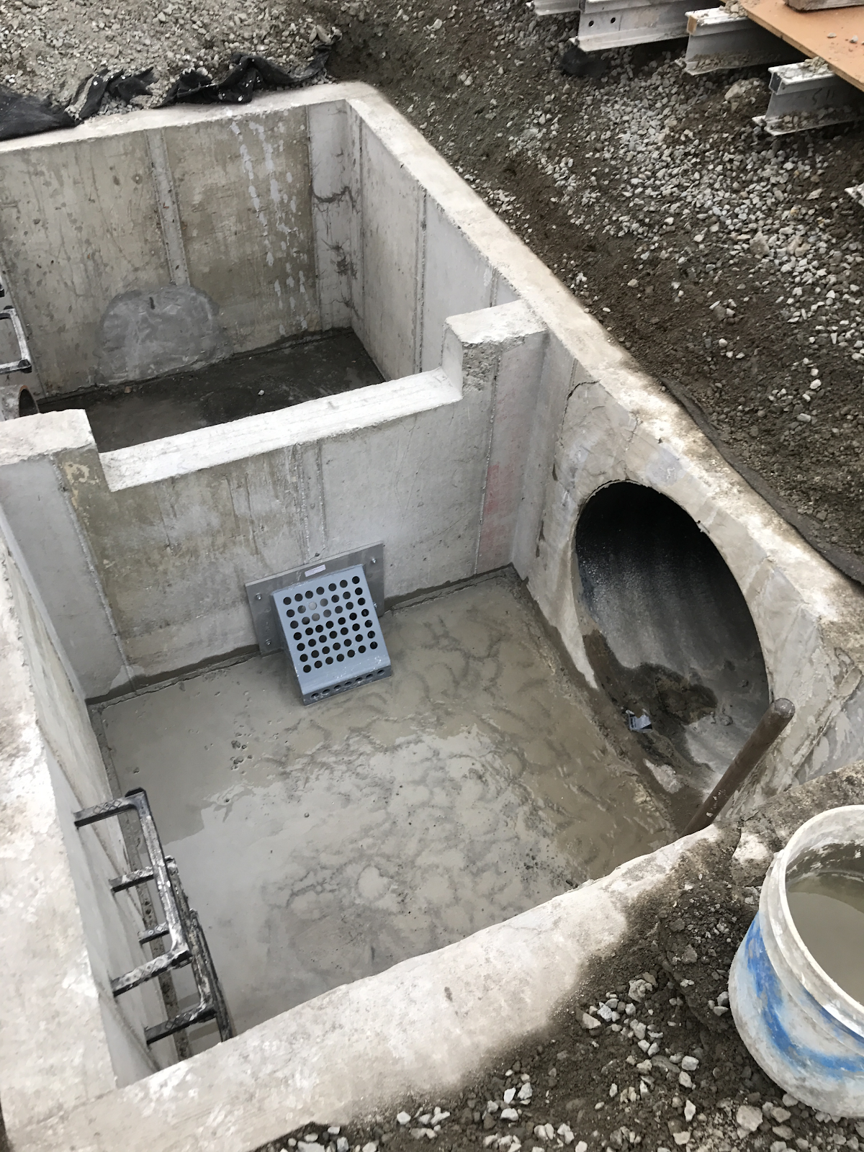
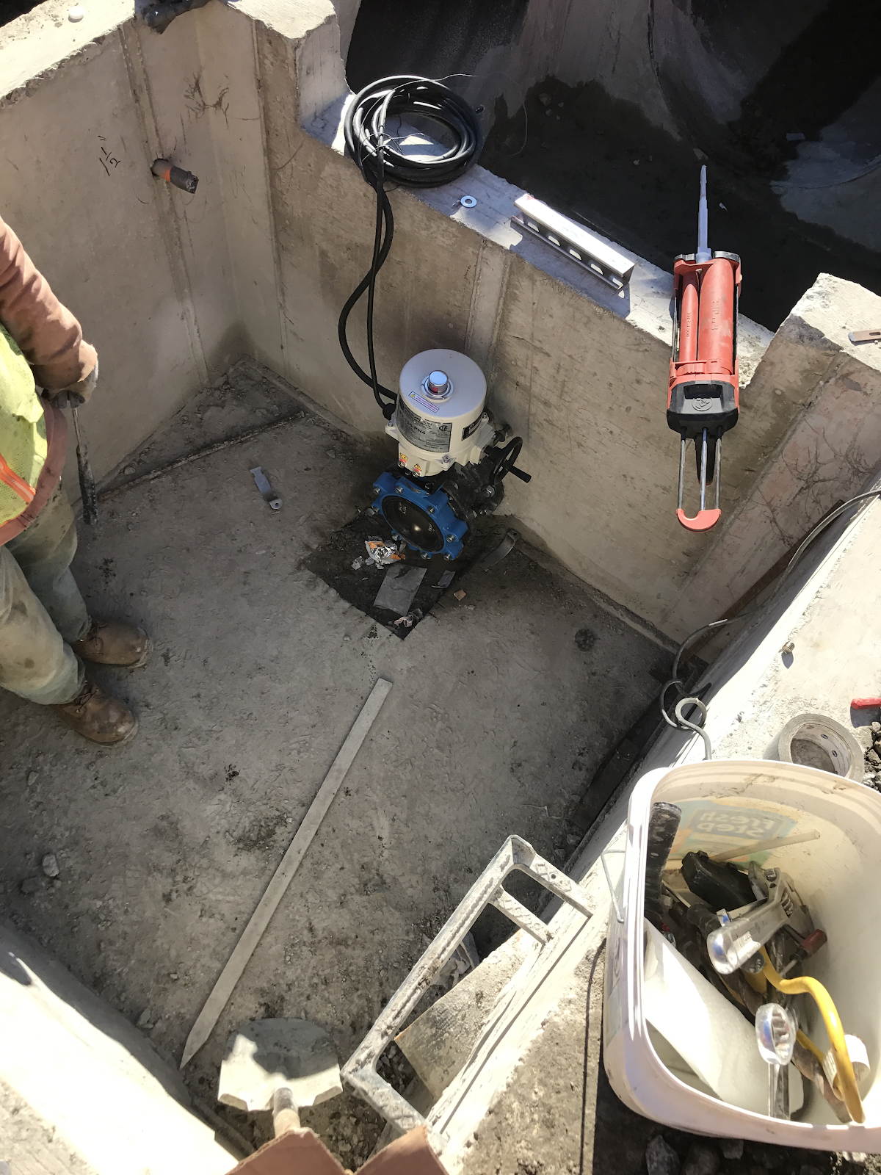
Projects – Monroe Center
Monroe Center, Hoboken, NJ
Notes:
MS:14 story high-rise PP v

Slide 18
Automated Control Valves
In Service
Southwest Park – Hoboken
Under Construction
Monroe Center
In Planning
PSE&G Substation - Hoboken
Carrigan Avenue – Union City
1300 Manhattan Avenue
Notes:
KK

Slide 19
Program Observations
Sewer Use Resolution Passed October 2018. Since Implementation:
There is streamlined stormwater review process.
Developers are using Green Infrastructure to meet our Program Goals.
Permeable Pavement
Green Roof
c
Notes:
KK

Slide 20
Conclusions
These efforts will contribute to goals in LTCP:
NHSA is implementing the Stormwater Management System Inspection Program.
The Online Tool is dynamic, NHSA can update it as the program evolves.
Continuation of Long Term Program – a new feature in the NHSA’s CSO tool box.
Notes:
KK

Slide 21
Special thanks to: Fredric J. Pocci, PE North Hudson Sewerage Authority Don Conger, Project Director, Jacobs
Questions?
Kevin Wynn, PE kevin.wynn@mottmac.com

