Slide 1

Wolf Trap District
Roundtable
November 14, 2024

Slide 2

Pledge

Slide 3
Welcome
New to Roundtable?
Please introduce yourself!

Slide 4
Agenda
Welcome and Pledge
Award(s)
Questions about Read-ahead
Council Announcements
General Announcements
Program
Cracker Barrel/Networking (Optional; NLT 9pm)
Next Meeting: Dec 12, 2024 - at Thoreau MS, Vienna, VA

Slide 5
District and other Award(s)

Slide 6
Questions/Clarification about Read-ahead?

Slide 7
Council Announcements
Web Site Updates – Delayed. DDOS attacks are taking sites offline
District Changes in my.scouting.org – still being worked
Renewal notices – some delays for emails to all registered Adults/Youth
  Bills individual youth/adults both National and NCAC Fees
  Units can choose to pay but will pay every 30-60 days
  Scholarship form available – ask DE
  Renewal Aids – Individuals; Unit Coordinators

Slide 8
General Announcements

Slide 9
Safety Moment
Here’s a breakdown of the different forms’ safety moments can take:
  Scouting Safely Resources: Utilize the extensive library of ready-to-use safety moments on Scouting Safely, covering a myriad of topics. These are regularly updated and expanded by BSA volunteers and professional staff.
  On-the-Spot Safety Moments: Scouts and Scouters can create ad-hoc safety moments tailored to specific situations or activities. These “just in time” reminders can precede an activity, providing concise information or notifying participants of safety essentials like fire extinguisher locations and exits.
  Localized Safety Moments: These can align with local procedures or conditions, offering reminders during pre-activity assessments. Camp leaders may plan a series of Safety Moments for each day, reinforcing important safety topics during camper orientation.
  External Resources Caution: While other organizations and companies may share safety moments online, exercise caution. Ensure that these align with Scouting values and adhere to BSA safety guidelines.
https://www.scouting.org/health-and-safety/safety-moments/

Slide 10
BSA Insurance
Comprehensive General Liability Insurance. This type of policy responds to allegations or claims from a third party that they suffered personal injury or property damage due to negligent action.
Coverage is limited to official Scouting activities (note list of prohibited scouting activities), and those activities must be consistent with the values, Charter and Bylaws, Rules and Regulations, operation manuals, and applicable literature of the Boy Scouts of America. Local councils, chartered organizations, and registered volunteers are provided with primary coverage. Scouting youth (age 17 and younger) are not insured under this policy. The insurance provided to unregistered volunteers through the general liability insurance program is excess over any other insurance the volunteer might have to his or her benefit.
Accident and Sickness. This insurance provides medical coverage to Scouting participants on an excess basis for injuries or fatalities that arise out of an official Scouting activity.
For example, if a youth falls during a hike and breaks a wrist, the parent’s health coverage may pay for the ER visit minus a $500 deductible; this insurance can reimburse the $500.

Slide 11
BSA Insurance
Automobile Liability Insurance. Coverage is provided above the vehicle owner’s insurance plus any automobile liability insurance provided by a local council. Vehicles MUST be covered at the minimum amount required by the state for automobile liability. It is recommended that coverage limits are at least $100,000 combined single limit.
  Vehicles carrying 10 or more passengers should have at least $1,000,000 in coverage.
  Note: The use of 15-passenger vans manufactured before 2005 is prohibited.
Coverage for Non-Owned Boats. General liability insurance coverage on an excess basis, after other applicable insurance is exhausted, is available for boat owners above their liability coverage limits. It is recommended that boats under 26 feet have at least $300,000 and boats 26 feet or over have at least $500,000.
More information - https://www.scouting.org/health-and-safety/gss/gss10/

Slide 12
BSA Insurance
Certificate of Liability Insurance – To get a new certificate, please fill out a Request for Certificate of Liability Insurance and return to the email listed on the form (with a cc: to the DE and Rus). You’ll receive a certificate of insurance back within two weeks. If the group/vendor requesting the COLI needs some special language, this needs to be put in writing and submitted with the request. This will add time to the turn-around. If the event is out of the NCAC boundaries, then NCAC processor will forward the request to National. This increases the turn-around time to about four weeks.
BSA Camps outside the NCAC area - Often require a COLI.
Incident Reporting - https://www.scouting.org/health-and-safety/incident-report/
  Deputy Scout Executive (Lee M) - Will follow-up, if appropriate.

Slide 13
BSA Insurance Questions?

Slide 14
Individual Renewals and Unit Recharter
Registration Renewal - Many parents and registered Adults are indicating that they have not yet received their 60-day renewal notice from National. While in some cases this could be due to a message being in the SPAM/Junk folder or due to a bad email address, we have also been notified that the volume of emails to be sent is delaying the process. Parents and registered adult can renew even without the email by going to:
  https://my.scouting.org
  Menu
  My Application
  My Renewals (on the top, middle of page)
  Click “Start Renewal” on any registrations that are listed. If not all positions are listed, move the "filter" to "off." "Multiple" positions will processed after payment is made and renewal date passes.
If a parent doesn’t have their youth listed in their my.scouting.org account, please send Rus Pittman the unit number, youth's name/BSA ID, parent’s name, email address and BSA ID (if they have one). I will send them info on how to join the youth to their account and/or work with Council to fix this.

Slide 15
Individual Renewals and Unit Recharter
Registration Renewal for Executive Officers - Executive Officers need to be renewed just like the rest of the unit’s membership; however, since Executive Officers DO NOT PAY a fee, their renewal will be handled by our Council Registrar. See this memo for submission instructions.
$100 Annual Unit Fee for Recharter – Internet Advancement is no longer used for Unit Renewal. Renewal is completed online by the COR, using my.scouting.org (login, Menu, Organizational Manager, Unit Renewal). The user guide is here. Note, the recharter will error if there are individuals without current YPTs. Your COR can remove them by checking the “Opt Out” next to their name in the Roster. May take overnight to process. If doesn’t work, send Rus their name and BSA ID.
The Annual Charter Agreements - The ACAs are due before the end of year (sooner is better). The current hard copy form is located here: https://www.scouting.org/wp-content/uploads/2024/04/BSA-Annual-Charter-Agreement-Charter-Orgs_2024-2025.pdf. Dates at bottom of page should be 3/1/2024 – 3/1/2025.

Slide 16
Program

Slide 17

Current 2024 Wolf Trap Calendar
12/12/25 – December Roundtable, Thoreau MS, Vienna
02/08/25 – Virtual Life to Eagle Seminar (1pm)
02/22/25 – University of Scouting, Alexandria, VA
03/08/25 – WTD MB Day, Fairfax Presbyterian Church, Fairfax, VA
03/22/25 – DCOH Award Nominations Due
03/28/25 – 03/30/25 – Joint Lodge Ordeal, Camp Snyder, Haymarket, VA
04/10/25 – District Court of Honor, Thoreau MS, Vienna, VA
04/25/25 – 04/27/25 – 2025 OA Spring Fellowship
05/03/25 – 19th NCAC Scout Orienteering Meet, PWD, Triangle, VA
05/XX/25 – 05/XX/25 – WTD Spring Camporee
05/XX/25 – 05/XX/25 – WTD Hike-O-Ree
05/10/25 - Jamboree on the Trail (JOTT)
05/26/25 – Memorial Day Flags In, National Memorial Park, Falls Church
05/08/25 – Program Launch, Thoreau MS, Vienna, VA
05/31/25 – OA Election Season Closes

Slide 18
STEM
Akela Chess Classic
  Cub Scout Tournament – 02/01/2025 at MSSC
  Scouts BSA Tournament – 02/15/2025 at MSSC
Burke Lake District NOVA Nights (Last Friday of Month) – 11/19/2024 at Prince of Peace Lutheran Church
STEM Speaker Series – Geology Night – 12/11/2024
NCAC STEM contact is Bruce Donlin (bruce.donlin@scouting.org; 240-395-0601)
Ancient Earth: Birth of the Sky (on PBS) - link
Anytime – DC STEM Trek- Showcases 24 government agencies, private organizations and monuments related to the tenets upon which STEM is based. Two hikes - 10.57 miles, or 4.75 miles

Slide 19

Fall Camporee Report-Out

Slide 20

Hunger is still out there, and so are we!
Wolf trap DISTRICT
SCOUTING FOR FOOD
2024

Slide 21
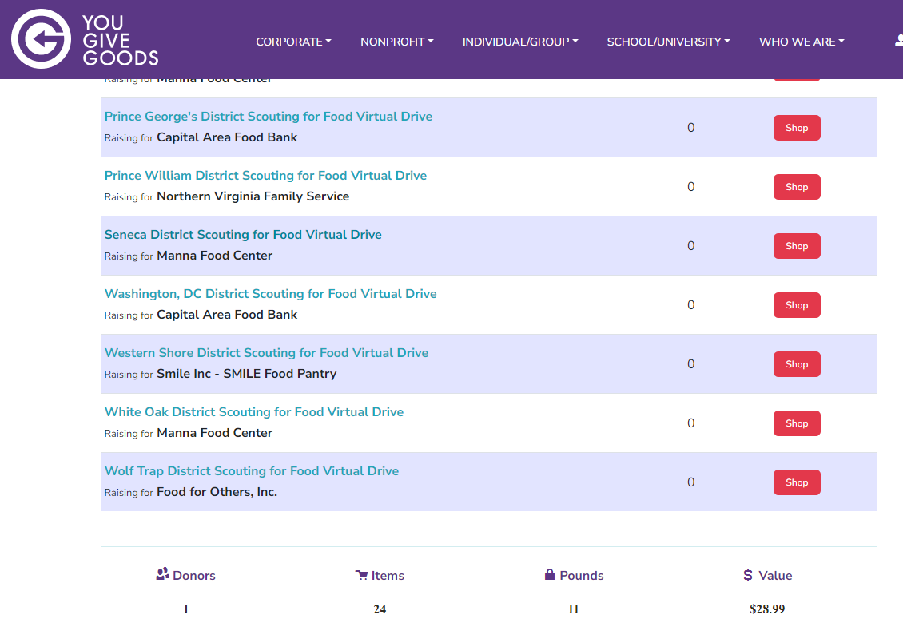
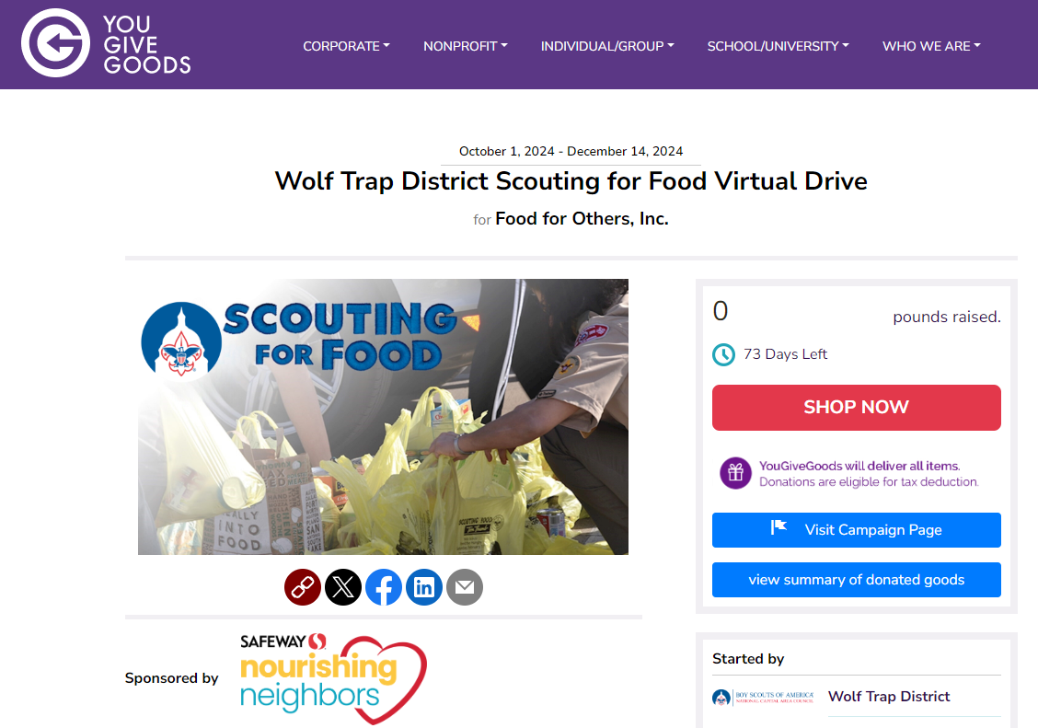
VIRTUAL COLLECTIONS
The links to the virtual collections went live on October 1st.
Be sure to share your district's link on this page:
https://yougivegoods.com/ncac-scoutingforfood2024
Flyer is posted on Basecamp with QR code to main site
  Note instructions for proper donation district/unit credit

Slide 22
Data Capture
Unit’s fill out at:
https://www.ncacbsa.org/scouting-for-food-unit-data/
District: Wolf Trap District
Number of Scouts and Other Youth Participants (siblings, friends, etc.)
Number of Adult Participants
Pounds of Food Collected
Food pantry delivered to
For your Scouts: Express the weight in fun terms, for example: Vehicles, animals, or dinosaurs

Slide 23

District Life to Eagle Seminar – February 8, 2025
Saturday, 8 February 2025
1:00 to 4:00 p.m.
Virtual
Register at: National Capital Area Council - 2024 Wolf Trap (Virtual) Life to Eagle Seminar
Who should attend:
Life Scouts or advanced Star Scouts who want to pursue the Eagle Rank
Eagle advisors, coaches or unit leaders that haven’t attended a seminar in two years
Parents of Scouts working on Eagle or other adults interested in Scouting
Registration is live now and must be registered by 6 February 2025 to get the Zoom link.
Any questions contact Matt Burns at 703-938-9550 or at gm.advancement @gmail.com.

Slide 24

District Court of Honor
To recognize adults who served/are serving at the unit level.
Two awards:
  Unit Commissioner’s Unit Scouter Award – 1 per unit
  Unit Appreciation Award – Maximum 8 per unit.
Please provide a sentence or two describing the individual’s service.
Submit Unit Commissioner’s Unit Scouter Award to Unit Commissioner.
Unit Appreciate Award to gm.adultrecognition@gmail.com
Must have all submissions by no later than March 22, 2025.
Will confer awards at District COH in April 2025.

Slide 25

SCHOLARSHIPS
Deadlines Approaching!!!
BSA Scholarship page - https://www.scouting.org/awards/scholarships/
American Legion Eagle Scout of the Year – Deadline is March 1 2025 – Apply to local Legion Post. Open to Scouts in units sponsored by an American Legion Post or who have a parent or grandparent that is a member of the Legion. Applications at: American Legion Eagle Scout of the Year Scholarship | The American Legion
Sons of American Revolution – Deadline ASAP Arthur M. & Berdena King Eagle Scout Contest – National Society Sons of the American Revolution)
National Eagle Scout Association – Deadline January 31, 2025 Scholarships - The National Eagle Scout Association

Slide 26

Glenn A. and Melinda W. Adams Award
Recognizes a noteworthy Eagle Scout Service Project.
Deadline is January 15, 2025
The Scout or a registered Scouting America volunteer can make a nomination. 2025 Adams Award Application
Scout must sign application to document their “consent.”
Also needs an electronic copy of the project workbook.
Some nominations include video.
Winners can receive:
  $300 at the Territory level.
  $3,500 for National winner.

Slide 27
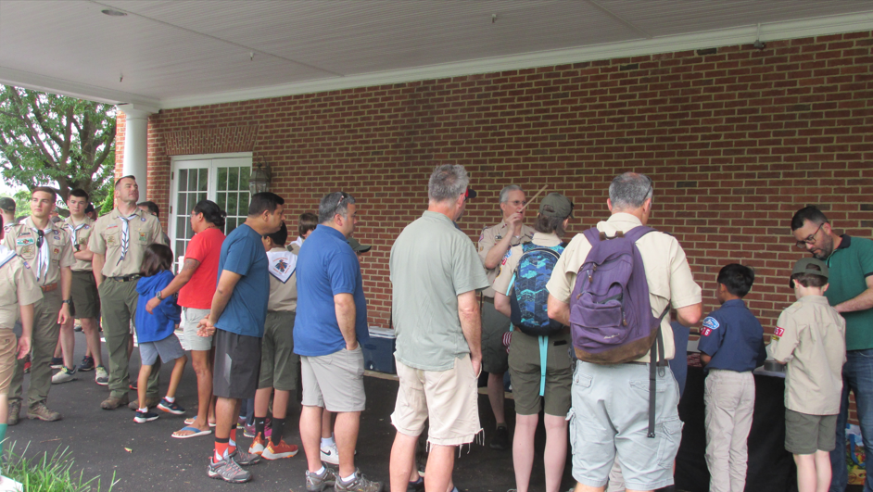
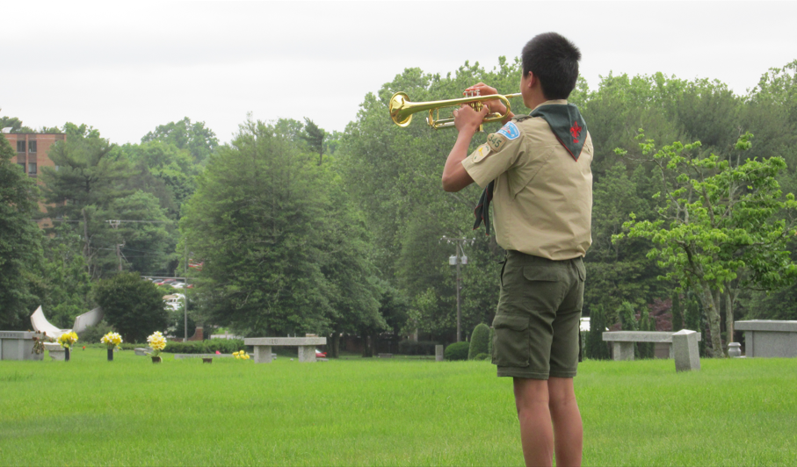
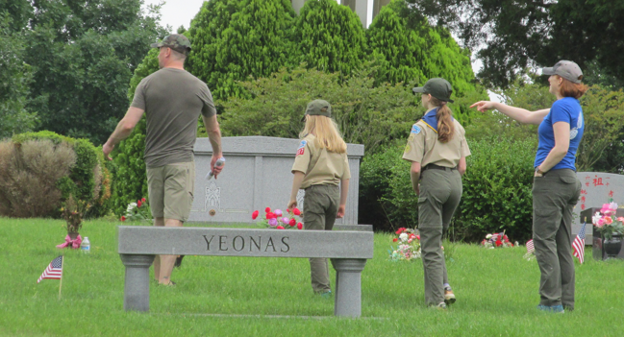
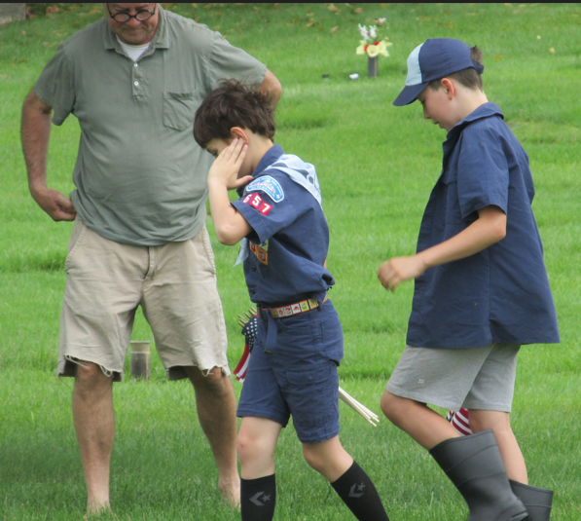
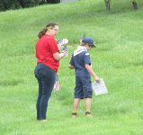
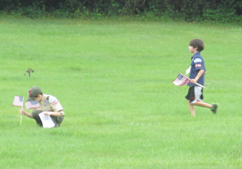
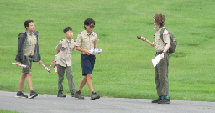
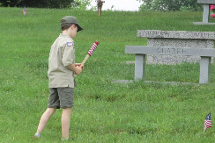
Flags In - Veterans Day (Sunday)
Honoring veterans by placing flags on graves at the National memorial Park in Falls Church, VA
Thanks to the NMP and the 250-275 scouts and family members that attended!

Slide 28
Time for Cracker Barrel
Minutes and slides available on the WTD web site (District Resources, Roundtable). Password is “GMDRT”
Next meeting – Dec 12, 2024, at Thoreau Middle School

Slide 29
Backup Slides

Slide 30
Scouts Deserve a Trained Leader
Wolf Trap Training site: https://www.ncacbsa.org/george-mason/training/
2024
Cub Leader Position Specific (C40)
  Available on-line (117 min),
  12/07/24 – Alexandria, VA
  01/11/25 – Alexandria, VA
  02/01/25 – Alexandria, VA
  03/08/25 – Alexandria, VA
  04/05/25 – Alexandria, VA
  05/03/25 – Alexandria, VA
Cub Scout Den Leader Specific (C42)
  Available on-line (125 min)
  12/07/24 – Alexandria, VA
  01/11/25 – Alexandria, VA
  02/01/25 – Alexandria, VA
  03/08/25 – Alexandria, VA
  04/05/25 – Alexandria, VA
  05/03/25 – Alexandria, VA
Basic Adult Leader Outdoor Orientation (BALOO;C32) – BALOO consists of two sessions, an online portion (https://my.scouting.org, Menu, My Training, Cub Scouts, Catalog, search on BALOO) that takes 35 minutes and a hands-on overnight session. The overnight sessions are listed below.
  11/16/24 – 11/17/24 – Lorton, VA (Contact Dominick dscscouting@aol.com for permission to register)
  03/29/25 – 03/30/25 – TBD, VA (Request permission to attend)
  06/14/25 – 06/15/25 – Lorton, VA (Contact Dominick dscscouting@aol.com for permission to register)
Scoutmaster Position Specific Training(S24)
  Available on-line (192 min)
  12/07/24 – Alexandria, VA
  01/11/25 – Alexandria, VA
  02/01/25 – Alexandria, VA
  03/08/25 – Alexandria, VA
  04/05/25 – Alexandria, VA
  05/03/25 – Alexandria, VA
Introduction to Outdoor Leadership Skills (IOLS; S11)
  11/16/24 – 11/17/24 – Lorton, VA (Contact Dominick dscscouting@aol.com for permission to register)
  06/14/25 – 06/15/25 – Lorton, VA (Contact Dominick dscscouting@aol.com for permission to register)
Miscellaneous:
Outdoor Ethics/Leave No Trace (D78)
Outdoor Ethics Newsletter
Scouterhorn Operations Training
11/16/24 – Camp Snyder, Haymarket, VA
Trainer’s Edge (H96)
12/07/24
University of Scouting
02/22/2025, Alexandria, VA (2024 Course Materials available on Basecamp)
Wilderness First Aid/CPR/AED (N02)
11/23/24 – 11/24/24 – Camp Snyder, Haymarket, VA
12/14/24 – 12/15/24 – Camp Snyder, Haymarket, VA
Youth Protection Training (YPT)
Online (72 minutes)
2025
BCOLS:
Spring: 03/01/25 & 4/26-27/25
Fall: 09/20/25 & 10/18-19/25
Trainers Edge: 08/09/25 & 12/06/25
University of Scouting: 02/22/25
Wood Badge:
Spring: 4/4-6/25 & 5/3-4/25
Fall: 09/12-14/25 & 10/4-5/25

Slide 31
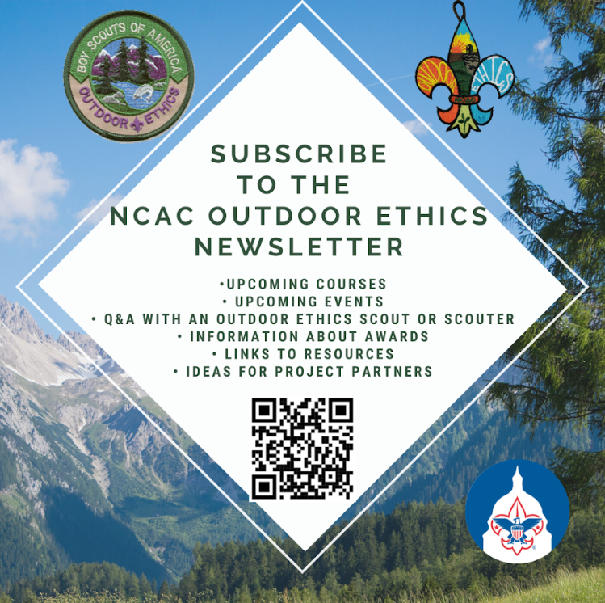
Outdoor Ethics
Newsletter

Slide 32


Merit Badges
The online Merit Badge Counselor registration.
New Merit Badge Counselors must complete online merit badge counselor training, in addition to YPT. Be sure the counselor uses his/her legal name – no nicknames.
Merit Badge Counselors, or the unit Dean/Leader, also need to scan and send Margee the Merit Badge application form listing the badges the counselor is applying to teach and providing a justification of his/her qualifications.
Youth Protection Training is the essential first step. Don’t hit “send” on the application without it!
Contact Margee if you have questions at GM.MB.Dean@hotmail.com.
Did you know:
The National Council does not limit the number of merit badges a youth may earn from one counselor, though a unit leader is permitted to do so, as long as the same limit applies to all Scouts in the unit. Ideally, Scouts should work with a variety of adults. (GTA 7.0.0.3)
Partial Merit Badges have no expiration except the Scout’s 18th birthday. (GTA 7.0.3.3)
Due to the BSA policies related to Youth Protection and two-deep leadership, a merit badge counselor must have another adult present during all merit badge counseling sessions. However, the parent or legal guardian of the Scout may serve as the second adult. This parent or legal guardian does not have to be a registered leader.
If the requirements for a merit badge differ between the merit badge pamphlet and the current edition of Scouts BSA Requirements, the requirements in the Scouts BSA Requirements book supersede all others.

Slide 33

GM High
Adventure
Members of the High Adventure Committee are available to assist units in planning and training for their upcoming high adventure trips – Contact Brian Heath for more information
Important notes for this month
  Registration for BSA’s high adventure bases – https://www.scouting.org/outdooradventures/open4adventure/
    2025 National High Adventure Base Reservations
      Registration for 2025 for all high adventure bases are now open
      OPIC: 25% off remaining slots for this winter!!
      PHILMONT
        Registration is mostly full – Only a few crew start dates still available
        Philmont is continuing to accept provisional attendance and will attempt to match them with crews willing to take them
      SUMMIT, NORTHERN TIER, & SEA BASE still have availability
    2026 National High Adventure Base Reservations
      NORTHERN TIER: Reservations open Jan 15, 2025
      SEA BASE: Reservations open Jan 15, 2025
      SUMMIT: Reservations open Jan 15, 2025
      PHILMONT: Lottery closed on Oct. 16, 2024
2025 NCAC-Organized High Adventure Trips
  Philmont – HAC is working with 1 crew – Slots may be available on this crew – Contact me for more information
  Lenhok’sin – Gathering interest for forming a crew – Contact me if you’re interested
Nov 2024
Notes:
Sea Base Trip on Jul 29-Aug 3, 2024 - FULL

Slide 34
GM High
Adventure
High Adventure Preparation Training
  Philmont Crew Training
    Virtual Sessions - November 17, 2024; January 5, March 23, 2025
    In-Person Session - April 5, 2025
  Philmont Adult Advisor Practice Hikes – March 8 & 16, 2025
  Northern Tier Training – In-Person - April 5, 2025; Online – April 19, 2025
  BCOLS Spring 2025 – Virtual Session - March 1; In-Person Session - April 26-27
  Wilderness First Aid – Multiple dates at Camp Snyder
National High Adventure Base Quick Links
  Philmont: https://www.philmontscoutranch.org/register/
  Northern Tier: https://www.ntier.org/provisional-scout-connections/
  Sea Base: https://www.bsaseabase.org/scouts/scout-connections/
  Summit: https://www.summitbsa.org/registration/scoutconnections/
Other High Adventure Bases
  Adirondack High Adventure Area: https://senecawaterways.org/massawepie-adirondack-treks/
  Maine High Adventure Area: https://www.mainehighadventure.org/
  Montana Outdoor High Adventure Base: https://montanabsa.org/camps/high-adventure/
Other useful links for high adventure information and opportunities
  NCAC High Adventure website - https://www.ncacbsa.org/high-adventure/
  List of units with available slots in their upcoming high adventure trips - https://public.3.basecamp.com/p/xWpkdrKHKAA9pCzwmHMNdbWb
Nov 2024 (cont.)
Notes:
Sea Base Trip on Jul 29-Aug 3, 2024 - FULL

Slide 35
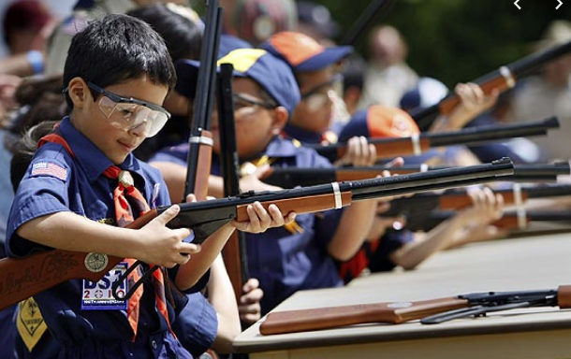
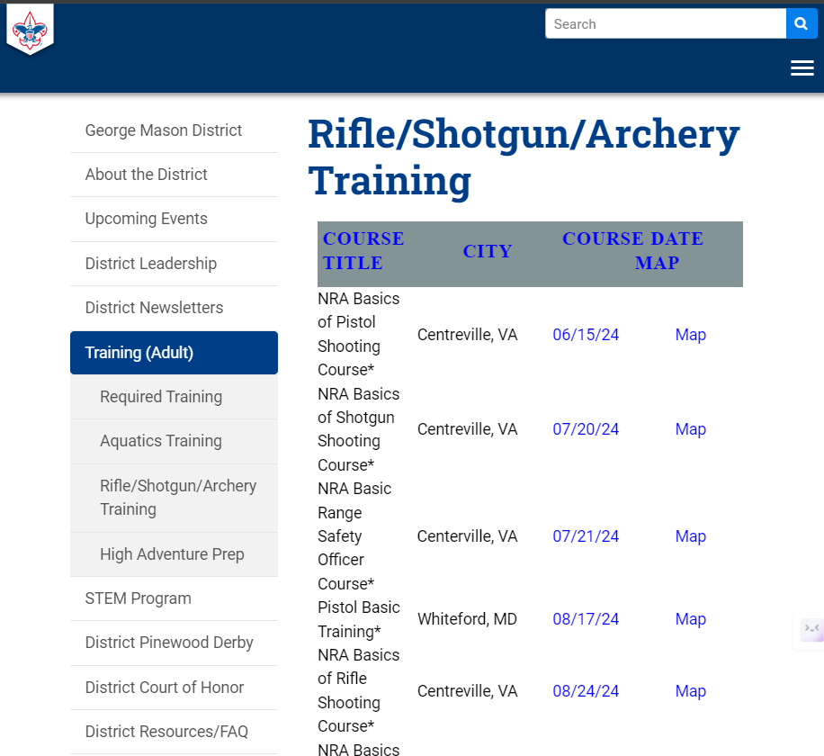
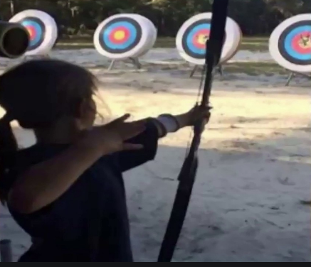
Range and Target Activities
Requests for Shooting Events – Lead Time!
  50+ scouts - 6mos
  Less than 50 scouts - 3mos
Shooting on private land:
  Requirements
  Permissions/protocols
R&TA web page
R&TA Instructor Classes

Slide 36
Order of the Arrow
  Brian Fleck is Chapter Advisor.
  2024 Dues can be paid online: https://wipit470.org/dues.html
  Registrations open online https://wipit470.org/index.html under “Events”

