Slide 1

Resource Management: Item, Holding, & Relinking Records
Shared Library Services Platform Project
Maggie McGee

Slide 2
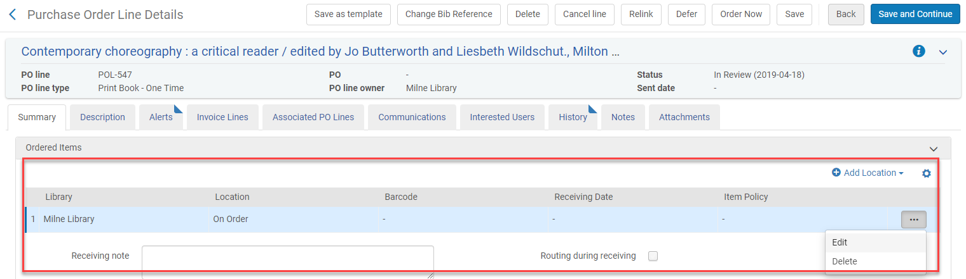
Holdings Records Overview
Holdings records are created upon Order in Alma
Holding records can be added/edited/deleted during PO Line (POL) creation
    Holding records and item records are created (one time order)
    Holdings records are created (continuous order)
    No inventory is created (standing order)

Slide 3
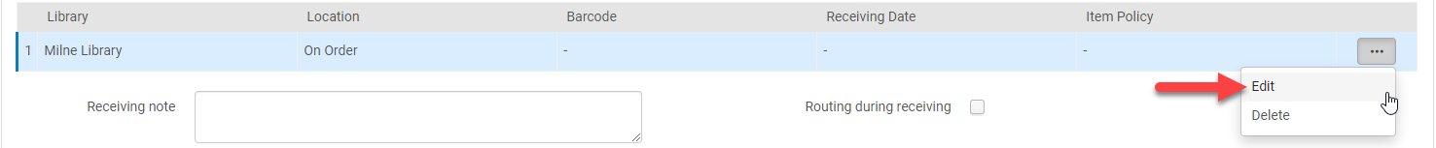
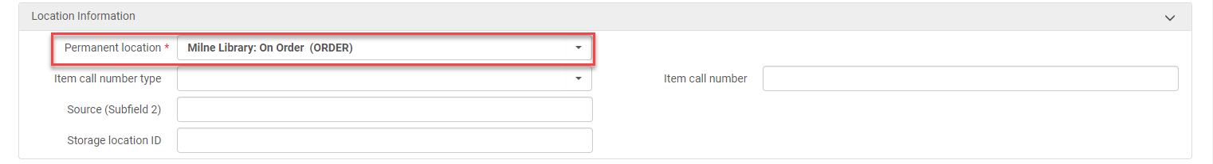
Holdings Records Management in the Order Record
The holdings record is created with a location of On Order and it can be:
  Left as it is
    Will change the location upon receiving or cataloging the item
  Edited
    Click Edit from the ellipses
    Change the Permanent Location from On Order to the desired location

Slide 4
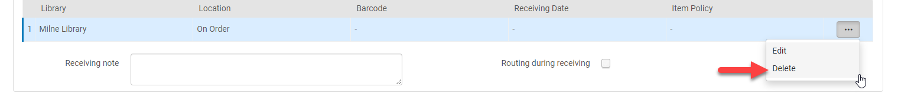
Holdings Records Management in the Order Record
  Deleted
    The “On Order” holding record can be deleted in the POL when:
      When ordering a Physical – Continuous Order (serials and continuous titles)
        Create the holding record for the permanent location in order to allow receiving to work properly
      If there are multiple copies and you want to identify the location of each copy

Slide 5
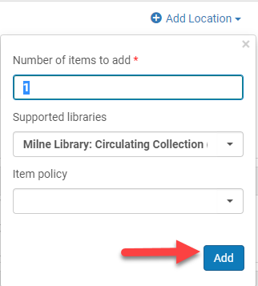
Holdings Records Management in the Order Record
  To add a holdings record in the POL
    Click Add Location
      Number of items to add: [defaults to 1]
      Support libraries: [select the appropriate library and location]
      Item Policy: [optional because it will be inherited from the Fulfillment Unit]

Slide 6
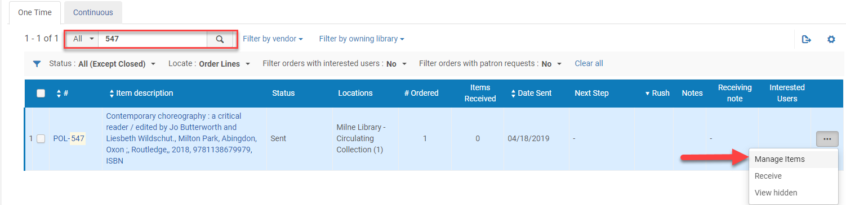
Holdings Records Management Upon Receiving
The holdings record can be changed when receiving an item
Go to Acquisitions>Receiving and Invoicing>Receive
  Click on the appropriate tab and search for the item
  Click Manage items from the ellipses
  Click Edit Inventory Item from the ellipses of the item record

Slide 7
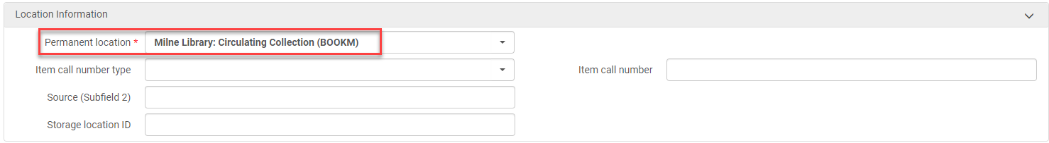
Holdings Records Management Upon Receiving
  Change the Permanent location to update the holdings
    This changes the location $$c in the MARC Holdings field 852
      $$c can be changed in the holdings record and it updates the item record location

Slide 8
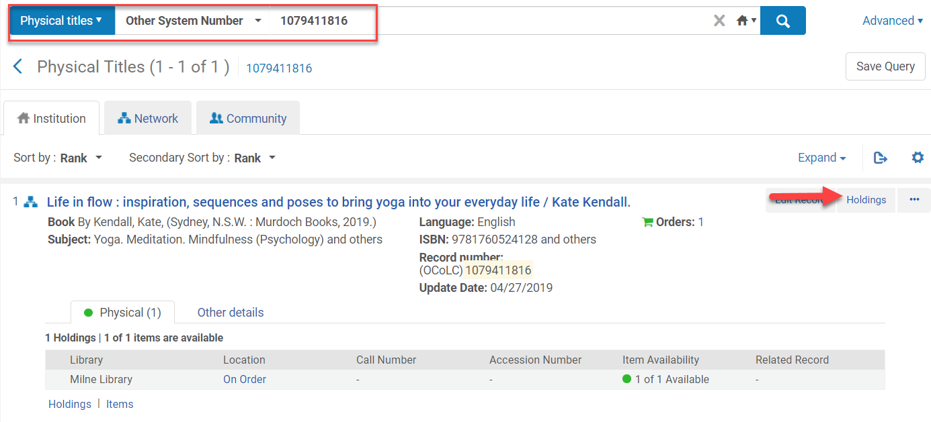
Editing Holdings Records from the MD Editor
Perform a repository search from the item in hand: Physical titles:[choose search criteria]: [search by title, ISBN, etc.)
Click Holdings

Slide 9
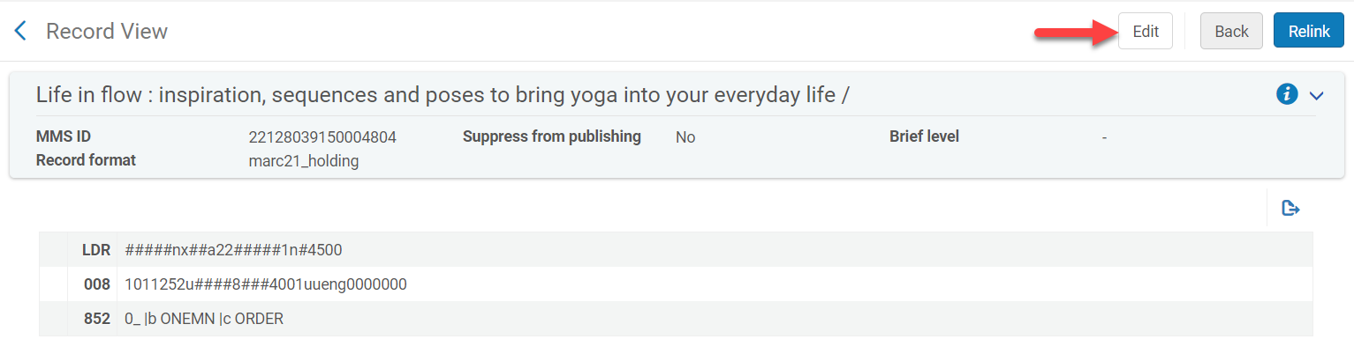
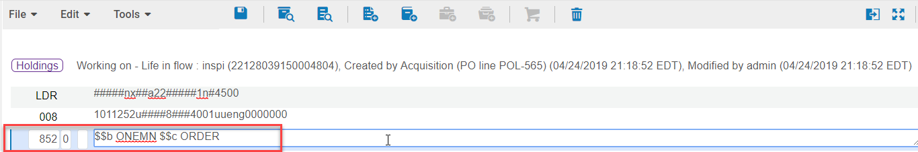
Editing Holdings Records from the MD Editor
Click Edit from the Holdings record screen
The MD Editor (Metadata Editor) opens
Click into the field you want to edit or Add Field (F8 or Edit>Add Field)

Slide 10
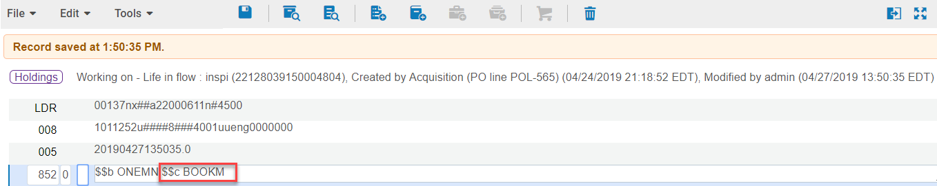
Editing Holdings Records from the MD Editor
Ctrl+F (Edit>Open Form Editor) or edit right in the MARC holdings field
Make the appropriate changes
  Example, change the location in MARC Holdings field 852 $$c

Slide 11
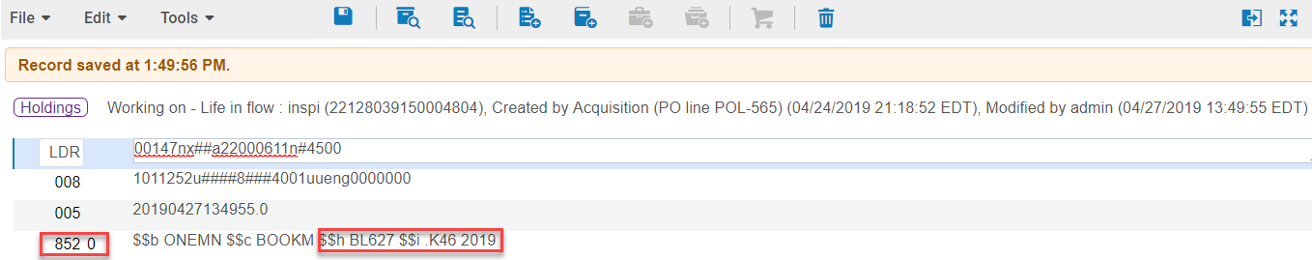
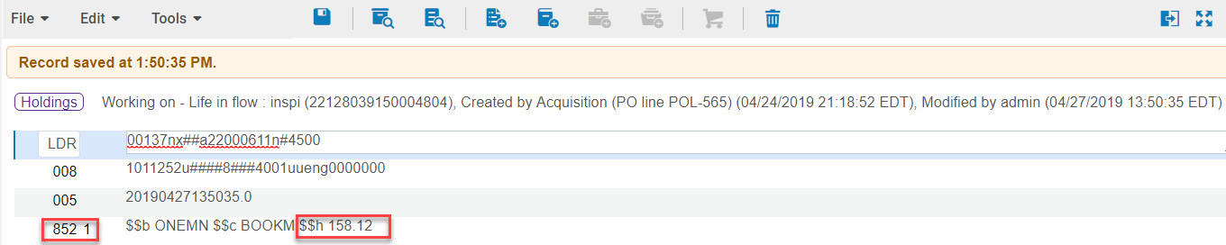
Editing Holdings Records from the MD Editor
If it is an On Order Holdings record being edited and there is no $$h or $$i
  Saving the record after changing the location will populate $$h and $$i with the first call number that meets all the criteria based on call number mapping
  Change MARC Holdings field 852 first indicator to have the correct call number populate
    Example 1: LOC call number
    Example 2: Dewey call number
  The call number can also be manually changed to meet local classification standards

Slide 12
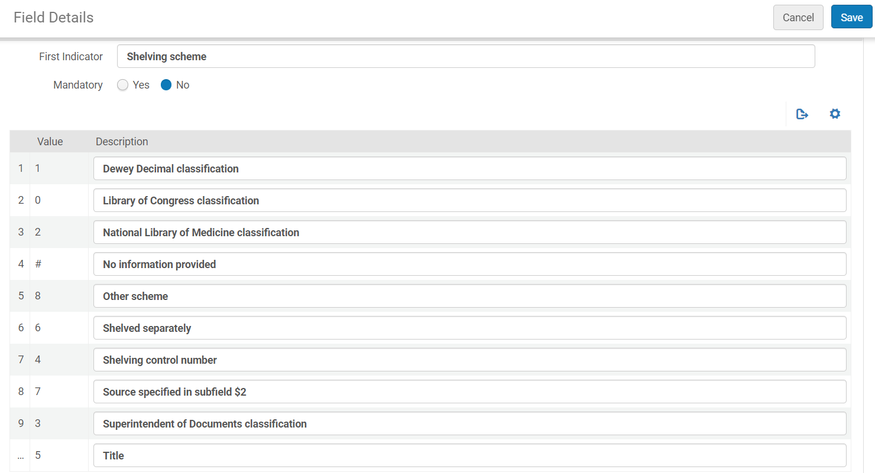
First Indicator MARC Holdings Field 852

Slide 13
Adding Holdings and Item Records from the MD Editor
Institutional holdings and item records can be added from the NZ or IZ bib record
Holdings and item records created from a NZ bib record will create the holdings and item records in the IZ
  There is no physical inventory in the NZ
Standing Orders titles are received by adding the holdings and item records from the NZ bib record

Slide 14
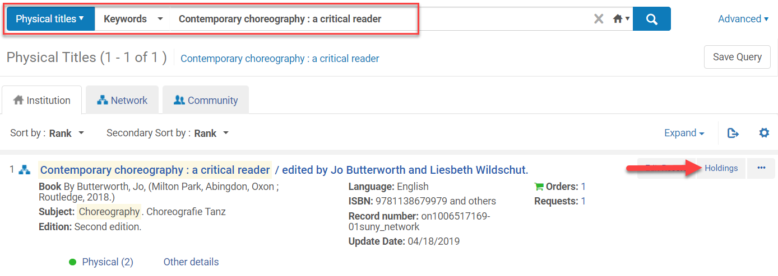
Adding Holdings Records in the MD Editor from the IZ
Perform a repository search in the IZ for the item in hand using: Physical Titles>Keywords: [title]
Click on Holdings

Slide 15
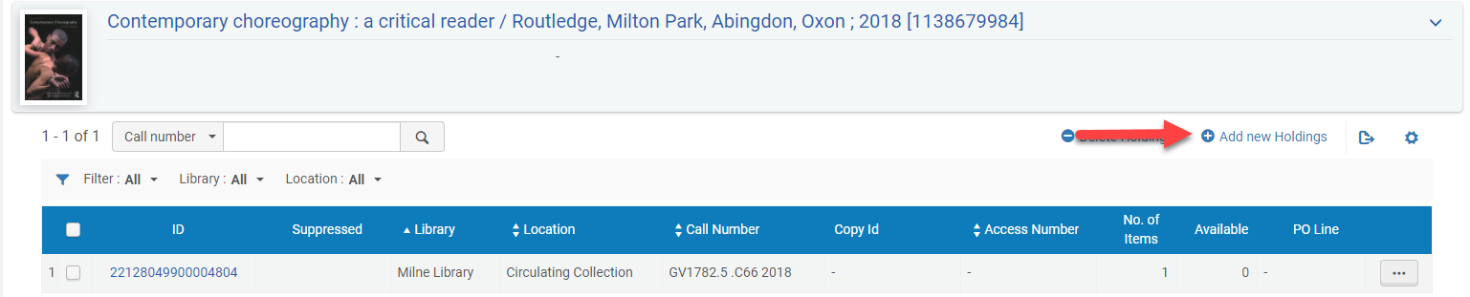
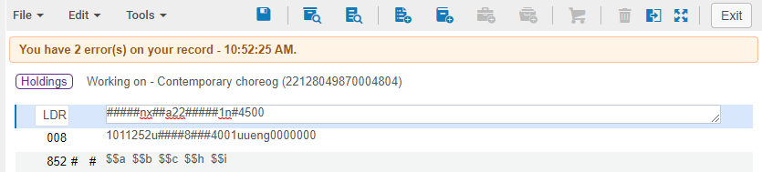
Adding Holdings Records in the MD Editor from the IZ
The holdings records list will open
  Click Add New Holdings
The holding record opens up in the Metadata Editor

Slide 16
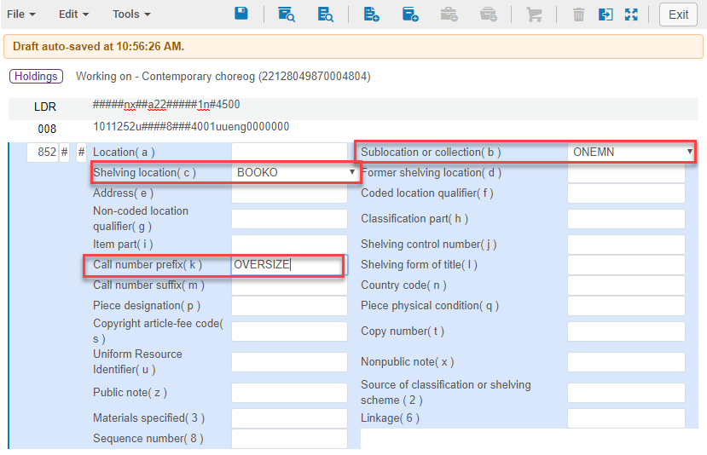
Adding Holdings Records in the MD Editor from the IZ
Edit MARC Holdings field 852 in the holdings record
  Change the first indicator to have the correct call number populate the holdings record
Edit directly in the MARC field or use Ctrl+F opens the form editor
  Select $$b
    Must populate this subfield first or there will not be any locations in $$c from the pull-down menu
  Select $$c
  Select $$k (if necessary)
  Hit ESC to close the form editor

Slide 17
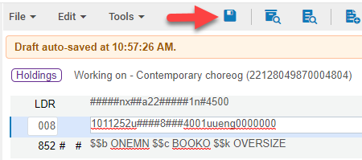
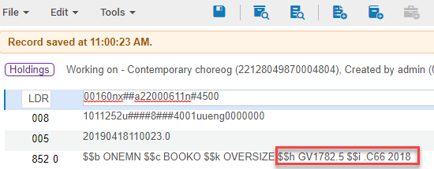
Adding Holdings Records in the MD Editor from the IZ
Click the Save icon (Ctrl+S)
  The call number from MARC Holdings field 852 indicator 1 will populate the call number upon saving
  Edit the call number if it does not reflect local classification schema
Save and Release the holding record once done (Ctrl+Alt+R)
  The holdings record has been created, but there are no items associated with this holding record
  Item record(s) need to be added

Slide 18
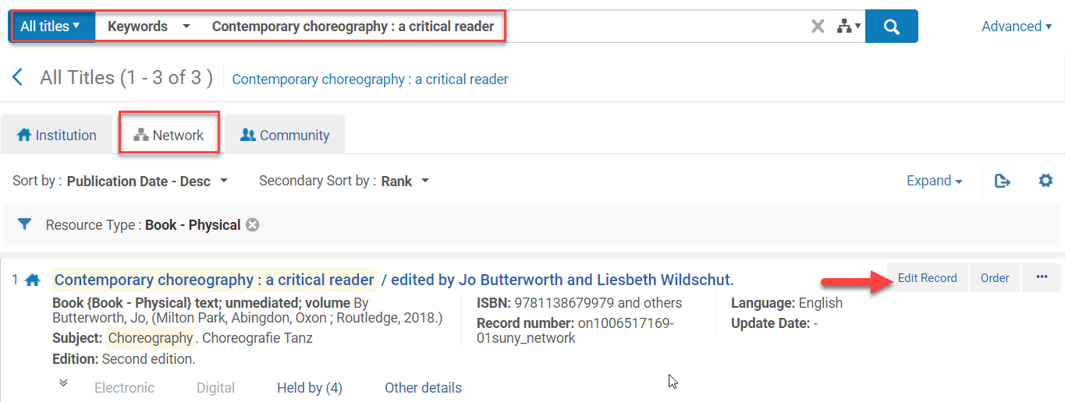
Adding Holdings Records in the MD Editor from the NZ
Perform a repository search in the NZ for the item in hand using: All Titles>Keywords: [title]
Click Edit Record
The bib records opens in the Metadata Editor

Slide 19
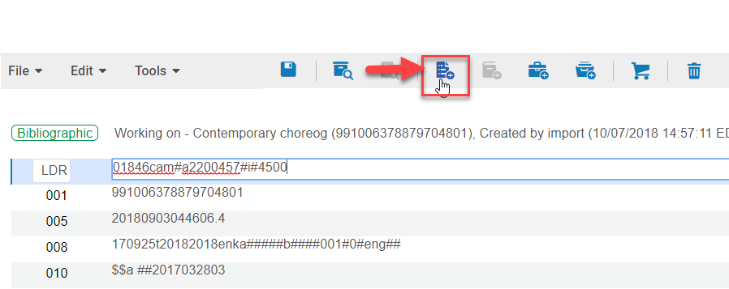
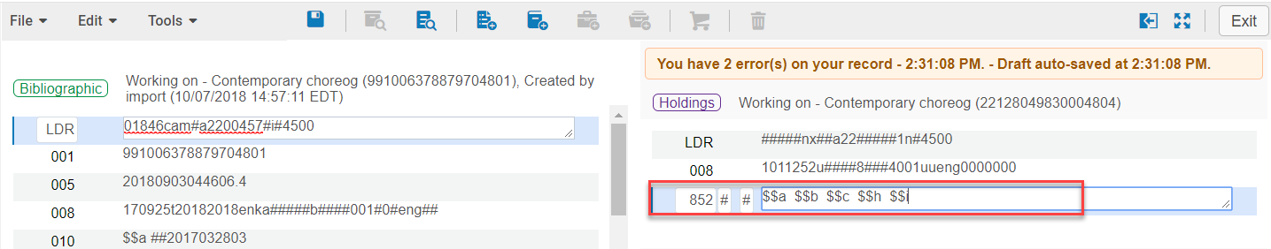
Adding Holdings Records in the MD Editor from the NZ
Click on the Add Holdings Icon (Ctrl+Alt+H)
The holdings record opens up in the split screen
Click in the 852 MARC Holdings field

Slide 20
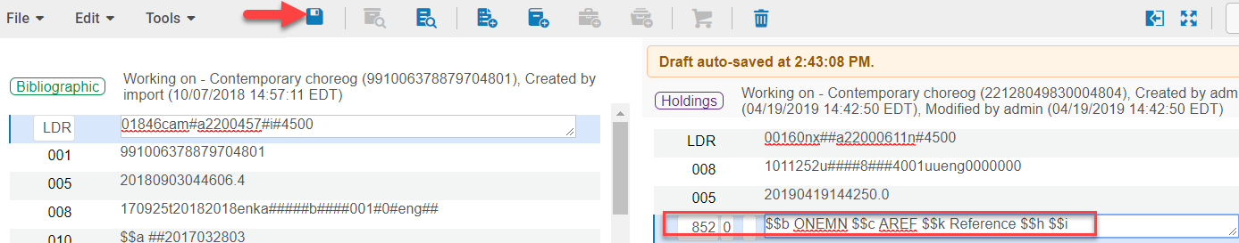
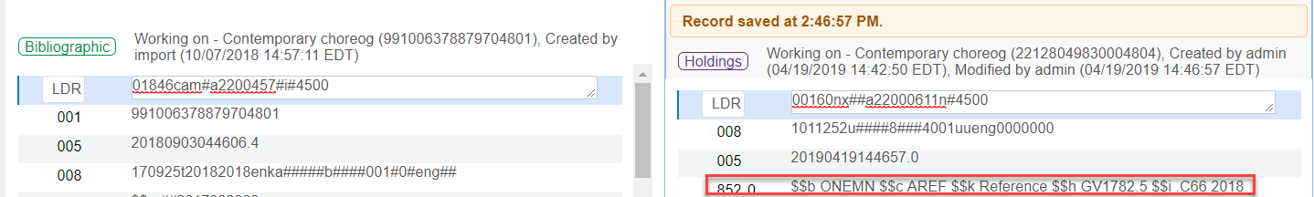
Adding Holdings Records in the MD Editor from the NZ
Change the first indicator in MARC Holdings field 852 to have the correct call number populate the holdings record
Enter $$b, $$c, $$k in the 852
Click on the Save icon (Ctrl+S)
After the holding record is saved the call number populates from the bib record based on the first indicator in MARC field 852
The item record needs to be added

Slide 21

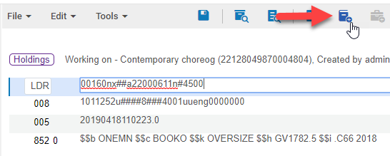
Adding an Item Record to Holdings Record
Click on the Add Item icon (Alt+I)
The Physical Item Editor screen opens. Add the following information:
  Barcode
  Material type
  PO Line if this is being attached to an existing POL (Standing Orders)
  Receiving date
  Temporary location (if applicable)
    This creates another holdings record
  Click Save

Slide 22
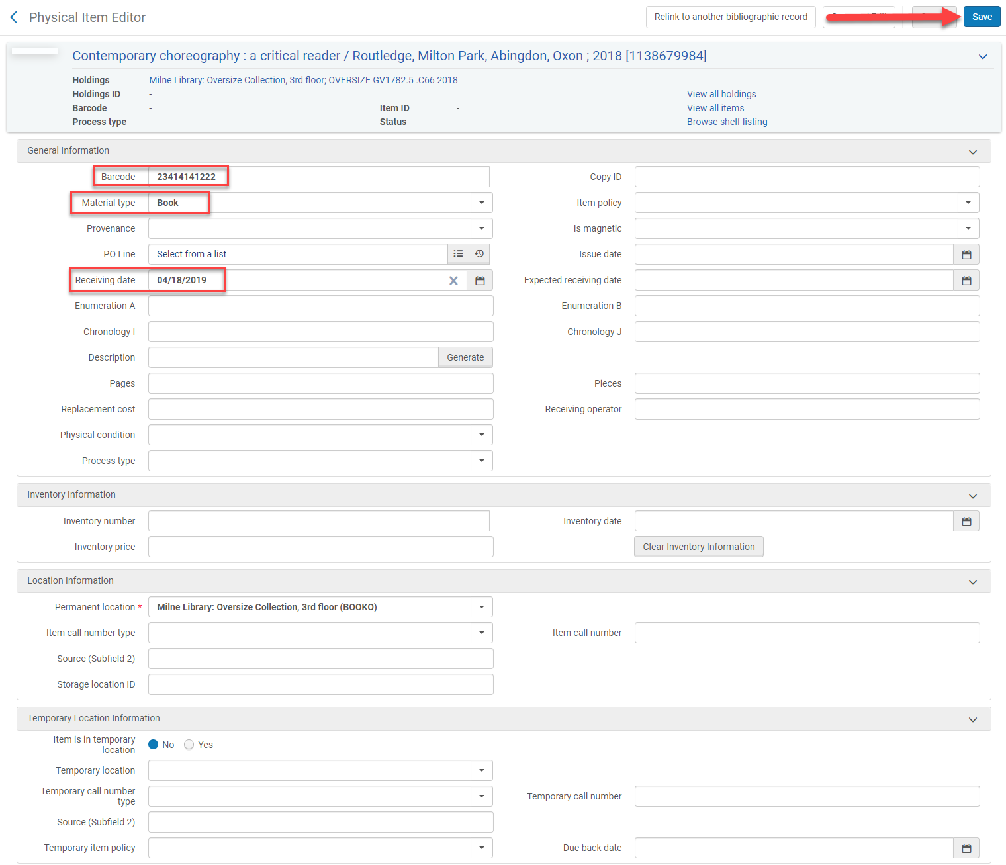
Adding an Item Record to Holdings Record

Slide 23
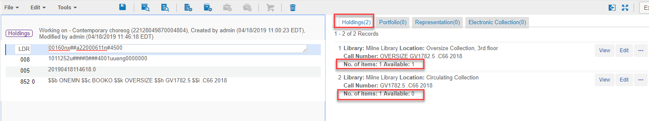
Viewing Inventory in the MD Editor
The Metadata Editor opens displaying the Holdings records once the item record has been saved
  It displays the number of items
  It displays if the item is available or not
  The holdings can be viewed, edited, or deleted

Slide 24
Viewing Inventory in the MD Editor
View – allows the holding record to be viewed
Edit – opens the holdings record in the MD Editor
Ellipses
  View Items – opens the List of Items screen where you can view, edit, duplicate, change location, withdraw, Toggle Missing Status, Work Order, View Hidden
  Delete – deletes the holding record

Slide 25
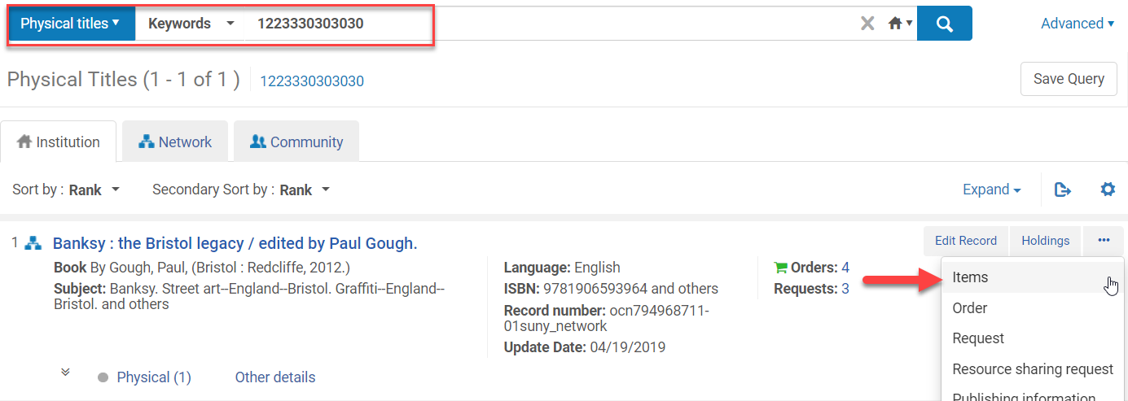
Withdrawing Item Records
Withdrawing = Deleting
Perform a repository search for the item by choosing Physical titles:Barcode (or other search term):[barcode]
Click Items from the ellipses

Slide 26
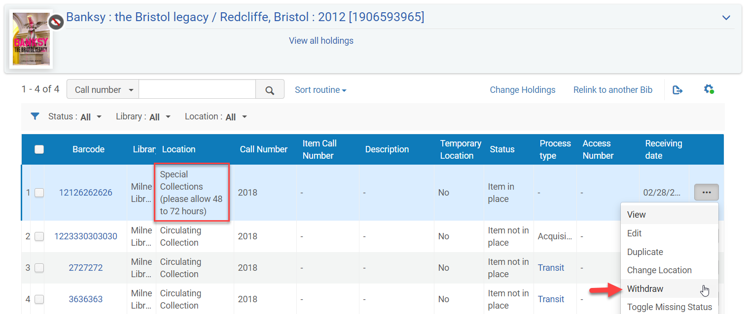
Withdrawing Item Records
Click on Withdraw from the ellipses next to the item being withdrawn

Slide 27
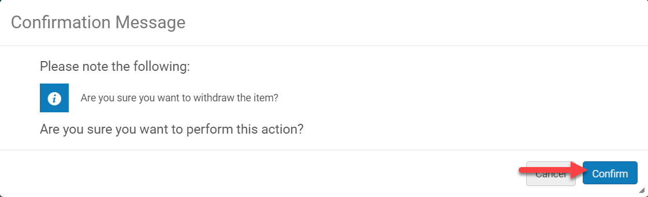
Withdrawing Item Records
Click Confirm if you really want to withdraw the item
If it is the last item on the Holdings record, but there are other holdings records a pop-up screen appears
  Select Delete holdings record
  Click Go

Slide 28
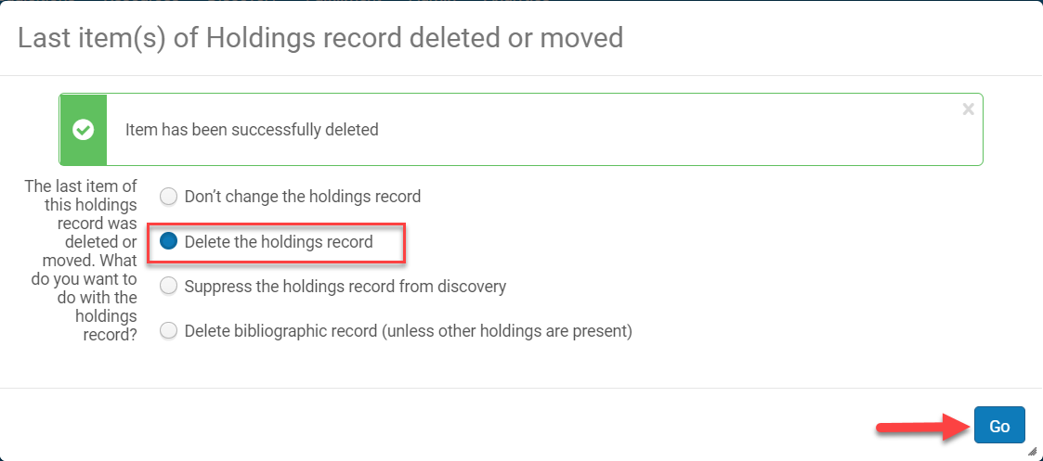
Withdrawing Item Records

Slide 29
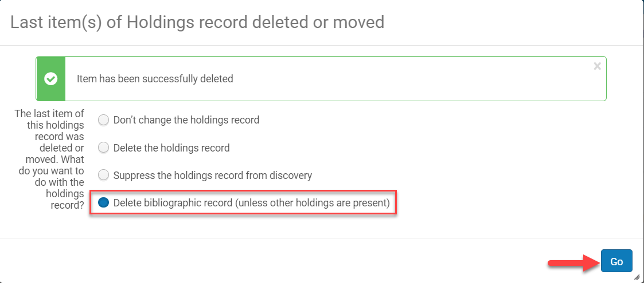
Withdrawing Item Records
If it is the last item on the Holdings record and there are no other holdings records a pop-up screen
  Select Delete bibliographic record (unless other holdings are present)
  Click Go

Slide 30
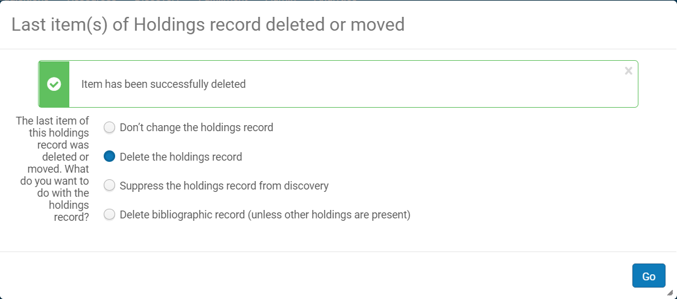
Last Item(s) and Holdings Record Deleted or Moved Screen Explained
Don’t change the holdings record
  This keeps the holdings record and it displays in PrimoVE
Delete the holdings record
  Withdraws the holding record, but the bib record remains in the IZ
Suppress the holdings record from discovery
  Withdraws the item record and suppresses the bib record in PrimoVE
Delete bibliographic record (unless other holdings are present)
  The holdings and IZ bib record are withdrawn

Slide 31
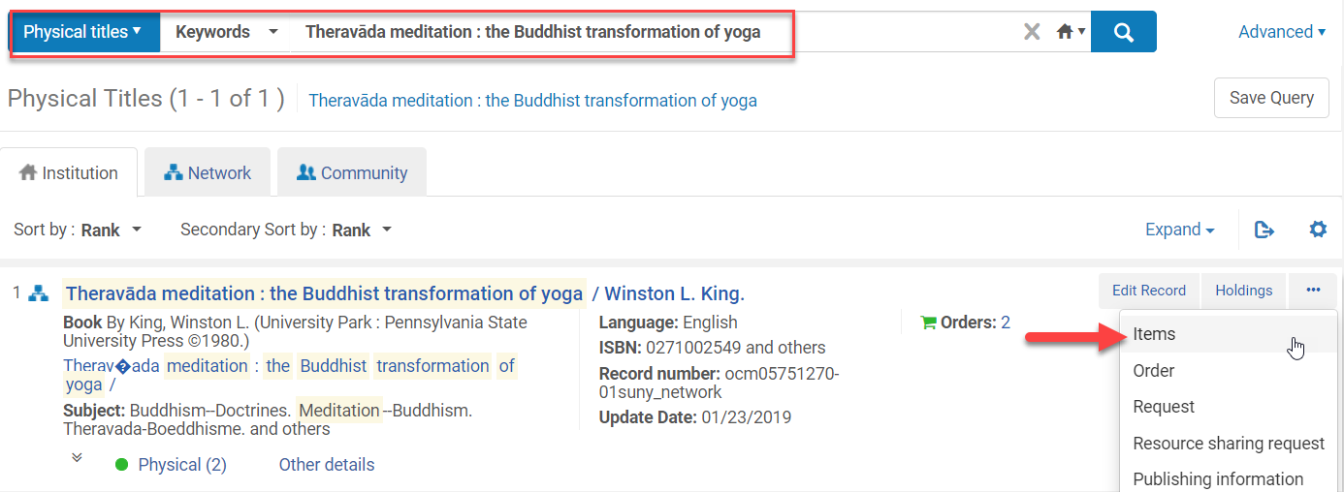
Missing Items
Marking an item missing in Alma does not happen in the item record
Perform a repository search for the item
Click Items from the ellipses

Slide 32
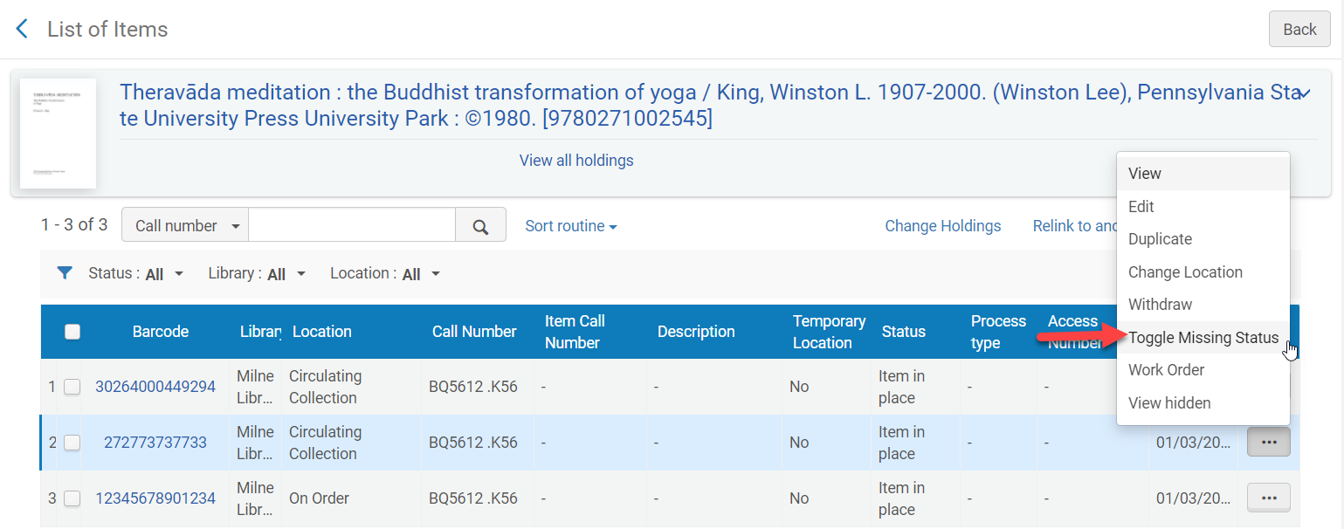
Missing Items
Identify the item to be marked missing
Click Toggle Missing Status from the ellipses

Slide 33
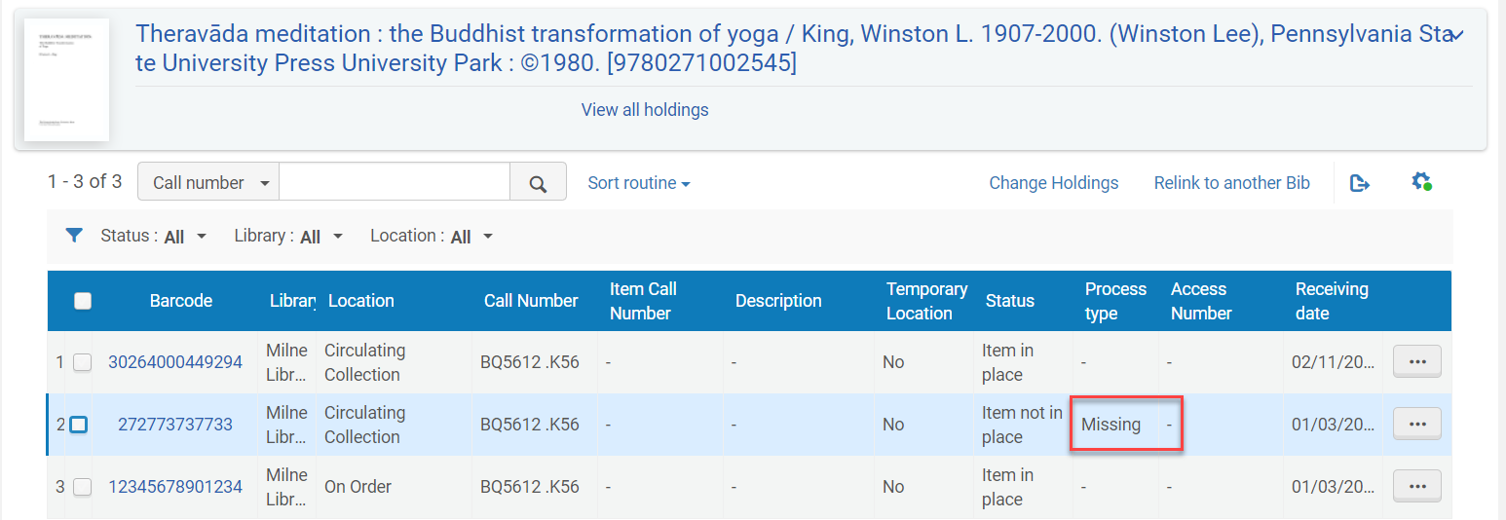
Missing Items
The Item Process type has been changed to Missing

Slide 34
Missing Items
Removing the Missing processing type
  Perform a repository search for the item that needs to be unmarked missing
  Click Items from the ellipses

Slide 35
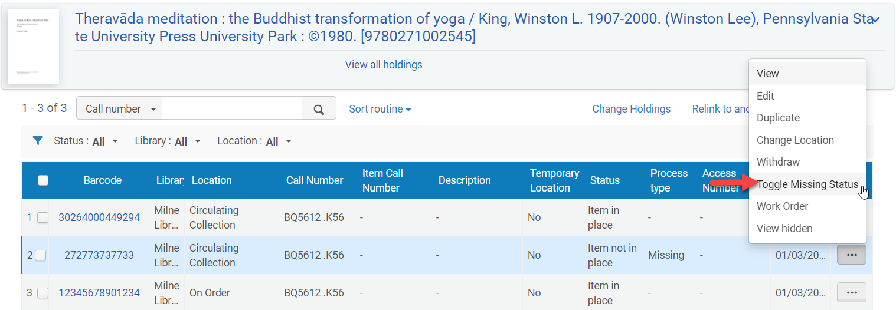
Missing Items
Removing the Missing processing type continued
  Identify the item to be unmarked missing
  Click Toggle Missing Status from the ellipses
  The Missing processing status has been removed

Slide 36
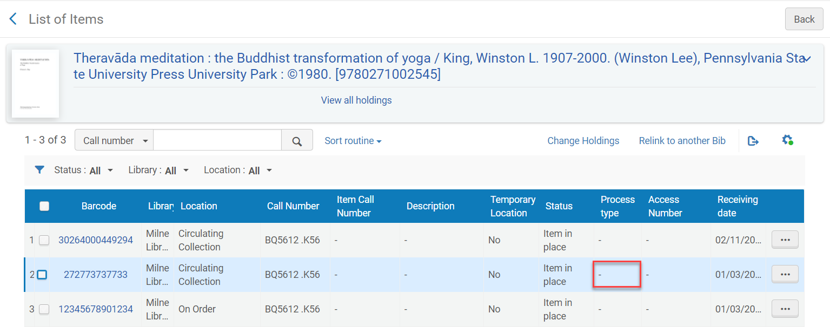
Missing Items
Removing the Missing processing type continued
  The Missing processing status has been removed

Slide 37
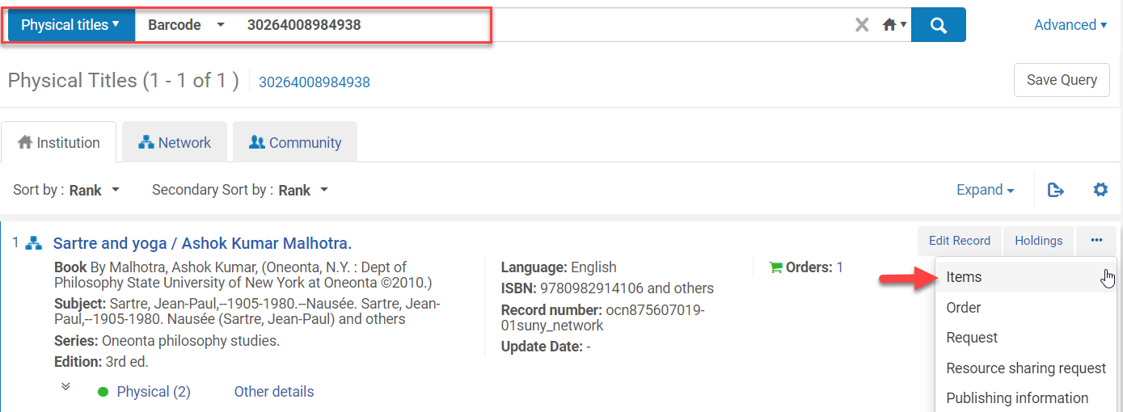
Moving Items Between Bib Records
Use this to move an item between bib records if an item was accidently added to the wrong bib record
Perform a repository search
Click on Items from the ellipses

Slide 38
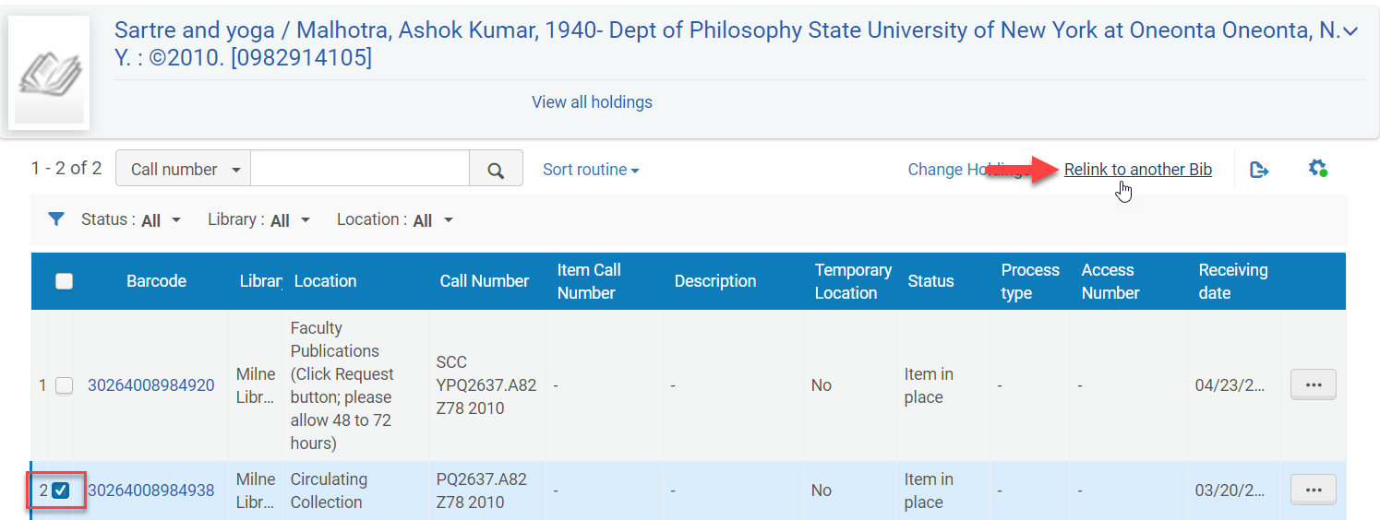
Moving Items Between Bib Records
Click in the box next to the item being moved
Click on Relink to another Bib

Slide 39
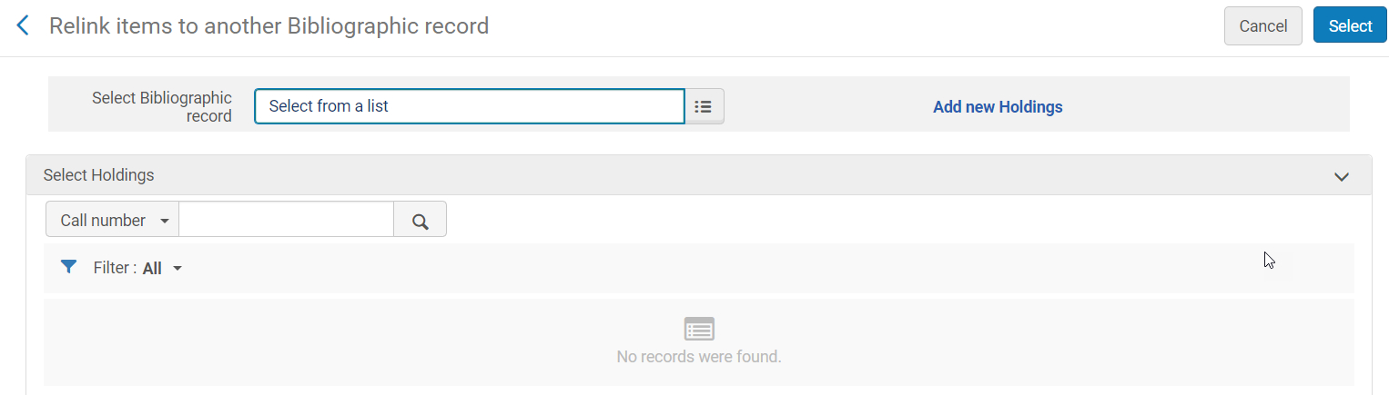
Moving Items Between Bib Records
The Relink items to another Bibliographic record screen opens
Select the new bib record

Slide 40
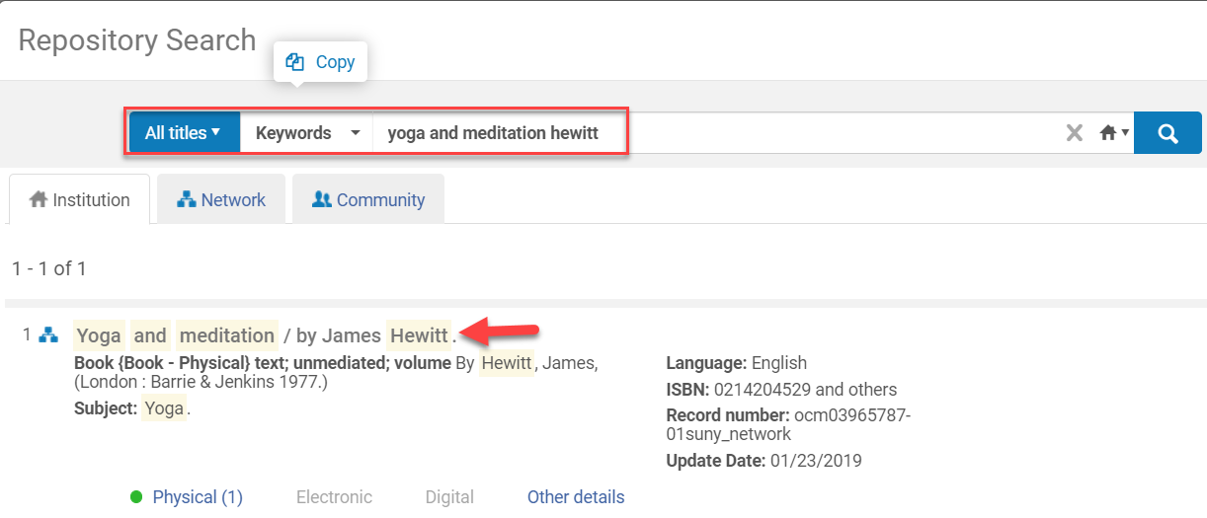
Moving Items Between Bib Records
Click on the title link where the item record will be moved to

Slide 41
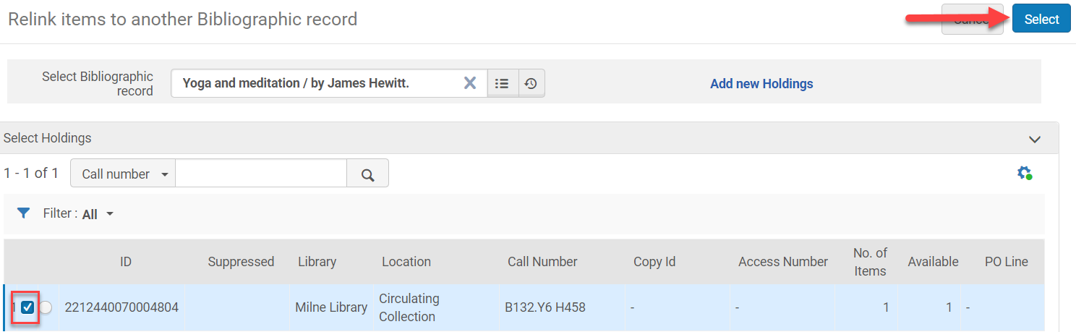
Moving Items Between Bib Records
Click in the check box next to the holdings record the item should be attached to
  Create a holdings record if the location is different by clicking on Add new Holdings
Click Select

Slide 42
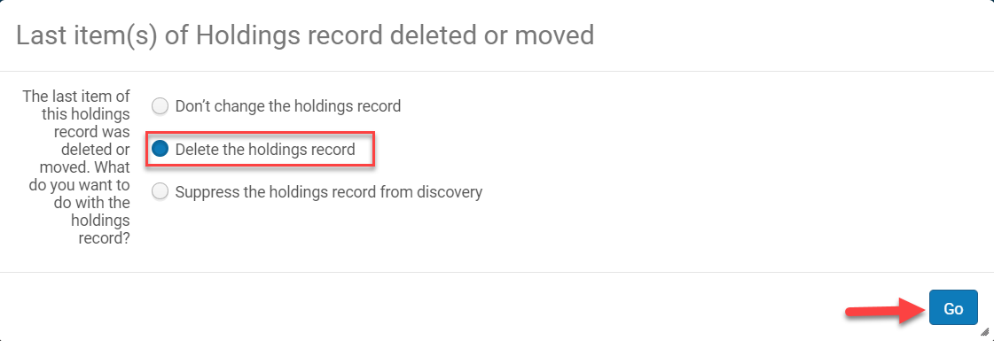
Moving Items Between Bib Records
Click on the desired action
  Don’t change the holdings record – keeps the holding record
  Delete the holdings record – deletes the holdings record
  Suppress the holdings record from discovery – does not display in PrimoVE
Click Go
The item is now attached to the new bib record

Slide 43
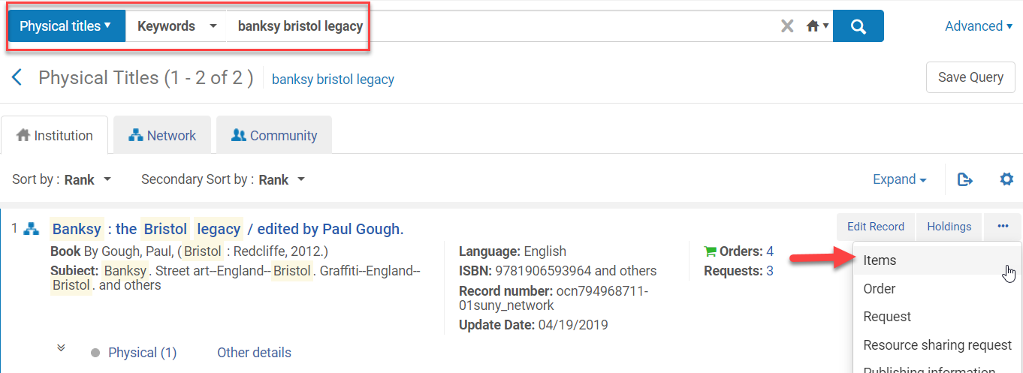
Moving Items Between Holdings on the Same Bib Record
Perform a repository search
Click on Items from the ellipses

Slide 44
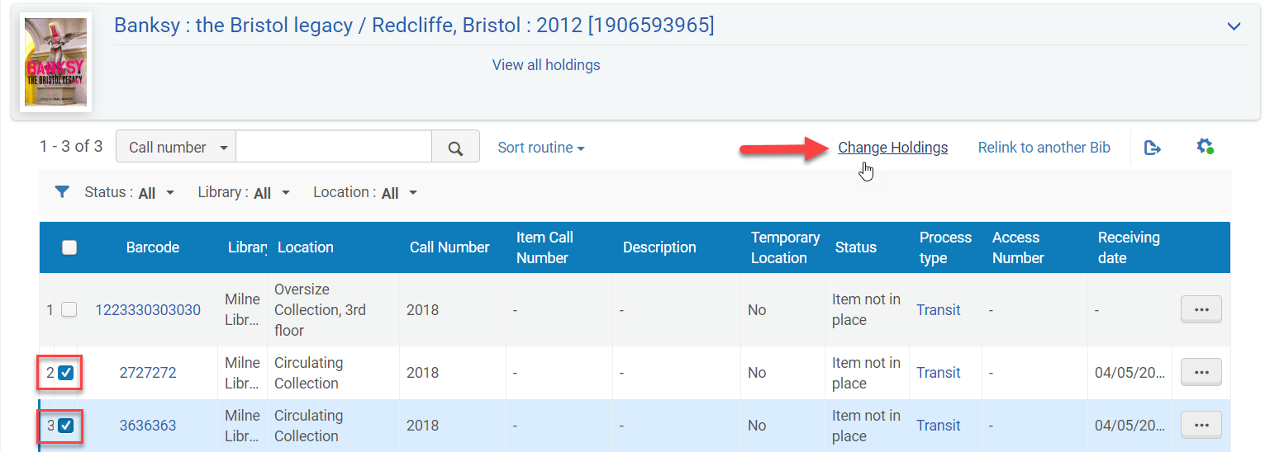
Moving Items Between Holdings on the Same Bib Record
Click in the box next to the item record that will be moved to another holdings record on the same bib record
Click Change Holdings

Slide 45
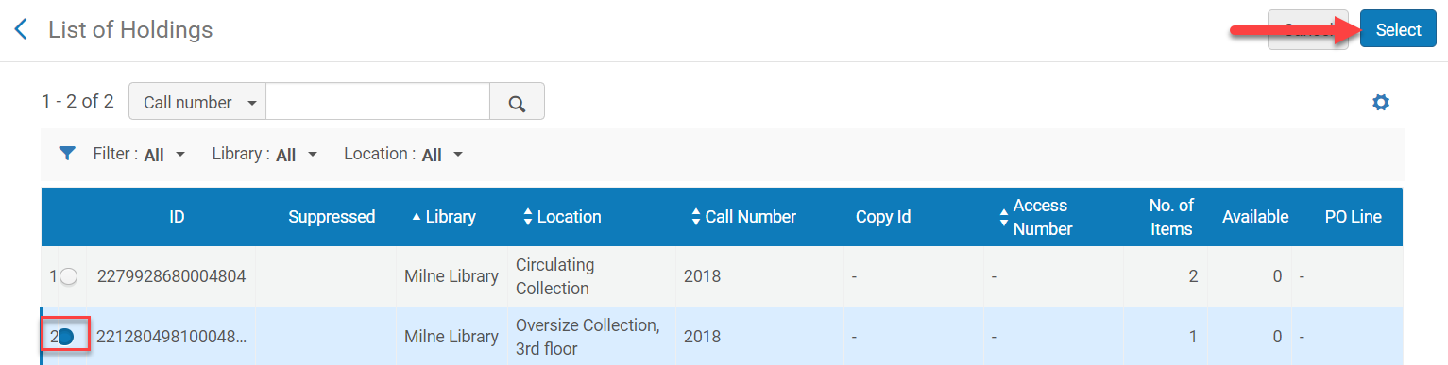
Moving Items Between Holdings on the Same Bib Record
Click on the radio button next to the holdings record the item is going to be moved to
Click Select

Slide 46
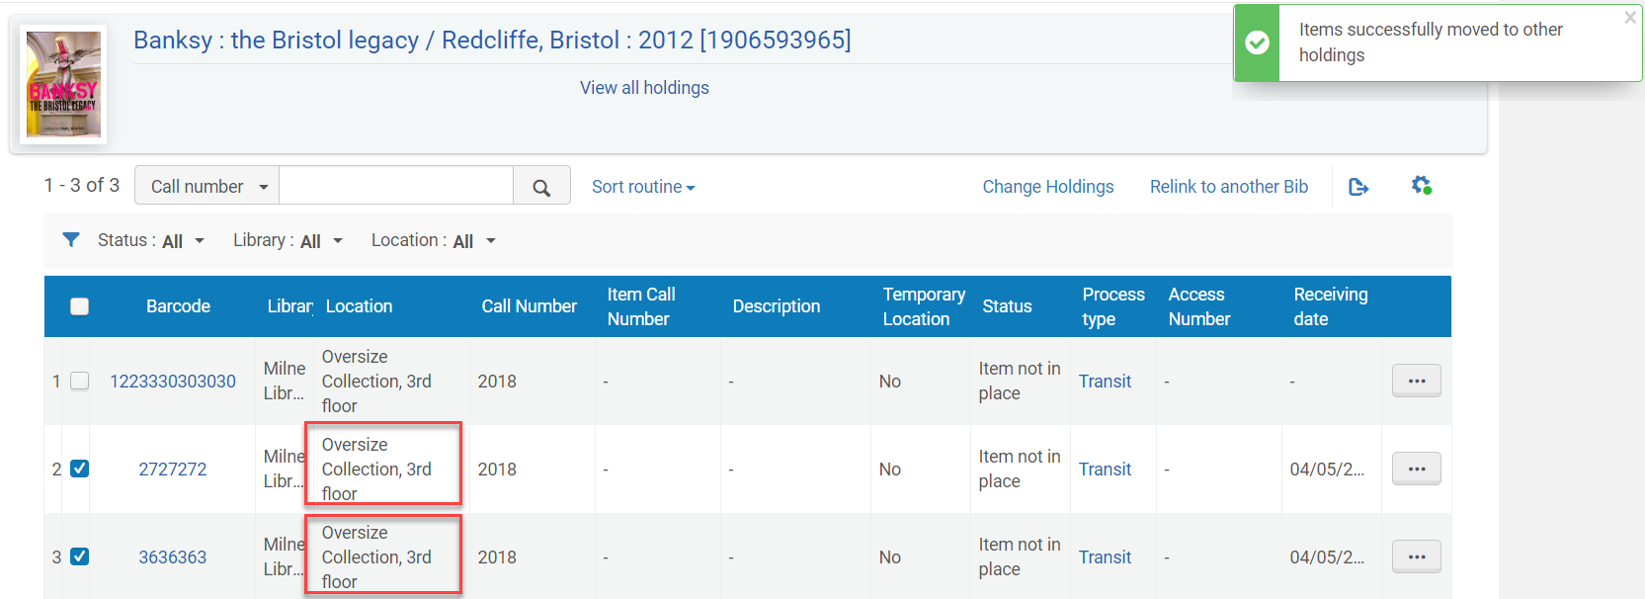
Moving Items Between Holdings on the Same Bib Record
The item(s) are moved to the new location

Slide 47
Relinking Holdings Records
Relinking holdings records relinks the holdings and associated item records
The bib record does not move and is still in the IZ and discoverable in PrimoVE
Holdings records cannot be relinked if there is an active request on an item
A holdings record can be relinked if an item is on loan

Slide 48
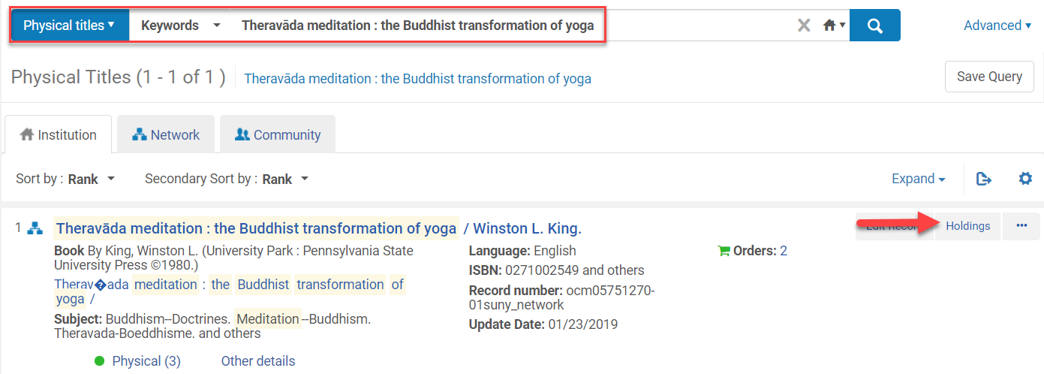
Relinking Holdings Records
Perform a repository search
Click on Holdings

Slide 49


Relinking Holdings Records
Click Relink on the ellipses of the holdings record being relinked
The MD Editor opens

Slide 50



Relinking Holdings Records
Click on the radio button next to Network
  Unless it’s an IZ record the holdings record is being relinked to
Input the appropriate search criteria
Click Search
Click Relink
The holdings record and associated items are relinked to the new bib record

Slide 51

Relinking Holdings Records
Open the bib record in the MD Editor by clicking on the View Bibliographic Record icon (Ctrl+Alt+B) to verify it was linked to the correct record
The split screen editor will open to display the bib records
Save and Release the record (Ctrl+Alt+R) or File>Save and Release Record

Slide 52
Relinking Bib Records
The OCLC number cannot be overlayed to replace a bib record that has items, holdings, and orders attached
Orders attached to the wrong bib record need to be relinked to the correct bib record from the PO Line (POL)
  Relinking from the POL will move the corresponding items and holdings to the correct bib record and retain the POL
Possible reasons to relink from the POL
  An EOD arrives for a single volume within a multi-volume work which is more suitable to link to than the existing link.
  An item arrives that matches an existing bibliographic record more suitably than the bib imported at the time of the order

Slide 53
Relinking Bib Records
Relinking is available for
  PO lines with the status In Review, Deferred, Autopackaging, Manual packaging, or Ready
PO lines cannot be relinked if
  The PO line has items in a temporary location
  The PO line has items on loan
  The PO line is linked to a record from the Community Zone
  The PO line contains items belonging to two different bibliographic records
  The PO line for an electronic title lacks an MMS ID

Slide 54

Relinking Bib Records
Perform a repository search for the POL that needs to be relinked
Click on the PO Line number link

Slide 55

Relinking Bib Records
Click Relink
Perform a repository search for the bib record to attach the POL to
Click on the title link for the appropriate title

Slide 56


Relinking Bib Records
Click Confirm from the pop-up menu
The POL is now attached to the correct bib record

