Slide 1

Best Practice Sharing Meeting:
NCQA Y2 Cohort
Care Transformation Collaborative of Rhode Island
October 27th, 2022

Slide 2

Agenda
8:00 am | Welcome | Dr. Nelly Burdette
8:05 am | Lessons and Highlights on the NCQA Distinction application process from Associates in Primary Care | William R. Webb Gregory Steinmetz, MD
8:40-8:55 am | Questions/Discussion
8:55-9:00 am | CTC-RI Updates/Next Steps | Dr. Liz Cantor
9:00am | Additional Technical Assistance/Office Hours available (optional) | Dr. Nelly Burdette Dr. Liz Cantor Dr. Kristin David
Thank you to UnitedHealthcare for sponsoring this project
Meeting will be recorded; Please keep your microphone on mute

Slide 3
Housekeeping
Please…
  Mute yourself when not speaking
  Feel free to put questions in the chat
  If possible, please have your camera when asking questions
Note: This meeting will be recorded and posted on the CTC-RI IBH webpage: https://www.ctc-ri.org/integrated-behavioral-health/tele-ibh-and-ncqa-bh-learning-collaborative

Slide 4
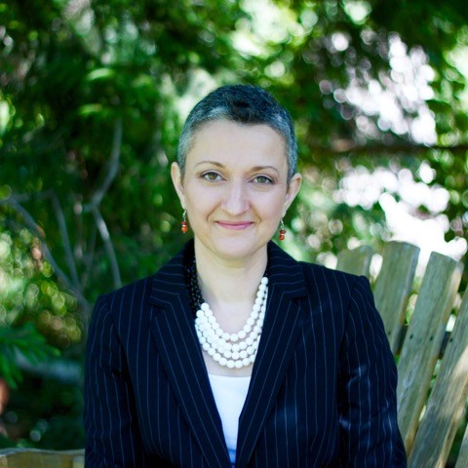
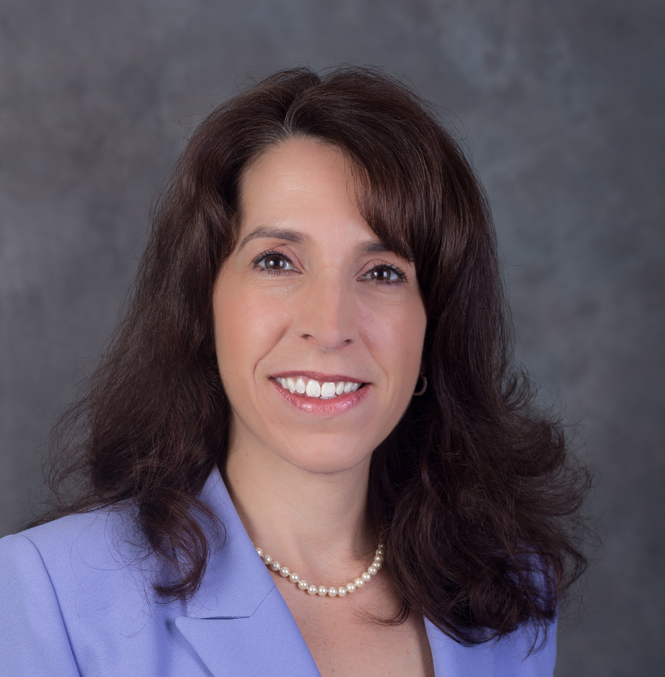
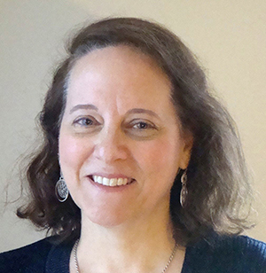

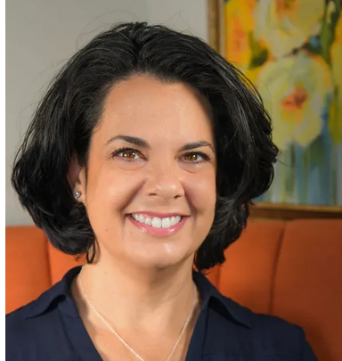
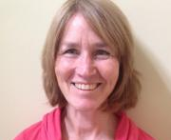

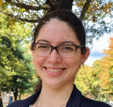

Meet the CTC-RI Team
Nelly Burdette, PsyD
Senior Program Director
Linda Cabral, MM
Program Manager
Liz Cantor, PhD
Practice Facilitator
Debra Hurwitz, MBA, BSN, RN
Executive Director
Susanne Campbell, RN, MS,
PCMH CCE
Senior Program Director
Kristin David, PhD
Practice Facilitator
Pano Yeracaris, MD, MPH
Chief Clinical Strategist
Edyth Dwyer, MPA, MPH
Program Coordinator
4

Slide 5
NCQA Y2 Participating Practices
Practices Continuing in Year 2 | New Practices for Year 2
Anchor Medical Lincoln | Hasbro Children's Hospital Pediatric Primary Care
Anchor Medical Providence | Barrington Pediatric Associates
Anchor Medical Warwick | Aquidneck Pediatrics
CNEMG Family Care Center | NRI Pediatrics
Brown Medicine *
* Achieved NCQA Distinction – Congratulations!

Slide 6
Introduction
William R. Webb, MHA, BSN, RN
Director of Clinical Operations and Value Based Programs
Physician Integration, CharterCARE Health Partners (CCHP)
Gregory Steinmetz, MD
Primary Care Physician
Associates in Primary Care Medicine

Slide 7
Experience of a Cohort 1 Practice Recently Awarded NCQA BH Distinction
Associates in Primary Care Medicine: Dr. Steinmetz and Bill Webb
Agenda:
  Lessons Learned
  Tips/Suggestions
  Questions/Discussion

Slide 8
Overview of Associates in Primary Care Medicine
Practice/SOC Overview
  Offering IBH since 2016
APCM recognized with NCQA BH Distinction in May 2021
  NCQA PCMH in 2008
  NCQA PCMH w BH Distinction in April 2022
PDSA Aim: Establish a standardized workflow, including Clinical Decision Support, for patients with a potential for suicide (NCQA BH Criteria BH03, BH13)

Slide 9
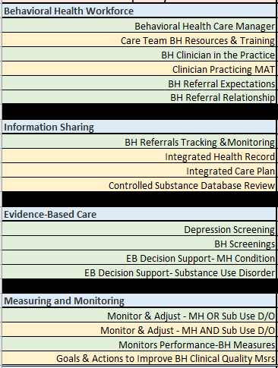
Summary of NCQA Criteria (18 total)
Behavioral Health Workforce (6 Criteria)
  4 Core, 2 Elective
Integrated Information Sharing (4 Criteria)
  1 Core, 3 Elective
Evidence Based Care (4 Criteria)
  4 Core, 0 Elective
Measuring and Monitoring (4 Criteria)
  2 Core, 2 Elective
Total 11 Core & 7 Elective

Slide 10
Summary of NCQA Criteria (cont.)
  All qualifying new and existing NCQA PCMH Recognized practices are eligible to apply for Distinction in Behavioral Health Integration.
  Practices seeking the NCQA PCMH BH distinction must meet all 11 core criteria and 2 elective criteria (13 total criteria).
Summary:
If you have already achieved NCQA PCMH you may have already completed 7 /13 or 54% of the requirements for NCQA PCMH BH.
Of the 18 total criteria, 7 are also included in the PCMH Recognition standards.
  Practices that complete these criteria will receive credit for the aligned criteria in both PCMH Recognition and the Behavioral Health Integration Distinction.

Slide 11
Which Elective Criteria did you choose, and why?
BH 04 Clinician Practicing Medication-Assisted Treatment
BH 08 Integrated Health Record
BH 10 Controlled Substance Database Review
  “Low hanging fruit” Given the practice’s historical experience with offering IBH services, these criteria were already being met.

Slide 12
Which criteria/improvements benefited patient care the most in your practice?
BH 03 Behavioral Health Clinician in the Practice
BH 08 Integrated Health Record
BH 11 Depression Screening
BH 12 Behavioral Health Screenings
BH 13 Evidence Based Decision Support: Mental Health Condition(s)
BH 14 Evidence Based Decision Support—Substance Use Disorder(s)

Slide 13
Which criteria/improvements increased provider satisfaction the most in your practice?
BH 03 Behavioral Health Clinician in the Practice
  Warm handoffs help to improve patient follow through with treatment and leads to more interaction between providers and IBH clinicians, which improves the overall program in many ways. It reminds the provider that the IBH clinician is truly part of the practice.
BH 13 Evidence Based Decision Support: Mental Health Condition(s)
  The regular use of the Columbia Suicide scale allows providers to quickly and effectively triage patients to appropriate level of care based on the severity listed in the score. Suicidal thinking is quite common in primary care, and this tool allows us to more effectively and confidently handle these situations.
BH 14 Evidence Based Decision Support—Substance Use Disorder(s)
  Adding the AUDIT screen for alcohol use as a backup to the CAGE-AID, along with the posted decision-making flowchart in the room, has allowed clinicians to more efficiently and objectively discuss alcohol use with our patients, and offer an appropriate level of support. This tool allows us to discuss this more effectively with our patients.

Slide 14
Which criteria were relatively easier to meet, and why?
Criteria already being historically satisfied and / or criteria supported in our EMR (AthenaHEALTH):
  BH 04 Clinician Practicing Medication-Assisted Treatment
  BH 07 Behavioral Health Referrals Tracking and Monitoring
  BH 08 Integrated Health Record
  BH 10 Controlled Substance Database Review
  BH 11 Depression Screening
  BH 12 Behavioral Health Screenings
  BH 13 Evidence Based Decision Support—Mental Health Condition
  BH 15 Monitor and Adjust—Mental Health or Substance Use Disorder
  BH 17 Monitors Performance using at least two behavioral health clinical quality measures

Slide 15
Which criteria were more challenging to meet, and why?
BH 03 Behavioral Health Clinician in the Practice
  During the NCQA application process, we had to hire and train a new IBH clinician
BH 05 Behavioral Health Referral Expectations
  Required us to pursue specialists willing to sign and commit to compact agreements
BH 14 Evidence Based Decision Support—Substance Use Disorder
  Not supported by EMR functionality. Required us to implement a decision-tree, office-based workflow for the AUDIT screening tool.

Slide 16
Lessons learned/tips for other practices
What did you learn from engaging in this process?
  Plan for additional time. APCM started process 02/2021 and achieved recognition 04/2022
What tips can you offer practices who are engaging in this process now?
  Identify someone in the practice to lead the Practice Transformation
  Schedule sufficient time each week to work on the Practice Transformation
  Keep office team updated regarding progress and involve in the Transformation whenever possible
  Perform an early and detailed office assessment in comparison to the NCQA PCMH BH criteria
    Identify “low hanging fruit” criteria and complete those quickly
    Identify criteria that may require more long-term investment and develop a plan
  Set up your NCQA QPASS account early
    Provide very clear evidence / documentation to NCQA

Slide 17
Lessons learned/tips for other practices
(cont.)
Anything else you’d like to share with other practices?
  You will complete virtual “check-ins” with an NCQA reviewer. Be sure to have key stakeholders present.
  Be prepared to quickly address “requests for clarification” from your NCQA reviewer.
  Be prepared for re-accreditation. Initial accreditation achieved 04/2022 with re-accreditation due 07/2022.

Slide 18
Questions from the practices?

Slide 19
Upcoming Milestones
Milestone | Date
Final PDSA Due | April 14, 2023
Y2 Wrap-up Meeting | April 27, 2023
NCQA Application / Action Plan for Y2 practices Due | April 30, 2023

Slide 20

CTC-RI Module to Support NCQA BH Distinction Preparation
Your practice lead will receive login instructions to access this module

Slide 21

Office Hours

