Slide 1
Licenses in Alma
Objectives for today’s presentation:
Discuss where licenses live in Alma
Demonstrate the following common licensing activities:
How to search for, add, and modify licenses
Attach documents and inventory
Create license templates and addenda for existing licenses
- See Laura's demo on February 25th: https://3.basecamp.com/3765443/buckets/8186639/documents/1620632999
- See ExLibris tutorial: https://knowledge.exlibrisgroup.com/Alma/Training/Alma_Essentials/Alma_Essentials_-_English/D_Acquisitions/01_Acquisitions_Conceptual_Background_(11_min)
Suggest helpful documentation (Basecamp, SUNY LibGuides, Ex Libris)
Review the ERMWG License Terms Recommendations/ guidelines
Recommend authorization roles for performing licensing activities in Alma
Show relevant licensing configuration
How to display license terms display to the public, re-order sections, etc.
See Ex Libris video tutorials:
Configuring Sections Order: https://knowledge.exlibrisgroup.com/Alma/Product_Documentation/010Alma_Online_Help_(English)/020Acquisitions/110Configuring_Acquisitions/160Configuring_Sections_Order
Configuring License Review Statuses: https://knowledge.exlibrisgroup.com/Alma/Product_Documentation/010Alma_Online_Help_(English)/020Acquisitions/110Configuring_Acquisitions/190Configuring_License_Review_Statuses
Configuring License Storage Locations: https://knowledge.exlibrisgroup.com/Alma/Product_Documentation/010Alma_Online_Help_(English)/020Acquisitions/110Configuring_Acquisitions/180Configuring_License_Storage_Locations
Configuring License Term Controlled Vocabulary Values: https://knowledge.exlibrisgroup.com/Alma/Product_Documentation/010Alma_Online_Help_(English)/020Acquisitions/110Configuring_Acquisitions/197_Configuring_License_Term_Controlled_Vocabulary_Values

Slide 2
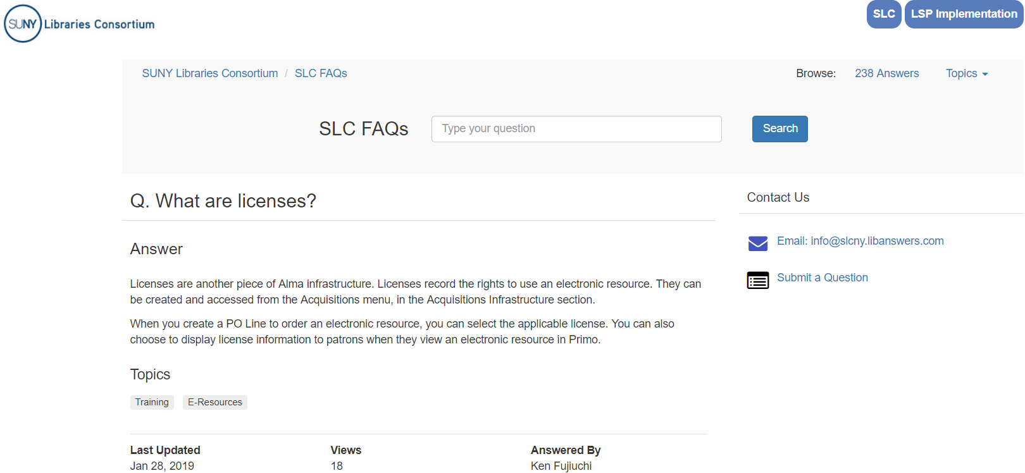
What is a license?
See https://slcny.libanswers.com/faq/235442
Notes:
Our license data is stored in different silos – ERM systems, miscellaneous localities like shared/ hard drives, intranets, print files, etc. Alma acts a centralized repository
Each campus is different BUT we are all subject to NYS records keeping law and still required to retain at least one fully executed print original on file. Increased scrutiny of SUNY operations. Alma can help us with statute compliance; can help us determine which licenses are due for renewal and allow us to show select fields from the licenses to the public (can be helpful for ILL/ resource sharing, authorized user notification requirements, public performance or perpetual access rights, etc.) What we decide to suppress/ unsuppress from public view is a policy decision that will have to be determined by individual campuses. The ERMWG recommendation guidelines can be referenced but first let’s talk about searching for and adding licenses.

Slide 3
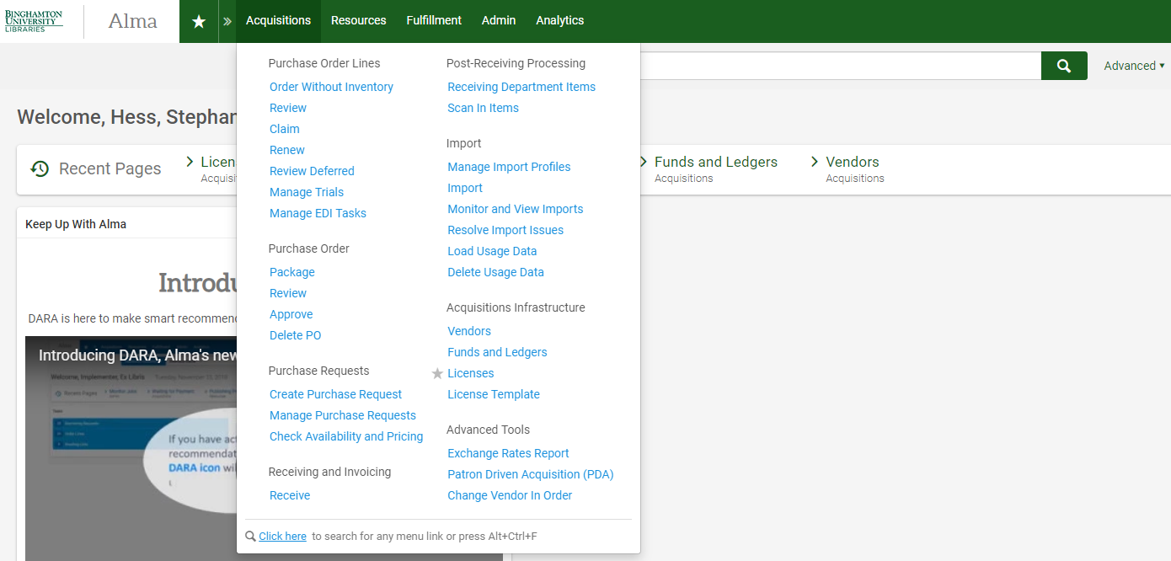
Where do licenses live in Alma?
Acquisitions > Licenses
Acquisitions > License Templates
Notes:
Our license data is stored in different silos – ERM systems, miscellaneous localities like shared/ hard drives, intranets, print files, etc. Alma acts a centralized repository
Each campus is different BUT we are all subject to NYS records keeping law and still required to retain at least one fully executed print original on file. Increased scrutiny of SUNY operations. Alma can help us with statute compliance; can help us determine which licenses are due for renewal and allow us to show select fields from the licenses to the public (can be helpful for ILL/ resource sharing, authorized user notification requirements, public performance or perpetual access rights, etc.) What we decide to suppress/ unsuppress from public view is a policy decision that will have to be determined by individual campuses. The ERMWG recommendation guidelines can be referenced but first let’s talk about searching for and adding licenses.

Slide 4
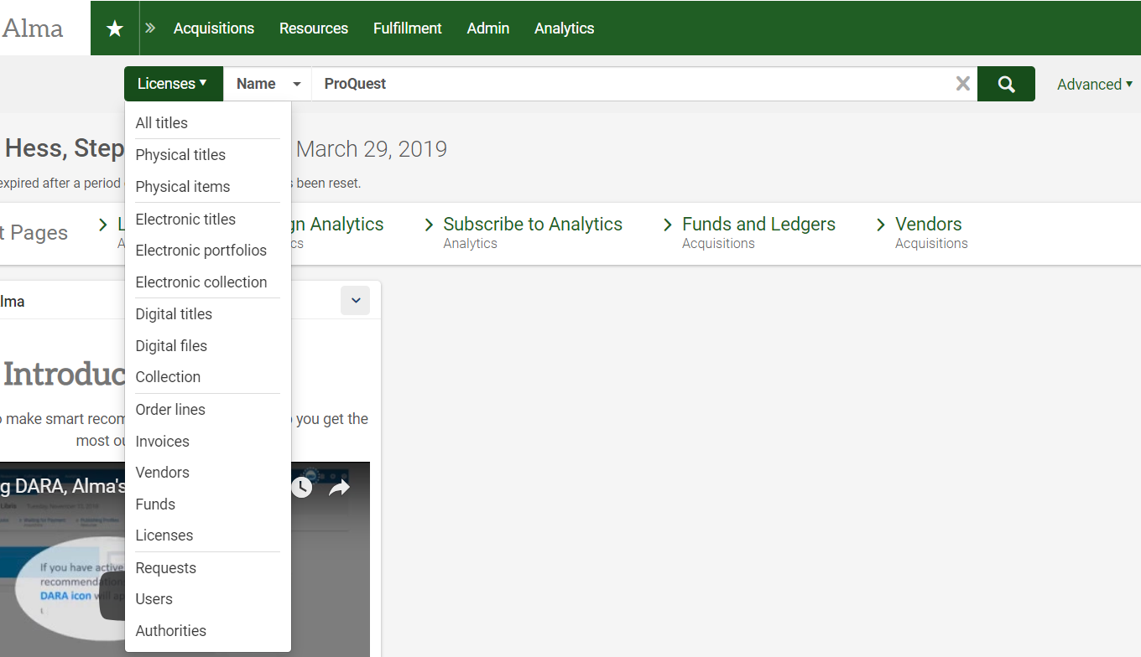
Searching for Licenses
Can search by license or vendor name to retrieve license list
Notes:
Can search for licenses using the main search drop-down options license name or vendor name

Slide 5
Searching for Licenses
Can search by license name, vendor type of licensor, or licensor code
Notes:
Can search for licenses using the main search drop-down options license name or vendor name

Slide 6
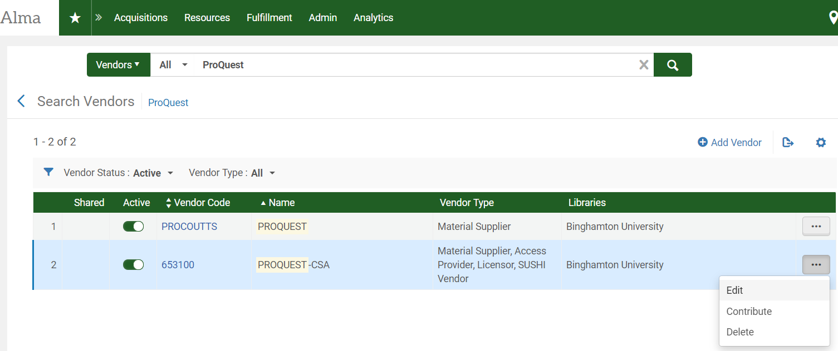
Vendor name search results
Notes:
Vendor must active and have Vendor Type “Licensor”; can edit IZ entry, contribute to NZ (SUNY policy not yet worked our), or delete

Slide 7
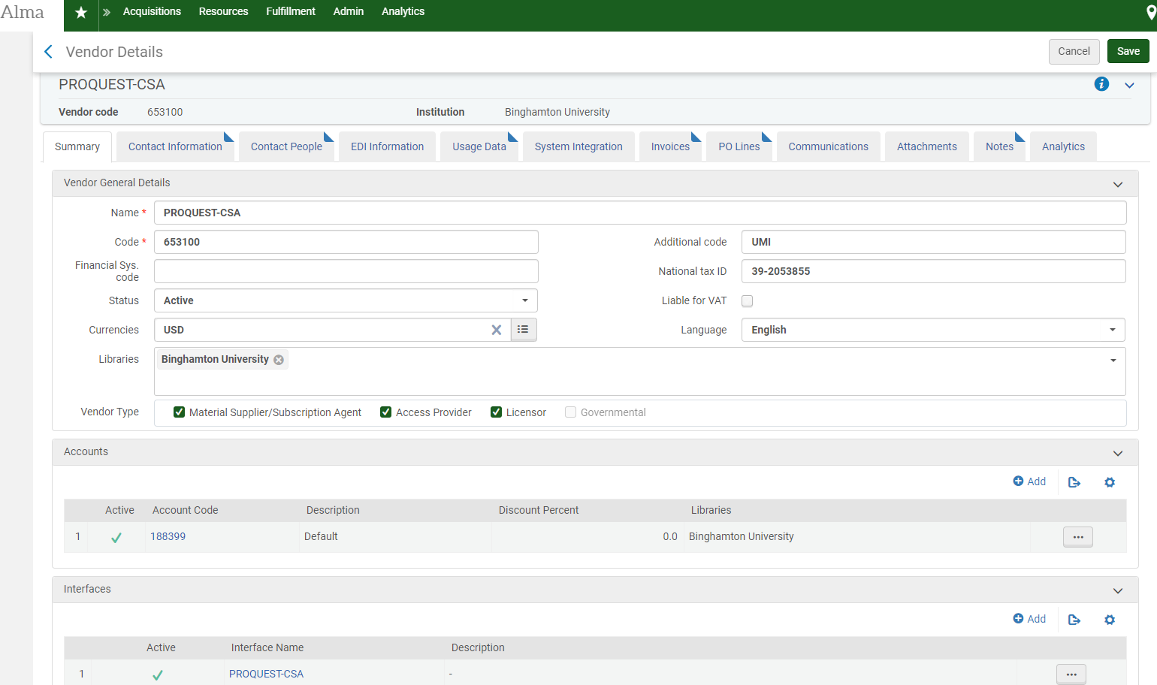
Prior to adding licenses, check the vendor entry
Can use vendor code in the License Details
Licensor must be selected as a Vendor Type in Vendor General Details entry
Notes:
Before adding a license to a vendor, make sure the relevant vendor entry has the Licensor checked under Vendor Type in general details
Also take note of the vendor code in the record; you might want to incorporate it into your local file naming conventions

Slide 8
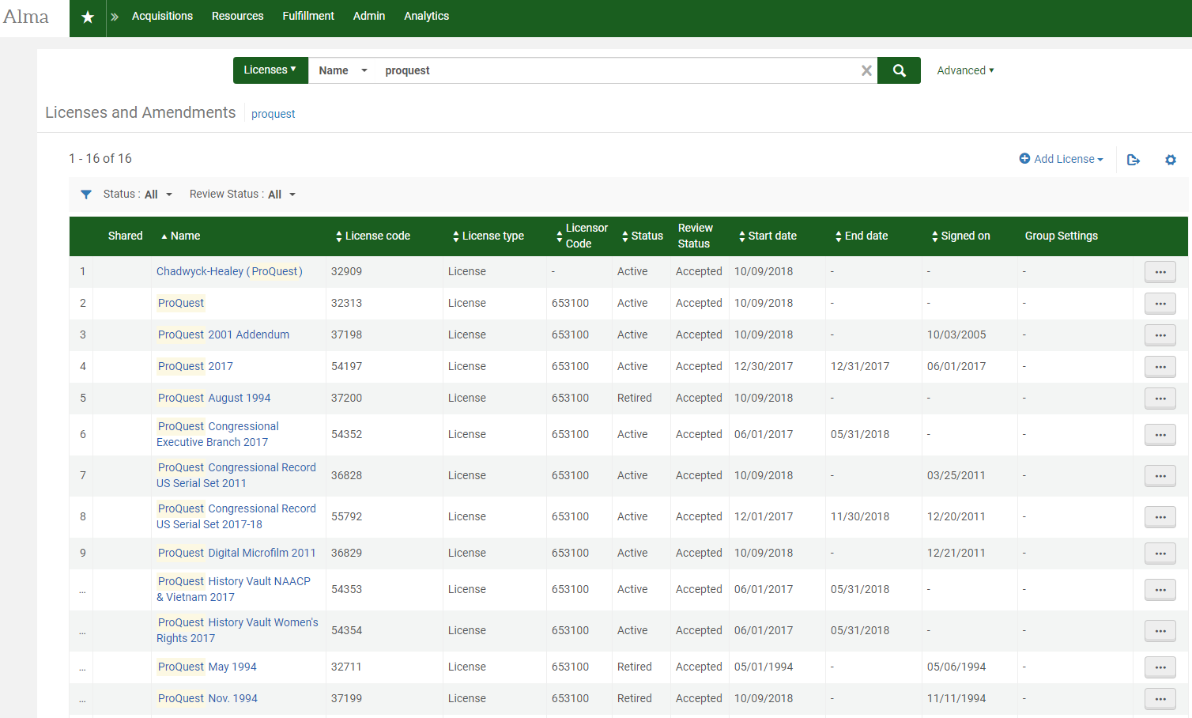
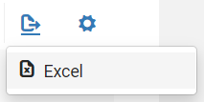
License name search results
Can filter list by name, code, type, review status, etc.
Can export list in Excel
Notes:
Can search for licenses using the main search drop-down options license name or vendor name ; can filter an dexport List

Slide 9
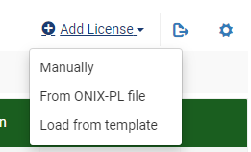
Adding Licenses

Slide 10
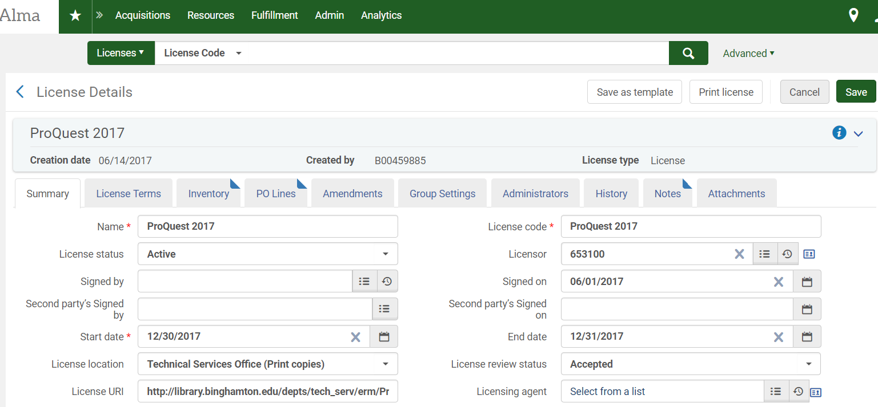
Enter & Save License Summary Details before adding Attachments
Three required fields: Name, License Code, and Start Date
License Code must be unique
Start Date must be entered in MMDDYYYY format

Slide 11
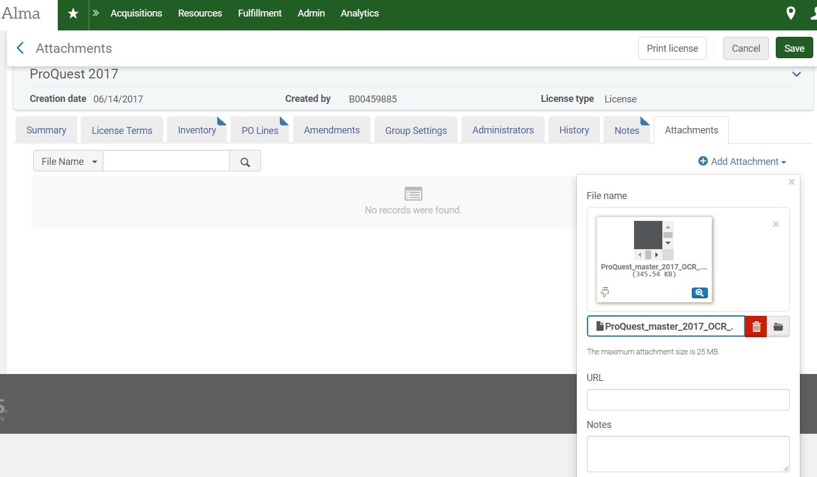
Attach License Documents

Slide 12
Confirm Upload of License Documents

Slide 13
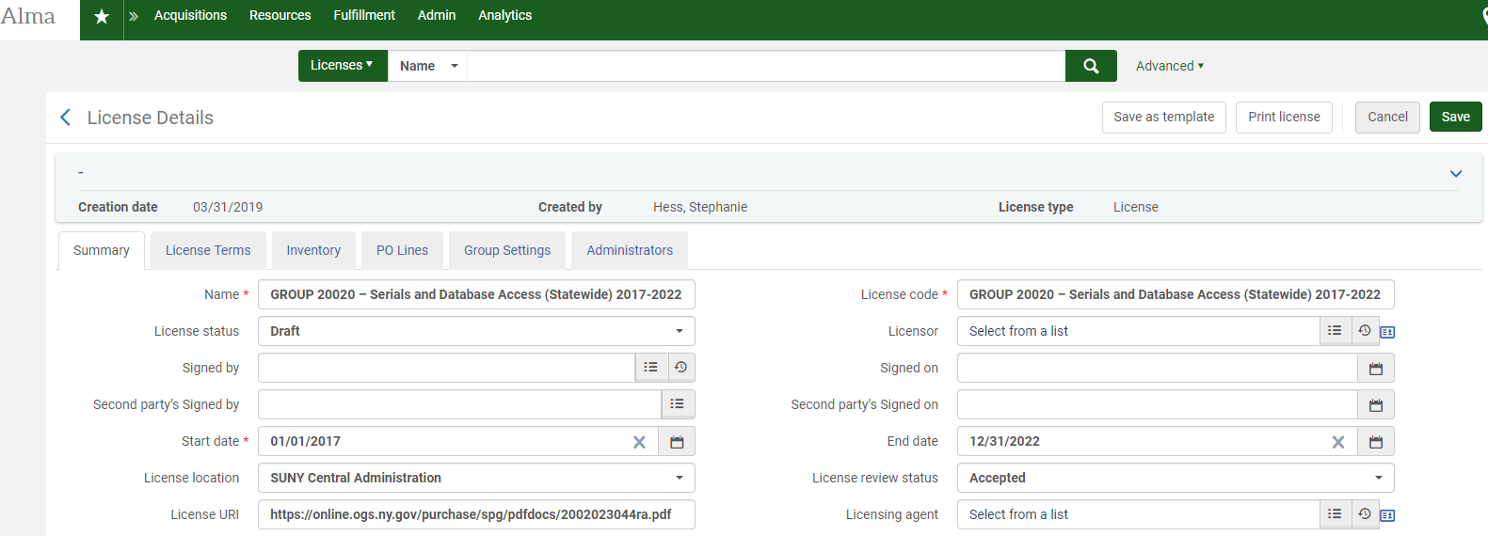
Creating Templates

Slide 14
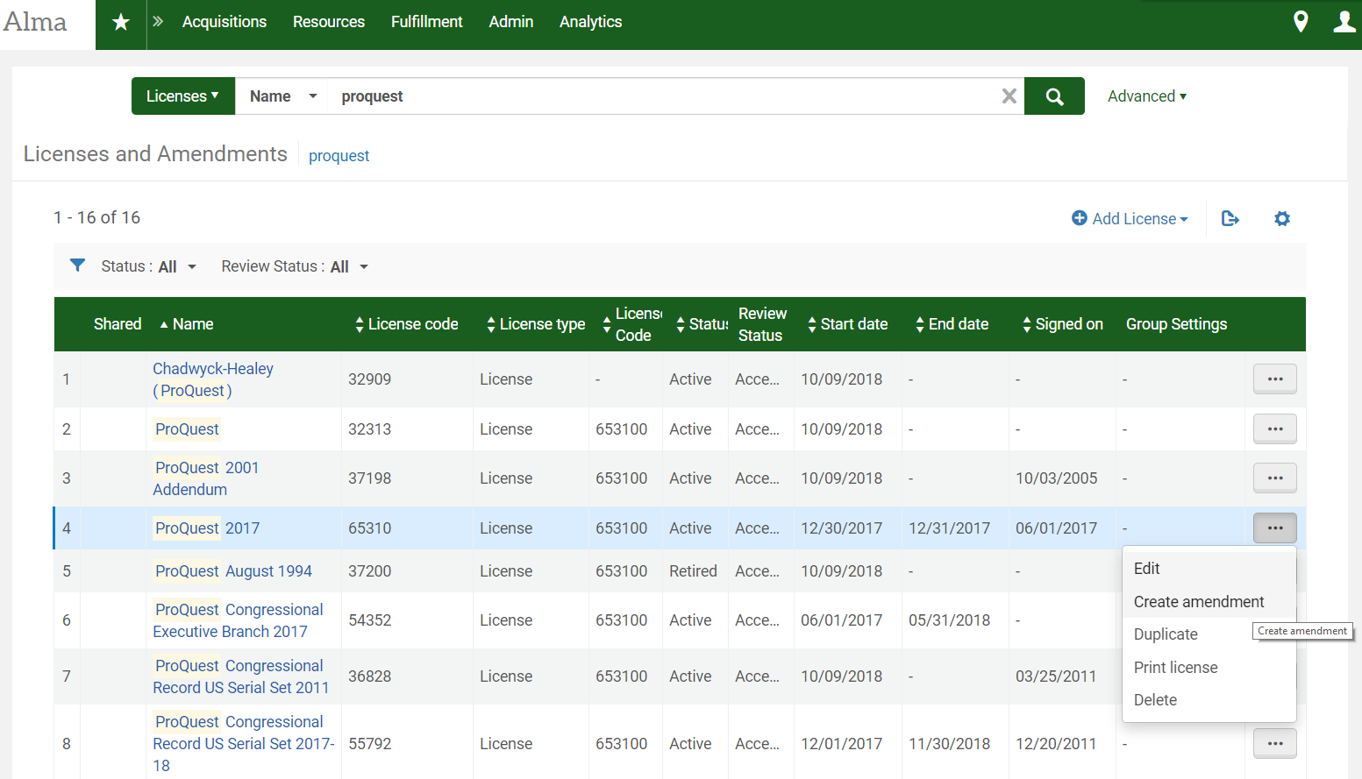
Create an Amendment

Slide 15
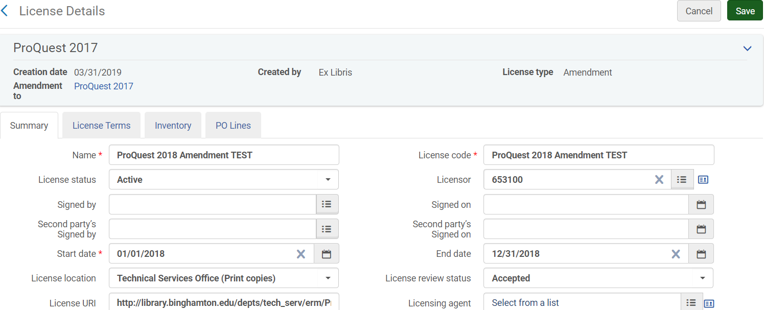
Create Summary Details of Amendment

Slide 16
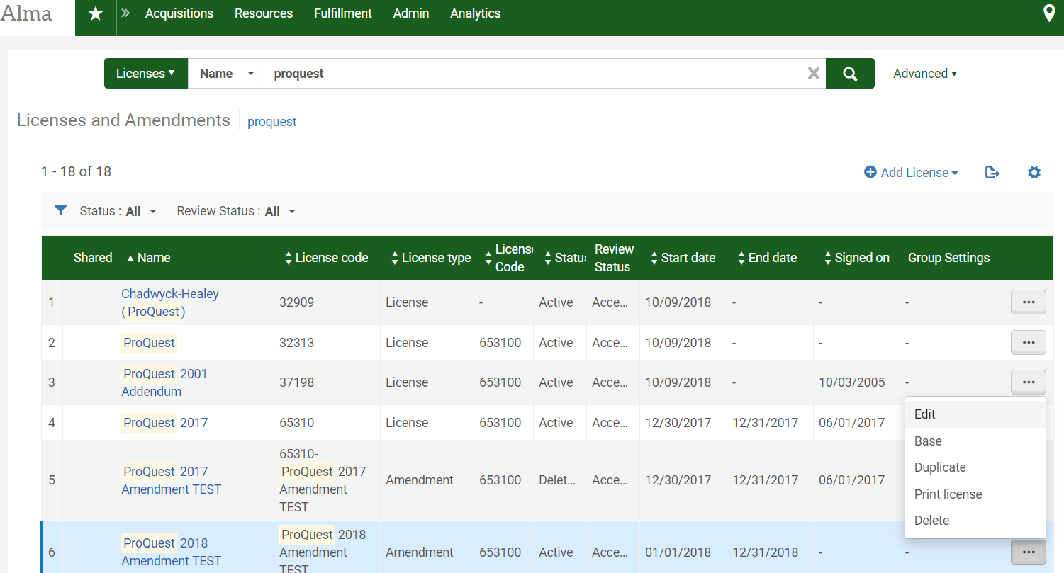
Amendments in License List
Notes:
Select base to view master/ original contract

Slide 17
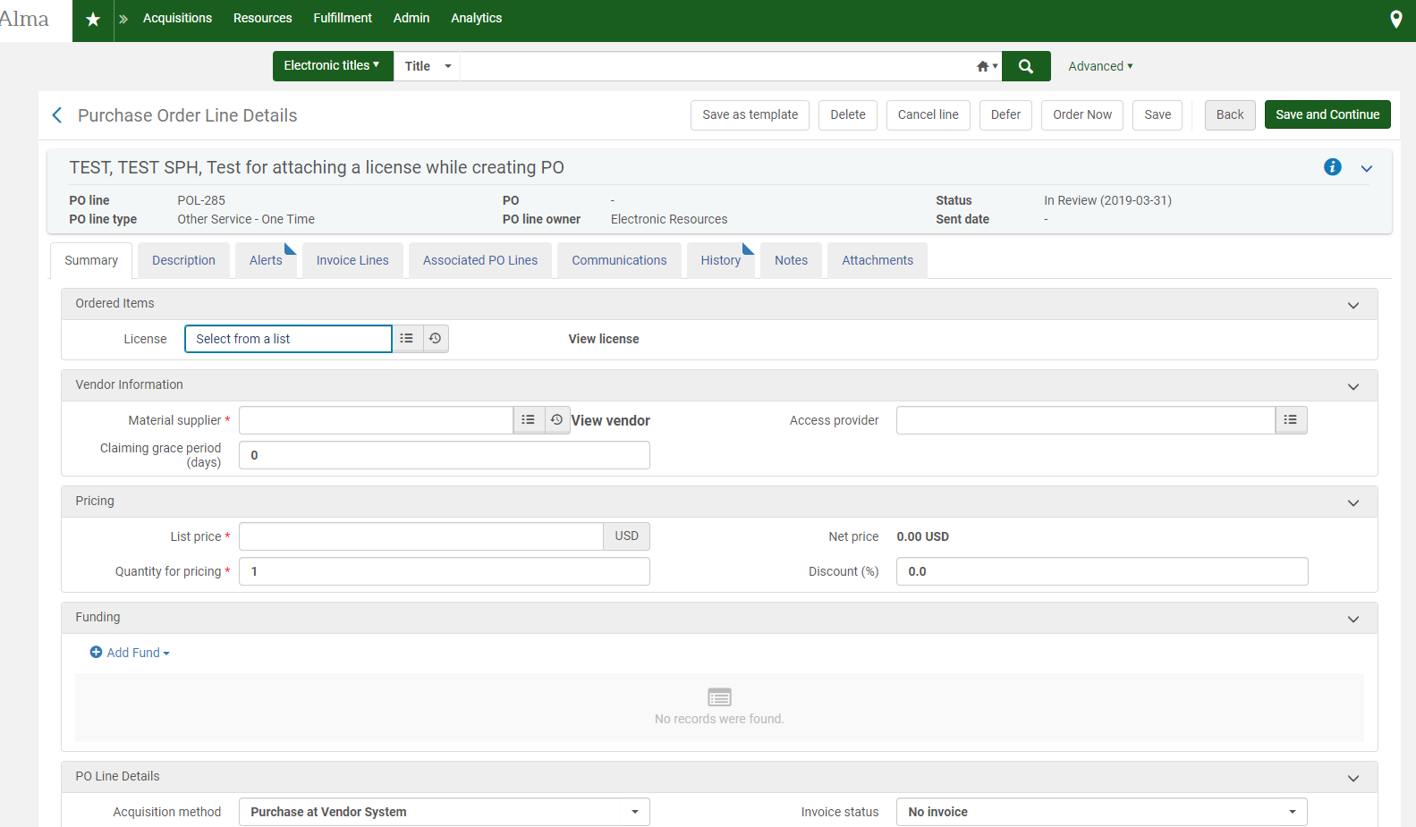
Attaching License to PO Line
Notes:
You can associate a license with an activated electronic resource in your local inventory on the Repository Search page (see Searching in Alma) or on the PO Line Summary page of the purchasing workflow (see Manually Creating a PO line).

Slide 18
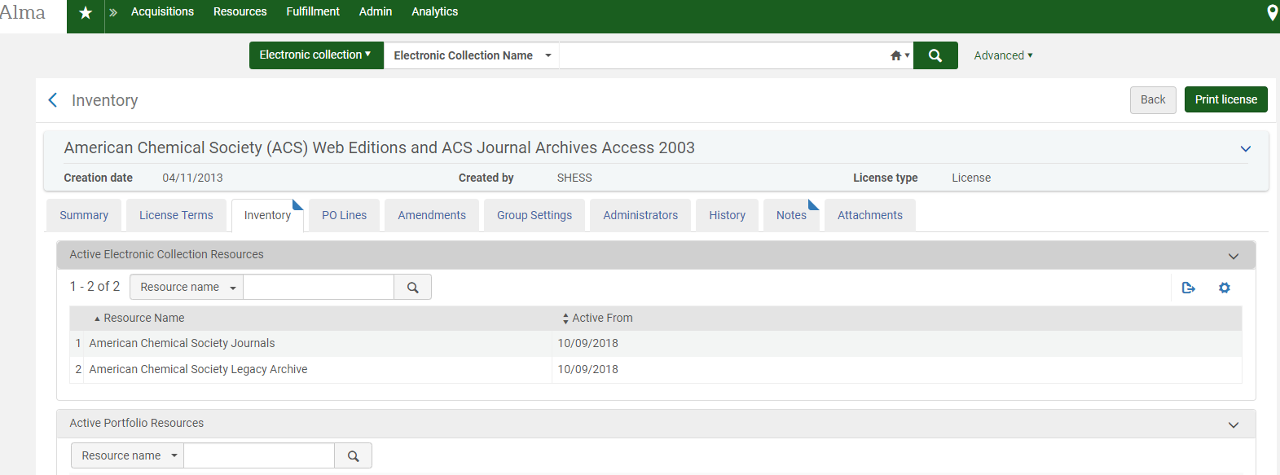
Adding Active Inventory to License
Notes:
Caveat: Known issue with adding active

Slide 19
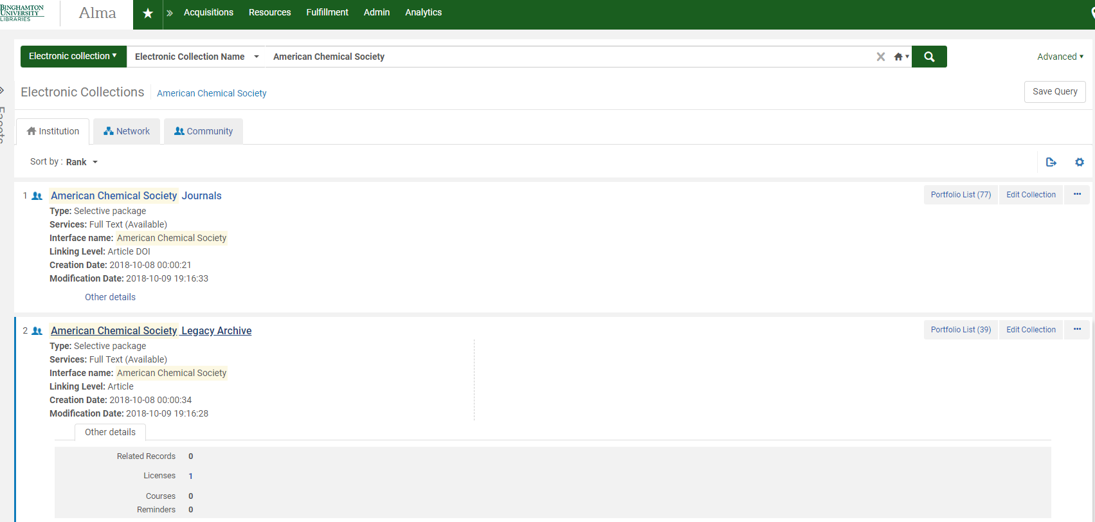
Inventory in the IZ: Electronic Collection

Slide 20
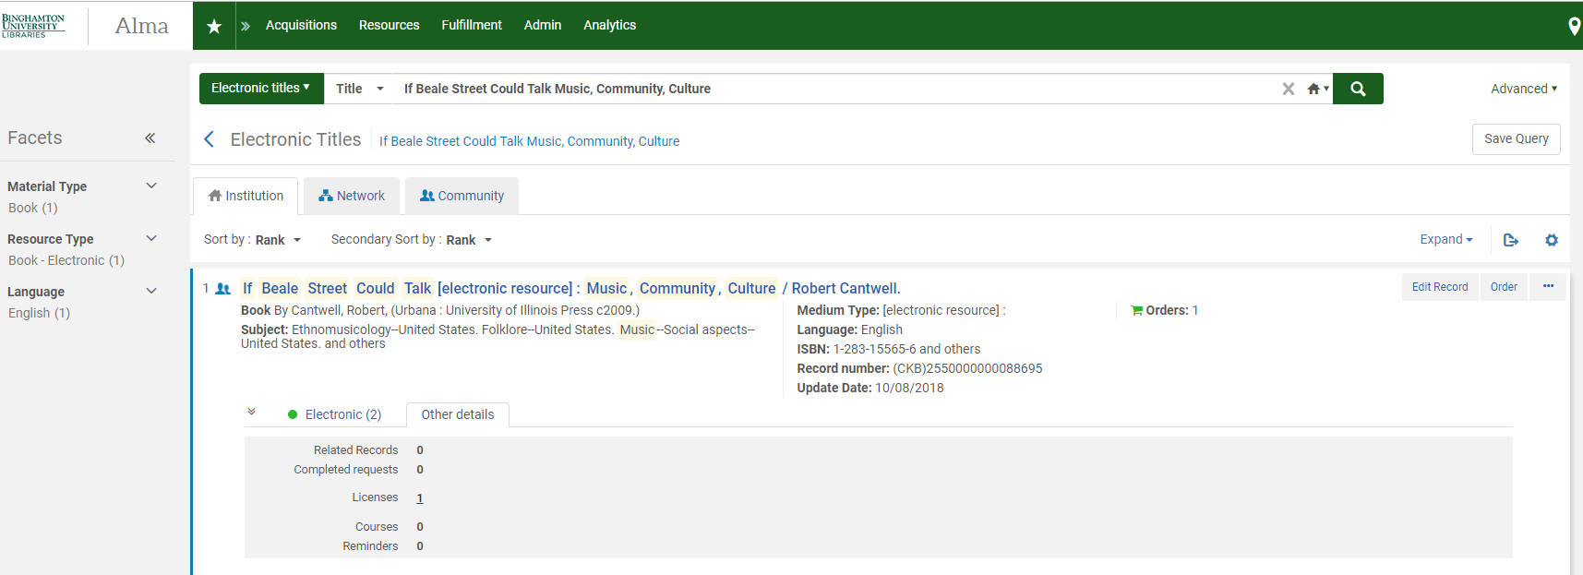
Inventory in the IZ: Electronic Titles

Slide 21
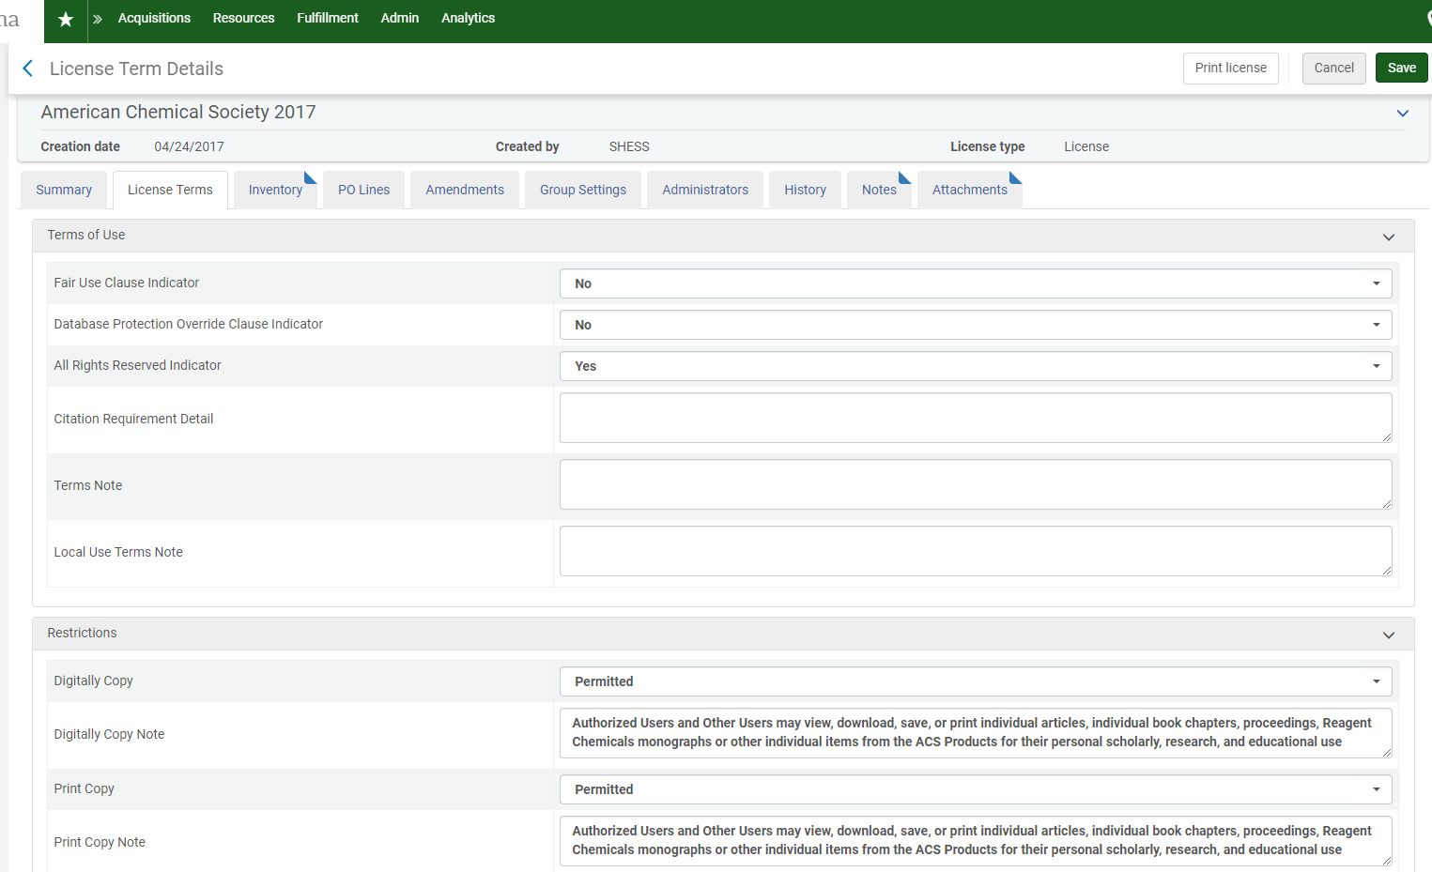
Entering License Terms
Notes:
Entering license terms is time intensive. This activity can wait until post-migration if necessary. Can backfill license terms but local campuses should have a conversation bout which rights to track and what to unsuppress to the the public, e.g. ILL privileges, scholarly sharing, public performance rights, etc.

Slide 22
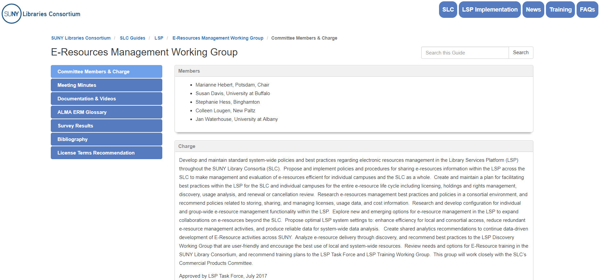
ERM Working Group LibGuide @ https://slcny.libguides.com/eresourceswg

Slide 23
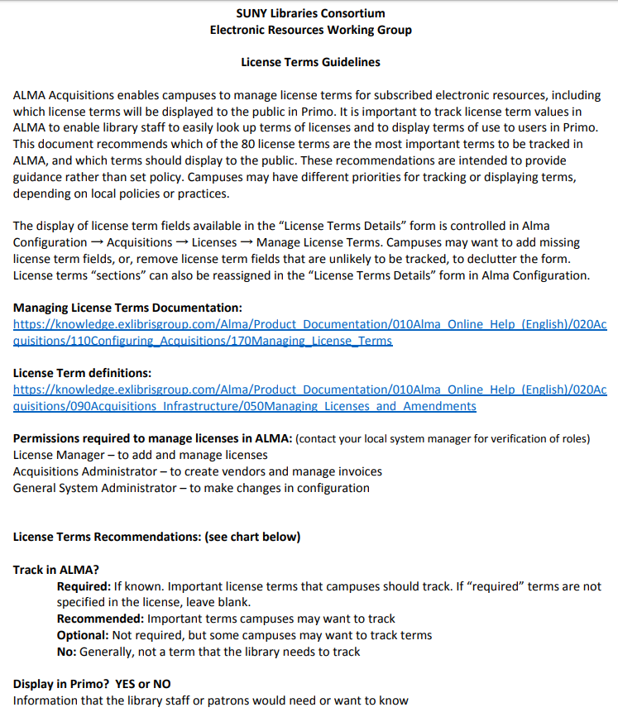
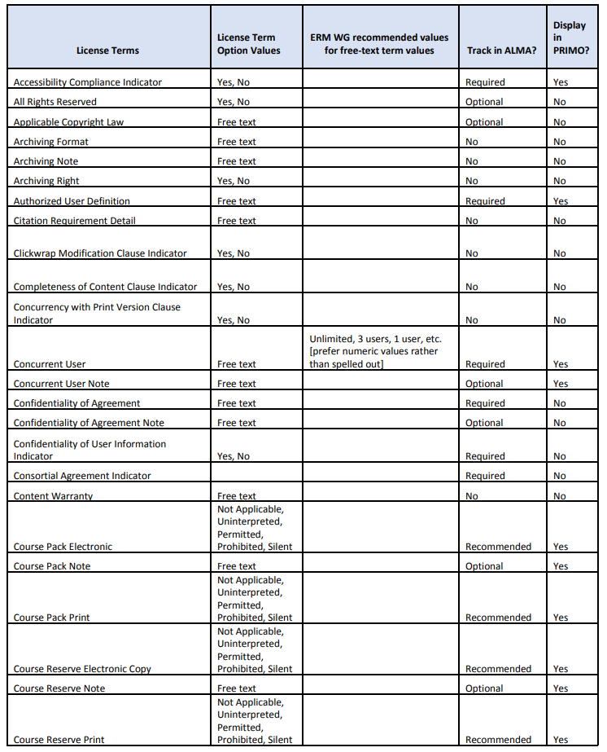
License Recommendations @ https://slcny.libguides.com/ld.php?content_id=47163327

Slide 24
Authorization Roles needed for License Activities in Alma
To view licenses and license amendments, you must have one of the following roles:
License Manager
License Viewer
Selector
Purchasing Operator
Purchasing Manager
To manage licenses, license amendments, and create license templates you must have the following role:
License Manager
See Managing Licenses and Amendments @ https://knowledge.exlibrisgroup.com/Alma/Product_Documentation/010Alma_Online_Help_(English)/020Acquisitions/090Acquisitions_Infrastructure/050Managing_Licenses_and_Amendments

