Slide 1

George Mason District
Roundtable
November 9, 2023

Slide 2
Agenda
Welcome and Pledge
Questions about Read-ahead
General Announcements
Joint Session - Discussion
Cracker Barrel/Networking (Optional; NLT 9pm)
Next Meeting: December 14, 2023 (7:30pm)

Slide 3

Pledge

Slide 4
Welcome
New to Roundtable?
Please introduce yourself!

Slide 5
Questions/Clarification about Read-ahead?

Slide 6
General Announcements

Slide 7

Hunger is still out there, and so are we!
GEORGE MASON DISTRICT
SCOUTING FOR FOOD
2023

Slide 8
THANK YOU!!
All Packs and Troops participated
Donated to six different food banks
Weight totals are starting to come in
Notes:
All of your Scouts should feel VERY GOOD about what they done: they’ve done a Good Turn to hundreds of families in our area. A quick shout out to just a couple of units:
Pack 1111: who had to reinvent its approach to Scouting for Food when their partner Troop folded. Their Scouts got out their, Did Their Best, and helped people
Troop 895: who either did a really good job with their territory OR looted a CostCo and brought in a huge amount food.

Slide 9
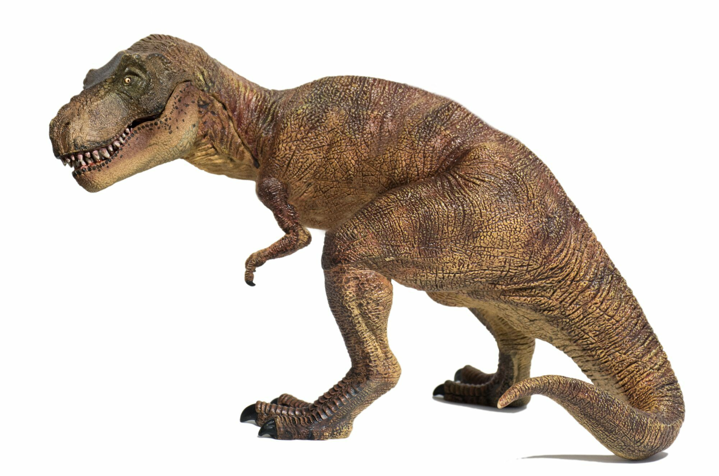
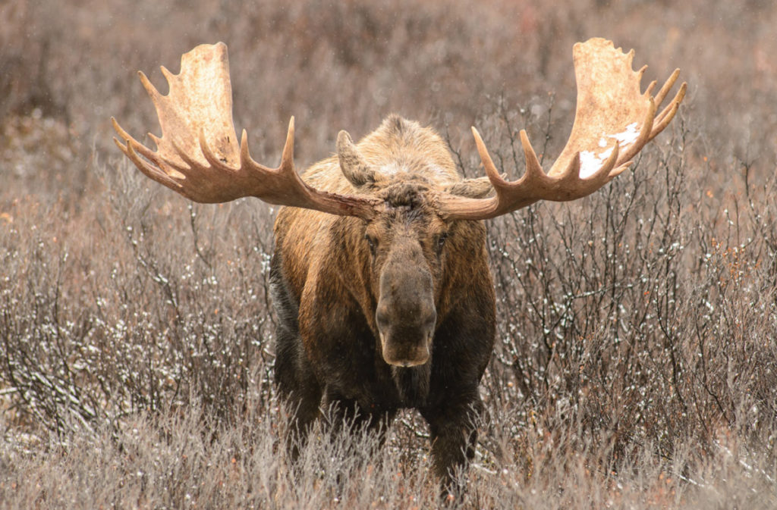
…And So Far We Have…
…About 17,000 pounds, or about the weight of a T-Rex and a moose!

Slide 10
…And We’re Less Than Halfway Done With Data Capture
Unit’s fill out at: https://www.ncacbsa.org/scouting-for-food-unit-data/
District: George Mason District
Number of Scouts and Other Youth Participants (siblings, friends, etc)
Number of Adult Participants
Pounds of Food Collected
Food pantry delivered to
For your Scouts: Express the weight in fun terms, for example
  Vehicles, animals, dinosaurs

Slide 11
New This Year: Online Donation Option
Partnering with You Give Goods, National Capital Area Council, (NCAC) has created 15 virtual food drives that will benefit specific nonprofit food pantries throughout the Council territory.
https://yougivegoods.com/ncac-scoutingforfood2023
Takes you to a site where you can “shop” for goods to donate
GMD donations go to Food for Others
Good for Scouts to send to relatives or contacts in other organizations

Slide 12
Big Rock
What do Camp Snyder and Goshen have to offer your units?

Slide 13

Current 2023 George Mason Calendar
November 11, 2023 – Flags In (Veterans Day) (Cancelled)
February 03, 2024 – Life to Eagle Seminar, Virtual
February 24, 2024 – University of Scouting, Alexandria, VA
March 09, 2024 – GMD Merit Badge Day, Fairfax, VA
March 23, 2024 – GMD Pinewood Derby, Fairfax, VA

Slide 14
Time for Cracker Barrell
Minutes and slides available on the GMD web site (District Resources, Roundtable). Password is “GMDRT”
Next meeting – December 14, 2023, at Thoreau MS

Slide 15
Backup Slides

Slide 16
Council Update
2024 National Dues – Effective 08/01/23 - https://public.3.basecamp.com/p/XoisQJcMr1NncMfshG7xCj9f
2024 Council Dues – Effective 1/1/24 - https://www.ncacbsa.org/participation-fee/https://www.ncacbsa.org/participation-fee/
Unit Charter Renewal - Charter Renewal opened on 10/02/23 at https://advancements.scouting.org/. Only the unit Key 3 and Key 3 delegates can access the software. Use the same Username and Password that you use for https://my.scouting.org and Scoutbook.
  Thanks to all that attended one of the two Charter Renewal training sessions. The first session was recorded. Link (Passcode: n%7N4C^u) to view the session (70 minutes long).
Here is a link to the GMD Basecamp site that contains the
2024 Annual Membership Handbook (PDF)
Internet Rechartering User Guide (PDF)
Membership Renewal for Units (PPTX)
NCAC Charter Renewal web site: https://www.ncacbsa.org/recharter/
In addition to the online Charter Renewal, we need units to get their unit’s Annual Charter Agreement signed by the Chartering Organization (Executive Officer), the COR, and your Unit Committee Chair. The fillable Annual Charter Agreement is here. If your Chartering Organization is a Catholic Dioceses/Parish, they may require this version. Please check with your Executive Officer to determine which version they would prefer to submit. NCAC will accept either version.

Slide 17
STEM
Cubs Can Code, 11-18-23 (6pm), Zoom
Ancient Earth: Birth of the Sky (on PBS) - link
Anytime – DC STEM Trek- Showcases 24 government agencies, private organizations and monuments related to the tenets upon which STEM is based. Two hikes - 10.57 miles, or 4.75 miles

Slide 18


Merit Badges
The online Merit Badge Counselor registration works for all Scouters who do not already hold another District position.
New Merit Badge Counselors must complete online merit badge counselor training, in addition to YPT. Be sure the counselor uses his/her legal name – no nicknames.
Merit Badge Counselors, or the unit Dean/Leader, also need to scan and send Margee the Merit Badge application form listing the badges the counselor is applying to teach and providing a justification of his/her qualifications.
Youth Protection Training is the essential first step. Don’t hit “send” on the application without it!
Contact Margee if you have questions at GM.MB.Dean@hotmail.com.
Did you know:
The National Council does not limit the number of merit badges a youth may earn from one counselor, though a unit leader is permitted to do so, as long as the same limit applies to all Scouts in the unit. Ideally, Scouts should work with a variety of adults. (GTA 7.0.0.3)
Partial Merit Badges have no expiration except the Scout’s 18th birthday. (GTA 7.0.3.3)
Due to the BSA policies related to Youth Protection and two-deep leadership, a merit badge counselor must have another adult present during all merit badge counseling sessions. However, the parent or legal guardian of the Scout may serve as the second adult. This parent or legal guardian does not have to be a registered leader.
If the requirements for a merit badge differ between the merit badge pamphlet and the current edition of Scouts BSA Requirements, the requirements in the Scouts BSA Requirements book supersede all others.

Slide 19

2024 GM District Merit Badge Day
March 9th, 2024 at Fairfax Presbyterian Church in Fairfax.
Registration will open on December 13th, 2023
Need Unit Merit Badge Day Coordinator names and contact details by November 30 to John Drisco at gmasonmeritbadgeday@gmail.com
Encourage Scouts to get merit badge books by December 31. Read requirements and start tackling “pre-work” by early January 2024.
Note: The “pre-work” is not the same as a “prerequisite.” The “pre-work” consists of tasks/activities that the Scout is advised to do in advance of the Merit Badge Day. A Scout can still participate in the Merit Badge Day class if he hasn’t completed the pre-work but failure to complete the pre-work may mean the Scout leaves the Merit Badge Day with a partial badge. A prerequisite is something that must be done in order to qualify to take the class. The only prerequisite we are aware of for the George Mason Merit Badge Day is that the Scout must be a registered member of the Boy Scouts in a participating unit.
Feedback to John Drisco at gmasonmeritbadgeday@gmail.com

Slide 20

Training (https://www.ncacbsa.org/george-mason/training/)
Basic Adult Leader Outdoor Orientation (BALOO;C32) –
10/13/23 – 10/14/23, Huntingtown, MD
10/14/23 – 10/15/23, Middleburg, VA
11/18/23 – 11/19/23, Lorton, VA
Introduction to Outdoor Leadership Skills (IOLS; S11)
    10/13/23 – 10/14/23, Huntingtown, MD
    10/14/23 – 10/15/23, Middleburg, VA
    11/18/23 – 11/19/23, Lorton, VA
Back Country Outdoor Leader Skills (BCOLS) - 10/21/23 – 10/22/23, Camp Big Mac, Markham, VA
NYLT 24-1: 01/12/24 -01/15/24 & 01/27/24-01/28/24
  24.2: 06/16/24-06/21/24
  24.3: 06/23/24-06/28/24
  24.4: 07/28/24-08/02/24
  24.5: 07/28/24-08/02/24
  Registration will open in the Fall and will be announced via email and on Facebook
  Wilderness First Aid (N02) –
  10/21/23 – 10/22/23, Camp Snyder, Haymarket, VA
  11/18/23 – 11/19/23, Camp Snyder, Haymarket, VA
  12/16/23 – 12/17/23, Camp Snyder, Haymarket, VA
Wood Badge (A90) https://www.ncacbsa.org/wood-badge/
04/12/24 – 04/14/24 & 05/04/24 – 05/05/24
10/14/24 – 10/15/24 & 10/05/24 – 10/06/24
Leave No Trace/Outdoor Ethics - 10/16/23 (Zoom) & 10/21/23 (Camp Snyder)
BSA Leave No Trace Trainer Course - Outdoor Ethics - 10/16/23 (Zoom) & 10/21/23 – Haymarket, VA
Outdoor Ethics Orientation Courses (Scouts and Cubs) - Outdoor Ethics Newsletter - Sign up here.
  12/03/23 – Brandywine, MD

Slide 21

GM High
Adventure
Important notes for this month
  HELP NEEDED FROM ALL George Mason Scouts BSA Troops, Venture Crews & Sea Scout Ships!!
    Thanks to the 7 units that have completed the survey!!
    If you haven’t already, please complete the Google Form survey on your unit’s high adventure activities (even if your unit hasn’t done any) at the URL below
    https://docs.google.com/forms/d/e/1FAIpQLSf9JOXShmdJVlDg4GeVD4a0bbrQUS6JDW4tOsruUsml9lJ9cw/viewform?usp=sharing
  Upcoming registration dates for 2025 trips
    NORTHERN TIER: Reservations open Jan 18, 2024
    SEA BASE: Reservations open Jan 18, 2024
    SUMMIT: Reservations open Jan 18, 2024
    Philmont: Lottery registration has closed, but treks are still available
  Most BSA High Adventure bases still have availability for summer 2024 trips – See the URL below for more information
    https://www.scouting.org/outdooradventures/open4adventure/
NCAC-Organized High Adventure Trips - 2024
  Lenhok’sin – James River Canoeing Trek - July 7-13, 2024
    Crew of 6-12 - $470 per participant
    Registration: https://scoutingevent.com/082-75664
    For more information, e-mail highadventure@ncacbsa.org
  Wind River Range, WY: 06/22 to 06/30/24
    Registration: https://scoutingevent.com/082-77027
    Space for 5 adults / 15 Scouts - $1,430 per participant
    Mandatory Training for Adults
      BCOLS
      Wilderness First Aid
    Mandatory Practice/Training for Everyone
      HAC Philmont Training Sessions
  Northern Tier – Jul 23-Aug 3, 2024 – Already full
  Philmont – Jul 13-27, 2024 – Already full
  Sea Base – Jul 29-Aug 3, 2024 – Already full
  Sea Base – Aug 6-11, 2024 - Already full
Nov 2023
Notes:
Sea Base Trip on Jul 29-Aug 3, 2024 - FULL

Slide 22
GM High
Adventure
High Adventure Base Scholarship Information for 2024
  NORTHERN TIER: Submit by Jan 31st, 2024. Go here for the application.
  PHILMONT: Up to $400. Submit by Feb 1st, 2024. Go here for the application.
  SEA BASE: Up to $300. Submit by Nov 1st, 2023. Go here for the application.
  SUMMIT: Submit by Mar 31st, 2024. Go here for the application.
Training - Open to all NCAC Scouts & adults that are participating in HA trips in the next few years
  Philmont 2024 Sessions: I – 11/19/23; II – 01/07/24; IIIa – 03/24/24; IIIb – 04/06/24
  Philmont Advisor Hikes: 8:00am, Sat 3/09 & Sun 3/17/24, 8:00am Catoctin Mt Park, Thurmont, MD
  Northern Tier 2024 Sessions: Sat, 04/06/24 (in-person); Sat, 04/20/24 (virtual)
  Sea Base Session: TBD
  Members of the High Adventure Committee are available to assist units in planning and training for their upcoming high adventure trips
NCAC High Adventure Committee is Planning for More Big High Adventure Trips
  Backpacking in Wyoming – Summer of 2024
  Climbing Trip to Zion National Park – Planning Underway
  Looking for more ideas and volunteers to plan the trips – See me for details!
National High Adventure Base Quick Links
  Philmont: https://www.philmontscoutranch.org/register/
  Northern Tier: https://www.ntier.org/provisional-scout-connections/
  Sea Base: https://www.bsaseabase.org/scouts/scout-connections/
  Summit: https://www.summitbsa.org/registration/scoutconnections/
Other High Adventure Bases
  Adirondack High Adventure Area: https://public.3.basecamp.com/p/hLgsVbk7Suju6cuDzQQJaEn4
  Maine High Adventure Area: https://www.mainehighadventure.org/
  Montana Outdoor High Adventure Base: https://montanabsa.org/camps/high-adventure/
Other useful links for high adventure information and opportunities
  NCAC High Adventure website - https://www.ncacbsa.org/high-adventure/
  List of units with available slots in their upcoming high adventure trips - https://public.3.basecamp.com/p/xWpkdrKHKAA9pCzwmHMNdbWb
Nov 2023

Slide 23
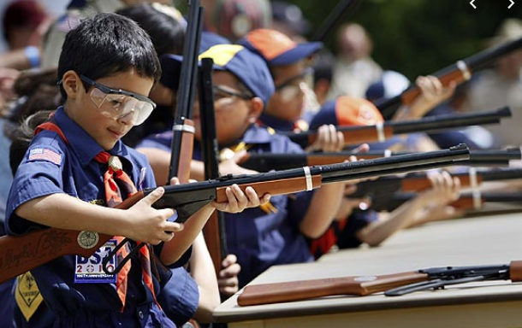
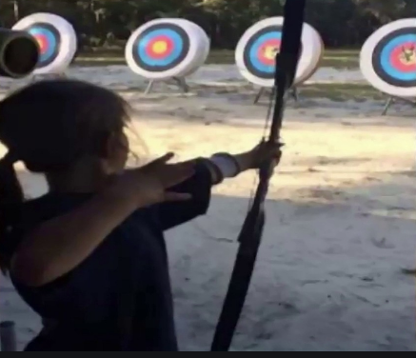
Shooting Sports
Requests for Shooting Events – Lead Time!
  50+ scouts - 6mos
  Less than 50 scouts - 3mos
Shooting on private land:
  Requirements
  Permissions/protocols
Shooting Sports web page
Shooting Sports Instructor Classes:
  Rifle/Shotgun
  Archery

Slide 24
Order of the Arrow
  Mary Neuse has accepted the Scoutmaster position at T1978G. Brian Fleck will be the new Chapter Advisor.
  2023 Dues can be paid online: https://wipit470.org/dues.html
  11/01/23 – Election Season Opens
The Amangamek-Wipit Lodge will be sending a contingent to the one-and-only National Order of the Arrow Conference (NOAC) next summer and we want you to join us! Registration is now open! Follow the directions below to register for the one and only 2024 National Order of the Arrow Conference (NOAC) at the University of Colorado at Boulder. Here are the steps to register for this once-in-a-lifetime opportunity!
Step 1: Click the registration link here!
Step 2: Fill out all information for the registration form.
Step 3: Congrats! You have reserved your spot for the 2024 NOAC! Look out for other emails in regard to both national registration AND further payments you may need to make! Can’t wait to see you there!!
If you have any questions regarding the National Order of the Arrow Conference email noac2024@wipit470.org
  * Registrations open online https://wipit470.org/index.html under “Events”

