Slide 1
Unit 4
Designing the Work Group
Work Group Lead Toolkit 2020/21

Slide 2
How do we design our Work Groups?

Slide 3
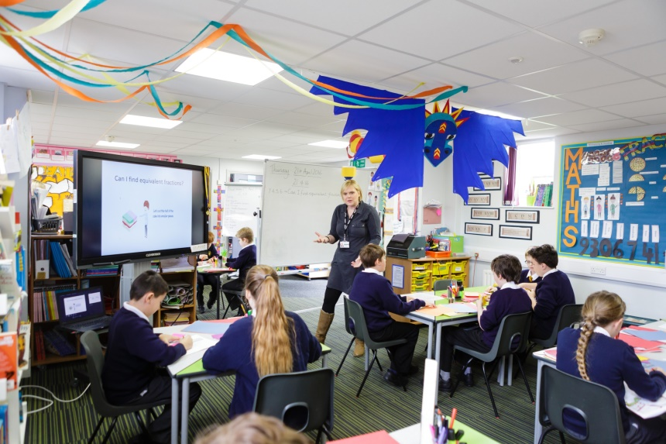

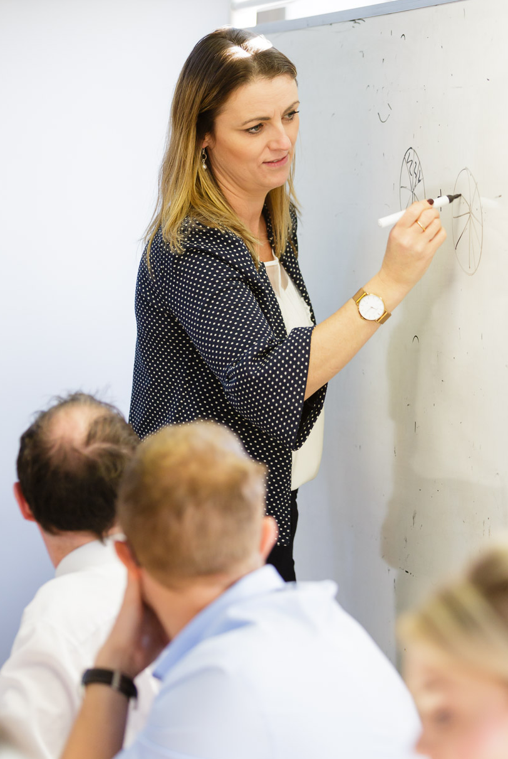
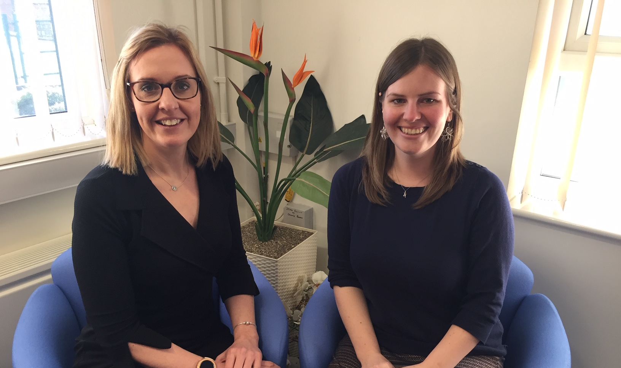

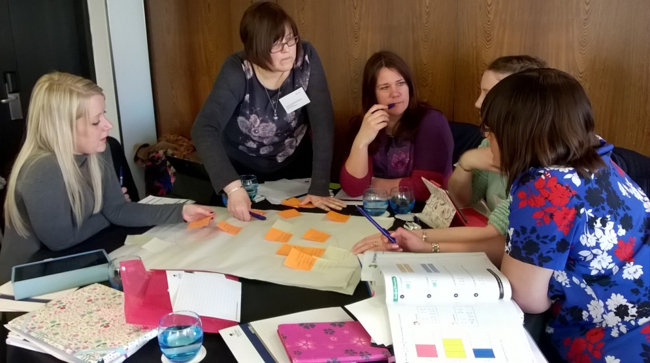
Clarifying and refining: Participants; outcomes; work
Participants
Outcomes
Work

Slide 4

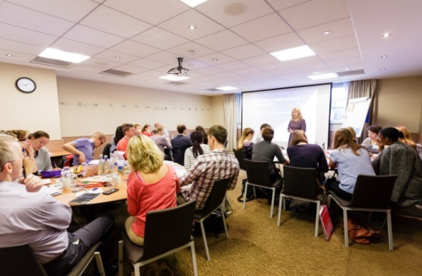

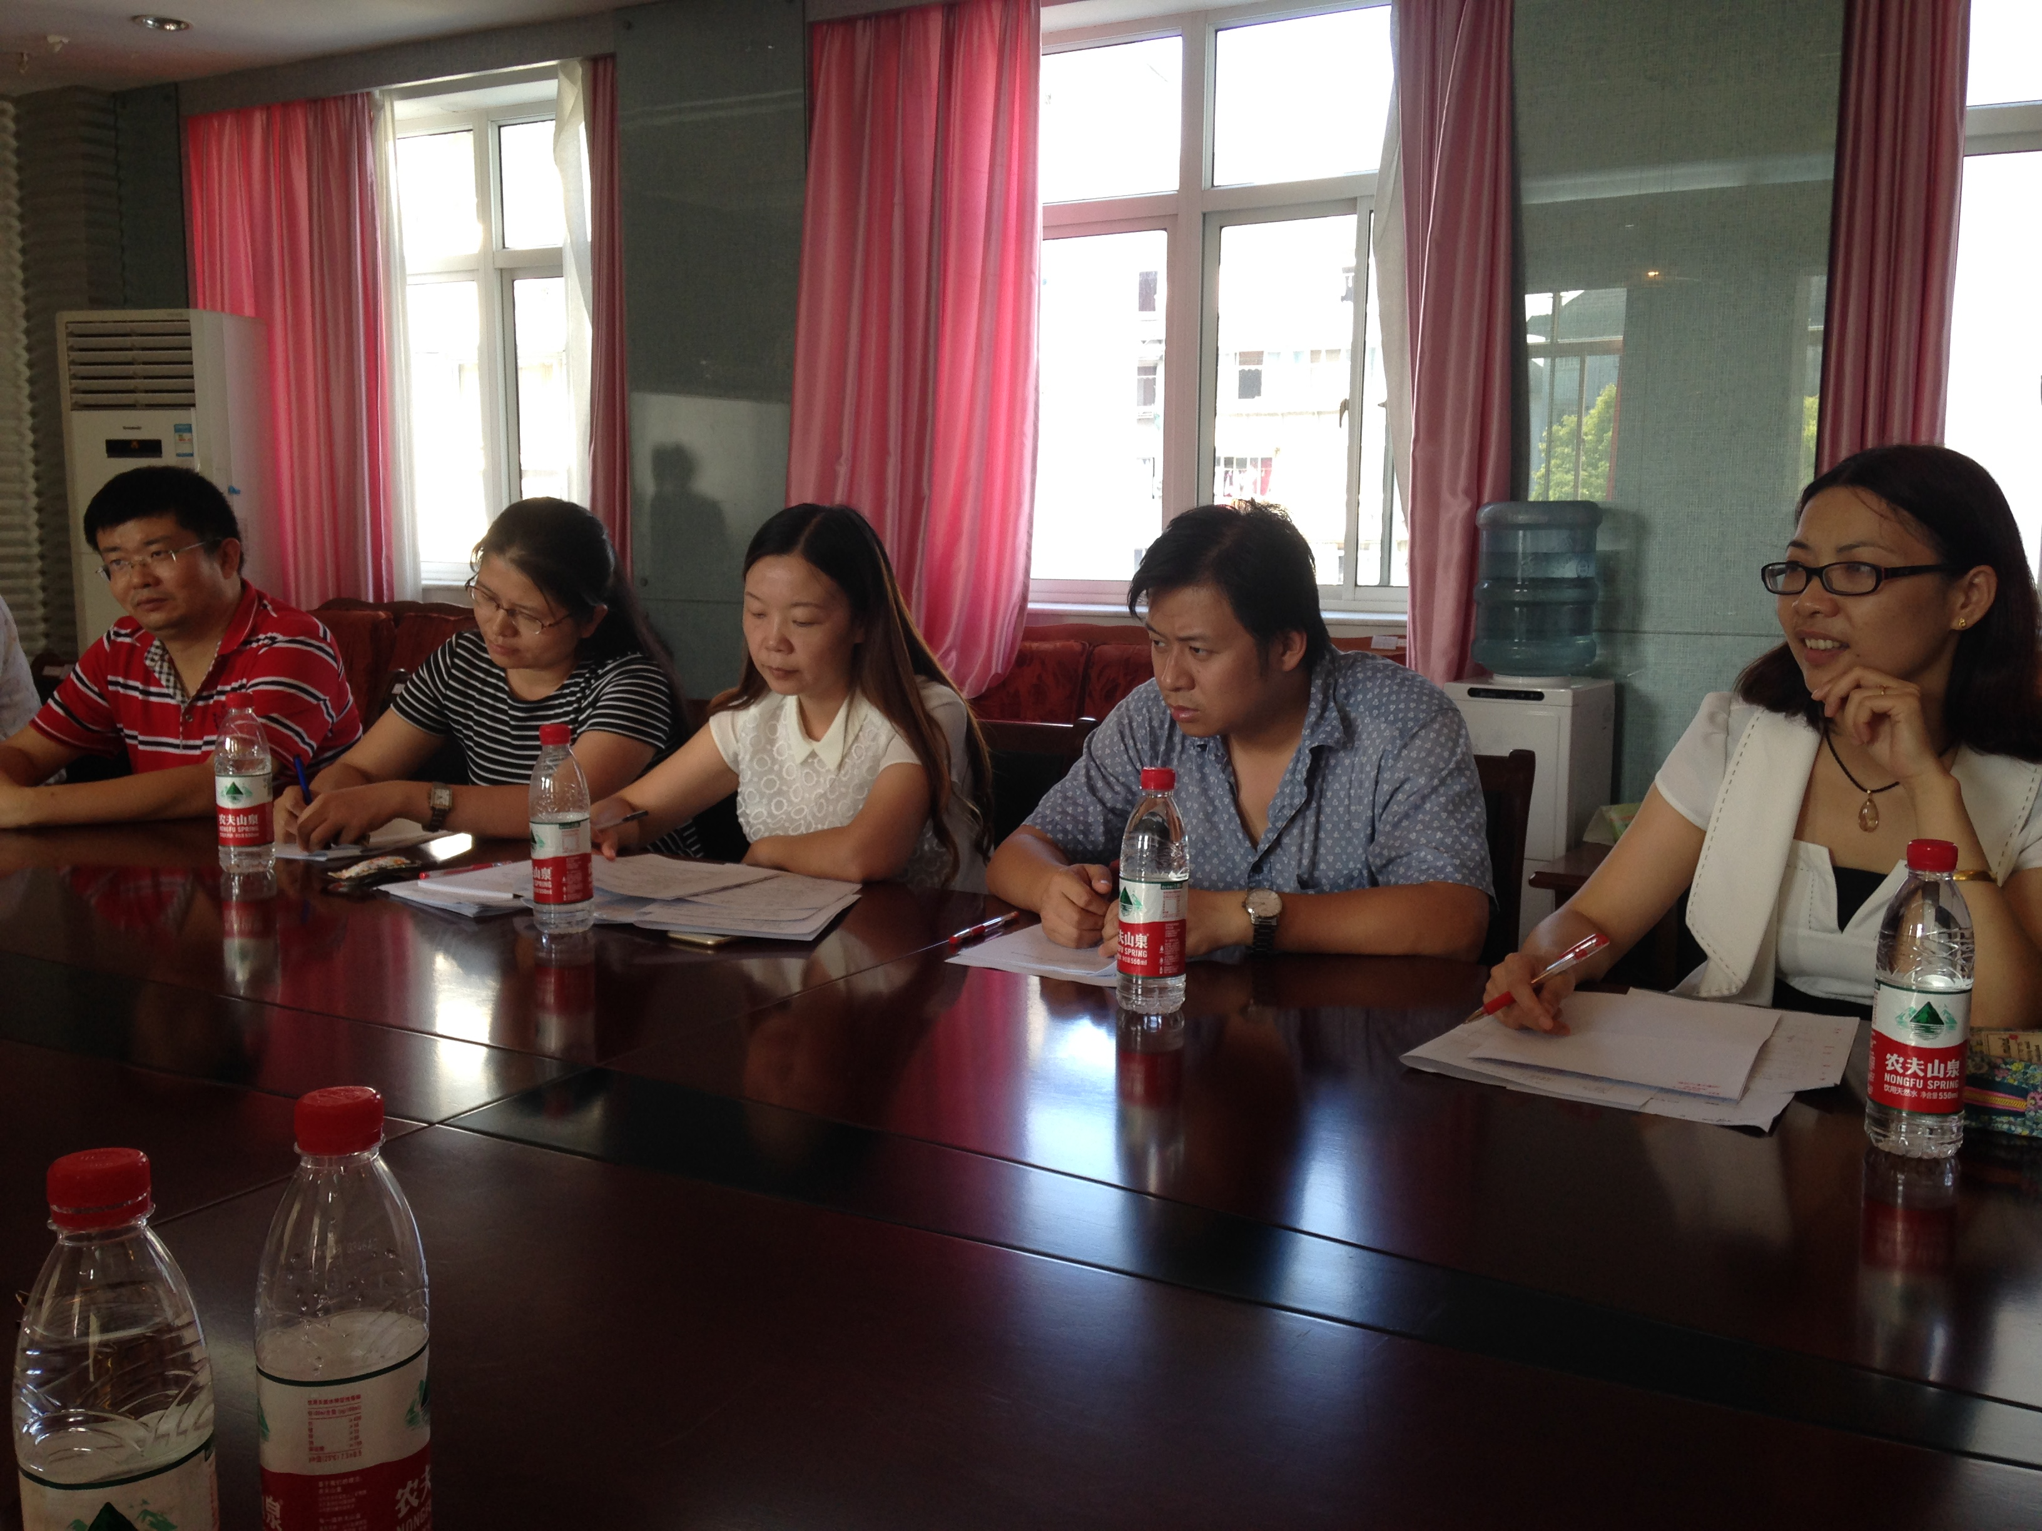
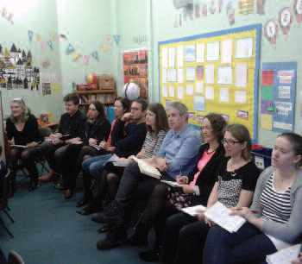


Designing the range and balance of work
Within school
Outside school
Practise the work so that it becomes normal work practice
Sometimes supported by Work Group Lead

Slide 5

Work Group cemetery
Gap
Task
Died 8th January 2020

Slide 6
What have you designed?
……a CPD course?
……a leadership development programme?
……a school improvement intervention?
……a TRG (Teacher Research Group)?
……a Maths Hub Work Group

Slide 7
Taking it further
Suggestions for reading, watching, listening
Read the DfE Standard for Teacher’s Professional Development
Suggestions for discussion with others
How do you design the inter-relationship between all the different types of work so that they effectively contribute towards the intended outcomes?

