Slide 1
Care + Community + Equity
Best Practice Sharing Meeting
June 21, 2023

Slide 2
Agenda – June 21, 2023
Welcome and Introductions
Nancy Sutton RIDOH CDC Proposed Funding 10 minutes
NuestraSalud - Dr. Pablo Rodrigues 15 minutes
Danai Boone “Ready for Health”& Benvinda Santos CHN updates 10 minutes
Practice presentations 30 minutes
Thundermist
Clinica Esperanza
Tri-County
Adrian Bishop AHP &Breanne DeWolf RIDOH QRS Stratification 20 minutes
AHA submissions
Closing Thoughts and Evaluation
Notes:
https://www.nuestrasalud.com/

Slide 3
Center for Chronic Care and Disease Management
9 Programs:
Diabetes, Heart Disease, & Stroke
Alzheimer’s Disease & Related Disorders
Arthritis
Healthy Eating & Active Living
WISEWOMAN
Women’s Cancer Screening (WCSP): Breast & Cervical Cancers
Colorectal Cancer
Comprehensive Cancer
Cancer Registry

Slide 4
11 CDC Grant Applications (Jan-June)
Diabetes, Heart Disease, & Stroke
- 1 competitive & 1 non-competitive
Alzheimer’s Disease & Related Disorders – 1 competitive
Arthritis – 1 competitive
Healthy Eating & Active Living – 2 competitive
WISEWOMAN – 1 competitive
Women’s Cancer Screening – 1 continuation (year 2 of 5)
Colorectal Cancer – 1 continuation (year 4 of 5)
Comprehensive Cancer – 1 continuation (year 2 of 5)
Cancer Registry – 1 continuation (year 2 of 5)

Slide 5
Key Strategies
Alzheimer’s Disease & Related Disorders (ADRD)
RI ADRD Advisory Council
Public and Professional Education & Community-Clinical Linkages
Surveillance System
Arthritis
Chronic Disease & Chronic Pain Self-Management Program; Walk with Ease
Physical activity counseling within primary care practices
Healthy Eating & Active Living
Healthy food procurement in facilities, programs, or organizations; Fruit/vegetable vouchers and prescription programs
Complete Streets policy to improve physical activity
Breastfeeding & Early Care and Education policies
2nd CDC Application – Pawtucket/Central Falls HEZ; Food & Nutrition Focus

Slide 6
Key Strategies (cont.)
4. WISEWOMAN
CVD and risk factor screening among WCSP-eligible patients
Monitored as needed
Access to:
Health Coaching (Patient Navigators)
Healthy Food Access (Farm Fresh, Market Mobile)
Fitness (YWCA, Yoga, Mindfulness)
Diabetes/CVD Education (CDOEs/CVDOEs, Vida Sana)
Smoking Cessation (QuitWorks)
CHN Programs
Transportation/Bus Passes (RIPTA)

Slide 7
RIDOH Proposed Funding - Diabetes
A Strategic Approach to Advancing Health Equity for Priority Populations With or At Risk for Diabetes
https://www.cdc.gov/diabetes/funding-opportunity/NOFO-CDC-RFA-DP23-0020.html
Diabetes focused proposed learning collaborative- July 2024
Prevent Diabetes Complications
Increase screening rates for diabetic retinopathy and chronic kidney disease (CKD).
Community Health Network Access
Increase enrollment and retention in National Diabetes Prevention Program (NDPP).
Expand availability of the NDPP as a covered health benefit for Medicaid beneficiaries.
Develop a bidirectional electronic exchange of information between health care and community-based organizations (CBOs).
Community Health Workers
Improve the workforce sustainability of CHWs.
Expand their involvement in evidence-based diabetes prevention and management programs and services.
Notes:
Additional notes:
Rhode Island adults (18 years of age and older) living on incomes <400% federal poverty level*
Two- year Learning Collaborative 5-10 sites
Implement and scale National DPP cohorts
Meet with State of RI Office of Employee Benefits to maintain and promote National DPP as a covered benefit for State of RI employee
Meet with RI health plans to assess interest in offering National DPP for Medicaid beneficiaries

Slide 8
RIDOH Proposed Funding - CVD
The National Cardiovascular Program
https://www.cdc.gov/dhdsp/funding-opps/national-dp-23-0004.htm
Cardiovascular Disease (CVD) focused proposed learning collaborative- July 2024
Community Based Organizations (CBO)
Track and monitor clinical and social services and support needs measures shown to improve health and wellness and health care quality.
Identify patients at the highest risk of CVD with a focus on hypertension and high cholesterol.
Team Based Care (TBC)
Implement TBC to prevent and reduce CVD risk with a focus on hypertension and high cholesterol prevention, detection, control, and management.
Social Determinants of Health (SDOH) and Community Linkages
Link community resources and clinical services.
Support bidirectional referrals, self-management, and lifestyle change programs.
Address SDOH that put the priority populations at increased risk of CVD with a focus on hypertension and high cholesterol.
Notes:
Additional info:
Rhode Island adults (18 years of age and older) living on incomes <400% federal poverty level* From Jasmine_=-RIghtMoves Toolkit would be a part of contracts with CTC. Arthritis/CDSME program will leverage the CTC-RI to release a call for applications for four-year learning collaboratives to their network of 190 practices to engage providers in Physical Activity assessments and counseling utilizing the RIghtMoves Toolkit 4-year learning collaborative of at least 5 practices and their partnering CBOs;
Practice/CBO teams to use standardized processes or tools to identify the social services
Build a coordinated network of multi-disciplinary partnerships that address identified barriers to social services and support needs
Track adults with hypertension, high cholesterol, or other risk of CVD who are referred to lifestyle change programs or social services and support
CHW =trainings for the Specialty Cardiovascular Health and Diabetes Endorsement and CHW Core trainings

Slide 9
Community Health Network
A centralized referral and data management system and pathway to evidence-based chronic disease management and prevention programs.
June 21, 2023

Slide 10
Program Menu
A Matter of Balance
Chronic Pain Self-Management Program
Ready for Health formerly National Diabetes Prevention Program
Gait Way to Better Balance
Healthy Eating for Successful Living
Healthy Heart Ambassadors: Blood Pressure Self-Monitoring Program
CDOE & CVDOE
LIVESTRONG at the YMCA
Powerful Tools for Caregivers
Strong African American Families
Tai Ji Quan: Moving for Better Balance
Tobacco Cessation Services
Tools for Healthy Living
Walk with Ease
Know the 10 Signs: Early Detection Matters

Slide 12
Community Health Network - Health & Wellness Workshops in RI (ripin.org)
CHN Program Referral Form (formtitan.com)

Slide 13
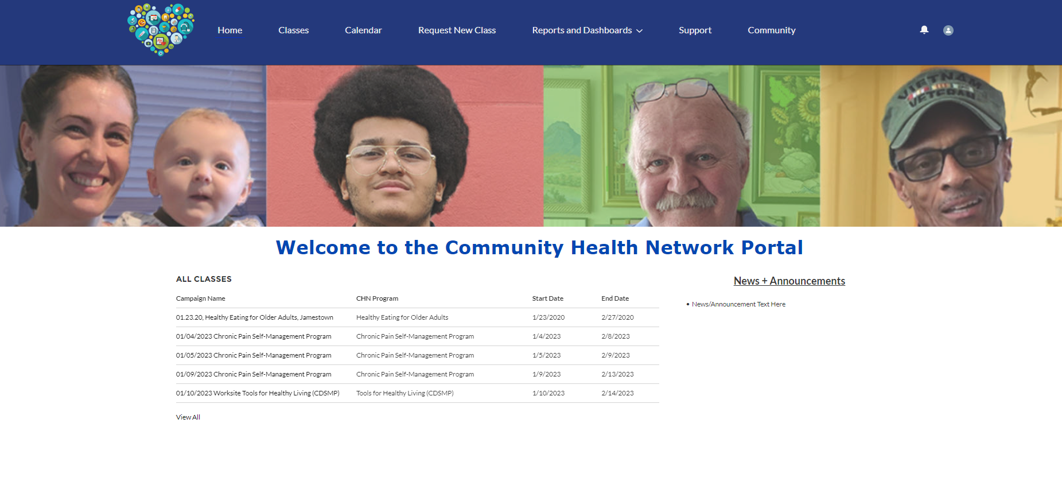
CHN Data Portal: New Features
Shift to a HIPAA secure Form Titan app
Text messaging – class reminders and follow-up
Collecting insurance information for billing
Value based payment model invoice generation
Bidirectional communication system – generate attendance and outcome reports for referring providers based on program benchmarks

Slide 14
Diabetes Prevention
CDC Diabetes Prevention Recognized Programs (DPRP)
Delivery modalities - virtual and online, English/Spanish
Upcoming diabetes prevention cohorts – CHN calendar
Capacity building opportunities for Lifestyle Coaches/CHWs
Diabetes Prevention Program Stakeholder Network (DPPSN)

Slide 15
Ready for Health
National Diabetes Prevention Program (DPP) rebrand to Ready for Health creating a more positive approach and outlook for diabetes prevention and overall health.
Partnered with KSA Marketing Firm:
- Google search/display, radio scripts (NPR), RI Medical Journal advertisements, targeted LinkedIn advertisements, collateral (e.g., Ready for Health brochure, CHN poster) and social media (META).

Slide 16
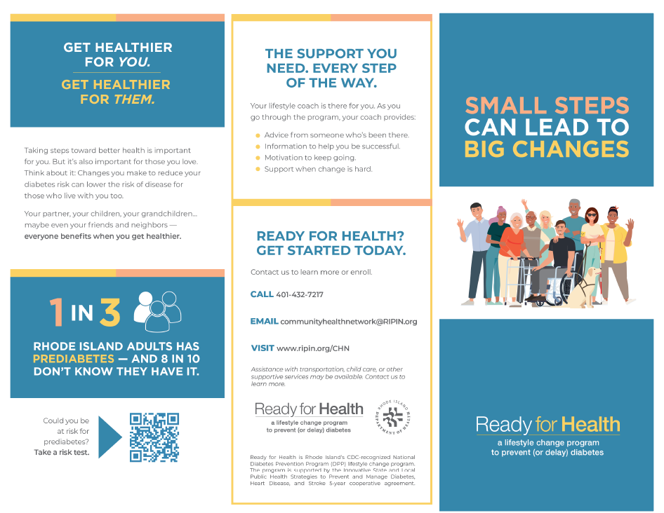
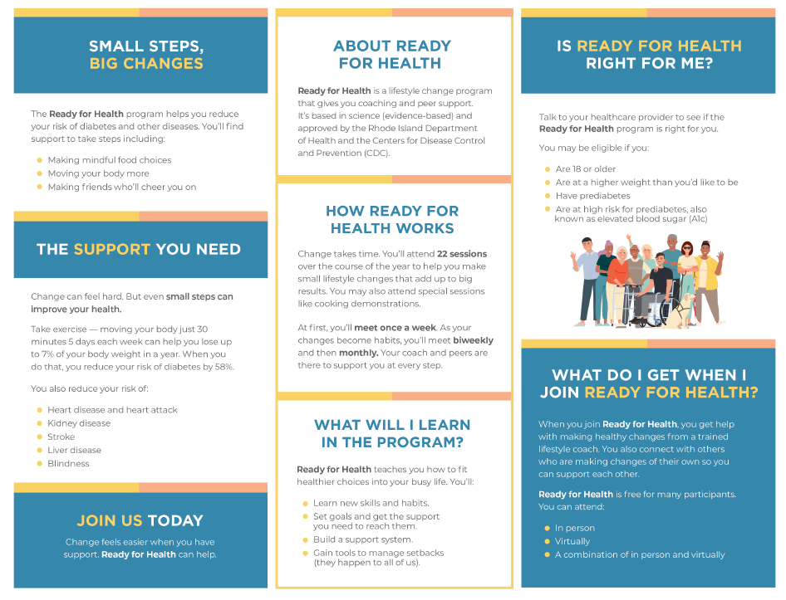
Ready for Health
Brochure Sample

Slide 17
CHN Phone: 401-432-7217
CHN Email: CommunityHealthNetwork@ripin.org
Calendar: https://ripin.org/chn/
Benvinda Santos, MPA
Sustainability Manager
Diabetes, Heart Disease, and Stroke Program
Rhode Island Department of Health
Benvinda.Santos@health.ri.gov
Cell: 401-712-3763 Office: 401-222-3763
Danai Boone, MSW
Diabetes Prevention Program Manager
Diabetes, Heat Disease, and Stroke Program
Rhode Island Department of Health
Danai.boone@health.ri.gov
Office: 401-222-5609

Slide 18
Thundermist Health Center SMBP Current Practices
Kathryn Czabanowski, RN
Marissa Delfino, RN
Claire Haynes, RN

Slide 19
Objectives
Define: Criteria for SMBP program
Identify: Workflow, satisfaction and areas for improvement
Education: Patient handouts

Slide 20
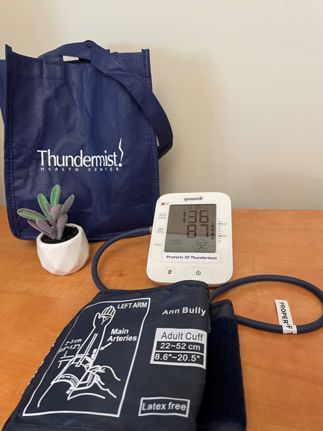
What is SMBP
SMBP, or Self-Management Blood Pressure, is the monitoring of blood pressure readings by the patient outside of the clinical setting, usually at home.
SMBP requires the use of a home blood pressure measurement device used by the patient to measure their blood pressure at specified times of the day, and as directed by their Medical Provider.
SMBP helps with both diagnosing and managing hypertension and increases patient participation in their own care.
When combined with other clinical supports, SMBP can help to improve hypertension control.

Slide 21
Who is eligible for SMBP
Patients who could benefit from the SMBP Program are identified during an office visit with a Medical Provider or during a Blood Pressure Check visit with a nurse.
The patient has persistent elevated readings for two or more subsequent office visits
The patient has a diagnosis of hypertension, is being ruled out for a diagnosis of hypertension or has “White Coat” hypertension
The patient desires to take blood pressure readings at home

Slide 22
General All-Site Data January 1, 2022-April 24, 2023
678 SMBP RN Visits
463 Patients Participated (Some patients participated in the program more than once)
1 Convenient Care
1 SC Dental
9 Med NP Fellow of WW
99 Medical of SC
52 Residency of WW
86 Medical of WO
215 Medical of WW
72 Providers referred patients to the program

Slide 23
Large BP Cuffs
Thundermist purchased a total of 25 Blood Pressure Monitors with Large cuffs in July of 2022
10 for Woonsocket
10 for West Warwick
5 for South County
A total of 62 patients benefited from those cuffs between 7/2022-4/2023
Out of those 25 cuffs, 20 remain in circulation

Slide 24
Large Blood Pressure Cuffs
Through a grant, Thundermist was able to purchase an additional 50 monitors and 50 Large cuffs in March/April 2023.
These cuffs are supplied with adaptors so that we can use them with any of the BP monitors in stock and significantly increase our ability to serve additional patients.

Slide 25
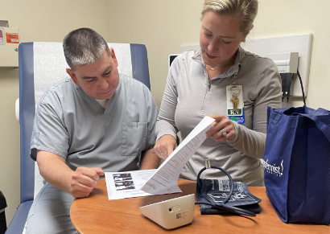
Workflow
Provider will request an RN to dispense an SMBP cuff to their patient
Provide patient name and DOB
Provide patient’s BP goal
Provide frequency and duration of checking
Provide parameters on when to call clinic

Slide 26
Workflow, Continued
After receiving the order from a provider, the nurse will complete the following:
Create a Nurse Visit for SMBP Enrollment
Add “Standard SMBP Program” template to Nurse Visit
Add SMBP to the patient’s Medical History
Educate the patient and/or caregiver how to use the SMBP monitor to record blood pressure.
Patient provides return-demonstration showing they understand how to use the SMBP device by taking their blood pressure.

Slide 27
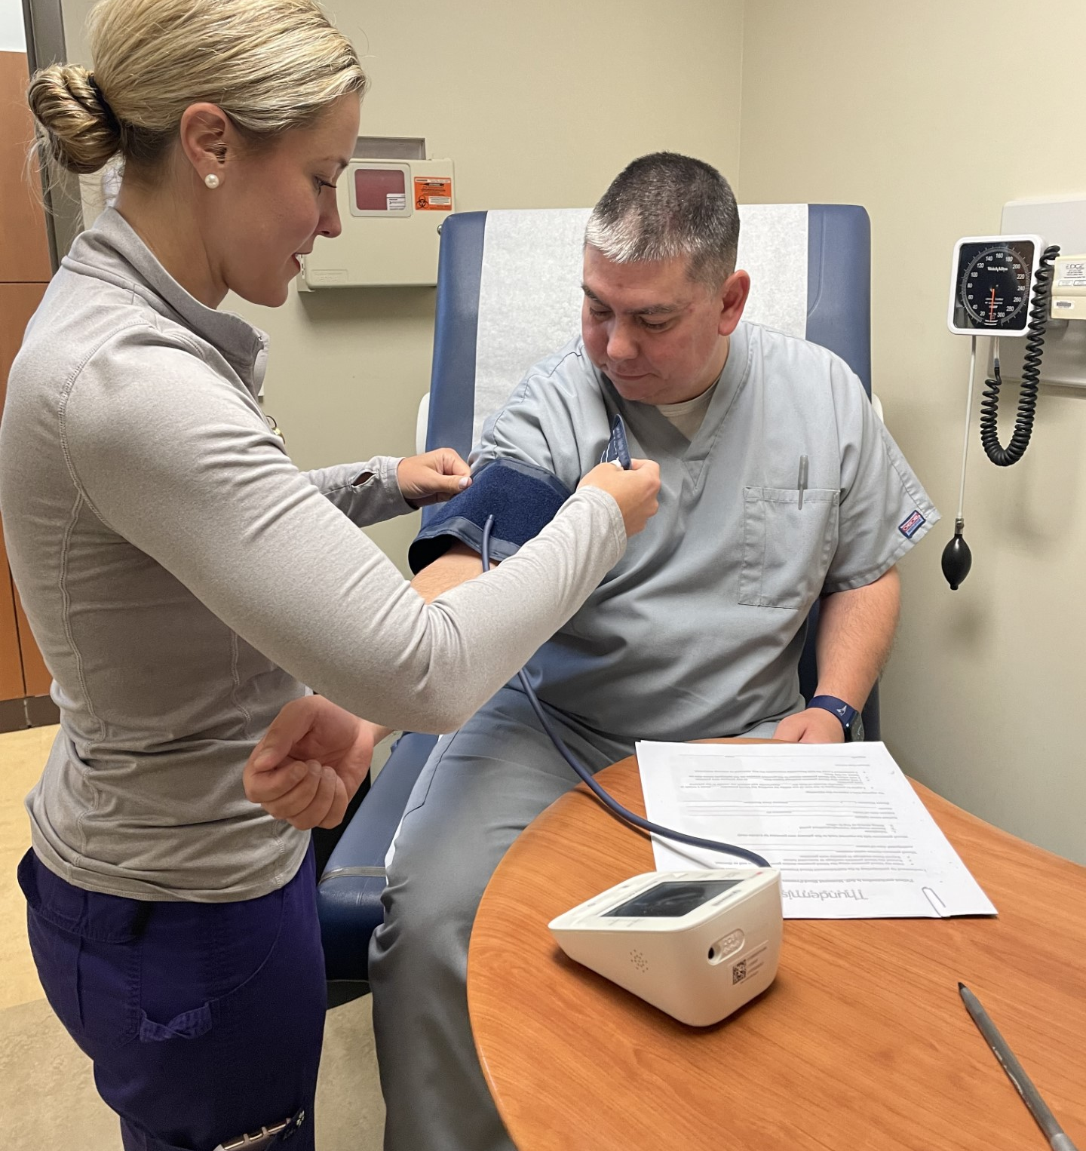
Workflow, Continued
Educate patient on hypertension, including what hypertension is, causes of hypertension, low-sodium diet, exercise and monitoring for hypertension
Educates patient on the SMBP Program, including proper positioning of body and equipment and ways to communicate blood pressure measurements to the care team
Create an action and send it to the project leader to track devices
1 week into program, RN sends an SMS text to the patient reminding them to check their Blood Pressure and report any high readings to clinic.

Slide 28
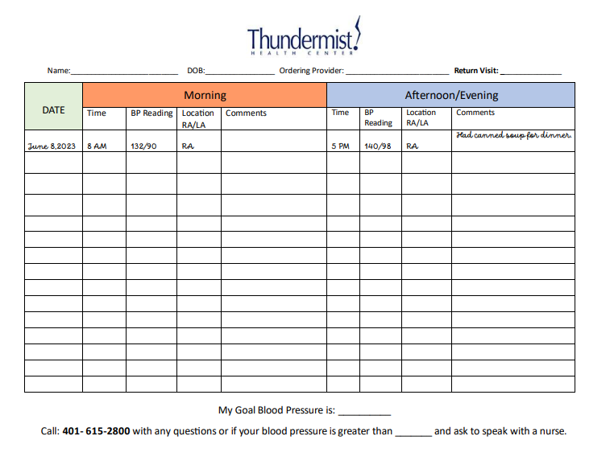
Blood Pressure Log

Slide 29
Tracking
Action is created and sent to SMBP project leader by RN after the visit
Once the Action is received, information is added to an Excel spreadsheet with:
Serial Number,
Once the BP cuff is returned, the patient’s pre-program and post-program BP averages are added to spreadsheet
These numbers are reported every 3 months to Health Informatics Team
Date given
Patient name & DOB
Note if dispensed a large cuff

Slide 30
Data Tracking

Slide 31
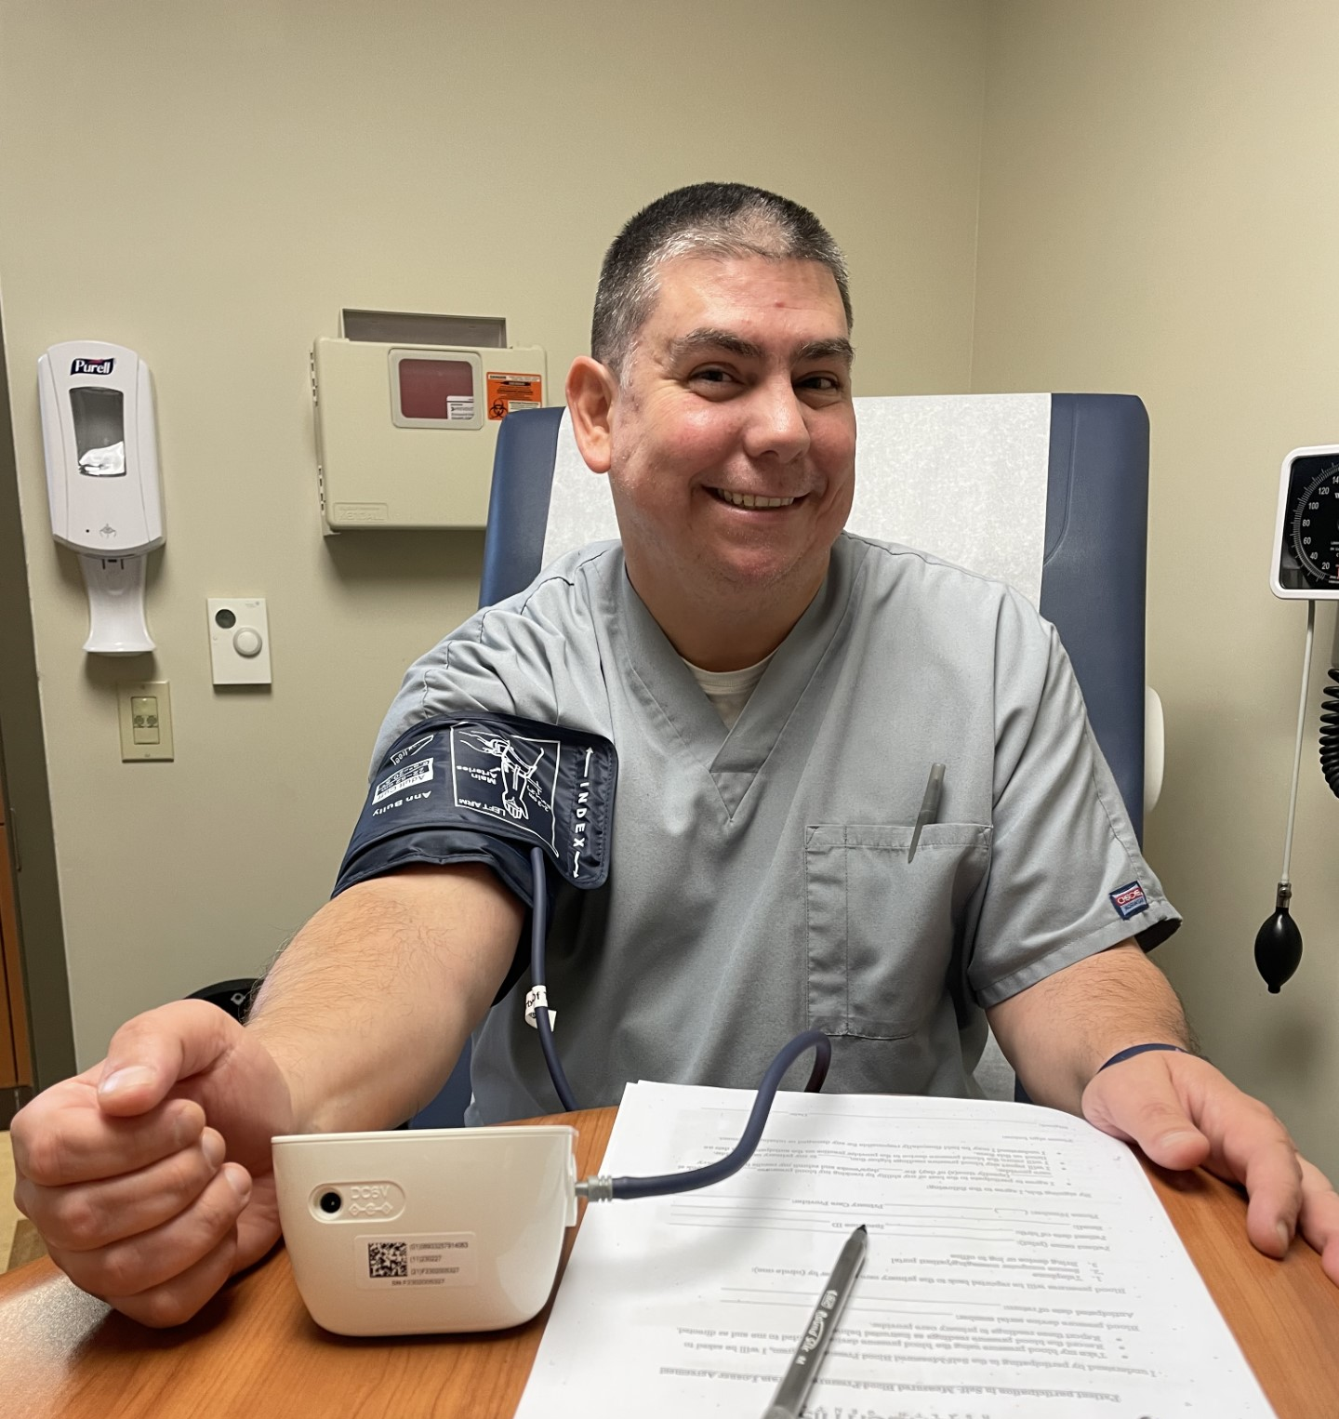
Benefits
Increase patient autonomy and partnership in their healthcare
Helps identify patients with Masked Hypertension or White Coat Hypertension
Offers providers a tool to better manage hypertension through pharmacotherapy and/or lifestyle modifications.
Patients who may be resistant to treatment gain a better understanding of their diagnosis and how to manage it.
Through education, patients can learn lifestyle modifications to help reduce their blood pressure.
Low Sodium & Low Fat
Stress reduction
Exercise

Slide 32
Challenges
Cuff size availability, specifically large cuffs
Inexact documentation of serial numbers makes it more difficult to track machines
Cuffs not returned limits availability for future patients
When initial return visits are missed:
70% of RNs report 3-4 outreach attempts are needed to retrieve the loaned monitor
30% of RNs report 5+ outreach attempts are needed to retrieve the loaned monitor
OB patients are not eligible

Slide 33
Challenges, Continued
Getting accurate numbers from patients can sometimes be challenging
Some cuffs are returned with empty logs or forget to bring their log with them
Nursing workflow requires many steps to enroll a patient
A significant number of cuffs are not returned or are taken out of service due to:
Patient does not return to care at the center
Patients move and seek care elsewhere
Deceased patients
Damage to the monitor/equipment

Slide 34
Provider Feedback
“Definitely a big help for patients that believe their BP to be normal at home or are resistant to meds. It’s an option to ease them into and prove that they need medication. Downside is patient compliance but out of our control. And the paper log, would be more usable in a graph form and trending am vs pm numbers so if "smart"-er cuffs (like the CGM data)”
“Access to large cuffs, inability to use in pregnant patients”
“Lack of pt participation, difficulty w/ BP cuff return”
“Allows me to have accurate blood pressure measurements. No cons.”
Provider Satisfaction:
50% of Providers felt Very Satisfied
50% of Providers felt Somewhat Satisfied

Slide 35
RN Feedback
“The enrollment process can be very time consuming. It would be great if the process was more simple.”
“Stricter rules for providers on who is eligible.”
“The process can be frustrating because it often requires multiple outreach attempts to patients to return the loaner blood pressure cuff.”
“Blood pressure cuffs are often returned after 2 or more weeks with no readings.”
RN Satisfaction:
12.5% of RNs felt Very Satisfied
12.5% of RNs felt Somewhat Satisfied
75% of RNs felt Neutral

Slide 36
Areas for improvement
Improve device tracking accuracy.
Improve our patient education packets to include signs and symptoms of stroke and heart attack and low-sodium diet.
Improving provider/RN education on appropriate patients.
Continue evaluating supply and demand to ensure we have ample inventory in both sizes.
Seek funding sources to re-supply BP cuffs.

Slide 37
Tri-County Community Action Agency Health Center Care + Community + Equity – Cardiovascular Disease
Karen Lachapelle, FNP
Assistant Medical Director

Slide 38
Cardiovascular Disease
Goal for 2022-2023/Practice-Designed Incentive:
The C+C+E team will review and revise the statin therapy clinical practice guidelines and workflows with the goal of improving the quality of care provided to patients with cardiovascular disease.

Slide 39
New Clinical Practice Guidelines
ASCVD risk score is assessed by provider after all yearly bloodwork
If STATIN therapy indicated, provider will order and registered nurse or dietitian will call and educate patient regarding new diagnosis risks/benefits of medication and if patient is agreeable will send medication to pharmacy. If patient is resistant, even after education patient will have follow-up appointment scheduled with primary care provider for further education.
3-6 month follow-up bloodwork will be obtained to ensure medication is effective.
If smoking was an identifiable risk factor, multiple options are available. Primary care provider will discuss risk and identify patient willingness to quit. QUITworks referral, medication options, gum/patches etc.

Slide 40
Provider Updates
Our quality team works with our HIT department to pull reports and at our monthly provider meetings we are reporting data to our providers
As a team we discuss various strategies to improve our patient adherence to medication regimens

Slide 41
Ongoing Work
Tri-county staff including physician, nurse practitioners, dietitian and registered nurses continue to educate patients on the benefits of a proper diet, exercise, weight management to improve overall cardiovascular health. When needed a lipid lowering agent is prescribed base on current guidelines.

Slide 42
Thank you!
Any Questions?
Karen Lachapelle, FNP
Klachapelle@tricountyri.org
www.tricountyri.com

Slide 43
AHA Initiatives
Deadline for submission was May 19, 2023
Submission met incentives for CVD and SMBP scope of work
Congratulations to the following organizations that submitted for Target BP and Check. Change. Control. Cholesterol:
CCAP
Thundermist
Tri-County
WellOne
Wood River

Slide 44
Closing Thoughts and Evaluation
Please take our meeting evaluation HERE
Next Meeting: September 13, 2023 8-9:30
Coming up….
Next data reporting due July 15 and September 15 (7.1.23-8.31.23)
During July and August continue quality improvement projects (PDSA)
Submit PDSA’s to your PF in September
THANK YOU
Notes:
Meeting evaluation: https://www.surveymonkey.com/r/CCE062123

