Slide 1

COVID 19 Response in SUNY Libraries
May 29, 2020
www.suny.edu

Slide 2
Future of Weekly COVID 19 Response Updates
Today's Update will be last one until after SLC/SUNYLA.
Will be looking at new day/time/frequency as we move into summer schedules.
If new important information or plans emerge, we'll put together a meeting as quickly as possible.
www.suny.edu
Notes:
To volunteer email Connie Perrin

Slide 3

OLIS Update
Mark McBride, Library Sr. Strategist
www.suny.edu

Slide 4
4-week Planning Committees
Resource Sharing | Tim Jackson/Shannon Pritting
Professional Development | Jennifer Smathers
Partnerships | Shannon Pritting/Mark McBride
Course Reserves | Mike Daly
Physical spaces | Jennifer Smathers
Library Instruction/Course Support | Mike Daly
Shared Collection Management | Esta Tovstiadi
Scholarly Communication | Maureen Zajkowski/Wendi Ackerman
Virtual Library Services | Susan Perry
www.suny.edu

Slide 5
Generate Possible Solutions: Professional Development
Recommend APT adjust to allow for digital publishing / presentations, online portfolios
Recommend mentoring – work with SUNYLA?
How to Evaluate PDOs, reach out to a mentor to ask for general guidance
Maintain shared listing of PDO opportunities
Leadership development training needs: Running Effective Meetings, Vulnerable Trust, Mentoring, Strategic Planning, Human Resources Ins and Outs, Personnel traits/preferences and strengths development, Communication Strategies, Advocacy
Fostering cross-campus networking
Create cohorts / learning communities across functional library areas. SLC Communications Audit of where conversations are taking place about SUNY Libraries
Monitor sources listed in the audit
Participate in your local ESLN affiliate functions and attend SLC conference
www.suny.edu

Slide 6
Generating Solutions: Partnerships
Partnerships
Will be collaborating to submit an IMLS CARES Act Grant to increase access to course related content.
Develop Five Areas of Cohort Model Professional Experiences:
  Collection Management
  OER/Open Access/Scholarly Communication
  Instructional Design and Information Literacy Instruction
  EIT and Library Accessibility
  Remote Services
Coordinating Shared Collections such as Ebooks
www.suny.edu
Notes:
To volunteer email Connie Perrin

Slide 7
Generating Solutions : Physical Space. (“There is too much, Let me sum up”)
Purchase and Distribute PPE
Purchase UV Disinfecting Equipment
4 days physical quarantine should work
Licensing across SUNY for virtual anatomy / physiology access. (Sanitizing anatomy models may destroy #s)
Physical Distancing Service Point needs; all masked, sneeze shield, 6’ line markings on floor or physical area blocked, staff sanitizes surfaces and objects at end of transaction
Add swipe machines for user handling or have staff search for users to avoid shouting IDs from 6 feet away Consider self checkout machines
Physical Distancing Studying / Open areas need 6-12’ spacing, masks must be on everyone properly, remove fans
Make all restrooms 1 person at a time
Closed stacks
Staffing on a rotation schedule
Cease all self-serve beverage and food services
No touch water fountains / bubblers need a sign regarding use
Touch water fountains (bubblers) need to be sanitized or closed
Remove staplers, scissors, paper cutters, paperclips…
Convert paper forms that library would use to online format
www.suny.edu
Notes:
Purchase UV Disinfecting Equipment
4 days physical quarantine should work CDC
Push for liscensing across SUNY for anatomy / physiology
Anatomy models -hand painting numbers concerns over degradation of numbering via UV and Chemical wipes
contact faculty who have integrated those models
what are their online anatomy model options
Will need to disinfect or have virtual versions of Reserve Materials/High Circ materials (enlist help of Deans of Student Affairs, ALUMNI, Foundation Funds)
Purchase and Distribute PPE
Screening Visitors (Upstate example, uses volunteers)
10-11 covid screen out questions
take temperature
If you pass then you get a mask
Colored Bracelet changes daily
Parking Lot or Entry Door
Only one open entrance per building/campus
Contact Tracing, taking names or swiping in. -If required
Physical Distancing Service Point
all masked
sneeze shield
6’ line markings on floor or Physical area blocked
Staff sanitizes surfaces and objects* at end of transaction *includes reserves
Add swipe machines for user handling or have student id read outloud
Self checkout machines
Physical Distancing Studying / Open area
6-12’
Mask Must be On
Assigned seating? to rotate need to sanitize
Computer Reservations ahead of time
Windows that can open? Ventilation
Remove fans
Make all restrooms 1 person at a time
Computers turned off, sign out of computers so you have a log of who used it and a pop up to ask about sanitizing after use (option)
Closed stacks
Staffing on a rotation schedule
Open Mon-Tue only? Give more time to clearing
Sharing Gym equipment space sanitize yourself
Loaning out Chromebooks instead of hardwired physical computers
Who is responsible to Clean?
Do not use individual rooms? -Too much cleaning
Disinfecting stuff out in public gets taken or disappears quickly
Reusable cloths to be disposed once a day
Only high use reserves kept on reserve
Indemnification clause when students check out reservations? Via Blackboard
24 hour access at Upstate requires a library quiz via blackboard (normally, indemnification clause is benign added)
Cease all self-serve beverage and food services
What about vending machines?
No touch water fountains / bubblers need a sign re: use
Fountain parts requiring touch need to be sanitized.
Remove staplers scissors paper cutter
Online only submission forms that library would use, papers, surveys, instruction exercises, reserves?
Qualtrex
Survey Monkey
LibWizard
Use giant QR codes to distribute links OR
Apple Air Drop sharing or bluetooth Android equipment
We need a statement from a higher power about this
SUNY Provost -can we limit student access to campus How does that interact with SUNY Board of Trustees --Governor Regardless of local policy or something

Slide 8
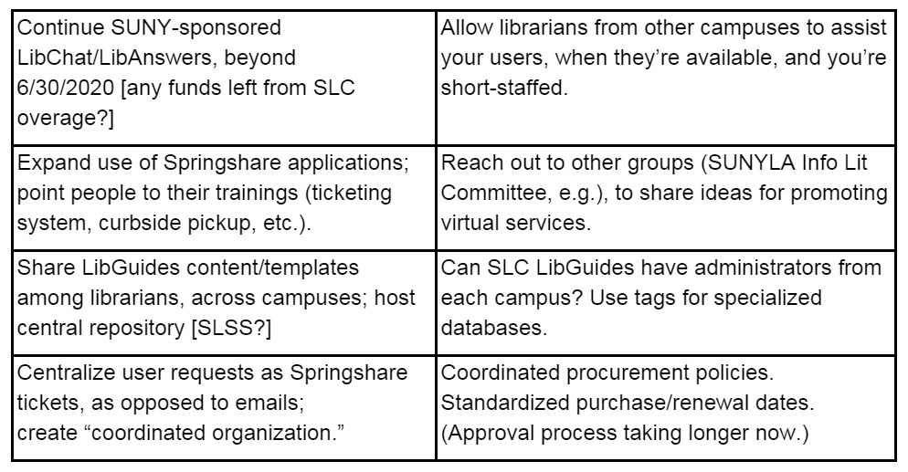
Generate Possible Solutions:
Virtual Library Services
www.suny.edu
Notes:
To volunteer email Connie Perrin

Slide 9
Generating Solutions: Resource Sharing
Developing RS guidelines for reopening
  Should develop a toolkit that campuses can adapt
  Coordination with other organizations such as ELD
Expanding RS in Alma:
  Expand Articles in Alma
  Universal Borrowing: how would a fulfillment network(s) work?
How would staff/workload sharing in RS work?
  Will be developing more specific focus in coming week.
How do we support each other across SUNY in RS?
  Will be developing more specific focus and tasks in coming week.
www.suny.edu
Notes:
To volunteer email Connie Perrin

Slide 10
Generating Possible Solutions: Course Reserves:
"Heatmap" of most common / most utilized course reserves to potential alternative content
  Library resources
  OER/OA
IMLS CARES Act Grant to increase access to course related content (Partnership).
www.suny.edu
Notes:
To volunteer email Connie Perrin

Slide 11
Generating Possible Solutions: Library Instruction:
Week three meeting postponed, stay tuned!
www.suny.edu
Notes:
To volunteer email Connie Perrin

Slide 12
Generating Solutions
Shared Collection Management:
Supporting libraries through the procurement process at their campus.
Clearinghouse of documents and best practices
Guidance for maintaining documentation related to the procurement process.
Guidance for justifying “criticality”/general tips for creating justifications for library resource expenditures
Examples of justification narratives and completed forms from campuses
Strategies for moving licenses through procurement
www.suny.edu
Notes:
To volunteer email Connie Perrin

Slide 13
Generating Solutions – Scholarly Communications
No additional funding
Common copyright/author rights questions – for librarians and broader audiences
  Create FAQ, SUNY-wide webinars, videos
  Develop SUNY micro-credentials program
  Identify SUNY copyright super-heroes to act as resources
OA and Training guides
  Promotion to faculty/researchers - talking points for librarians
  Training guides – getting started, basic workflow for campus liaisons
Additional funding
Automate submission processes – APIs with publisher platforms
ORCID iD member – API capabilities (ORCID-DataCite integration)
Single-sign on
www.suny.edu
Notes:
To volunteer email Connie Perrin

Slide 14
Final Presentations on 4-Week Problem-Solutions
Final Presentation on outcomes and planned responses for 4-week Problem-Solution groups will be presented during the SLC Virtual Meeting.
Exact time forthcoming, with details being shared broadly.
www.suny.edu
Notes:
To volunteer email Connie Perrin

Slide 15
SLSS Update
Shannon Pritting, Director of SUNY Library Shared Services
www.suny.edu

Slide 16

New Training Opportunities – Acquisitions
June 4, 2020 – Webinar
Fiscal Year Rollover in Alma
https://slcny.libcal.com/event/6718984
June 23, 24, 25, 29 - (8) hour course
CPD fee - $100
Using or upgrading to full acquisitions
Registration Open Now:
https://sunycpd.eventsair.com/fla-alma/fla-info
www.suny.edu

Slide 17
Accessibility/EIT
Repository of Vendor Accessibility Information, such as VPATs
Available at:
  https://slcny.libguides.com/third-party-repository
Request for volunteers for SUNY Libraries Accessibility Cohort:
Volunteer form at:
  https://slcny.libwizard.com/f/accessibility-volunteer
www.suny.edu

Slide 18
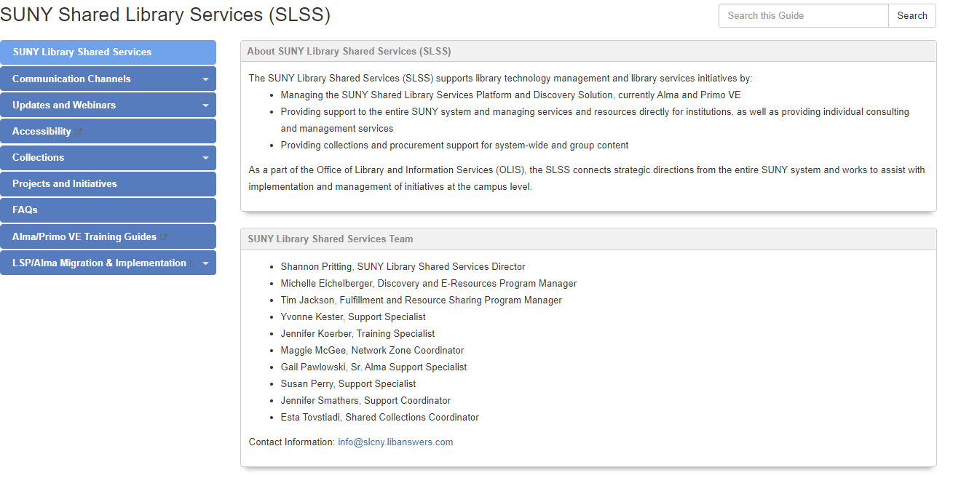
Website Adjustments
As SLSS expands initiatives, we needed to adjust the LSP/SLC/SLSS site to make it clearer where things area and who's doing what.
LSP related SLC working groups now under SLC
SLSS content and initiatives now under SLSS.
Easier access to training content.
Please let us know if we need to adjust further.
www.suny.edu

Slide 19
Shared Collections Update
Esta Tovstiadi, Shared Collections Coordinator
www.suny.edu

Slide 20
Want Some Help in Reviewing What to Cut?
SLSS is offering a service to assist you with identifying cuts in your collections.
Send us a request via libanswers (info@slcny.libanswers.com), and we'll work with you to help make the best decisions on resources that can be cancelled to meet demands for budget cuts.
Will need administrative logins (for usage data), a spreadsheet or other information about resources, target percentage for cuts, and any other relevant information.
We'll do as many of these consults as we can.
Please give us at least 3-4 days advance notice before any deadlines/meetings you have.
www.suny.edu

Slide 21
Resource Sharing Update
Timothy Jackson, SUNY Library Shared Services
www.suny.edu

Slide 22
Libraries Accepting Returns from All SUNY Users
List of libraries accepting returns from all SUNY users
  https://slcny.libanswers.com/faq/302298
  Info gathered from responses to https://slcny.libwizard.com/f/returns
  Please submit new responses whenever you have new information to share!
www.suny.edu

Slide 23
Libraries Accepting Returns from All SUNY Users
Important that returns are reflected in user records, so a webform for providing information about returns to SLSS is currently being tested
SLSS will use this information to update user records
Looking for additional libraries to help test the webform and workflow, so please email info@slcny.libanswers.com if users from other SUNYs have returned items to your library
All this may prove to be impractical, so please do what you can to encourage your users to keep what they have checked out!
www.suny.edu

Slide 24
Libraries Accepting Returns from All SUNY Users
SLSS staff creating "Returned at Other SUNY" location in your main library, and items returned at other campuses are being temporarily moved to that location
That location is being placed in its own Fulfillment Unit, and Fulfillment Unit Rules are being configured to block loans and requests
Configuration work being done on an as needed basis
SLSS will undo configuration once it is no longer needed
www.suny.edu

Slide 25
Empire Library Delivery
ELD sent out an email about resuming service on Wednesday
Also posted to COVID-19 Basecamp
Summary:
  Courier restart dates must be requested from ELD
  The courier will determine the start date based on the route and number of other locations on the route or hub that are open
SLSS in contact with ELD about restart plans and will align our plans to restart Alma RS with their plans
www.suny.edu

Slide 26
SLC Update
Jennifer Smathers, SLC Consortial Engagement Coordinator
www.suny.edu

Slide 27


Mon -Reports from 4-week Spring Planning Committees
Tue -OCLC Procurement Update & Discussing SLC's Future
Wed -Sector & Business Meetings
SLC Spring Meeting Agenda Highlights
www.suny.edu
Notes:
https://slcny.libwizard.com/f/SLCspring2020

Slide 28
Afternoons of Monday June 8
-Wednesday June 10
Open to All SLC at no cost
Required Registration by June 4
https://slcny.libwizard.com/f/SLCspring2020
SLC Spring 2020 Virtual Meeting
www.suny.edu
Notes:
Decorative image from https://www.pxfuel.com/en/free-photo-xnwek

Slide 29
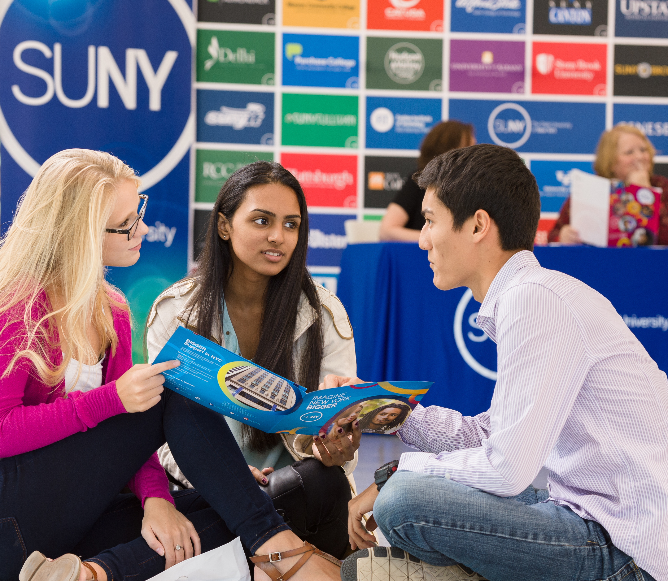

Questions?
How are Things Going at your Campus?
www.suny.edu

