Slide 1
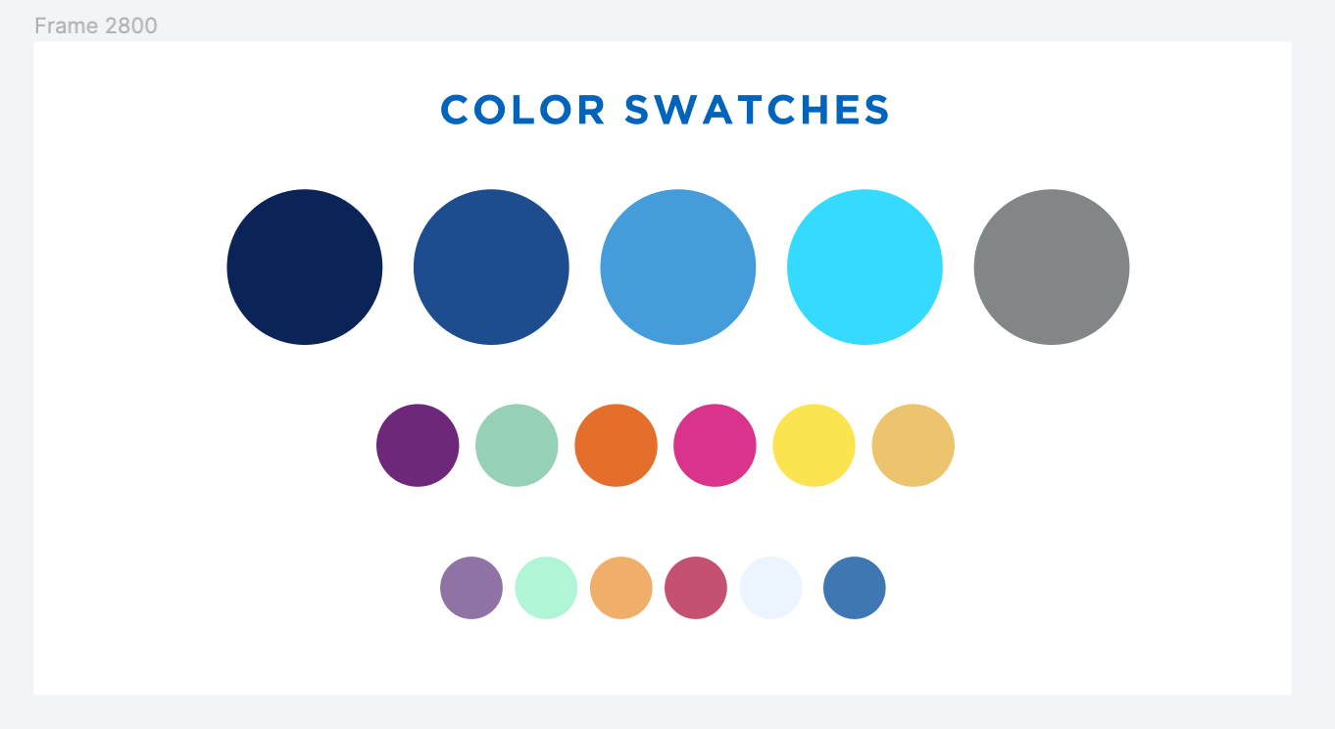
Overlap Analysis in Alma: New Features
April 2022
Esta Tovstiadi and Michelle Eichelberger

Slide 2
What is it?
A tool that allows you to compare holdings of electronic collections in Alma.
Overlap Analysis in Alma

Slide 3
Overlap Analysis in Alma
Package A
Titles and coverage
Package B
Titles and coverage

Slide 4
How can Overlap Analysis help you in Collection Development?
Evaluate overlap of a new resource with current holdings
Compare new SpringerNature journal package to Academic Search Premier
Evaluate overlap of two unsubscribed/unowned resources with each other
For instance, compare PQ Academic ebook collection with EBSCO Academic ebook collection
Evaluate current subscription to see what is unique and would be lost if the subscription was cancelled
Compare Academic Search Ultimate to Academic Search Premier

Slide 5
Using Overlap Analysis in Collection Development
Provides an additional data point for evaluating renewals, cancelations, new offers.
Can be used to demonstrate value in renewals
If making cuts, could factor in overlap percentage as a factor to decide what should be cut
For new offers, can help you understand how much unique content a product brings to your collection
Provide title and coverage-level review of large collections
Which titles and years are included in various databases
Which titles are unique to certain resources

Slide 6
Alma Overlap Analysis Limitations
Limited to Alma KnowledgeBase
Designed to compare between collections in Alma
Sometimes limited by quality of data in Alma
Matching is done by title or ISSN/ISBN.
Collections that lack identifiers used for analysis such as streaming video are difficult to analyze
Title matching in selected titles is only as good as the data allows it to be.
Some CZ collections lack ISBN/ISSNs for all titles, so unless vendor provides title list with identifiers, the comparison is only partially useful.

Slide 7
Overlap Analysis Questions to Ask
A second level of analysis is almost always helpful to make overlap analysis reports useful.
What platforms are important to my institution?
If complete overlap is in a database that your users don't prefer, will they use it?
What journals are important to my institution?
Not all journals are created equal. Review what journals are duplicated.
Factor in cost of subscriptions to journals
Journal quality and relevance are also important
What coverage is important to my institution?
Frontfile content is often most important
But backfile content can be important too (if you're planning to weed a legacy print collection, for example)
Length of gaps in coverage are also very important. If complete overlap for a title is spread across multiple access points, are users likely to discover and use it?

Slide 8
Request an Overlap Analysis from SLS
If you don’t do this process often, it’s confusing.
The documentation on overlap analysis is dense, and sometimes omits information that would clarify how to interpret reports.
Expect to spend some time getting familiar with the process.
Because of this, if you want an overlap analysis, you can request one from SLS.
Just be as specific as possible with what you’d like us to compare.
Submit request to: info@slcny.libanswers.com

Slide 9
Alma Workflow

Slide 10
New Overlap Analysis Tool
Changes in March 2022 release, more changes to come
Ability to select an unactivated CZ collection as a source for comparison (compare to IZ for instance). In the past, you could have done this by uploading a spreadsheet of identifiers; you can still do this, but it's no longer necessary
Ability to select entire IZ as a target for comparison
Add NZ holdings as an option for overlap analysis

Slide 11
What has changed
Look and feel
Can now delete previous analyses
Better visualization and interface for results
Export of titles includes a summary page
When you upload an input file, it is saved in the report results for future reference

Slide 12
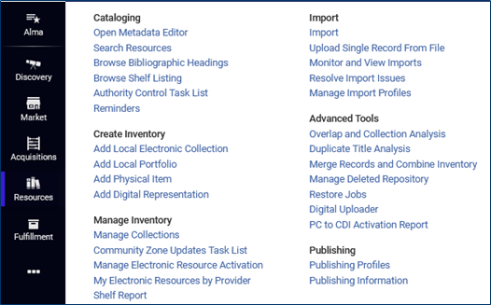
Workflow Review
Find tool under Resources, Advanced Tools
Roles (need one of the following):
Purchasing Operator
Purchasing Manager
Repository Manager
Electronic Inventory Operator

Slide 13
Workflow Review, cont.
Choose either Compare Collections or Look up Titles
Give the report a name and description
Choose the collection/source for which you want to look at overlap
Decide what you'd like to compare it to: collection(s) in IZ, collection(s) in CZ, entire IZ
Choose how you want to match: Title, ISSN, ISBN, 035, LCCN
Decide if you want to include date coverage

Slide 14
Workflow Review, cont.
Download Excel files to see which titles had overlap, which had partial coverage overlap, etc.
If you choose to compare to the whole IZ, you'll get an Excel file with multiple tabs: single match, multi match, no match, and analysis information

Slide 15
Network Zone
As part of the recent update, you can now compare collections or a title list with a collection in the NZ or the whole NZ. This would be most useful for consortia who manage a large number of e-resources in the NZ. SUNY manages the following:
Subscription:
Sciencedirect current/core titles
New England Journal of Medicine
STAT!Ref central purchase
NNYLN Overdrive (4 campuses)
SUNY Press 2003-2006
DDA/Unique Packages/Projects
eBook Central Lending collection
DDA Cohorts A and B
OA
New York State Historic Newspapers

Slide 16
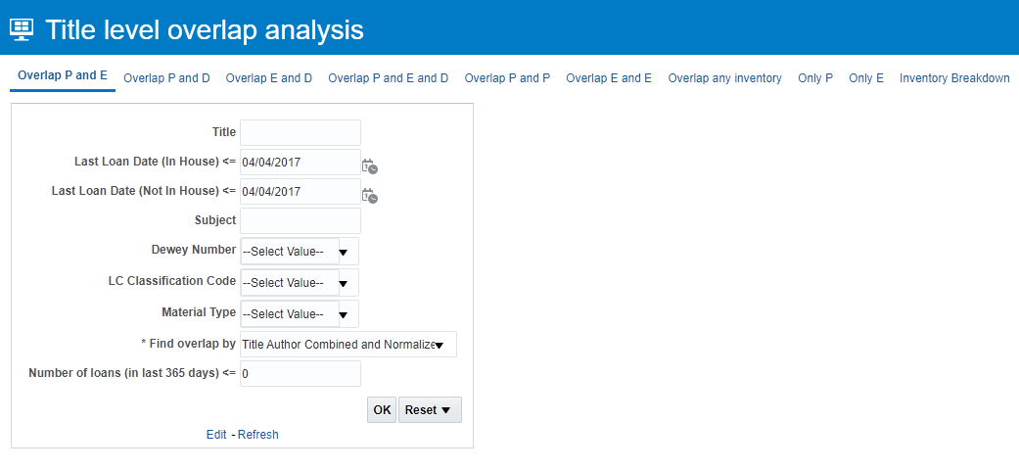
Sneak Peek
Tentative plans to include print in future version of overlap analysis; use Alma Analytics Title Level Overlap Analysis dashboard, under Shared folders->Alma->Titles->Dashboards

Slide 17
Demos

Slide 18
Demo
You are considering purchasing the JSTOR Essentials collection, and you want to know how much overlap there is between this package and your other electronic holdings.

Slide 19
Additional Resources
March 29, 2022 Ex Libris:
Recording: https://www.youtube.com/watch?v=13yERolZjEY
Slides
SLSS Collections Renewal and Cancellation Strategies: Webinar 2 Overlap Analysis from May 26, 2020
Ex Libris Knowledgebase Documentation: https://knowledge.exlibrisgroup.com/Alma/Product_Documentation/010Alma_Online_Help_(English)/040Resource_Management/070Advanced_Tools/010Overlap_Analysis

