Slide 1
CyberPatriot: A Fun Way To Stimulate STEM Interest with Middle and High School Aged Students
NICE K-12 Conference
December 3, 2018
Elizabeth “Alex” Farrell, CISSP, MBA
Program Coordinator, Global Cyber Education and Workforce Development
Approved for Public Release #18-2501
Notes:
Presentation format: 2 x 40 min drop in sessions at a table top
Suggested presentation timeline: Rotation of 5-10 min lightning talks using listed topics

Slide 2
Presentation Overview
What is CyberPatriot?
CyberPatriot Competition - How it Works
How You Can Get Involved
You CAN be A CyberPatriot Coach!
Competition image demo
2
Notes:
Topics are hyperlinks to specific topic slides. Northrop Grumman logo on individual slides is a hyperlink to this slide “Lightning Talk Topics”
The competition image demo is provided by the AFA CyberPatriot program office

Slide 3
CyberPatriot Overview
CyberPatriot is the largest and fastest growing national youth cyber education program designed to excite, educate, and motivate the next generation of cyber defenders (and other STEM grads) critical to our nation’s future security
Created and led by the Air Force Association
Program Objectives:
Promote basic cybersecurity education and understanding
Provide a fun and exciting competitive team experience
Enhance team-based leadership, communication, and cooperation skills
Teach defensive techniques; no offensive operations
CyberPatriot provides students the opportunity to gain hands-on, practical knowledge that prepares them for post-secondary education and jobs in cybersecurity
3
Notes:
Slide approved for public release eProcs 18-1670
Slide Instructions:
Brief overview of topics covered during presentation
48% of CP X participants surveyed plan to participate in CP XI
Key Takeaway(s):
The presentation is framed to provide fundamentals about cybersecurity, an overview of cyber workforce needs, and provide an example of a program that is very effective with engaging diverse student interest in cyber and STEM
Transition / What’s Next:
Start with cybersecurity fundamentals to ensure audience understands what cybersecurity is and how it relates to them

Slide 4
CyberPatriot Overview
CyberPatriot | III | IV | V | VI | VII | VIII | IX | X | XI | Growth
All Service Division | 475 | 611 | 806 | 868 | 1,007 | 1,281 | 1,589 | 1,717 | 1,851 | 290%
Open Division | 186 | 403 | 419 | 628 | 978 | 1,638 | 2,217 | 2,757 | 3,293 | 1,670%
Middle School Division |  |  |  | 70 | 190 | 460 | 598 | 1,110 | 1,243 | 1,676%
Total Teams | 661 | 1,014 | 1,225 | 1,566 | 2,175 | 3,379 | 4,404 | 5,584 | 6,387 | 866%
Northrop Grumman committed over $402,500 in scholarships to top three teams in each high-school aged division since 2011
Over 355 CyberPatriot competitors have been hired by Northrop Grumman across the U.S. for paid internships since 2011; other sponsors and Government agencies also hire interns
4
Notes:
Slide approved for public release eProcs 18-1670
Slide Instructions:
Brief overview of topics covered during presentation
48% of CP X participants surveyed plan to participate in CP XI
Key Takeaway(s):
The presentation is framed to provide fundamentals about cybersecurity, an overview of cyber workforce needs, and provide an example of a program that is very effective with engaging diverse student interest in cyber and STEM
Transition / What’s Next:
Start with cybersecurity fundamentals to ensure audience understands what cybersecurity is and how it relates to them

Slide 5
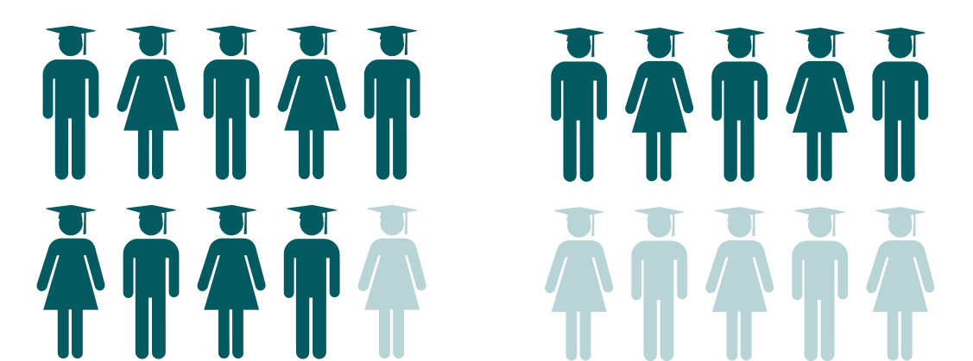
CyberPatriot Youth Impact
87.3% vs 44.4%
87.3% of those CyberPatriots enrolled in high school plan to pursue a four-year degree, compared with the national average of 44.4%
88.7% vs 14.9%
88.7% of high school CyberPatriots surveyed who plan to pursue a 4-year or 2-year degree will do so in cyber or STEM, compared with the national average of 14.9%
5
Statistics derived from CyberPatriot Alumni Survey Report, June 2018
Notes:
Slide approved for public release eProcs 18-1284
Slide Instructions:
-
Key Takeaway(s):
-
Transition / What’s Next:
-

Slide 6
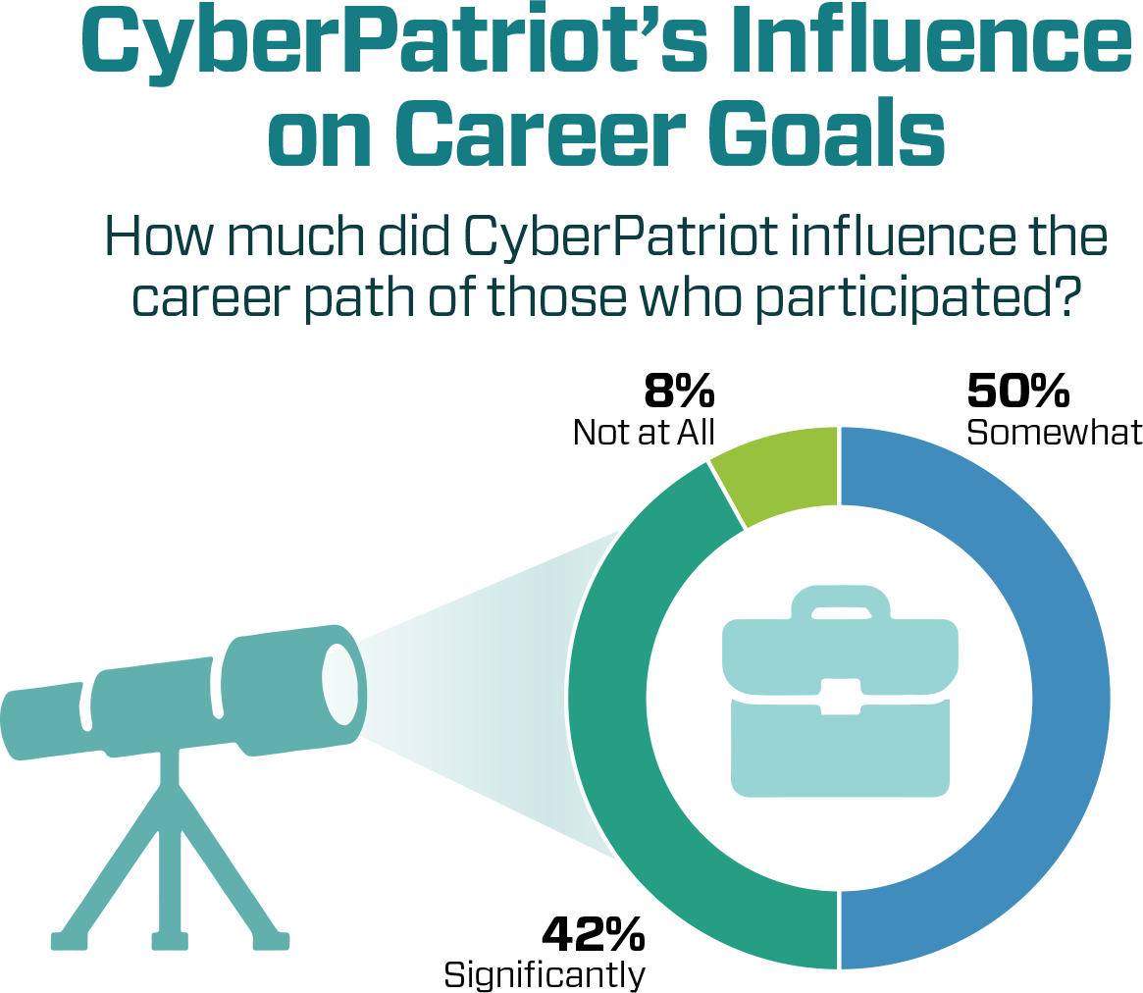
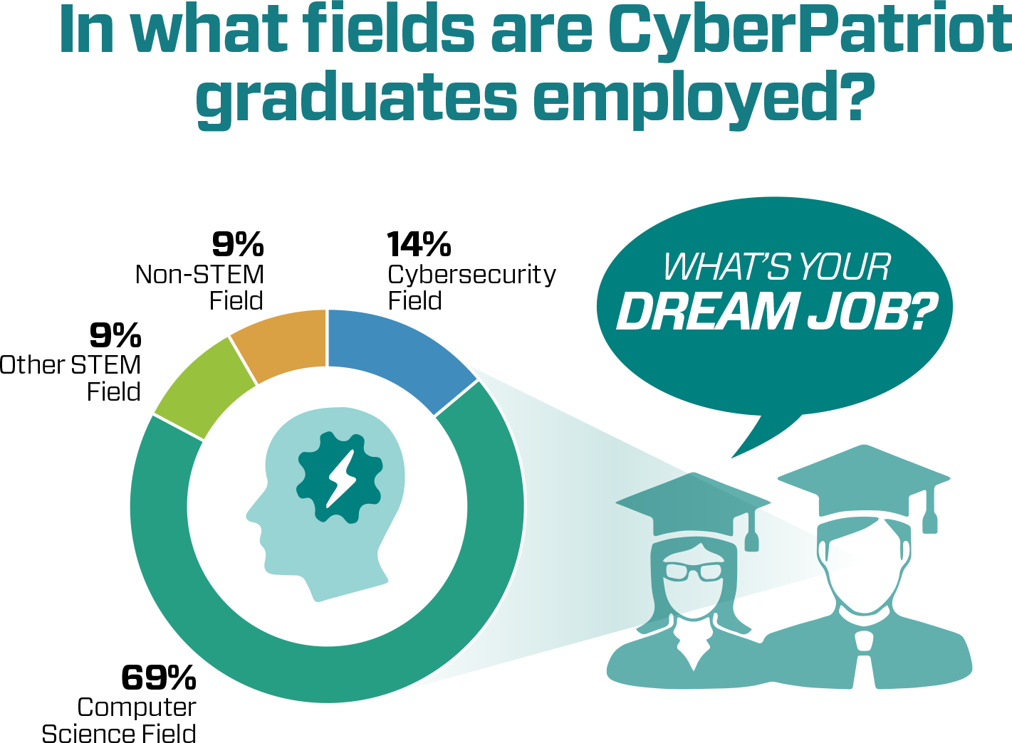
CyberPatriot Youth Impact
Computer Science
6
Statistics derived from CyberPatriot IX Post-Season Competitor Survey, 2016-2017
Notes:
Slide approved for public release eProcs 18-1284
Slide Instructions:
-
Key Takeaway(s):
-
Transition / What’s Next:
-

Slide 7
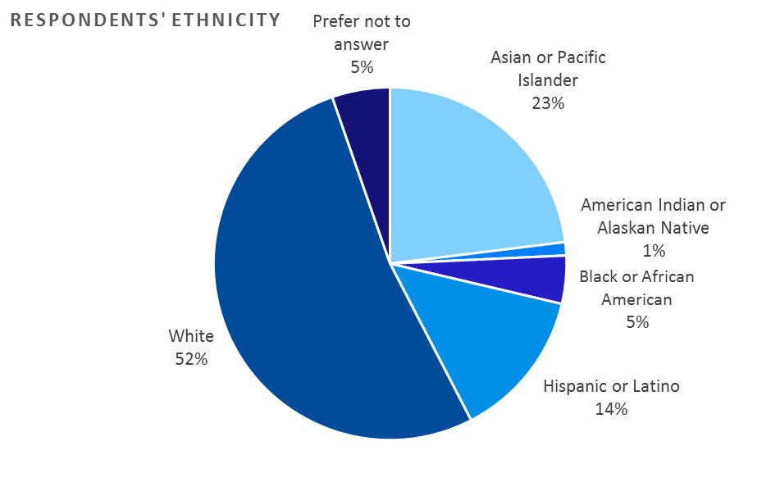
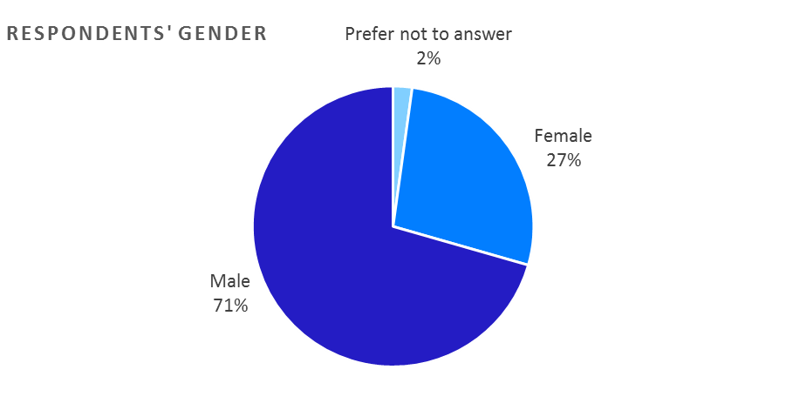
CyberPatriot Participant Demographics
Source: CyberPatriot Student Alumni Survey Report – June 2018
7
Notes:
Slide approved for public release eProcs 18-1284
Graphics provided by the AFA CyberPatriot Program Office
Slide Instructions:
-
Key Takeaway(s):
-
Transition / What’s Next:
-

Slide 8
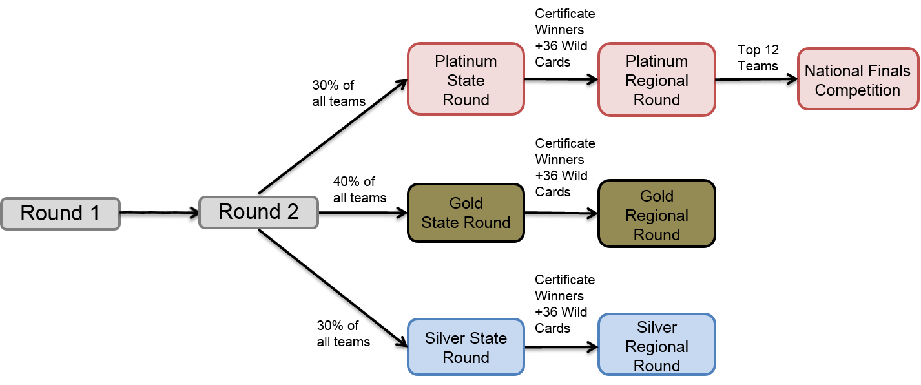
The CyberPatriot Competition – How it Works
Real-time, online, qualification rounds are designed to test each team’s ability to find and remediate vulnerabilities in their network
Online rounds are six hours in length; conducted over a 36-hour window
Each team will start the competition with identically mis-configured networks
Teams must defend against ‘red team’ attacks by reconfiguring the network they’ve been given, repairing holes in their firewall, implementing security policies, closing any open/vulnerable ports, and taking preventive measures
The teams are assessed points by the automated scoring system
Team placement based on performance in each round
8
Notes:
Slide approved for public release eProcs 18-1670
Slide Instructions:
Brief overview of topics covered during presentation
Key Takeaway(s):
The presentation is framed to provide fundamentals about cybersecurity, an overview of cyber workforce needs, and provide an example of a program that is very effective with engaging diverse student interest in cyber and STEM
Transition / What’s Next:
Start with cybersecurity fundamentals to ensure audience understands what cybersecurity is and how it relates to them

Slide 9
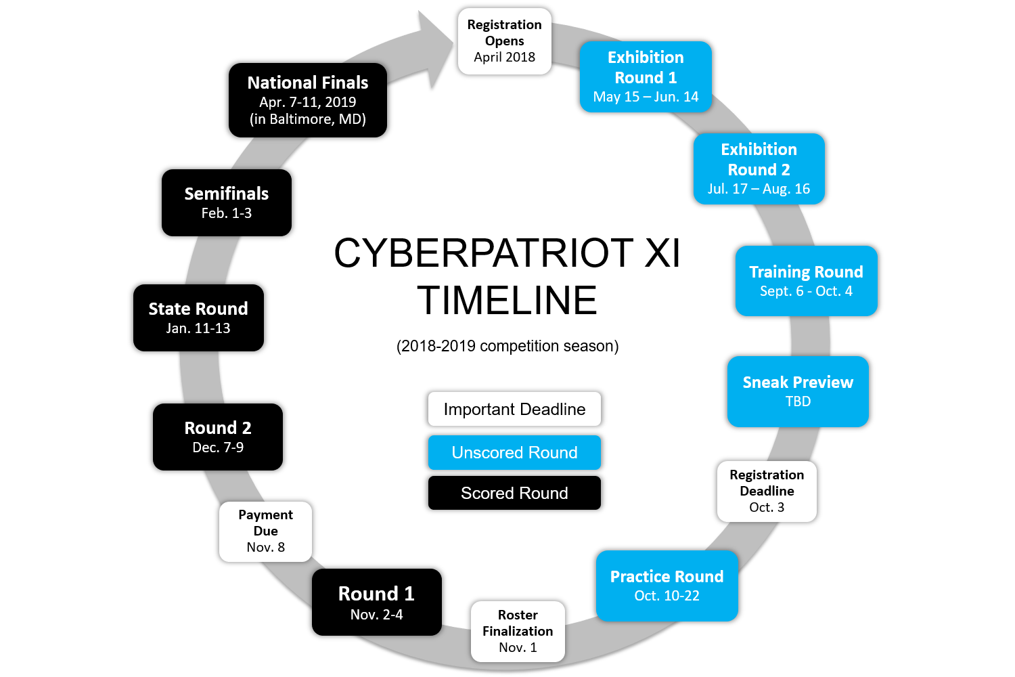
CP- X Competition Timeline
Team Registration Closes on October 3
Competitor Registration Closes on November 1
© Air Force Association
9
Notes:
Slide approved for public release eProcs 18-1670
Slide Instructions:
Brief overview of topics covered during presentation
Key Takeaway(s):
The presentation is framed to provide fundamentals about cybersecurity, an overview of cyber workforce needs, and provide an example of a program that is very effective with engaging diverse student interest in cyber and STEM
Transition / What’s Next:
Start with cybersecurity fundamentals to ensure audience understands what cybersecurity is and how it relates to them

Slide 10
Getting Started: Resources Needed
Identify Team Coach
Pay registration fee* and register the Coach
Covers all direct costs, including transportation, food, and lodging for teams qualifying for the in-person National Finals Competition
Provides licenses for Microsoft Academic Alliance Developer software package
Participant kits (shirts, certificates, etc.) for each competitor
Schools financially unable to pay the registration fee may apply for a grant from Northrop Grumman
Determine resource availability
Teams will need computers, internet access, and a place to practice
* Registration fees per team: Refer to program web site for current information
10
Notes:
Slide approved for public release eProcs 18-1670
Slide Instructions:
Brief overview of topics covered during presentation
Key Takeaway(s):
The presentation is framed to provide fundamentals about cybersecurity, an overview of cyber workforce needs, and provide an example of a program that is very effective with engaging diverse student interest in cyber and STEM
Transition / What’s Next:
Start with cybersecurity fundamentals to ensure audience understands what cybersecurity is and how it relates to them

Slide 11
How Can I Bring CyberPatriot to My School?
School Information package
Provides information for different perspectives
CyberPatriot XI Fact Sheet
Why Hire a CyberPatriot
CP XI for Principals
CP XI for Coaches
CP XI for Mentors
CP XI for Parents
CP XI for Students
Notional Career Path
Why is CyberPatriot Important?
Information updated annually
Timing is important to prepare for first time participation
11
Notes:
Slide approved for public release eProcs 18-1670
Slide Instructions:
-
Key Takeaway(s):
-
Transition / What’s Next:
-

Slide 12
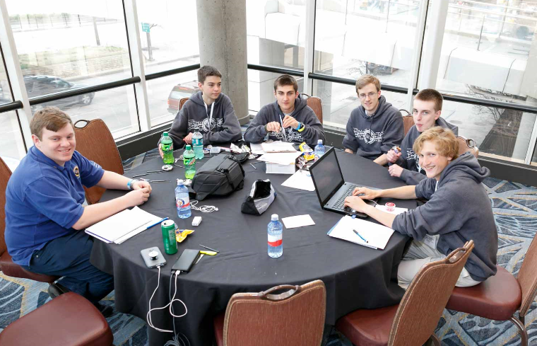
I’m Not Technical – Can I Be a Coach?
Practical Needs
Logistics (meeting space and equipment)
Internet connection to participate and research
Student Experience Goals
Have FUN!
Teach students to make good decisions online to mitigate decisions that can exclude them from future job opportunities
Problem solving approaches (scientific method, root cause analysis, etc)
Grow by doing and learning from experience – hallmark of STEM careers
Making mistakes is OK – mistakes led to many of the worlds best discoveries
Tips for Success
Focus on the things you’re good at – outsource for expertise you need help with
Help students set goals - guide them; let them figure out how to reach those goals
It’s ok not to have all of the answers – work as a team to fill knowledge gaps
Google and YouTube are great resources
Add yourself to the picture
Anyone who can lead a team can be a coach!
12
Notes:
Slide approved for public release eProcs 18-1284
Slide Instructions:
Tips and discussion to dispel poor confidence in being able to lead a team of CyberPatriot students

Slide 13
Back-up Slides
Notes:
In this section, set the stage to explain to the teachers why Cybersecurity is important

Slide 14
For More Information
AFA’s CyberPatriot website
www.uscyberpatriot.org
Direct contact at info@uscyberpatriot.org
Northrop Grumman’s CyberPatriot site
http://www.northropgrumman.com/CorporateResponsibility/Pages/CyberPatriot.aspx
Direct contact at cyberpatriot@ngc.com
CyberPatriot Video
https://www.youtube.com/watch?v=sesaiofAEWA
Search “CyberPatriot X” on YouTube
14
Notes:
Slide approved for public release eProcs 18-1670
Slide Instructions:
Tips and discussion to dispel poor confidence in being able to lead a team of CyberPatriot students

Slide 15
15

