Slide 1

Yvonne Kester
Configuring Role Profiles
June 8, 2020
www.suny.edu

Slide 2
Role Profiles
A role profile is a pre-set collection of roles needed to carry out common jobs in the Alma environment. You can create a role profile for any position in your library, such as:
Systems Librarian
E-Resources Librarian
Cataloger
Acquisitions Clerk
Circulation Manager
Student Assistant
www.suny.edu

Slide 3

Why Create Role Profiles?
Role profiles take the guesswork out of giving roles to new colleagues, saving you time and saving a new person the frustration of being unable to carry out their tasks fully.
www.suny.edu

Slide 4
Configuring Role Profiles: Roles
To configure role profiles, you must have one of the following roles:
User Administrator
General System Administrator
www.suny.edu

Slide 5
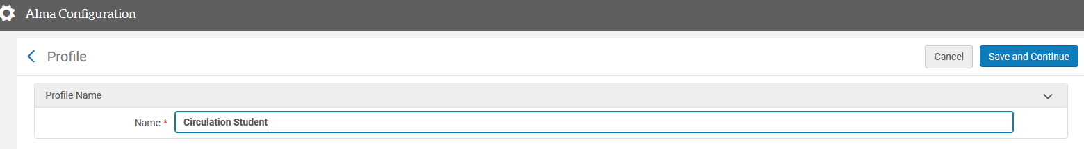
How to Add a Role Profile
Go to Configuration>>User Management>>Roles and Registration>>Profiles
Select Add Profile
Enter a name for your profile that will be easy to recognize/understand
Select Save and Continue
www.suny.edu

Slide 6
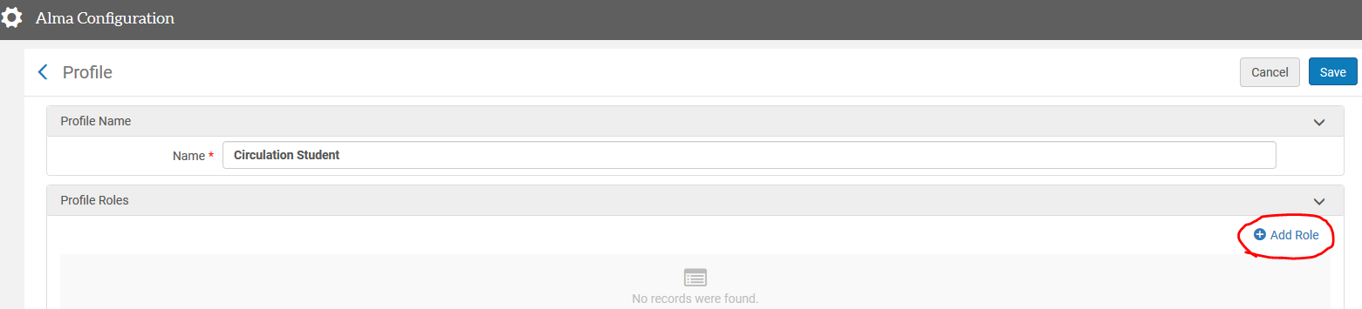
How to Add Roles
In the Profile Roles area, click Add Role.
www.suny.edu

Slide 7
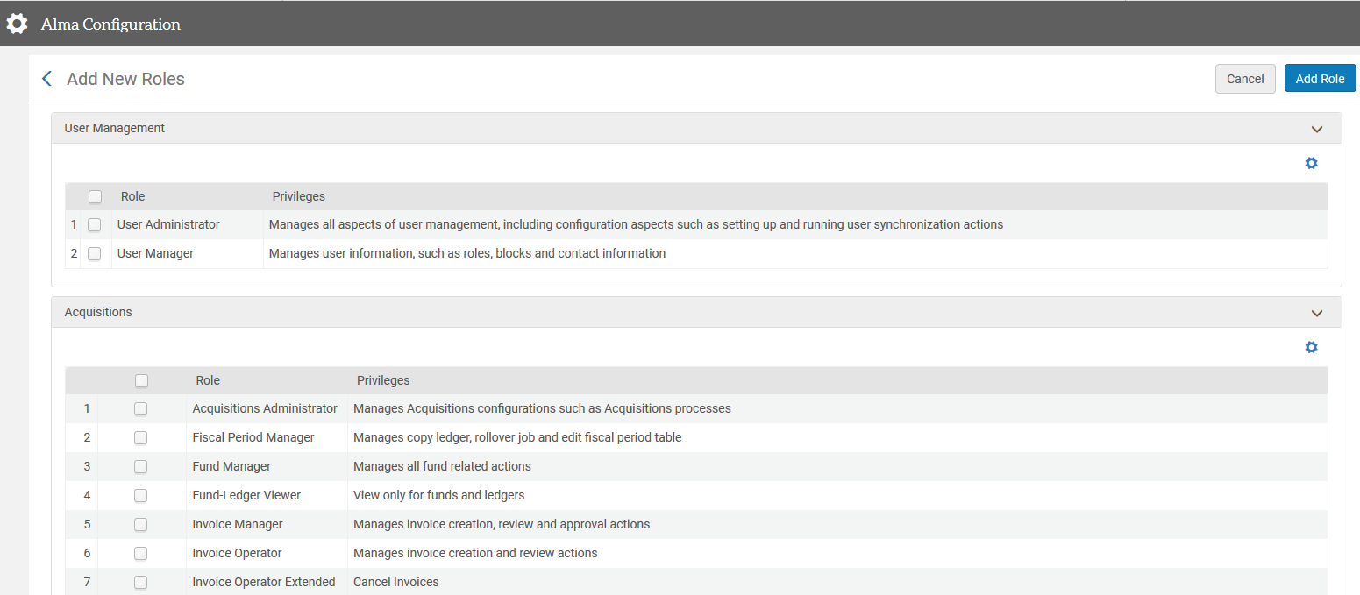
How to Add Roles
The Add New Roles page appears.
www.suny.edu
Notes:
You can add roles one at a time by checking a single box next to a role and clicking Add Role. This will take longer but will enable you to add scopes, etc., as you go. The other option is to select all the roles you wish to add to the profile and click Add Role. If you do this, all the roles will be added at once. However, roles that need to be configured will not be active until you go back in and configure them.

Slide 8
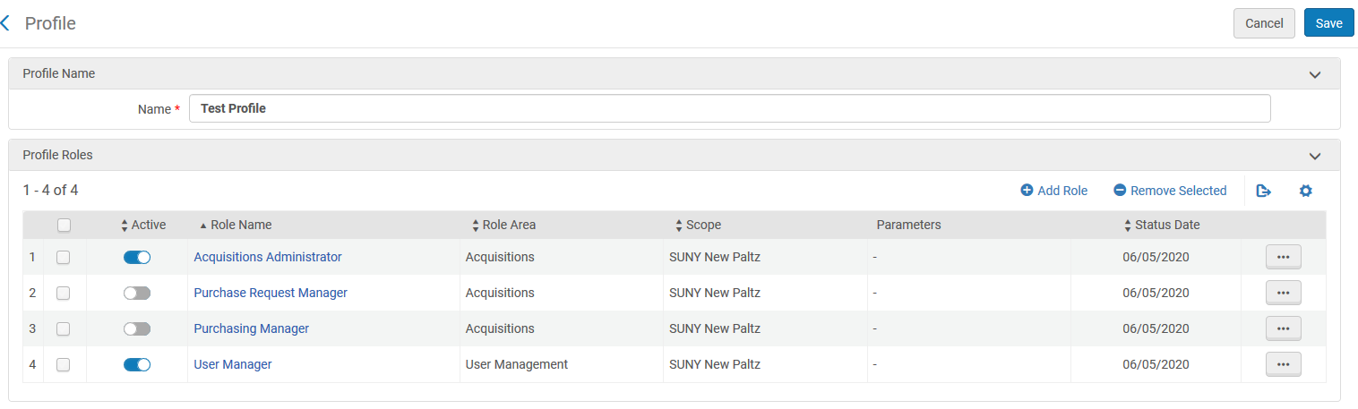
How to Add Roles
Some roles require configuration before they become active
www.suny.edu
Notes:
You can add roles one at a time by checking a single box next to a role and clicking Add Role. This will take longer but will enable you to add scopes, etc., as you go. The other option is to select all the roles you wish to add to the profile and click Add Role. If you do this, all the roles will be added at once. However, roles that need to be configured will not be active until you go back in and configure them.

Slide 9
How to Add Roles - Configuration
To edit a role, click on the role name or click the ellipsis and choose Edit.
www.suny.edu
Notes:
You can add roles one at a time by checking a single box next to a role and clicking Add Role. This will take longer but will enable you to add scopes, etc., as you go. The other option is to select all the roles you wish to add to the profile and click Add Role. If you do this, all the roles will be added at once. However, roles that need to be configured will not be active until you go back in and configure them.

Slide 10
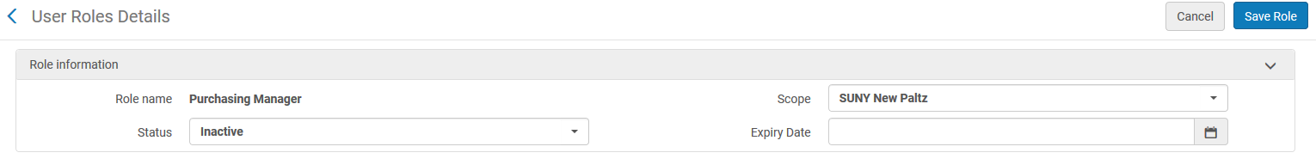
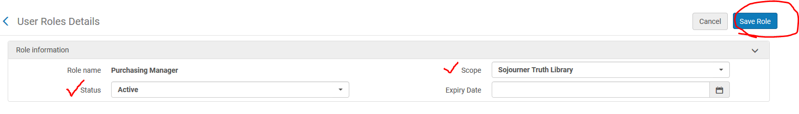
How to Add Roles - Configuration
The Purchasing Manager role should be scoped to the Library and the Status set to Active
www.suny.edu
Notes:
You can add roles one at a time by checking a single box next to a role and clicking Add Role. This will take longer but will enable you to add scopes, etc., as you go. The other option is to select all the roles you wish to add to the profile and click Add Role. If you do this, all the roles will be added at once. However, roles that need to be configured will not be active until you go back in and configure them.

Slide 11
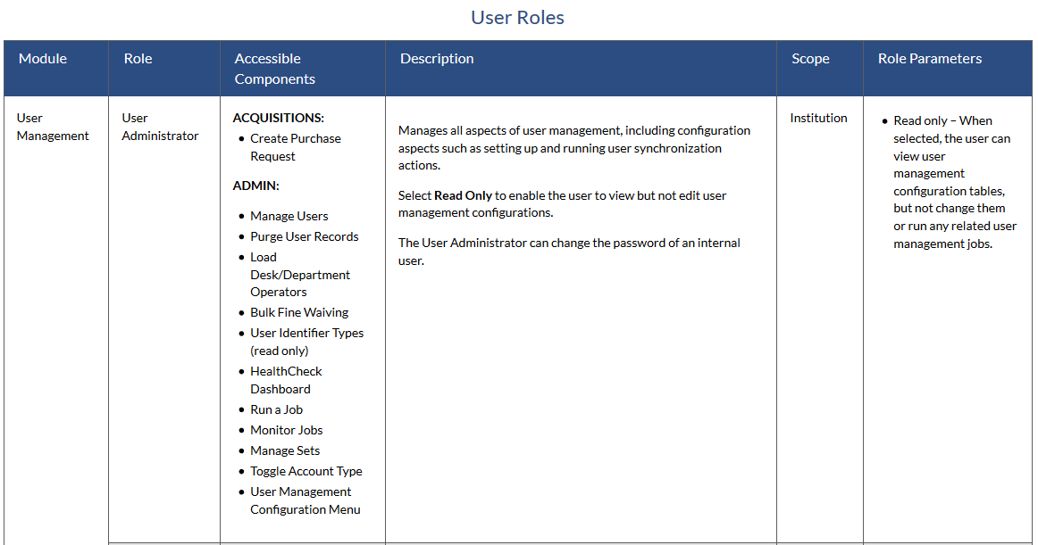
How to Add Roles - Configuration
For detailed descriptions and accessible components, as well as scoping and role parameters, see the User Roles table in ExLibris’ documentation
www.suny.edu

Slide 12
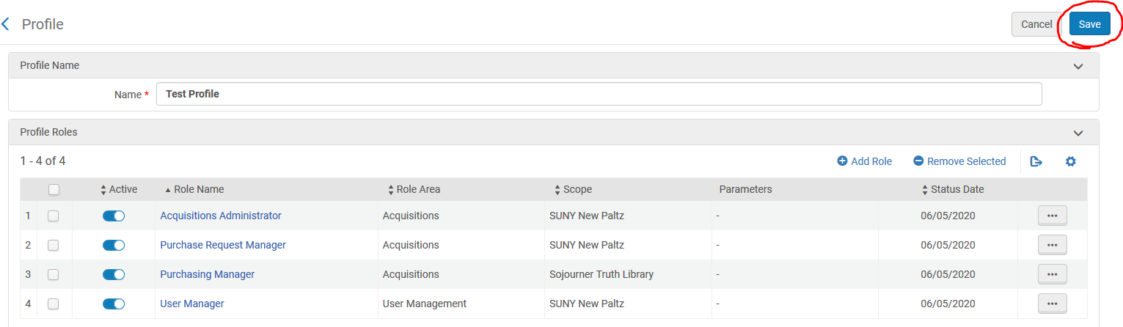
How to Add Roles - Configuration
When you have finished selecting and configuring all the required roles, Select Save.
www.suny.edu

Slide 13

How to Know What Roles to Put into a Profile
The easiest way to know what to add is to look at the roles of a person who is already doing that work:
Look up a staff account in Alma by going to Admin>>Manage Users
Open the account and scroll down to their roles
If the position is straightforward, without many roles, you can just write them down
www.suny.edu
Notes:
For a full description of all user roles and what they allow and require as far as scope, etc., see https://knowledge.exlibrisgroup.com/Alma/Product_Documentation/010Alma_Online_Help_(English)/050Administration/030User_Management/060Managing_User_Roles#User_Roles_.E2.80.93_Descriptions_and_Accessible_Components

Slide 14
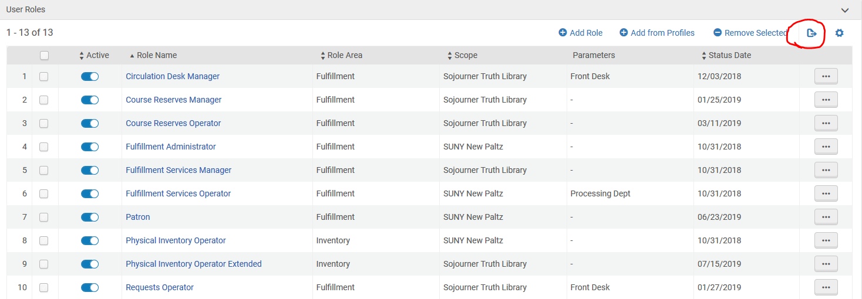
How to Know What Roles to Put into a Profile
For complex positions it is better to export the roles and work from that. In the staff account, under User Roles, click the export button.
www.suny.edu

Slide 15
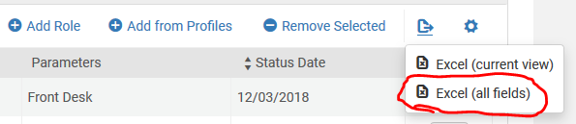
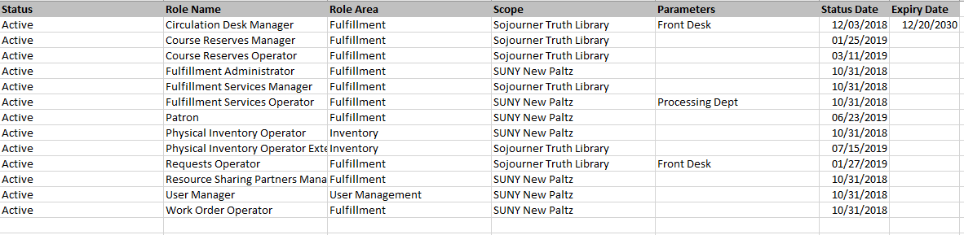
How to Know What Roles to Put into a Profile
Choose Excel (all fields) to export a complete list of all roles, scopes, and parameters
www.suny.edu

Slide 16
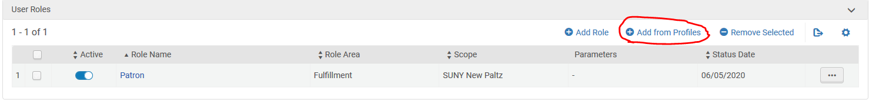
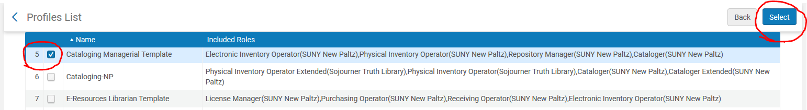
Add the Profile to a User Account
Under User Roles in the user’s account, click Add from Profiles
When the Profiles List opens, select the desired profile and click Select
You may add more than one profile to a user’s account
www.suny.edu

Slide 17
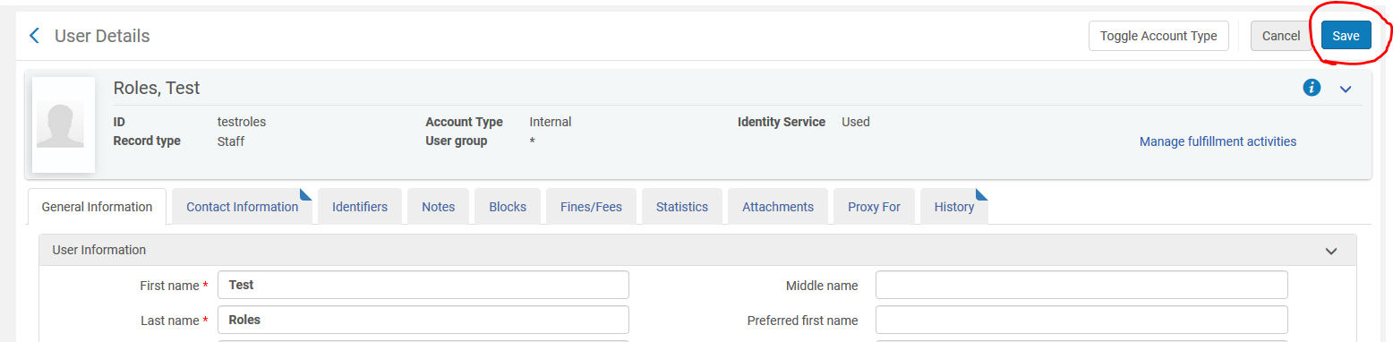
Add the Profile to a User Account
Don’t forget to click Save!
www.suny.edu

Slide 18
Role Profile Caveats
If you add a role to a profile after you have already applied the profile to users’ accounts, the new role will not automatically appear on the users’ accounts—you must manually add it.
Similarly, if you remove a role from a profile after you’ve applied it to users’ accounts, that will not remove the role from those accounts.
www.suny.edu

Slide 19


Questions?
Yvonne Kester
yvonne.kester@suny.edu
www.suny.edu

