Slide 1
DULCE Learning Collaborative
September 8, 2022
Care Transformation Collaborative of RI
5/12/2022
Prepared by Care Transformation Collaborative of RI
‹#›

Slide 2
Agenda
Topic | Time
Welcome | 5 Minutes
Introductions from CTC-RI & Practices | 10 Minutes
Center for the Study of Social Policy DULCE Overview and Implementation in Vermont | 50 Minutes
MLPB Local Role | 5 Minutes
RI Association for Infant Mental Health Reflective Consultation and IMH Consultation | 5 Minutes
Milestone Summary and Next Steps | 10 Minutes
5/12/2022
Prepared by Care Transformation Collaborative of RI
‹#›

Slide 3
Thank you!
5/12/2022
Prepared by Care Transformation Collaborative of RI
‹#›

Slide 4
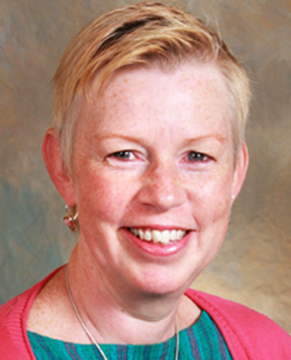
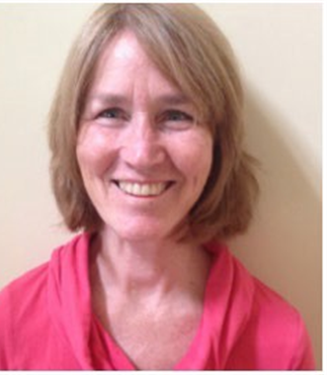
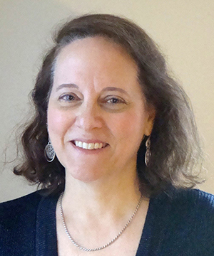
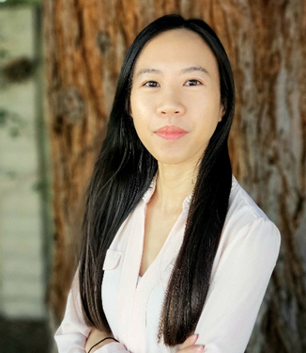
Getting to Know the CTC-RI / PCMH Kids
Patricia Flanagan, MD, FAAP, PCMH Kids Co-chair
Susanne Campbell, RN, MS, PCMH CCE, Senior Project Director
Liz Cantor, PhD, Pediatric IBH Practice Facilitator and Consultant
Kim Nguyen-Leite
MHA, CPHQ, PCMH CCE, Program Coordinator II
5/12/2022
Prepared by Care Transformation Collaborative of RI
‹#›

Slide 5
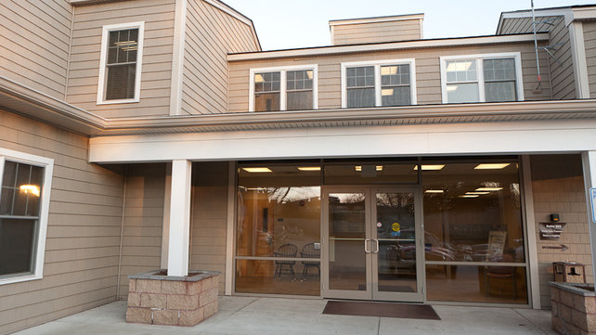
Coastal Toll Gate Pediatrics
Team Members
Stacey Nickerson, Practice Manager
Dr. Raymond Zarlengo, MD
Denise Green, RN
Cynthia Walbridge, LICSW
Mice Chen, MBA, MIS, Chief Information Officer
Warwick, RI
Our practice consists of a group of dedicated pediatric clinicians (i.e. physicians and advanced practitioners) and a comprehensive care team, including a nurse care manager, medical assistants, medical secretaries and practice manager. We also offer behavioral health counseling on-site.
280 unique newborns seen during calendar year 2021
Why join the learning collaborative?
support parents and families
earlier identification of potential concerns
comprehensive care coordination
5/12/2022
Prepared by Care Transformation Collaborative of RI
‹#›

Slide 6
CNEMG Family Care Center
Team Members
Dr. Marybeth Sutter, MD
Margaret Lebeau, Nurse Care Manager
Debra Moorhead, Academic Social Worker
Pawtucket, RI
Practice serving the people of Pawtucket and Central Falls with the goal of reducing health disparities.
188 unique newborns seen during calendar year 2021
Why join the learning collaborative?
help alleviate some of the barriers facing our families to pave the way for generational change
help address some of the most important social determinants of health
5/12/2022
Prepared by Care Transformation Collaborative of RI
‹#›

Slide 7
Center for the Study of Social Policy
Patsy Hampton
Samantha Morton
Dr. Breena Holmes
5/12/2022
Prepared by Care Transformation Collaborative of RI
‹#›

Slide 8
MLPB – Local Role
Jeannine Casselman
5/12/2022
Prepared by Care Transformation Collaborative of RI
‹#›

Slide 9
Rhode Island Association for Infant Mental Health
Susan Dickstein
5/12/2022
Prepared by Care Transformation Collaborative of RI
‹#›

Slide 10
Milestone
CTC/PCMH Kids DULCE Learning Collaborative MILESTONE SUMMARY DOCUMENT¹ September 2022 – November 2023
Milestones and Deliverables | Timeframe Due Dates² | Notes
Planning
Kick-off Learning Session | September 8, 2022 7:30am – 9am | Zoom Link DULCE One Pager
Interdisciplinary team identified, to include CHW/FS, BH Lead, practice clinical champion, office/practice manager/project lead, NCM, Family Voice, and an IT/EHR staff member | September 30, 2022 | Identified as part of application Practice Team Contact Information Submitted to knguyenleite@ctc-ri.org & Liz.cantor@gmail.com
Community Health Worker/Family Specialist on boarded | October 31, 2022
Trainings completed by CHW/FS DULCE, Brazelton Touchpoints, NBO | October 2022 through December 2022 | Other staff encouraged to attend training. Final attendee list to be completed with Liz
Interdisciplinary team attends monthly practice facilitation meetings | September 2022 – November 2023 | Scheduling Poll
5/12/2022
Prepared by Care Transformation Collaborative of RI
‹#›

Slide 11
Milestone
Implementation
CHW/FS participate in monthly Reflective Consultation with RIAIMH | November 2022-November 2023
Interdisciplinary team participates in weekly team meetings (case conferences) to discuss families enrolled in DULCE | January 2023-October/November 2023 | Case Review Guidance
CHW Billing processes established | March 31, 2023 | Community Health Worker Services EOHHS Community Health Workers RI Medicaid CHW Provider Manual
Quarterly peer Learning Collaborative meetings: | Wednesday 7:30am – 9am EST December 7, 2022 March 8, 2023 July 12, 2023 | Zoom Link Practice to present on their training experience, case conferences, reflective consultation, enrollment workflow, data, billing, PDSA or improvement plan, etc.
PDSA Improvement Plan | Plan due April 30, 2023 | Plan-Do-Study-Act (PDSA) submit completed PDSA to knguyenleite@ctc-ri.org and Liz.cantor@gmail.com
5/12/2022
Prepared by Care Transformation Collaborative of RI
‹#›

Slide 12
Milestone
Implementation
Family Experience Survey – establish workflow for distribution and collection of survey at 6mo well visit | July 2023 – November 2023 | English Spanish
CHW/FS & Interdisciplinary Team Survey | TBD
Data and Reporting at project end Report must include all DULCE enrolled families. Total number of enrolled DULCE families Total number of CHW visits Total number of screenings completed for health related social needs Total number of linkages completed for family identified needs | Due October 31, 2023 | Submit spreadsheet to: knguyenleite@ctc-ri.org and Liz.cantor@gmail.com
PDSA/Improvement Plan | Final due October 31, 2023 | Submit to: knguyenleite@ctc-ri.org and Liz.cantor@gmail.com
Wrap Up Session: | Wednesday 7:30am – 9am EST November 8, 2023 | Zoom Link
5/12/2022
Prepared by Care Transformation Collaborative of RI
‹#›

Slide 13
Next Steps
Schedule Practice Facilitation Monthly Meetings
Next Quarterly Meeting
Wednesday, December 7, 2022 @ 7:30am
Practices to report on:
Training Experience
Interdisciplinary Team Plan
CHW/FS Staffing Plan
W9
Prepared by Care Transformation Collaborative of RI
‹#›

Slide 14
THANK YOU
www.ctc-ri.org
CTC-RI
5/12/2022
Prepared by Care Transformation Collaborative of RI
‹#›

