Slide 1
Dennis Klaas – Warren Career Prep Center Carlos Garcia – Jackson College Patrick Schultz – Bay-Arenac ISD Career Center
MICE
Michigan Initiative for Cybersecurity Education

Slide 2
History
Many Years Ago
Initial Discussion of Cyber Security in Michigan
October 2016
NICE K-12 Cyber Education Conference (Virginia)
Draft Standards Creation
January 2017
Approval of 11.1003 - Computer and Information Systems Security/Information Assurance as a new CTE program. – Aligned to NICE / NIST Framework
April 2017
Pilot Train the Trainer Hosted at Bay-Arenac ISD Career Center
Governor’s Education & Talent Summit
Late 2017
Working Early College Program development with WCCCD/Davenport/Baker/Jackson College
Multiple Train the Trainer Multi-Day Trainings

Slide 3
What is MICE?
Michigan Initiative for Cyber Education
Cooperative of IT Teachers
Train the Trainer Professional Development
Central Repository of Cyber Education Curriculum (LMS)
President Trump and Governor Snyder’s Cybersecurity Education Focus

Slide 4
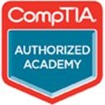
MICE Initiatives (LMS)
Repository of Cyber Education Curriculum

Slide 5
MICE Initiatives (LMS Continued)
Learning Management System
Courses Offered (examples)
Cybersecurity Awareness
Ethical Hacking
Ethics
Laws and Regulations
Penetration Testing
Digital Forensics
Network Forensics
Linux Essentials
Certification Preparation
(Network+, Security+, Linux+, A+, MTA, CEH, CISSP, CCNA)

Slide 6
MICE Initiatives (LMS Continued)
Learning Management System
Courses Offered (examples)
Computer Science
Python
C#
Java
C++
Preparation for AP Computer Science Principles
Preparation for AP Computer Science A (Java)
Digital Citizenship (K12, Staff)

Slide 7
MICE Initiatives (LMS)
Import and Export Data from School Data Warehouse (Skyward, PowerSchool, etc)
Credentialing system through digital badges (Credly and Mozilla Backpack)

Slide 8
MICE Initiatives (LMS Continued)
General Resources
Step by Step Example of How To Capture the Flag
Competitions
Cyber League, Capture the Flag, etc…
Virtual Sandbox Environment Competitions
CTSO National Connections
Business Professionals of America
SkillsUSA

Slide 9
Additional MICE Initiatives
State Wide Sandbox NetLABS+ System
Host multiple trainings for those interested in Cyber Education
K12 to Post-Secondary Alignment
Cisco Networking Academy

Slide 10
Regional Training Hubs
State Wide Sandbox System
Funding Q1-Q2 2018

Slide 11
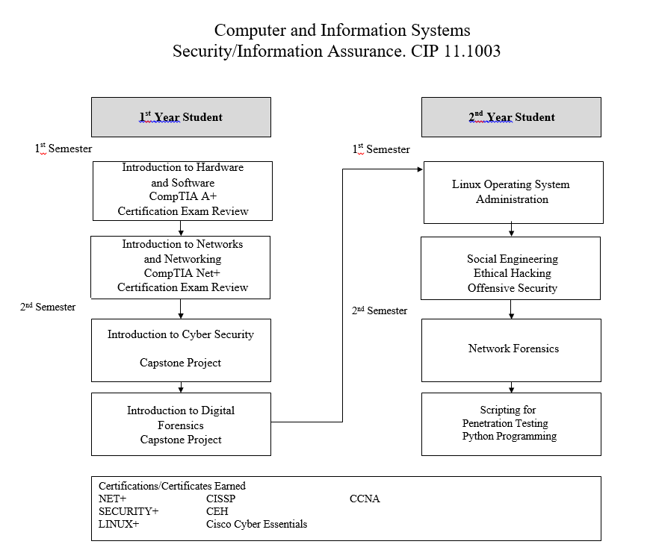
Sample Two-Year Curriculum
1st Year - 12 Segments
2nd Year - Section Q
Delivery Models Could Differ

Slide 12
Top 10 in 10
Strategic Goals Targeted
3. Develop, support, and sustain a high-quality, prepared, and collaborative education workforce.
6. Create a strong alignment and partnership with job providers, community colleges, and higher education to assure a prepared and quality future workforce, and informed and responsible citizens.

Slide 13
Strategic Goal #3 Industry Connections
Internships
Mentorships
Workbased Learning

Slide 14
Strategic Goal #6 Post-Secondary Partnerships
Articulation
Average 15 credit hours earned at College Level
Dual Enrollment
Early College
Direct Credit

Slide 15
What else is upcoming with MICE?
December 2017
NICE K-12 Conference Presentation
January 2018
Cisco Community Outreach – Hillsdale Community Schools
February 2018
Bay-Arenac ISD – 3 Day Train the Trainer PD
April 2018
Jackson College – 3 Day Train the Trainer PD

Slide 16
Q & A Copy of Presentation https://goo.gl/DFDx5K
Carlos Garcia
517-759-8439 garciacarlosj@jccmi.edu
Dennis Klaas
810-841-2550 dklaas@gmail.com
Patrick Schultz
989-714-7572 schultzp@baisd.net

