Slide 1
Making Care Primary: CMS Alternative Payment Model
Greg Griggs, MPA, CAE
NCAFP Executive VP & CEO

Slide 2
Goals for Today
Provide an Overview of the Making Care Primary (MPC) Model
Examine How the MPC Model Aligns with What is Happening in North Carolina
Further Discussion on Increasing Primary Care Investment and Participation in Value-Based Payment Programs

Slide 3
What is Making Care Primary
MCP: A new Value-Based Payment and Delivery Model – Designed Specifically for Strengthening Primary Care
Pilot in Eight States Including North Carolina
Three-track Model
No Down-Side Risk
Designed for Independent Practices, FQHCs, Smaller Systems, etc. – Low Attribution

Slide 4
What is Making Care Primary
Upfront infrastructure funding for eligible organizations
10.5-year model for sustainability
Incorporation of specialty care partnerships
Support to reach patients beyond the walls of the clinic

Slide 6
Participating States

Slide 7
Progressive Three Track Approach
Tracks based on experience level with value-based payments.
Supporting practices across a readiness continuum.
Enhanced payments in all three tracks (increasing primary care investment).
Greater opportunities for bonus payments based on performance.

Slide 8
Track One- Building infrastructure/capacity
100% Fee for Service
Can stay in track for up to 2.5 years.
Upfront Infrastructure payment -- $72,500 per year for two years – assist with risk stratification and better care management.
Additional Financial Incentives for improved outcomes
Performance Incentive payments up to 3%
Many practices in NC likely beyond this track.

Slide 9
Track Two- Improving Efficiency
Can stay in track for up to 2.5 years.
Moves to half prospective, population-based payments. Half Fee for Service.
Additional financial incentives up 45 percent of overall payments.
Practices asked to increase partnerships with social services agencies and identify high quality Specialty Care Partners.
Greater Behavioral Health Integration.

Slide 10
Track Three- Optimizing Care
Moves practices to full prospective, population-based payments.
Greatest incentives for improving outcome – up to 60 percent.
Practices asked to deepen connections with community resources and specialists.
Time-limited co-management agreement with specialists.

Slide 11
Payment Model
UIP – Upfront Infrastructure Payments – Only Track 1. ($145K).
ESP – Enhanced Services Payments – All Tracks. Goes down as you move forward. Clinical risk tiers.
PPCP – Prospective Primary Care Payment – Track 2 (50%) and 3 (100%). Based on historical billing plus a regional component beginning in Year 3.
PIP – Performance Incentive Bonus – Based on meeting quality metrics. Up to 45% bonus in Tier 2 and up to 60% bonus in Tier 3.

Slide 12
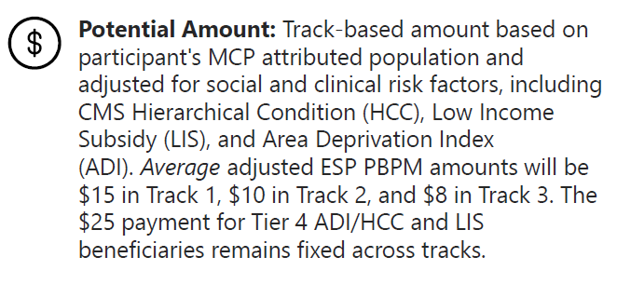
More on Enhanced Services Payments

Slide 13
Payment Model
E-consults with a specialists - $40 per service payment subject to geographic adjustment for primary care practice. (Track 2 and 3)
Ambulatory Co-Management Code for Specialists - $50 per beneficiary per month for time-limited co-management activities designed to encourage specialist involvement with primary care. (Track 3)

Slide 14
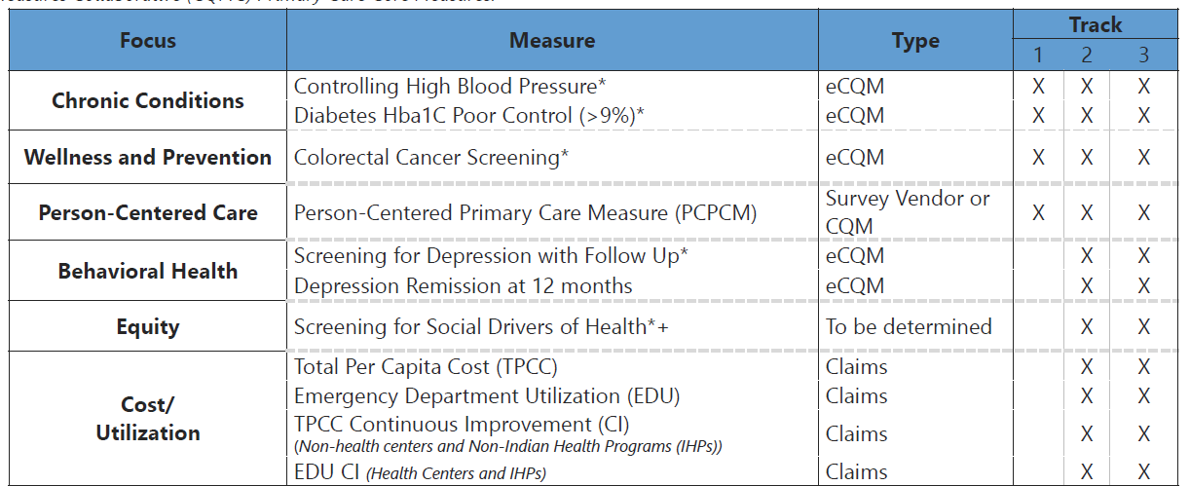
Quality Performance Metric/Bonuses – Short List and Measures that Matter

Slide 15
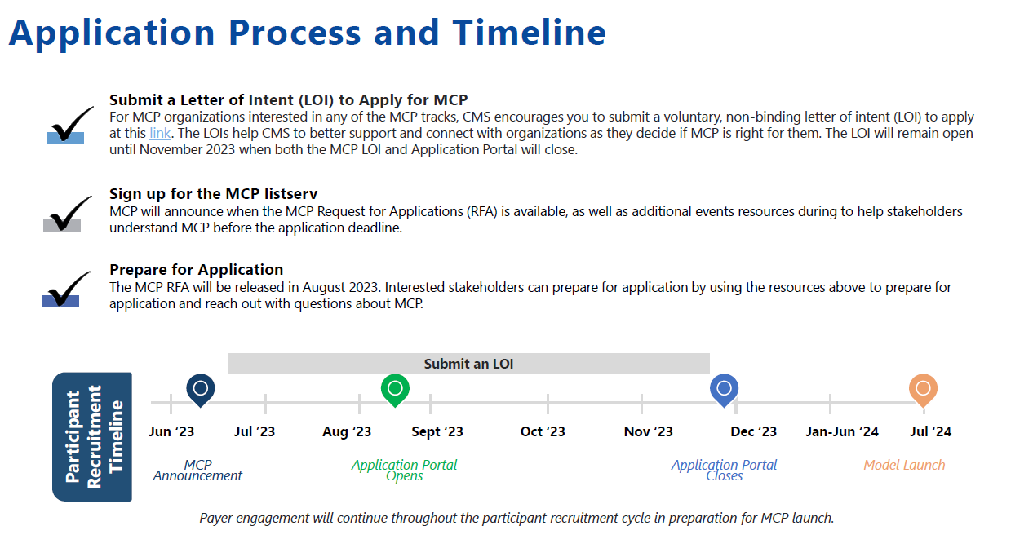

Slide 16
North Carolina Alignment
Desire for greater investment in primary care to prevent downstream costs. Aligns with Study of Primary Care Investment.
Medicaid work around Social Determinants of Health and Better Care Management.
Desire for move away from fee for service and pay for outcomes. Keep people healthy.
Desire to increase the primary care workforce.

Slide 17
Main Takeaways from Announcement
Access to high-quality primary care is associated with better health outcomes and equity for people and communities.
MCP is an important step in strengthening the primary care infrastructure in the country, especially for safety net and smaller or independent primary care organizations.

Slide 18
Keys for True Success – Multi-Payer Alignment
Can’t be just a small number of patients. Must be more than Medicare Fee For Service patients.
Medicaid Alignment – Incorporate in re-procurement?
Medicaid work potentially impacted by:
Redeterminations
Expansion Population
Tailored Plans
Private Payer Alignment – Blue Cross/State Health Plan, etc.

Slide 19
More Information – CMMI Website
https://innovation.cms.gov/innovation-models/making-care-primary
General Information on Model
Past Webinars
Fact Sheets
Upcoming Webinars
How to Submit a Letter of Interest
More
Notes:
Good

Slide 20
Contact Information
NCAFP
2501 Blue Ridge Road, Suite 120
Raleigh, NC 27607
(919) 833-2110
ggriggs@ncafp.com
shawn@ncafp.com
Greg Griggs, MPA, CAE – Executive Vice President and CEO
Shawn Parker, JD, MPA – General Counsel and Chief of Staff

