Slide 1
Roundtable Survey

Slide 2
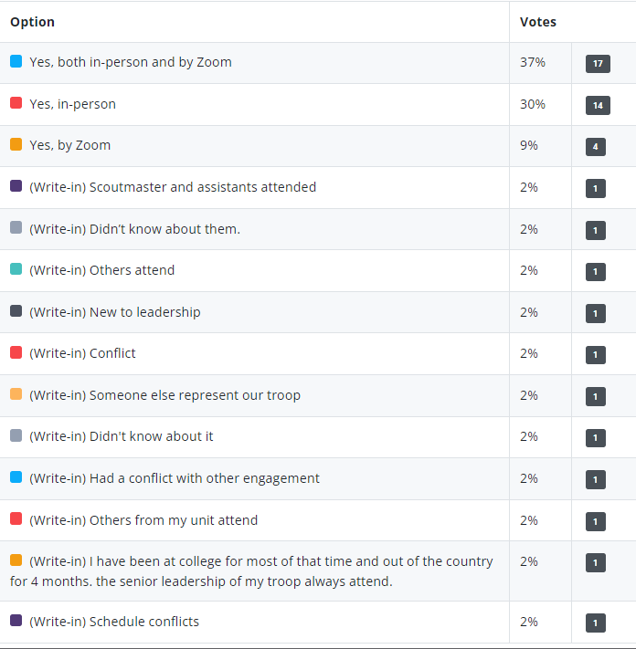
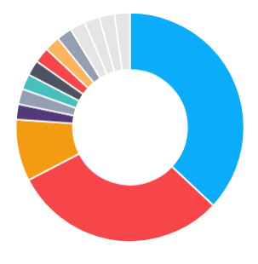
Have you attended a Roundtable?

Slide 3
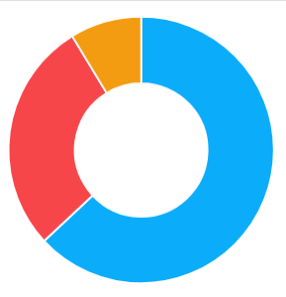
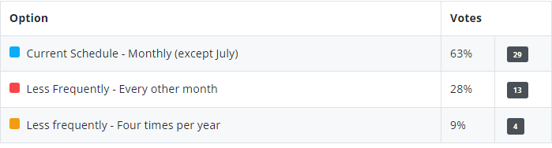
How many Roundtables should we have/year?

Slide 4

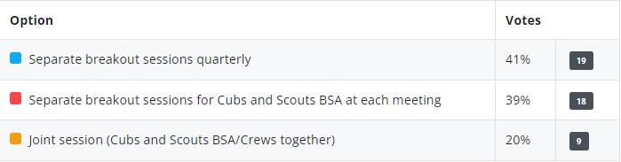
Breakouts for Cubs and Scouts BSA?

Slide 5
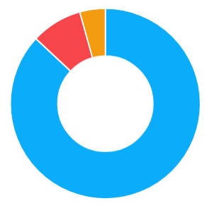
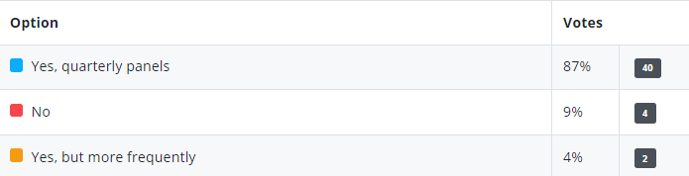
Should we have panel discussions?

Slide 6

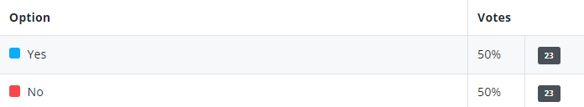
Willing to lead/participate in a discussion panel?

Slide 7

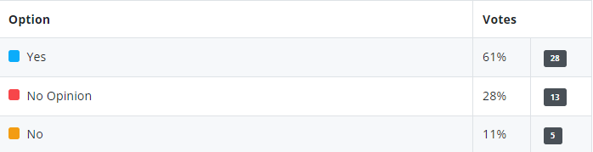
Should we set aside time for unit updates?

Slide 8
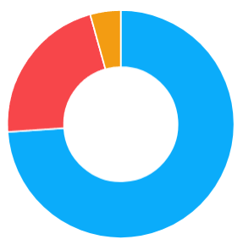
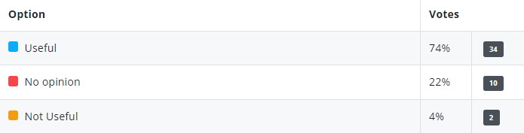
Upcoming community activities slide useful?

Slide 9

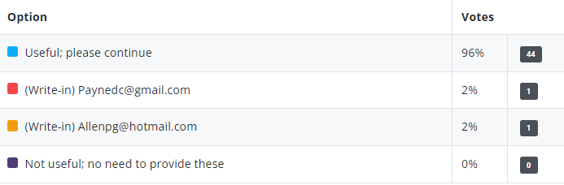
Having minutes/slides available useful?

Slide 10


Become a Roundtable Commissioner?

Slide 11

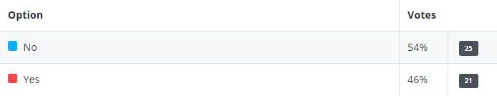
Willing to develop/present topic?

Slide 12

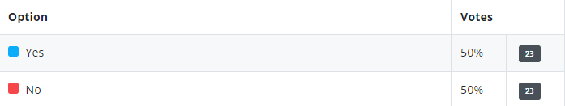
Bring someone from your unit and introduce?

Slide 13
Bring in outside speaker (quarterly)?
Developing Leadership/leadership stories
Success stories – fund raising, recruitment, volunteers, cub program
Effective communication and team building
In-unit youth training – we are all rebuilding after the pandemic
High adventure options
Unique opportunities for scouts, recruiting, fund raising, and training
Kids development
Outdoor/Camping activities and great sites/unique HA activities
Cub camping places and getting approval
Youth Mental Health courses available locally
Local organizations that have activities/programs/opportunities for scouts
Local experts in topics pertinent to scouting program (e.g., Conservation)
Adventures/inspiring service projects
Specific options to expand the scouting experience beyond NCAC
Programming that is not currently part of the unit planning
Discussions related to transition from Cubs to Scouts BSA
Discussions related to issues as scouts age through the program
Recruiting, membership and how to reach non-traditional youth
How to better publicize activities
STEM opportunitie
Backpacking, paddle, climbing and biking locations; program support
Eagle Scout project opportunities and fund raising alternatives

Slide 14
Other Comments?
Make the Calendar items a pre-read or handout.
De-emphasize information transmission and focus on comradery
Periodic social event in lieu of standard meeting - Foster more networking
Panels on specific topics – clearly identify if Cubs, Scouts or both
Get more people involved with themes – e.g., advancement coordinator night
Move Scout Expo to a community location for exposure – e.g., Vienna Community Center on Saturday
Roundtable topics planned out for whole year – announce the schedule, type (e.g., panel)
Share best practices
Be more interactive
Stay on time
Thanks (several)
None

