Slide 1
The California Master Plan for Aging: How Will it Benefit You?
May 14, 2021
www.ccltss.org

Slide 2
Welcome
Susan Houston
Vice President, Older Adult Services
Peninsula Family Services
www.ccltss.org

Slide 3
Housekeeping
All attendees will be muted during the presentation.
Please submit your questions by selecting the Q&A icon on your toolbar. If you are calling in, email your questions to Email@Email.com. The final 10 minutes are reserved for Q&A.
Closed Captioning is available. Select the “CC” icon on your toolbar to enable subtitles.

Slide 4
Age Forward Coalition of San Mateo
About

Slide 5
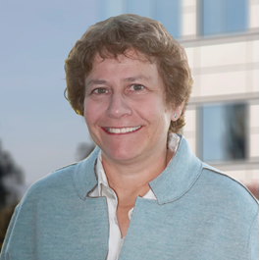
Master Plan for Aging
Susan Houston
Vice President, Older Adult Services
Peninsula Family Services
www.ccltss.org

Slide 6
Senator Josh Becker
Honorable Senator Josh Becker
California State Senate, District 13
www.ccltss.org

Slide 7
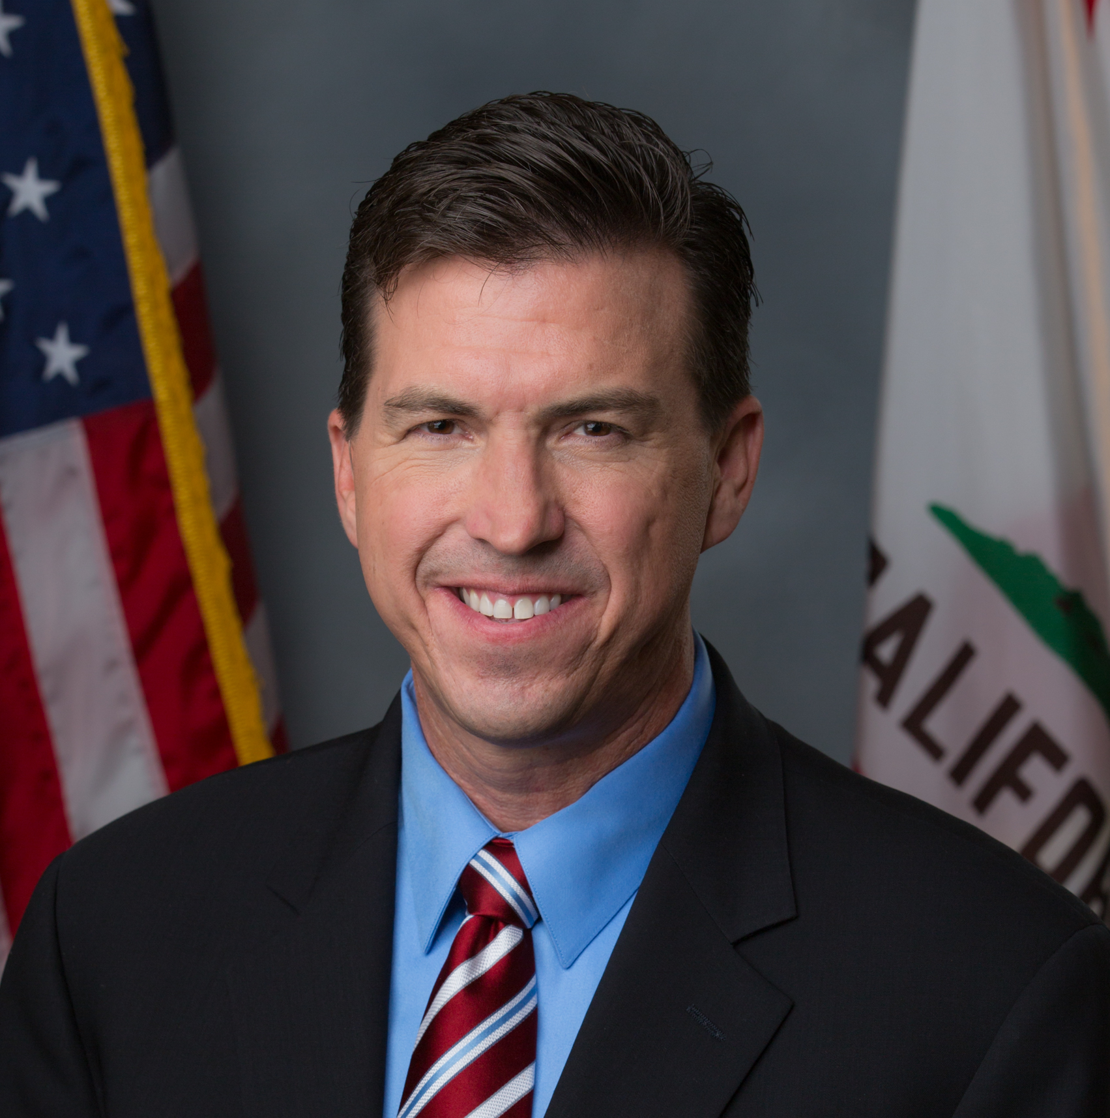
Assemblymember Kevin Mullin
Honorable Assemblymember Kevin Mullin
California State Assembly, District 22
www.ccltss.org

Slide 8
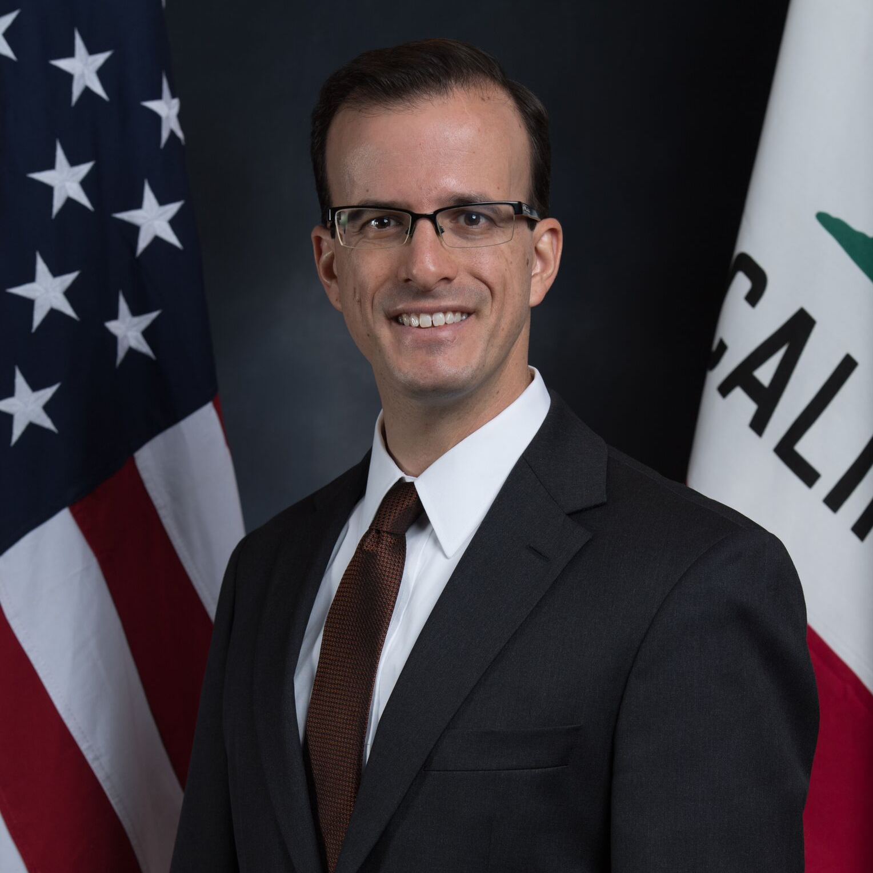
Assemblymember Marc Berman
Honorable Assemblymember Marc Berman
California State Assembly, District 24
www.ccltss.org

Slide 9
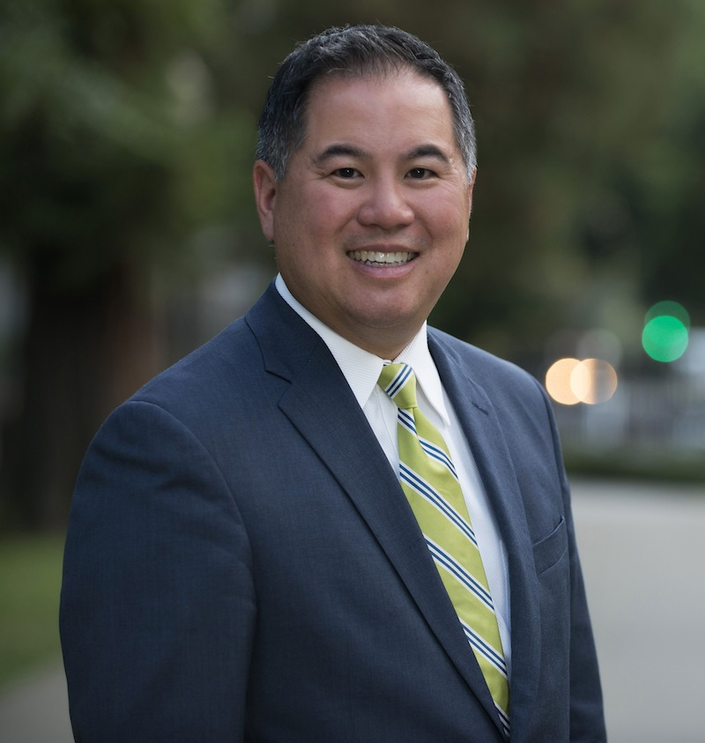
Assemblymember Phil Ting
Honorable Assemblymember Phil Ting
California State Assembly, District 19
www.ccltss.org

Slide 10
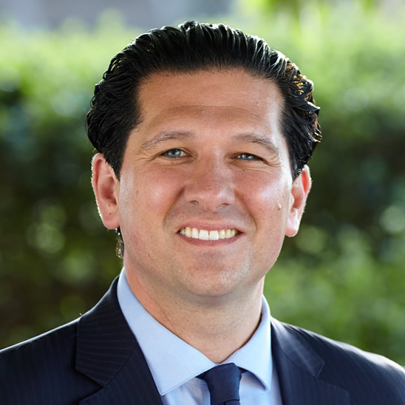
Supervisor David J. Canepa
Supervisor David J. Canepa
San Mateo County Board of Supervisors
District 5
www.ccltss.org

Slide 11
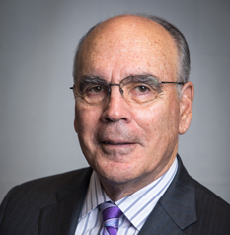
Supervisor Don Horsley
Supervisor Don Horsley
San Mateo County Board of Supervisors
District 3
www.ccltss.org

Slide 12
Q&A Discussion
Select the Q&A icon on your toolbar to submit a question.
For those joining by phone, email Email@Email.com to submit a question

Slide 13
Thank you!
Contact the Age Forward Coalition of San Mateo at Email@Email.com
www.ccltss.org

