Slide 1
Integrated Behavioral Health in Primary Care: Coping and adjusting to COVID-19
Residency Scholarship / Research Seminar
March 18, 2020
Kari A. Stephens, PhD
Associate Professor, Director of Clinical Research Informatics, Family Medicine
Adjunct Associate Professor, Psychiatry & Behavioral Sciences
Adjunct Associate Professor, Biomedical Informatics & Medical Education

Slide 2
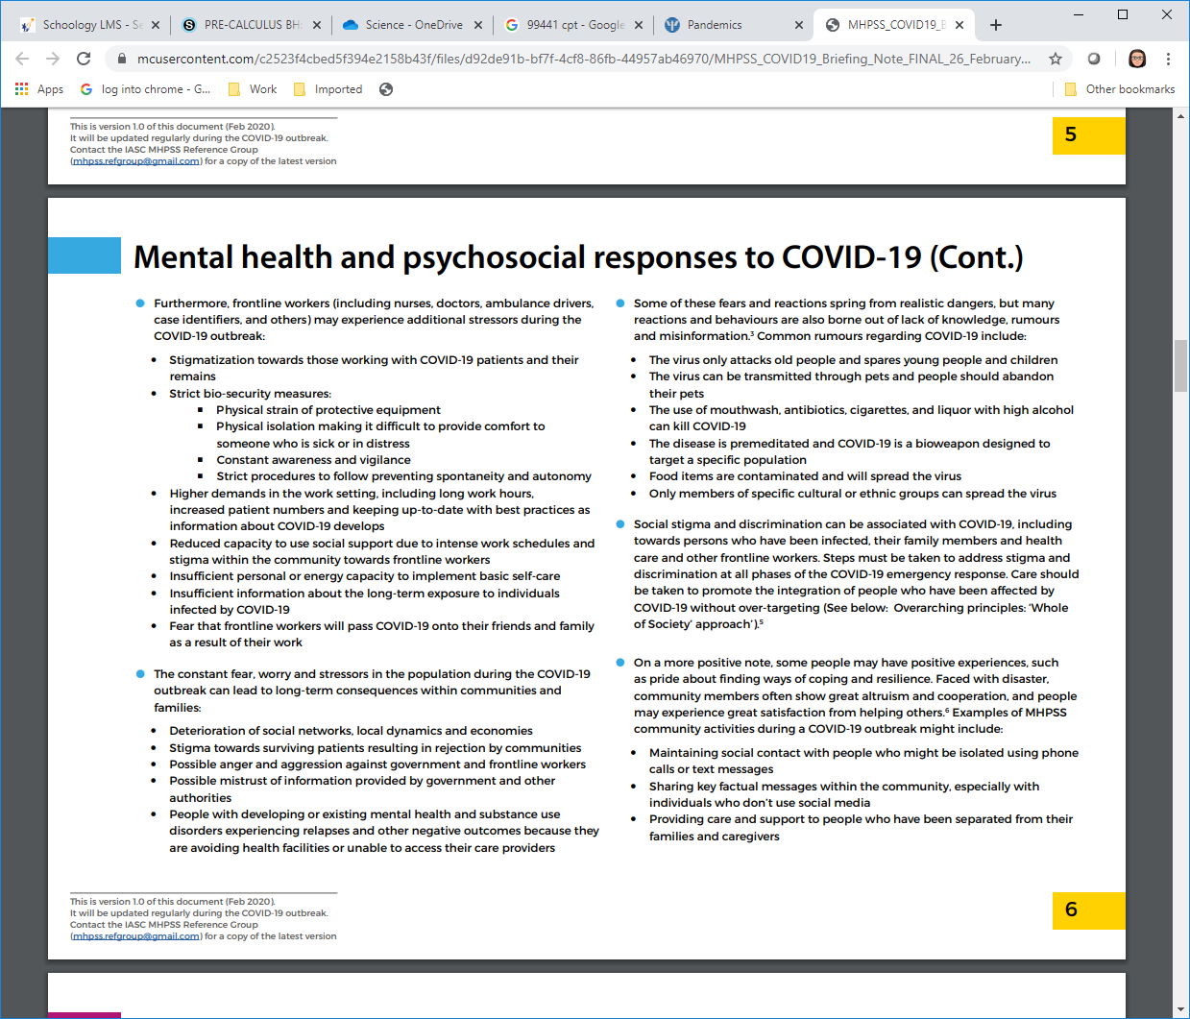

Slide 3
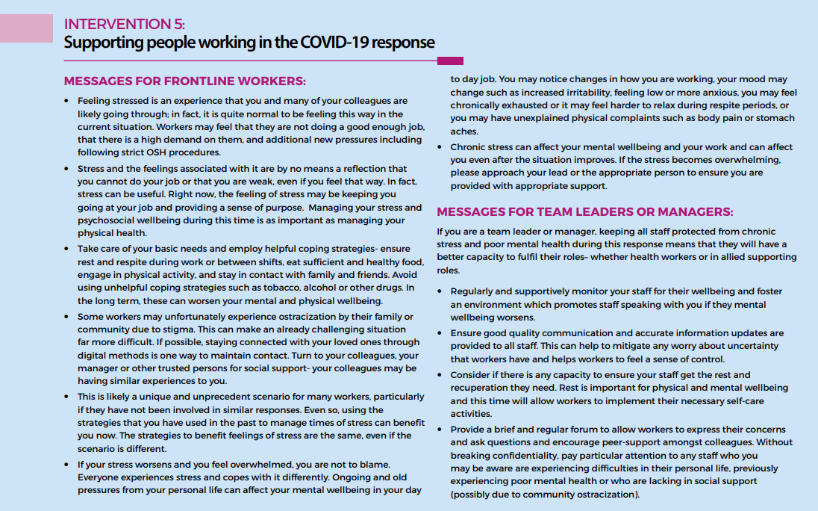
What APA offers as lessons learned from other disaster events
Social media may escalate anxiety more than traditional media
Too much media of any kind can undermine mental health
Trustworthy information sinks in
A lack of control fuels stress
Managing stress ASAP can prevent long-term troubles
Don't forget the needs of health-care workers
Quarantines and isolation may increase the odds of negative outcomes

Slide 4
Promoting Psychological Well-Being in the Face of Serious Illness
Create conditions for challenge – positive affect (excitement, eagerness or optimism) with threat of failure (anxiety)
Find out what matters to the patient
Establish goals
Emphasize opportunities for personal control
Encourage behavior to achieve goals
Keep them immediate and concrete
Sadness, anger, or frustration is normal when skills might be lacking → revise the goal as needed
Maintain background of positive mood
Recount a positive event
Schedule activities for a sense of achievement and pleasure
Folkman, S., & Greer, S. (2000). Promoting psychological well-being I the face of serious illness: when theory, research, and practice inform each other. Psycho-Oncology, 9, 11-19.

Slide 5
Psychological First Aid: helping patients
Create a sense of safety
Communicate that the stressful situation is over. Shield the patient from a disturbing scene or explain that they’re safe. Show them what you’ve done to make the scene safe.
Create calm
Speak and act calmly, it can show your patient they’re in a safe place. If you’re struggling to calm yourself or your patient, use simple tools like taking a deep breath, counting to four, then letting your breath out slowly, and coaching your patient to do the same. It’s hard to calm someone else when you don’t feel calm yourself, so check your own composure before helping your patient.
Create self and collective efficacy
Foster self-efficacy by making the patient an active part of their own rescue. Remind them of existing strengths, allow them to care for themselves or help their companions, and involve them in decisions about their care. This helps them overcome the feeling of helplessness and feel more like part of the team.
Create connection
Helps the patient tap into the social supports that surround them. Create connection by building an on-scene relationship with your patient: use their name and build a rescue partnership. This also includes connecting the patient with loved ones and important others.
Create hope
Although the current situation may be grim, it can get better. Build hope, point to specific, accurate, and positive facts about the event, and discuss next steps that are realistic and predictable. Maintaining hope is as important for the individual patient as it is for your team as you provide care.
Shultz, J. M., & Forbes, D. (2013). Psychological First Aid: Rapid proliferation and the search for evidence. Disaster health, 2(1), 3–12. https://doi.org/10.4161/dish.26006

Slide 6
Dos and Don’ts
Do remain calm when speaking to a person in distress. Show concern but be a confident reassuring presence. The other person will gain confidence from your confidence.
Don't get caught up in the situation. Remember the antidote for stress is calm and confidence.
Do listen. Encourage the person to talk about what happened and their reactions to those events. If the person does not want to speak at that time, ask if you can check back with them later.
Don't interrupt, unless the disclosure seems to be escalating the distress.
Do try to identify “the worst part” of the situation, if possible. Do this carefully, and it can help you identify the core issues at hand if they are not otherwise obvious.
Don't rush. If the person is medically stable and safe, the passage of time alone begins to de-escalate situations.
Don't be dismissive. Don't minimize their concerns or say, “Well at least…” as an attempt to distract, or help the person feel better.
Don't act on some preconceived notion of what you think the person needs. Ask what they need (Everly, Brelesky & Everly, 2018). Perspective taking such as this will foster trust.
Don't hesitate to ask specific questions about the person’s ability to competently attend to others (significant relationships, childcare, eldercare) or perform the duties of their job.
Don't hesitate to ask about intention to harm themselves or others. Seldom will this be an issue, but sometimes you may sense feelings of profound hopelessness, depression, anger, or vindictiveness. In such cases, it’s important to inquire and follow up. In the most rare and extreme cases, you may have to help the person get immediate professional care.
Don't make promises you can't keep.
Do determine what else if anything is needed after your initial conversation. Don’t hesitate to ask for guidance or assistance from a healthcare professional if you are worried about the person’s well-being.
Do serve as a liaison to connect the person with continued assistance, if necessary.
Do advocate for this person in seeking further assistance, if necessary.
https://www.psychologytoday.com/us/blog/when-disaster-strikes-inside-disaster-psychology/201810/psychological-first-aid

Slide 7
Dialectical Behavior Therapy’s Distress Tolerance What is a Crisis?
A crisis is when you have a serious problem but you can’t solve it (at least not now).
In a crisis, there is a pressure to solve the problem and it is difficult to stop trying.
In a crisis, emotions are high so the problem is distressing and having high emotions generally makes things worse.
A crisis is short-term.
If it is happening all the time, it isn’t a crisis, it’s your life!
Notes:
These skills are only appropriate for when patients are experiencing crisis, so let's talk about what a crisis is. A crisis is when you have a serious problem, but you can't solve it. If you could solve it, you would. In a crisis, there is pressure to solve the problem, but it's difficult to stop trying to solve the problem, and emotions are high, and distressing, and they tend to make everything worse.
A crisis is a short-term situation. If it's happening all the time, we don't call it a crisis, it's a chronically stressful life. Let's think about our case. He's somebody who can't work, he's not getting paid. This is a chronically stressful situation, and that by itself does not represent an immediate crisis. Pain flares, however, would be an immediate crisis for our patient.
Now, distress tolerance was originally developed as a skill to help treat borderline personality disorder, and crises that come up for patients who have intense and frequent emotional distress, and that can sometimes lead patients to feel suicidal. When we think about chronic pain patients, intense pain flares can also become a crisis, and in these cases, our distress tolerance skills can be very useful strategies.

Slide 8
Distress Tolerance Skills are for…
Patients face many stressors
Clinicians face many stressors
Pain flares
Frustrations with medical care
Intense emotions
Family conflicts
Housing
Money
Drugs and alcohol
Dangerous neighborhoods
Long waits for social services
Large caseloads
Difficult and sick patients
Hearing many traumatic stories
Inability to help their patients
Lack of time or resources to help their patients
Frustrating interactions with social services
Unhelpful rules or regulations
Paperwork
COVID-19
Notes:
So, one thing we recommend is that we always use the skills ourselves that we teach to patients. So, I want to lay out how these distress tolerance skills are not just for patients in these many ways you see here, but also for clinicians. So, when we look at patients, they may face many stressors, but we may also face many stressors. So, patients, while they may be dealing with pain flares or frustrations with their care, in all the things you see on the list here as clinicians we may also want to us use distress tolerance skills for all of the stressors we face, like having large case-loads, having difficult and sick patients, hearing many traumatic stories, that can be really hard to hear throughout the day and have lasting effects on us, the inability to help our patients sometimes where resources are very slim or we just don't have enough time packed into the day to do all the things we want.
We may have a lack of resources available in the community. We may have frustrating interactions. Lots and lots of things get to all of us that become problems we can't solve. So, we want to use these distress tolerance skills not just for our patients, but for ourselves as well.

Slide 9
Distress Tolerance is Surviving Without Making the Situation Worse
Don’t expect distress tolerance skills to make you “feel better”
The fact is that you often may feel better, but that is not the purpose of the skill
The skills are so you won’t make the situation worse
If the skills prevent the crisis getting worse but don’t make you feel better, DON’T STOP - if you do, things may get worse
Notes:
When we move from a mindset of problem solving to one of using distress tolerance, we must change our goal. Usually the goal with problem solving is to fix something, to make it better. But with distress tolerance it's about surviving without making the situation worse. The new goal becomes, “don't make things worse”, as opposed to “make things better” or “fix them”. So, we can't expect that distress tolerance skills are necessarily going to result in us feeling better, we must instead look for potentially just not making things worse. You often may feel better but that's not the purpose of this particular set of skills that you're going to use with patients.
The last piece here is, don't stop. If the skills prevent the crisis from getting worse but they don't make you feel better, don't stop using them. This can often be the hardest thing to convince a patient around, and even the first time I often talk to a patient about using these skills, they forget that the goal is to not make the situation worse and come back in and let me know that they didn't feel better, especially with pain.

Slide 10
Distraction is deliberately turning your attention away from the crisis.
Activities
Contributing
Comparisons
opposite Emotions
Pushing away
Thoughts
Sensations
Remember, wise mind ACCEPTS
Notes:
Let's first start with what the distraction skills are. In dialectical behavior therapy there are many acronyms and with this we use these as memory aids to help us remember what all these skills are and what we like to say with distraction and distress tolerance is that "the wise mind accepts" and "accepts" is our acronym of different ways a patient can use distraction.
The first is using Activities. That's straight forward. The idea here is that you can go and do different activities that take your mind off whatever the crisis is.
The second is about Contributing. Contributing is the idea. It can be an activity in and of itself, but the idea is that you go outside yourself and ask somebody else how they're doing in some way or do an activity that contributes to the well-being of somebody else to get your mind off your own distress.
The third is Comparisons, so comparing your life to how it might have been before and how this may not be as bad as that point or comparing yourself on the outside to some other situation or other person that might be worse than your own situation. Comparisons can often be a wonderful way to sort of get perspective on what you're going through now.
Using opposite Emotions is a common skill in DBT in general. The idea here is that when you get distressed there are one or two negative emotions that tend to dominate the scene for you, so figure out an emotion opposite from the negative one that you're feeling and try to bring it on. If you're angry, watch a comedy. If you're scared, watch someone that's daring. If you're sad, listen to some upbeat music. Pick an opposite emotion that you can go evoke.
The Pushing away is really the idea that you're deciding that this is something that can't be dealt with right now and put it out of your mind, push it away literally, and just imagine yourself putting it on a shelf and come back to it later.
Thoughts is another way that we use distraction, so the idea is when you're in a crisis that you can't solve, often our minds are stuck on thinking about that crisis over and over but if you can fill your brain with other thoughts there's no room for that crisis to continue to be in there. Singing songs to lyrics you don't quite remember or counting backwards by some high number by a factor of seven that makes you must think about it are often quick ways that you can use to fill your mind with other kinds of thoughts.
Sensations is the best strategy to get unstuck when you're feeling very distressed, when you mobilize your body and bring your mind and emotions with it. You can put your face in cold water or hold onto ice. You can run up and down stairs or take cold showers. Often patients with chronic pain have limitations in the kinds of things they can do, so using sensations to sort of shock the system into distraction can be useful.

Slide 11
Self-Soothe with Five Senses
Vision
Decorate your space, go somewhere inspiring
Sound
Music, soothing voices, nature sounds
Smell
Cooking, lavender, the beach
Touch
Comfortable clothes, pet animal, foot massage
Taste
Favorite food, hard candy or mint, good cup of coffee
Notes:
Generally, when we self-soothe, we can think about ways to do that with our five senses. We can help patients to brainstorm ways to do this for each of their senses. Just think about the visual sense, that they can be encouraged to decorate their homes or their spaces in pleasing ways. Again, we as clinicians, can think about the same ways to soothe ourselves. It's always helpful to think about ways that we can use these skills as well. You'll see a lot of different examples for the other five senses: Sound, smell, touch and taste. Help patients see the range of different ways that they can soothe themselves.

Slide 12
IMPROVE the moment
Skills to accept pain and reduce suffering
Imagery
Meaning
Prayer
Relaxation
One thing in the moment
Vacation
Encouragement
Notes:
Okay, let's cover the last part of the distress tolerance skills which are about improving the moment. We are back again to helpful acronyms that help us remember that skills to accept pain and reduce suffering are about improving the moment or seeing all of these different skills here. So, let me go through each one, one by one.
The first is imagery. You can use imagery with a patient that has chronic pain or a patient that's in crisis by planning ahead of time to have some way to image in their own mind, or even look at images that help invoke that image, that usually tend to involve something like feeling happy or safe or some kind of relief or being relaxed. Those are generally the kinds of imagery that are the most helpful.
Patients can also find meaning in what they're going through, as can we as clinicians. So, finding a deep sense of meaning about why we're going through what we're going through can often help us get through it in a skillful way.
Prayer is another useful skill. Prayer is not necessarily meant to be a religious skill. We can also say serenity prayers to ourselves regardless of what our religious background. Things that can mean "this too shall pass, I can get through this as well."
Relaxation is a pretty straightforward explanatory skill that we can use. We can do this in brief bursts where we can clinch for five seconds and then release for five seconds. This can be helpful in our own clinical practice before we see that patient that we're really dreading, or it's feeling like it's going to be difficult. And you can do full on progressive muscle relaxation. That's helpful with chronic pain as well with a patient.

Slide 13
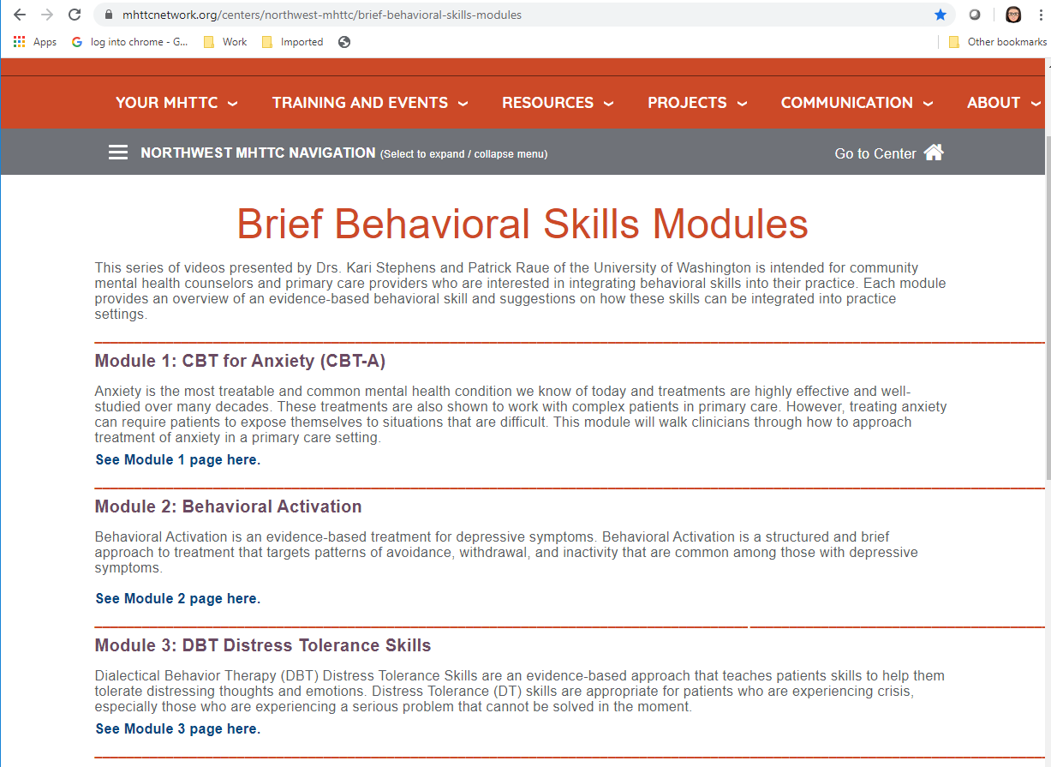
https://mhttcnetwork.org/centers/northwest-mhttc/brief-behavioral-skills-modules

Slide 14
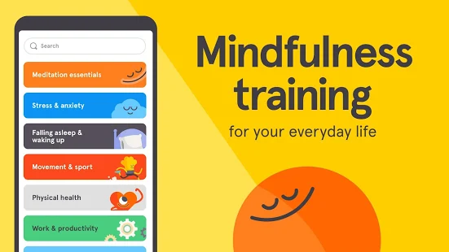
What Can We Learn From Other Complex Emergencies - how they affect providers?
Frequently providers can become distressed in these situations
…But Not ALL of them. (ie in some cases 70% are not showing signs on distress scales)
Common contributing factors include working directly with effected patients, social isolation, personal isolation, stigma, job stress, and the providers personal life
Providers may not be great at recognizing their own distress/need for self care
Courtesy of Dr. Jennifer Erickson
There’s an app for that!
(free now with anyone with an NPI!
https://www.headspace.com/health-covid-19

Slide 15
Thank you!
Contact: Kari Stephens kstephen@uw.edu

