Slide 1

SIS Loading and Troubleshooting
Gail Pawlowski
Shannon Pritting
SUNY Shared Library Services
October 11, 2019
www.suny.edu

Slide 2
Related FAQ and Documentation
http://slcny.libanswers.com/faq/267697
https://knowledge.exlibrisgroup.com/Alma/Product_Documentation/010Alma_Online_Help_(English)/090Integrations_with_External_Systems/050User_Management/010Student_Information_Systems
Data Dictionary for User Tags: https://developers.exlibrisgroup.com/alma/apis/docs/xsd/rest_user.xsd/
www.suny.edu

Slide 3
Support for SIS
SSLS staff will continue to support SIS loading for another ~6 months to give campuses time to refine processes and get through another semester of loading students.
Campuses can reach out to us via libanswers for assistance.
If one of the SSLS staff is engaged in working with you/your IT to get SIS loading working, we’ll work with you until the process is working.
Limitations are that SSLS staff won’t do complex data cleanup on users.
  SSLS will consult on data cleanup needed, but won’t perform the work for campuses.
www.suny.edu

Slide 4
After 6 months, SIS Integration Support
SFTP Server questions/issues
Internal vendor management with SICAS on SORYALM improvements and adjustments.
Updates to user management enhancements in Alma and training on these processes.
  Ex. of recent user management improvements:
    SAML Self-Registration
www.suny.edu

Slide 5
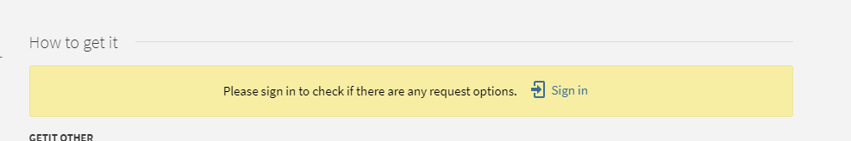
Why is User Data Important?
Primo/Link Resolver options rely on user groups.
Service and delivery capabilities rely on user groups.
Logging into Primo at all requires an account.
www.suny.edu

Slide 6
How is Alma Different from Aleph
Missing Data will load as empty data overwriting legitimate/accurate data.
Match point defined in job/integration profile parameters.
No preview mode: must run file in update to fully test process.
Duplicate Identifiers not allowed: this doesn’t matter if the value is in a completely different id field or user.
www.suny.edu

Slide 7
Overview of Process: File Placement and File Format
Files must be on SFTP server
  Gail set up the SFTP server in Alma, so no adjustments should be needed.
Files must be zipped.
  Must use a zip format that uses a .zip file name extension.
  We haven’t noticed any issues using built-in Windows zipping features.
Multiple files or a single file are okay.
  Many campuses are loading 1 file for fac/staff, and one file for students.
We’ve sent SFTP address and credentials out multiple times, but please let us know if you need the login and address information.
www.suny.edu

Slide 8
How the XML File data/SIS job interacts with Alma data
Any data that is in XML will overwrite data in Alma.
If data that is not mandatory or part of a data element is missing, blank data will overwrite your existing valid data in Alma.
  Ex. of issues we’ve seen:
    Missing email addresses
    Patron Expiry Dates
    Address information deleted
    Identifiers missing in XML file deleted from Alma.
If there’s any local data you want to protect from SIS, you can, but must request to be identified as “internal” via Salesforce.
www.suny.edu

Slide 9
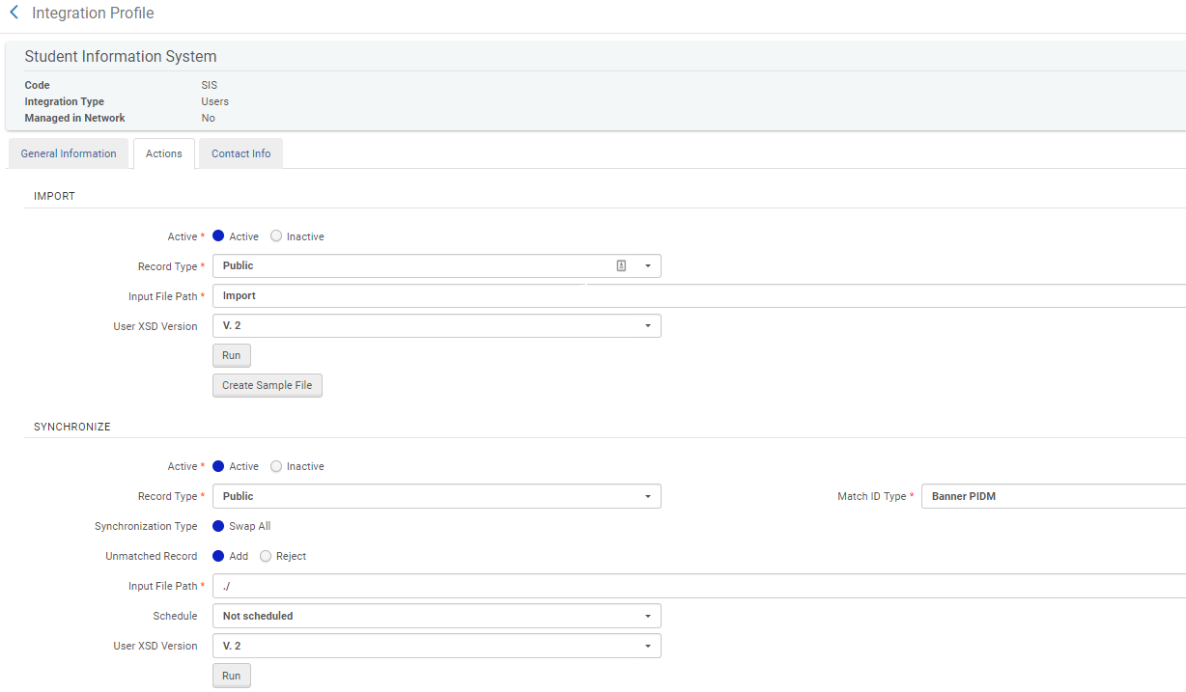
Running the Job: Synchronize
www.suny.edu

Slide 10
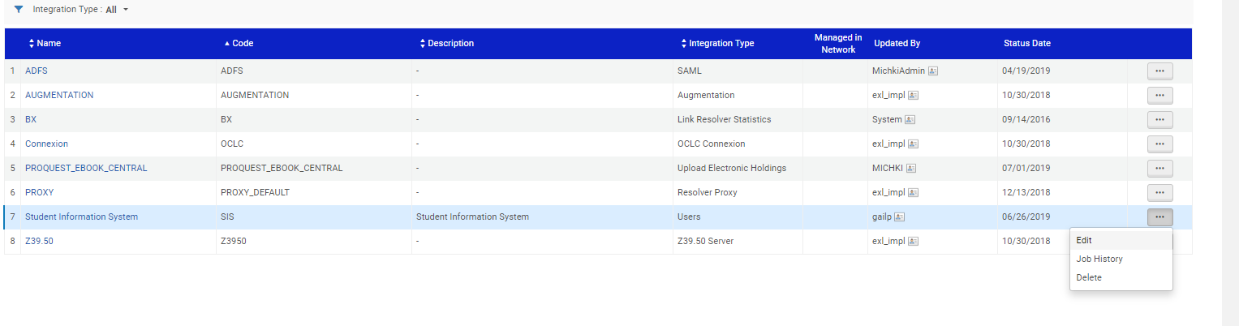
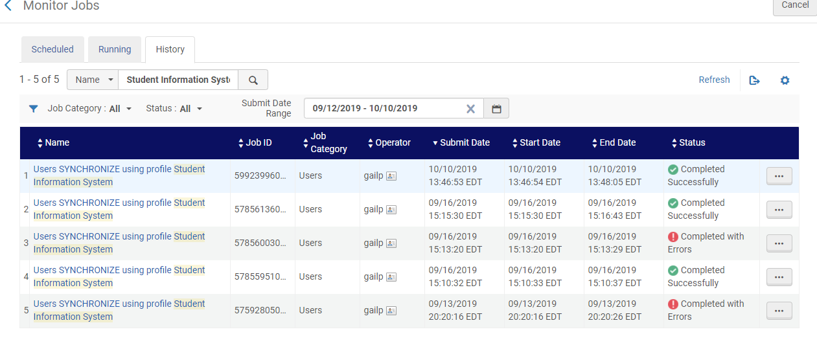
Reviewing the Job Report: Finding Job
Option 1: From Integration Profile
Option 2: From Admin→Monitor Jobs→Search for Name “Student Information System”

Slide 11
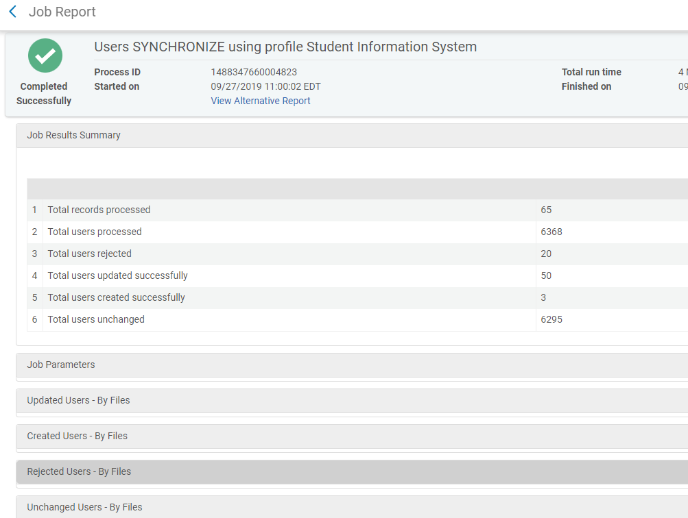
Reading the Report
www.suny.edu

Slide 12
What Happens to File After Job Runs?
Alma differentiates files that need to be run and those that have been run by changing the file type to .old
Any zipped file in the SIS directory will be run by Alma when you run the Users Synchronize job.
www.suny.edu

Slide 13
Major Questions to Ask From Report
Did you expect the # or percentage of users to be updated that were?
  Ex if you’re running daily/weekly, you shouldn’t see a lot of updated users.
Is the number of new users as expected?
  Would you expect hundreds of new faculty users?
  More than expected new users may indicate duplication (or maybe not)
  When would you expect hundreds of new student users?
Are the rejected users important enough to you that you want to put the effort into fixing data and reloading?
www.suny.edu

Slide 14
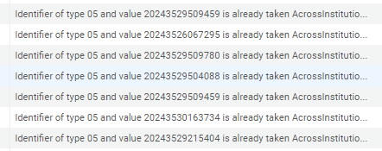
Common Rejection Reason: Identifier Exists but in a Different Identifier
www.suny.edu

Slide 15
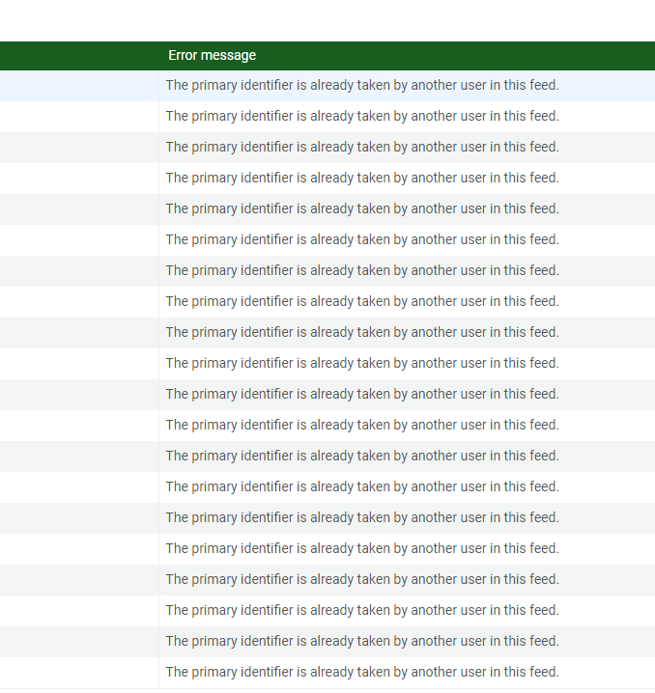
Common Rejection Reasons
Although identified as the primary identifier, this can be changed in Alma.
Users “in this feed” may also indicate that there is duplication in file, which may be fine, but should be investigated.
www.suny.edu

Slide 16
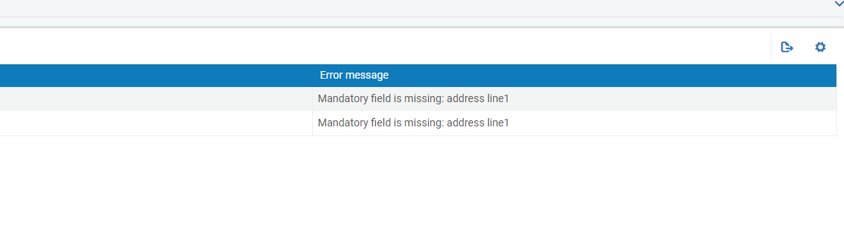
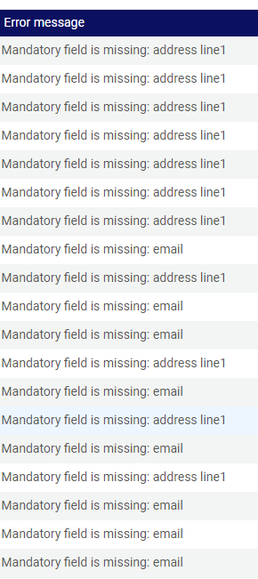

Common Rejection Reasons: Missing/Invalid Data
www.suny.edu

Slide 17
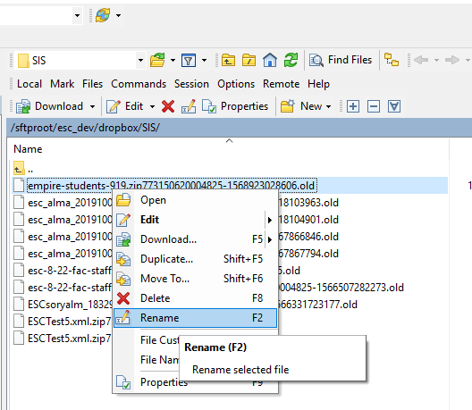
How to Re-Run the XML
Easy way to re-run the file is to rename the file on the FTP server by removing the .old and everything else up to the .zip.
Or, you can create a copy of the .zip before you run in Alma.
www.suny.edu

Slide 18
Re-Running Only Specific Users
If you need to clean up data, you might want to just pull out the users that need their data cleaned up.
Can create a second file from the file you ran to re-run again.
Just copy and paste the users between <Users> and </Users> tags.
Need Following Nesting Tags:
<?xml version="1.0" encoding="UTF-8" standalone="yes"?>
<Users>
</Users>
www.suny.edu

Slide 19
XML’s not that bad, and a little review goes a long way
Although the XML files can be pretty complex, luckily the SICAS xml only includes the essential XML and can be reviewed pretty quickly without a whole lot of expertise.
General focus of XML review is to check the data points that are going to update your user data.
Conduct searches in XML for this data.
I use Notepad++ and do a simple ctrl-f/find to search for issues.
  Find All in Current Document is a nice feature to do a search for aggregate values that you can quickly scan
  Notepad ++ has a nice dropdown for frequently used searches.
www.suny.edu

Slide 20
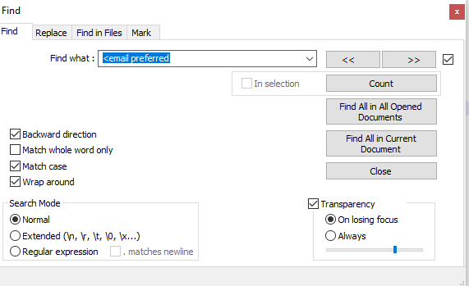
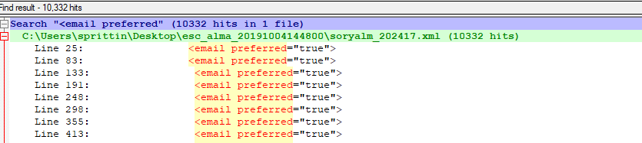
Search strategies
Search for tags or parts of tags for best results.
If you’re looking to make sure your users have data (like email address), the SICAS file will give you a user count in the beginning.
  Values of count should match or be pretty close.
You may not have to do all of these searches each time, but until you’re comfortable with your data, you may want to.
www.suny.edu

Slide 21
Specific Searches and What They’re Looking for
<email preferred
  Searching to find if you have <e-mail preferred=“false”>, which will prevent emails from sending.
<expiry_date>
  Do all your users have expiry dates and is it what you want it to be for the user groups in your file?
Types:
  <address_type
  <email_type
  <phone_type
    Look for invalid types (often state names like Massachusetts due to invalid SORYALM mapping).
    Number of “types” will give you a sense of the variants that you’re loading
      Ex. If you have 10,000 users, and get 20,000 phone types, you’ll know you’re loading two phone types and generally what they are.
<user_group
  Will show all the user groups
www.suny.edu

Slide 22
So, what are the valid types and what do they look like?
Email:
<email_type desc="Work">work</email_type>
<email_type_desc="Personal">personal</email_type>
<email_type desc="School">school</email_type>
Phone:
<phone_type desc="Office">office</phone_type>
<phone_type desc="Home">home</phone_type>
<phone_type desc="Mobile">mobile</phone_type>
Address:
<address_type desc="Work">work</address_type>
<address_type desc="School">school</address_type>
<address_type_desc="Alternative">alternative</address_type>
<address_type desc="Home">home</address_type>
www.suny.edu

Slide 23
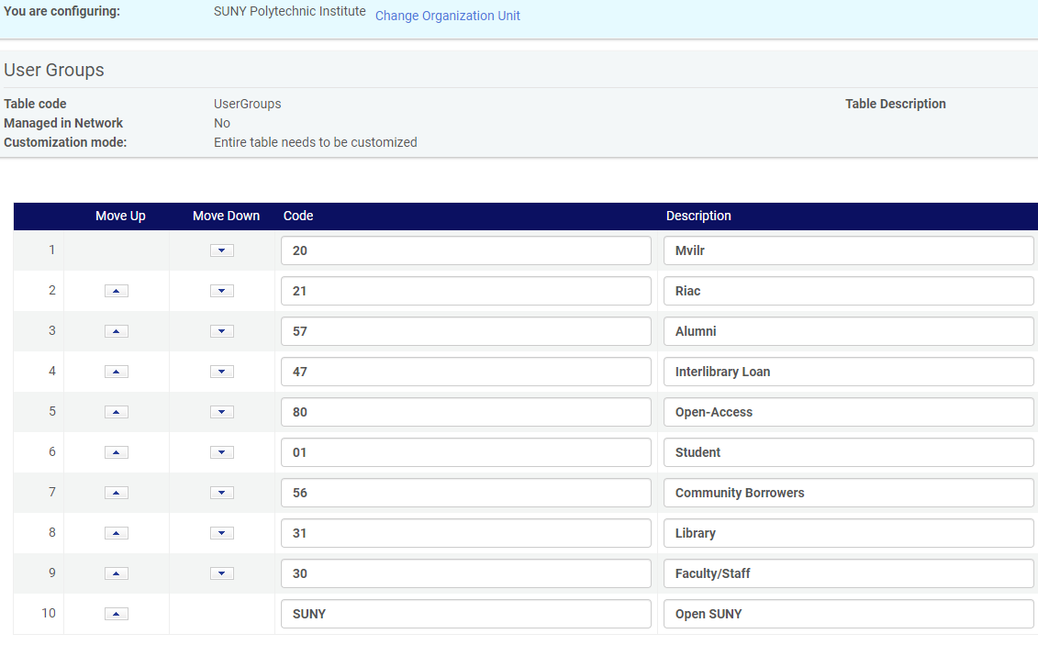
How do I find User Groups in Alma?
Alma→ Config→ User Management→User Details→User Groups
Groups are mapped to fulfillment policies.
  So, you can change here, but you probably shouldn’t.
If XML and Alma description doesn’t match, that’s okay.
Codes must match, and should match what they’re for.
  Ex: if 30 is faculty in XML, 30 should be faculty in Alma.
www.suny.edu

Slide 24
Reviewing Identifiers
This should be something either we/you did as part of your initial load.
But, if not, make sure that your identifiers match what’s in Alma.
  Review User Groups that are valid.
  Review Identifier data points in analytics.
www.suny.edu

Slide 25
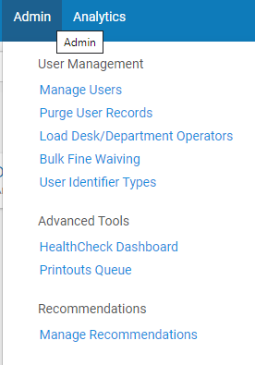
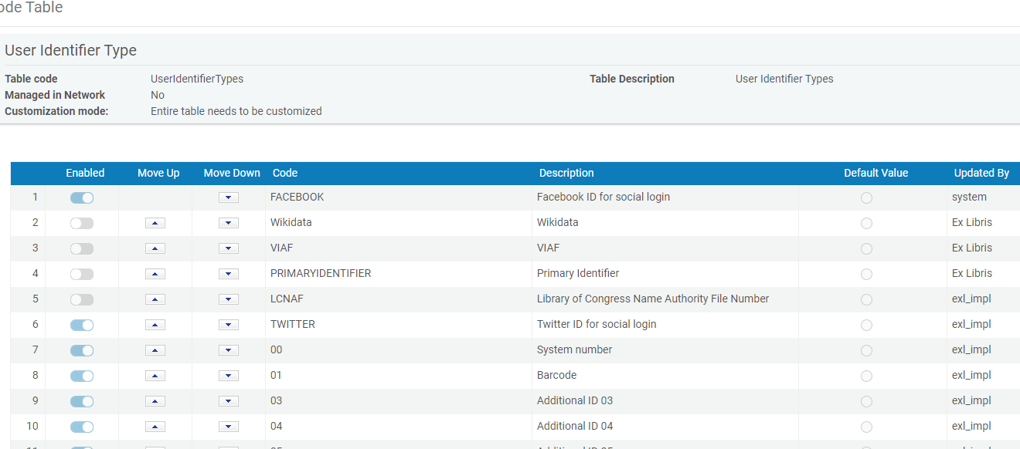
Where do I find Identifiers in Alma?
www.suny.edu

Slide 26
Review of Data Once You’ve Loaded
Good strategy after loading is to look at 5-6 representative users and check the data points in the users.
Data loaded could be problematic, and you won’t see it from the reports.
  Blank expiry dates
  Blank emails
  Email=Preferred
www.suny.edu

Slide 27
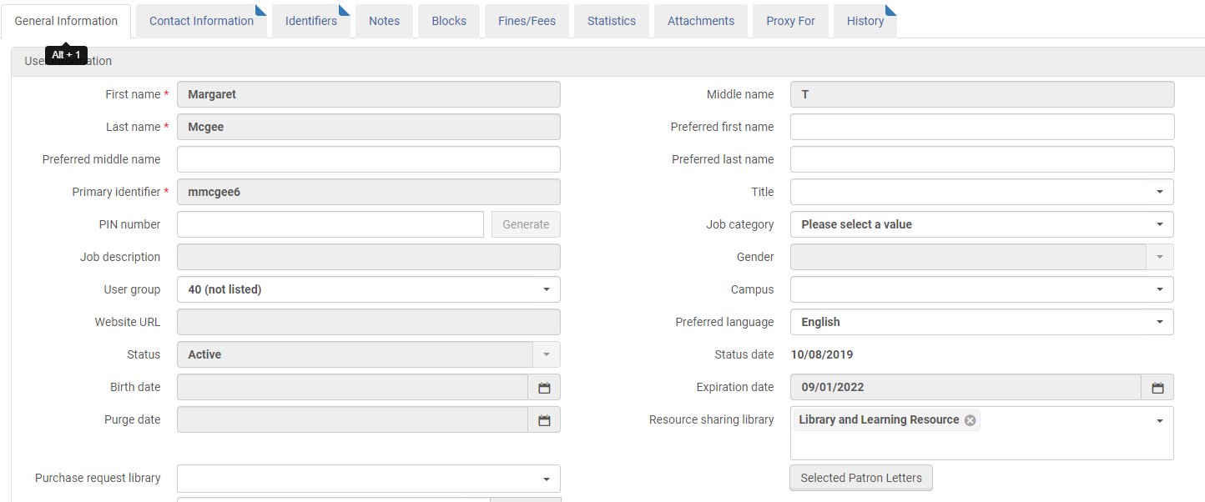
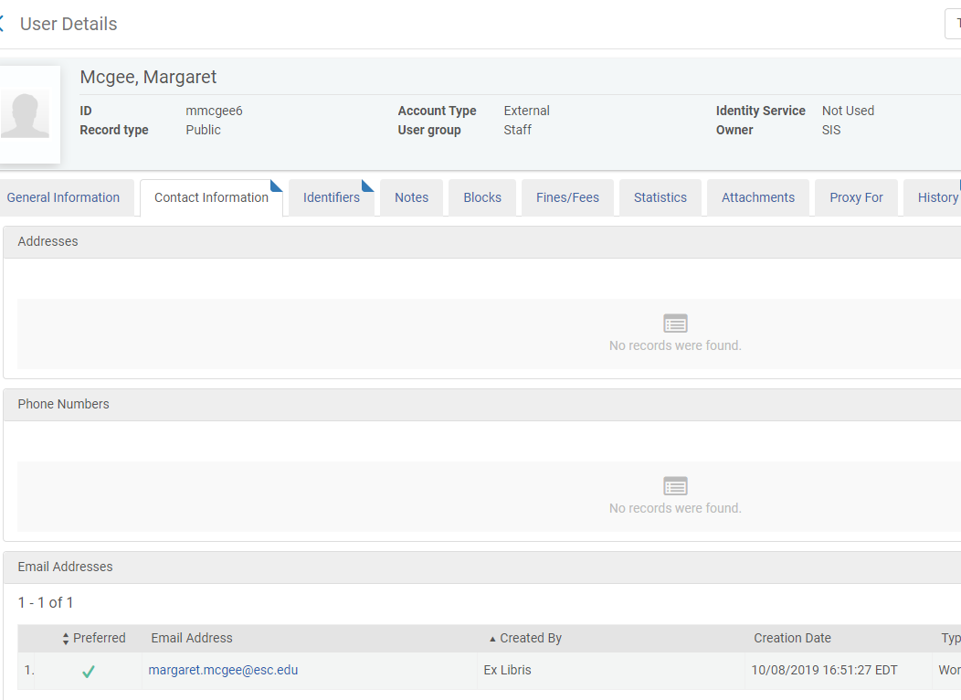
Review 3 Tabs for Data
General/Contact/Identifiers
www.suny.edu

Slide 28
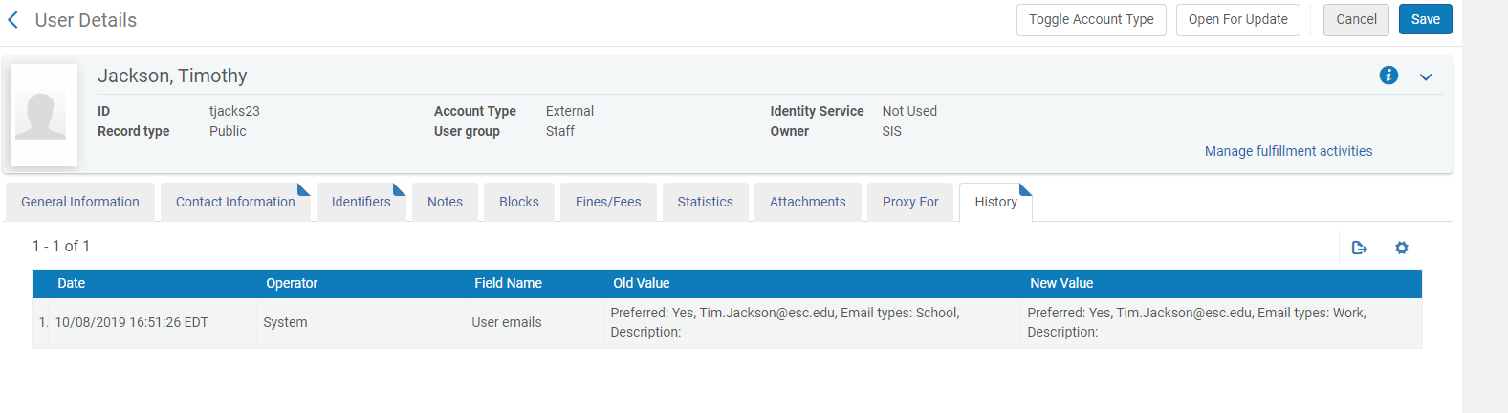
Known Issue: Your History Might or Might not Work
History tab can show what fields were updated, which is great for troubleshooting.
Some campuses have a functioning history tab; others don’t.
SUNY has an open dev. SF issue, and this is slated to be fixed in Dec. release.
www.suny.edu

Slide 29
A day after: Analytics
Searching your user database for most/all of the data points for what you’re loading via SIS synchronization is a great way to see what your data looks like globally.
Creation of a report can make this a very simple task to look at and address issues.
We created an Analytics report you can use to check user data.
  /Shared Folders/Community/Reports/Institutions/01SUNY/Users/Report of Users
  Even if you don’t do this every time, can be a good thing to look at during first part of semester, etc.
www.suny.edu

Slide 30
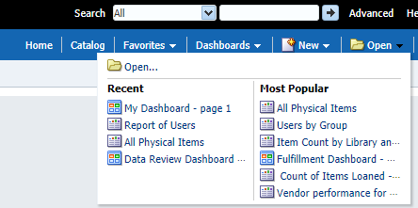
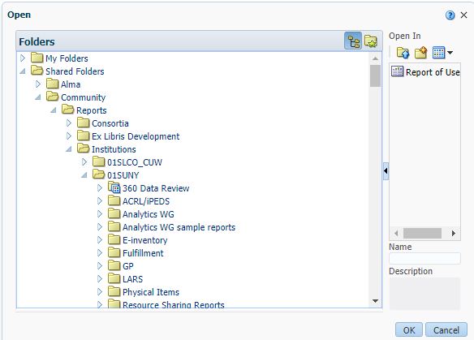

To Open Shared Report
www.suny.edu

Slide 31
Review of Known Issues and Problems Caused
<e-mail preferred=“false”>
  No e-mail sent to user
No address marked as preferred
  Notices that are printed will not print any address.
www.suny.edu

Slide 32
Questions to Ask if You’re Automating Loading
Do the rejected users represent the same people over and over again?
Do the rejected users represent a pattern, mapping issue, or configuration change?
Can I easily fix the file and reload?
Is this a problem with the source data (missing this information) or a mapping issue?
If you want SUNY to work with you on these issues over the course of the next 6 months, just let us know.
www.suny.edu

Slide 33
Recommendation: Get Notified when job runs if you’re automating.
Go to Admin→Monitor Jobs→ Scheduled
Find the “Users SYNCHRONIZE using profile Student Information System” Job
Set yourself up as to be notified both on success and failure.
Job won’t show up there until you schedule.
www.suny.edu

Slide 34
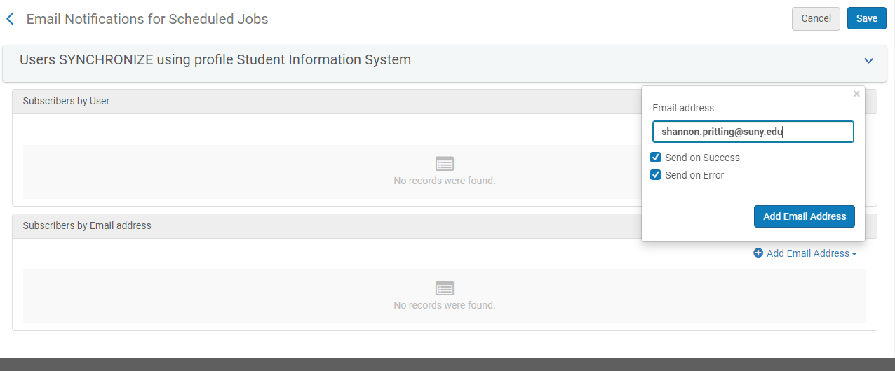
Since a successful job can be bad, select both success and error.
www.suny.edu

Slide 35
Duplicate Users and Merging
User Merging was released in September, but has since been disabled, and the release of this feature is “not known at this time.”
Duplicate users will need to be handled via deletion of one user and keeping the other, which can be a hassle.
www.suny.edu

Slide 36


Questions or Discussion?
www.suny.edu

