Slide 1
Collection development and cultural context: The accommodation of professional to cultural values among Senegalese Academic Librarians

Slide 2
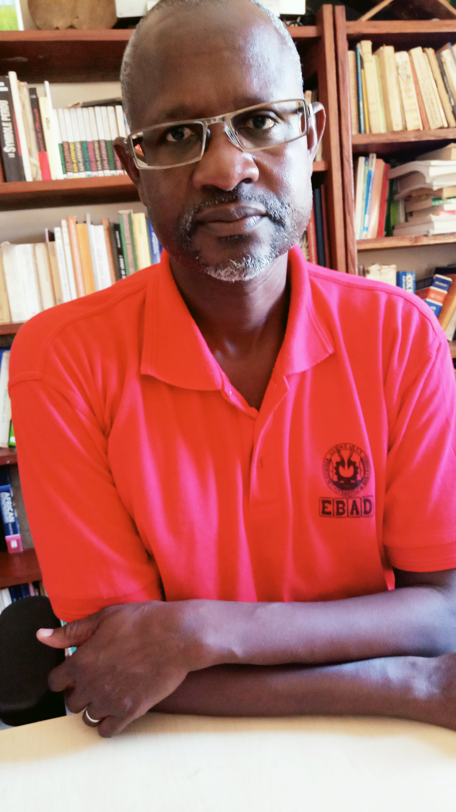
Hello!
I am Bernard Dione
I’ll talk about the importance of cultural context in the adoption of professional values. I’ll consider especially the accommodation of “intellectual freedom”and its impact on collection development.
Bernard.dione@ucad.edu.sn

Slide 3
Profession,Values,… ?
Words and things

Slide 4
Profession
“[…] a service performed for the benefit of humanity and with a high sense of purpose and dedication.” (Shera, 1970, p,29).
According to the functionalist perspective, 3 core criterias are required to define a profession:
a formal technical training;
skills and competencies;
some institutional means of making sure that such competences will be put to socially responsible uses.
The item (3) implies Values and Ethics

Slide 5
Our dedication as a librarian?
“The role of information institutions and professionals, including libraries and librarians, in modern society is to support the optimisation of the recording and representation of information and to provide access to it”.
(IFLA Code of Ethics for Librarians and other Information Workers)

Slide 6
Value
“[…] an enduring belief that a specific mode of conduct or end-state of existence is personally or socially preferable to an opposite or converse mode of conduct or end-state of existence” (Rokeach (1973).

Slide 7
Values …
Values are cognitive representations of individual
needs and desires, and societal demands.
They express what is important to people.
Values
(1) are beliefs linked inextricably to affect;
(2) pertain to desirable and end states or behaviors;
(3) transcend specific situations,
(4) guide selection or evaluation of behaviors and events, and
(5) are ordered by relative importance : value system

Slide 8
Values are socially constructed
The acquisition of cultural values and professional values result from the socialization process.
The socialization process include 2 phases: (1) primary socialization and (2) secondary.
Primary socialization : First step, from childhood, it makes us become member of a society.
Secondary socialization : all posterior processes which incorporate an individual already socialized in one of the subgroups of the society: association, profession, etc. (Berger & Luckmann, 2006).
Notes:
Primary socialization is the first socialization which the individual undergoes in his childhood, it makes us become member of a society.
Secondary socialization consists of any posterior process which allows to incorporate an individual already socialized in one of the subgroups of the: association, profession, etc. (Berger & Luckmann, 2006).

Slide 9
Value system / Value structure
Value system : the way values are prioritized.
Value structure: the conflicts and compatibility among values.
Ex. Values opposite on the Schwartz Circumplex usually conflict (see next slide).
Cultural values can conflict with professional ones.
Important : How to make decisions in professional settings (e.g. when developing library collections) when cultural values conflict with professional values?

Slide 10
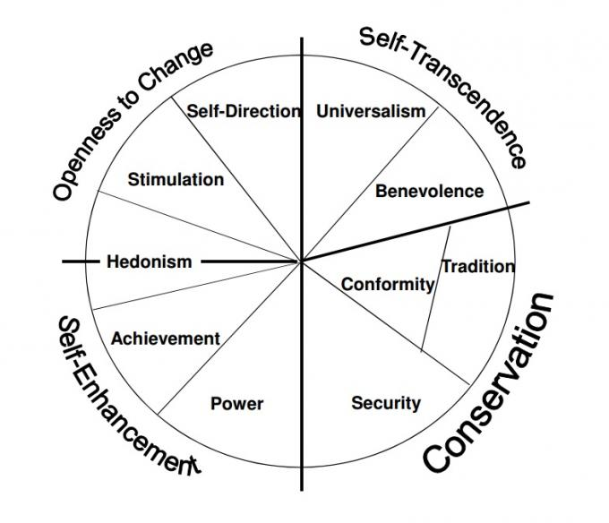
Theoretical Background The Schwartz theory of basic values identifies 10 basic personal values common to all human beings

Slide 11
Accommodation of professional to cultural values: exploring intellectuel freedom among Senegalese academic librarians
We describe and explore the interactive co-existence and adaptation of professional values within the cultural value system of Senegalese academic librarians.
We emphasize here on intellectual freedom.

Slide 12
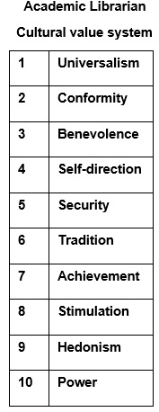
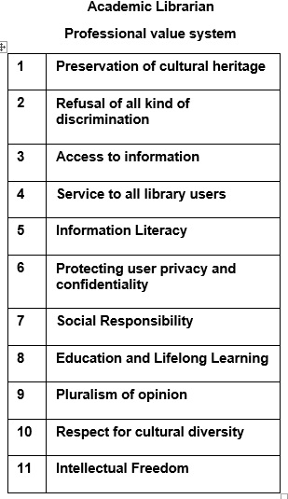
Findings (1)

Slide 13
Findings (2)
On the cultural level: Senegalese academic librarians prioritize the interests of their social group, the respect of social order and adoption of normative behaviour in order to facilitate their relationships with the other group members.
The value system favours a strong integration of the individual into a group but do not encourage an action and thought autonomy which may destroy social harmony.

Slide 14
Findings (3)
On the professional level : Senegalese academic librarians regard access to information, preservation and conservation of heritage and the denial of all sorts of discriminations as essential professional values.
Intellectual freedom is ranked 11th on 11
In case of value conflict: seek of compromise, a balanced position which does not basically challenge cultural values.
But the final decision is made in favour of cultural values.

Slide 15
Conclusion
This attitude furthered self-censorship in selecting materials for library collections. Senegalese academic librarians tend to avoid book that might not reflect the beliefs or ideas of their community
Necessity to reinforce professional socialization by including courses on ethics and values in the training of Senegalese academic librarians.

Slide 16
Thank you!
Questions?
Comments to:
bernard.dione@ucad.edu.sn
bernard.dione@gmail.com

