Slide 1
SUNY Library Accessibility Cohort Update
February 8, 2021

Slide 2
The Big Picture
Inclusion
Accessibility
Accommodation

Slide 3
Overview of EIT Accessibility Policy
Each campus & System will have an EIT Accessibility Officer.
Each campus & System will create an Accessibility Plan.
Each campus & System will use the standards devised by the Committee:
1. Web Accessibility Standards
2. Digital Content Accessibility Standards
3. Classroom Accessibility Standards
4. Library Accessibility Guidelines
5. Procurement Accessibility Conformance Guidelines
For more information, visit www.suny.edu/accessibility

Slide 4
EIT Plan Requirements
Aspect | Description
Authority & Responsibility | An assignment of roles, authority, responsibility and accountability for achieving policy compliance
Awareness Raising | A campaign to communicate electronic and information technology (EIT) accessibility across all campus divisions and departments
Design | A comprehensive approach to engrain accessibility into the creation of web and technology resources
Procurement | A procedure to include accessibility as a requirement within purchasing processes, including centralized and decentralized purchasing activities
Monitoring Compliance | A means for monitoring compliance with all the standards outlined in the Policy
Training | A method for training all campus personnel who develop, select, purchase and maintain EIT

Slide 5
Common Themes & Approaches
Policy-focused approach
Data/results-driven approach
Multi-year plan
Campus-wide committee
Liaison model
Dividing plan templates to address multiple areas (e.g., student life, instructional and communicative digital content)

Slide 6
Best Practices
Shared responsibility/governance model
Comprehensiveness in scope - not just public-facing websites and instructional materials
Utilizing combination of personnel and current students and technologies to proactively address accessibility
Incorporating accessibility-related duties in various job descriptions
Incorporation within broader strategic plan, diversity plan, enrollment plan, library plan
Requiring training (web editors, content creators, p-card holders, faculty, etc.) and delivering in multiple modes (asynch, certifications)

Slide 7
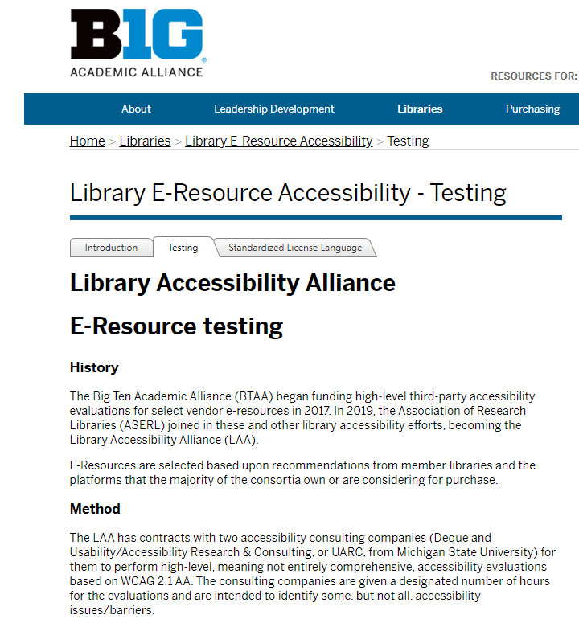
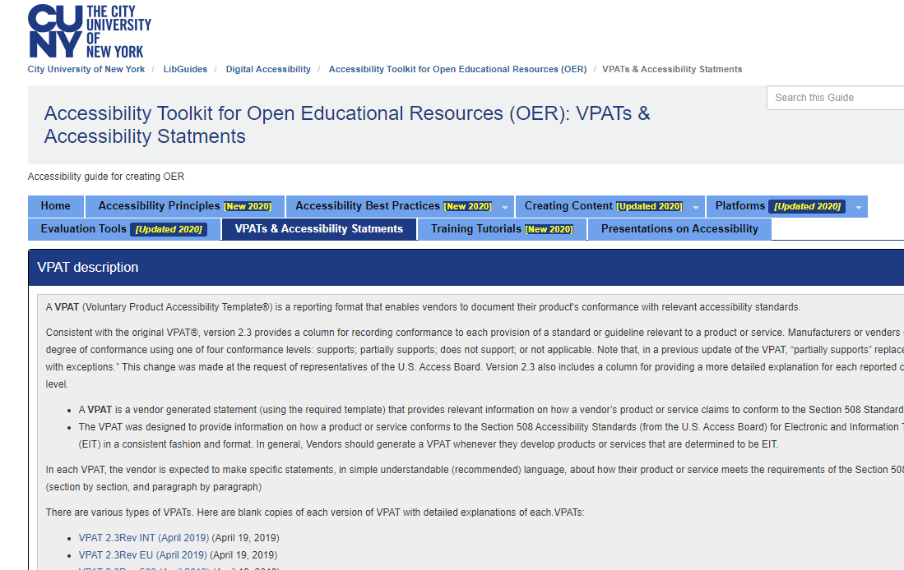
SLS Research and Overview of Approach
Benchmark with what other consortia/groups are doing:
Big Ten/Library Accessibility Alliance
CUNY
Outreach to SUNYs to determine:
EIT capacity
EIT processes
Findings
Many SUNYs requiring not only VPATs, but testing.
No other consortia had internal testing groups or processes.
No ability/willingness to commit funds to outsourcing, even though that was likely most effective.

Slide 8
Trends and Opportunities
Verified 13 campuses already requiring testing for renewals/new products (of 30 respondents)
Most indicated they wanted/needed help with testing and reviewing.
Experience with cohort confirmed amount of time it takes to become comfortable.
Approaches at campuses varied widely:
Spectrum of conservative for compliance to no attention
Very few explained a reasonable approach that was multi-year
Libraries often felt “out of loop”
Many parallels with approach to copyright

Slide 9
Vision of the cohort
Ongoing self-directed and guided training
Develop mutual understanding of accessibility and standards
Gather input on accessibility issues from stakeholders
Develop and maintain a shared repository of accessibility documentation
Critically review accessibility documents in a SUNY shared repository

Slide 10
Overview of training for cohort
SUNY Blue
Libraries Accessibility Guidelines
EIT Accessibility Webinar Series
Communities of Practice
SUNY Accessibility Week Playlist
SUNY EIT Accessibility Evaluation Training (Presentation)
Expert user demo of screen reader with a Q&A opportunity
Use of Workplace for sharing resources, asking questions, sharing successes

Slide 11
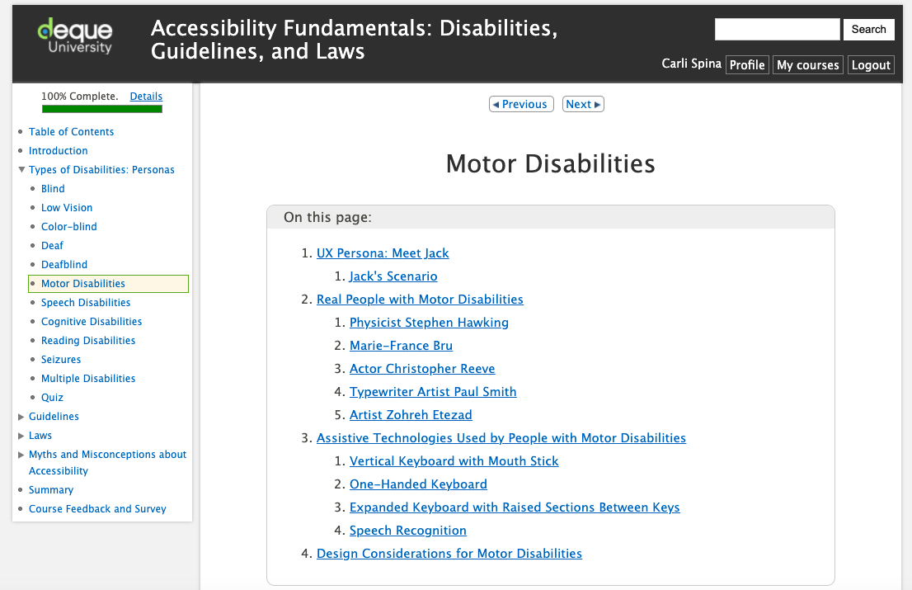
Overview of training resources - Deque University
Getting Started
Contact your Deque University Administrator.
If you don’t have one, contact your campus EIT Accessibility Officer.

Slide 12
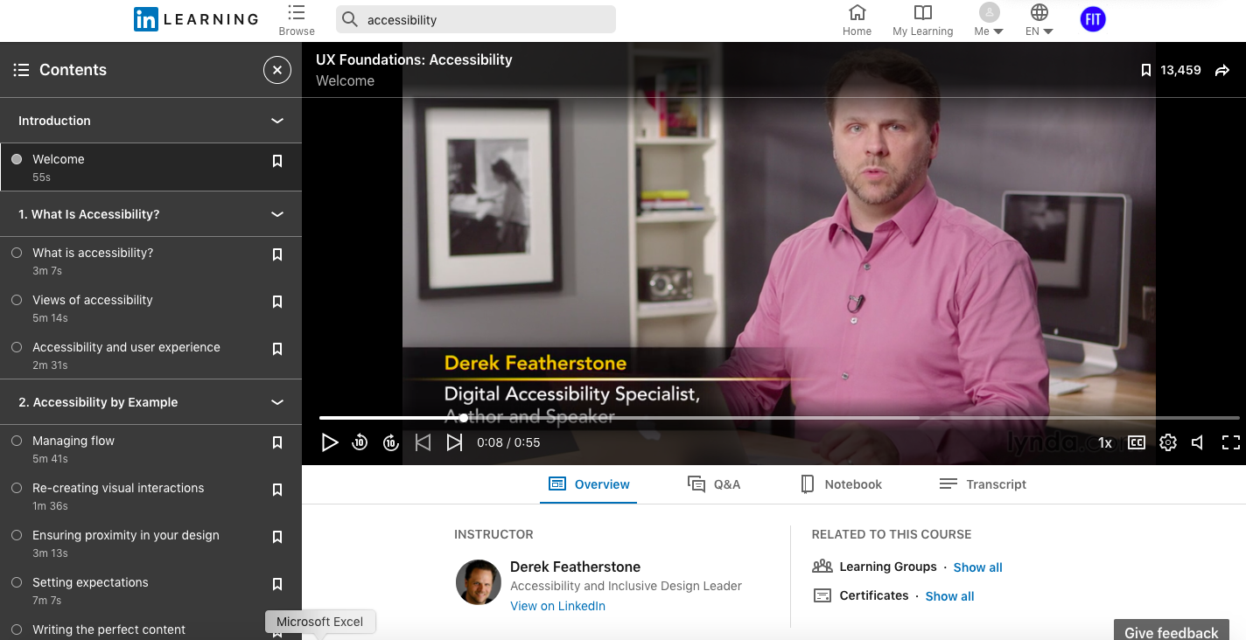
Overview of training resources - LinkedIn Learning
Getting Started
Some campuses have LinkedIn Learning subscriptions through their Library or IT department

Slide 13
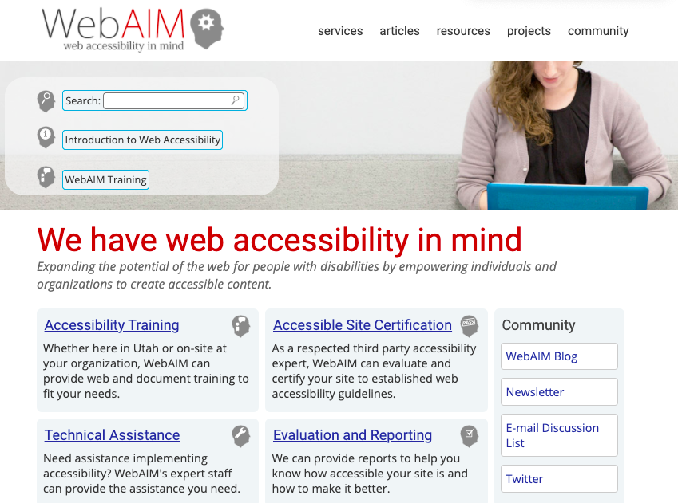
Overview of training resources - WebAIM
Getting Started
Freely available training, data, and introductory articles

Slide 14
Free Testing & Evaluation Resources
Accessibility Testing Tools
WAVE - https://wave.webaim.org/
Axe - https://www.deque.com/axe/
Paciello -
https://www.paciellogroup.com/color-contrast-checker/
Free Screen Readers
VoiceOver - Included on iOS devices
Microsoft Narrator - Included on Windows computers
NVDA - Free for PCs
Individual campuses may have access to additional paid resources

Slide 15
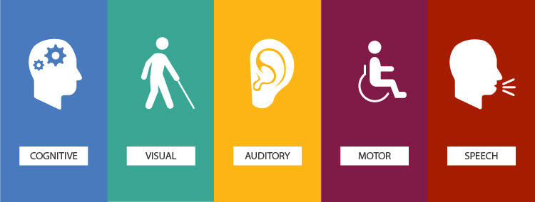
Accessibility training perspective from a cohort member

Slide 16
SUNY Library Accessibility Repository
Approach:
Determine what content is most widely used in SUNY libraries
Double reviews and peer review
Goal is getting the reviews completed for 80% of resources subscribed to by SUNY

Slide 17
SUNY Library Accessibility Repository (Review/Testing)
VPAT-based Conformance Reports: Reviewing and Testing
Form development and norming
VPAT Review form: https://slcny.libwizard.com/f/vpat_product_testing_part1
Methodology Tasks Based on ITAG: https://slcny.libwizard.com/f/vpat_product_testing
Tested with group
Break out into pairs to review a VPAT
Bring new knowledge and experience with VPAT review back to larger group
Each member completed the Methodologies form separately, keeping a log of questions that came up to share and discuss with cohort.

Slide 18
SUNY Library Accessibility Repository (Top Level Testing)
Reviewing and Testing:
VPAT review and “top-level testing”:
Preliminary reviews based upon VPAT Review and Methodologies Tasks forms
Share these prototype reviews with Cohort and invite others to do their own reviews
Continue peer review and refinement of the process
Put aside insecurities about not being an expert
Talk to the VPAT, not the platform

Slide 19
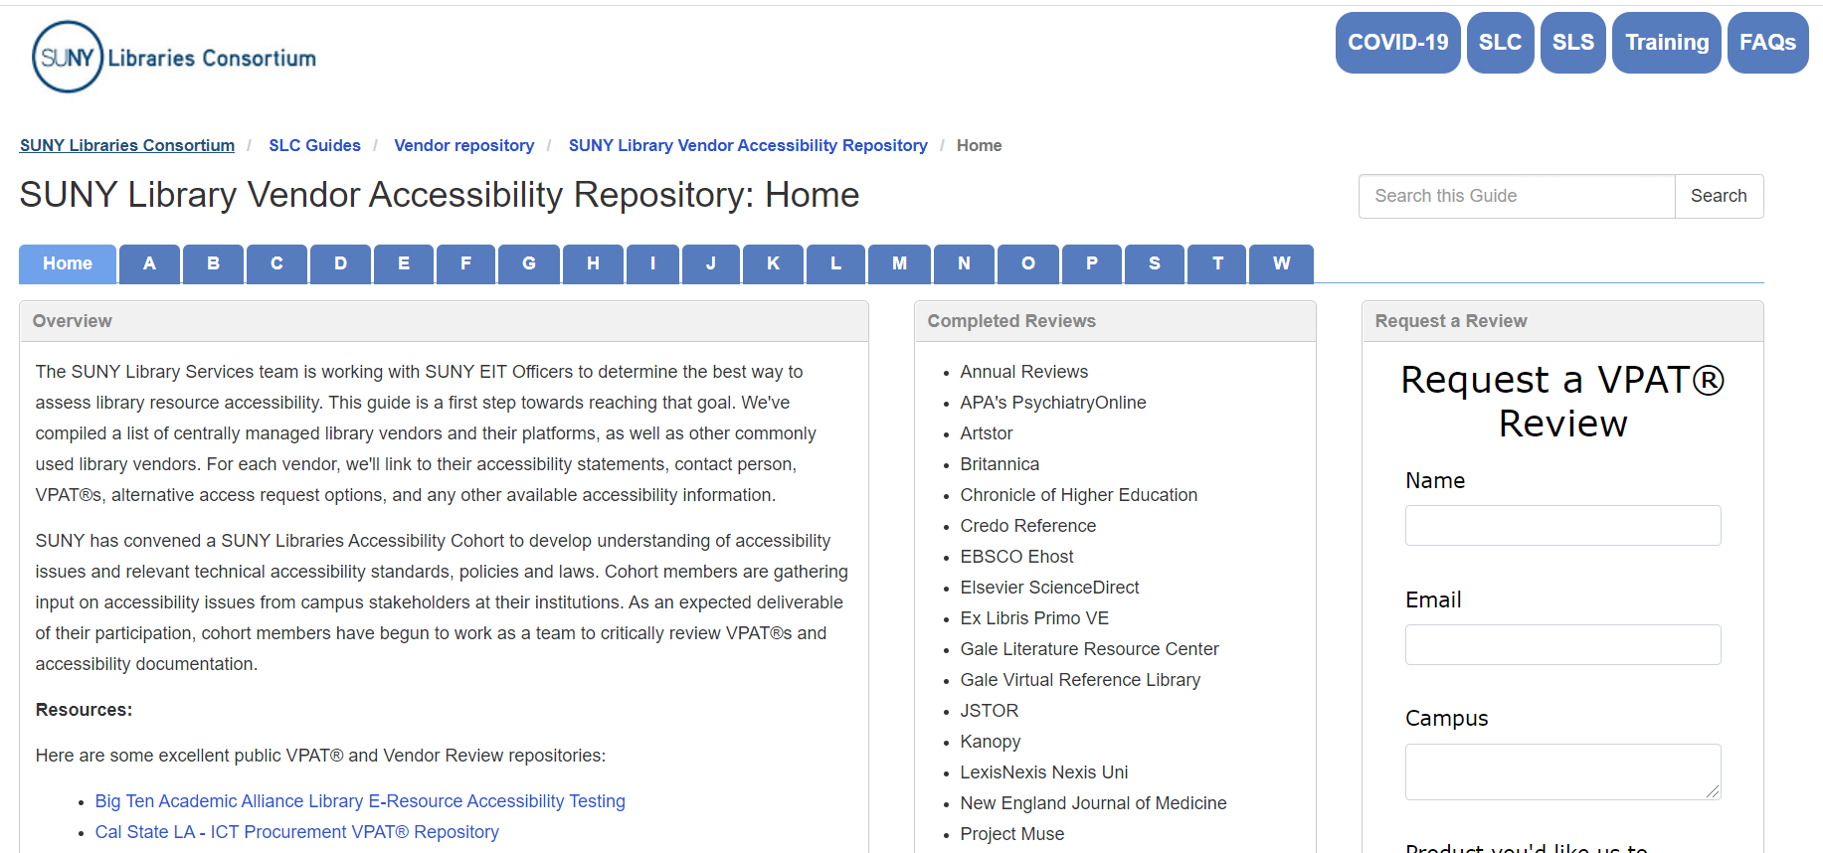
SUNY Library Accessibility Repository (Navigating)
https://slcny.libguides.com/vendor_accessibility

Slide 20
SUNY Library Accessibility Repository (Contents)
Place to store vendor links to accessibility resources (road maps, contact info, conformance reports, etc.)
Load VPATs received from vendor - behind password
Place to house cohort reviews - behind password

Slide 21
Second Half of Cohort
Focus on development of best practices
Implementation toolkit(s)
Training tools
Model vendor communications
Access to Repository
Guidance on creation of an exception processes
Fostering relationship between campus Library and EIT

Slide 22
SLS Lessons Learned: Responsibility vs. Partnership
Campuses may need/want some consulting on EIT strategies
Training vs. Shared Services or a Training Shared Service?
Reviewing library databases is time consuming
Accessibility assessment quickly becomes complicated requiring consultation.
Sustainability will almost certainly be very difficult.
Local vs. Shared
Funding

