Slide 1

Shared LSP Update
December 19, 2019
www.suny.edu

Slide 2
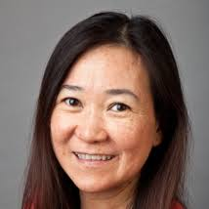
Thanks to Kristy!
Kristy Lee’s 2-year release time agreement ends this month, and she’ll be returning back to New Paltz full-time.
Thanks to Kristy for all of her work in making the migration and period after implementation successful!
Thanks to New Paltz Sojourner Truth Library and Mark Colvson for partnering with SUNY on Kristy’s release time.
www.suny.edu

Slide 3

Welcome to Yvonne Kester!
Yvonne Kester will be joining SLSS team on January 2, 2020 as Alma and Primo Support Specialist.
  Has been institutional lead and systems librarian at New Paltz for past two years
  Will be providing Alma and Primo support for extended services campuses
  Delivering training and helping with documentation in multiple areas.
  Will be 100% release time to SLSS, but based in New Paltz.
Thanks to New Paltz for this partnership, and to Mark Colvson and Kristy Lee for working with SUNY on this.
www.suny.edu

Slide 4
New Position: SUNY Shared Collections Coordinator
In March 2020, Esta Tovstiadi will be shifting from Alma/Primo Support specialist to a new position as SUNY Shared Collections Coordinator.
Next 2-3 months will be transitioning Esta’s current duties to Yvonne and others.
Shared Collections Coordinator position will be evolving, but will work to support and provide direction to shared collections, shared licensing, and development of shared collection strategies.
www.suny.edu

Slide 5
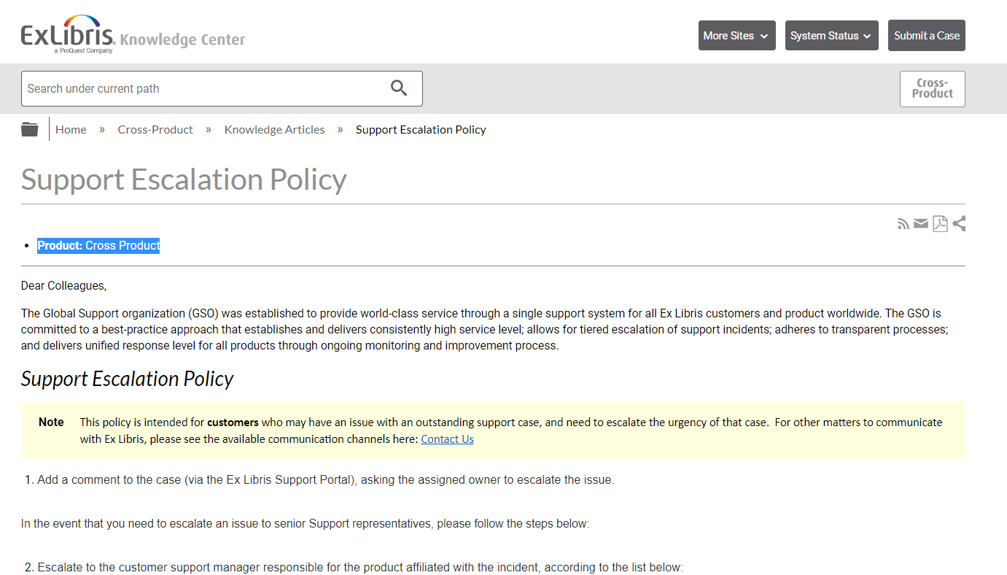
Support Update
SLSS/SLC met with:
  ExLibris support managers on December 18th
Continuing targeted discussions on Primo VE issues and getting corresponding data to assess level of improvement in performance after November Primo release.
Have requested quarterly downtime report as per SLA guidelines.
Reviewing cases across institutions, and engaging with ExLibris on initiatives, but it’s currently unclear whether some of our initiatives can be handled without a formal contract.
https://knowledge.exlibrisgroup.com/Cross_Product/Knowledge_Articles/Escalation_Policy
www.suny.edu

Slide 6
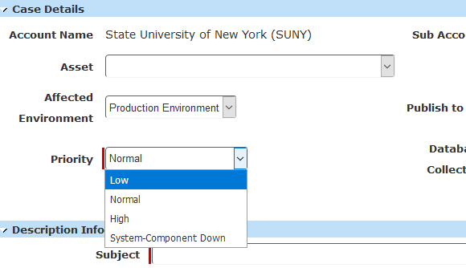
If you want results, make things High Priority
At last support meeting, we reviewed the slow response on several cases of the PQ Ebook Central Integration job not working.
The support managers responded that these were not marked as “High Priority,” so they weren’t getting attention for quick resolution as there are many high priority cases.
Discussed a general idea of High Priority as cases that “involve financial matters such as acquisitions,” or involve disruption to “daily processes.” SUNY indicated that anything that effects the user also should be high priority, which did not get disagreement on.
Please mark anything that’s problematic and preventing you from doing your job as high priority or anything that is causing bad user experience as high priority.
www.suny.edu

Slide 7
The LSP Year in Review
By The Numbers:
  SLSS Training and Support: 426 FAQs; 5,330 LibAnswers searches; 37,230 FAQ views; 404 tickets submitted
All 60 campuses moved to first ever Shared library system.
For 56 campuses, implemented first E-Resources Management System.
Major updates to systems practices for many, including authentication, SIS loading, and use of acquisitions functionality.
No major unanticipated data migration issues.
www.suny.edu

Slide 8
Upcoming SLSS Initiatives
SLSS Initiatives are on the Initiatives webpage:
  https://slcny.libguides.com/overview/initiatives
New Initiatives will be added as we review and plan them.
If you’re interested in an initiative, the best place to start is by contacting the appropriate working group or submitting a Libanswers request.
www.suny.edu

Slide 9
Preview of Planned 2020 Initiatives
Shared Alma/Primo analytics reports
CDI Implementation
Review E-resource management in NZ
Implement Local Resource Types
Review article resource sharing in Alma
Test or implement using Alma-based resource sharing outside of NZ
Coordinate a conference on shared library initiatives in a consortial environment.
www.suny.edu

Slide 10
Alternative Access Presentations and Support
SLSS staff have presented on alternative access strategies for articles.
If your campus would like a consult with your individual library to determine how you could enhance/review your article alternative access options, please send a request to libanswers with some days/times that will work for you:
  info@slcny.libanswers.com
Will assist you with Reprints Desk Set up within Alma or ILLiad workflows.
www.suny.edu

Slide 11
Potential Issue with Current User Expiry Date Practices
Gail ran an analytics report recently that indicated about 20 campuses had expiry dates for their users in December, January or early Feb. 2020.
Alma and Primo use expiry date for much more than just circulation date, so the repercussions of an expired user are more than in Aleph.
  Primo login won’t work
  Due date for any loan won’t go beyond the expiry date
  Any service within link resolver that requires login won’t work
Recommendation is to be liberal with expiry dates to allow users to have some additional time.
If need to get books back is driving expiry dates, recommendation is to use end of semester event in TOUs.
Also has effect on walk-in borrowing (won’t pull users within 30 days of expiry).
www.suny.edu

Slide 12
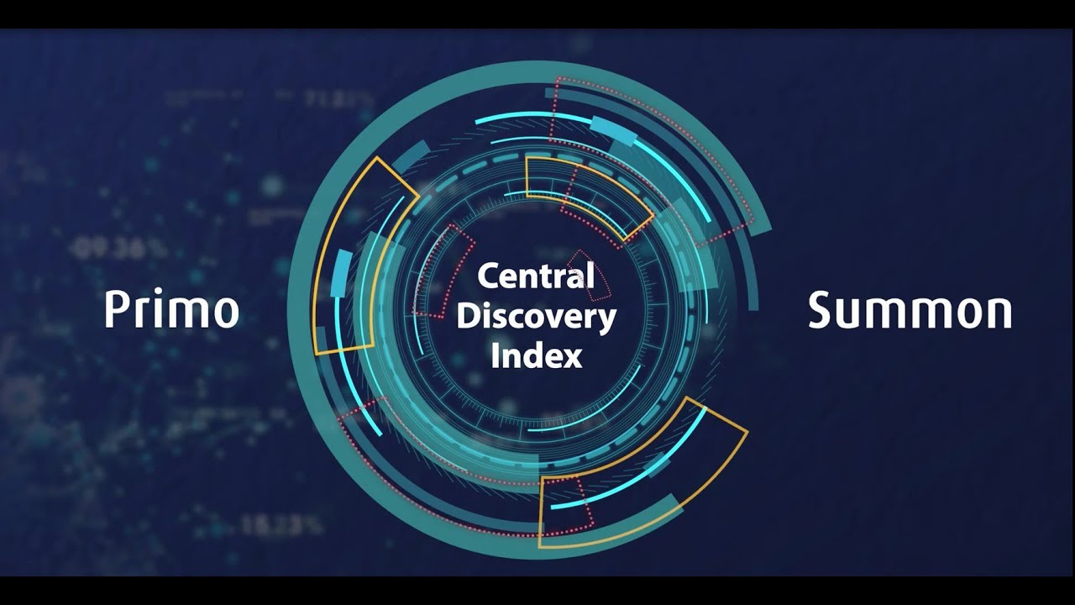
Central Discovery Index Update
CDI Task Force is continuing to test and provide feedback to Ex Libris
Some core functionality isn't fully ready yet – important components being released in January 5 Alma Update
We've identified issues with suppressing content, availability, and filters
There's no mandated migration date, and the goal is to not force a transition until we're confident that the system is ready
Minutes and Ex Libris Documentation
Ex Libris YouTube https://www.youtube.com/watch?v=9k-JZdtSuo8
www.suny.edu

Slide 13

January Alma/Primo E-Resource & Discovery Highlights
Primo Release Notes
Voice Search Assistant allows users to enter search terms using their device's microphone. Enabled by default.
Improved Handling of Suppressed Records
Fixed proxies that weren't working for Primo Central records when direct linking was enabled.
Fixed missing rft_dat parameter tag for Primo Central records for OpenURL.
Fixed inconsistent searches within course reserves using course code.
Alma Release Notes
Alma is now fully compliant with COUNTER 5
This Photo by Unknown author is licensed under CC BY-NC.
www.suny.edu

Slide 14

Café Alma:
January will be Resource Sharing month. Take some time over break to talk workflows, letters, logic, and other magical resource sharing topics with your SUNY peeps.
January 16 | Resource Sharing - Letters and Slips
January 23 | Resource Sharing - Local Documentation and Training Practices
January 30 | Resource Sharing - GES and Display Logic
February 6 | Resource Sharing - Open Call
Visit Café Alma online for sign up info, session links, presenter and host guidelines, and other details.
www.suny.edu

Slide 15

Resource Sharing Update
Timothy Jackson
www.suny.edu

Slide 16
December Resource Sharing Volumes
Top 10 Borrowers |  | Top 10 Lenders
Campus | Volume | Campus | Volume
1. University at Buffalo | 315 | 1. University at Albany | 95
2. Binghamton University | 41 | 2. Binghamton University | 84
3. University at Albany | 38 | 3. University at Buffalo | 43
4. The College at Brockport | 28 | 4. SUNY New Paltz | 35
5. SUNY Cortland | 23 | 5. SUNY Oswego | 29
6. SUNY Purchase | 21 | 6. Buffalo State College | 24
7. SUNY New Paltz | 19 | 7. The College at Brockport | 23
8. Maritime College | 12 | 8. Erie Community College | 21
9. SUNY Geneseo | 9 | 9. SUNY Oneonta | 21
10. FIT | 8 | 10. SUNY Geneseo | 20

Slide 17
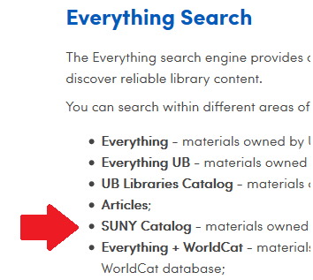
December Resource Sharing Volume Takeaways
The University at Buffalo is still the biggest borrower in SUNY by a wide margin
Using customized rotas to divert more lending requests to Buffalo
  Thank you to SUNY Geneseo for testing this
Will be reaching out to other libraries about customized rota management over winter break
www.suny.edu

Slide 18

December Resource Sharing Volume Takeaways
Borrowing volumes still low at many campuses, so I reached out to libraries about editing WorldCat OpenURL configuration to direct requests to Primo instead of ILLiad
Benefits:
  16 week loan period, guaranteed renewals for faculty & grads, no recalls
  Low turnaround times
  Unfilled reqeusts can be exported to ILLiad
FAQ: https://slcny.libanswers.com/faq/278349
Thank you, Michelle!
www.suny.edu

Slide 19
Resource Sharing Turnaround Time and Fill Rate Statistics
Month | Fill Rate | Turnaround Time
August | 50.2% | 4.7 days
September | 54.0% | 4.3 days
October | 56.1% | 4.3 days
November | 60.0% | 3.9 days
December | 55.1% | 3.8 days
www.suny.edu

Slide 20
Resource Sharing Turnaround Time and Fill Rate Takeaways
Slight decrease in fill rate
Continuing to work with Ex Libris on potential locate issues
Turnaround times are improving
Training sessions on advanced workflows will hopefully help turnaround times improve even more
  Borrowing: https://public.3.basecamp.com/p/oVhZo3KAvLxYx5c1hY7E2VoS
  Lending: https://public.3.basecamp.com/p/Kp5Ji4kmxmgnF3cjiXwWvuAh
Will be sending those links to all resource sharing contacts
www.suny.edu

Slide 21
Future Resource Sharing Initiatives
Improved borrowing NCIP integration
  January 2020
Testing article resource sharing
  Spring 2020
  Allow non-ILLiad libraries to provide better article requesting services to users
Alma resource sharing with non-SUNY libraries
  Summer 2020
  CUNY and non-SUNY Alma libraries on ELD courier (Ithaca College, Union, etc.)
  CSCU system
  Exapand access within Alma & improve Alma reource sharing fill rate
www.suny.edu

Slide 22
Network Zone
Maggie McGee
www.suny.edu

Slide 23

OCLC Import Profile Updates
Edited the Update and Merge OCLC Import Profiles
  Split the merges and updates import profiles to review manual handling issues more effectively
  Unchecked "Do not overlay/merge with a lower brief level" to allow bib records to be updated and reflect changes in the OCLC master record
  Created an indication rule for merges and updates from OCLC nightly jobs to allow for migrated bib records that have been cataloged in languages other than English to be updated
    Approximately 16K bib records migrated in a language of cataloging other than English (040 $b eng)
Edited the New OCLC Import Profile
  Changed the Match Profile to from merge to overlay upon match to allow brief bibs with OCLC #s added to be updated to full bib records
www.suny.edu
Notes:
Good attendance and engagement for all sessions. A successful switch to registration-based training, which makes it easier to communicate with and count participants.

Slide 24

Suppressing Dedup/FRBR for Special Collections
Successfully implemented suppress dedup/frbr with the University at Buffalo
Workflow is in place to implement and maintain suppress dedup/frbr for special collections
Suppressing dedup/frbr for special collections is being opened SUNY-wide
  If a campus is interested in suppressing dedup/frbr for special collections, please fill out the form: Request to Suppress Dedup/FRBR.
    The form is also available at: https://slcny.libguides.com/overview/contact
www.suny.edu

Slide 25

Brief Bib Course Reserves Created in the NZ
There were 528 potential brief bib personal copy course reserves in the NZ at the end of November
40 campuses were contacted that they potentially had brief bib personal copy course reserves linked to the NZ
  Campuses were asked to review the titles, unlink brief bib personal copy course reserves from the NZ, and report the NZ record(s) to be deleted
More than half of the brief bib personal copy course reserves have been unlinked and deleted from the NZ
www.suny.edu

Slide 26

Alma January Release Notes
Acquisitions – Resolved issues
  When receiving multiple journals on the Received Items List page, an error occurred
  In some cases, the PO status was stuck in Sent even though all PO Lines were closed or cancelled
Resource Management – Enhancements
  "Phrase search" now available in Alma's simple search with the use of quotes
  For Network Zone member institutions, import can now be used for adding / managing local extensions in the Network Zone
  New Order API functionality: Alma now uses the vendor proprietary identifier number or the ISBN/ISSN to search and match the incoming order to an existing portfolio in an electronic collection. If no match is found Alma will attempt to activate the relevant portfolios from the collection in the Community Zone. Currently only available with OASIS
  Alma now supports exporting bibliographic records in the BIBFRAME and RDA/RDF output formats
www.suny.edu
Notes:
Good attendance and engagement for all sessions. A successful switch to registration-based training, which makes it easier to communicate with and count participants.

Slide 27
Training Update
Jennifer Koerber
www.suny.edu

Slide 28
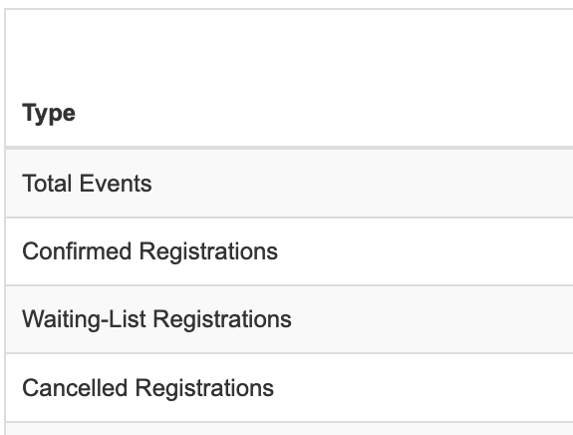
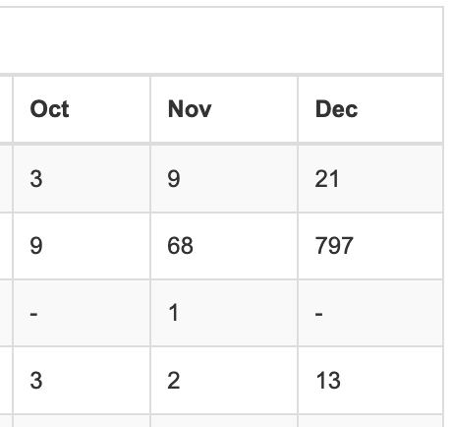
Training Statistics *
* Not all sessions used registration
www.suny.edu
Notes:
Good attendance and engagement for all sessions. A successful switch to registration-based training, which makes it easier to communicate with and count participants.

Slide 29
Upcoming Training
In-Person Training
Online Training Highlights
Cataloging – February or March
E-Resources Management – 3 dates and locations the week of April 6
Fulfillment Units Configuration – 2 dates and locations in late April
Local Holdings, 1/9 @ 10a
Optimizing OA Content in Primo, 1/13 @ 10a
Course Reserves, 1/14 @1p
Functional Area Analytics Sessions:
  Resource Sharing, Primo VE, EResources, Fulfillment
Weekly Discovery/eResources Sessions, Wednesdays @ 11a
www.suny.edu

Slide 30
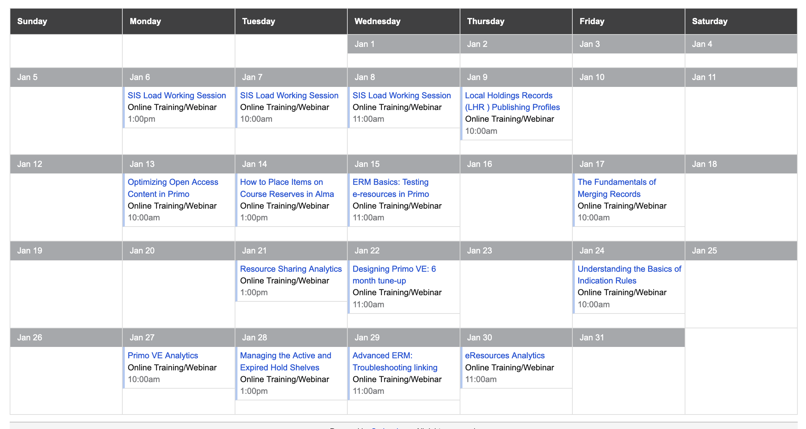
January Sessions https://slcny.libcal.com/calendar/training/
www.suny.edu
Notes:
As trainings are scheduled, we'll add them to the training calendar, which is where all registration information, pre-requisites or pre-work, and webinar information will be.

Slide 31
Upcoming Training
Online Courses – coming in Spring 2020
  Multi-week course in a functional area
  Registration required, with fee
  Small groups
  Interactive
  Planning to roll out eResources course first
www.suny.edu

Slide 32
Training Guides
Four guides now available
  Basecamp Basics: https://slcny.libguides.com/basecamp
  Alma/Primo VE Getting Started: https://slcny.libguides.com/lsptraining
  (Note: this guide consists mostly of links to other guides, and not all other guides are published yet)
  Search and Navigation: https://slcny.libguides.com/training-search-navigation
  Sets & Jobs: https://slcny.libguides.com/training-sets-jobs
www.suny.edu

Slide 33
Upcoming Guides
Guides available by 12/31/19:
  Analytics
  Fulfillment
Additional guides available in January 2020:
  EResources
  Resource Management
  Resource Sharing
Guides available later in the spring
  Acquisitions
  Configuration (all areas)
www.suny.edu

Slide 34


Questions or Discussion?
www.suny.edu

