Slide 1



DigComp and digital reskilling in VET apprenticeships: The Erasmus+ project DigiGo
Project No: 2020-1-FR01-KA226-VET-094938

Slide 2
A few words about our Organisation…
LEGAL NAME
ACRONYM
FOUNDED
LEGAL STATUS
EMPLOYEES
CERTIFIED
AINTEK SYMVOULOI EPICHEIRISEON, EFARMOGES YPSILIS TECHNOLOGIAS, EKPAIDEFSI ANONYMI ETAIREIA
IDEC S.A.
1989
Initially L.T.D. and since 2001 S.A.
40
WITH ISO 9001
IDEC is a
training, consulting & high technology company,
founded by SME consultants with extensive experience in training & industry

Slide 3
A LOOK into… our services
Management Consulting
Business plans,
Feasibility studies
Production planning
Personnel management
Quality management
Implementation of quality standards
Internet & software applications
Portals
e-learning solutions
e-commerce
e-consulting
Tailor-made software packages
Multimedia training packages
Training
EU projects
Certified Lifelong Learning Centre
Development of a series of methods, games, manuals, e-learning & multimedia software tools
Project planning
Partner search – consortium building
Proposals writing & submission
Project management
Project implementation
Technical assistance
Project evaluation
More than 300 trainees / year

Slide 4
A LOOK into…OUR NETWORK
Universities
NGOs
Research centres
Chambers of commerce
Unions / Associations
SMEs
Public bodies
IDEC cooperates with more than 800 organisations throughout EU

Slide 5

Introduction
The current era is characterized by the digitalization of media and services. The fourth industrial revolution, also known as Industry 4.0, introduces a new way of working which is defined by tasks that are completed with the help of machines. Given the evolution of technology and the emergence of artificial intelligence, everyone must adapt to these changes in order to meet the needs of this era.
Digital skills play a very important role not only in our professional development but also in our personal life, as everything now is displayed in a digital format.
Digitalization has become more important than ever and using it to our advantage is of huge importance in our daily lives. The same applies to VET apprenticeships. However, many companies still do not know how to implement such training, while VET students have not sufficiently developed their digital skills.
Notes:
Digital skills are defined as the ability to find, evaluate, use, share and create content using digital devices such as computers and smartphones.
Digital transformation is becoming more and more prominent, and it is influencing every business sector. The digital transition of business operations has accelerated the need for digitally skilled professionals who will help their businesses become digital world. On the other hand, employers are prioritizing candidates who have cultivated their digital skills to a significant level. At the same time, employees can contribute to their communities, secure their future careers and explore a wide range of career opportunities.

Slide 6

The DigiGo project
DigiGo was a transnational project supported by the Erasmus+ programme that started in June 2021 and it ended in May 2023.
The project promoted the digitalization of apprenticeships, and it provided solutions to the skills’ mismatch between acquired and needed digital competences in the labor market for VET students. The project did not focus only on the skills that apprentices lack, but also on those that VET and company trainers needed to acquire.
Consortium:
CDE Petra Patrimonia (France)
Portugal (CECOA)
Greece (IDEC and IEK DELTA)
North Macedonia (SABA)
the Netherlands (Inqubator Leeuwarden)
Malta (Eurodimensions).
Notes:
The objectives of the project were:
The enhancement of the digital competences of company trainers and mentors
The support of VET teachers/trainers and company trainers and mentors in order to develop apprenticeship programmes (traditional and virtual) with the aim to cultivate the digital competences of students
The provision of training to company trainers and mentors on how to enhance digital competencies of apprentices in the workplace and through smart working
The awareness-raising of VET teachers and trainers, on the possibility to use apprenticeships for the development of digital skills of VET students
The engagement of companies in providing quality apprenticeships that will develop the digital skills of students.

Slide 7

Digital skills and apprenticeship training
Apprenticeships are an effective way of developing students' skills and of making a smooth transition from school/university to work. They enhance the employability of young people, and they combat serious problems such as unemployment, lack of skills, social exclusion, etc.
However, according to the Digital Education Action Plan, the digitalization of apprenticeship programmes is a challenge not only for students but also for the businesses:
There are many VET students who have not developed their digital skills at an adequate level.
At the same time, the training organizations either do not possess the technical infrastructure that is needed for the digitalization of apprenticeships, or they have not adopted a strategy that facilitates the implementation of such programmes.
Notes:
Although the younger generation is familiar with the use of new technologies, this familiarity is being done in a very unskilled way and thus they do not know how to use these technologies in a professional context.
According to recent studies, 32.2% of business training staff need more training on digital approaches to teaching and learning, while 50.1% say more training opportunities should be offered to trainers. At the same time, the Digital Education Action Plan reports that less than 40% of teachers and business trainers/mentors feel comfortable using digital technologies.

Slide 8
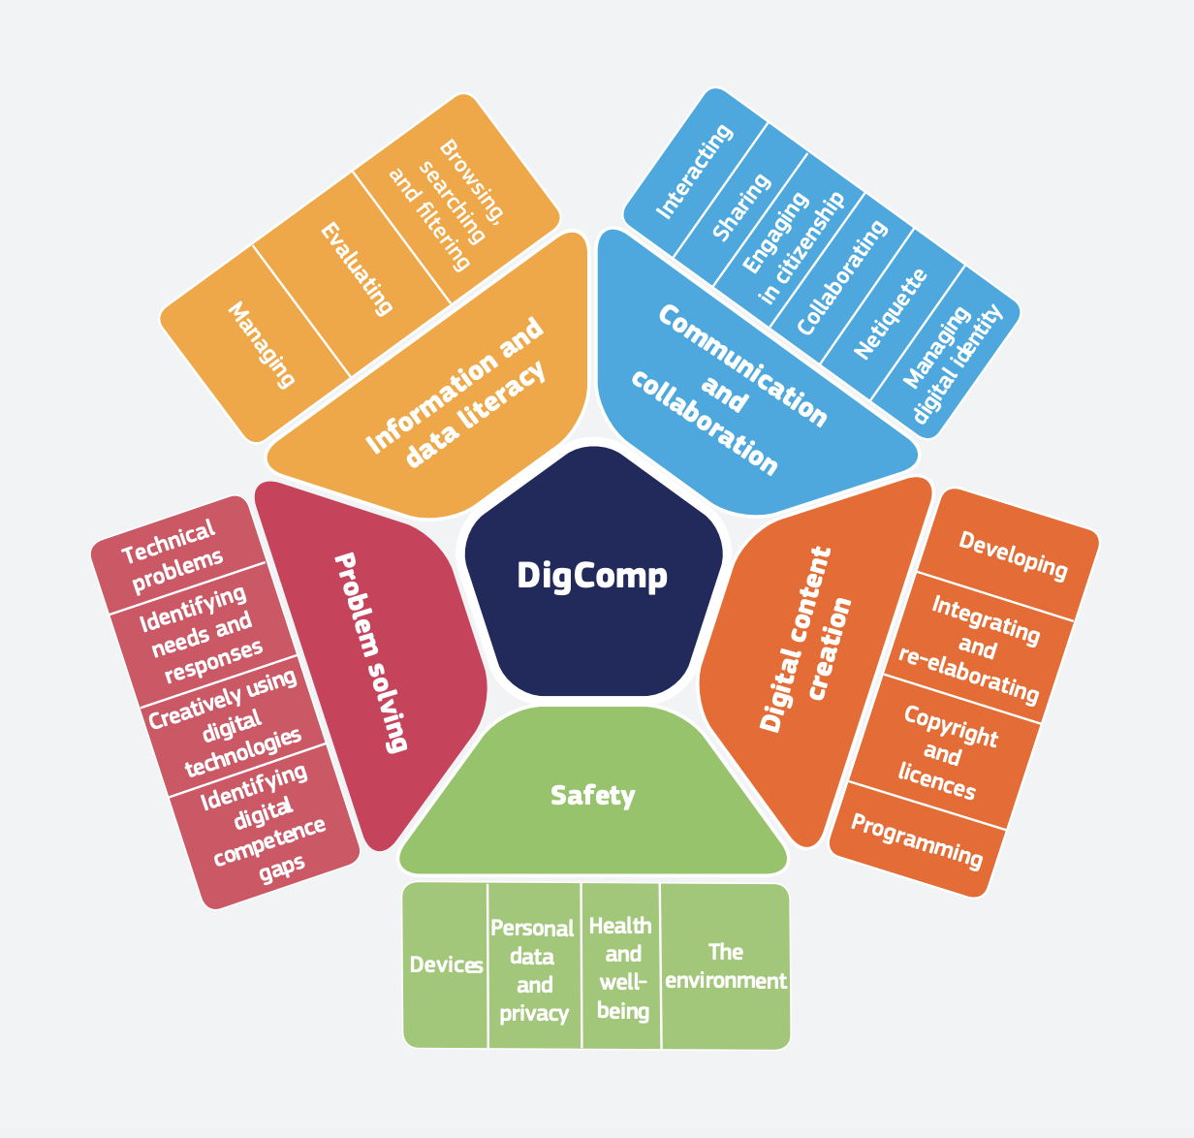
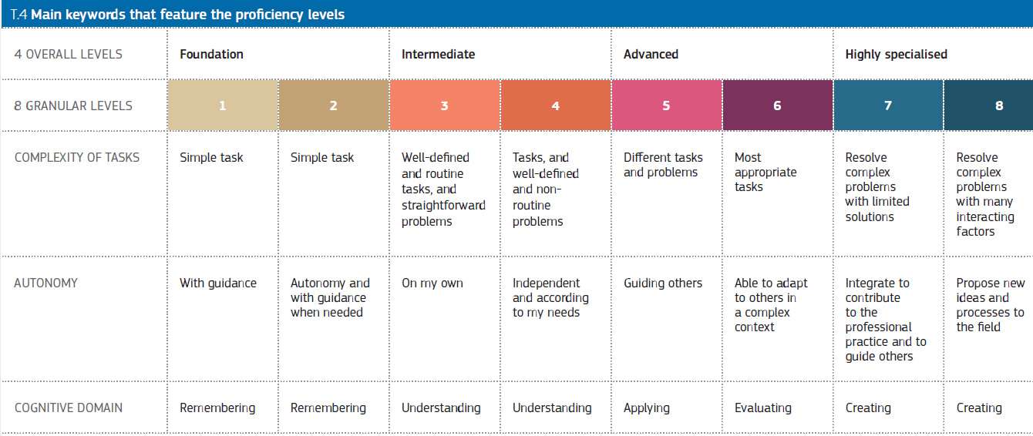
The DigComp Framework
Notes:
DigComp establishes 5 areas and 21 skills which correspond to 4 overall and 8 granular levels. The aim of this framework is to achieve a common European understanding of what digital competences are and it aims to provide guidelines for the development of policies related to digital skills. The latest update of this framework, DigComp 2.2, was published in March 2022 and includes up to 250 new examples of knowledge, qualifications and actions applicable to each skill.

Slide 9
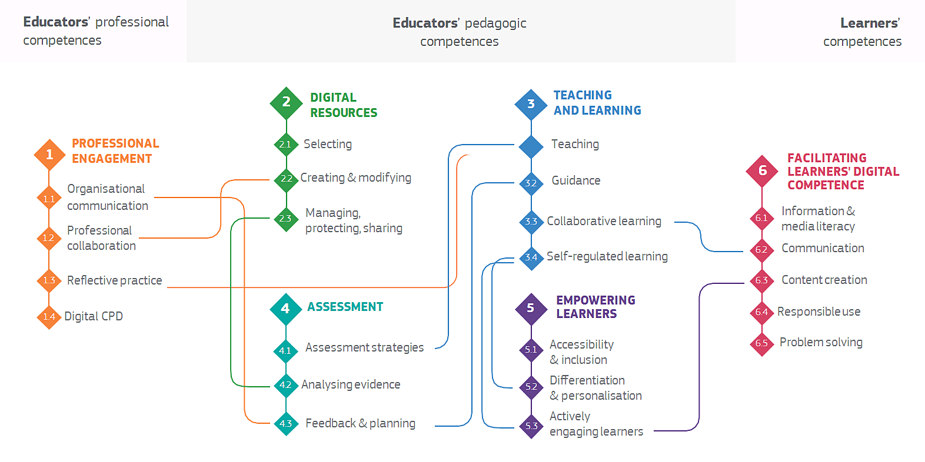
The DigCompEdu Framework
Notes:
DigCompEdu provides a general framework for the development of digital skills, and it is addressed to teachers at all levels of education. It features 22 competences organized into six domains and it expalins how digital technologies can be used to enhance the educational and training process thus making them more innovative.

Slide 10
Project result 1
E-learning programme: Apprenticeships in the digital era
The project produced an e- learning course for company trainers, based on the DigiCompEdu Framework.
Furthermore, the project developed a methodology for the digitalization of apprenticeships and the enhancement of the digital skills of students, based on the DigComp Framework.
Module 1: Practical tools for the development of Digital skills
Module 2:Introduction to DigComp
Module 3: Facilitating learners’ digital competences
Module 4: Digital resources for teaching and training
Module 5: Methodology for the digitalization of apprenticeships
Module 6: Empowering Learners
Module 7: Professional’s engagement
The course is available on the following languages: English, French, Portuguese, Dutch and Macedonian.

Slide 11
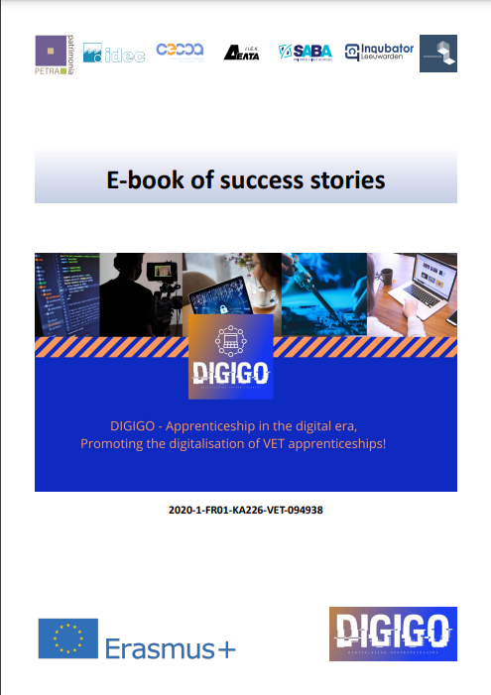
Project result 2
Apprenticeships in the digital era: Success stories
The partnership piloted the methodology with apprentices that they hosted, or they sent to other companies.
Through these digitalized apprenticeships, all the partners gathered a set of successful stories, accompanied with testimonials and videos by participants in apprenticeships, thus proving the importance of this type of apprenticeships to company trainers/mentors and VET students on developing skills that are useful for their transition to employment.
Notes:
The project served as an experiment of digitalized apprenticeships

Slide 12
The DigiGo methodology
Preparation
VET - company partnerships
Identify companies
Follow up with the involved parties
Follow up
Apprenticeship
Planning
Explain the digital tools that the apprentices will use
Identify bodies and partnerships
Secure Funding
Self assessment
Share values
Design curriculum
Identify the level of “digital readiness”
Decide specifications of the apprenticeship
Make sure you have the best tools
Look at the latest opportunities for tools
Follow up on the digital tools
Use digitalisation to follow up on the apprenticeship
Make clear who is responsible for the development of the students
Based on the DigComp Framework
Supports digitalisation of apprenticeships
Five steps methodology
Consisted of guidelines, instructions, practical examples and templates

Slide 13
Piloting the DigiGo methodology
15 apprentices in total
(at least 2 apprentices per partner)
Duration of the apprenticeship: 2 months – 2 years
Duration of the pilot: 2 months
Different fields of activity:
Beauty, massage and well-being technician
Programming and game development
Marketing
European studies
Business Administration
Scope:
Some apprenticeships focused on the competences in all areas of the DigComp, while some others focused on specific areas only.

Slide 14
DigiGo apprenticeships
Country | Apprentice – field of studies | VET provider | Host company | Duration
 | Beauty, Massage and Well- Being Technician | CECOA | Dermstetik | 5 months
Portugal | Beauty, Massage and Well- Being Technician | CECOA | BodyConcept | 2 months
 | Programming, Game Development | IEK ALFA | IDEC | 6 months
 | Software Development | S. E. I. M. | IDEC | 7 months
 | International Relations | University de Deusto | IDEC | 7 months
Greece | Public Administration | Universidad de Castilla-La Mancha | IDEC | 4 months
 | Marketing School | IEK DELTA | IEK DELTA (Marketing Department) | 7 months
 | Graphic Design Department | IEK DELTA | IEK DELTA (Marketing Department) | 9 months
France | European studies (Not stated) | Université de Cergy-Pontoise CFA Neos | CDE Petra Patrimonia Cooperative d’Initiatives Jeunes | 2 years 1 year

Slide 15
DigiGo apprenticeships
Country | Apprentice – field of studies | VET provider | Host company | Duration
Netherlands | (Not stated) (Not stated) | NHL Stenden University (Not stated) | Inqubator Leeuwarden Inqubator Leeuwarden | 2 months 2 months
North Macedonia | Business Administration Business Administration | Private high school SABA Private high school SABA | Touristic agency Kamelija Touristic agency Kamelija | 4 months 4 months
 | (Not stated) | University of Malta | Malta Business Bureau | Ongoing employment as full time
Malta | (Not stated) | University of Malta | Malta Business Bureau | 4 months
 | (Not stated) | University of Malta | Malta Business Bureau | Ongoing since February 2023

Slide 16
Evaluation of the DigiGo methodology
01 Commitment
The company implements the terms of commitment
02 Beginning of the training
A specific orientation programme is prepared for the learners' arrival in the company
03 Training
The company works with all parties involved in the learning process
The company helps the learner acquire the competences and knowledge required professionally and it takes time to train them
04 Commitments and end of the apprenticeship
Quality improvement process (trainers/mentors)
The company trainers/mentors followed the Quality improvement process which involved the Quality improvement Tool.
The tool consisted of indicators that evaluated the quality of the apprenticeship training thus offering tips for further improvement.
Evaluation of learning outcomes and experience (apprentices)
Ex-ante and post self-assessment questionnaire on competences.
Assessment on the background of the apprenticeship experience.

Slide 17
Results of the pilots
From the Quality improvement tool (trainers/mentors’ side)
The objectives set have been attained
The trainers were designated according to the methodology
The apprentices received information about the apprenticeship’s learning outcomes, and they were supported
The methodology was applied consistently

Slide 18
Results of the pilots
Indicative competences acquired (apprentices’ side)
Information and data literacy
Search and navigate data and information through digital environments
Communication and collaboration
Use a variety of digital tools for collaboration and communication
Digital content creation
Solve digital problems through a variety of digital means
Problem solving
Safety
Customize digital environments according to their personal needs
Select ways to protect themselves and others from dangers in digital environments
Adapt the communication strategies according to the cultural and generational diversity aspects of each audience
Protect the devices from malware content
Apply the rules of copyright and licenses of digital content
Evaluate the credibility and reliability of online sources and store them for retrieval
Differentiate technical problems when operating devices and using digital environments

Slide 19
Results of the pilots
Recommendations (trainers/apprentices’ side)
Set specific digital learning objectives for the digitalization of apprenticeships.
Encourage challenging projects and hands-on tasks.
Do not dissociate “digital” activities from the general activities of the host company
Create an environment that encourages supervisors, mentors, and colleagues to provide feedback on their performance
Connect the apprentices with experienced professionals through meetings, events, or mentorship programs.
Dedicate more time for digital apprenticeships
Foster a sense of autonomy
Try to link the learning objectives with the DigComp 2.2 reference system

Slide 20

Reflections
First of all, the VET institutions should upgrade both the devices and the approach for the digital upskilling and reskilling so that the apprentices will feel more confident and prepared to go to the companies.
The companies should develop a strategy that will enable both trainers and students to develop or improve the digital skills necessary for the labor market. These companies should motivate the interest of the students who will be supported by the trainers/mentors.
Throughout the apprenticeship, both trainers/mentors and the students should be given the opportunity to provide feedback on how the apprenticeship training was conducted in order to identify areas for improvement and the students are more aware of their level of digital skills.
Last but not least, it is important to close the gap between the VET institutions and the companies, meaning that these two entities should share a closer connection and they should collaborate effectively when conducting the apprenticeships. Furthermore, the apprenticeships’ goals and learning outcomes should be relevant not only to the apprentices’ field of expertise but also to the needs of the current digital era.

Slide 21


Learn more about the DigiGo project
Website
E-learning course
www.digi-go.eu
https://e-trainingcentre.gr/course/index.php?categoryid=61

Slide 22
Sources
Alberto A.P. Cattaneo; Chiara Antonietti; Martina Rauseo (2022). How digitalised are vocational teachers? Assessing digital competence in vocational education and looking at its underlying factors. Computers & Education (Volume 176).
https://doi.org/10.1016/j.compedu.2021.104358
Cedefop (2022). Built to last: Apprenticeship vision, purpose, and resilience in times of crisis. Short papers from the Cedefop community of apprenticeship experts. Working paper series (No. 12) https://www.cedefop.europa.eu/files/6212_en.pdf
Directorate-General for Employment, Social Affairs, and Inclusion (2017). Business cooperating with vocational education and training providers for quality skills and attractive futures. Publications Office of the European Union (Luxembourg). European Commission. https://ec.europa.eu/social/main.jsp?catId=738&langId=en&pubId=8053&furtherPubs=yes
European Education Area - Quality education and training for all. Digital Education Action Plan (2021-2027). European Commission, Directorate-General for Education, Youth, Sport and Culture https://education.ec.europa.eu/focus-topics/digital-education/action-plan
EU Science Hub – Joint Research Centre. DigComp Framework. European Commission https://joint-research-centre.ec.europa.eu/digcomp/digcomp-framework_en
EU Science Hub – Joint Research Centre. Digital Competence Framework for Educators (DigCompEdu). European Commission
https://joint-research-centre.ec.europa.eu/digcompedu_en

Slide 23
Sources
Flake R; Meinhard B. D; Werner D (2019). Digitalisation in Dual Vocational Training: Progress to Date and Companies’ Ongoing Need for Modernisation and Support. IW-Trends (2)
https://www.iwkoeln.de/en/studies/dirk-werner-regina-flake-david-b-meinhard-progress-to-date-and-companies-ongoing-need-for-modernisation-and-support-424075.html
International Labour Organization (2022). The digital transformation of apprenticeships: Emerging opportunities and barriers. The Future of Work and Lifelong Learning https://www.ilo.org/wcmsp5/groups/public/---ed_emp/---ifp_skills/documents/publication/wcms_861712.pdf
JRC Publications Repository (2022). DigComp 2.2: The Digital Competence Framework for Citizens - With new examples of knowledge, skills and attitudes. European Commission https://publications.jrc.ec.europa.eu/repository/handle/JRC128415
McKinsey & Company (2022). What are Industry 4.0, the Fourth Industrial Revolution, and 4IR? USA. Featured Insights.
https://www.mckinsey.com/featured-insights/mckinsey-explainers/what-are-industry-4-0-the-fourth-industrial-revolution-and-4ir
UNLV Continuing Education (2022). What Are Digital Skills? https://digitalskills.unlv.edu/digital-marketing/what-are-digital-skills/

Slide 24
Thank you!
www.idec.gr
info@idec.gr
k.maniadaki@idec.gr
+30 2104286227
Iroon Polytechneiou Avenue, 96
18546, Piraeus - Greece
Katerina Maniadaki
EU Project Manager, IDEC S.A.
IDEC S.A.
@idec_gr

