Slide 1

Resource Management: Getting ready
Shared Library Services Platform Project
Maggie McGee

Slide 2
Resource Management
Resource Management contains the following workflows:
  Metadata Management
    Bibliographic records, authority records, normalization rules, merge rules, and holdings records
  Inventory
    Adding, updating, and deleting
  Record import
    From OCLC to the NZ
    From OCLC to the IZ for exceptions
  Publishing profiles
    Managing bibliographic and serials holdings in OCLC

Slide 3
Resource Management Roles
Cataloging Roles
  Catalog Manager
    Manages the institution's catalog records, including cataloging activities for bibliographic and holdings records, adding and monitoring import/export processes, and creating and managing sets.
  Cataloger
    Performs cataloging activities for bibliographic, holdings, and authority records, and creates, delete item records, and manages sets. Can manage normalization rules.
  Cataloger Extended
    Deletes records managed as a cataloger
    Must be combined with Cataloger

Slide 4
Resource Management Roles
Inventory Roles
  Physical inventory operator
    Adds inventory records to the repository for the library and/or institution’s print materials, and creates and manages sets.
  Physical Inventory Operator Extended
    Can delete physical inventory. When deleting the last item associated with a bibliographic record, can also delete that bibliographic record.
    Must be combined with Physical Inventory Operator.

Slide 5
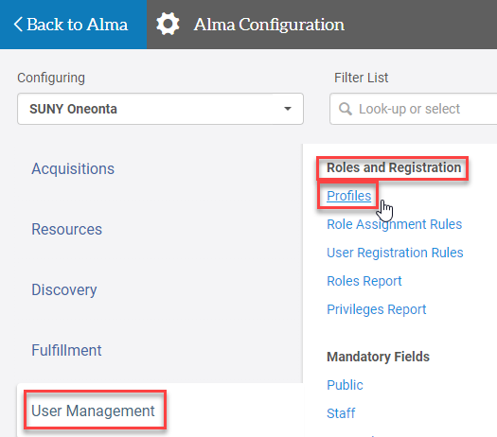
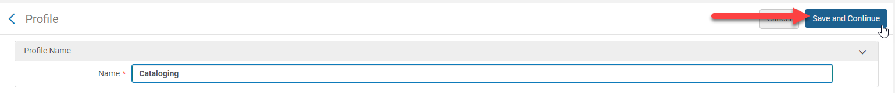
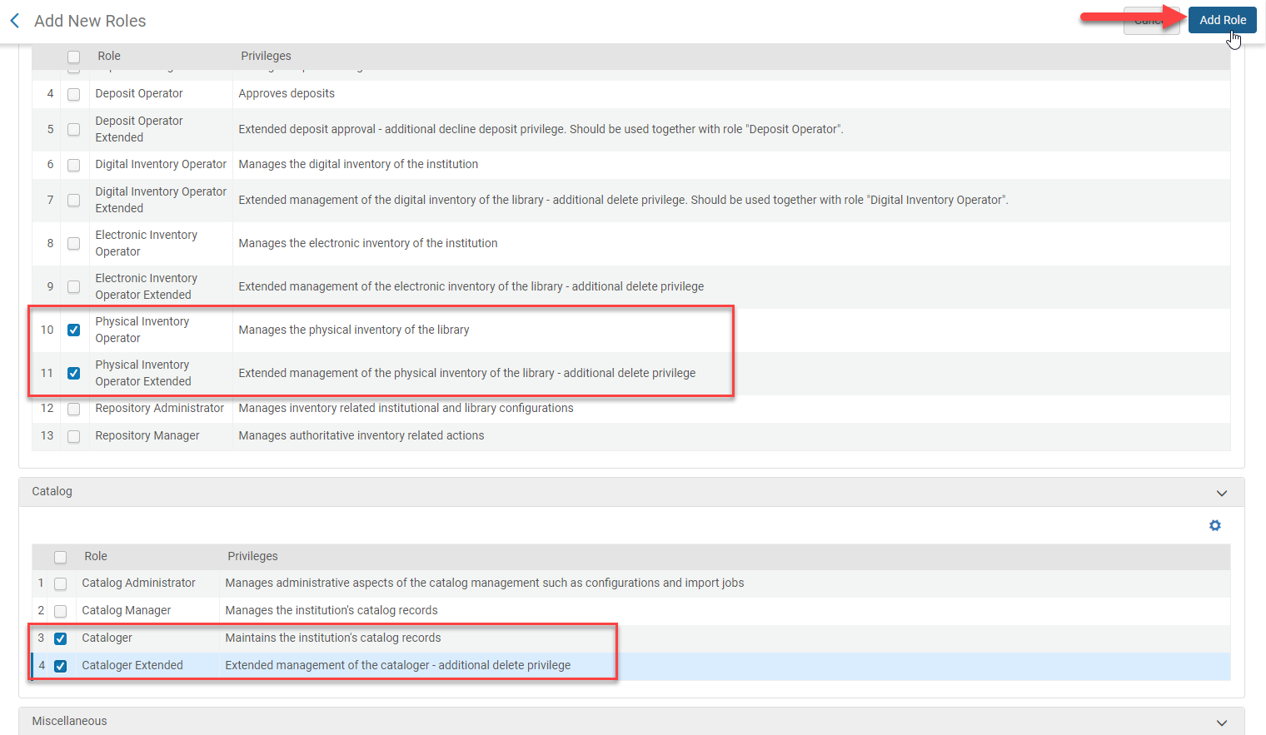
Create a Profile for Cataloging
Go to Configuration>User Management>Roles and Registration>Profiles
Click Add Profile
  Name: [type in a name]
  Click Save and Continue
  Click Add Role
  Check the following roles:
    Cataloger
    Cataloger Extended
    Physical Inventory Operator
    Physical Inventory Operator Extended
  Click Add Role

Slide 6
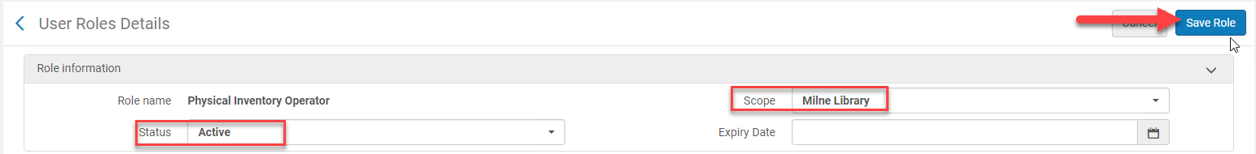
Create a Profile for Cataloging
Scope the following roles to the
  Physical Inventory Operator
  Physical Inventory Operator Extended
Click Edit from the ellipses
Scope: [change it to the circulation desk library]
Status: [change to active]
Click Save Role
Click Save

Slide 7
Metadata Standards and Policies
SLC Policies and Best Practices: Metadata Standards and Policies
  https://slcny.libguides.com/c.php?g=802476&p=5814451
Key Policies affecting Cataloging in Alma
  MSP-1 Bibliographic Utility
  MSP-2 Cataloging a the WorldCat Level
  MSP-3 Alma Network Zone (NZ)
  MSP-4 Floor Bibliographic Standards
  MSP-12 Language of Cataloging
  MSP-14 In-Process Brief Bibliographic Records
  MSP-25 Overlaying Brief Bibs in the Network Zone
  MSP-27 Deleting Bare Network Zone Records from an IZ
  MSP-28 Working in Alma and the Network Zone
  Bibliographic Record Network Zone and Local Fields Policies

Slide 8
Working in Alma and the Network Zone
The Network Zone (NZ) in Alma is SUNY’s shared bibliographic environment
  Allows for developing collections and a shared catalog
All non-electronic bibliographic records should ALWAYS be searched in the NZ first
  If no records exists in the NZ the record should be exported from OCLC into the NZ
    For both copy or original cataloging
  Brief records can be created when no OCLC record exists for ordering purposes
DO NOT change the OCLC number in NZ records
  Relink to the appropriate record instead
Editing bibliographic records should be done in OCLC Connexion and then exported into the NZ
  A job will run nightly to update changes to bib records in OCLC
Original cataloging should be done in OCLC Connexion and then exported into the NZ
ONLY Local fields can be added to the Institutional Zone (IZ) bibliographic record

Slide 9
Cataloging in the Institutional Zone (IZ) Exceptions
The following are examples of records that should not reside in the NZ:
  Personal-copy course reserves
  Titles borrowed on ILL from outside the SUNY Libraries Consortium
  Inventory control of equipment
  Host bibliographic records for bound-withs
  Vendor record sets that the library is not allowed to share
  Brief bib records to track inventory locally
  Electronic Government documents*

Slide 10
Cataloging Differences in Aleph vs. Alma
ALPEH
ALMA
Local fields added in OCLC or Aleph
Call number and other bibliographic changes can be made in OCLC without replacing the record in OCLC
Ability to overlay OCLC numbers
Relinking records from the bib record
OCLC holdings codes map location in holdings records
Item Processing status is done in the item record
Deleting Bib record (item, adm, holding & bib record)
Manually add or remove holdings in OCLC
Local fields are the ONLY fields edited in the IZ using the Metadata Editor
Uses different local MARC fields
Bibliographic changes/enhancements are made in OCLC by locking and replacing the record and then importing the bib record into the NZ
DO NOT overlay OCLC numbers in the NZ, instead relink to the correct bib record
Call numbers need to be modified in the holdings record if the local call number differs from the OCLC record
Change the first indicator in MARC Holdings field 852 to have the correct call number populate
Relinking records from the POL
Holding records location is established upon order or receiving
Publishing Profiles adds and removed holdings in OCLC
Item status is changed from the row actions menu

Slide 11
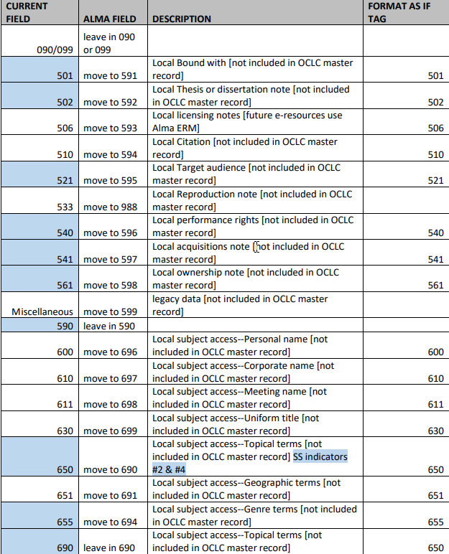
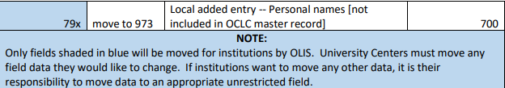
Local Fields in Alma

Slide 12
OCLC Integration with Alma NZ
In Connexion: Tools > Options > Export > Click Create
  Select OCLC Gateway Export
  Click OK
  Host Name: suny-network.alma.exlibrisgroup.com
  Port: 5500
  Timeout: 90 Retries: 3 Delay:0
  Remember to click Send Local System Logon Id and Password before inputting:
  Logon ID: 01SUNY_NETWORK
  Password: 4almatesting [password may change after go-live, check with LSP support team]
  Click OK,
    Name your Gateway Export something like "Alma NZ" to differentiate it
  Click on the Record Characteristics button
    Record Standard MARC21
    Character Set UTF-8 Unicode
    Click Ok
  Click on the gateway export you just created
  Click Apply

Slide 13
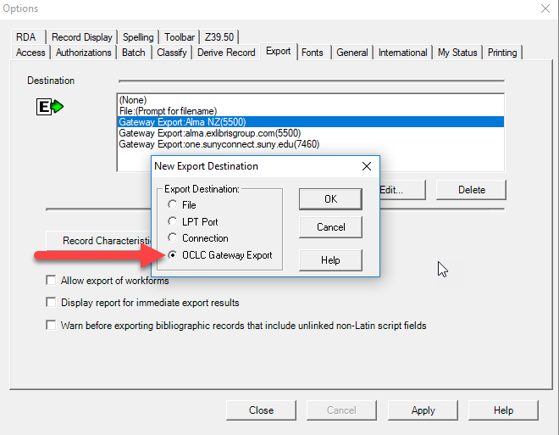
OCLC Integration for the Alma NZ

Slide 14
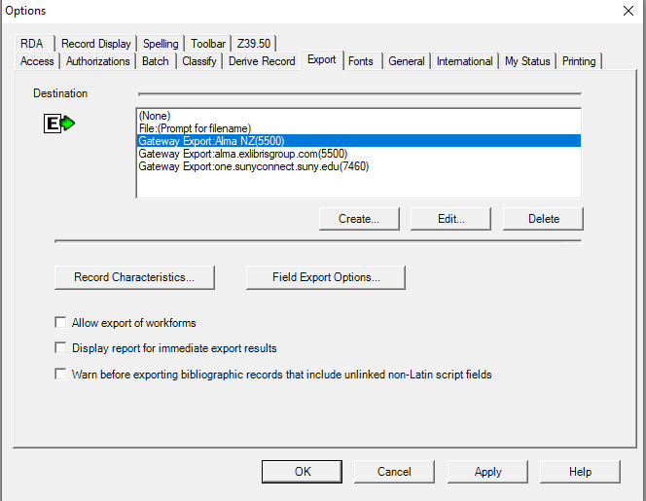
OCLC Integration for the Alma NZ

Slide 15
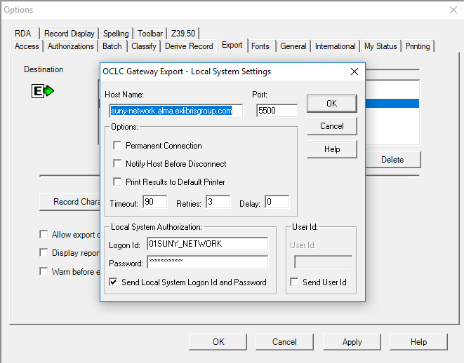
OCLC Integration for the Alma NZ

Slide 16
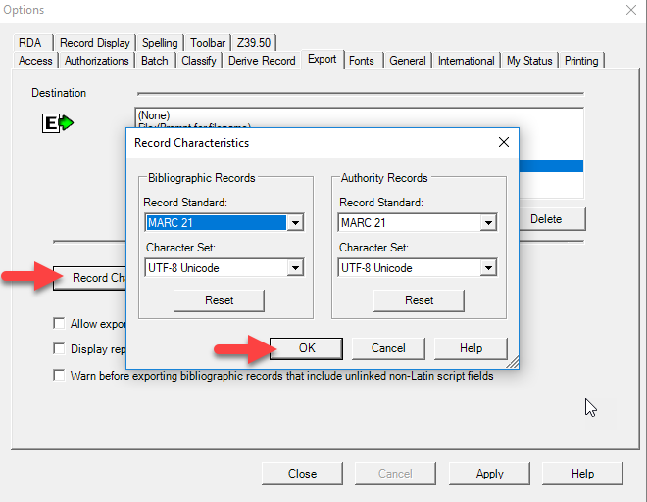
OCLC Integration for the Alma NZ

Slide 17
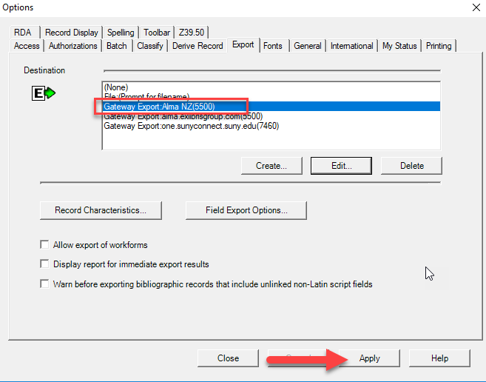
OCLC Integration for the Alma NZ

Slide 18
OCLC Integration with Alma IZ
In Connexion: Tools > Options > Export > Click Create
  Select OCLC Gateway Export
  Click OK
  Host Name: suny-one.alma.exlibrisgroup.com [replace you campus three digit identifier with one]
  Port: 5500
  Timeout: 90 Retries: 3 Delay:0
  Remember to click Send Local System Logon Id and Password before inputting:
  Logon ID: [use your OCLC ID]
  Password: [use your OCLC password]
  Click OK
    Name your Gateway Export something like "Alma Institutional Zone (IZ)" to differentiate it the NZ import profile
  Click on the Record Characteristics button
    Record Standard MARC21
    Character Set UTF-8 Unicode
    Click Ok
  Click on the gateway export you just created
  Click Apply

Slide 19
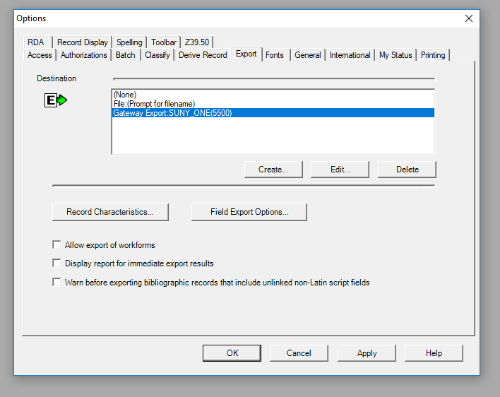
OCLC Integration for the Alma IZ

Slide 20
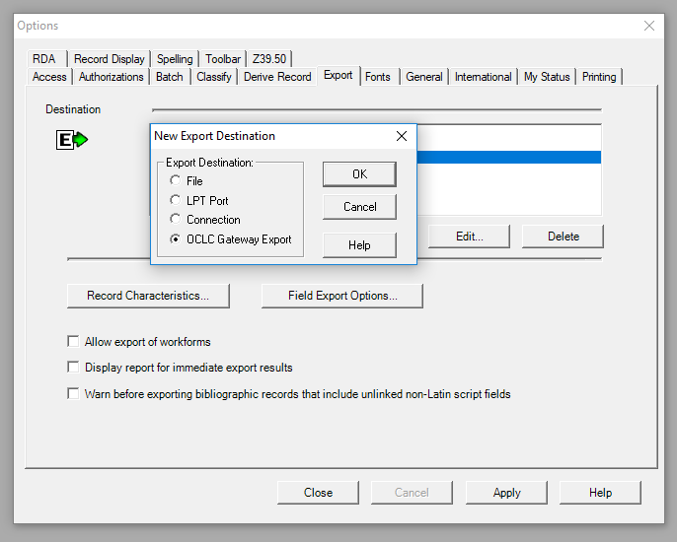
OCLC Integration for the Alma IZ

Slide 21
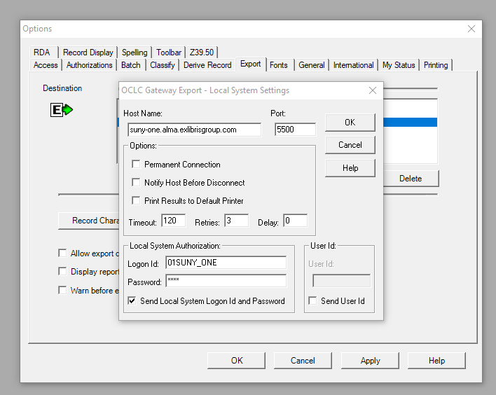
OCLC Integration for the Alma IZ

Slide 22
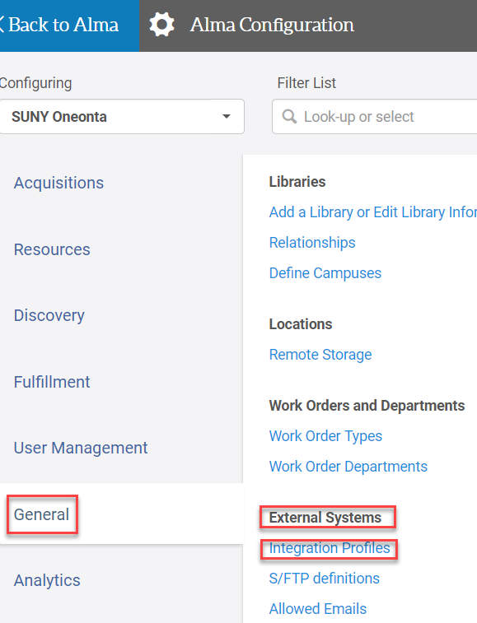
Create an Import Profile for the IZ OCLC Integration
Go to Configuration>General>External Systems>Integration Profiles
Click Add Integration Profile
The Integration Profile screen page 1
  Uncheck the Use network zone box
  Code: [assign a code]
  Name: [name the profile]
  Integration Type: OCLC Connexion
  Click Next

Slide 23
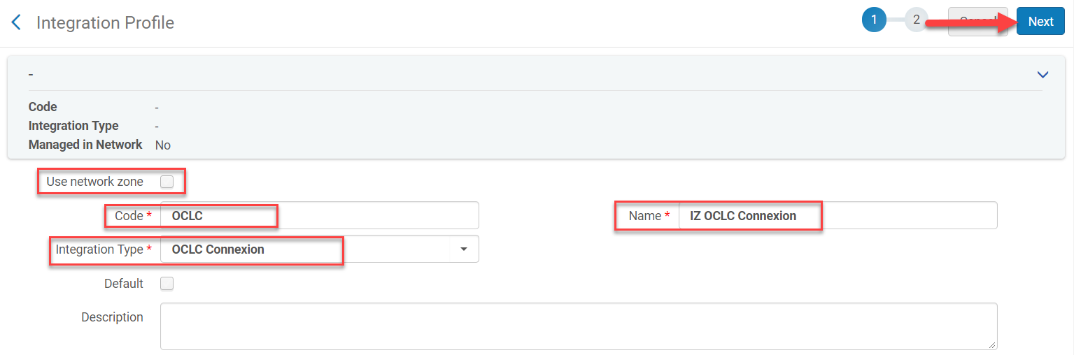
Create an Import Profile for the IZ OCLC Integration

Slide 24
Create an Import Profile for the IZ OCLC Integration
The Integration Profile screen page 2
  Target format: [keep default]
  Check the data using: [keep the default]
  Serial match method: Unique OCLC Identifier Match Method
  Non Serial match method: Unique OCLC Identifier Match Method
  Merge Method: Overlay all fields but local
  Synchronize with External Catalog: [if using publishing profiles choose Publish Bibliographic records]
  Password: [OCLC password]
  Click Save

Slide 25
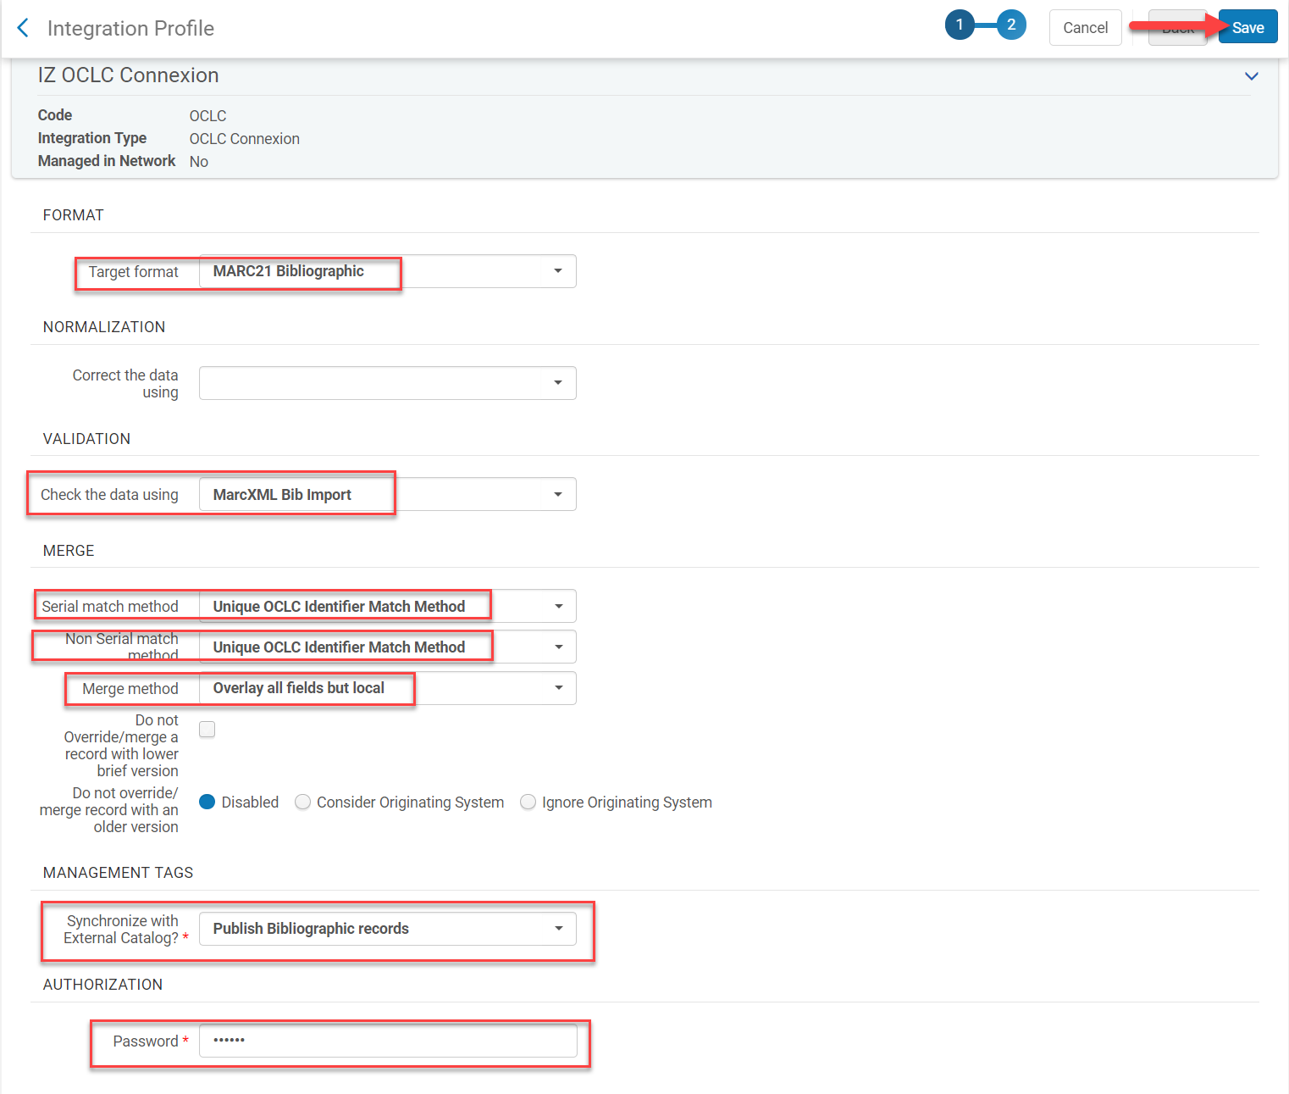
Create an Import Profile for the IZ OCLC Integration

Slide 26
Call Number Mapping
Call number mapping allows for the mapping of call numbers from bibliographic records to holding records
The call number mapping table is used in Alma when:
  New holdings records are saved in the Metadata Editor
    New holdings records only
  Using the Update from Bibliographic tool in the Metadata Editor
    Tools>MARC21 Holdings
      New and updated holdings
  Running an Import Profile job
  Running the Change Holding Information job

Slide 27
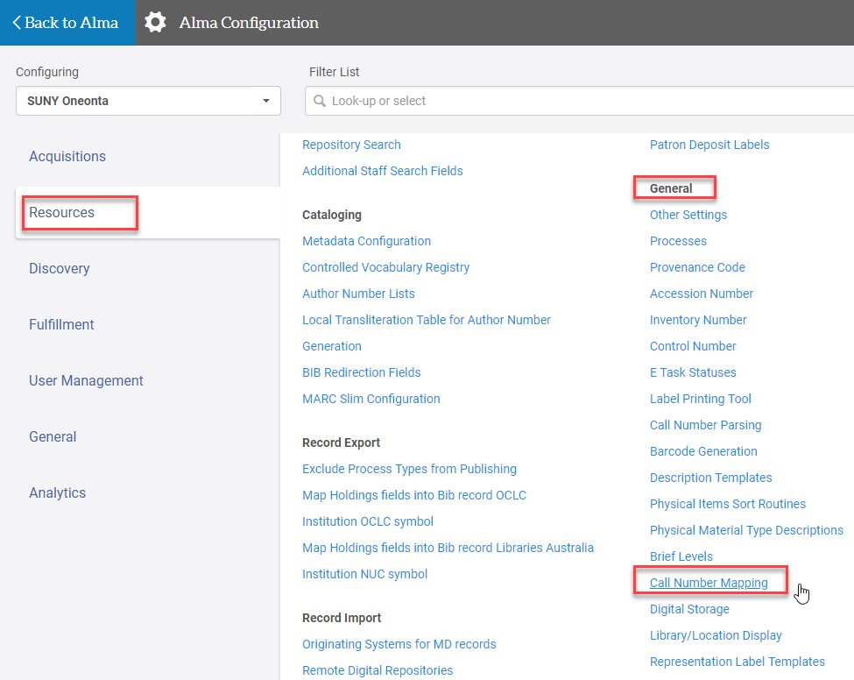
Call Number Mapping
Go to Configuration>Resources>General>Call Number Mapping

Slide 28
Configuring Call Number Mapping
ExLibris has predefined call number mapping, but they can be configured as well
Uses a hierarchy, so order is important
  It will stop at the first call number mapping rule that meets all the criteria
852 1st Indicator reflects the classification system
  0 = Library of Congress
  1 = Dewey Decimal
  2 = National Library of Medicine
  3 = Superintendent of Documents
  7 = Source specified
  8 = Other Schema

Slide 29
Configuring Call Number Mapping
852 subfield 2 is empty unless it is source specified classification
  The source specified in 852 1st indicator must match
Bib Field to Copy specifies field from which to map the call number
  5 digits in length
  ? marks are used as wildcards
Bib Subfields to Copy specifies which subfields are to be copied to the holdings record
852 Subfield Destitutions are the subfields the call number will be mapped to in the holding record

Slide 30
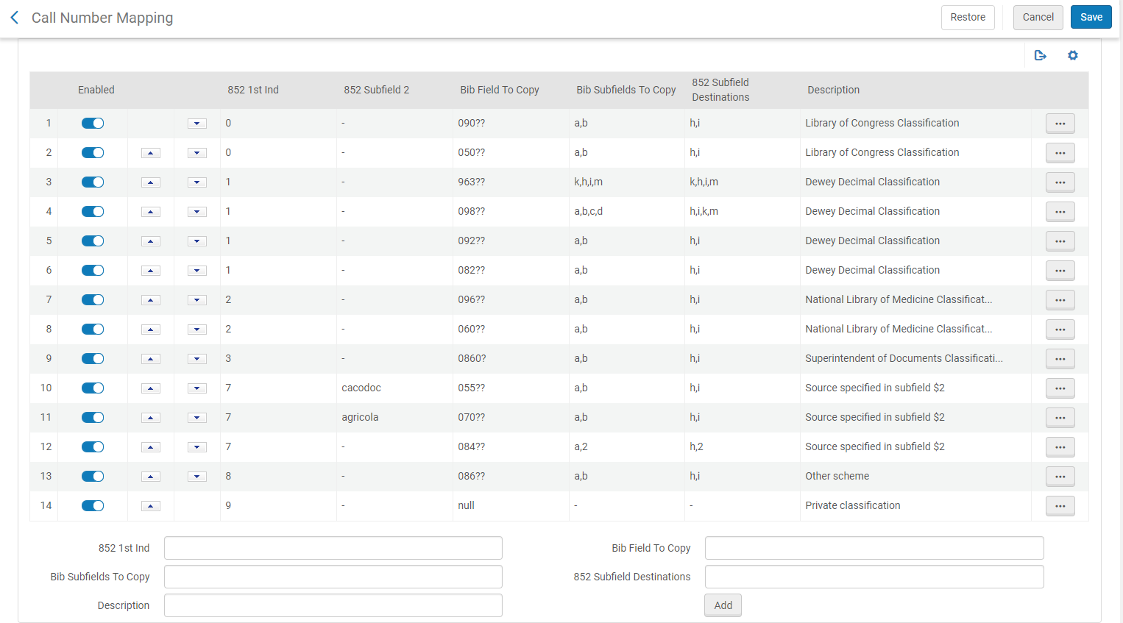
Configuring Call Number Mapping

Slide 31
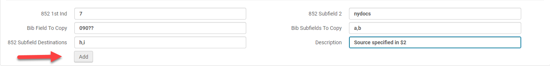
Adding A New Call Number Mapping
Go to Configuration>Resources>General>Call Number Mapping
Use the all number mapping examples above to input information into the form at the bottom of the screen
Click Add
Click Save
If you make an error click Restore to undo the changes made to the call number mapping

Slide 32
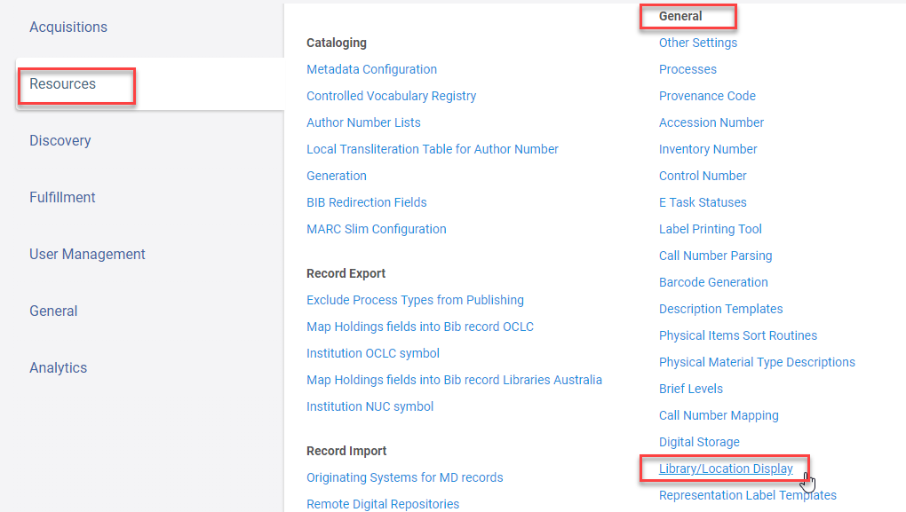
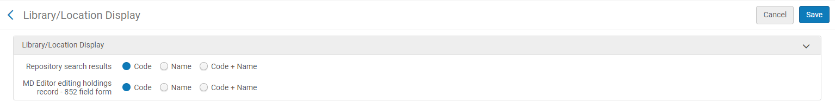
Library/Location Display in a Repository Search
To configure go to Configuration>Resources>General>Library/Location Display
Select:
  Code – displays the code only
  Name – displays the name only
  Code + Name – displays the code and name

Slide 33
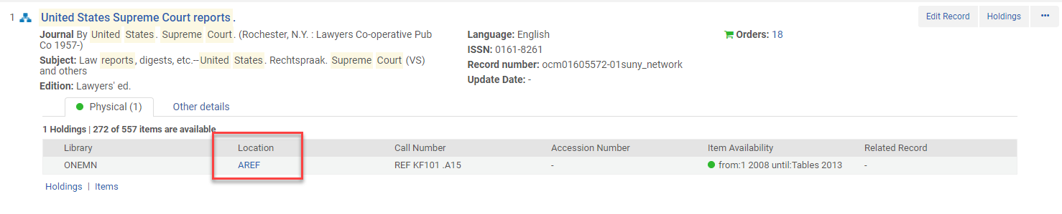
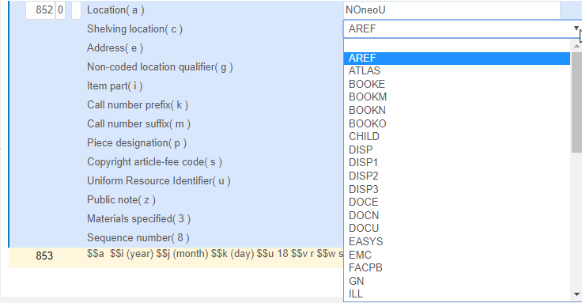
Library/Location Display in a Repository Search and Holdings Record
Code

Slide 34
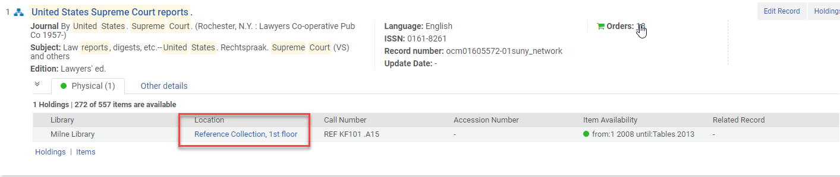
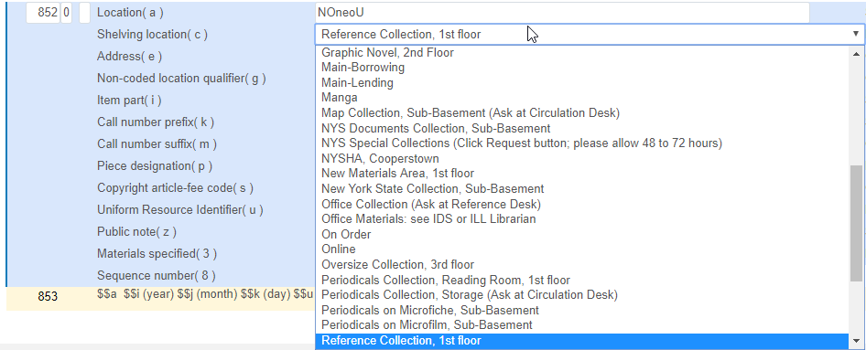
Library/Location Display in a Repository Search & Holdings Record
Name

Slide 35
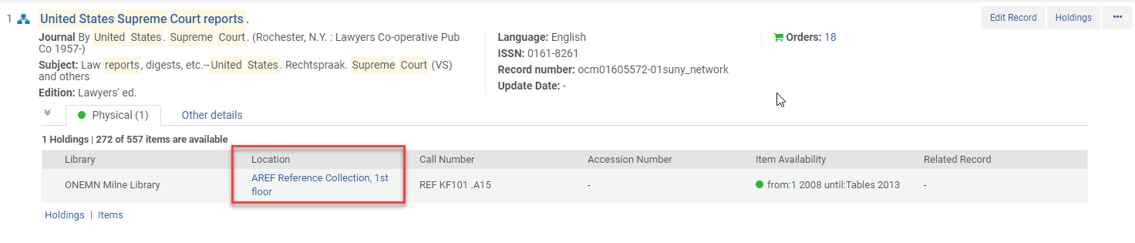
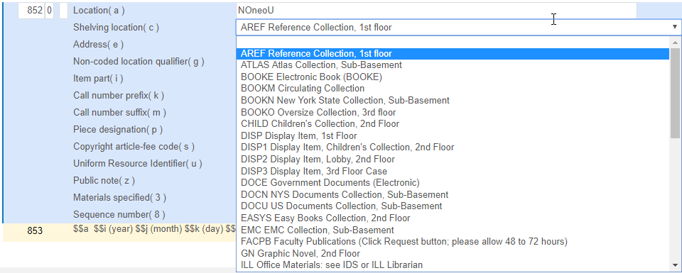
Library/Location Display in a Repository Search & Holdings Record
Code + Name

Slide 36
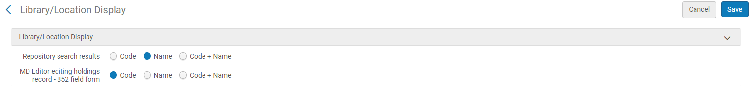
Library/Location Display in a Repository Search & Holdings Record
Name (repository search) and Code (holdings record)

