Slide 1



Bridging the Clinical & Community Divide:
The Rhode to Equity Journey
Prepared by Care Transformation Collaborative of RI

Slide 2

Agenda
Introduction to Rhode to Equity
Planning, Strategies, and Tools
Team Growth Over Time
Team Specific Accomplishments
Panel Session
Public Questions and Comments

Slide 3

Intro to Rhode to Equity
5/12/2022
Prepared by Care Transformation Collaborative of RI
‹#›
3

Slide 4
How did Rhode to Equity begin?
In 2020 and the first six months of 2021, the RI Department of Health (RIDOH) supported a project called the Diabetes Health Equity Challenge.
The project was a learning collaborative to build clinical-community linkages and support people living with diabetes who might be especially vulnerable to equity gaps in the context of COVID-19. Under the program, geographically-based teams applied to collaboratively work to improve outcomes for people with diabetes who were at risk of poor outcomes during the pandemic.
Funded by The RI Executive Office of Health and Human Services (EOHHS) Health System Transformation Project (HSTP), EOHHS and RIDOH partnered to expand and enhance this program as the Rhode to Equity project, which launched in July 2021

Slide 5
Why did EOHHS make an investment into this project?
In 2020, EOHHS conducted interviews with AEs regarding potential investments in other centralized activities, and learned that a more systematic, coordinated approach to addressing social determinants of health would be valuable, and that in particular it was important to develop more robust collaborations between AEs and community-based organizations (CBOs) to serve AE members with health-related social needs.
Because of this, EOHHS invested $3.5M of the Health System Transformation Project funds into four Social Determinants of Health projects, otherwise known as the SDOH Investment Strategies, to:
  Help address health related social needs
  Enable clinic & community linkages and improve the coordination between AEs and CBOs
  Support AEs in impacting upstream social determinants of health and racial inequities to improve population health

Slide 6
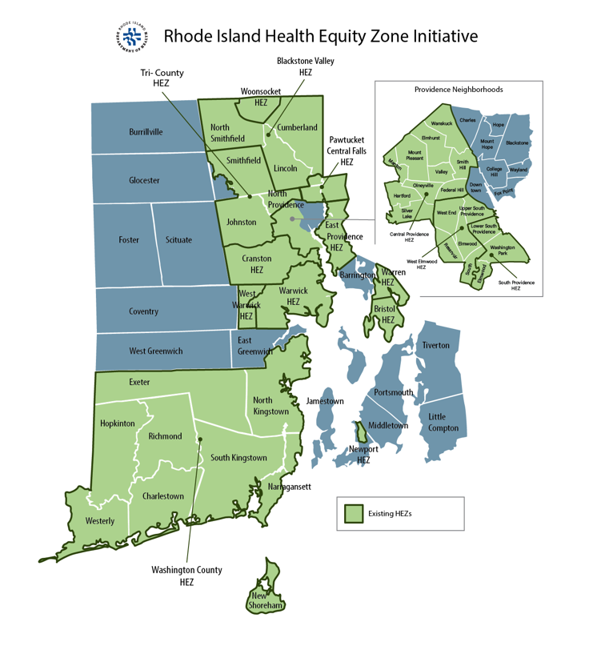
Accountable Entity
An Accountable Entity (AE) is Medicaid’s version of an Accountable Care Organization (ACO), in which integrated providers and healthcare networks that are grounded in primary care, are accountable for their attributed Medicaid patient population’s total cost of care, quality of care, and health outcomes

Slide 7
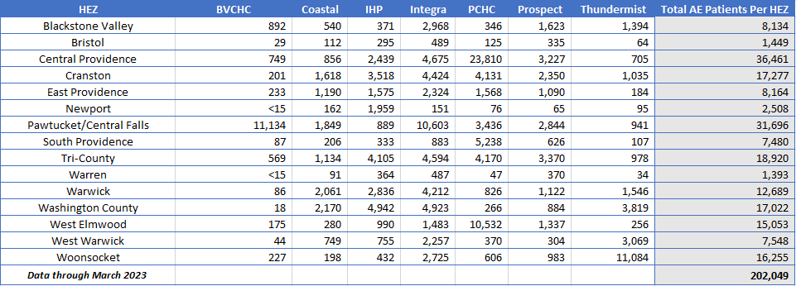
Our Patients = Our Community

Slide 8
What was the project framework?
Rhode to Equity was a learning & action collaborative that supported place-based, cross-sector teams to test and evaluate place-based population focus and strategies
Timeframe:
July 2021 – June 2023
24-month
Learning & Action Collaborative
Forming local and state-wide learning communities and sessions
Applying evidence-based population tools for data gathering and work planning
Building leadership and operational capacity
Technical assistance from national health equity content experts

Slide 9

Who was Involved?
Components of the 6 Place-Based Teams:
Health Equity Zone
Person with lived experience of inequities (PLE)
Accountable Entity (AE)
Clinic/primary care leaders
Community Health Team Community Heath Workers (added via CDC grant) – through August 2024
Team Support:
Health Equity Content Experts:
  WE in the World who helped develop the Pathways to Population Health tools in the context of 100 Million Healthier Lives
Rhode to Equity Facilitators:
  Care Transformation Collaborative of Rhode Island/Rhode Island Department of Health
  Person with Lived Experience Coaches
Prepared by Care Transformation Collaborative of RI

Slide 10
What were the project strategic goals & objectives?
To enhance place-based teams with local partners and community residents to improve population health with an equity lens
Apply evidence-based Pathways to Population Health tools to more effectively build community-clinical linkages that reduce health disparities (physical and behavioral) and their social drivers.
Use clinical and community data to identify population health needs, test strategic actions, and build sustainable community solutions

Slide 11
Planning, Strategies, and Tools
5/12/2022
Prepared by Care Transformation Collaborative of RI
‹#›
11

Slide 12






Y1 – Planning, Data Collection and Infrastructure
Focus on geographic area jointly served by HEZ and other team members
Quarterly momentum meetings to learn from cohort teams and report out on progress
Commit to learning about needs and solutions from people with lived experience
Monthly cohort coaching sessions
Use the Pathways to Population Health tools to design action plan with community and clinical components
Team meetings: monthly
Commit to meeting Milestone expectations as organized on the Journey Map
Prepared by Care Transformation Collaborative of RI

Slide 13







Y2 – Moving from Planning to Action
Implementation of Y2 Action plans with Quarterly Reporting
In-person Biannual Conferences
Leverage technical assistance from subject matter experts to further work
Dyad Meetings
Sustainability Planning
Team meetings: monthly
CHW Mobilization
Prepared by Care Transformation Collaborative of RI

Slide 14


Pathways to Population Health
Tools developed by 100+ health care and public health organizations and adopted by 250+
Useful in aligning assets to advance population and community health with an equity lens
Prepared by Care Transformation Collaborative of RI

Slide 15
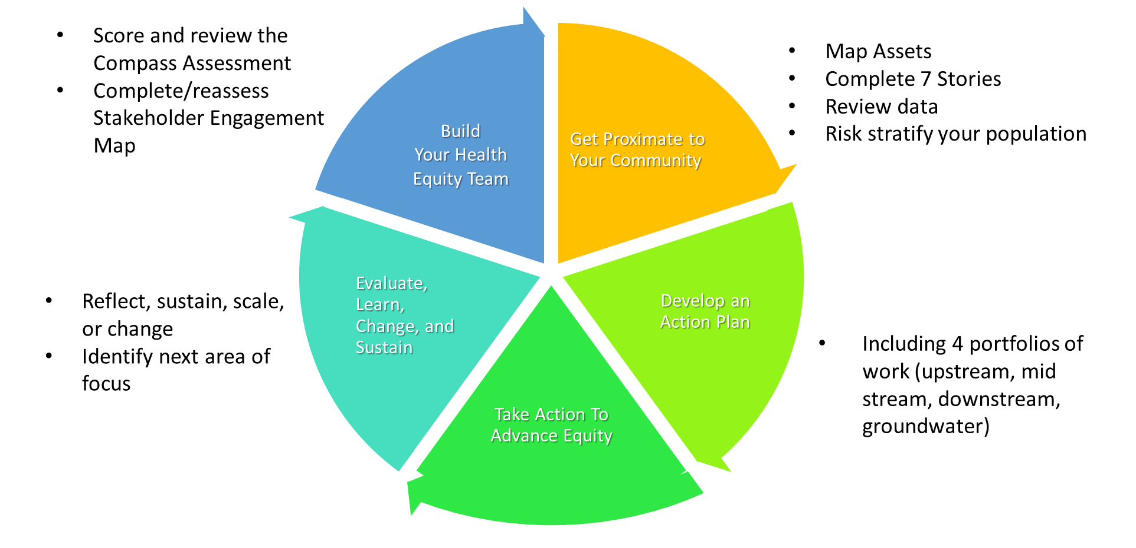

Slide 16
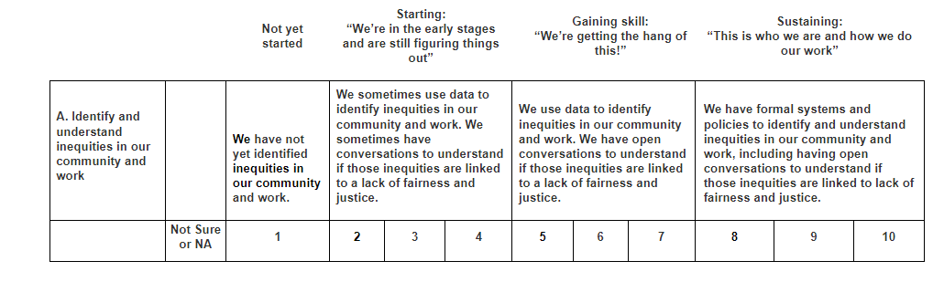
Understanding our Equity Baseline
https://www.publichealthequity.org/assess
Prepared by Care Transformation Collaborative of RI

Slide 17
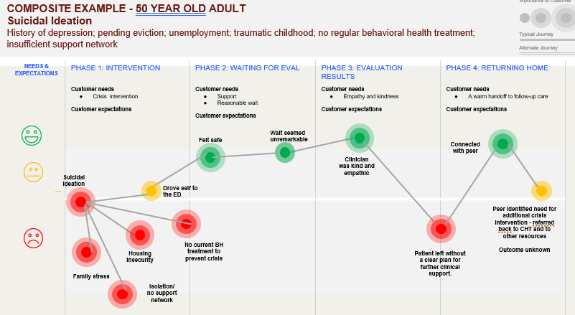
“There is a correlation and trend that shows individuals who visit their PCP frequently also visit the ED frequently as well. Now that we have identified this important data piece, the 7 stories will help our team fill in the “why” to inform solutions and strategies to address this”
“The 7 stories exercise confirmed the food affordability is significant for PCF residents. It was mentioned by every participant.; The circumstances of each story also contained layers of inequality, systemic barriers, feelings of isolation, and reminders that addressing food insecurity is personal and highly dependent on individual circumstances.”

Slide 18
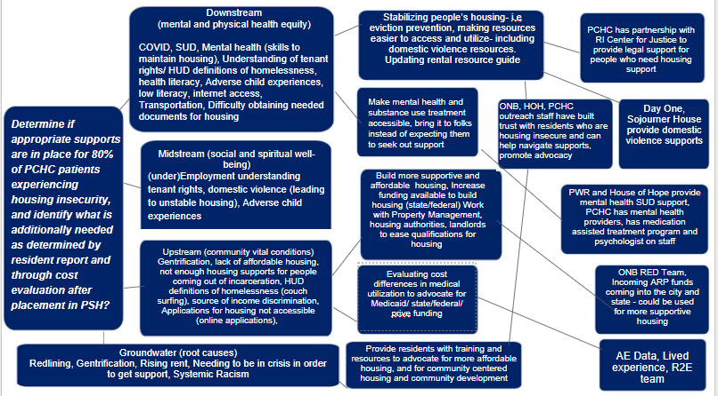
“The driver diagram has helped us see the drivers of homelessness from the individual, all the way to the systemic level.”
“As we worked to complete the Driver Diagram last month [it] rapidly became apparent that CHWs will be a key element in our initiative.”

Slide 19
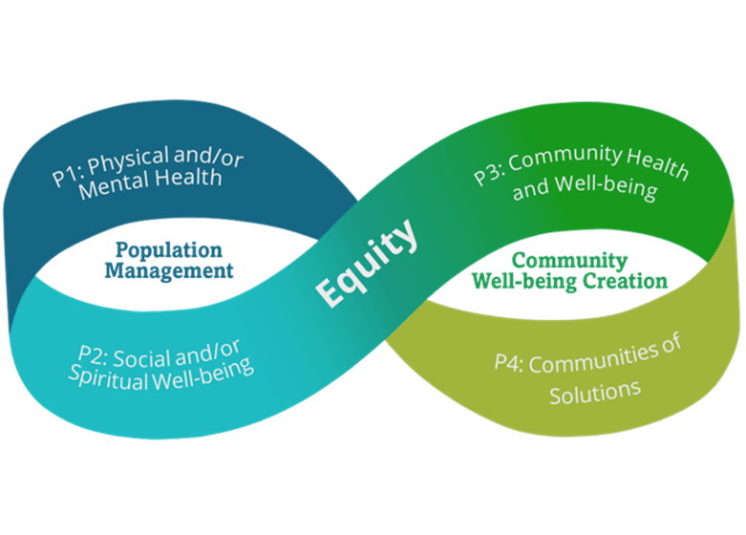
Portfolio 1
Hire and train Community Health Advocates to work with high-risk patients (those who have been hospitalized for Asthma)
Portfolio 3
Host community education efforts with American Lung Association and residents to inform them of air quality issues and to encourage advocacy. Support efforts to conduct air quality monitoring in and around the HEZ.
Portfolio 2
Reduce the risk of asthma clients going to the hospital by running HARP/Breath Easy at Home health housing interventions with rising risk population
Portfolio 4
Collaborate with Central Providence HEZ to train CHAs and community advocates on land use, zoning and the upcoming comprehensive planning process in the City of Providence

Slide 20
Team Growth Over Time
5/12/2022
Prepared by Care Transformation Collaborative of RI
‹#›
20

Slide 21
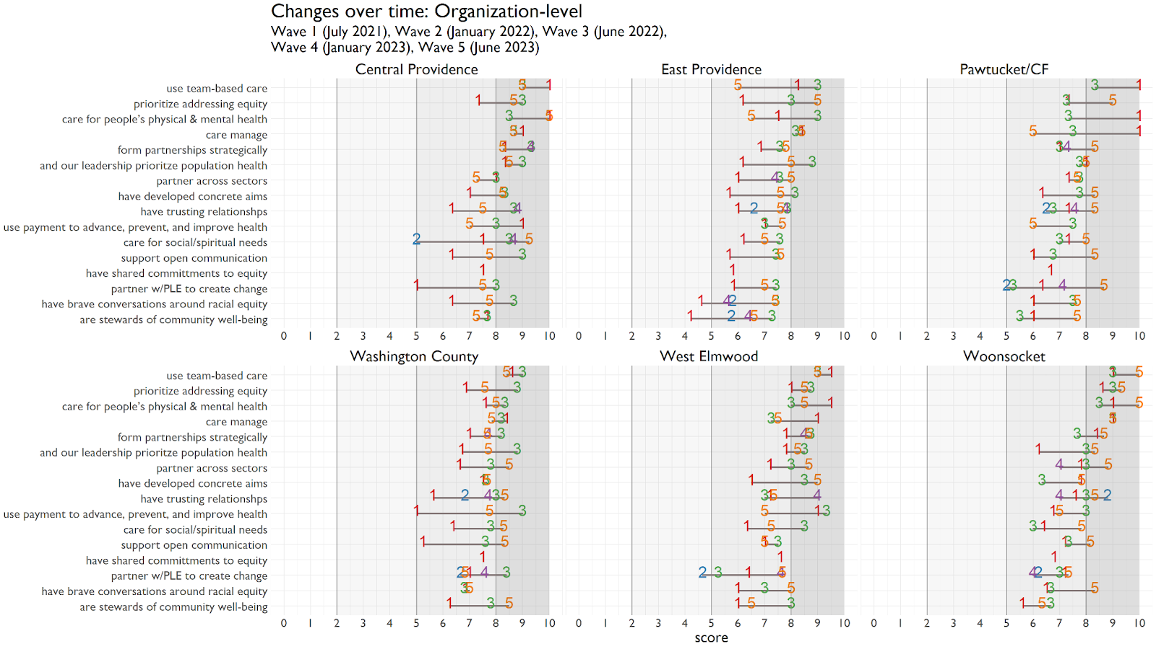

Slide 22
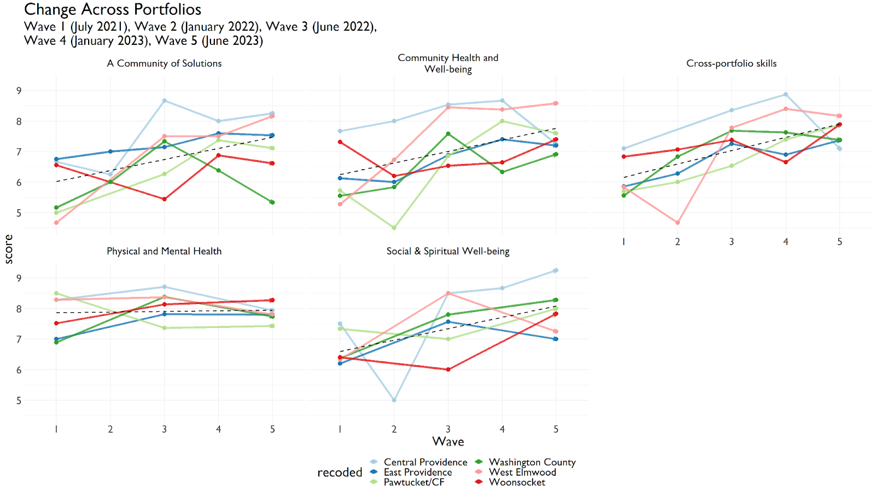

Slide 23
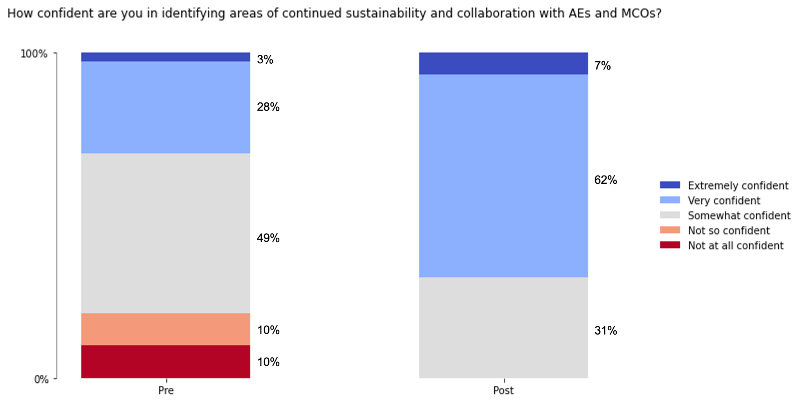

Slide 24
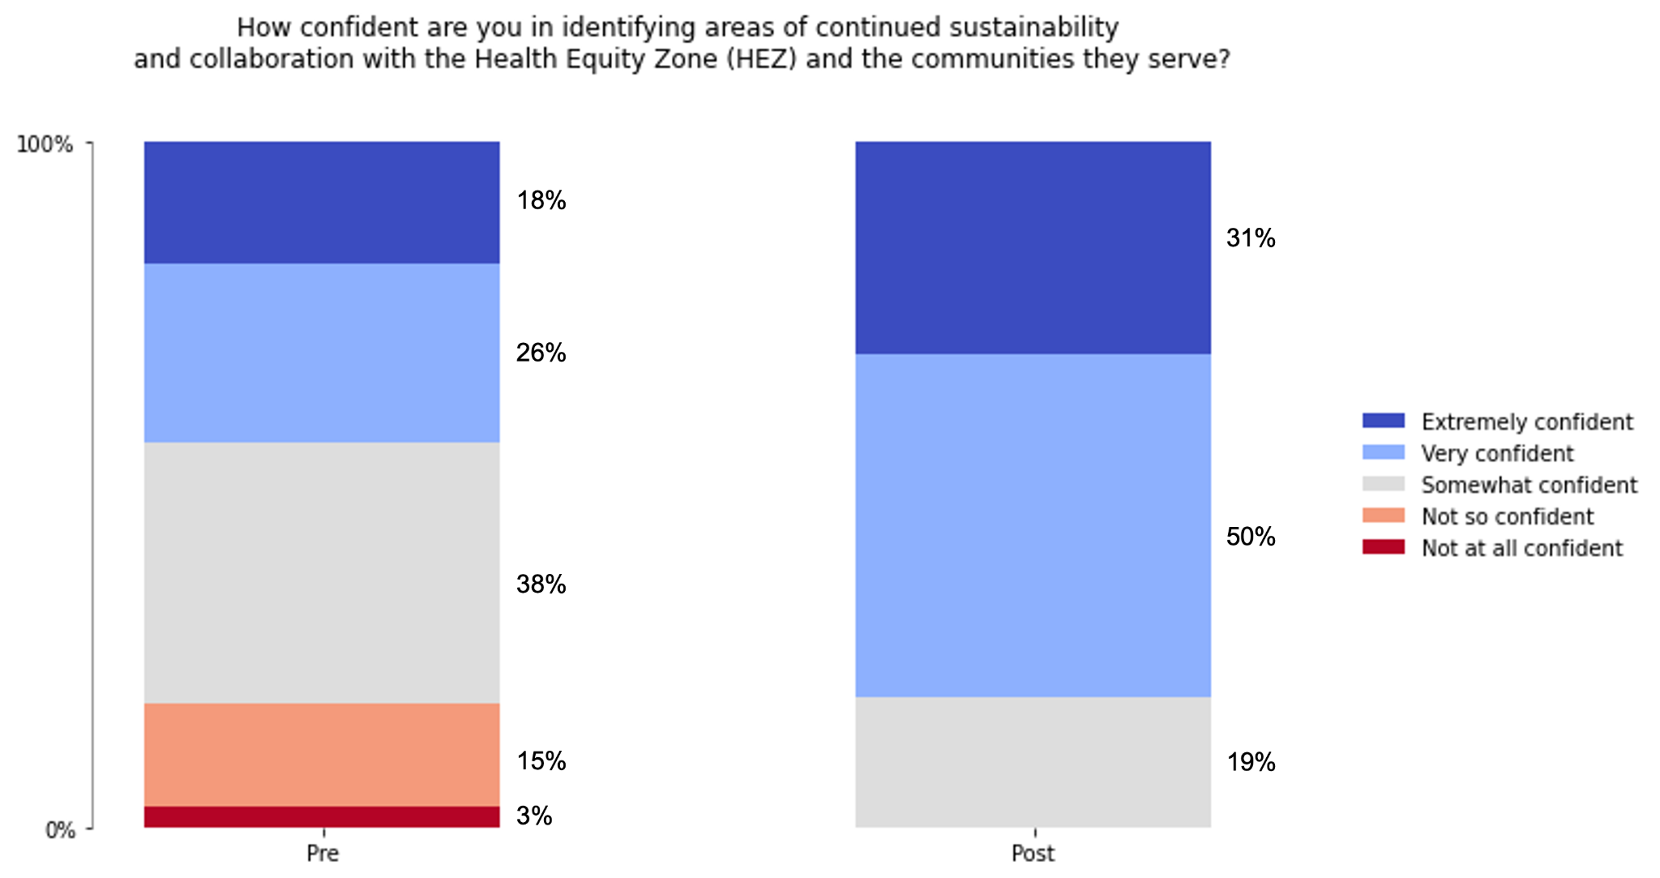

Slide 25
Team Specific Accomplishments
5/12/2022
Prepared by Care Transformation Collaborative of RI
‹#›
25

Slide 26
Team Members | Project Goal | Key Accomplishments
02907 02907 HEZ, Prospect AE, PCHC AE, PLE, FSRI.. | Pediatric Asthma | Leveraged funding from Green and Healthy Homes Initiative and UnitedHealthCare (MCO) to continue work past original funding period Established relationship with the Home Asthma Response Program (HARP) to make direct referrals for poorly managed asthma and certified their Community Health Advocates to work on asthma home visiting
Central Providence Central Providence Opportunities HEZ, PCHC AE, PLE, CLINIC.. | Homelessness and Healthcare Utilization | Successfully launched the CHW Pre-Apprenticeship program focused on expanding the housing support workforce and engaging people with lived experience in the field
East Providence East Providence HEZ, IHP AE.. | Food Insecurity | HEZ Leveraged funding from School Department, Integration of SDOH screening and referral process from East Providence Fire Department to HEZ

Slide 27
Pawtucket/Central Falls | Food Insecurity | Engaged community members, CHWs, and MLPB to improve food system, enrolling individuals in the VeggieRx program Developed community wide CHW cohort, and food and nutrition task force
Washington County | Behavioral Health and Homelessness | Reduced Length of Stay for BH at South County Hospital
Woonsocket | Behavioral Health and Homelessness | 90-day Equity Action Lab Focused on Nonviolence in Woonsocket Debunked theory or residents using emergency room in lieu of primary care systematically Integrated CHWs in the schools and advocated for/achieved a restorative justice framework for the school department

Slide 28
Panel Session
5/12/2022
Prepared by Care Transformation Collaborative of RI
‹#›
28

Slide 29

Public Questions and Comments
5/12/2022
Prepared by Care Transformation Collaborative of RI
‹#›
29

