Slide 1
Ordering eBooks in the IZ
SUNY Library Shared Services
Maggie McGee

Slide 2
Order, Activate and Manage Ebooks in the IZ
eBooks are ordered, activated, and managed in the IZ when:
The CZ eBook record does not exist
The CZ eBook record does not have adequate bibliographic information
The CZ eBook record exists, but it is not for the correct Electronic Collection
eBook records can be exported into the IZ via:
OCLC
EOCR or API new orders for eBooks
Creating a Local Portfolio should be used for adding eBooks to the IZ for campuses that are not using full or technical acquisitions in Alma

Slide 3
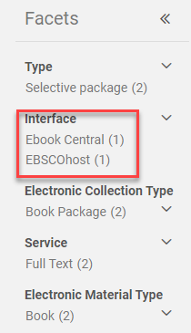
Ordering an eBook in the IZ Using a Bib Record From OCLC
First search for the eBook in the CZ for the correction Electronic Collection
Perform an Electronic Portfolio repository search in the CZ
Check to see if the interface name is available for the ordering ebook package
Export the bib record from OCLC to the IZ
Make sure the export is applied to the IZ in OCLC
Tools>Options click on the Export tab
Perform an All Titles repository search in the IZ
Click Order from the bib record in the IZ

Slide 4
Activating an eBook Ordered from an OCLC Bib Record
Perform an Electronic Portfolio repository search in the IZ for the eBook
Click Edit Portfolio

Slide 5
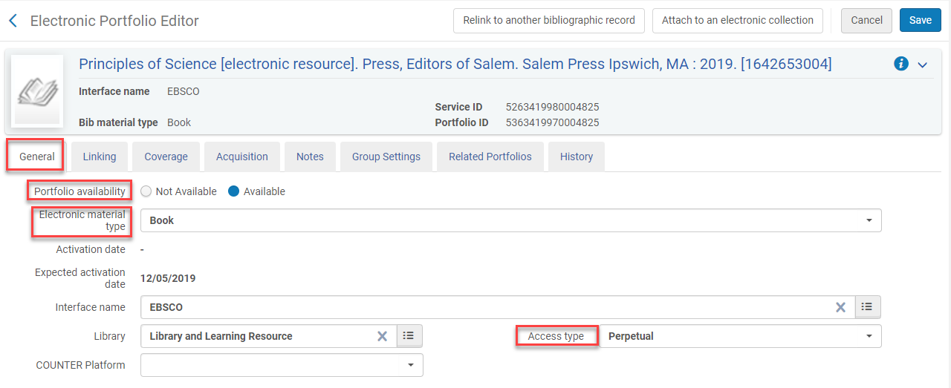
Activating an eBook Ordered from an OCLC Bib Record
Electronic Portfolio Editor - General Tab
Portfolio availability: Available
Electronic material type: Book
Interface name: [Comes from the POL]
Library: [Comes from the POL]
Access Type: [select the access type – Current, Perpetual, Current and perpetual]
Counter platform: [select is configured]

Slide 6
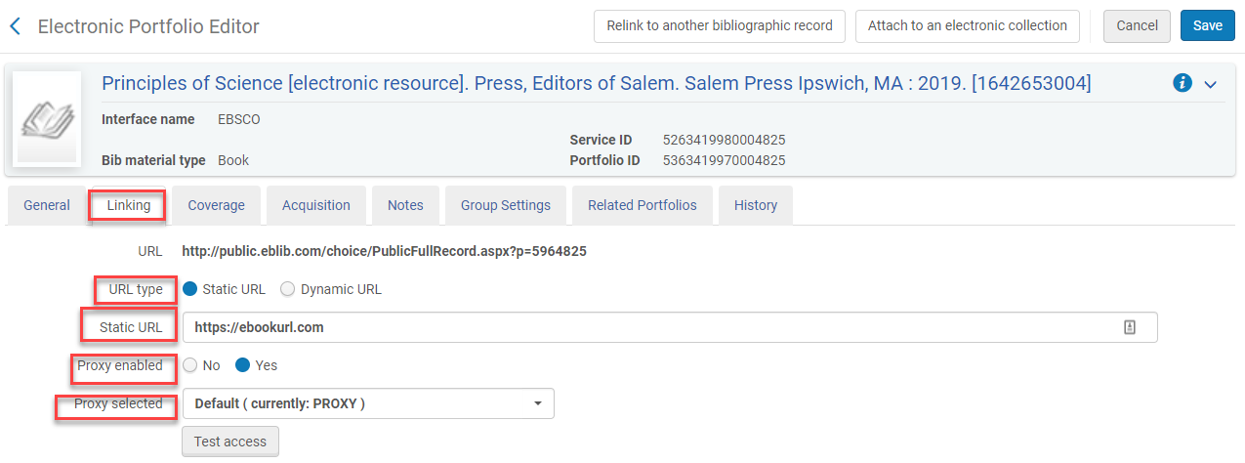
Activating an eBook Ordered from an OCLC Bib Record
Electronic Portfolio Editor - Linking Tab
URL Type: Static URL
Static URL: [type in the eBook URL]
Proxy enabled: [select yes if it is required]
Proxy selected: [select Default (currently; PROXY) is proxy enabled is “Yes”]
Test Access

Slide 7
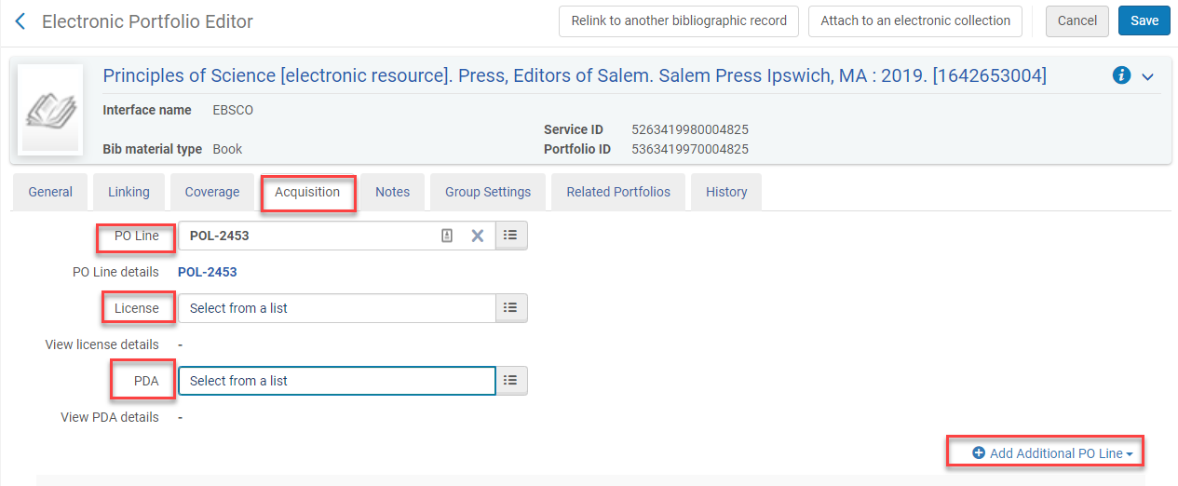
Activating an eBook Ordered from an OCLC Bib Record
Electronic Portfolio Editor – Acquisition tab
PO Line: [populated from the POL]
License: [select a license if it is uploaded into the vendor record]
PDA: [selected the associated PDA if applicable]
Add Additional PO Line: [add if applicable]

Slide 8
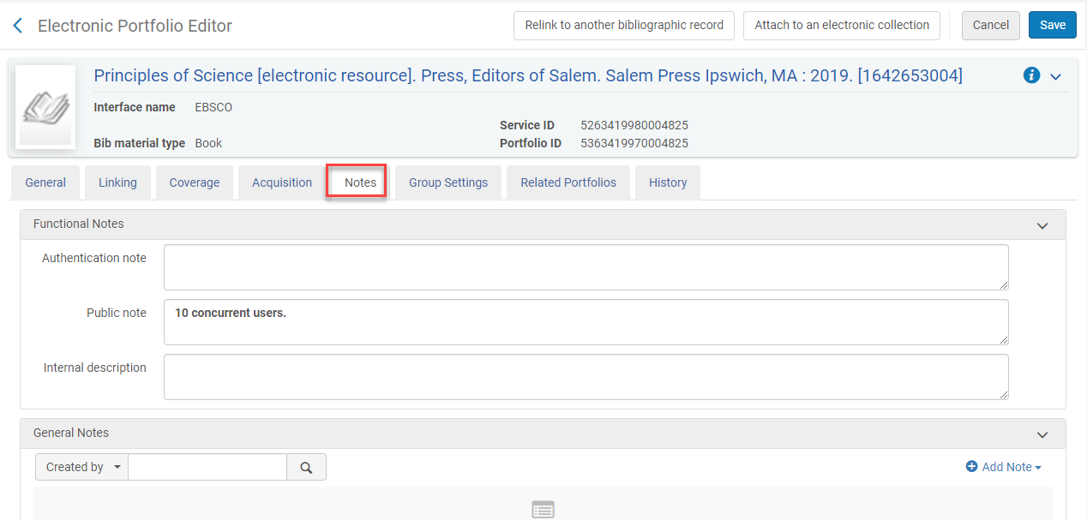
Activating an eBook Ordered from an OCLC Bib Record
Electronic Portfolio Editor – Notes tab
Notes can be added as necessary
Notes can be public facing or internal notes

Slide 9
Activating an eBook Ordered from an OCLC Bib Record
Electronic Portfolio Editor – Group Setting and Related Portfolios tabs
Group Settings tab – use if Group Settings for access are configured at your campus
Related Portfolios tab - displays a list of all portfolios that are linked to the same bibliographic record as the electronic portfolio

Slide 10
Activating an eBook Ordered from an OCLC Bib Record
Electronic Portfolio Editor -Relink to another bibliographic record
Used when a portfolio is associated with an incorrect descriptive record
Used when there is a better bibliographic record for a portfolio
Used when you want to relink it to another bib record
Used when you want to link it to a CZ bib records so that it can be updated automatically
Click Relink to another bibliographic record
Click on the select list icon
Perform an All Titles search in the CZ

Slide 11
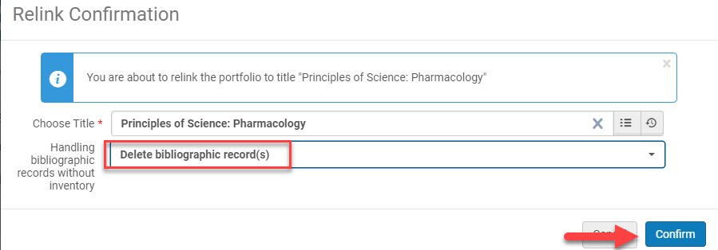
Activating an eBook Ordered from an OCLC Bib Record
Electronic Portfolio Editor - Relink to another bibliographic record continued
Click on the bib record you want to relink the record to
Handling bibliographic records without inventory: Delete bibliographic record(s)
If you do not delete the bib record ghost records will remain in the IZ
Click Confirm

Slide 12
Activating an eBook Ordered from an OCLC Bib Record
Electronic Portfolio Editor – Attach to an electronic collection
Click Attach to an electronic collection
Click the select from list icon

Slide 13
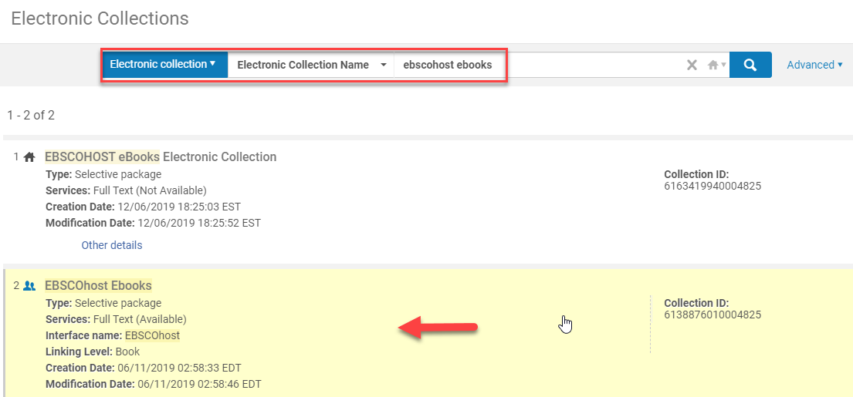
Activating an eBook Ordered from an OCLC Bib Record
Electronic Portfolio Editor – Attach to an electronic collection continued
Perform a repository electronic collection search
Allows you to search for local and CZ electronic collections
Click on the electronic collection

Slide 14
Activating an eBook Ordered from an OCLC Bib Record
Electronic Portfolio Editor – Attach to an electronic collection continued
Service: [populates based on the collection selected]
Click Confirm
Click Save

Slide 15
Ebooks ordered via EOCR or API in the IZ
SUNY Library Shared Services
Maggie McGee

Slide 16
eBooks Ordered in the IZ via EOCR/API
eBooks that are ordered via EOCR or API should be configured to be added to the IZ
eBooks that are ordered via EOCR or API require activation after ordering. eBooks can be activated either:
Immediately by updating the electronic portfolio
Follow the steps for Activating an eBook (slides 4-14)
Creating an e-activation task list
Click Create e-activation task list from the ellipses of the electronic portfolio
Follow e-activation task list workflow to activate the electronic portfolio

Slide 17
Creating a Local Portfolio
SUNY Library Shared Services
Maggie McGee

Slide 18
Creating a Local IZ Portfolio from an OCLC Bib Record
Perform an CZ repository search for the electronic portfolio
Export the bib record from OCLC to the IZ
Go to Resources>Create Inventory>Add Local Portfolio
Creation type: [select Use Exiting Title]
Click on the Select from list icon

Slide 19
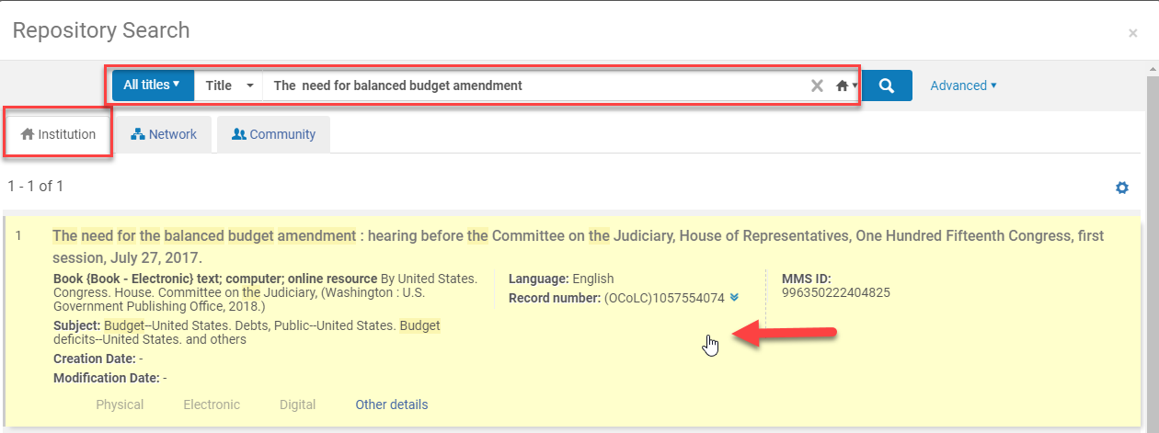
Creating a Local IZ Portfolio from an OCLC Bib Record
Perform an IZ repository search for the electronic bib records
Click on the correct bib record

Slide 20
Creating a Local IZ Portfolio from an OCLC Bib Record
Select the Portfolio Type under General information
Standalone
Interface Name: [select interface name/comes from the vendor record]
Library: [select library]
COUNTER Platform: [select is configured under the vendor record]
Part of an Electronic collection
Select the Electronic Collection
Service: [service populated from the collection]
Library: [select library]
COUNTER Platform: [select is configured under the vendor record]

Slide 21
Creating a Local IZ Portfolio from an OCLC Bib Record
Coverage information – populate if necessary
Inventory and Linking Information
URL: [type/copy paste URL]
Proxy enabled: [select Yes is proxy is required]
Proxy selected: [if Yes to Proxy enabled, select Default (currently; Proxy)]
Availability Status: [select Active]
Electronic material type: [select the correct material type]

Slide 22
Creating a Local IZ Portfolio from an OCLC Bib Record
Notes – add notes if necessary
Click Save and Done

Slide 23
Report ebooks to Ex Libris
SUNY Library Shared Services
Maggie McGee

Slide 24
Report eBooks (Portfolios) to Ex Libris
Report eBooks (portfolios) to Ex Libris if:
The metadata is too brief
The portfolio is not the CZ
The portfolio is not in the correct Electronic Collection
Go to Salesforce to open a case: https://exlidp.exlibrisgroup.com/adfs/ls/

Slide 25
Supporting Documentation
SUNY Library Shared Services
Maggie McGee

Slide 26
Supporting Documentation
Alana’s Presentation: Choose Your Own Adventure
Ex Libris Documentation: Managing Local Portfolios
Svetlana’s Presentation (Ex Libris): Local and Standalone Portfolios
Svetlana’s Presentation (Ex Libris): Electronic Portfolios, Linking to Collections, and the Community Zone

