Slide 1
Accessibility in the institutional repository
Jennifer Jensen Scholarly Communication Librarian, SUNY Oneonta
For discussion with the SUNY Accessibility
March 31, 2023
Notes:
EIT links
1. SOAR: https://soar.suny.edu/
2. Library Guide to SOAR: https://libguides.oneonta.edu/openaccess/repository
3. Oneonta SOAR collections: https://soar.suny.edu/handle/20.500.12648/1448
4. SOAR content guidelines: https://soar.suny.edu/pages/SOAR_content_guidelines
5. Accessibility Statements
Page example at https://oneonta.sunycreate.cloud/about/accessibility-in-openlab/
Item-level examples - Cornell https://ecommons.cornell.edu/handle/1813/111254
6. SRCA posters: https://www.acadiate.com//ee/SRCA/All_Displays

Slide 2
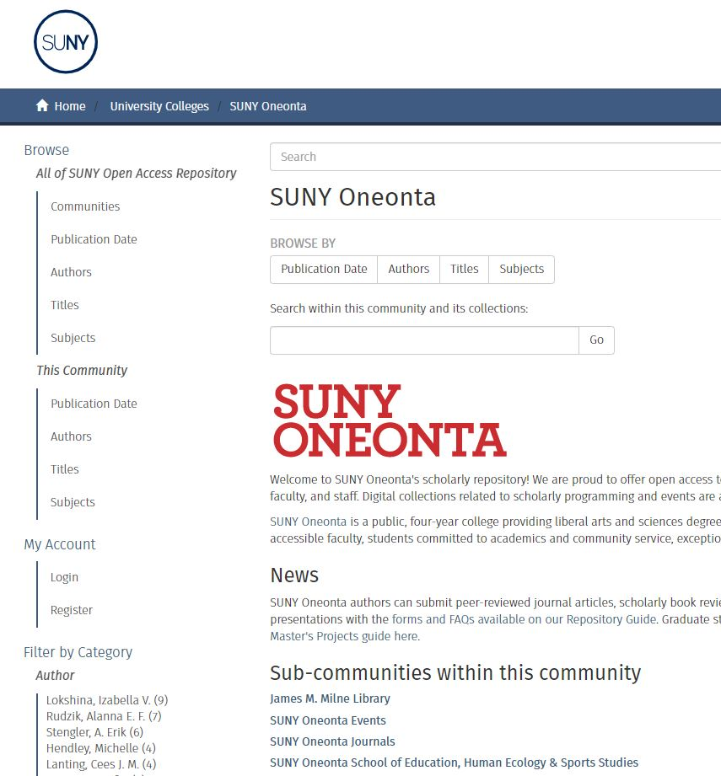
SUNY Open Access Repository (SOAR)
DSpace open-source digital library platform customized and hosted for SUNY by Atmire
Launched in October 2020
Supports Green Open Access (self-archiving) policies
soar.suny.edu/

Slide 3
SOAR at SUNY Oneonta
Management of SOAR
What we collect (so far)
Administered by Milne Library (me)
Offers self-archiving for our campus’s OA policy
A mediated repository
~200 items in our collection to date
Published journal articles and book reviews
Theses & Master’s Projects
Artifacts from creative & scholarly events on campus (posters & videos)
A college-hosted student journal
Visit the SUNY Oneonta SOAR collections at
soar.suny.edu/handle/20.500.12648/1448
Notes:
Oneonta SOAR collections: https://soar.suny.edu/handle/20.500.12648/1448

Slide 4
Accessibility in SOAR
SOAR website-level statement
soar.suny.edu/pages/SOAR_content_guidelines
Notes:
SUNY EIT Accessibility Policy: https://www.suny.edu/sunypp/documents.cfm?doc_id=883
Conferences/presentations about IR accessibility – many orgs do not have a process/guidelines

Slide 5
SOAR Accessibility at SUNY Oneonta
Asked for Guidance on Electronic Accessibility
Developed Accessibility Statements & Plans
Results?
Ed Beck from SUNY Oneonta’s Teaching, Learning and Technology Center (TLTC)
SUNY Oneonta Electronic & Information Technology group
Director of SUNY Oneonta Accessibility Office
Yvonne Kester at SUNY Office of Library and Information Services (OLIS)
Wrote statements for our SOAR page & individual items
Established remediation process (and limits!)
Made plan for further accessibility requests
Asked OLIS to create an Accessibility metadata field for SOAR
(More) transparent accessibility plan & statements for the library and its patrons
Stronger accessibility partnerships on campus and around SUNY
SOAR now has dc.accessibility.statement metadata field which displays on the download page
Notes:
Spring 2022 Southern Miss IR Conference – lots of accessibility ideas there
Summer and Fall 2022 wrote statements and made plan, met with lots of partners to get help and feedback
Fall 22 and spring 23 – using the plan, statements
Go to site to show
Next steps: Set up occasional/planned review of processes (new practices or technologies?), learn from you folks!

Slide 6
My remediation approach
What I DO remediate
What I do NOT remediate
In Word versions:
Add Heading paragraph styles
Check table headers
Add publisher statements
Alt text on images
Complicated tagging issues (e.g., autotag fails beyond Headings and Paragraphs, table headers issues, link issues)
…but I report any known/remaining “hazards” in SOAR’s DC.Accessibility.Statement metadata field
In PDF versions:
Run Adobe Acrobat Accessibility Check
Fix title & language metadata
Check & fix basic tagging issues (Headings, unmarked content)
Check and fix Tag & Reading Order
Notes:
I know this is not sufficient, but it was the start I was able to make in fall ‘22. My main goals are to provide the accessibility statement, make the main text of the document screen readable through basic tags and ordering, and to name known hazards for transparency.

Slide 7
W3C Web Accessibility Initiative “Developing an Accessibility Statement” Deque University courses Accessibility Statement Page example from SUNY Oneonta’s Open Lab Item-level accessibility statement in Cornell’s repository Cornell metadata libguide Cornell accessibility metadata workflow case study
Resources

