Slide 1
George Mason
District Court of Honor
Honoring the Volunteers That Support Our Youth and Units
2023 - 2024

Slide 2


Slide 3
Agenda
Service to our Units
  Unit Scouter Awards
  Unit Appreciation Awards
Service at the District Level
  2024 District Award of Merit
  2024 Silver Beaver
  Order of the Arrow Key Three Challenge
  2024 Schenekar Award
Unit Leader Award of Merit to Chris Hunter
George Mason Roundtable (to follow immediately after)

Slide 4
Unit Scouter Award
The Unit Scouter Award is presented to a limited number of persons from the district.
The award recognizes volunteers for noteworthy service to the unit in which the awardee is registered.
The award can be for excellence of duty, action during a crucial period, or sustained performance on behalf of the unit.

Slide 5
Pack 78
Chetan Tiwari
  CD has been an outstanding leader in our Pack. In the last 1.5 years he has redeveloped our recordkeeping, our treasury, and our scouting activities. His passion for scouting has resulted in an expansion of volunteerism across the Pack and the infusion of new ideas for fundraising and recruiting. CD spends a lot of time working on his leadership development through courses taken at council and the university of scouting. His participation in the monthly district round tables has brought greater awareness of our Pack across the district as well as opportunities for our Pack to continue to thrive through scouting activities and collaboration across the district.

Slide 6
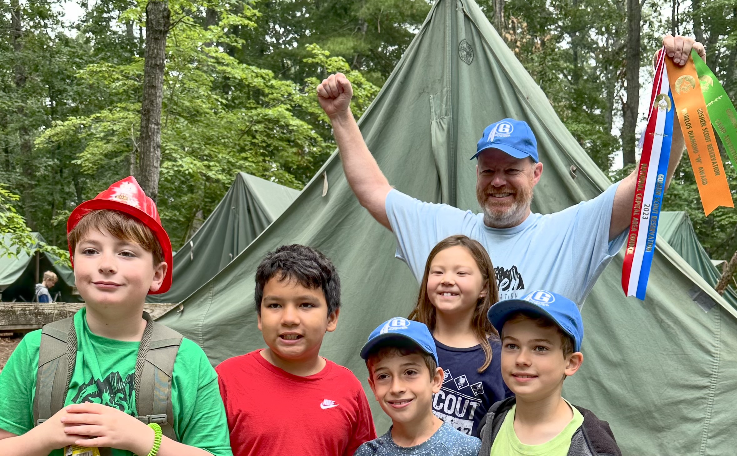
Pack 152
Matt MacLean
  We nominate Matt MacLean for Unit Scouter for his three years of service as Pack 152's Cubmaster, leading us out of the dark days of COVID. Matt's Scout Spirit is evident to all - his positive attitude, energy, and sense of humor have set the tone for Pack 152 events. Thank you for everything Matt!

Slide 7
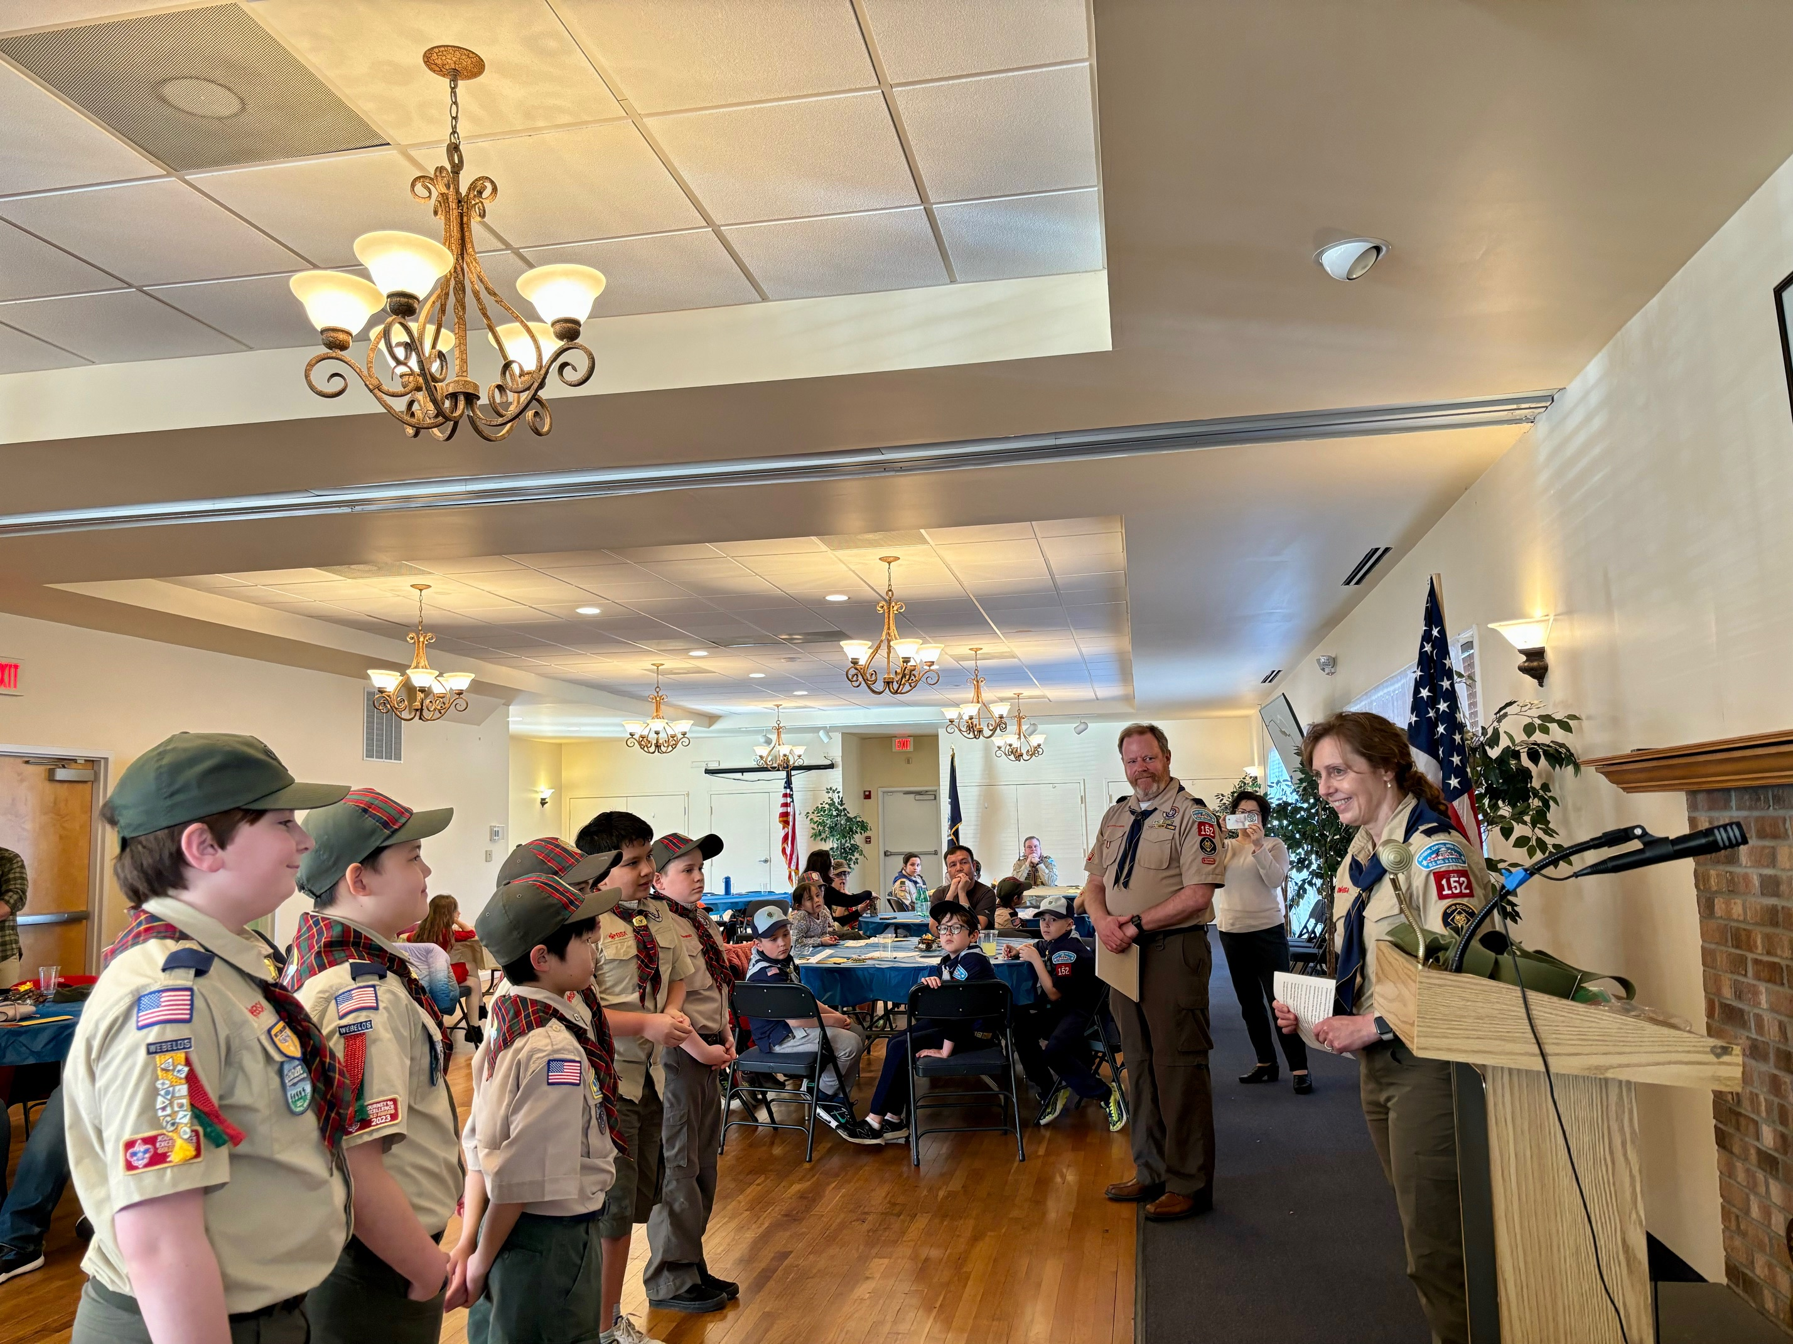
Pack 152
Ann Christopher
  Pack 152 is extremely thankful for Ann’s enthusiastic leadership as a den leader for the past five years. In addition to leading her son and his fellow Scouts to fun and adventure from Tiger through Arrow of Light, Ann was also a central member of our Pack camping committee, helping to lead us in campouts every spring and fall, and the coordinator of our successful Scouting for Food program. This year, Pack 152 collected 966 pounds of food for the hungry, about the equivalent of an orangutan riding on a zebra. We will dearly miss Ann and her family, and we wish them luck as they carry on with their Scouting career in Troop 987.

Slide 8
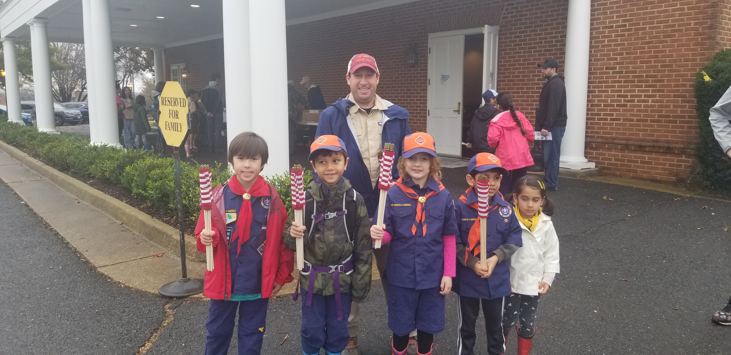
Pack 656
Jason Soules
  Jason Soules has single handedly led Pack 656’s Scouts, registered adults, and the families into working together to reinvigorate the Pack and set it up for future growth, and service, and fun. In his first year as Cub Master, Jason demonstrates that he takes his new role seriously. He routinely attends George Mason District roundtable meetings and passes along his notes and scouting ideas with the pack. He maintains good relations and open lines of communication with the pack’s chartering organization, the Fairhill Elementary School PTA. Jason schedules and leads a wide variety of pack activities and brings topics of discussion to the monthly committee meetings. He does all this while leading the pack with enthusiasm, a good sense of humor, and humility. Jason’s leadership of Pack 656 is in keeping with the highest traditions of the Cub Scouts and the Boy Scouts of America.

Slide 9
Pack 657
Scott Van Alstine
  Scott has served as an Assistant Cubmaster for 3 years. Scott heads up our Pack camping efforts, including campouts and summer camp. Scott also coordinates our annual participation in the Memorial Day in Falls Church, an important community outreach event. Scott is always willing to help and provides key support to the Cubmaster and Pack Committee. Scott is also an avid camper and hiker teaching by example and brings his infectious enthusiasm to everything he does. Scott is an Eagle Scout.

Slide 10
Pack 675
Sheri Wolfrom
  Sheri has been an invaluable member of Pack 675, and frequently works independently to manage Pack events and finances. This year, Sheri spearheaded the preparation of a Pack Handbook to provide info for new families; collaborated with our COR during the re-chartering process; instituted a hiking program, and organized monthly hikes for all scouts in our Pack. She put in the legwork (pun intended) to scout out sites, organize a calendar and set up a reward structure for Scouts who enjoy hiking. Sheri also assumed the role of Treasurer and keeps everyone regularly updated, and organized an event creating lunch bags for families in need over Spring Break. Sheri works tirelessly to make our Pack a well run organization, and manages everything with a professional attitude. We are grateful for all of her efforts.

Slide 11
Pack 976
Maureen Bunn
  Maureen Bunn joined our pack two years ago and immediately became a fixture in the pack, making her the ideal Cubmaster for the past year. Maureen has brought organization, tireless energy, creativity, and a supreme love and patience for every single Scout in the pack. Any one of those attributes would have made her valuable; the combination of all of them has made her a superstar. She’s a pleasure to work with for the other adult leaders too. Maureen is moving at the end of this year and will be sorely missed by everyone in Scouting and in the community.

Slide 12
Troop 187
Roxanna Edwards
  Troop 187 wishes to express its sincere appreciation to Ms. Roxanna Edwards, who plays a vital role in our Troop as Treasurer! In addition to her regular duties managing Troop funds and reimbursing Scouts and Scouters for expenses related to camping and awards, Ms. Edwards has rendered exceptional service over the last year. She took on the difficult and time-consuming task of transferring bank accounts from our prior organization to our new Charter Organization. This took months of coordination with both Charter Organizations and the bank and dealing with ever-changing document requirements. The Troop is on a firm financial footing thanks to her efforts.

Slide 13
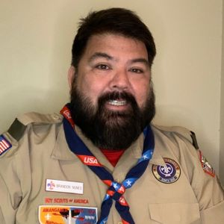
Troop 345
Brandon Nunes
  Brandon's service and commitment to Troop 345 never wanes. He is the consummate scouter and supports all the scouts as they continue their scouting journey.

Slide 14
Troop 349B
Taudi Hansen
  Taudi Hansen has served as Committee Chair for Troop 349 for two years, providing efforts big and small to keep the Troop operating in an efficient manner. Whether fundraising, Scoutbook administration, budget, recruiting, or advancement, Taudi is overseeing the work and mentoring the next group of leaders. Taudi is invaluable to the Troop and indispensable to the uniformed leaders. We thank her for her service to the Troop!

Slide 15
Troop 976
Abe Bacarra
  Abe is an all-around blessing to the troop. He started the 2023 as Scoutmaster and oversaw an incredible spring program of snow sports, camping, paddling, and cycling. Under his leadership the Troop sent 30 Scouts to Camp Olmstead, 2 crews to Lenhok’sin, and 1 to Philmont. In September 2023, after four and a half year as Scoutmaster, he “retired” to other jobs in the Troop. He is the Life to Eagle Coach and an Assistant Scoutmaster. He is an active presence at Troop meetings and campouts, including towing the Troop trailer. He picks up hundreds of wreaths from a farm for our annual fundraiser. And he is always around to advise both the Scouts and the other leaders, setting a great example with his dedication.

Slide 16
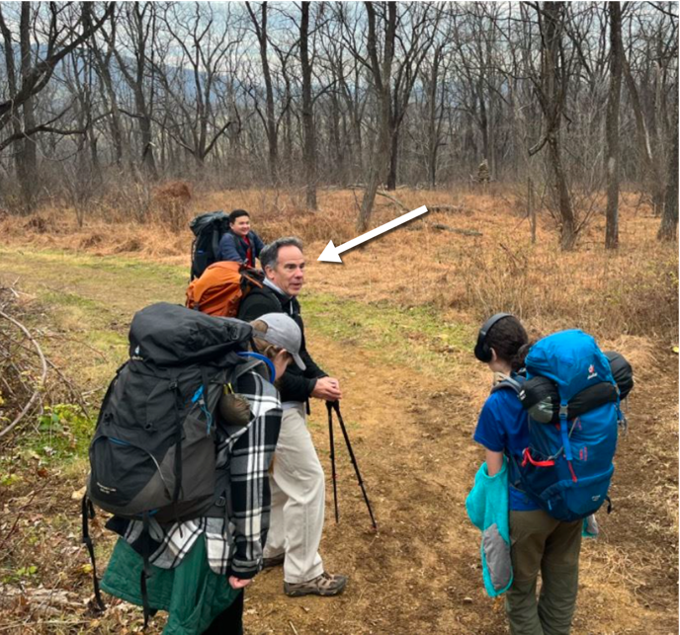
Troop 987B
Mike Angove
  Troop 987B is grateful for Mike’s service as our High Adventure Coordinator. Mike does an amazing job coordinating multiple crews per year attending various BSA high adventure base programs, as well as creating and leading local/regional high adventure programming for our youth.

Slide 17
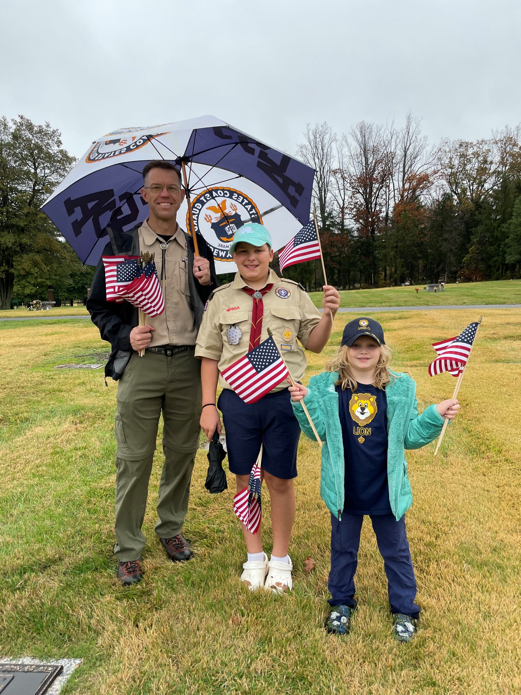
Troop 1539
Thom Remmers
  For four years, Scoutmaster Thom Remmers has worked tirelessly to inspire the scouts of Troop 1539 to live up to the Scout Oath and Law, to challenge them to try new things, to take on leadership opportunities, and to learn from experience. Thom has shared with our scouts his enthusiasm for the outdoors on numerous campouts and high adventures, and has patiently guided our scouts with positivity and grace.

Slide 18
Troop 1887
Tony Fasullo
  This award is given to Tony by our troop posthumously. Tony passed away unexpectedly in July of 2023, survived by his Wife, Kristin, and their children, Anthony and Lilli. Tony had only recently registered as a leader with our Troop, but he had already helped guide our Scouts during our Annual Shooting Camp and accompanied us to an excursion in Green Bank, West Virginia, where his leadership and cheer were evident to all. Tony was instrumental in planning and executing our annual Summer Camp at Rock Enon in July of 2023, just before his passing. Tony’s positive attitude and smile remain an example for all of Troop 1887, and he is missed every day. We are so thankful that he was a part of our lives, and we remain blessed to have the Fasullo family a part of Troop 1887.

Slide 19
Troop 1888
Catherine Arrage
  Mrs . Catherine Arrage was a founding member of Troop 1888 in 2019 and has been an essential leader throughout the last five plus years. She has served in many roles in that time period, but mostly recently she has served as the T1888 advancement & award chair & committee member for the last three years. In that role, she has ensured that all scouts have received their ranks, badges and awards on time and without mistake. Mrs. Arrage has always made herself available and is an important role model to our female scouts. She has constantly volunteered to organize and run scout trips and outings. Furthermore, she has served on numerous Boards of Review. Mrs. Arrage is a dedicated leader who has given so much to the scouts and Troop 1888 would not be where it is without her leadership and compassion.

Slide 20
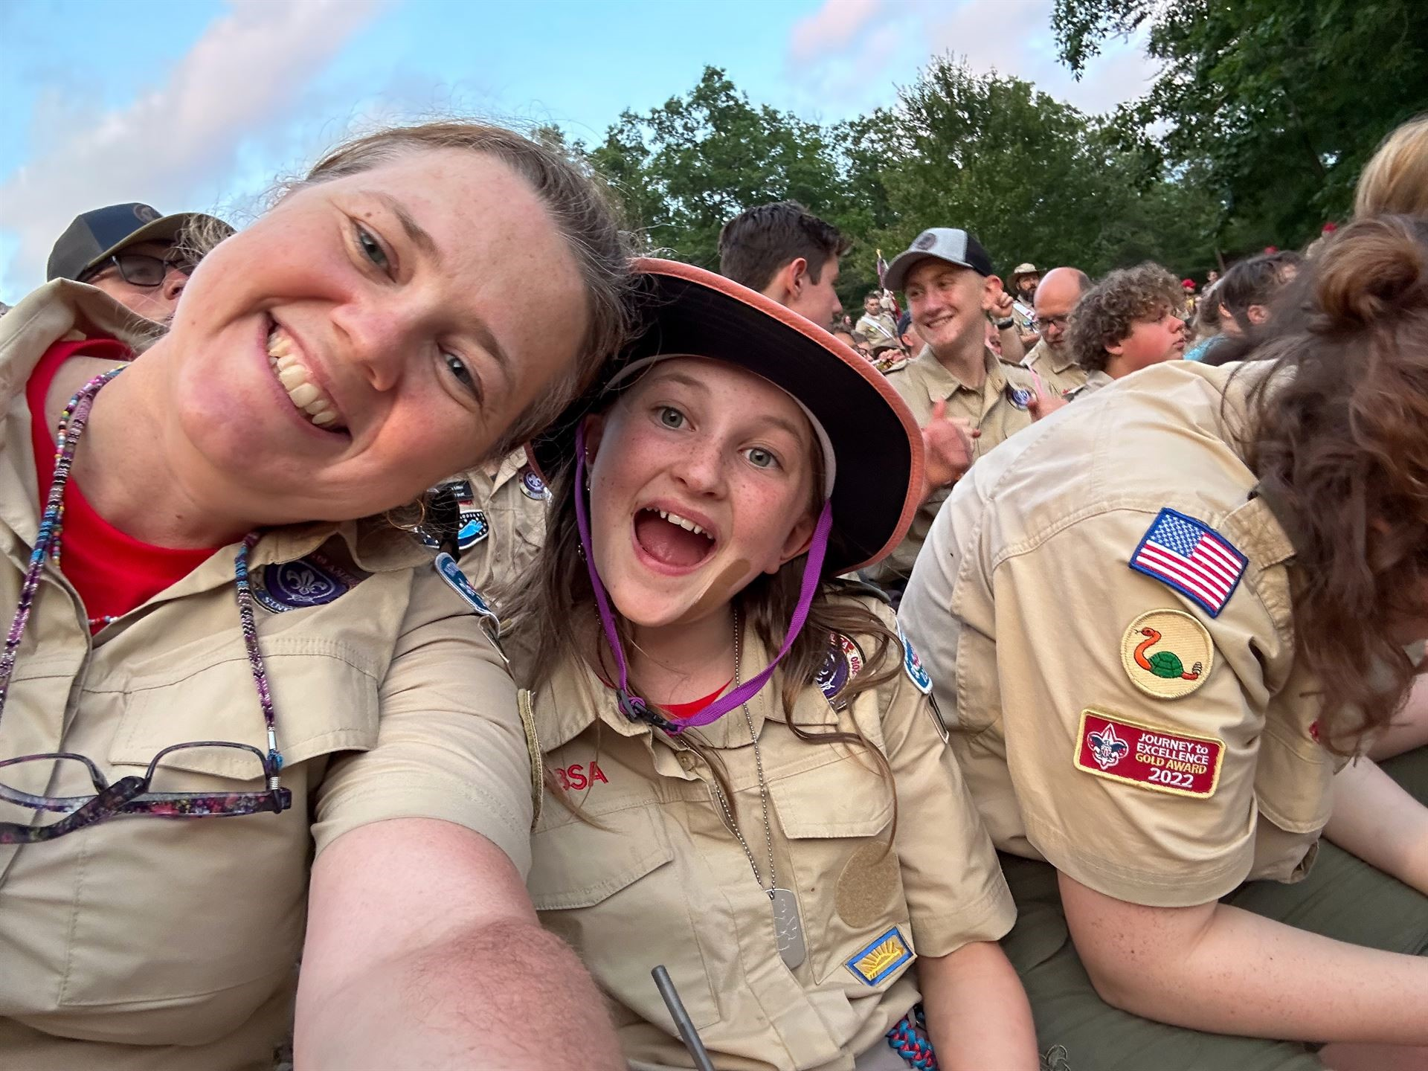
Troop 1978 G
Julia Beach
  Mrs. Beach has been an invaluable resource to our Troop this year. We transitioned to a new Troop infrastructure set up and Mrs. Beach has been the point person for the Scouts/Parents/Administration. She has given multiple training sessions to Scout and Parents ensuring that they understand how the system works and how to use it for their various positions within the Troop. She has also troubleshooted all issues within the system to keep it running smoothly. She is a mentor to all in our Troop.

Slide 21
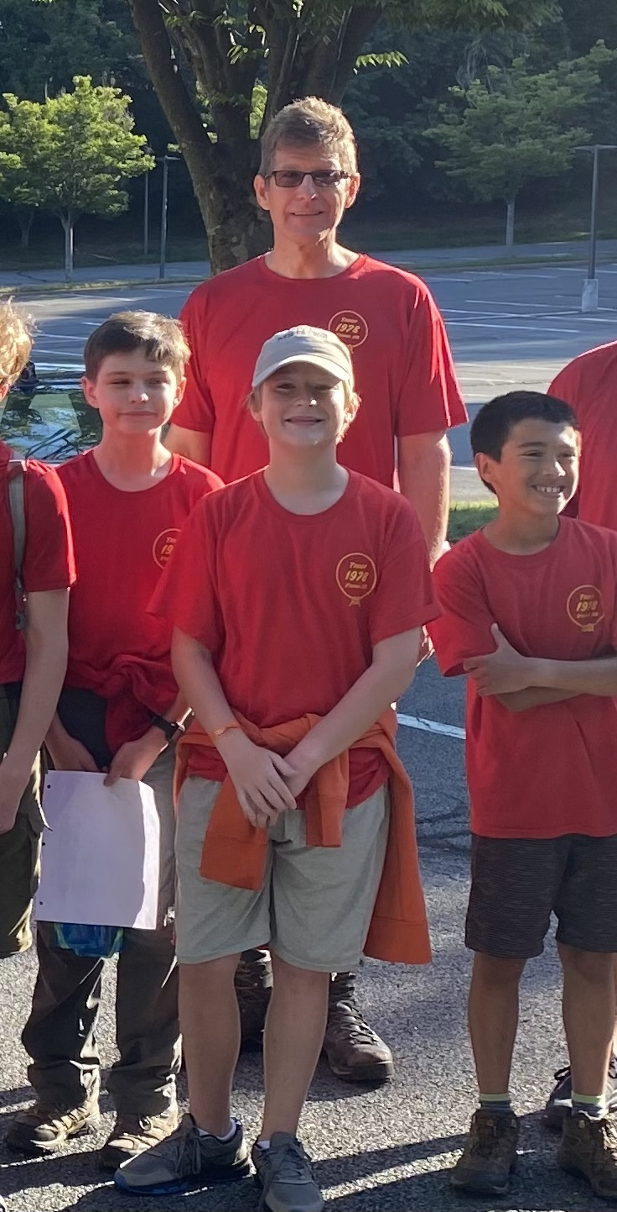
Troop 1978B
Kirk Silva
  Kirk is a dedicated scouter who is fully engaged in all aspects of the Troop’s annual program serving as an Assistant Scoutmaster (ASM), Summer Camp Lead ASM, Winter Merit Badge Camp ASM, and 2024 Philmont Adult Advisor. Kirk has the full trust and confidence of the Super Green Bar and is an excellent example and mentor to scouts and scout leaders. His love of the outdoors is infectious, and he is fantastic at teaching scouting skills and encouraging scouts to learn and grow.

Slide 22
Troop 1996
Bill Schmittel
  Bill Schmittel stepped into the vacant role of Committee Chair in the Spring of 2021 when the prior Chair was called away by professional obligations. Since that time, he has led by example, participated in recruiting our next generation of leaders, and even spent a week at summer camp in 2023 to ensure sufficient leadership for the week. He has positioned the troop to take the next steps and installed a new generation of leaders who are prepared for success in the coming years. Bill, your service to the youth of Troop 1996 is appreciated.

Slide 23
Unit Appreciation Award
The unit appreciation award is a District award presented by a unit to a Scouter who has provided outstanding service to the unit and its youth.

Slide 24
Pack 78
Collin MacInnes
  After Collin’s son joined the pack, he immediately approached us with a desire to see where he could step up and help with the pack. Since joining he first jumped in as our advancement chair where he hit the ground running to get us organized, and all of our digital systems up to date for all of our Scouts. He implemented an organizational system for each den leader to easily capture who attended what event and what requirements were covered … the changes have been a HUGE success for our pack! Now Collin's daughter has joined the pack as well and he has chosen to further expand his impact on the program and our youth by stepping up as a den leader, we are truly appreciative of what he has done and is continuing to do for the Pack!
Susan Swithenbank
  Since Susan’s son has joined the pack she immediately approached us to see how she could help with the pack and has stepped up as a committee member, and has with any task that was needed to help the pack run smoothly. She has been a true asset to the pack, bring years of experience as a Girl Scout leader with her. Recently her daughter has also joined the pack and Susan has made the leap to further help the program by stepping into a den leadership role. The pack is truly appreciative of what she has done and is continuing to do for the pack!

Slide 25
Pack 78
Ben Edwards
  As our pack was growing, we were in need of leaders to step up and take on den leadership, without hesitation Ben raised his had and since last year has been running a successful Wolf den for the pack and has also stepped up to help to elevate our fishing program. His efforts have made a lasting impression on our scouts and the program. Pack 78 thanks Ben for all that he has, and continues to do, for Scouting!
Jon Besko
  After Jon’s son joined the pack, being a Eagle himself he immediately raised his hand to jumped in see how he could give back to Scouting. He has joined the pack leadership and has been an assistant den leader for almost 2 years now. Jon’s tireless efforts have delivered a truly rich and immersive program for our Scouts and he has been a driving force to countless aspects of the behind the scenes work that has made our overall program a true success! Pack 78 is truly appreciative of all the he has done, and continues to do for our scouts, and scouting!

Slide 26
Pack 78
Annie Besko
  A key area that many overlook is the engagement of the pack leadership with the parents to keep them informed in an appealing and consumable fashion. Last year Annie stepped in to fill the role for as our pack communications lead. Since she has taken over our engagement with our pack has never been better.
Jacqui Phillips
  This last year when Jacqui’s sons reengaged with the pack, she realized that the pack had grown and needed all the help it could get to be successful, without hesitating she stepped up to take on one of our largest dens. Since taking over she has helped deliver a strong program for the scouts in her den and the pack as a whole. Pack 78 is truly appreciative of all the she has done, and continues to do for our scouts, and scouting!

Slide 27
Pack 78
Dexter Payne
  Dex and his family have been a part of the pack for a few years now, and last year raised his hand to jump in and fill a need we had when our current Cub master leave when his son aged out. Dex jumped in with both feet serving as the Cub Master, Committee Member and currently as our Webelos den leader. He has truly given back to the program by helping in any position or task needed to deliver a amazing program for our scouts! Pack 78 is truly appreciative of all the he has done, and continues to do for our scouts, and scouting.
Frank Farruggia
  Frank has been the heart and soul of our pack for many years now, he has taken on numerous roles in the pack across every aspect, especially while keeping things running during the covid years. There are countless items that I could detail out, but we would run out of time … The pack is what it is today due to all of his hard work, sacrifice, and efforts .. not to mention him keeping us all fed with his absolutely AMAZING cooking!! Pack 78 truly appreciates all that you have done and continue to do for the scouting movement!!

Slide 28
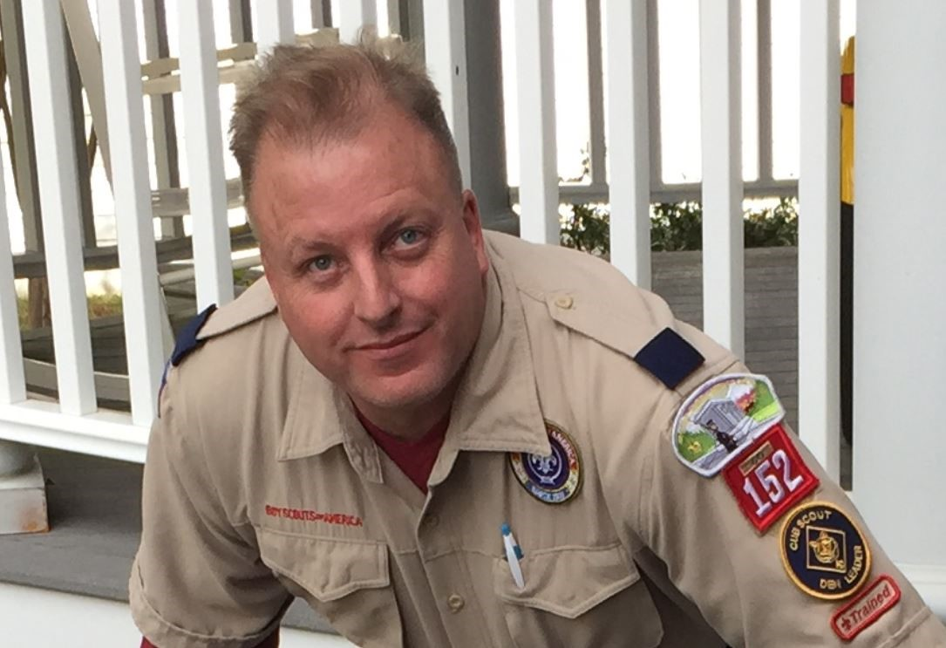
Pack 152
Brian Christopher
  At seven years with Pack 152, Brian is our longest-tenured remaining leader, having led his oldest son’s den through AOL and then remaining on our Pack committee while his youngest son crosses. Brian has continued to help lead our awesome Pack events, particularly our Pack campouts, where he has been indispensable. We will miss Brian and his family as they move on with their Scouting career in Troop 987.
Chip Cullen
  Chip joined Pack 152 with his son and daughter in the midst of Covid shutdowns, when he helped keep us alive, bringing us into the 21st Century with his tech savvy as our Communications Chair. He rose through ranks quickly to become our Pack Committee Chair, helping to lead Pack 152 out of Covid and through a critical rechartering process in which we found a new home with American Legion Dyer-Gunnell Post 180. We’ll miss Chip as he and his son leave us to join his daughter in Troop 987.
Brian Christopher

Slide 29
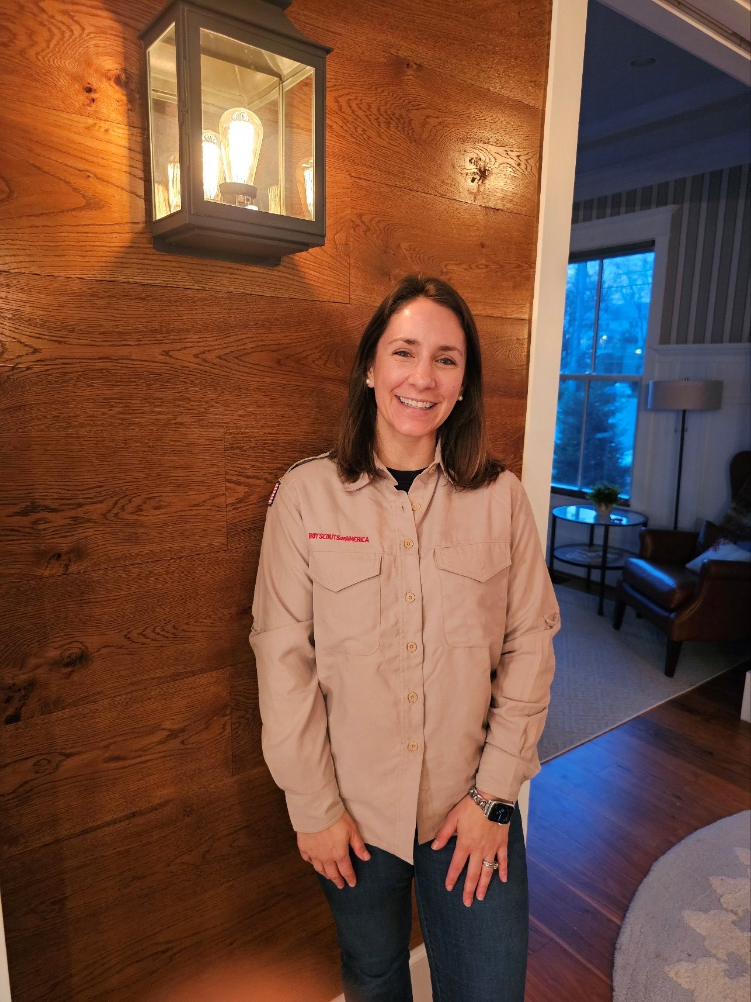
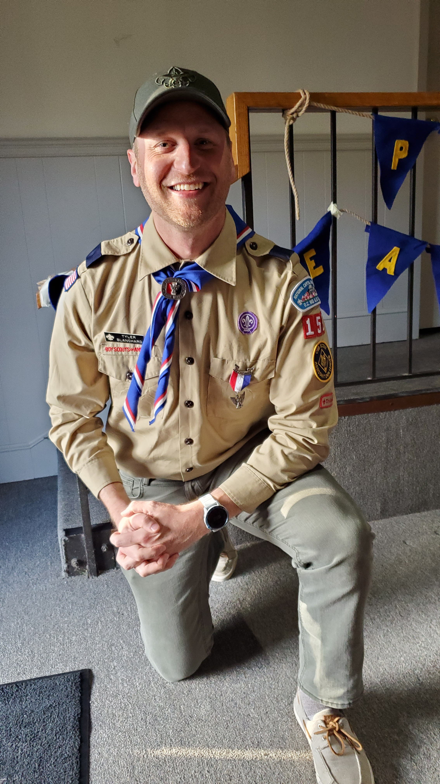
Pack 152 (cont.)
Terese Blanchard
  As our Pack Treasurer, Terese oversees the business side of the financial behemoth that is Pack 152. From managing the transition from our old chartered organization bank account to negotiating our clean campsite discount for our Fall Campout, Terese runs a tight ship.
Tyler Blanchard
  Tyler moved up from Assistant Den Leader of last year’s Tiger Den to Den Leader of this year’s Lion Den, and has recently agreed to step up again as the Pack’s Assistant Cubmaster. We’ll have a long and bright future with leaders like Tyler.
Terese Blanchard
Tyer Blanchard

Slide 30
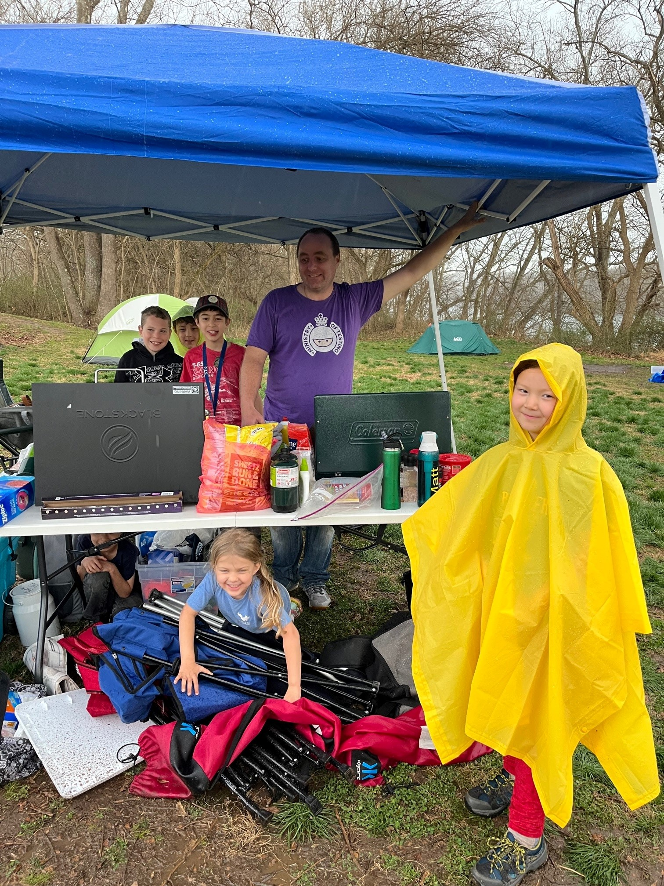
Pack 152 (cont.)
Glenn Buckholz
  Glenn ably leads our small but mighty Bear den, and he also serves as our Special Events Chair, Pinewood Derby Grand Marshal, Director of Flight Operations, and Pack Bugler.
Matthew French
  Matt has served as Pack 152’s Advancement Chair, tracking and obtaining awards and rank advancements. We’ll miss Matt and his son as they cross into Scouts BSA.
Glenn Buckholz

Slide 31
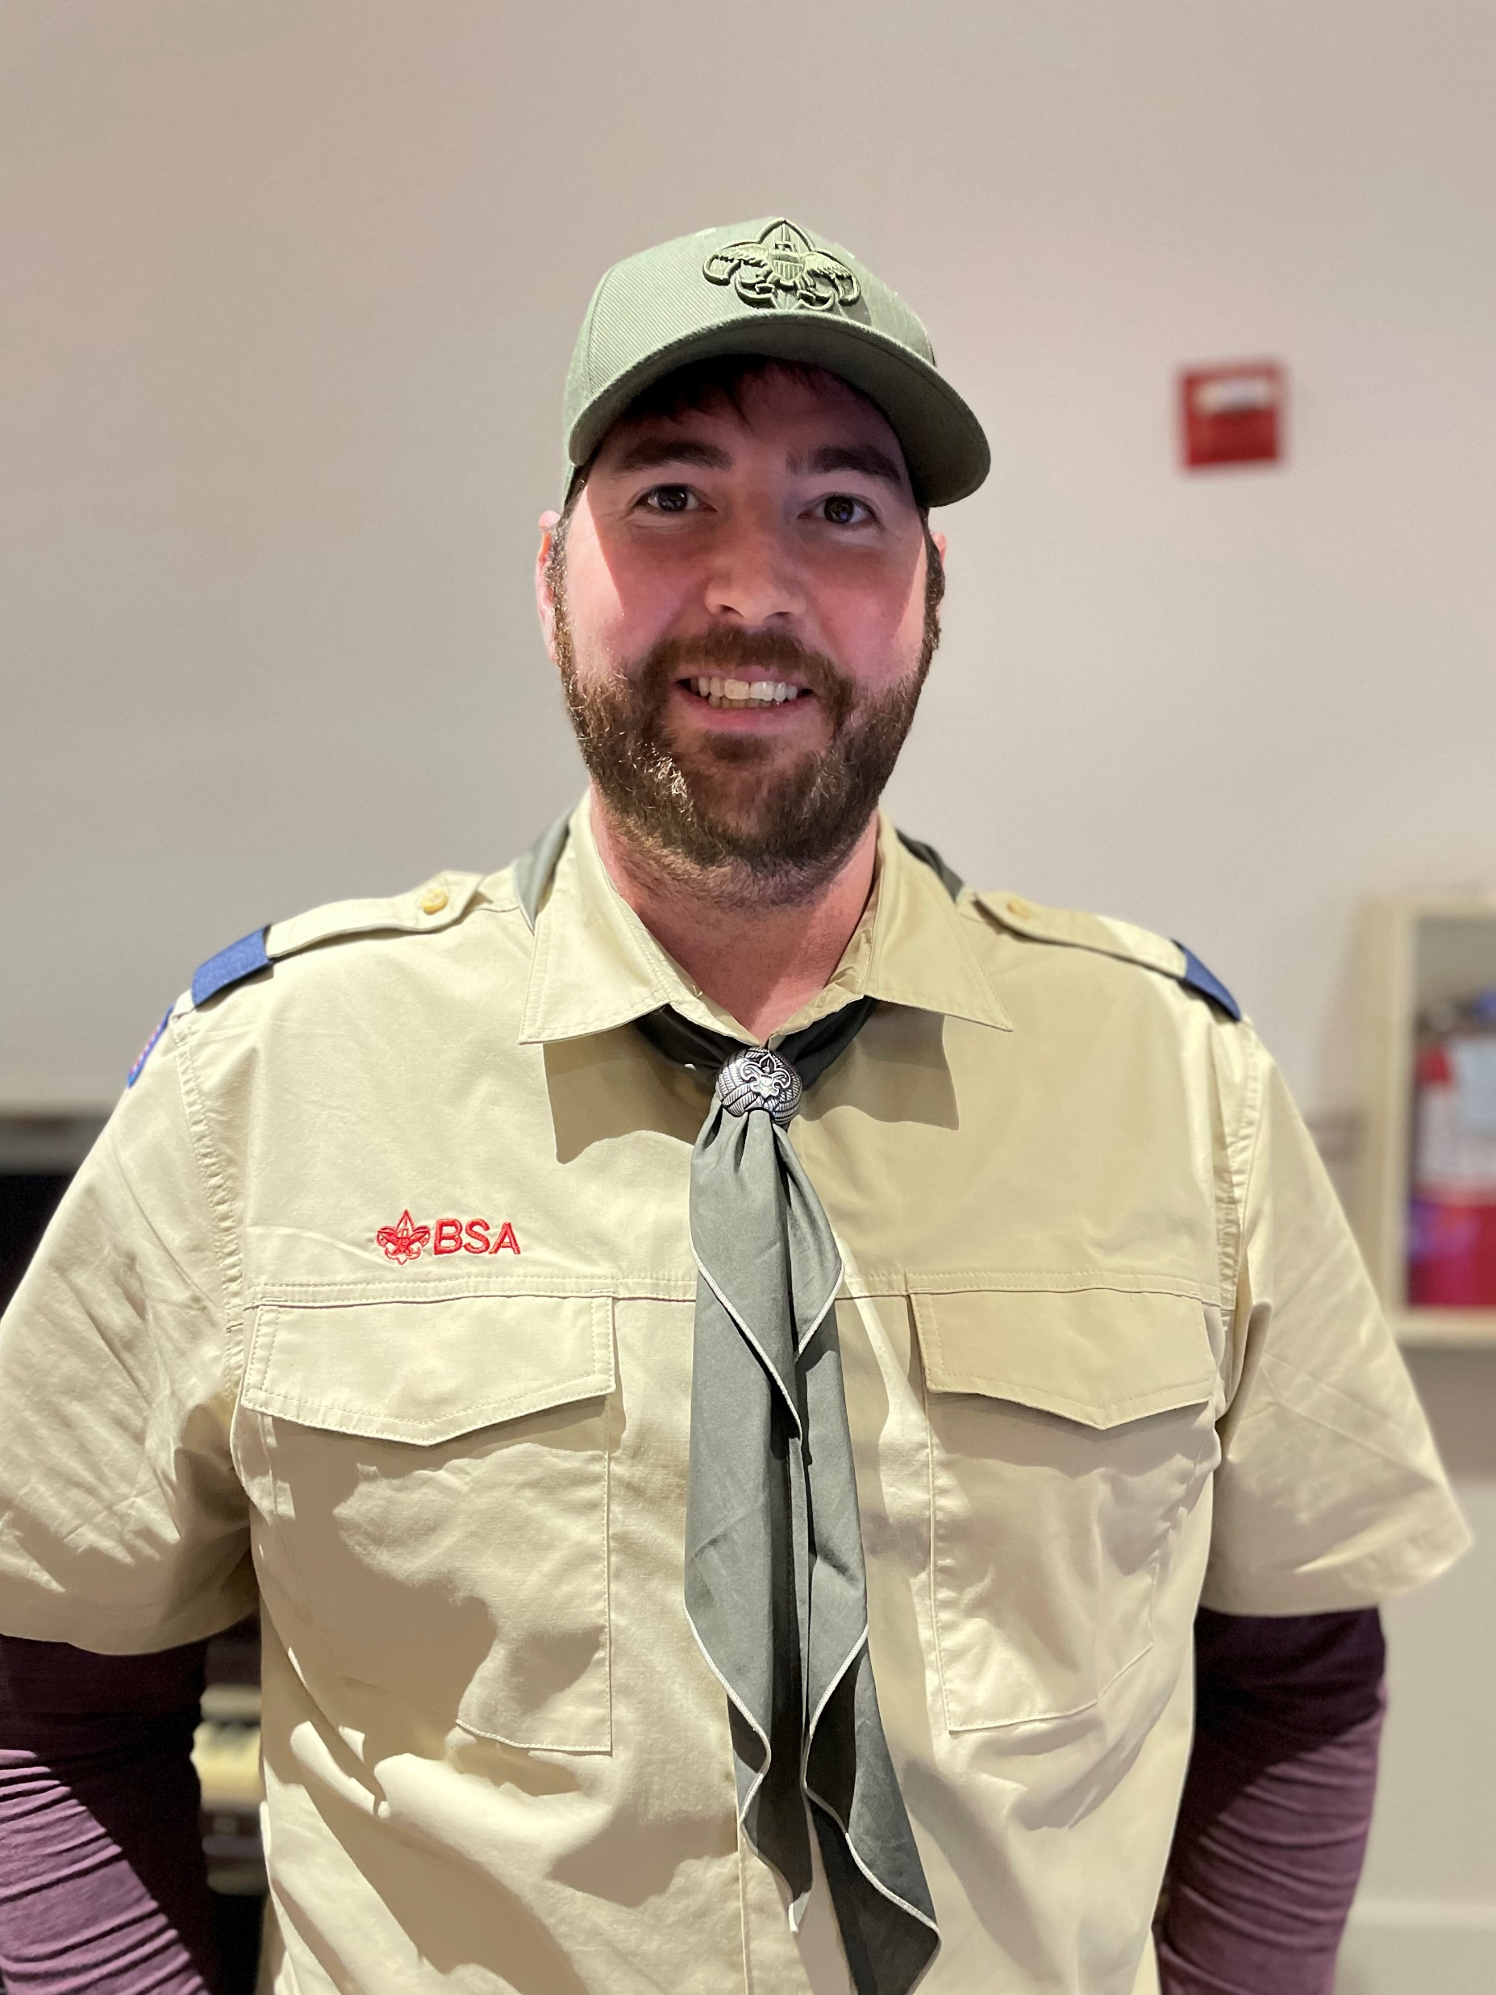
Pack 152 (cont.)
Scott Kelly
  Scott leads Pack 152’s combined Wolf and Bear den, and he also leads our Cubnapolis car build and race.
Cheryl Schlosnagle
  Popcorn Kernal Cheryl Schlosnagle has revived our popcorn sales program, which had fallen into disuse during Covid shutdowns. Kernal Schlosnagle led our troops to victory and glory, meeting and exceeding our popcorn sales goal for the year.
Scott Kelly

Slide 32
Pack 656
Ben Huebner
  Trusted treasurer and dedicated den leader; responsible budgeting and financial planning; and for moving our non-profit from the old chartering organization to the new organization with the bank and IRS
Allyson Laskowski
  Committed pack committee member and whole-hearted volunteer
Mike Reese
  Dedicated den leader and committee member
Diane Reese
  Dedicated den leader and committee member .
Maari Hanson
  Enthusiastic pack volunteer and chartered organization representative

Slide 33
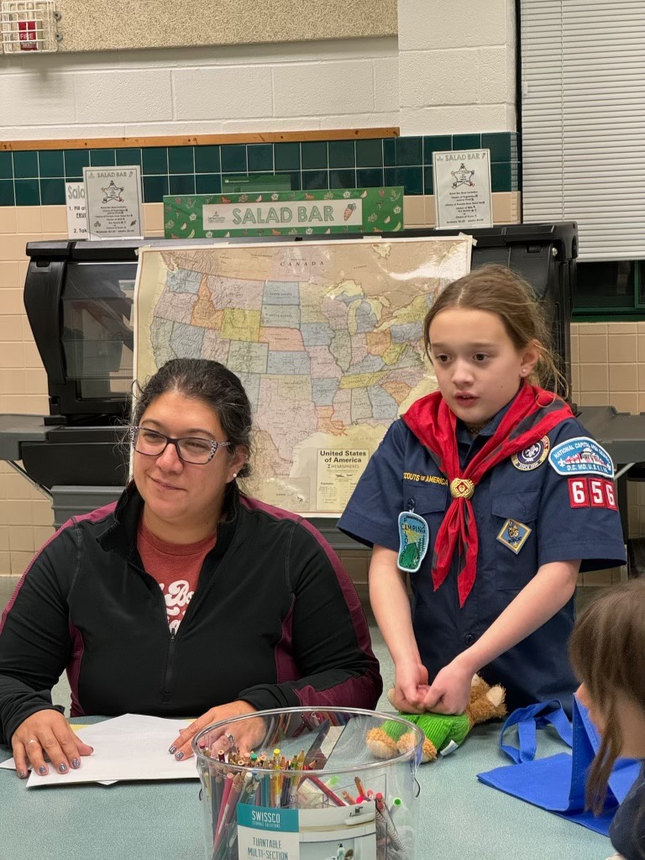
Pack 656 (cont.)
Celeste Jensen
  Fervent float lead for the Fourth of July parade
James Bosworth
  Pine Wood Derby lead
Terry Brown
  Ben den supporter
Celeste Jensen

Slide 34
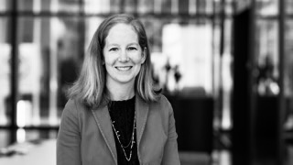
Pack 657
Michael Chase
  Mike is Pack 657's Advancement Chair. He tirelessly ensures everyone receives their adventure loops and patches. Mike is always willing to volunteer and help out. He's a vital part of our Pack.
Michael Economou
  Mike serves as Pack 657's Pack Treasurer. His son was unable to participate this year, but he still agreed to serve because he hopes that his younger son is able to join next year. He was an essential part of our team that tried to deal with the complex fee situation that resulted from this year's transition to the new Scouts BSA and NCAC fee structure.
Emily Smith
  Emily stepped up to become a den leader this year so that we had a female den leader for our AOL girls. Emily is a constant volunteer and helper at pack events.
Emily Smith

Slide 35
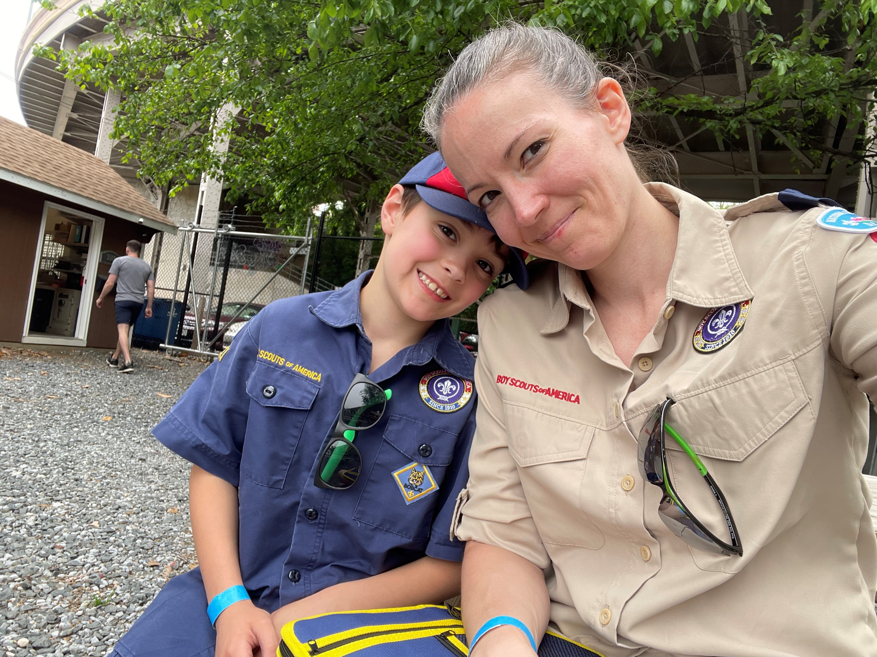

Pack 657 (cont.)
Matt Wieseler
  Matt has served as a longtime den leader. Matt is always there to help out whenever asked.
Alec Williamson
  Alec is and exceptional den leader. He has led one den from formation to Bears. His den as completed every adventure in the Lions and Tigers program. His plans serve as a templated for other den leaders. Alec is now leading a second den with his younger son, who is a Tiger. Aled is an Eagle Scout.
Lindsey Munera
  Lindsey shows exceptional Scout Spirit and has done an excellent job leading one of our Bear dens. Her den is extremely active doing numerous activities on their own and supplying a number of leaders for the pack. She helps out constantly and provides important support to a number of the pack's activities.
        Lindsey Munera

Slide 36
Pack 657 (cont.)
Drew Walter
  Drew is the leader of our large girls Webelos Den. Drew has been a key volunteer and is helping lead our Cubmobile races this year
Rob Hux
  Rob Hux is our Pack Hiking Chair (2 years) and leads our extremely successful and popular Pack hiking program. Rob also serves as an assistant den leader of one of our Webelos dens.

Slide 37
Pack 675
Toni Kislear
  Toni quietly works behind the scenes and provides support throughout many activities within the pack. In addition to being our Popcorn Kernel and running a fundraising program which exceeded expectations, Toni manages our social media presences, assists with Den leadership and preparation, created outreach materials for community events, makes and sells popcorn, purchases materials, and runs many errands behind the scenes which are not always visible to the Pack. Her work allows events to happen smoothly. Although she is quiet about the work that she does, the Pack would not be where it was without her.
Erik Bergman
  Erik continues to be an exceptional chef and ally of many of our Pack wide meals. He has handled multiple instances of preparing food, organizing families to contribute, and creates exceptional meals for our camping trips. Everyone looks forward to the camping meals, and we commend Erik for the hard work he puts in to make them happen.

Slide 38
Pack 833
Neena Raj
  For service to the youth and families of Pack 833 as Committee Chair.
David Michehl
  For service to the youth and families of Pack 833 as Cubmaster and AOL Den Leader.
Andrew Huling
  For service to the youth and families of Pack 833 as Treasurer and Pinewood Derby coordinator.
Steve Goehrke
  For service to the youth and families of Pack 833 as Webelos Den Leader, Popcorn Kernel and Committee member.

Slide 39
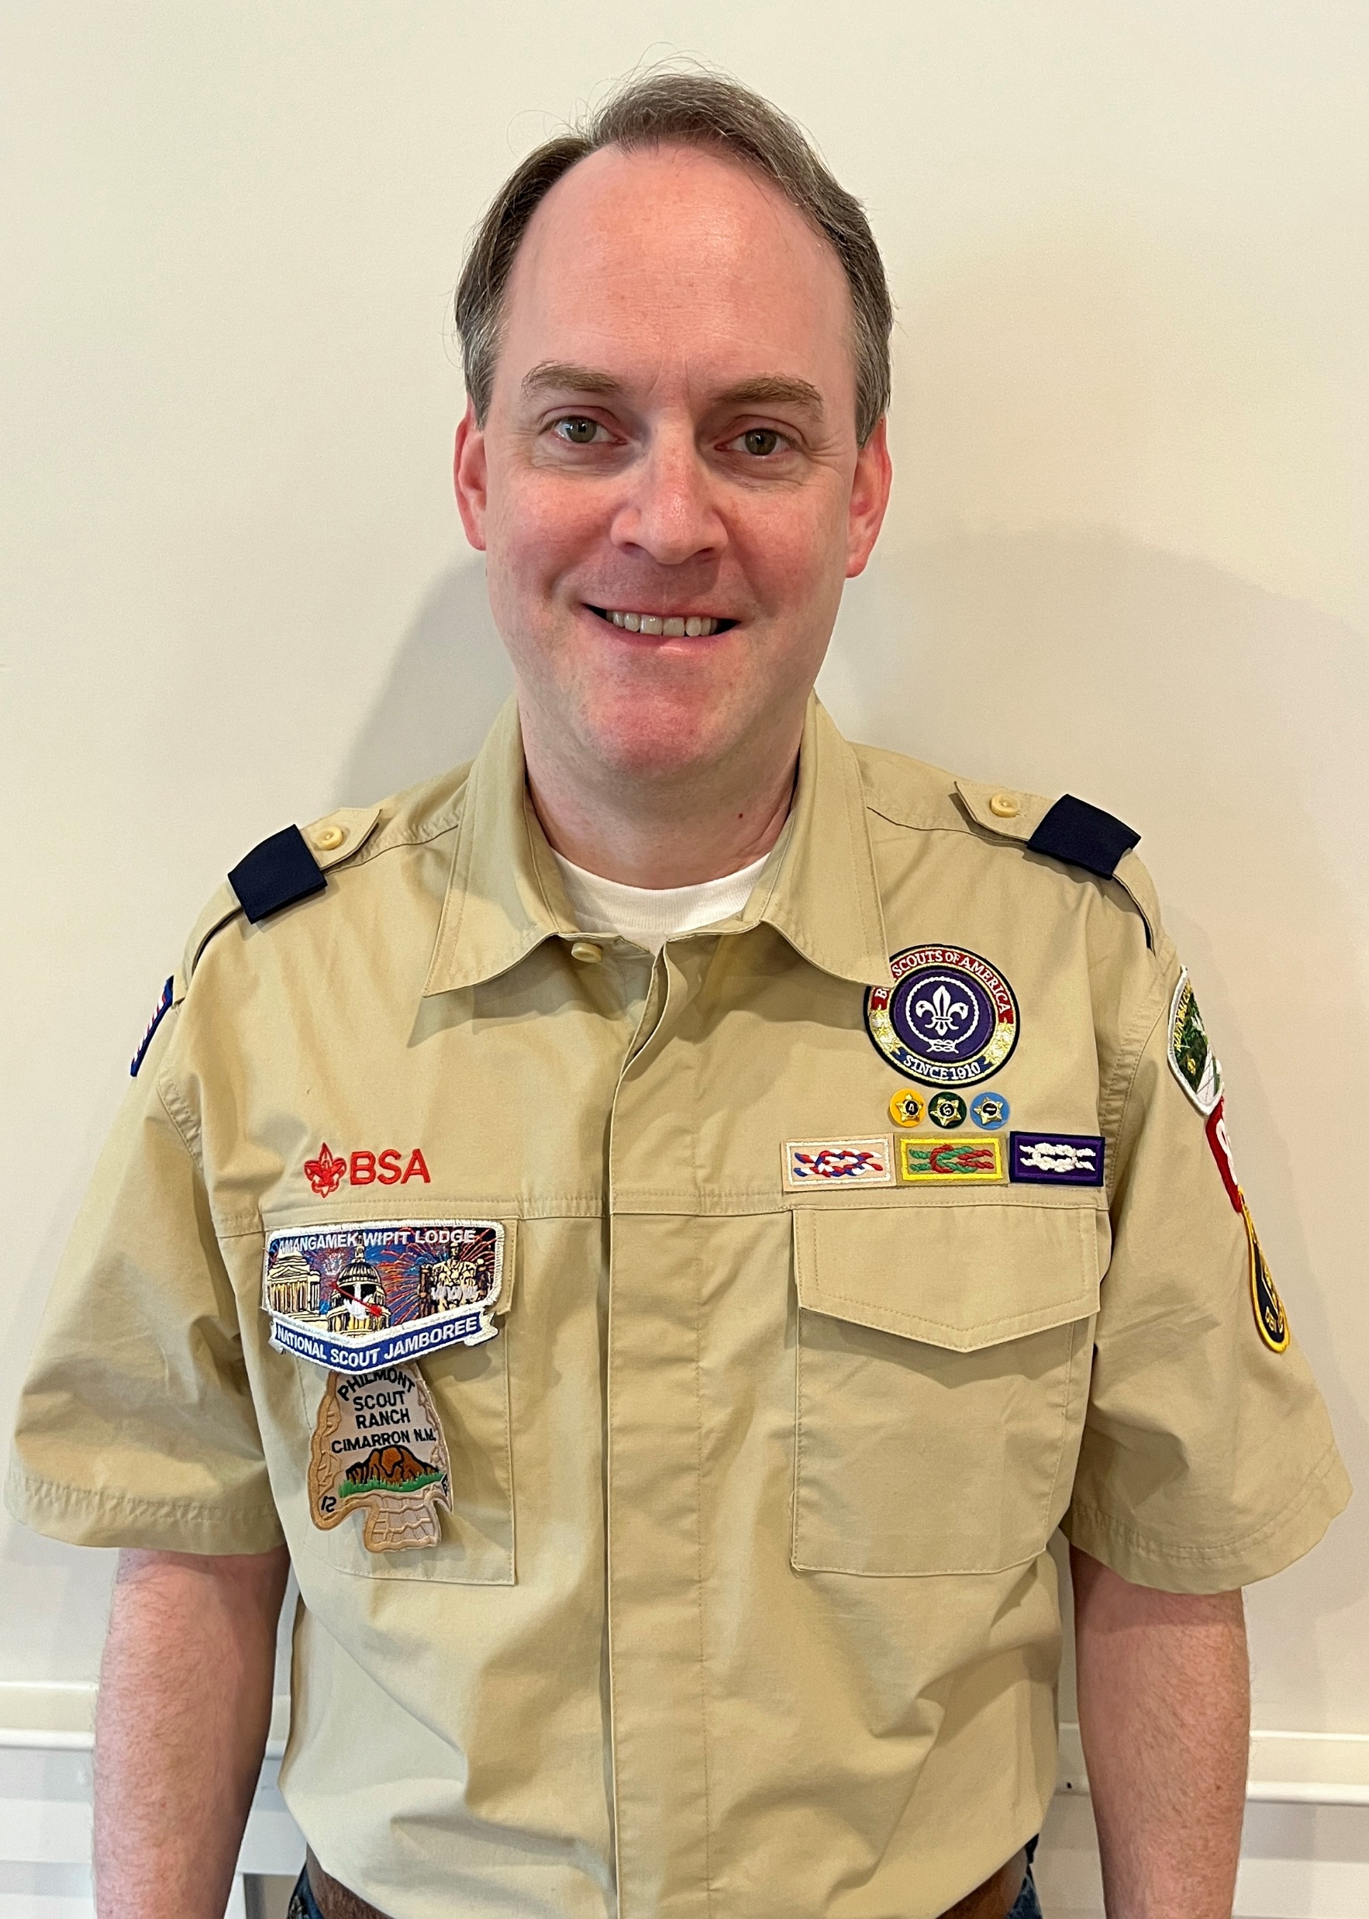
Pack 833
Sachin Nene
  For service to the youth and families of Pack 833 as Bear Den Leader and Committee member.
Mark Pollak
  For service to the youth and families of Pack 833 as Wolf Den Leader and Committee member.
Tom Rohrback
  For service to the youth and families of Pack 833 as Tiger Den Leader and Committee member.
Tom Rohrback

Slide 40
Pack 976
Chris Lavery
  Chris has shown dedication, organization and creativity in the job of pack committee chair.
Christian Sotomayor
  In addition to running a great den, his vision and work made for a memorable experience for the whole pack of sleeping over on a battleship .
Alice Bottcher
  Alice stepped into the crucial job of new member coordinator, helping recruit and welcome and new members. Her wealth and experience makes her a much-appreciated part of the leadership team.

Slide 41
Pack 976 (cont.)
Richard Jones
  Richard volunteered during the summer to lead the new Lion den and has done an outstanding job wrangling 11 rowdy kindergartners. He’s also been a big contributor to running Pack events.
Cardiel Trevizo
  Cardiel registered himself as a volunteer as soon as his son signed up - a preview of his incredible gracious and extroverted leadership, which he has brought to both our largest den and to numerous Pack events.
Claudia Sotomayor
  Claudia and her husband, Christian, lead the Bear den with some of the most diverse ad experiential set of activities of any pack. Her leadership has helped the den grow each year.

Slide 42
Pack 976 (cont.)
Rebecca Bolchoz
  Becca enthusiastically answered the call to bring two-deep and female leadership to our Webelos den and has been a much-appreciated leader. Whether taking charge in our Ultimate Frisbee game or helping the pack treasure hunt, she has led the way.
Eric Hernandez
  Eric enthusiastically answered the call for two-deep leadership and was instrumental in helping the AOL den finish their requirements on time before they crossed over to the Troop.

Slide 43
Pack 1139
Sara Snyder
  Sara stepped in as Pack Committee Chair at the beginning of the year and brought a great deal of structure to our Committee that has been lacking in the past few years. She has also helped rejuvenate our core of volunteers which has been needed recently.
Heather Etner
  Heather serves as our Tiger Den Leader. She brings an energy and compassion to serving an unwieldy den of young Scouts.
Amy Scott
  Not only does Amy lead our Wolves, our largest den, she also organizes a number of our monthly outings and somehow keeps all of our awards straight as our Advancement Chair

Slide 44
Pack 1139 (cont.)
Annemarie McCaslin
  Annemarie has organized summer camps for a number of years and serves as our Bear den leader.
Elizabeth Korondy
  In addition to leading our AOL den and bridging all of them into BSA troops, Elizabeth uses both her business and political connections to include our community leaders in our activities and find opportunities for our Scouts to serve and be known in the community.
Luke Harris
  Luke serves as our treasurer and has helped get our finances well documented and got our budget to a healthy place.

Slide 45
Troop 140
Andro Franetovic
  Andro has been a member of the Troop Committee since his oldest son bridged over to the Troop in March 2019. Andro is a Executive Sous Chef, and the Troop has benefited enormously form his talents. It is safe to say that he has elevated the Troop's cooking to new heights and has demonstrated many cooking techniques to the Scouts.
William Mulligan
  Bill has been active in the Troop as a Committee Member since his son bridged over to the Troop in April 2005. During this time, he has undertaken several responsibilities, including a stint as financial recorder. For many years, Bill has been the Troop's camping coordinator to identify suitable campgrounds and make site reservations within the Troop's budget.

Slide 46
Troop 187
Kristinha Sabatino
  Troop 187 wishes to express its appreciation to Ms. Kristinha Sabatino for serving as our Membership Chair! We especially appreciate her dedication and persistence in learning the arcane art of rechartering and chasing down signatures for our charter and Facilities Use Agreements!

Slide 47
Troop 345
Andy Lee
  Andy has tirelessly served for the past 8 years as the Troop Camping Coordinator. In addition to organizing outings, he camps with the scouts and serves as an amazing mentor. Andy chaperoned a crew of scouts last summer at Philmont.
Fred Muhlenberg
  Fred has served as a High Adventure chaperone and has taken crews to Sea Base, Northern Tier and twice to Philmont.
Neal Sikka
  Neal accompanied the scouts to Philmont last summer. He's been a great mentor to the scouts and shared his medical knowledge.

Slide 48
Troop 345 (cont.)
Stanley Antoine
  Stan is one of our newest ASM with dedication and commitment to Troop, meetings and Campouts, service events and assisting Troop Webmaster.
Mark Enstrom
  Mark is one of our newest ASM with dedication and commitment to Troop, meetings and campouts, service events
Anjum Sikka
  Anjum has been advancement chair for numerous of years and in planning Troop COH’s

Slide 49
Troop 345 (cont.)
Keith Robinson
  Keith's steadfast support of the scouts and Troop 345 are exemplary. He serves as an example of what an Eagle Scout is to all.
Seema J
  Seema has been Troop Secretary for numerous of years and also planning Troop COH

Slide 50
Troop 349B
Laura Hill
  Internet advancement and Troop Purchaser. Laura is doing double duty on our parent committee, attending most meetings to be available for advancing scouts. She tracks each Scout's rank advancement, merit badge progress, and other achievements, maintaining all relevant records. She also manages the troop's supplies of merit badge patches, service pins, and similar materials, purchasing items as necessary. While it's not an official role, Laura is also a welcoming ambassador for our troop when we have guests.
James Hinderks
  Fundraising Coordinator. James shoulders the herculean task of managing our annual fundraiser, the sale of mulch. He coordinates sales materials, product sourcing, delivery venues, and vehicle rentals. During the sale period, he is always on hand to provide support and answer questions for scouts and their families. He maintains the running sales statistics, and sends out weekly updates. He also developed an email sales strategy to boost last-minute sales. James also serves as the Webmaster for our troop and keeps our website up to date.

Slide 51
Troop 349B (cont.)
Susan Janec
  Board of Review Coordinator. Susan maintains the board of review calendar, scheduling each board of review as requests come in. She also performs the critical role of recruiting volunteers to serve on the boards of review. She is exceptionally methodical and organized; she developed a repeatable process for notifying the Scout family and the reviewers by email, to remind them of the scheduled time and anything they need to do to be prepared. She's always willing to fill in on a board of review whenever we are short on volunteers. Susan has also provided dinner and refreshments on nights where we have had multiple Eagle Boards of Review.
Hans Miller
  Assistant Scoutmaster and Cub Scout Den Leader. Hans has been a steadfast leader to our Troop while simultaneously leading a Cub Scout Den in Pack 657. His energy and enthusiasm were central to our recruiting efforts which will bring us seven new Scouts this Spring. Hans is slated to become our next Scoutmaster in Summer 2024 and the Troop will benefit from his tireless commitment to Scouts.

Slide 52
Troop 349B (cont.)
John Bonds
  Assistant Scoutmaster. John is a highly motivated and energetic ASM who has taken on multiple challenges for the Troop including organizing Summer Camp, getting trained to resurrect the Troop's climbing program, helping coordinate the annual ski trip, and helping with various meetings and events. John's efforts provide incentive and excitement to keep our Scouts coming back for more.
Nicholas Draper
  Former Scoutmaster and current ASM and Eagle Advisor. Nicholas has had a busy term as Eagle Advisor, especially lately as he sheparded five new Eagles through the sometimes daunting process. These Scouts chose to celebrate their achievement with the Troop during the Spring Court of Honor and Nicholas modified the program to ensure each Scout was honored individually. And he's not done-we are expecting 5-7 additional Eagles by June. His organizational skills are impressive and serve as a great example to our Scouts.

Slide 53
Troop 349B (cont.)
Chris Ross
  Former Scoutmaster and current ASM. Chris is the Troop 349 brain-trust and teacher of many Scouting skills. Whether tying obscure knots, placing a bear bag, explaining the logic of campsite set-up steps, or strategizing on loading a backpack, Chris is a master of the trade. He has also served several years as the Quartermaster Advisor helping Scouts learn the value of organization and planning. He can often be found on Troop campouts and is currently helping prepare the Philmont 2024 crew for the challenges in New Mexico. We are glad for his willingness to share his knowledge!

Slide 54
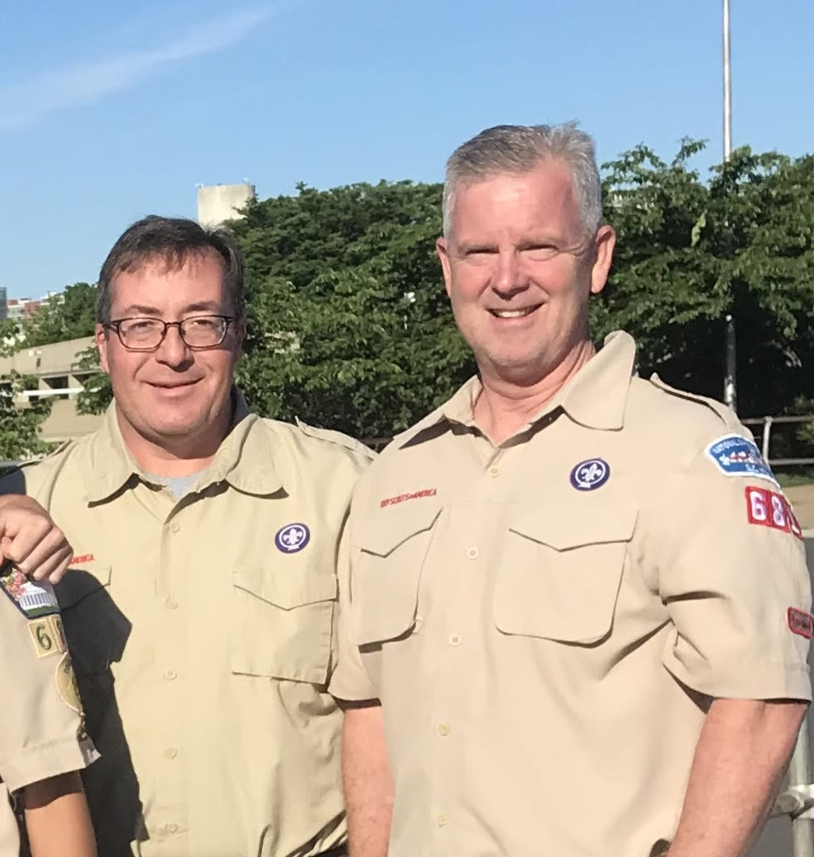
Troop 681
James Simonson & Larry Williams
  Jim and Larry are concluding their ASM service to Troop 681 and the Night Hawk Patrol with six Eagle Scouts. Together, they organized Troop and Patrol outings for Fish Camp, Gettysburg Battlefield tours, Sea Base, a Half Dome hike and high adventure 50-milers for backpacking at Philmont, cycling from Cumberland to Georgetown and canoeing on the James River.

Slide 55
Troop 681 (cont.)
Elizabeth Vogel Rogers
  Elizabeth has served Troop 681 and the Guardian Patrol as an ASM for several years and we look forward to several more. This last year, she has organized some awesome Scouting experiences including for fly fishing merit badge, Commander's football game and overnights for kayaking and fishing, the CLIMBOREE, Historic Ships in Baltimore, Great Lakes Sailing Adventure and Sea Base.

Slide 56
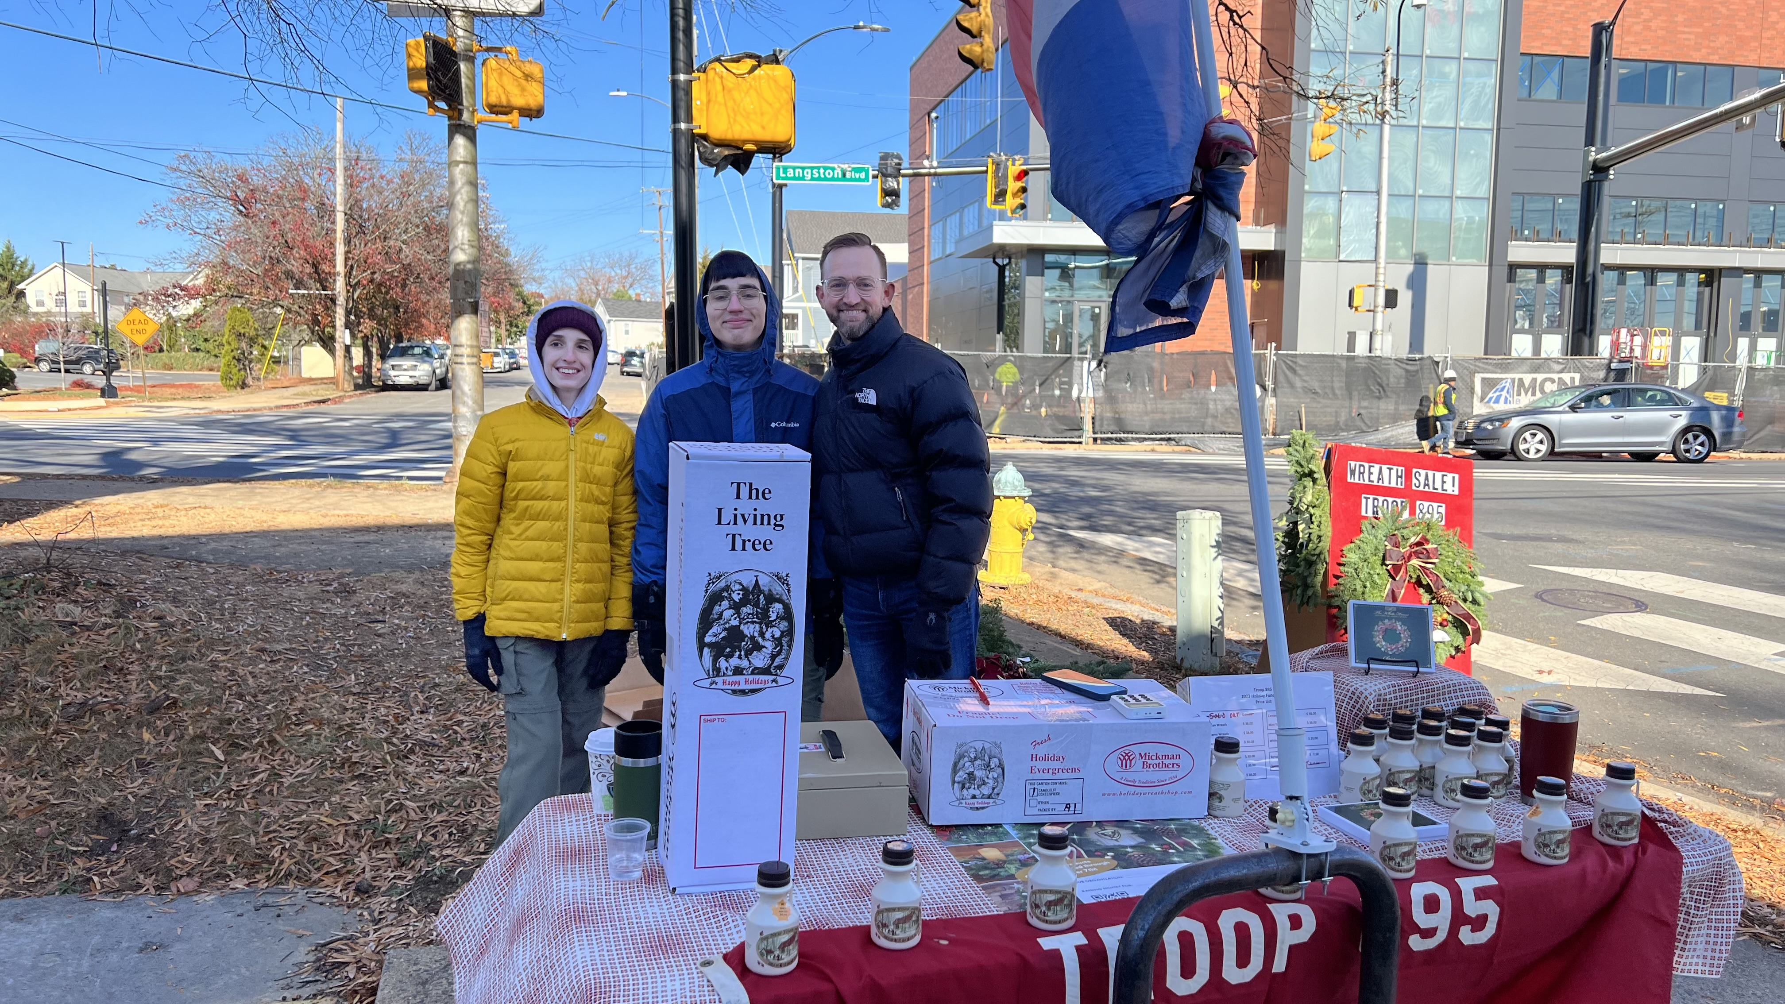
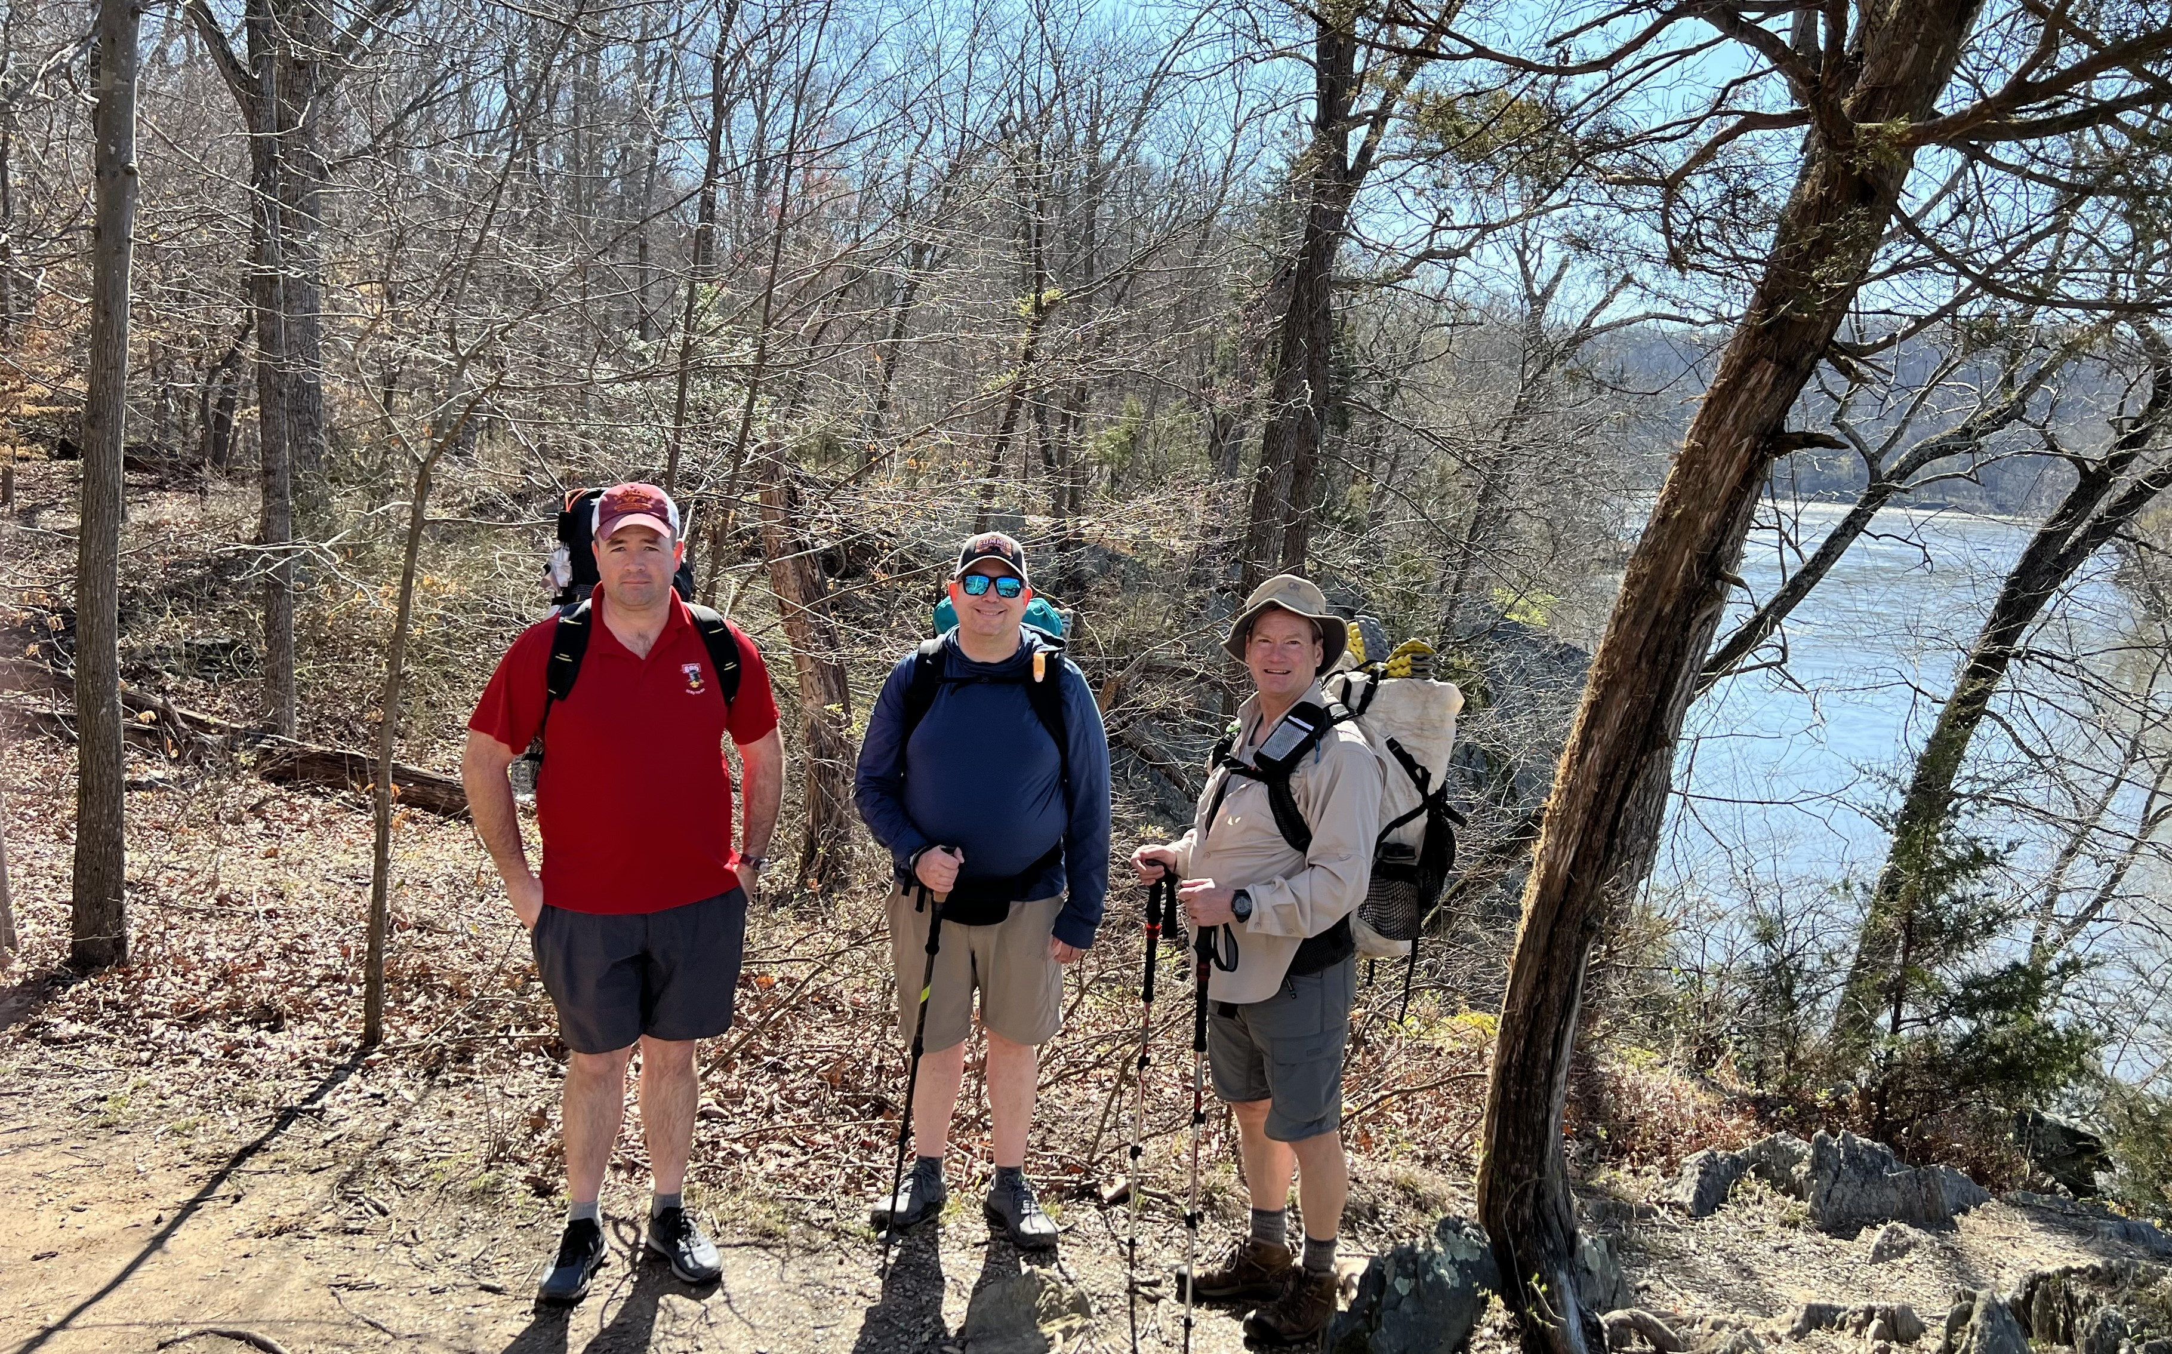
Troop 895
Chris Mahon
  Chris organized and executed the Troop's annual holiday fundraiser, which supports the Troop's activities including participation in High Adventure.
Karen Eisner-Enriquez
  Karen went above and beyond by driving the Troop's gear from Virginia to Colorado and back last summer for the Troops big trip.
Chris Mahon
Karen Eisner-Enriquez second from left

Slide 57
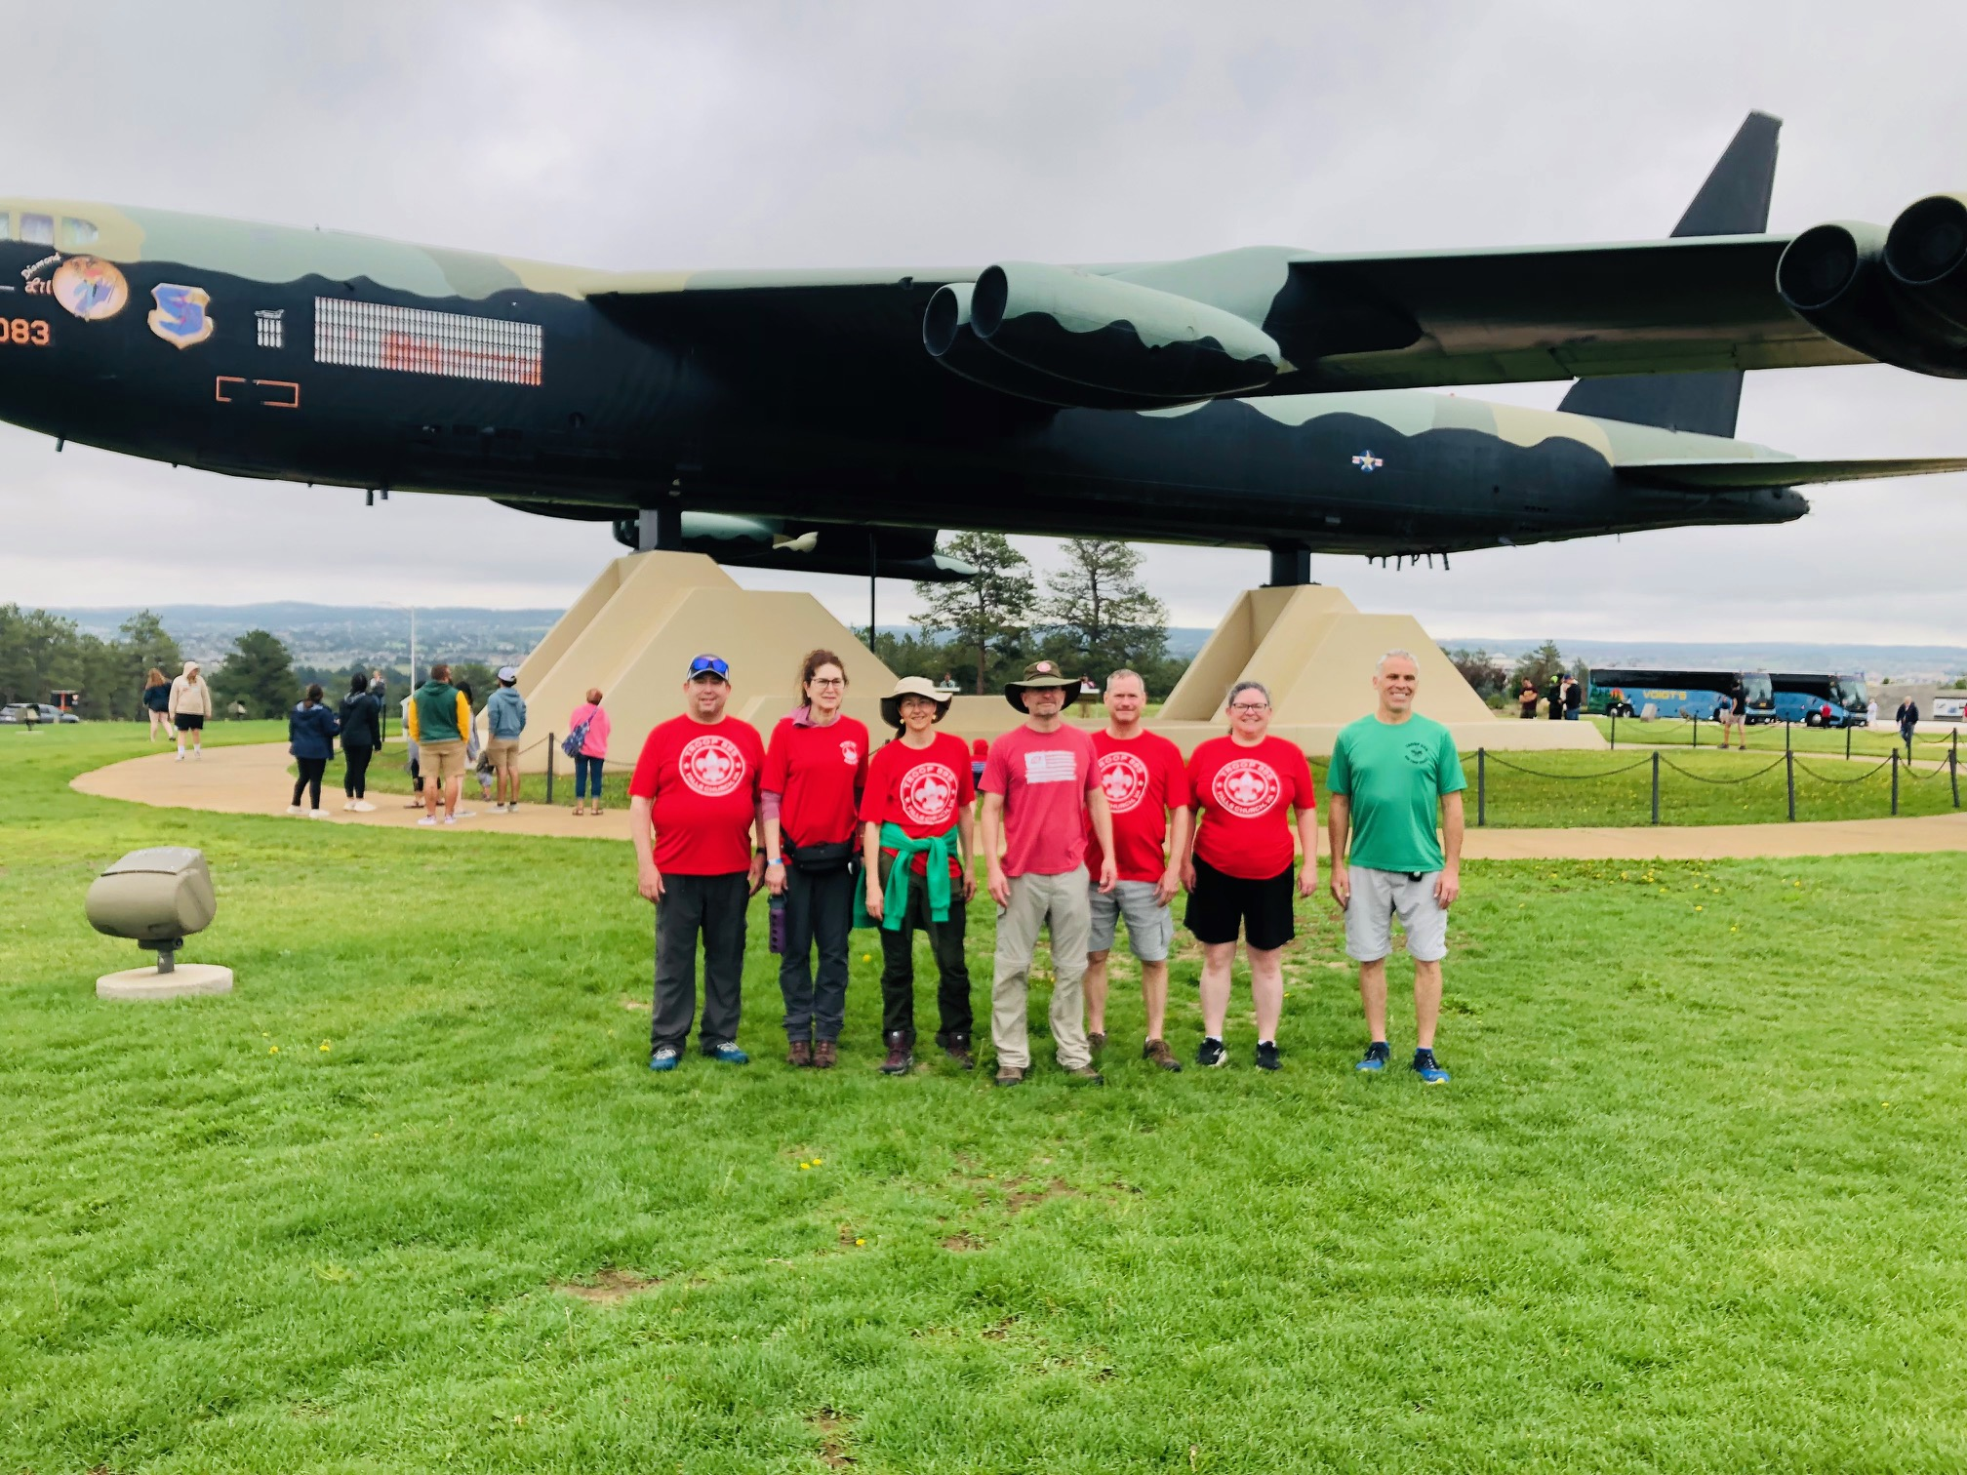
Troop 895 (cont.)
Rob Barnett
  Rob, himself an Eagle Scout, is always willing to be a scout camp and campout leader, and this year has taken on the role of merit badge coordinator for the troop.
Eric Thomton
  Eric shares his love of the outdoors with the scouts as a camping and hiking leader, and merit badge counselor for camping, hiking, backpacking and wilderness survival.
Rob is on the left Eric is on the right

Slide 58
Troop 976
Gregory Beatty
  Greg Beatty is a terrific new Scoutmaster after serving as an assistant for three years. He is a calm and steady presence who draws great respect from the Scouts. He is organized and always focused on the most important aspects of scouting and growth opportunity for the boys.
Stephanie Findlay
  Stephanie Findlay is an unsung hero. Along with managing adult training, she is a one-woman cheerleading squad for the Troop. She encourages families to join, patiently answering questions for them. She gives generously of her time and attends virtually all troop events, spreading her helpful and upbeat attitude.
Mike Hughes
  Mike Hughes brings incredible dedication to the assistant scoutmaster role. He and his wife, Nikki, do a huge amount of work to make our only fundraiser (wreath sales) a major success. Mike is putting all kinds of effort into leading a weeklong bike trip this summer along the entire C&O Canal and has been a key player in planning and supporting high adventure trips for our troop as well as many campouts

Slide 59
Troop 976 (cont.)
Tara Rice
  Tara Rice manages our advancement efforts very successfully. She’s a thoughtful leader always considering ways for our troop to operate better. And she successfully balances all the detail work of managing boards of reviews and tracking Court of Honor awards. She does it with great care and concern for every scout in the troop and she is extremely supportive and welcoming of other parents in the troop.
Timothy Argauer
  Tim Argauer brings great institutional knowledge and experience to the role of committee member and treasurer. With four Eagles in his own family and a fifth working on it, he has long experience with the Troop and its high adventure efforts. And he manages all the finances of a large and active troop. Tim is kind and cheerful in all he does for and with the troop and he is also a great mentor to many other parents in the troop.
Betsy Argauer
  Betsy Argauer is a merit badge counselor who stepped up to become a counselor for the new Citizenship in Society badge and has guided many Scouts through that badge already. She also deftly handles all our Eagle Scout paperwork. Beyond her official jobs, Betsy shares her knowledge and experience freely with grace and cheerfulness.

Slide 60
Troop 976 (cont.)
Wendy Yoviene
  Wendy Yoviene took on the role of new Scout onboarding/membership and now is moving into the crucial role of Chartered Organization Representative, bringing with her a close relationship with our sponsoring organization and history of volunteer work for them. She asks insightful questions, is present for many events and brings a positive environment to our Troop.
Harry Rice
  Harry Rice juggles two important jobs: collecting and organizing our medical forms and rechartering. His tech skills are very handy when registering new families because he brings a wealth of knowledge for trouble shooting. He’s key to our troop finding its way through the maze of rechartering each year. Harry’s dedication to the Troop extends to cold weather camping—he was one of two adults on our winter
  campout where the overnight low was 11 degrees.

Slide 61
Troop 987B
Elizabeth Korondy
  Troop 987B appreciates Elizabeth's leadership of troop fund raising activities, community outreach, and service projects.
Tom VanDenBrink
  Troop 987B appreciates Tom's commitment to our camping and high adventure programs and his willingness to endure the conditioning programs associated with them.
Jim Miller
  Troop 987B appreciates Jim's contributions to troop fundraising and community outreach activities, as well as his leadership as a troop merit badge counsellor.
Iana Ahmed
  Troop 987B appreciates Iana's leadership and coordination of the troop's summer and winter camp programs, as well as her participation in them.

Slide 62
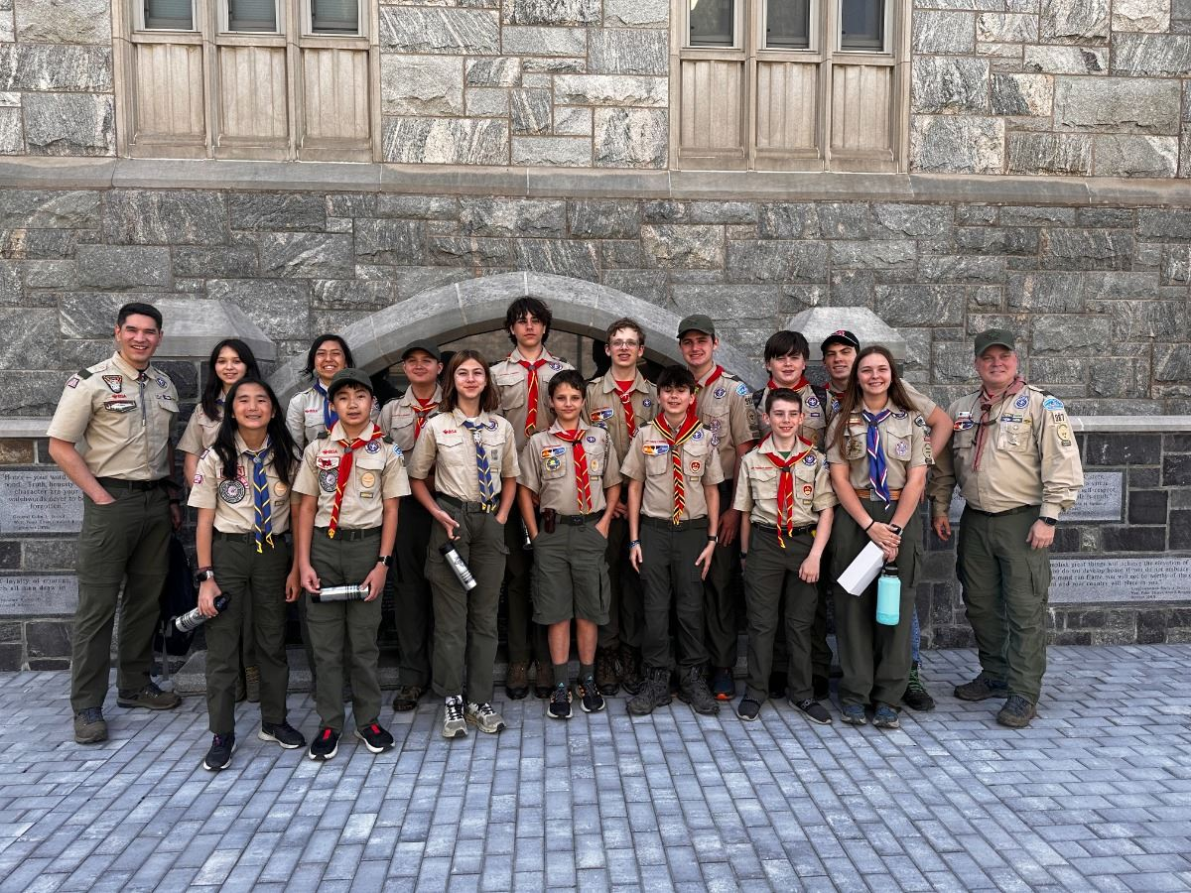
Troop 987G
Johnathan Ng
  Johnathan has served as an ASM for GT987 for nearly three years, and in that time taken over running the New Scout Quest program for both GT and BT. He frequently hosts Merit Badge classes, serves as a Merit Badge Counselor for several Eagle required Merit Badges, and has worked with the Scouts to develop planning tools to assist the PLC.

Slide 63
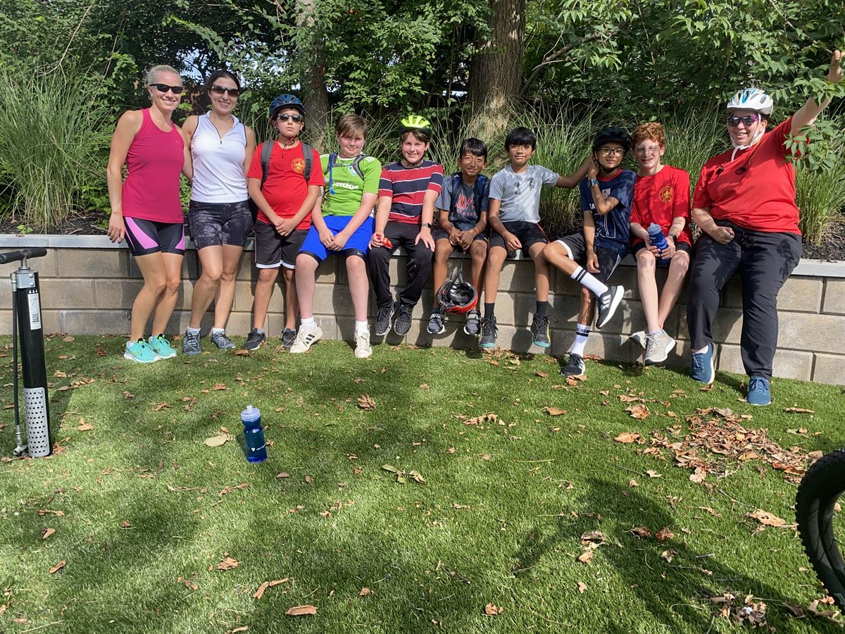
Troop 987G (cont.)
Annmarie McCaslin
  Annmarie has been an invaluable asset to GT 987, as one of a handful of female leaders who enjoys backcountry camping and backpacking. Without Annmarie's commitment to the outdoor program, there would have been several trips that GT could not have participated in. Additionally, she has been instrumental in our fundraising efforts, taking on a leading role in our largest fundraisers.

Slide 64
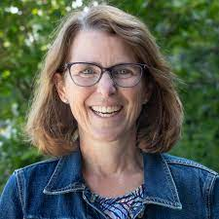
Troop 987G (cont.)
Karen Landwehr
  Karen provides steady and patient leadership and mentoring, in the backcountry, at camp, and at meetings. She has taken on the role of coordinating adult training, has worked tirelessly on fundraising and outreach, and is always happy and eager to take on new challenges on behalf of the Troop. Karen is a key part of GT 987 team.

Slide 65
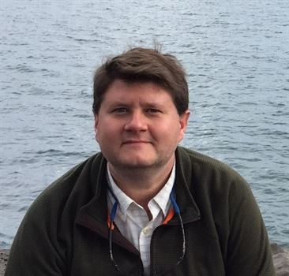
Troop 987G (cont.)
Jason Dalton
  Jason serves as our Advancement Chair, responsible for coordinating weekly Boards of Review, managing the final stages of an Eagle Scout's advancement, and keeping all of our Scouts advancement in proper order. He has recently taken on an additional role as the Life to Eagle Coach, to streamline that process for our Scouts. Despite his committee roles, it would be easy to confuse Jason for a Scoutmaster as he is always the first to arrive and the last to leave every event .

Slide 66
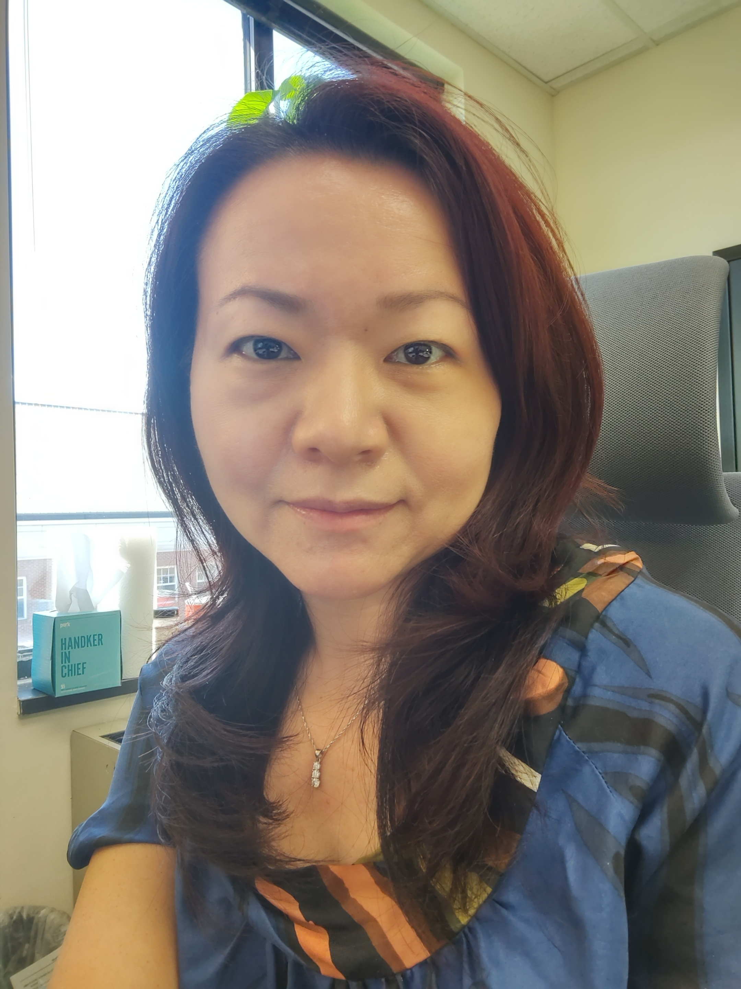
Troop 1113
Jenny Fishman
  Jenny Fishman joined Troop 1113 in 2023 and volunteered to be the Troop's Treasurer. In her inaugural year, she has led the Troop's transition to accepting digital payment for dues and open the ability to process credit card payments for this year's fundraiser.
Patrick Murray
  Pat Murray was the adult lead for Troop 1113 Scouting for Food Drive, Religious Emblem Award Program, and Recruitment drives for 2023-2024. He and his scout coordinated with Saint Leo's leadership to execute an successful program.
Daniel Perugini
  This is Dan Perugini's first year as Scoutmaster for Troop 1113 and is deserving recognition for his constant efforts in delivering the program, being the 1st adult at all scouting events, and motivating the Senior Patrol Leader to run a successful Troop meeting every week.
Jenny Fishman

Slide 67
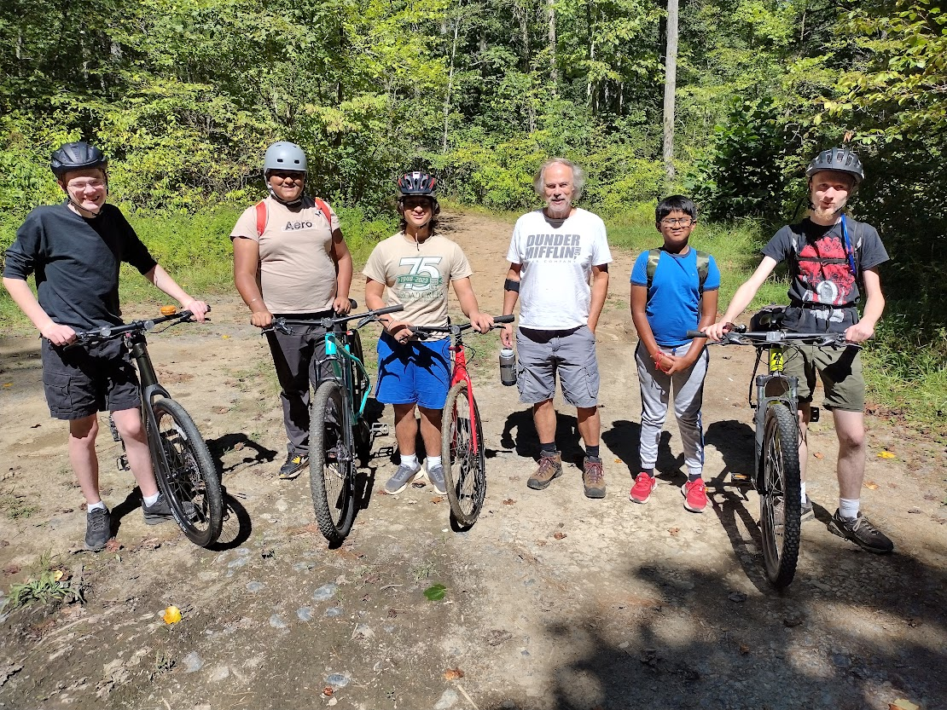
Troop 1143
Mark Quigley
  Assistant Scoutmaster Mark Quigley steadfastly participated in T1143 activities and meetings to include summer camp at Broad Creek Scout Reservation's Camp Safran as well as a unit campout near Elizabeth Furnace Recreation Area where he and the scoutmaster swept for wayward scouts who fell behind during their mudhole gap trail mountain bike challenge.

Slide 68
Troop 1143 (cont.)
Robert Sansone
  Mr. Sansone provided significant logistical support to the T1143 fundraiser activity establishing a luminary display for an HOA. He also emailed on delivering the digital technology merit badge for our troop's scouts.
David Phillips
  Mr. Phillips organized the T1143 fundraiser establishing a luminary display for an HOA. He also delivered a Citizenship in Society merit badge seminar to our scouts.

Slide 69
Troop 1539
Steve Costner
  Steve has 15 years of service with the troop, starting as an adult volunteer and serving as the Scoutmaster from 2010 to 2013, and again graciously stepping in as interim Scoutmaster in late 2019-early 2020. Even though his scout aged out years ago, Steve continues to faithfully serve as a knowledgeable, capable, and experienced Assistant Scoutmaster, working weekly with scouts on rank advancements, serving as our troop’s adult OA advisor, and continuing to serve as an adult advisor on High Adventure trips, most recently at Northern Tier.
Andy Cretal
  Andy is a go-to troop committee member for Boards of Review, but the troop has also kept him busy this year with various projects, including bamboo removal at a troop service project and a daunting engineering feat that involved lifting and moving our troop shed to keep it from slowly sliding down a hill. Andy will also serve as an adult advisor on one of our Philmont crews this coming summer.

Slide 70
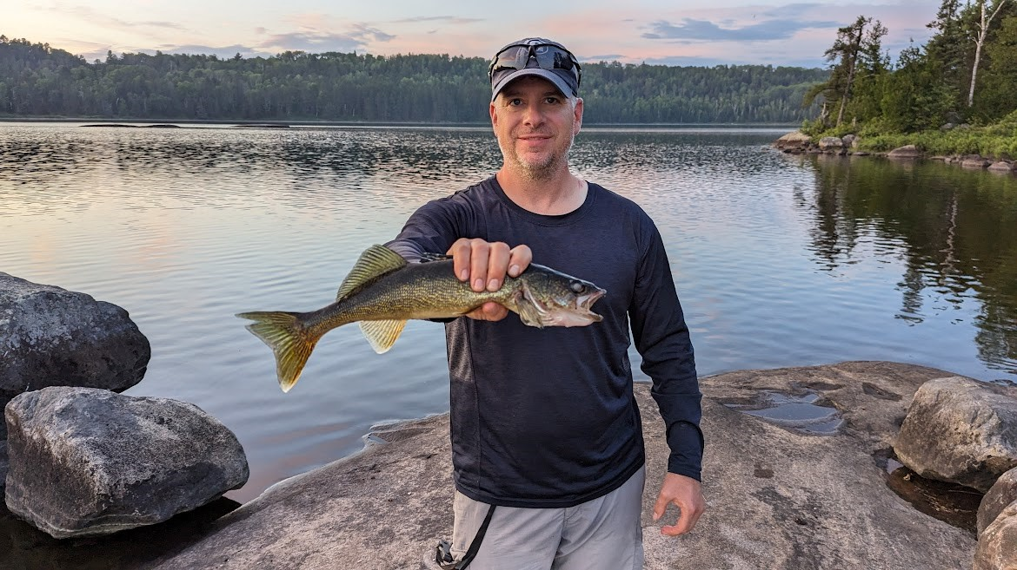
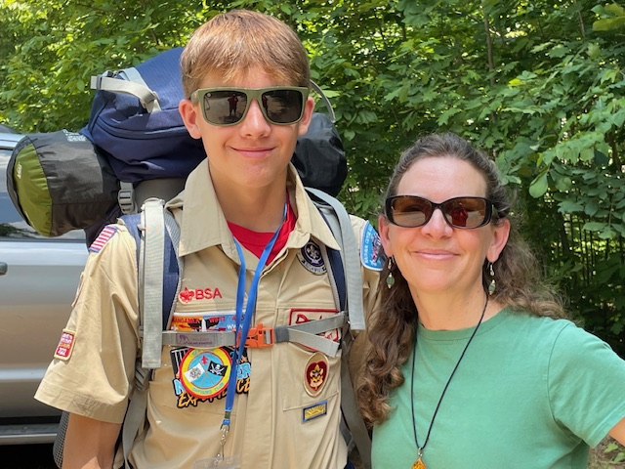
Troop 1539 (cont.)
Calvin Liu
  Calvin is a regular Board of Review committee member and is always available for last-minute Boards. Calvin cheerfully helps with various volunteer tasks, lugging around coolers of sodas for troop events, attending campouts, and spending quality time at the Scout Shop before a Court of Honor.
Bret Nickels
  Bret has been our Advancement Chair since 2020, and he is one of our most active non-uniformed adult volunteers at campouts and high adventure trips (most recently at 2023 Northern Tier, our small but mighty "COVID" Bike trip in 2021, and again this upcoming summer at Philmont). Bret’s homemade backpacking fish smoker ensured the Northern Tier crew stayed well-fed.
Donna O’Harren
  Donna has been our Activities Coordinator since September 2019, and has scheduled dozens of campouts and outings, knows the ins and outs of every park website, and what power-players and decision makers to talk to when there’s a problem. Even when the scouts want to do an activity that our troop has never done, Donna’s ability to find the right spot at the right time is a true superpower.
Bret Nickels
Donna O’Harren

Slide 71
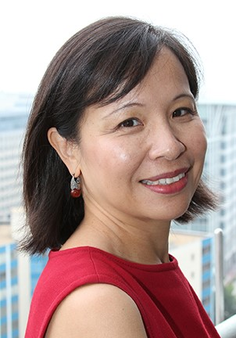
Troop 1539 (cont.)
Cheryl Schlosnagle
  Cheryl has served as our Troop Committee Secretary for about 2 years, working on administration and recruitment, and playing a key role in the successful onboarding of new scouts and their parents. When she isn’t working on committee business, Cheryl often supports the troop as an awesome adult volunteer on campouts and will be attending summer camp as an adult advisor for the third year in a row this coming June. Kudos to Cheryl as she took over as our Committee Chair in early April!
Sindy Yeh
  Sindy has been the head of the Board of Review Committee since 2019, coordinating the committee members who sit on each Board and providing guidance for adults who are new to the process. She works hard to ensure that each scout’s Board of Review is scheduled quickly, and she is an expert at making nervous scouts comfortable with the review process.
Handa Xi
  Handa has readily stepped forward to facilitate a wide variety of troop activities, doing so without hesitation and with an uncanny foreknowledge of when he is needed most. His duties have included running to the Scout Shop, helping with supervision at troop service projects and troop outings, going on innumerable campouts, and volunteering at Merit Badge Day.
Sindy Yeh

Slide 72
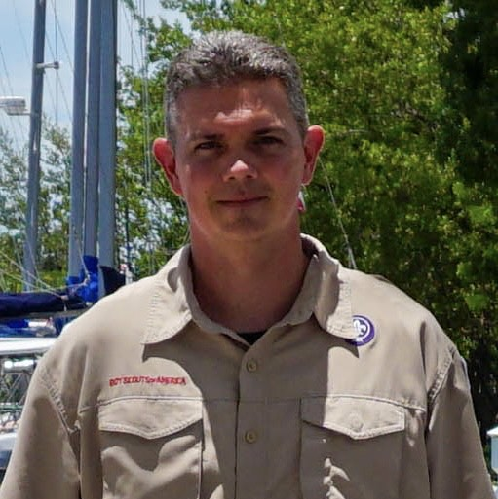
Troop 1887
Andrew Arrage
  Andrew is "the guy by the door, aka Devan's Dad," at every scout meeting. He handles our awards purchases, court of honor reports, and records updating so well that he often remains invisible to the Scouts, but the adults and Committee greatly appreciate the hours of work he puts in to make this all happen.
Steve Johnson
  Steve is a long-serving ASM who always brings great new programs to our troop. This year he ran our Chopped Challenge Cooking Campout and an excursion to Green Bank Observatory in West Virginia, all of which were big hits with our Scouts.
Peter Stafford
  Peter Stafford is a long-serving ASM who manages our Shooting Sports program. The Campout was a huge success this year with thousands of rounds of shotgun and .22 fired in a safe and encouraging environment for all of our scouts from the biggest to the smallest.
Peter Stafford

Slide 73
Troop 1887 (Cont.)
Robert Deal
  Bob serves as our Merit Badge Dean and is always ready to assist scouts with finding a counselor. He also arranged and promoted two high adventure crews for Sea Base, all of whom are excited to complete SCUBA and Sailing in July of 2024
Patti Coates
  Patti patiently coordinates all of our quarterly Courts of Honor and ensures that the events go off without a hitch each time! These events could not happen without her hard work, patience, and dedication.
Travis Tempel
  Travis is an ASM who also runs our Sustainability Merit Badge program, which has helped many scouts earn a challenging merit badge. Travis also traveled to Maine for a High Adventure trek with our crew last year. The event could not have happened without his hard work and enthusiasm.
Chris Coates
  Chris is a long-serving ASM who never fails to put in sweat equity on any outdoor event that we have. Chris was the lead adult advisor for our Main High Adventure crew in 2023. The event was a huge success for the scouts in the crew because of all the prep and training that Chris put in with them.

Slide 74
Troop 1888
Scott Smith
  Mr. Scott Smith joined Troop 1888 in March 2023 and serves as an Assistant Scoutmaster. Since joining, he has been a key leader for the troop and mentor to the scouts. He routinely offers his time and leadership to go on scouting campouts and trips. He is always willing to sit down with the scouts and help them learn and grow within the program.

Slide 75
Troop 1978B
David Best
  As Troop 1978B's Advancement Chair, David plays a leadership role in implementing one of the key methods of Scouting Advancement. David is proactive and thorough, allowing Troop 1978 to promptly recognize Scout advancement and reward it. As a result, a high proportion of Troop 1978 Scouts complete their journey to the rank of Eagle Scout.
Meaghan Molinini
  Meaghan has served as Troop 1978 B's treasurer for several years. Troop 1978 B is a sizeable Troop. It also needs to work within the fiscal management practices set forth by our sponsoring organization, St. Mark Catholic Church. Meaghan has successfully managed the complexities associated with these two factors. This enables the Troop to thrive and make capital investments to ensure that the Troop continues to thrive for years to come.

Slide 76
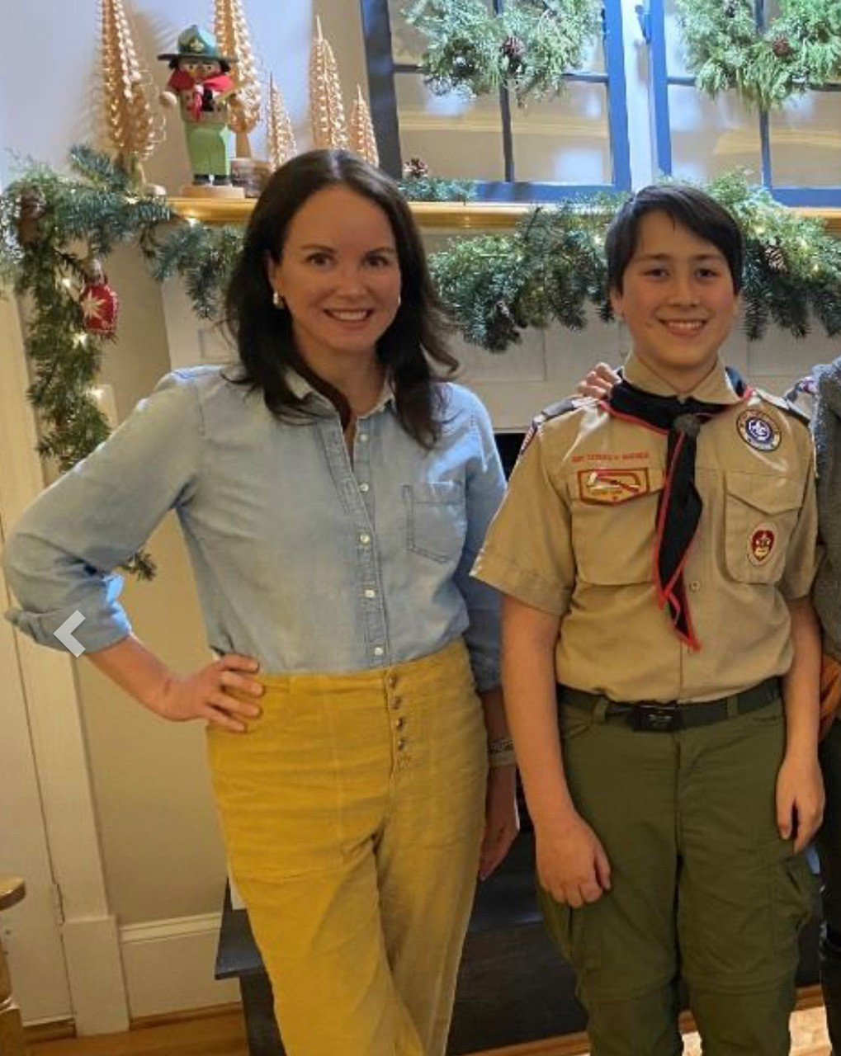
Troop 1978B (cont.)
Tiffany McGettigan
  Tiffany raised her hands to serve the Troop the moment her son crossed over to Troop 1978 B. She is Troop 1978's Troop Web Host Administrator. This role requires heavy involvement at specific times of year and Tiffany is successfully meeting these moments
Margaret Schottler
  Margaret is our Scout's trusted guide on their Eagle journey. Margaret is a role model for Scouts - showing them how to effectively communicate, track action items and stay organized. Whether our Scouts are right on track, or in need of catching up, Margaret makes herself available at a moment's notice to allay anxiety or nudge Scouts along.
Margaret Schottler

Slide 77
Troop 1978B (cont.)
Kristin Root
  Kristin is currently Troop 1978 B's Court of Honor Coordinator but has served in many roles for the Troop. From communications to systems management to team leader. Kristin’s contributions are too numerous to fully describe. Regardless of her role or the size of the effort, Kristin drives us forward with a steady hand and good cheer.
Matthew Zawislak
  Matt is fully engaged in all aspects of Troop activities serving as an Assistant Scoutmaster(ASM). Lead ASM for March activities, Quartermaster ASM, Philmont Advisor, and Merit Badge Counselor. Matt loves the outdoors and is an excellent mentor to the Scouts. Matt has the trust and confidence of the Super Green Bar and interfaces well with fellow adult leaders and parents.

Slide 78
Troop 1978B (cont.)
Brian McCabe
  Brian is an excellent Assistant Scoutmaster (ASM) who has brought new life and excitement to the Troop as the Summer Camp ASM, GAP Trail Bike Trip ASM, and Hiking MB Counselor. When Brian is involved with an activity, Scout and Scouter participation is high and everyone enjoys themselves. Brian's leadership and empathy provides a great example to the Scouts and Scout leaders.
Brian Summers
  For nine (9) years, Brian has served the Troop as a dedicated and enthusiastic Assistant Scoutmaster (ASM), lead ASM for monthly campouts and shooting sports activities and the Order of the Arrow ASM. Brian has earned a reputation as a true and loyal “Scouter". His shooting sports activities are a highlight of the year for scouts.

Slide 79
Troop 1978G
Christina Brown
  Mrs. Brown is our Troop's Board of Review (BoR) Coordinator/Eagle Scout Coordinator. This is Mrs. Brown's 2nd year as our BoR coordinator and first as our Eagle Scout Coordinator. In addition to scheduling BoRs, she has been able to step in and help our Scouts navigate the Eagle process. Her communication with parents and Scouts to get these BoRs accomplished is first rate.
Melinda Berardi
  Ms. Berardi is our Troop's Advancement Chair and has done a fantastic job. This is her first year handling the Troop's Advancement and thus she had to increase her knowledge of Scout Book in addition to learning a new software package the Troop uses for administration. Through her efforts our Troop's Scout's advancement progress is managed and visible to Scouts, their parents and Troop's leadership.

Slide 80
Troop 1996
Wayne Casey
  Scoutmaster – Now in his second year, Wayne continues to lead the success of our young men as they journey through the scouting adventures of Troop 1996. Wayne spent a week at summer camp this past July working with our summer SPL. That effort was rewarded with both Honor Troop recognition and First Place in Camp Shenandoah Olympics, a first for our troop.
Bob Dunn
  Committee Member – Bob is a long-time committee member whose son presently serves as our 2023/24 SPL. He has been active in the troop, recruited his wife to be a MBC the new Cit in Society MB, and attends meetings and outdoor activities with our troop. His service is appreciated and valuable to our organization.
Jeff Kuck
  ASM – Jeff is the Scoutmaster of a female troop in Mclean. In spite of that workload, he has been active and supported several campouts, and works with his son and his patrol to ensure they have adult supervision but not too much. He is one of only two adult Eagle Scouts currently registered with our Troop and we appreciate him giving back.

Slide 81
Troop 1996 (cont.)
Ryan Conner
  Committee Member – Ryan is a self-less and giving individual who has supported several Eagle scout projects as well as offered the Woodworking merit badge. Ryan consistently gives when asked with little concern for the time or effort required. He is a true volunteer, and his work is appreciated by all of our troop leadership.
Chris Sturgill
  Treasurer – Chris has served as treasurer for three years now and he continues to provide valuable support to our youth facing leaders. His work to keep our finances in order and ensure our fund raising is successful and sufficient to fund ongoing operations is critical to the success of Troop 1996.

Slide 82
Service at the District Level

Slide 83

District Award of Merit
The District Award of Merit is presented by the District to Scouters who have rendered service of an outstanding nature to youth, both in the community and in Scouting.

Slide 84
District Award of Merit
Jerry Driscoll
Jerome Driscoll was Scoutmaster for Troop 1539, overseeing 41 Scouts before the pandemic in 2020. His tenure saw numerous young individuals achieve the prestigious Eagle rank, and despite the challenges posed by the pandemic, he ensured a seamless transition to a successor who continued to uphold the Troop's strong program. Following this, Jerry held multiple district positions, including being a Unit Commissioner for Pack 1139 and Troop 1539. Jerry served as the George Mason Conservation Coordinator for two years, dedicating his time to promoting conservation within the district. In 2020, he assumed the role of Chartered Organization Representative (COR) for Pack 1139 and Troop 1539, which he continues to hold. He also extended his service as the COR to Pack 152 and Troop 345 in 2023.

Slide 85
District Award of Merit
Bob Freeman
Bob Freeman began Scouting in Charlotte, North Carolina as a Cub Scout and Boy Scout. In 1999, he joined Cub Scout Pack 1114 in Vienna as a Den Leader, serving three years. In 2003, Bob joined Emmanuel Lutheran Troop 987 as an Assistant Scoutmaster and became Scoutmaster in 2010, serving until 2014. With his sons, Bob entered the Order of the Arrow and saw both sons earn the rank of Eagle Scout. In 2011, GM District Commissioner Bob Dice awarded Bob the “Commissioner’s Unit Scouter Award” for increasing Troop 987’s enrollment from about 30 to over 90, the second largest Troop in the District. Later, Bob served as Troop 987’s Committee Chair for one year (2014-15) and Chartered Organization Representative for four years (2015-19). In 2019, Bob joined the George Mason District Advancement Committee serving as a District Eagle Representative. In this role, Bob has mentored over 50 Scouts on their path to the Eagle rank.

Slide 86
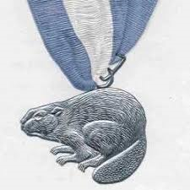
Silver Beaver
The Silver Beaver Award is the council-level distinguished service award of the Boy Scouts of America. Upon nomination by their local Scout council and with the approval of the National Court of Honor, recipients of this award are registered adult leaders who have made an impact on the lives of youth through service given to the council. The Silver Beaver is an award given to those who implement the Scouting program and perform community service through hard work, self-sacrifice, dedication, and many years of service. It is given to those who do not seek it.

Slide 87
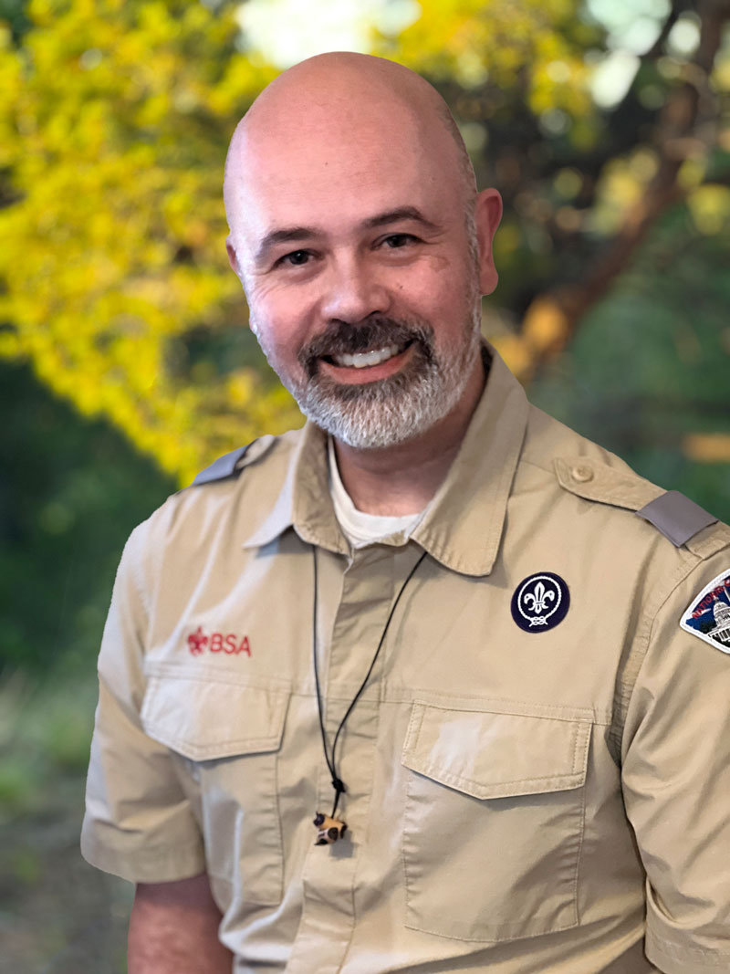
William Cullen Bengston
Cullen Bengston is a scouter who has had significant impact in developing and providing quality youth leadership in national BSA, council and district programs. Through Cullen’s 15-year scouting career he has been a Cubmaster, Scoutmaster and Assistant Scoutmaster. He served the George Mason District representing Friends of Scouting, Baloo training and continues to serve in the District’s Training Committee introduction to Leadership Skills (ILST) and National Youth Leadership Training (NYLT).
In 2015 Cullen began investing time in the Council’s Leadership Training Continuum courses: staffing both Wood Badge (2015 and 2022) and National Youth Leadership Training (NYLT) since 2015 (7 years with 3 years as course Director and continuing). In 2017 he was asked to be the Council Coordinator for NYLT. In addition to leading NCAC’s program, Cullen has also helped other council’s in Council Service Territory 12 with their NYLT programs.

Slide 88
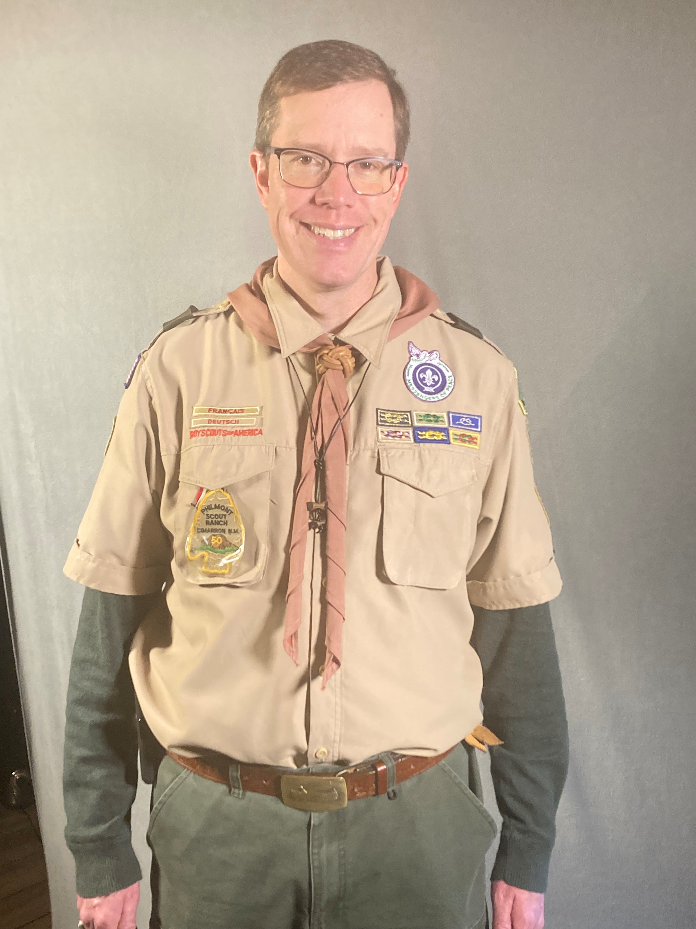
Scott Willey
Scott Willey is a volunteer with a passion for serving Scouting and his community. Scott joined Cubs as a youth in Iowa, earning the Arrow of Light in 1982. Scott bridged to a troop in his community, attended the 1985 National Jamboree, was elected to the Order of the Arrow in 1986 and earned the Eagle rank in 1987.
Scott volunteered to be an Assistant Scoutmaster with Troop 697 in Patriot district and served as a Merit Badge Counselor for Citizenship in the World merit badge. He became a Den Leader in Pack 1513 in 2009 and later served as the Cubmaster for three years. Subsequently, he served as Scoutmaster of Troop 187 for four years. He completed his Woodbadge ticket in 2018. He led the 2018 “Greeks and Romans” District Camporee, led the Scouting for Food campaign for several years, pioneering the use of things like firetrucks and dinosaurs to describe our results. Scott has been the District’s Special Needs Coordinator since 2021 and received the District Award of Merit in 2022.
In addition to his Scouting roles, Scott has been an election officer for Fairfax County since 2020, volunteers as a Tree Rescuer, has chaperoned elementary and middle school field trips, regularly runs in 5K and 10K races and has completed 7 triathlons!

Slide 89
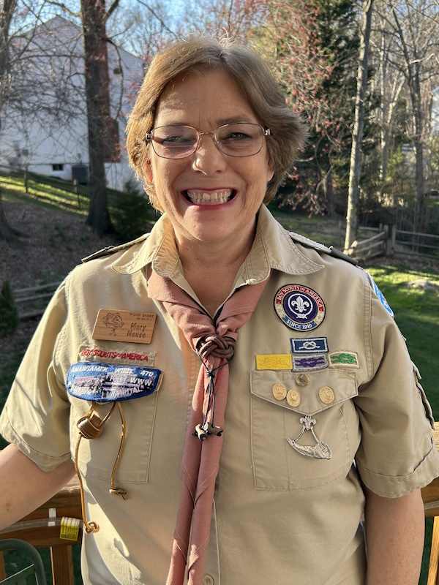
Mary Nuese
Mary Neuse has played a crucial role at the unit level as the Troop 1978G Scoutmaster since the summer of 2023 and as an Assistant Scoutmaster for Troop 1978G for four years as a female Troop. Mary is a dedicated district merit badge counselor, covering a wide range of merit badges, including American Heritage, Camping, Citizenship in Community, Citizenship in Nation, Citizenship in World, Family Life, Music, Personal Management, Public Speaking, Reading, Scout Heritage, and Theater. Mary was the chapter advisor for the Order of the Arrow from 2020 to 2023. In 2020, she achieved the distinguished Vigil Honor, a testament to her commitment to the values and principles upheld by the BSA. Mary actively participates in district training teams within both the Transatlantic Council and the National Capital Area Council. Her dedication to her own development is evident through her completion of Powder Horn and Wood Badge training. Her outstanding contributions to scouting have not gone unnoticed. The Frontier Council/Pikes Peak district honored her with the Golden Bow award and the Transatlantic Blazer patch. Additionally, in 2019, she received the District Award of Merit from the National Capital Area Council (NCAC)/George Mason District.
Mary has been actively involved as the youth minister at St. Mark Catholic Church since 2013. She was honored as the St. Mark Youth Minister Volunteer of the Year in 2022. As a Eucharistic minister since 2013, she has been an integral part of the religious life of her parish.

Slide 90
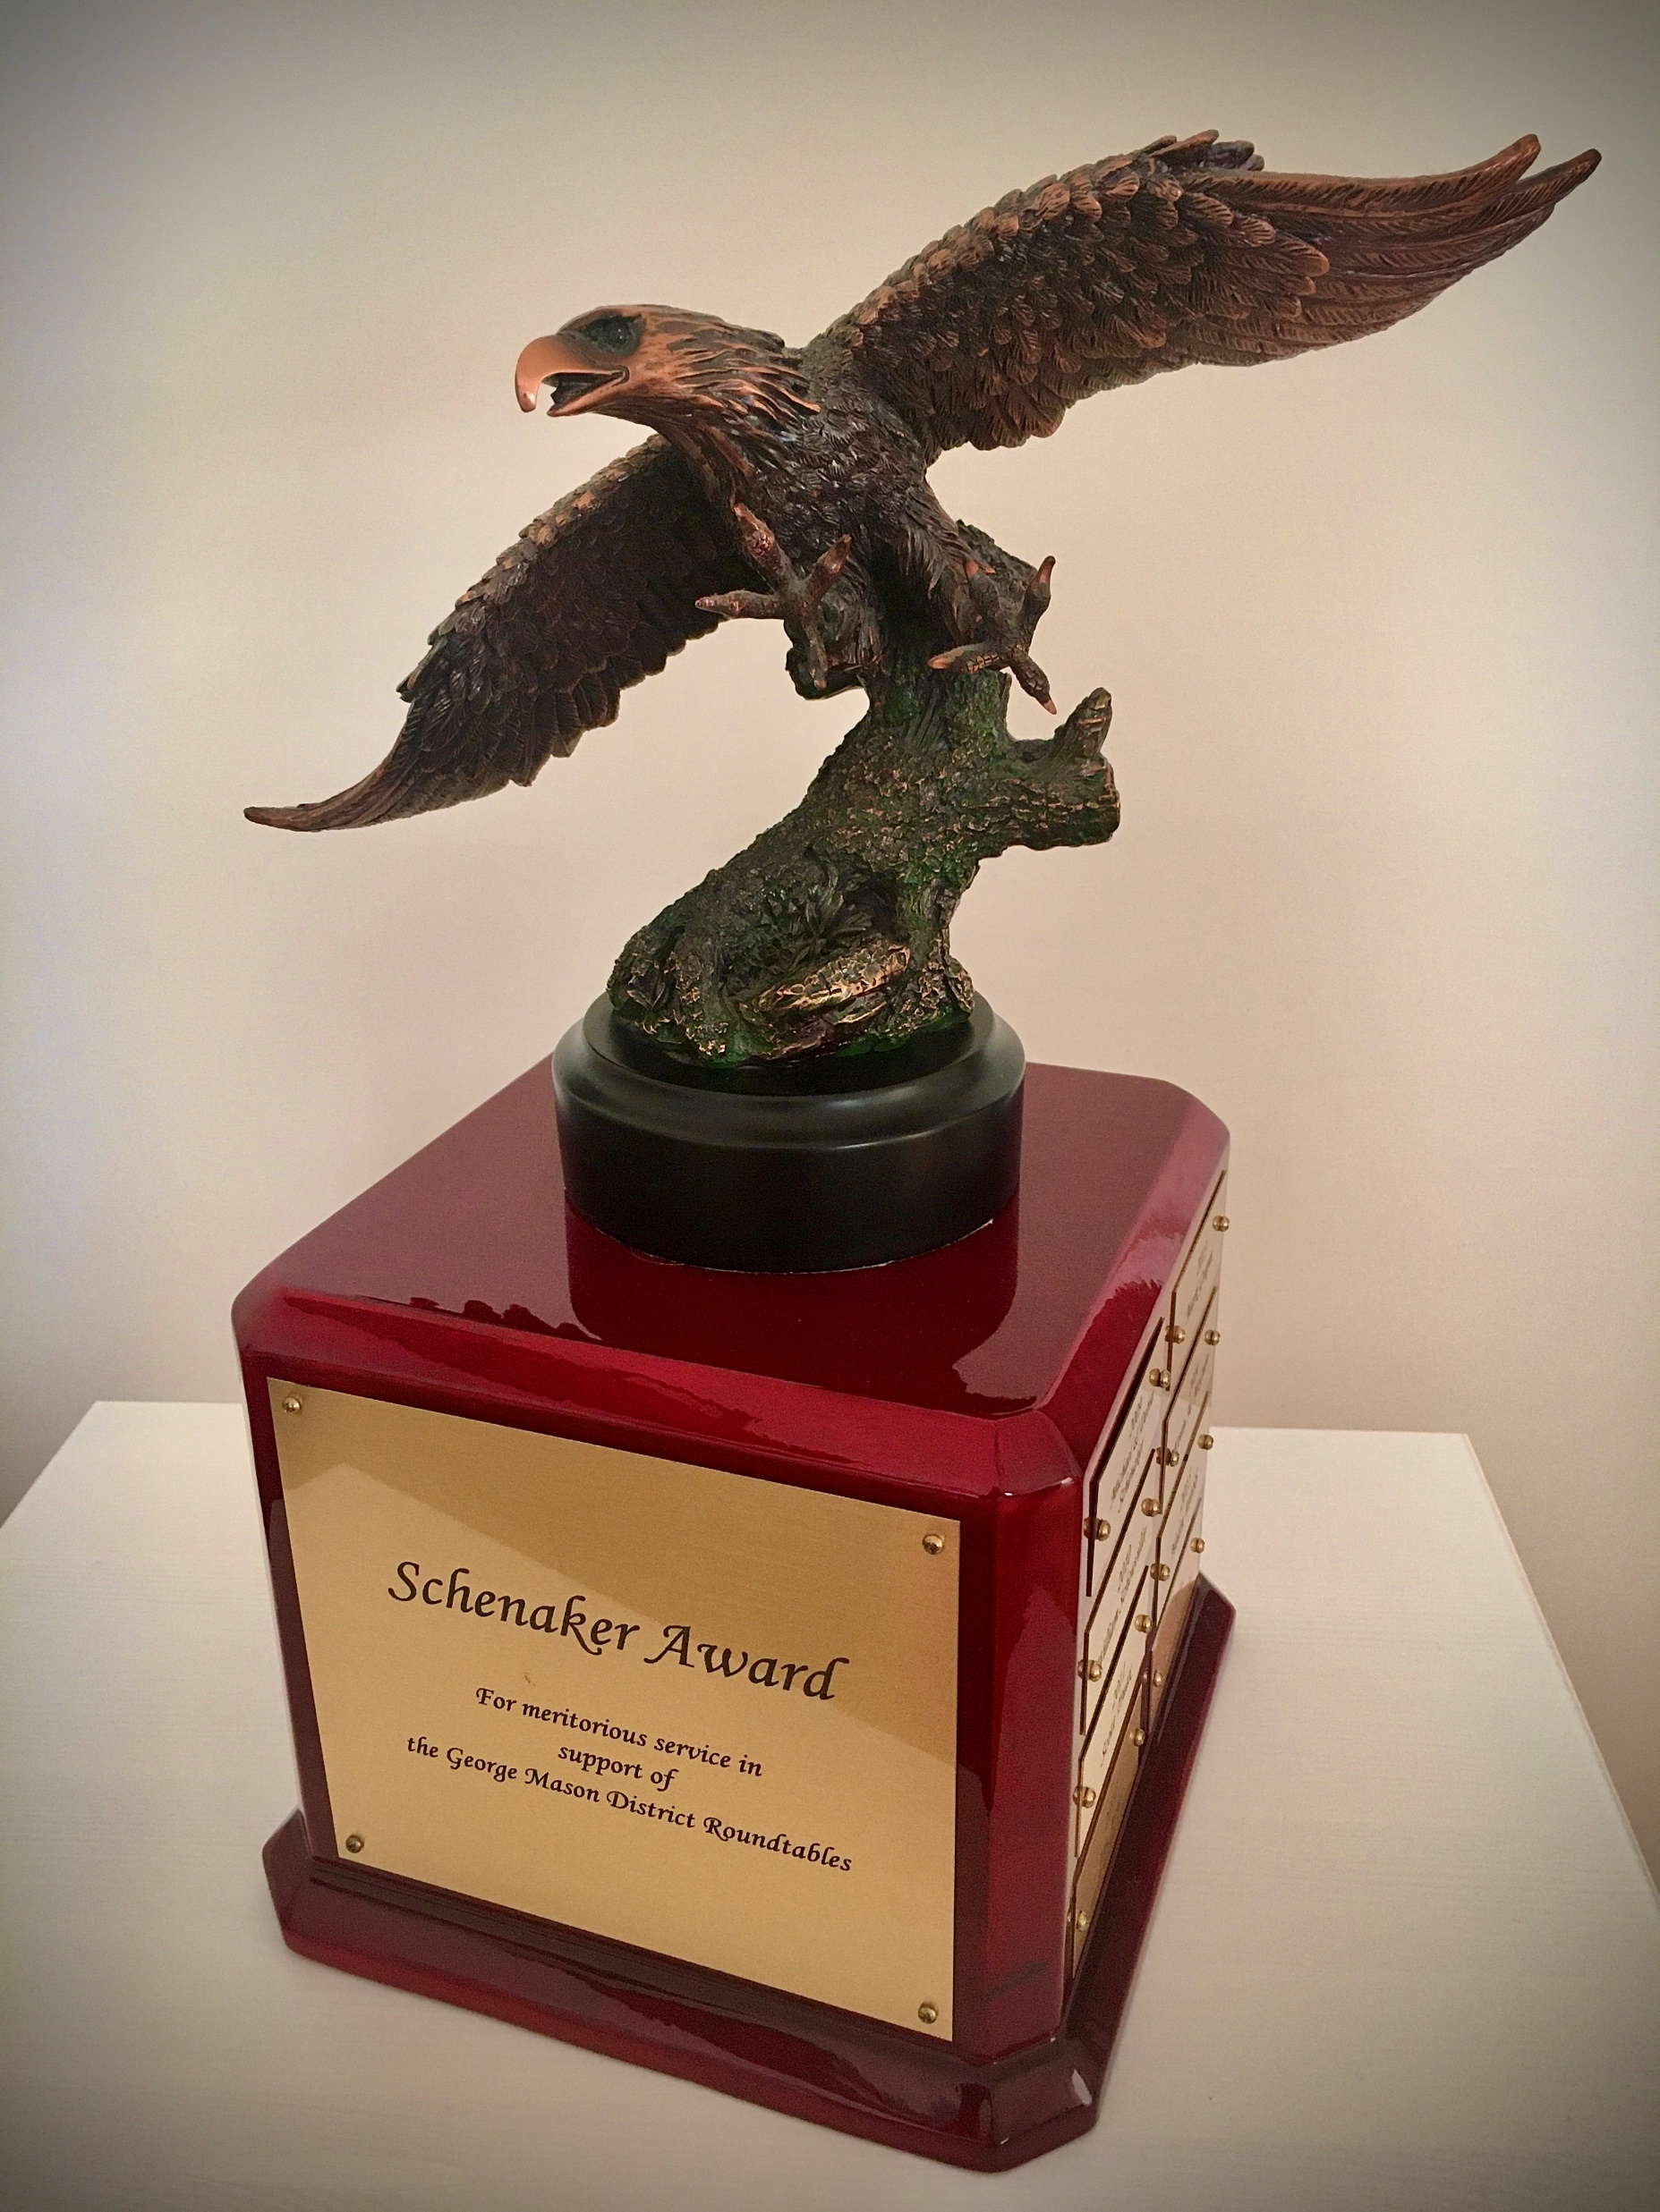
Schenaker Award for Meritorious Service in Support of District Roundtables
This Award is presented by the District to a volunteer that provides meritorious service to the George Mason District Roundtables.
The award honors Deb and Mike Schenaker who, beginning in the early 2000s when they joined the Cub Scout Roundtable staff, invested countless hours in support of the Cub Scout and Boy Scout Roundtables over more than 15 years.
Deb and Mike set the standard for selfless support of the District’s Roundtables and unit leaders. We recognize each year a volunteer that follows their example of Roundtable support.

Slide 91
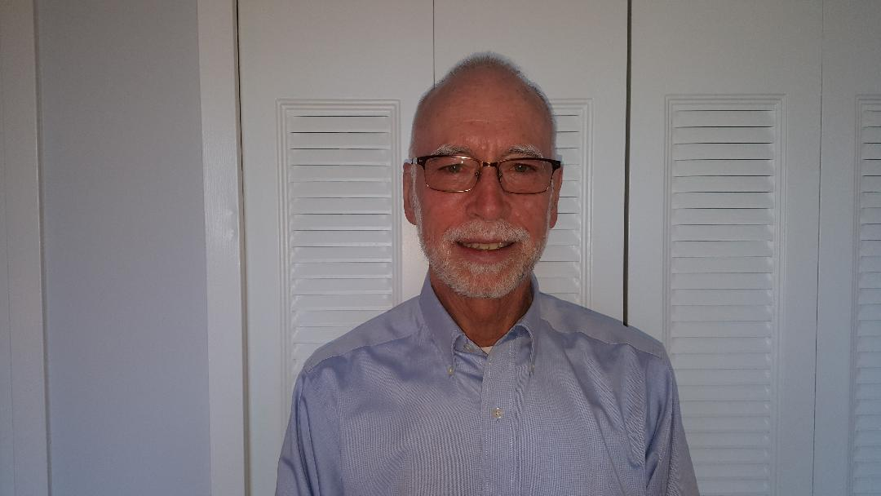
2024 Schenaker Award Recipient
John has been a steady cheer leader, booster, and attendee at the George Mason District Roundtables. The Commissioners and the Uniformed Leaders of our District recognize him as a truth-teller and a totally unselfish promoter of all the best that we see in Scouting. He is fully deserving of the Shenaker Award for his Outstanding support of District Roundtable Program
John Kilduff

Slide 92
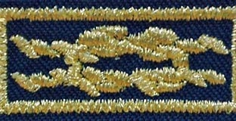
Unit Leader Award of Merit – Matthew Maclean P152
Quality unit leadership is the key to a quality unit program—and it leads to better Scout retention.
A quality Scouting experience will help keep Scouts in the program, and the Boy Scouts of America created the Unit Leader Award of Merit to recognize the quality unit leaders who make that happen.
You cannot hope to find a better Cubmaster than Matthew Maclean. He embodies Scout spirit not only in word but in action. He takes his role in leading pack programming seriously, but also acts a teacher for the scouts.
He exhibits the wealth of patience needed to be a successful Cubmaster, but he knows how to keep scouts on task. As a result, the scouts in our Pack hold great respect for Matt.
He also understands how the bigger picture machinations of Scouting work, and is a primary reason that our unit functions as well as it does.
Matt Maclean is most deserving of the Unit Leader award of Merit.

Slide 93
Unit Level Awards
Den Leader Training Award
  Rapheal Balsam (Pack 78)

Slide 94


April 11, 2024
District Court of Honor

