Slide 1

George Mason District
Program Launch
June 13, 2024

Slide 2

Pledge

Slide 3
Welcome
New to Roundtable?
Please introduce yourself!

Slide 4
What is Program Launch?
Information and resources that can assist your Unit plan for the upcoming Scouting year. This includes:
Program planning tips
Dates for District events/FCPS Holiday
Unit resources and tools
Camping information, and
District and Program contacts

Slide 5
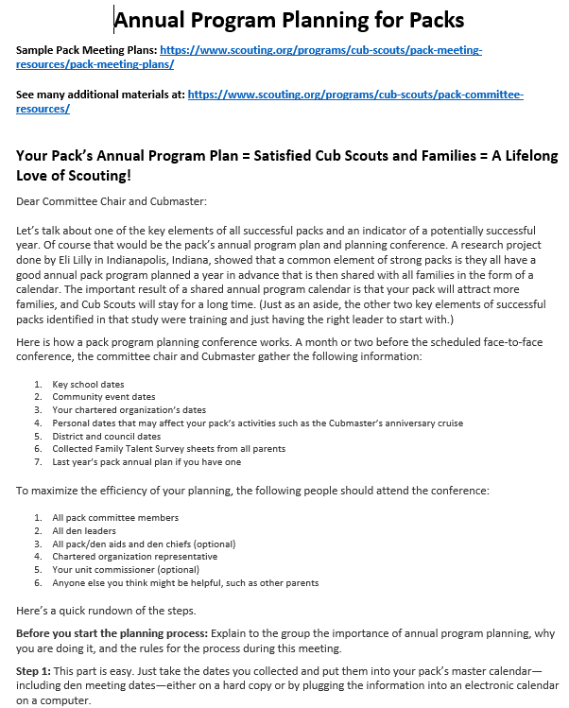
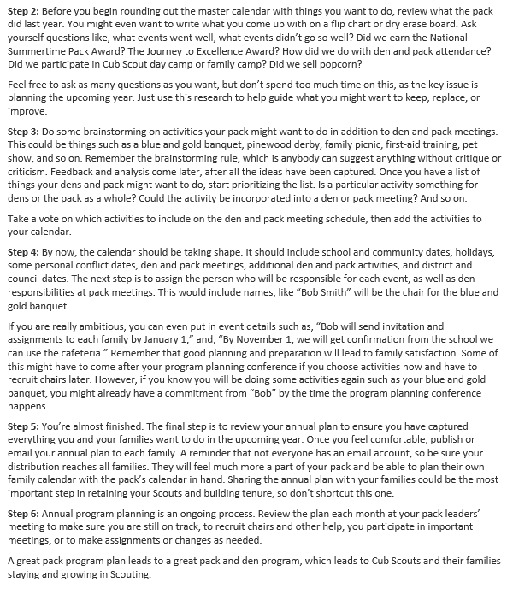
Pack Resources Annual Planning Meeting for Packs

Slide 6
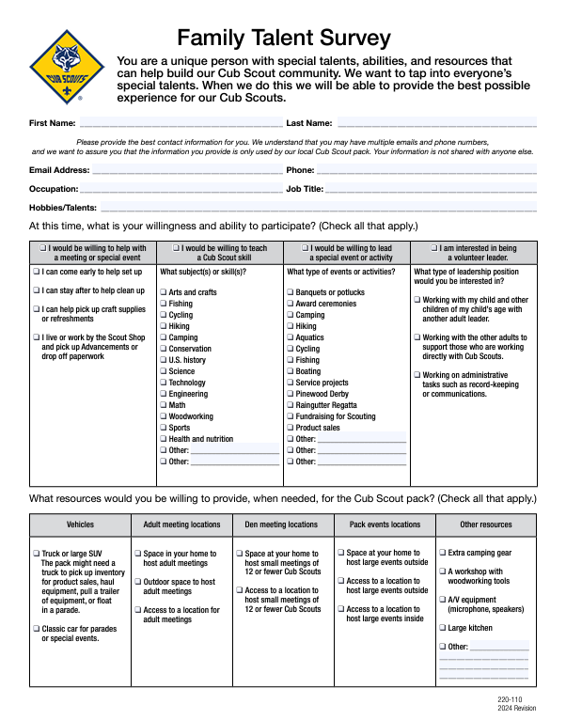
Pack Resources
Family Talent Survey

Slide 7
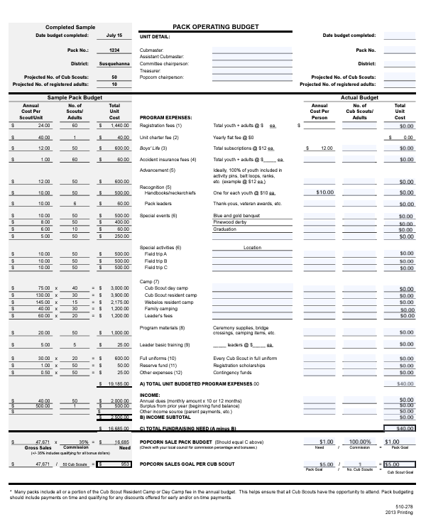
Pack Resources
Pack Budget Worksheet

Slide 8
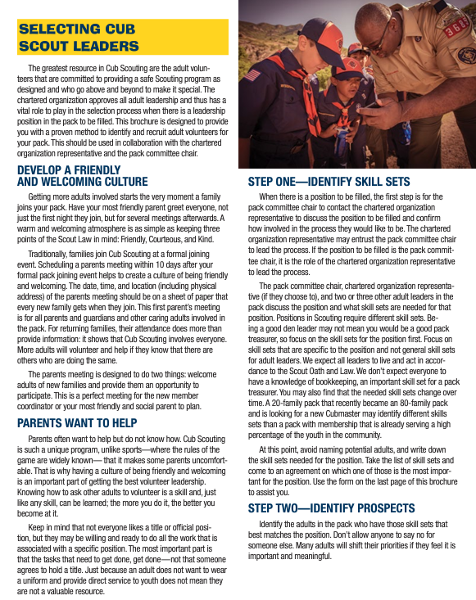
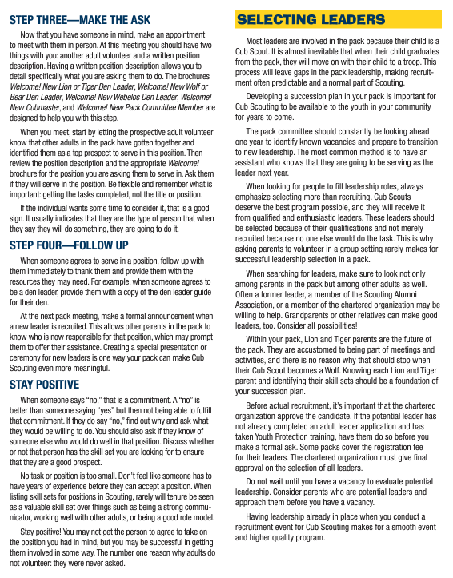
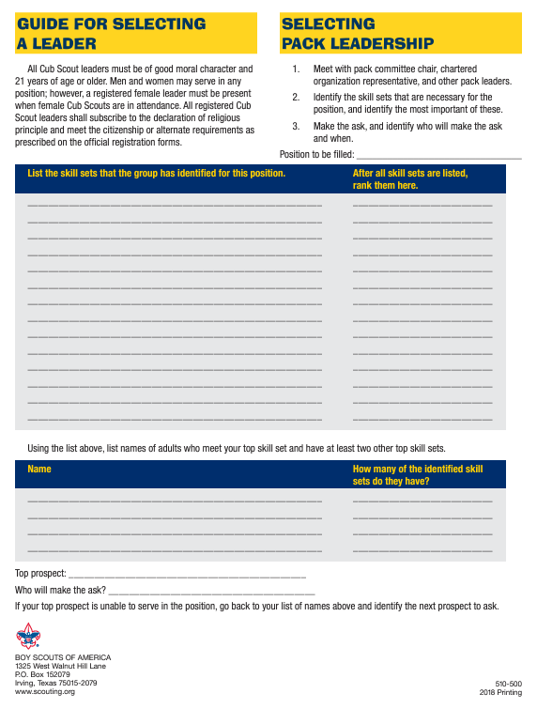
Pack Resources - Selecting Cub Pack Leadership

Slide 9
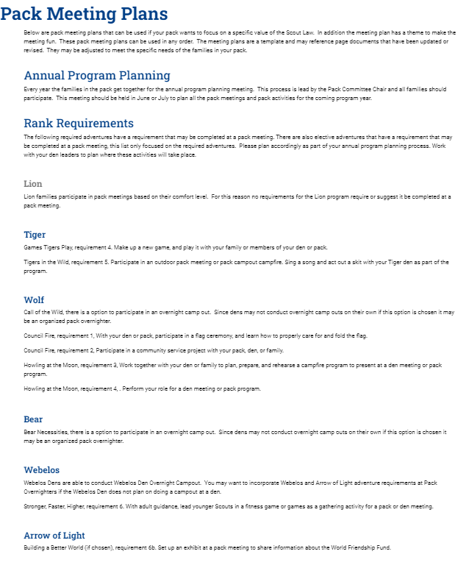
Pack Resources
Sample Pack Meeting Plans

Slide 10
Pack Resources (cont.)
See many additional materials at: https://www.scouting.org/programs/cub-scouts/pack-committee-resources/
Video for new den leaders: https://vimeo.com/569858696
Cub Chat Live podcast for Cub Scout leaders on Facebook each Friday at 3:00 pm (Eastern) https://blog.scoutingmagazine.org/cubchatlive/

Slide 11
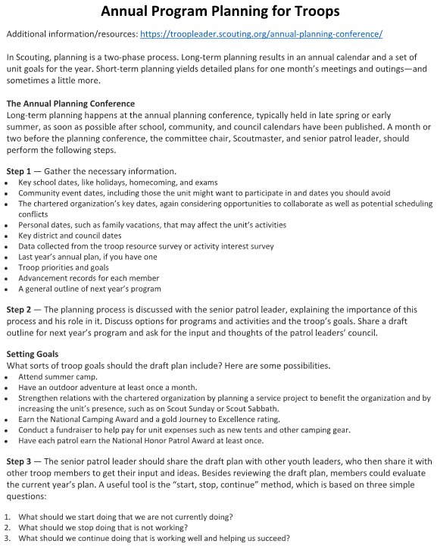
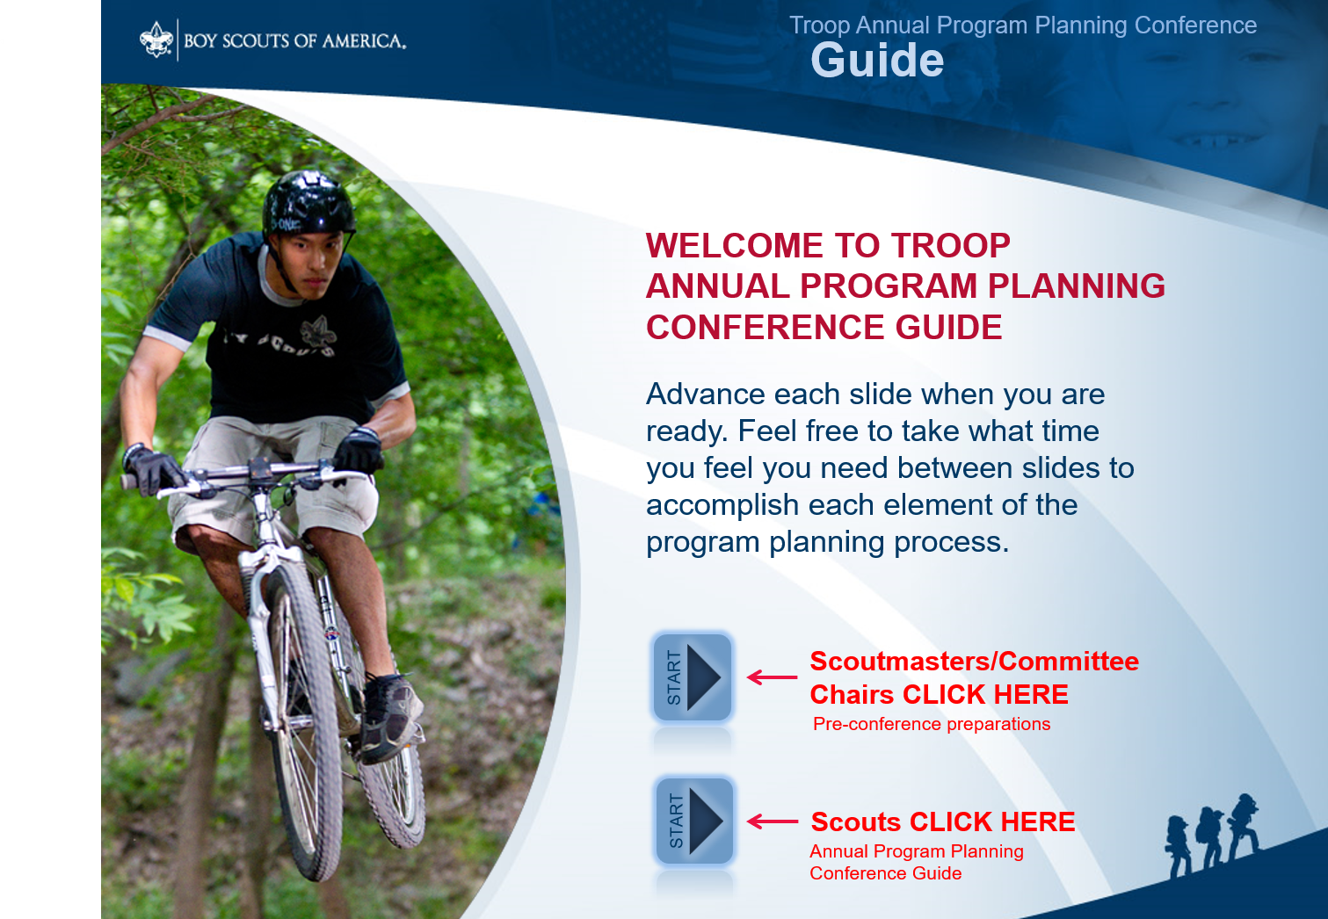
Troop Resources
Annual Program Planning for Troops (step-by-step)
Annual Planning Guide
Contains audio PowerPoint guide for SM, CC, and SPL
Troop Operating Budget Worksheet PDF

Slide 12
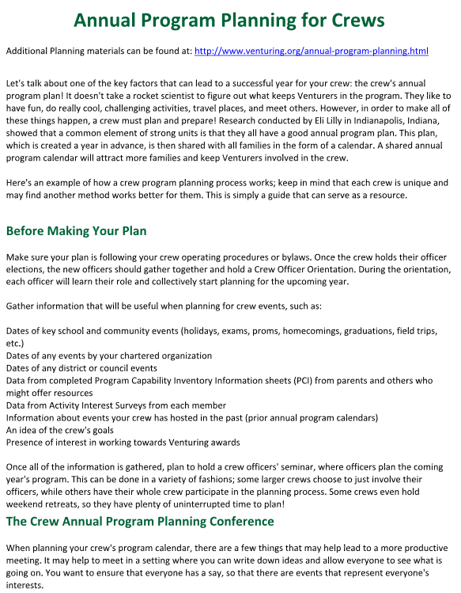
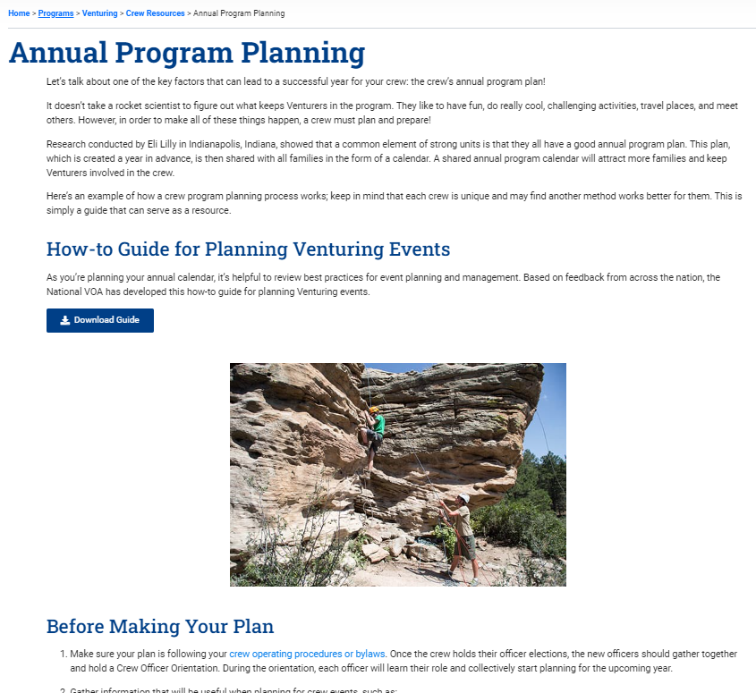
Crew Resources
Annual Program Planning
https://www.scouting.org/programs/venturing/crew-resources/annual-program-planning/

Slide 13

2024/2025 NCAC Calendar
2024
09/20/24 – NCAC Golf Tournament
09/21/24 – 09/22/24 – Fall Festival
10/11/24 – 10/14/24 – Climb-o-ree
10/26/24 – 10/27/24 – Hike-o-ree
11/02/24 – Scouting for Food (Tags)
11/09/24 – Scouting for Food (Pick-up)
2025
02/XX/25 – Montgomery MBC
03/08/25 – 03/09/25 – Commissioners College
05/03/25 – Orienteering Meet
06/01/25 – Council Court of Honor
09/26/25 – 09/28/25 - Fall Festival
10/10/25 – 10/12/25 - Climb-o-ree
10/24/25 – 10/26/25 - Hike-o-ree
11/01/25 – Scouting for Food (Tags)
11/08/25 – Scouting for Food (Pick up)

Slide 14
Goshen Scout Reservation
2024
Family Camps: August 30 - September 2
Alumni Weekends: October 18-20
Volunteer Weekends: September 27-29
2025
Alumni Weekends: April 25-27 & October 17-19
Volunteer Weekends: May 9-11 & September 26-28
Family Camp: May 23–26 & August 29-September 1
2025 CAMPS
Week 1: June 22-28
Week 2: June 29-July 5
Week 3: July 6-12
Week 4: July 13-19
Week 5: July 20-26
Week 6: July 27-August 2

Slide 15
Camp William B. Snyder
2024
Cub Day Camps: June 24-28 & July 08- 12
Cub Resident Camps: June 20-23, June 27-30, &
July 11-14
Scout BSA Weeks: July 14-20 & July 21-27
Family Camp: July 05-07, Oct 18-20 & 11/15-17
2025 - TBD

Slide 16

Camp Catoctin – Thurmont, MD
2024
August 11-17
2025 - TBD

Slide 17
Youth Training – NYLT
2025
01/17-20/25 & 02/01-02/25: Winter
06/15/25 – 06/20/25: 25-2
06/22/25 – 06/27/25: 25-3
07/27/25 – 08/01/25: 25-4 & 24-5
2024
06/16/24 – 06/21/24: Course 24-2
06/23/24 – 06/28/24: Course 24-3
07/28/24 – 08/02/24: Course 24-4 & 24-5
Youth Training - National Advanced Youth Leadership Experience (NAYLE)
National Advanced Youth Leadership Experience (NAYLE) is an exciting program where young
men and women enhance their leadership skills through team building, ethical decision-making,
problem solving and service to others.
Philmont: https://www.philmontscoutranch.org/ptc/nayle/
The Summit: https://www.summitbsa.org/programs/training/seven-day-conferences/nayle

Slide 18
Summer/Fall 2024 GM Calendar
2nd Thursday of the month – Roundtable (7:30pm), Thoreau MS, Vienna, VA
2nd Thursday of the month – OA Meeting (7:30pm), Thoreau MS, Vienna, VA
07/14/24 – 07/20/24 – Camp Snyder Specialty Week (Merit Badges), Haymarket, VA
07/21/24 – 07/27/24 – Camp Snyder Specialty Week (Merit Badges), Haymarket, VA
08/04/24 – Scouts Days – Nationals vs Milwaukee Brewers, 1:35pm, Nationals Park
08/04/24 – 08/06/24 – Lodge Summer Ordeal, Camp Snyder, Haymarket, VA
08/08/24 – Join Scouting Night/Roundtable, 7:30pm, Thoreau MS, Vienna, VA
08/15/24 – 08/18/24 – Powder Horn, Camp St. Charles, Newburg, MD
09/07/24 – Paddle Craft Safety (Still Water), Camp Snyder, Haymarket, VA
09/08/24 – Paddle Craft Safety (Moving Water), Riley’s Lock, MD
09/12/24 – Roundtable, 7:30pm, Thoreau MS, Vienna, VA
09/13/24 – 09/15/24 – 2024 OA Fall Fellowship, Camp Goshen, Goshen, VA
09/21/24 – 09/22/24 – Fall Festival (Scout-tober Fest) , Camp Snyder, Haymarket, VA
09/28/24 – Life to Eagle Seminar, St James Catholic Church, Falls Church, VA
09/XX/24 – 10/XX/24 – Fall Ordeal, TBD
10/XX/24 – Aquatics Partial Merit Badge Completion Clinic, Location TBD
10/11/24 – 10/14/24 – Climb-o-ree
10/10/24 – Roundtable, 7:30pm, Thoreau MS, Vienna, VA
10/18/24 – 10/20/24 – Fall Camporee, Camp Rock Enon, Gore, VA
10/19/24 – 10/20/24 – Jamboree on the Air/Jamboree on the Internet (JOTA/JOTI)
10/26/24 – 10/27/24 – Hike-o-ree
11/02/24 – Scouting for Food (Tags)
11/09/24 – Scouting for Food (Collection)
11/10/24 – Veterans Day Flags In, National Memorial Park, Falls Church, VA
11/01/24 – OA Election Season Opens
12/06/24 – 12/07/24 – OA Trade-o-ree, Camp Snyder, Haymarket, VA
12/XX/24 – Peace Light distribution

Slide 19

Current Spring 2025 GM Calendar
01/XX/25 – OA Lodge Banquet, College Park, MD
02/22/25 – University of Scouting, Hayfield Secondary School, Alexandria, VA
03/08/25 – 03/09/25 – Commissioner College
03/28/25 – 03/30/25 – Joint Lodge Ordeal, Camp Snyder, Haymarket, VA
04/10/25 – District Court of Honor, Thoreau MS, Vienna, VA
04/25/25 – 04/27/25 – 2025 OA Spring Fellowship
05/03/25 – 19th NCAC Scout Orienteering Meet, PWD, Triangle, VA
05/XX/25 – 05/XX/25 – GMD Spring Camporee
05/XX/25 – 05/XX/25 – GMD Hike-O-Ree
05/10/24 - Jamboree on the Trail (JOTT)
05/26/25 – Memorial Day Flags In, National Memorial Park, Falls Church
05/08/25 – Program Launch, Thoreau MS, Vienna, VA
05/31/25 – OA Election Season Closes

Slide 20
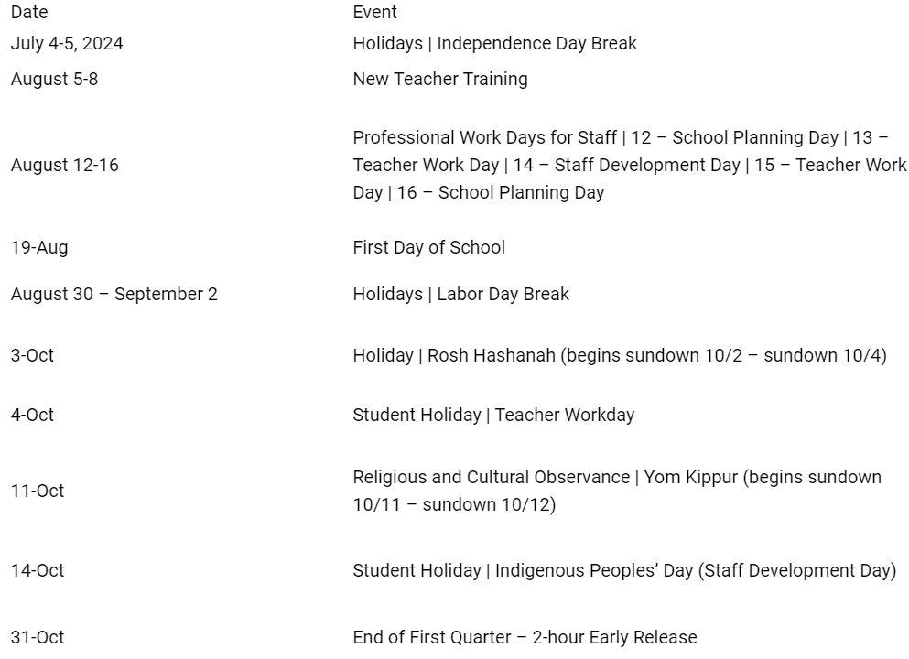
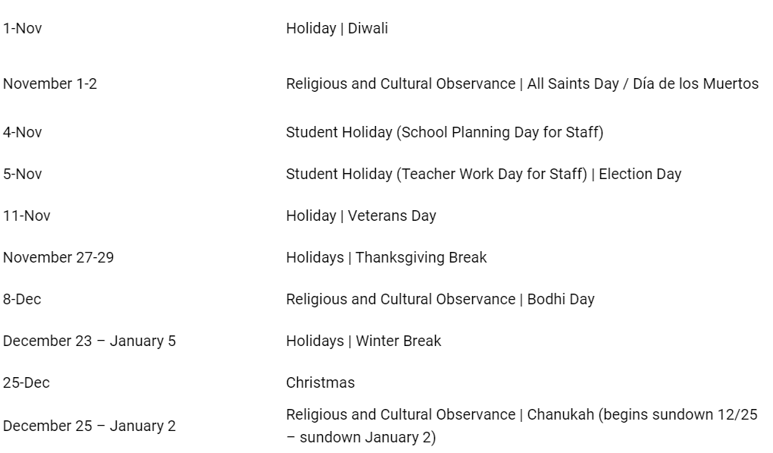
FCPS Fall
2024 Schedule

Slide 21
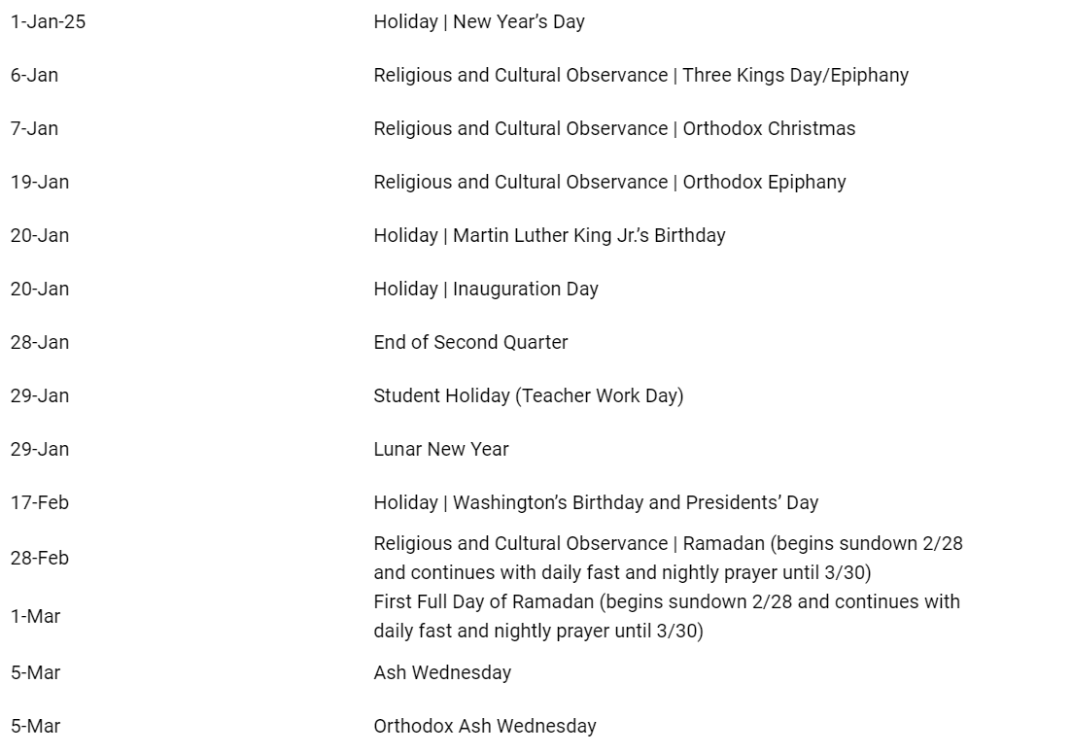
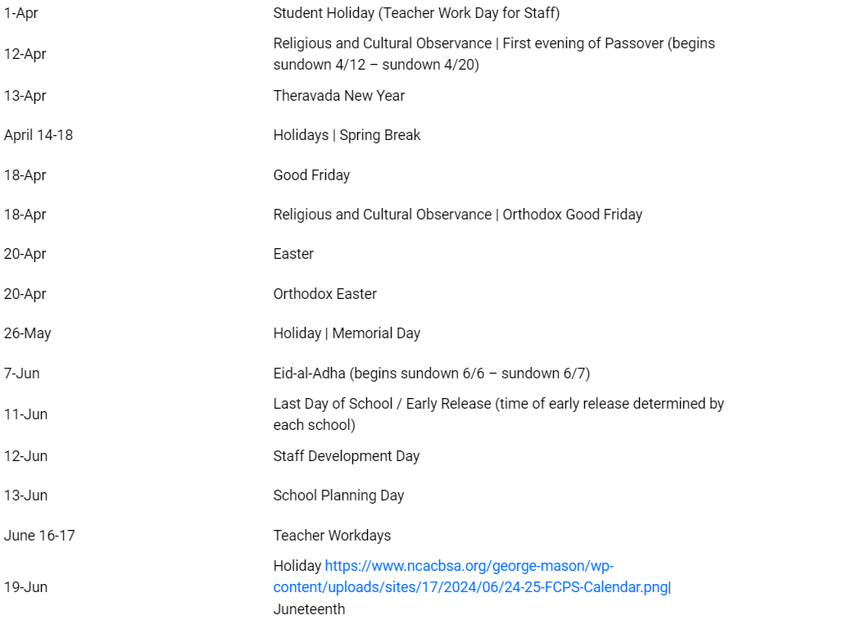

FCPS Spring 2025 Schedule

Slide 22
FCPS Facilities https://www.fcps.edu/resources/community-use-school-facilities
The priority for community use of facilities is assigned in the following order per Regulation 8420:
  FCPS instructional and extracurricular programs.
  School-related groups such as PTA, PTO, booster club, private tutoring, and school-business Ignite Partners operating under special provisions.
  Fairfax County Department of Neighborhood and Community Services and Fairfax County Park Authority.
  Others, when space is available, including youth groups; Fairfax County employee organizations; cultural and civic groups; colleges and universities; religious organizations; state and federal agencies; private organizations and individuals; and commercial entities.
Once you have registered and have been approved as an organization event coordinator (OEC) in the online reservation system, CommunityUse, you can request space for any FCPS facility (login top right). Please note per Regulation 8420, requests must be submitted at least fifteen (15) business days prior to the event date. Once your schedule has been approved, the OEC cannot make any adjustments to the schedule, including cancellations. Please contact the community use school contact, see below list, if changes are necessary. Please refer to the helpful user's guide provided below.

Slide 23
Other Calendars
NCAC Council Calendar: https://www.ncacbsa.org/calendar
NCAC 2024-2025 Brochure: https://www.ncacbsa.org/wp-content/uploads/2024/06/2024-2025-NCAC-CALENDER-BOOKLET-Electronic.pdf
BSA’s Calendar of Religious Observations
  2024: https://www.scouting.org/resources/relationships/religious-observances/calendar-of-religious-observances-2024/
  2025: https://www.scouting.org/resources/relationships/religious-observances/calendar-of-religious-observances-2025/
Order of the Arrow Lodge Calendar
https://wipit470.org/calendar.html

Slide 24
Service Projects
Many Units put their proposed service projects in the Unit Calendar (in addition to the ones that come up throughout the year).
Service projects can be found with your Chartering Organization, Camp Snyder, Fairfax County Park Authority, etc.
Be sure to record the hours for your Unit in Internet Advancement - Units should log service hours via the Scoutbook redirect when they click “Activity Logs” (under either the individual or ‘Quick Entry’) or directly in Internet Advancement.
Video Help in Recording Service Hours: LINK
Information on Recording Service Hours: LINK

Slide 25


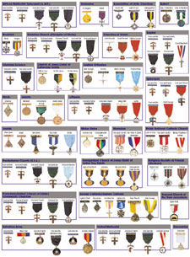


Other Planning Opportunities
Journey to Excellence
Cub Scout Awards – Also, don’t forget the Summertime Fun
Scouts BSA Awards
Religious Awards
Scouter (Adult) Awards

Slide 26
Camping Sites
Pack Overnighter Approve Camping Sites https://www.ncacbsa.org/approved-camp-sites/
OA Camping Site List
  https://www.ncacbsa.org/wp-content/uploads/2020/12/Approved-Camp-Sites.pdf
Want to add a campground to the list?
  The unit would fill out a Pack Overnight Campout Site Appraisal Form and submit to NCAC Director of Camping Services (matthew.keck@scouting.org) for review.

Slide 27


Fund Raising
Popcorn (info below)
Camp Cards
Other – please fill out Unit Money-Earning Application and send to the DE.

Slide 28
Scouting Youth Deserve a Trained Leader
George Mason Training site: https://www.ncacbsa.org/george-mason/training/
2024
Cub Scout Den Leader Specific (C42)
  Available on-line (125 min)
Basic Adult Leader Outdoor Orientation (BALOO;C32)
  06/15/24 – 06/16/24 – Lorton, VA
Scoutmaster Position Specific Training(S24)
  Available on-line (192 min)
Introduction to Outdoor Leadership Skills (IOLS; S11)
      06/15/24 – 06/16/24 – Lorton, VA
Back Country Outdoor Leadership Skills (BCOLS)
09/21/24 (Alexandria, VA) & 10/19/24 – 10/20/24 (Markham, VA)
Climbing Level 1 Instructor
June 15-16 at Great Falls Park, 7:30 AM to 5:00 PM. Logistics memo
Sept 7-8 at Great Falls Park, 7:30 AM to 5:00 PM. Logistics memo
Sept 21-22 at Sugarloaf Mountain, 8:15 AM to 5:00 PM. Logistics memo
Mental Health First Aid https://www.fairfaxcounty.gov/hscode/ereg/Registration.asp
Scouterhorn Operations Training
06/18/24 – Gaithersburg, MD
06/19/24 – Gaithersburg, MD
06/20/24 – Gaithersburg, MD
10/19/24 – Camp Snyder, Haymarket, VA
11/16/24 – Camp Snyder, Haymarket, VA
Wood Badge (A90) https://www.ncacbsa.org/wood-badge/
09/13/24 – 09/15/24
2025
BCOLS:
Spring: 03/01/25 & 4/26-27/25
Fall: 09/20/25 & 10/18-19/25
Trainers Edge: 08/09/25 & 12/06/25
University of Scouting: 02/22/25
Wood Badge:
Spring: 4/4-6/25 & 5/3-4/25
Fall: 09/12-14/25 & 10/4-5/25

Slide 29
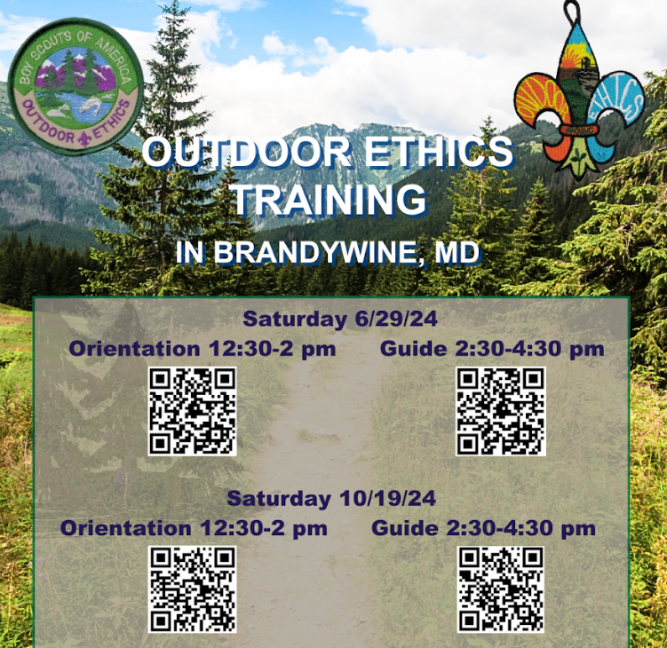
Outdoor Ethics
Orientation – After completing this course, you will have:
- Knowledge of Outdoor Ethics
- Knowledge of the Outdoor Code
- Knowledge of how Leave No Trace, Tread Lightly! And
The Land Ethic / Stewardship support the Outdoor Code
- Knowledge of Outdoor Ethics Awareness and Action
Awards Program
- Knowledge to locate additional Leave No Trace, Tread
Lightly! and BSA Outdoor Ethics resources and opportunities for further training
After this course and completion of the online Leave No Trace Online Awareness course and Tread Lightly! online Awareness course, participants should have enough knowledge to:
- Earn the Outdoor Ethics Awareness Award
- Conduct Outdoor Ethics workshops & activities within their respective units
- Help scouts & scouters earn their Outdoor Ethics Awareness
Award
Guide - Learn how to operationalize this position of responsibility to have the greatest positive impact in your unit. Join Outdoor Ethics Guides and adult advisors for an in-person session to learn best practices, meet other Outdoor Ethics Guides and adult advisors, share experiences, discuss ways to overcome challenges, and create a network of Outdoor Ethics Guides across NCAC.

Slide 30
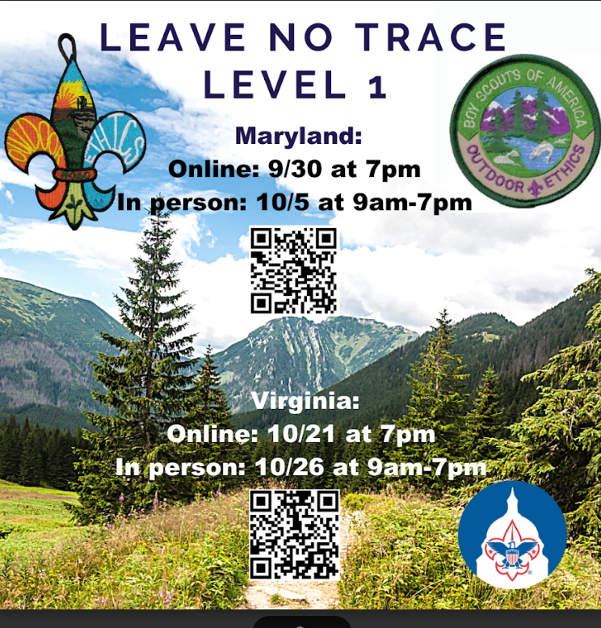
Leave No Trace
Course Description
This course is for BSA members 18 and older who teach outdoor skills to others.
Participants learn Leave No Trace awareness, principles, skills and ethics through a combination of presentation, discussion, and hands-on activities. They learn and practice techniques for teaching these concepts.
Each participant will prepare and present a short (10-15 minute) lesson. Topic assignments will be given to participants before the course.
At least 10 days before the Saturday outdoor session, students will be assigned approximately 6 hours of online self-study learning which must be completed prior to the outdoor session. Students who do not complete the self-study portion will not be allowed to attend the outdoor session.
Preregistration is required and class size is limited, so register soon.
The class will be held at Camp Snyder in Haymarket, VA. A suggested equipment list, driving directions, etc., will be provided to participants before the course.
We need at least 4 registered adults to hold this course. Otherwise, we will cancel it

Slide 31
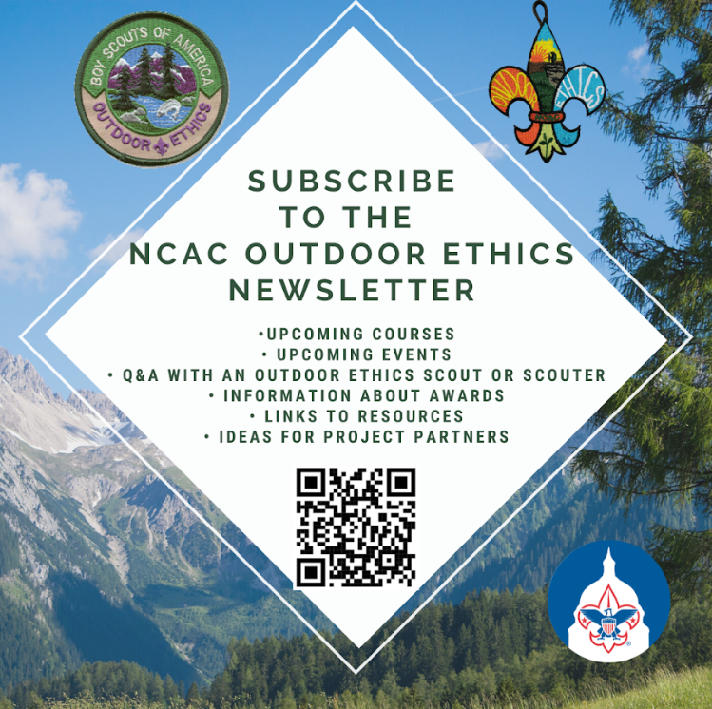
Outdoor Ethics
Newsletter

Slide 32
Roundtable
Roundtables provide unit leaders with the skill to do and the will to do what is needed to ensure that every member of every unit has a great Scouting experience. They build upon the foundation provided by position-specific basic training and each leader’s commitment to serving youth through Scouting.
  Meets monthly on second Thursday at 7:30pm
  Contact brian.summers@verizon.net for more information or visit the Roundtable web site (password is GMDRT)

Slide 33

STEM
STEM is an initiative the Scouting America has taken on to encourage the natural curiosity of youth members and their sense of wonder about these fields. From archery to welding, Scouts can’t help but enjoy the wide range of STEM-related activities. To support this initiative, the BSA developed the STEM Nova Awards program so that youth members have fun and receive recognition for their efforts.
GMD STEM Web Page:
https://www.ncacbsa.org/george-mason/stem-program/
NCAC STEM Events: https://www.ncacbsa.org/s-t-e-m/
2024 STEM Trek at Philmont: https://www.philmontscoutranch.org/philmonttreks/individualprograms/stem/

Slide 34
International Scouting
World Scout Jamborees
https://www.scout.org/what-we-do/world-scout-events/world-scout-jamboree
Jamboree on the Trail (May)
https://jamboreeonthetrail.org/
Jamboree on the Air/Internet (October)
https://www.scouting.org/international/jota-joti/
International Peace Light (December)
https://peacelightnorthamerica.org/

Slide 35


Merit Badges
The online Merit Badge Counselor registration.
New Merit Badge Counselors must complete online merit badge counselor training, in addition to YPT. Be sure the counselor uses his/her legal name – no nicknames.
Merit Badge Counselors, or the unit Dean/Leader, also need to scan and send Margee the Merit Badge application form listing the badges the counselor is applying to teach and providing a justification of his/her qualifications.
Youth Protection Training is the essential first step. Don’t hit “send” on the application without it!
Contact Margee if you have questions at GM.MB.Dean@hotmail.com.
Did you know:
The National Council does not limit the number of merit badges a youth may earn from one counselor, though a unit leader is permitted to do so, as long as the same limit applies to all Scouts in the unit. Ideally, Scouts should work with a variety of adults. (GTA 7.0.0.3)
Partial Merit Badges have no expiration except the Scout’s 18th birthday. (GTA 7.0.3.3)
Due to the BSA policies related to Youth Protection and two-deep leadership, a merit badge counselor must have another adult present during all merit badge counseling sessions. However, the parent or legal guardian of the Scout may serve as the second adult. This parent or legal guardian does not have to be a registered leader.
If the requirements for a merit badge differ between the merit badge pamphlet and the current edition of Scouts BSA Requirements, the requirements in the Scouts BSA Requirements book supersede all others.

Slide 36

GM High
Adventure
GM High Adventure / Brian H
Members of the High Adventure Committee are available to assist units in planning and training for their upcoming high adventure trips – Contact Brian Heath for more information
Important notes for this month
  Registration for BSA’s high adventure bases - https://www.scouting.org/outdooradventures/open4adventure/
    2024 treks – Most BSA High Adventure bases still have availability
    2025 treks – Registration for all high adventure bases are now open
2024 NCAC-Organized High Adventure Trips
  Lenhok’sin – James River Canoeing Trek - July 7-13, 2024
    Crew of 6-12 - $475 per participant – 6 slots remaining
    Registration: https://scoutingevent.com/082-75664
    For more information, e-mail highadventure@ncacbsa.org
  Lenhok’sin Provo Backpacking Trip June 23-29, https://scoutingevent.com/082-83116
    3 spaces available for Scouts or adults
  11-12 year old Scout High Adventure Experience - Sept 28-29 Prince William Forest
  Joshua Tree with Climbing Committee - Winter Break 2024/25 (Gathering interest)
  Wind River Range, WY Backpacking Trip: 06/22 to 06/30/24 – Registration is Full
  All NCAC-sponsored trips for Philmont, Northern Tier & Sea Base are already full
2025 NCAC-Organized High Adventure Trips
  Sawtooth Mountain, ID Trip - 06/21 to 06/29/2025
    Registration begins June 1, 2024 - $1,385 per person – Ask for details
High Adventure Preparation Training
  All sessions for this year are finished
June 2024
Notes:
Sea Base Trip on Jul 29-Aug 3, 2024 - FULL

Slide 37
GM High
Adventure
Other Training
  Back Country Outdoor Leadership Skills - Virginia session
    Fall 2024: 9/21/2024 (classroom), 10/19-20 (overnight)
  Paddle Craft Safety Training: Aug 24-25, Sept 7-8
National High Adventure Base Quick Links
  Philmont: https://www.philmontscoutranch.org/register/
  Northern Tier: https://www.ntier.org/provisional-scout-connections/
  Sea Base: https://www.bsaseabase.org/scouts/scout-connections/
  Summit: https://www.summitbsa.org/registration/scoutconnections/
Other High Adventure Bases
  Adirondack High Adventure Area: https://public.3.basecamp.com/p/hLgsVbk7Suju6cuDzQQJaEn4
  Maine High Adventure Area: https://www.mainehighadventure.org/
  Montana Outdoor High Adventure Base: https://montanabsa.org/camps/high-adventure/
Other useful links for high adventure information and opportunities
  NCAC High Adventure website - https://www.ncacbsa.org/high-adventure/
  List of units with available slots in their upcoming high adventure trips - https://public.3.basecamp.com/p/xWpkdrKHKAA9pCzwmHMNdbWb
June 2024 (cont.)

Slide 38
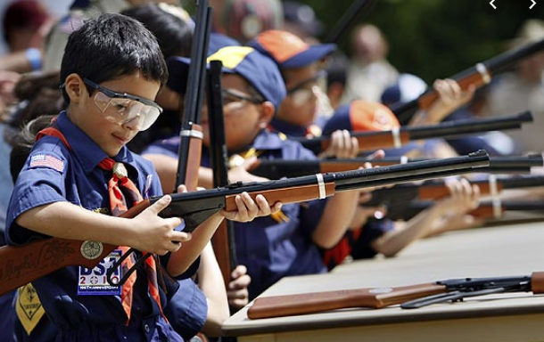
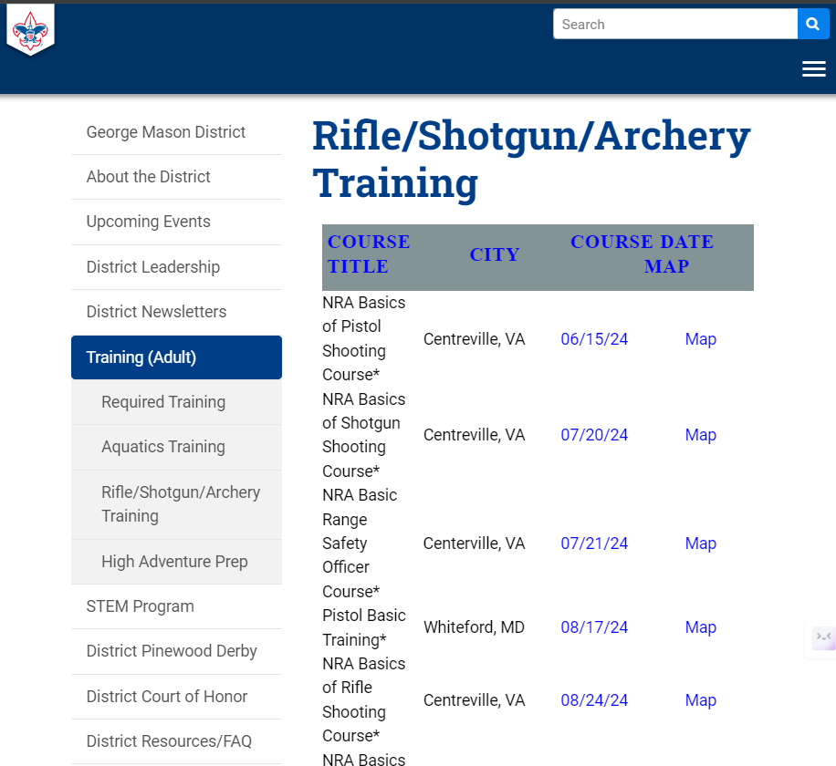
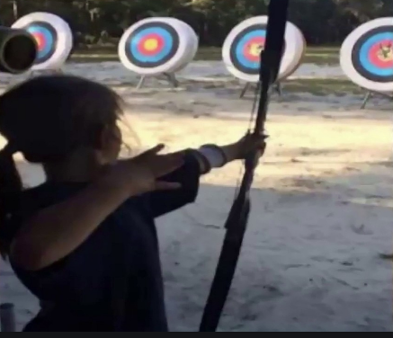
Range and Target Activities
Requests for Shooting Events – Lead Time!
  50+ scouts - 6mos
  Less than 50 scouts - 3mos
Shooting on private land:
  Requirements
  Permissions/protocols
R&TA web page
R&TA Instructor Classes:
  Rifle/Shotgun - 07/20/24, 08/24/24

Slide 39

Fall Camporee

Slide 40
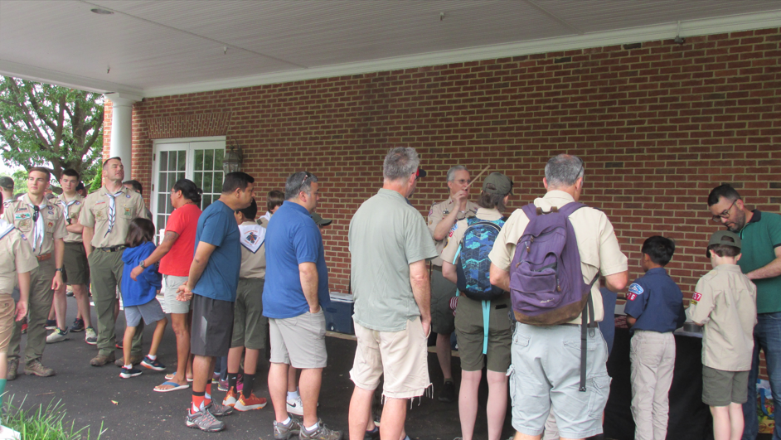
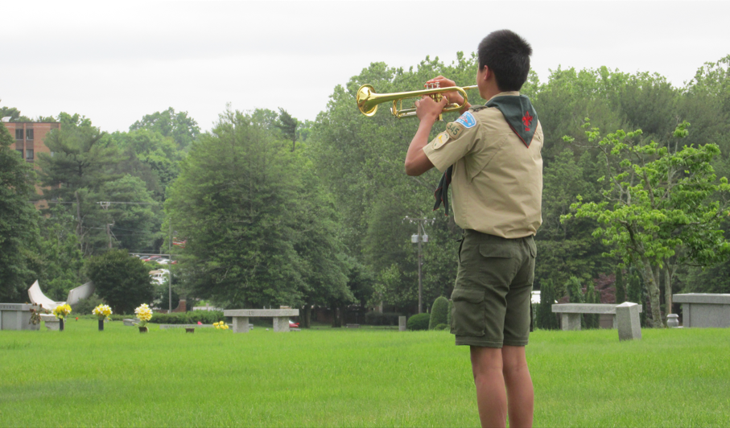
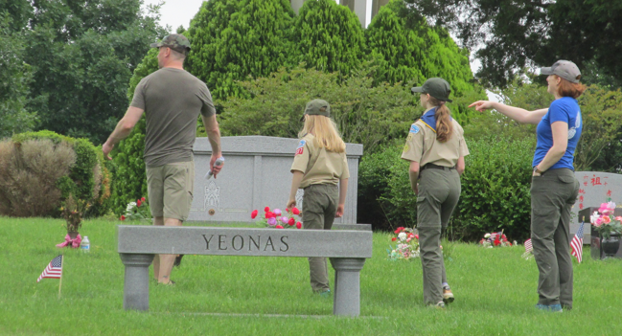
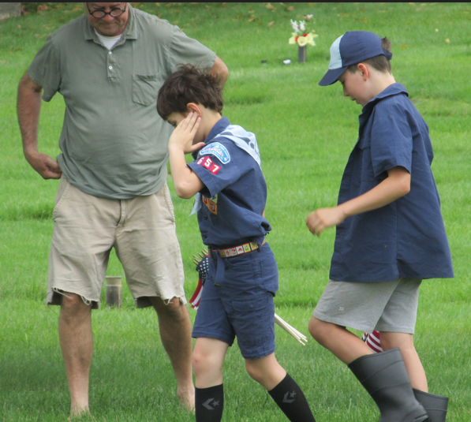
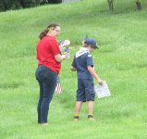
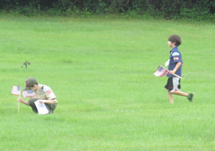
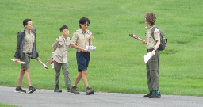
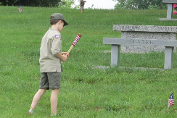
Flags In
Honoring veterans by placing flags on graves at the National Memorial Park in Falls Church, VA
Memorial Day and Veterans Day

Slide 41
Order of the Arrow
  Brian Fleck is Chapter Advisor.
  Chapter meetings are the second Thursday of the month at Thoreau Middle School in Vienna. There is no meeting in July. Please send your OA Reps.
  2024 Dues can be paid online: https://wipit470.org/dues.html
Registrations open online https://wipit470.org/index.html under “Events”

Slide 42


Stay Safe

Slide 43
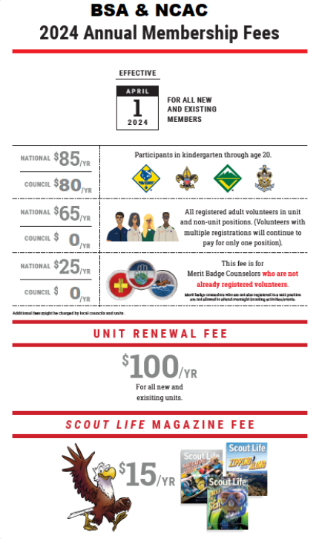
National BSA Annual Fees (Council Fees announced on or about July 1)
Effective May 1, 2024, BSA implemented the following national membership fees which were approved by the National Executive Committee:
$85 for Cub Scouts, Scouts BSA, Venturing and Sea Scouting participants ($5 increase)
$65 for all adult volunteers ($5 increase)
$0 one-time joining fee for new program participants in Cub Scouts, Scouts BSA, Venturing, and Sea Scouting ($25 decrease from 2023)
$30 for Scoutreach (No change)
$25 for Merit Badge Counselors (New Fee applies only for Merit Badge Counselors not already registered as leaders – No change)
$50 for Exploring participants Youth & Adult (No change)
$100 for a unit charter/affiliation fee (No change)
$15 for Scout Life magazine (No change)

Slide 44
How The District Can Support You

Slide 45

District Committee
Purpose
To work through chartered organizations and community groups to organize and support successful units.
Functions
Membership - The membership function strives for growth through the organization of new Scouting units, through new members and adult volunteers joining existing units, and through the retention of current members.
Fund Development - The fund development function sees that the district provides its share of funds to the total council operating budget.
Program - The program function concentrates on helping Scouting units with camp promotion, special activities including community service, training adult volunteers, and youth advancement and recognition.
Unit service - The unit service function provides direct coaching and consultation for unit volunteers to help ensure the success of every Scouting unit.

Slide 46
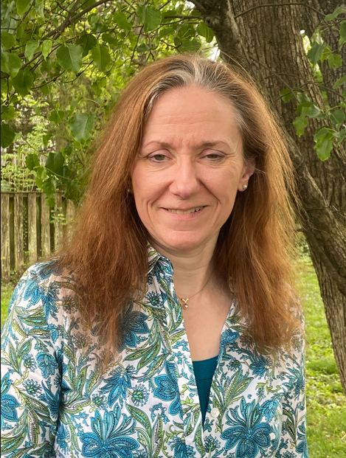
District Chair
Contact:
Mr. John Kilduff
Traci.Yates@cox.net
Photo

Slide 47



Commissioners
OUR MISSION
  As commissioners, we share the BSA’s mission: To prepare youth to make ethical and moral choices over their lifetimes by instilling in them the values of the Scout Oath and Law.
OUR VISION
Every member of the BSA has a great Scouting experience.
OUR OBJECTIVES
  Supporting unit growth and retention through the journey to excellence.
  Contacting units and capturing in commissioner tools their strengths, needs, and a unit service plan that enables continuing improvement.
  Linking unit needs to district operating committee and other resources.
  Supporting timely unit, district, and council charter renewals.
  Supporting unit leaders by collecting and distributing information, enabling program training, and providing networking opportunities.

Slide 48
Commissioners
District Commissioner: Rus Pittman
Asst. District Commissioner: Pat Berney, Justine Podolny, Mark Serfass
Roundtable Commissioners:
  Steve Banowit (Cubs)
  Brian Summers (Scouts)
Unit Commissioners:
  - Eric Assur - Julia Lesko - Mark Serfass
  - Steve Banowit - Tom McMillen - Brian Summers
  - Pat Burney - Jim Miller - Hector Uranga
  - Jerry Driscoll - Justine Podolny
  - Rus Pittman

Slide 49
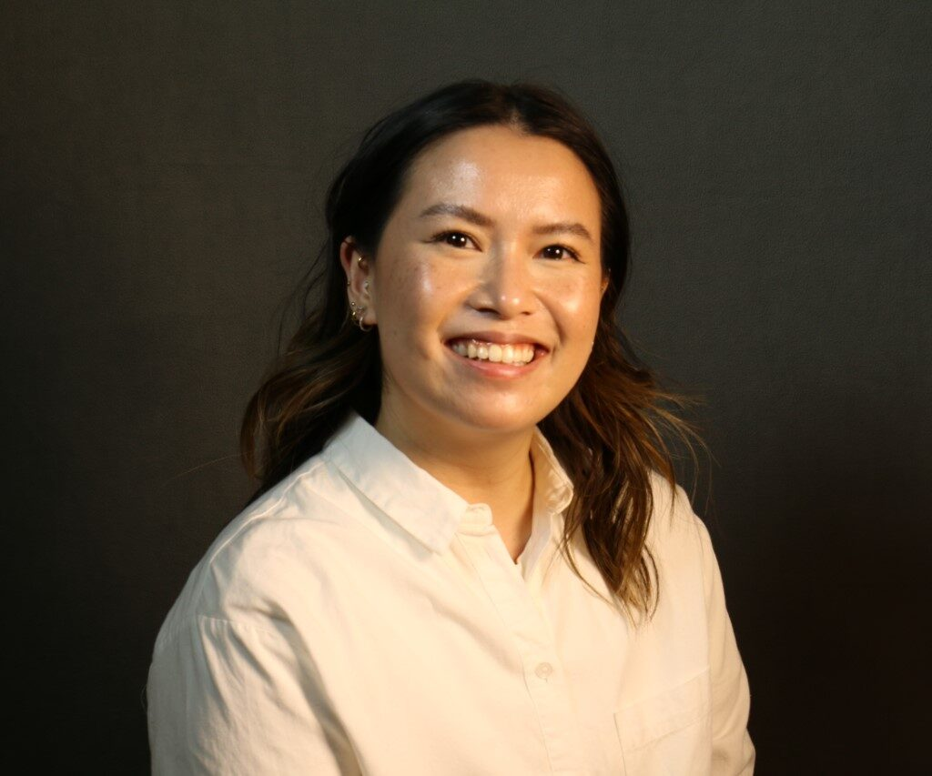
District Executive
While most paperwork and questions can be addressed by your Unit Commissioner, if there is a need, Liz’s contact information is:
Ms. Liz Kohler
District Executive
NCAC, Marriot Scout Service Center
9190 Rockville Pike, Bethesda, MD 20814
301-214-9147
elizabeth.kohler@scouting.org

Slide 50
Relationships
Builds and maintains relationships with religious organizations and service organizations to:
  Encourage youth members to join Scouting
  Encourage organizations to charter Scout units
  Offer opportunities for religious and service awards
Contact:
Mr. Pat Berney
patberney4scouts@gmail.com

Slide 51
George Mason District Program
Vice Chair for Program – John Drisco
Advancement – Matt Burns
Merit Badge Day – Jason Dalton
Merit Badge Dean – Margee Egan
Special Needs – Scott Willey
Camping and Outdoor Programs – Kurt Legenhausen
Aquatics – Rus Pittman
Conservation – Joe Knecht
Cope/Climbing – John Lesko
Health and Safety – Kevin Kirchgraber
High Adventure – Brian Heath
Order of the Arrow – Brian Fleck
Outdoor Ethics/LNT – Joe Knecht
Range and Target Activities – Brian Summers
Activities and Civic Service – Pat Berney
Camporee – Andy Zaso
Flags In – Rus Pittman
Hike-O-Ree – John Drisco
International – Hector Uranga
Pinewood Derby – Pat Berney
Scouting for Food – Brian Brennan
STEM – John Drisco, Acting
Training: Roy DeLauder
NYLT - Cullen Bengtson
Wood Badge: TBD

Slide 52
Program Launch Closing
How to have a successful planning effort
  Set a date for your annual planning meeting
  Provide materials/links listed to those that will lead the meeting
  Be sure to include the stakeholders
    Cubs – include the den leaders/parents
    Scouts/Crews – Encourage youth-leadership
    Consider inviting your Unit Commissioner and/or COR
  Match your planned activities to your anticipated budget
  Plan the appropriate number of Service Projects and Outings/Campouts/Adventures
  Make it FUN!

Slide 53
George Mason District
Roundtable
June 13, 2024

Slide 54
Agenda
Welcome and Pledge
Questions about Read-ahead
Award(s)
Council Announcements
General Announcements
Program Announcements
Cracker Barrel/Networking (Optional; NLT 9pm)
Next Meeting: August 8, 2024 - at Falls Church Presbyterian Church, Falls Church, VA

Slide 55
Questions/Clarification about Read-ahead?

Slide 56
District and other Award(s)

Slide 57

Council Announcements
Brand changing to
Outdoor Programs 2025 Strategic Initiative
June 1 – New Cub Program
July – Dec – Renewal notices, via email, to registered Adults/Youth
  Bills both National and NCAC Fees
  Still working on Scholarships
Key 3 replacement error – my.scouting.org (60 days)
Powder Horn (8/15/24 – 8/18/24), Camp St. Charles, Newburg, VA
  Adult and Youth (13 years/8th grade or 14 years)
  Program being phased out

Slide 58
Shooting Sports –> Range and Target Activities
Except for law enforcement officers required to carry firearms within their jurisdiction, firearms shall not be brought on camping, hiking, backpacking, or other Scouting activities except those specifically planned for target shooting under the supervision of a currently certified BSA national shooting sports director or National Rifle Association firearms instructor.
June 1, 2024 - Cub Scout program includes elective adventures versus awards for Cub Scouts. These elective adventures can still only be offered at an accredited camp program (day camp, short-term camp, long-term camp) or a council organized one day event. For information on delivering these new elective adventures, please visit the shooting sports website.
Sept 1, 2024 –
  Firearm programs may only take place on a nationally authorized camp property’s range(s) or at a commercial firearm range. This does not apply to district or council programs that utilize BB devices*, but applies to pellet rifles, airsoft (any type), rifles, pistols, shotguns, and muzzle loading rifles and shotguns.
  The use of personal firearms and personal ammunition is prohibited in all Scouting programs at nationally authorized camp properties. Personal firearms and personal ammunition may be used at a commercial firearm range, subject to restrictions regarding caliber, gauge, and action as described in the National Shooting Sports Manual and herein.
  Venturing and Sea Scouting rifle use is limited to the following types (All other rifle or caliber types are prohibited.):
    .177 caliber air rifle, min 2.5 lbs. trigger pull (open, scope or dot sights);
    air, CO2, or precharged pneumatic rifle,
    .22 caliber rimfire long rifle or short rifle (breech-loading, single shot, bolt action or repeater bolt action with box magazine), min 3 lbs. trigger pull.
    Muzzle loading rifle;

Slide 59
General Announcements

Slide 60

Current 2024 George Mason Calendar
Sep 28, 2024 – Life to Eagle Seminar(In Person), St James Catholic Church, Falls Church, VA
Oct 18-20, 2024 – Fall Camporee, Camp Rock Enon, Gore, VA
Nov 02, 2024 – Scouting for Food (Tags)
Nov 09, 2024 – Scouting for Food (Pick-up)
Nov 10, 2024 – Flags In (Veterans Day), NMP, Falls Church, VA
Feb 22, 2025 – University of Scouting, Alexandria, VA
Mar 08, 2025 – GMD MB Day, St James, Falls Church, VA

Slide 61
STEM
07/08/24 – 07/12/24 – STEM Summer Workshop, Alexandria, VA
08/05/24 – 08/09/24 – STEM Summer Workshop, Alexandria, VA
Ancient Earth: Birth of the Sky (on PBS) - link
Anytime – DC STEM Trek- Showcases 24 government agencies, private organizations and monuments related to the tenets upon which STEM is based. Two hikes - 10.57 miles, or 4.75 miles
Ancient Earth: Birth of the Sky (on PBS) - link
Anytime – DC STEM Trek- Showcases 24 government agencies, private organizations and monuments related to the tenets upon which STEM is based. Two hikes - 10.57 miles, or 4.75 miles

Slide 62

Elks Youth
Recognition Dinner
For youth that earned Eagle in 2023 (i.e. their Eagle Board of Review was held in the 2023 calendar year) and their Scoutmasters.
Wednesday, May 29, 2024
Elks Lodge - 2188, 8421 Arlington Blvd., Fairfax, VA.
Thanks to all that attended

Slide 63
Flags In
275 – 300 Youth and Adults participated
Placed about 2,500 flags in three hours
Bugler from T345 – Thanks!

Slide 64
Alignment Update

Slide 65
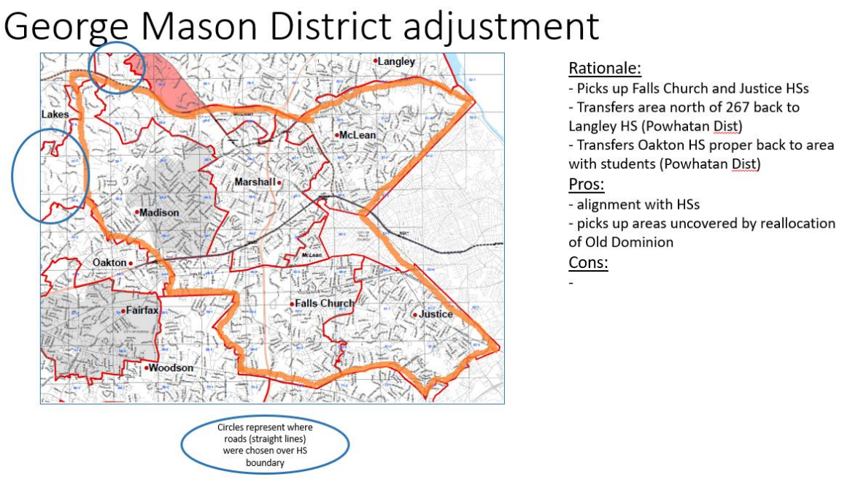

Slide 66
Units Impacted
GMD (to Powhatan)
  Packs – 0187, 0882, 1513
  Troops – 0187, 0918, 1113, 1887, 1888
Old Dominion District (to GMD)
  Packs – 0855, 1845, 1962
  Troops – 0875, 1845
Chain Bridge District (to GMD)
  Packs – 0667, 0861, 1127, 1867
  Troops – 0652, 0667, 0869, 1130, 1916, 2119
  Crew - 0652

Slide 67
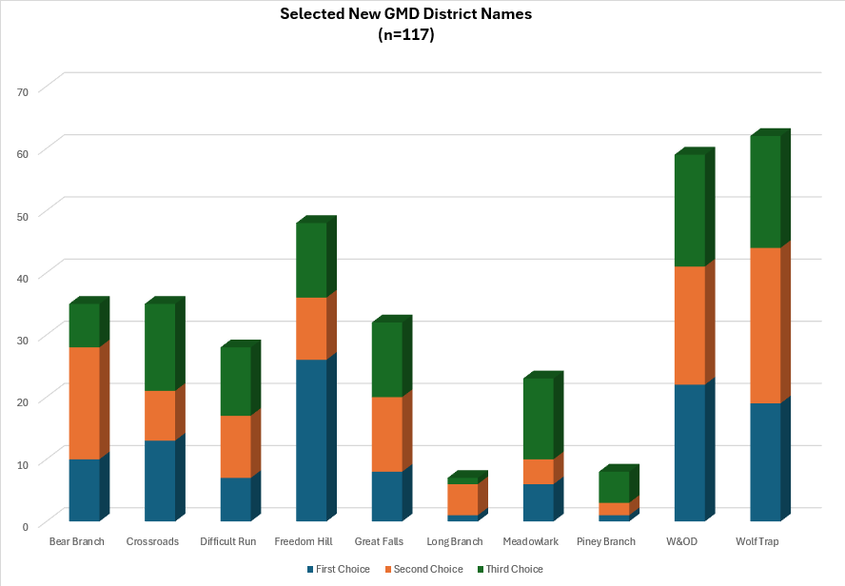
New District Name (voting closes 06/14/24 at noon)

Slide 68
Time for Cracker Barrel
Minutes and slides available on the GMD web site (District Resources, Roundtable). Password is “GMDRT”
Next meeting – August 8, 2024, at FC Presbyterian Church

Slide 69
Backup Slides

Slide 70
Chain Bridge Units moving to GMD
Crew 0652 - St Dunstans Episcopal Church | 1830 Kirby Rd Mclean, VA 22101
Pack 1867 (F) - St Dunstans Episcopal Church | 1830 Kirby Rd Mclean, VA 22101
Pack 0667 (B) - Chesterbrook United Methodist Church | Meets at Franklin Sherman ES, 6633 Brawner St, McLean, VA 22101
Pack 0861 (F) - Lutheran Church of the Redeemer | 1545 Chain Bridge Rd McLean, VA 22101
Pack 1127 (F) - American Legion McLean Post 270 | 1205 Dolley Madison Blvd McLean, VA 22101
Troop 0652 (B) - St Dunstans Episcopal Church | 1830 Kirby Rd Mclean, VA 22101
Troop 0667 (B) - Chesterbrook United Methodist Church | Meets at Franklin Sherman ES, 6633 Brawner St, McLean, VA 22101
Troop 0869 (B) - American Legion McLean Post 270 | 1205 Dolley Madison Blvd McLean, VA 22101
Troop 1130 (B) - American Legion McLean Post 270 | 1205 Dolley Madison Blvd McLean, VA 22101
Troop 1916 (B) - Lutheran Church of the Redeemer | 1545 Chain Bridge Rd McLean, VA 22101
Troop 2119 (G) - Lutheran Church Of The Redeemer | 1545 Chain Bridge Rd McLean, VA 22101

