Slide 1
Improving PCP – Specialist Communication in Rhode Island:
Implementation of AAMC Project CORE

Slide 2
Conflict of Interest
Planners:
None of the planners for this educational activity have any relevant financial relationship(s) to disclose with ineligible companies whose primary business is producing, marketing, selling, re-selling, or distributing healthcare products used by or on patients.
Speakers:
Dr. Joe Diaz, Dr. Paul Larson, Dr. Anita Arora, & Meaghan Quinn, faculty for this educational activity, have no relevant financial relationship(s) with ineligible companies to disclose.

Slide 3
Project Objectives
Improve communication between primary care and specialty care.
Develop consensus regarding the clinical management of common diseases.
Engage patients in equitable, high value and lower cost specialty access.
Discuss improvement opportunities in care coordination and delivery.
Engage statewide, multi-payer, multi-system collaboration.

Slide 4
Project CORE: Coordinating Optimal Referral Experiences
Improving Care at the Interface of Primary and Specialty Care
CTC-RI Annual Conference
October 5, 2023

Slide 5
Who We Are: AAMC Clinical Innovations Team
Goal: Increase health system’s capacity to deliver high value care and accelerate the adoption and sustainability of innovative care models through:
Convening learning collaboratives and providing expertise to health system clinical leaders and teams
Developing tools and resources, educational programs, and data to support high value care delivery
Influencing the national conversation through advocacy and dissemination
Equity
Ambulatory Care Innovations
Telehealth Implementation & Training
Access to Specialty Care
Delivery at the Primary Care-Specialty Care Interface

Slide 6
Common Problems at the Interface of Primary & Specialty Care
Poor communication & coordination
Poor access
Wide variations in care

Slide 7
Project CORE Goals
By improving communication, coordination and culture between primary care providers and specialists, the CORE model aims to:
Improve timely and equitable access to specialty care
Improve quality and experience for patients and providers
Enhance primary care comprehensiveness
Control costs of care

Slide 8
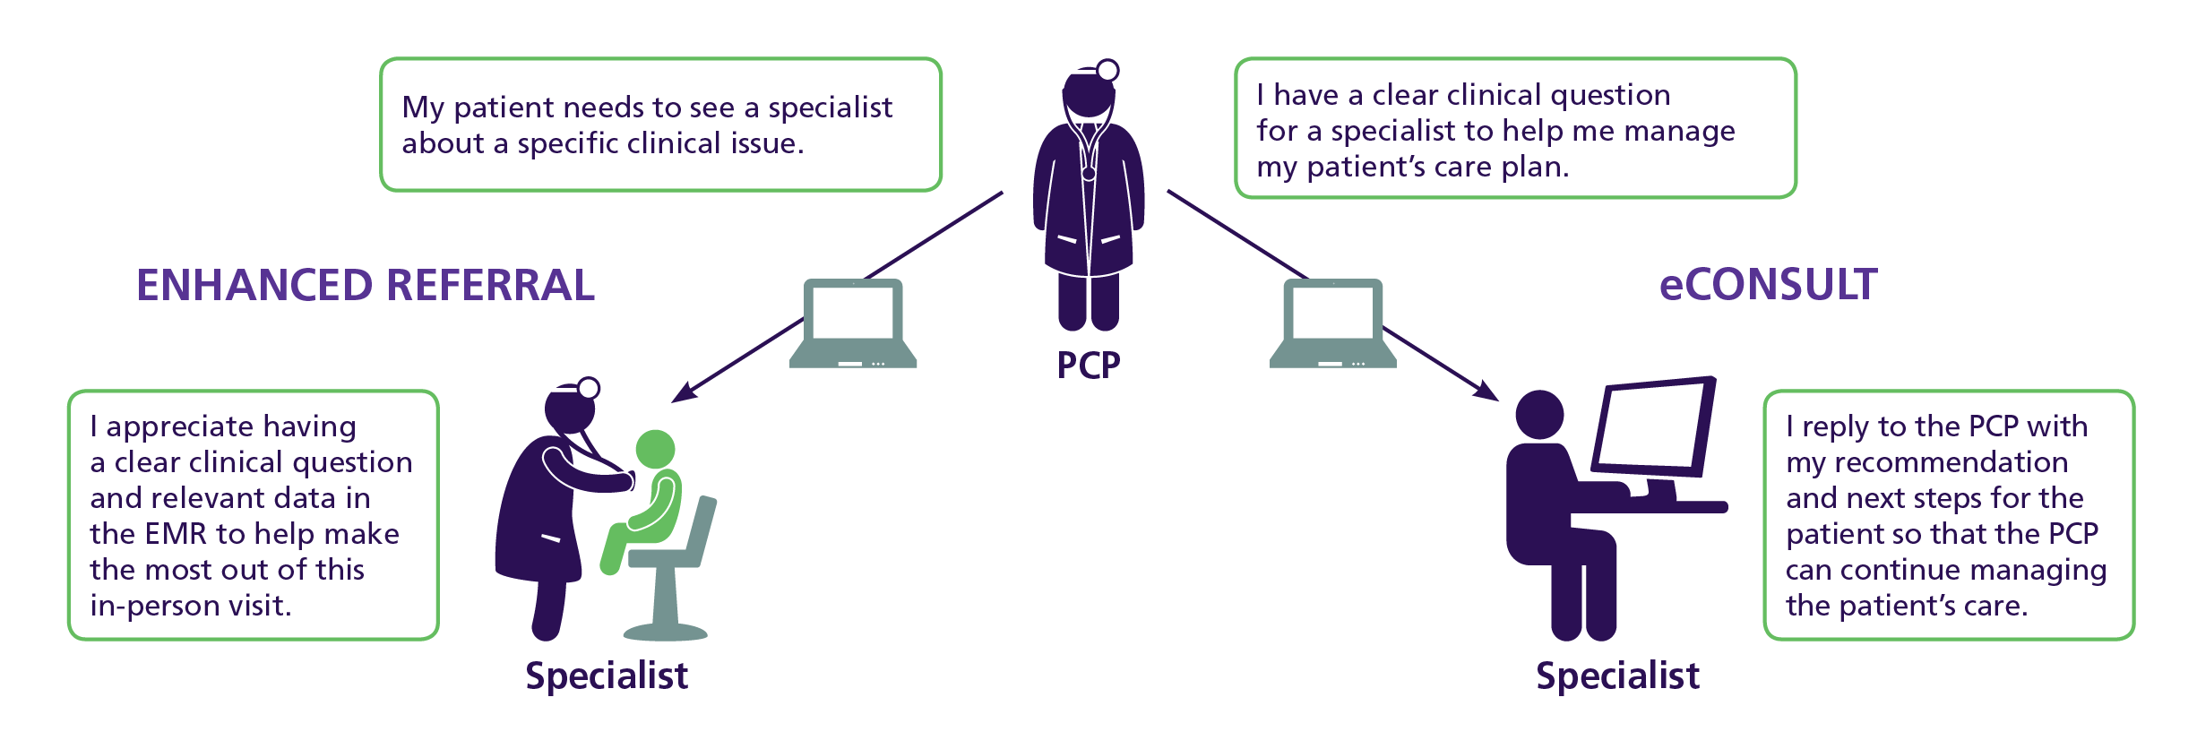
The CORE Model
IMPLEMENTATION STRATEGY
to engage providers and establish a culture of collaboration between PCPs and specialists leading to increased standardization in care delivery

Slide 9
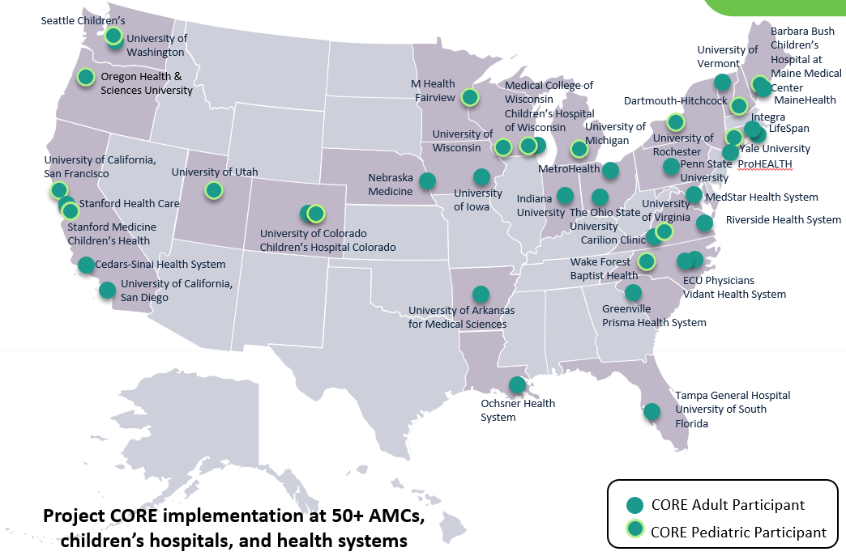
Project CORE Network

Slide 10
Enhancing Referrals with Point-of-Care Decision Support in the EHR
Problem-Specific Decision Support Through:
Pre-referral evaluation & management guidance
Clear clinical question
Relevant data (tests, labs)
Co-management preference

Slide 11
Implementing CORE eConsults
eConsult Overview:
Implemented in the EHR alongside the referral workflow
Condition specific templates
Initiated by a PCP to a designated specialist colleague
Typically, straight forward, low-acuity issues (answerable with data available in the EHR)
< 3 business day response
If too complex, specialist can recommend in-person visit
RVU credit to PCP & specialist for completed eConsults

Slide 12
Specialties Active in Project CORE
Adult Specialties
Allergy/Immunology
Bariatrics
Burn & Wound
Cardiology
Colorectal Surgery
Dermatology
Endocrinology
ENT
Gastroenterology
General Surgery
Geriatrics
Hand/Plastic Surgery
Hematology
Hepatology
HIV Medicine
Infectious Disease
Maternal Fetal Medicine
Medical Genetics
Nephrology
Adult Specialties (Cont’d)
Neurology
Neurosurgery
Ob-Gyn
Occupational & Enviro
Oncology
Ophthalmology
Orthopedics
Palliative Care
Pain Management
Pharmacy (Ambulatory)
Psychiatry
Pulmonary
Radiology (Diagnostic & Interventional)
Rheumatology
Sleep Medicine
Toxicology
Urology
Vascular Surgery
Pediatric Specialties
Pediatric – Adolescent Gynecology
Pediatric – Adolescent Medicine
Pediatric – Allergy
Pediatric – Allergy/Immunology
Pediatric – Cardiology
Pediatric – Child Protection
Pediatric – Dermatology
Pediatric – Developmental Medicine
Pediatric – Endocrinology
Pediatric – ENT
Pediatric – Genetics
Pediatric – GI/Hepatology
Pediatric – Headache
Pediatric – Hematology
Pediatric – Hematology/ Oncology
Pediatric – Immunology
Pediatric Specialties (Cont’d)
Pediatric – Infectious Disease
Pediatric – Integrative Medicine
Pediatric – Lipid & Weight Management
Pediatric – Nephrology
Pediatric – Neurology
Pediatric – Ophthalmology
Pediatric – Orthopedics
Pediatric – Ortho/Sports Medicine
Pediatric - Pharmacy
Pediatric – Psychiatry
Pediatric – Pulmonology
Pediatric – Rheumatology
Pediatric – Sleep Medicine
Pediatric – Sports Medicine
Pediatric – Surgery
Pediatric – Teen Health
Pediatric – Toxicology
Pediatric – Urology

Slide 13
Making the Health System ROI Case
Timelier access to specialty input
Positive provider and patient experience
Reduction in curbsides and low value referrals
Increased referral completion rates
Decreased leakage to external health systems
Improved access to specialty care for new patients and higher acuity patients
Fewer no shows
*Summary of results from CMMI Health Care Innovation Award cohort, 5 pilot AMCs, 2014-2017

Slide 14
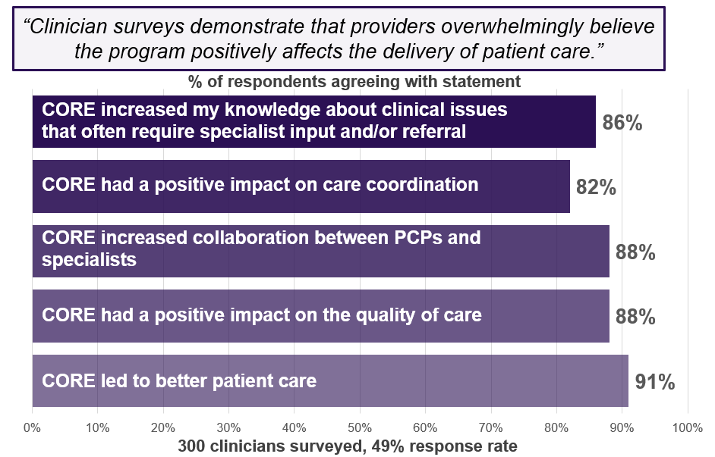
Provider Feedback on eConsults and CORE

Slide 15
Positive Patient Experience
81% of patients satisfied with the specialists’ recommendations via eConsult (the same as those with an in-person referral)
95% of patients felt that the specialist’s eConsult advice was conveyed promptly and recommendations were clearly explained
For every specialty visit averted, eConsults saved patients ~$100 in avoided copays, transportation costs, and missed work
Sources: Comparing Patients' Experiences with Electronic and Traditional Consultation: Results from a Multisite Survey (J GEN INTERN MED 35, 1135–1142 (2020). https://doi.org/10.1007/s11606-020-05703-7); Project CORE analysis of eConsult opportunity costs

Slide 16
Advancing Health Care Equity
eConsults enable improved access to specialty care for underserved populations (e.g., uninsured or under-insured, rural communities, incarcerated populations)
Unlike telemedicine, eConsults don’t rely on patient internet connection or device access, comfort with technology, or ability to speak English
During COVID-19, eConsults helped overcome barriers to specialty input during the height of the pandemic*​
eConsult percent of specialty contact increased regardless of patient language and for most payers, except for uninsured and self-pay
*Findings from Trends in Utilization of Electronic Consultation Associated with Patient Payer and Language Among US Academic Medical Centers During the COVID-19 Pandemic (AAMC CORE Group, JAMA Network, 2022 May)

Slide 17
Project CORE: A Bridge to Value
Living in Both Worlds
Value Based Care
Fee for Service
Increase in new patients and higher acuity patients
Decreased leakage
Potential for increased surgical yield
Reduction in wait times, fewer “no shows”
Increase in primary care comprehensiveness
Decrease in specialty utilization and association costs
Promotes right care, right place, right time
Aligns with APM requirements
Improved Access to Care
Improved PC-SC Coordination and Collaboration
Patient Experience
Provider Experience

Slide 18
Key eConsult Payment Policy Updates
In 2019, CMS approved payment for two new CPT codes for interprofessional consults (99451, 99452)
Valued at 0.7 wRVU each to the treating provider/PCP and consulting provider/specialist
Commercial payers increasingly covering the service
In January 2023, CMS issued a letter to Medicaid State Health Officials authorizing and encouraging coverage of eConsults in the Medicaid and CHIP programs (reversing a previous policy)
In June 2023, CMS announced its new Making Care Primary model, which focuses on PC-SC collaboration and encourages use of eConsults for advanced track participants (RFA announced 8/14/23)

Slide 19
AAMC CORE in Rhode Island
With multi-payer funding, CTC-RI engaged AAMC to implement CORE program as critical part of strategy to improve primary care and specialty collaboration and alignment on value. Goal to support statewide adoption including exploring HIE for non-EPIC EHRs
Health Plans; United HealthCare, BCBS RI, Tufts
Lifespan (LPG, Coastal Medical) & Brown Physicians Inc.
Integra Community Care Network (CareNE. RI-PCPC, South County)
2-year implementation seed-funding for eConsult implementation
CTCRI CORE Oversight Committee - Facilitates program goals, template development, specialty engagement, outcome measurement & payer engagement for sustainable funding.
Notes:
Care Transformation Collaborative Rhode Island (CTC-RI) accelerates CORE adoption to optimize primary care and specialty collaboration on value.
Program seed funding: Program Development & Completed eConsults $35 to PCP/$35 to specialist ($70 total)
Long term sustainability and payment for eConsults: Commitment from BCBSRI for commercial and Medicare Adv without copay/co-insurance and high-level commitment from UHC to cover codes in all products...

Slide 20
Shared Year 1 CORE Program Goals
PCP Engagement
60-70% of eligible PCPs have completed at least one eConsult
25% or more of PCPs use eConsults monthly
A newsletter or similar serial method of program marketing, updates, and framework for sharing examples of high-quality questions/responses is in place
Co-management conferences occur regularly for family medicine and general internal medicine
Specialties Usage
Defined # of specialties live on the model (to be designated by each health system)
eConsults as a percentage of all specialty contact at CORE benchmark within 6 months of go-live
95% or more eConsults are completed in <3 business days (aim for 50% completed within 24 hours of submission)
QA and Data Infrastructure
Standard and effective processes of QA and QI are in place to identify and respond to problems in a timely manner
Gather PCP feedback on the program
Gather specialist feedback on the program
Less than 20% conversion and decline rate
Data infrastructure in place to support QA and program monitoring

Slide 21
e-Consults
First Year In Review
Joseph Diaz, MD,MPH - Primary Care Lead
Kaila Defosse - Program Manager

Slide 22
Overview - Build
Template build
AAMC conditions matrix
Example templates
Specialist input
PCP working group feedback
Epic build and implementation

Slide 23
Overview
Established July 22, 2022
295 e-Consults placed
5 Declined, 3 Converted
59 PCP Providers Utilized an e-consult

Slide 24
5 e-Consult Departments Available
Department | Go-Live Date
Cardiology | July 22,2022
Endocrinology | August 17, 2022 (Paused July 12, 2023)
Psychiatry | December 6, 2022
Infectious Disease | June 28, 2023
Pulmonary | August 17, 2023
Sleep | July 11, 2023
Orthopedics / Sports Medicine | October 1, 2023
OB/GYN | TBD (Est. October 15, 2023)

Slide 25
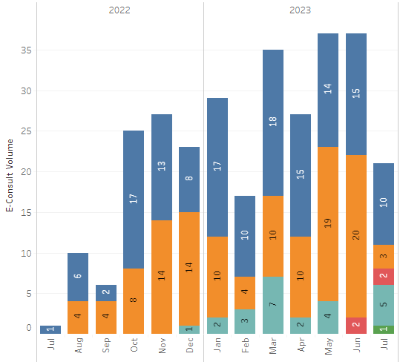
Growth of e-Consults Since Launch
e-Consults per month, per specialty
1 10 6 25 27 23 29 17 36 27 37 37 21

Slide 26
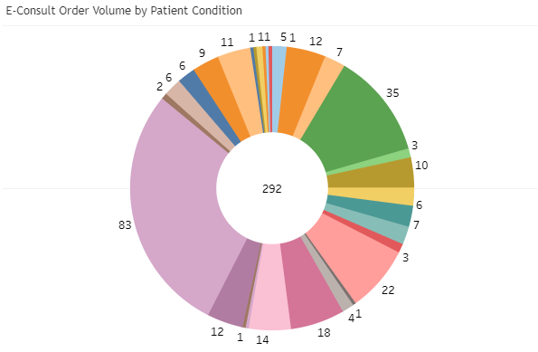
Overall Volume by Patient Condition
Adrenal Insufficiency (5)
Adrenal Mass (1)
Afib/Flutter (12)
Anxiety (7)
Arrhythmia-Palpitations-Abn ECG (35)
Bipolar Disorder (3)
Chest Pain (10)
CAD (6)
Depression (7)
Diabetes Mellitus (6)
Heart Failure (3)
Hyperparathyroidism/Hypercalcemia (22)
Hyperprolactinemia (1)
Hypertension (4)
Hyperthyroidism (18)
Hypothyroidism (14)
Latent TB (1)
Osteoporosis (12)
Other (83)
Pituitary Mass (2)
Pre-Operative Evaluation (6)
Psychiatry Other (6)
Syncope (9)
Thyroid Nodule/Goiter (11)
Babesiosis (1)
Lyme Disease (1)
Restless Leg Syndrome (1)
Substance Use Disorder and Depression (1)
Syphilis (1)
Other: mostly would have fit into existing templates

Slide 27
eConsult volume by practice

Slide 28
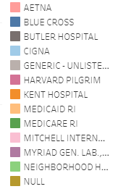
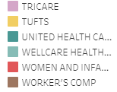
eConsult volume by insurance

Slide 29
Response Time
Average
Overall Response Time : 2.0 Days
<24hrs
Total e-Consults Completed <24hrs: 148
24-48hrs
Total e-Consults Completed 24-48hrs: 39
Total e-Consults Completed 48-72hrs: 23
>72
Total e-Consults Completed >72hrs: 55
48-72hrs

Slide 30
AAMC CORE @ Lifespan

Slide 31
11 eConsult departments are available
Department | Go-Live Date
Pedi Gastroenterology | June 6, 2022
Adult Gastroenterology | June 6, 2022
Psychiatry | June 6, 2022
Cardiology | December 1, 2022
Concussion | December 1, 2022
Neurology | December 1, 2022
Rheumatology | January 3, 2023
Hematology Benign | February 1, 2023
Obstetric Medicine | March 6, 2023
Physiatry / PM&R | May 10, 2023
Plastics - Hand | May 10, 2023

Slide 32
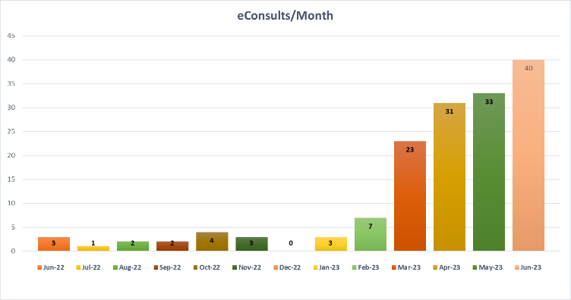
eConsults grow every month

Slide 33
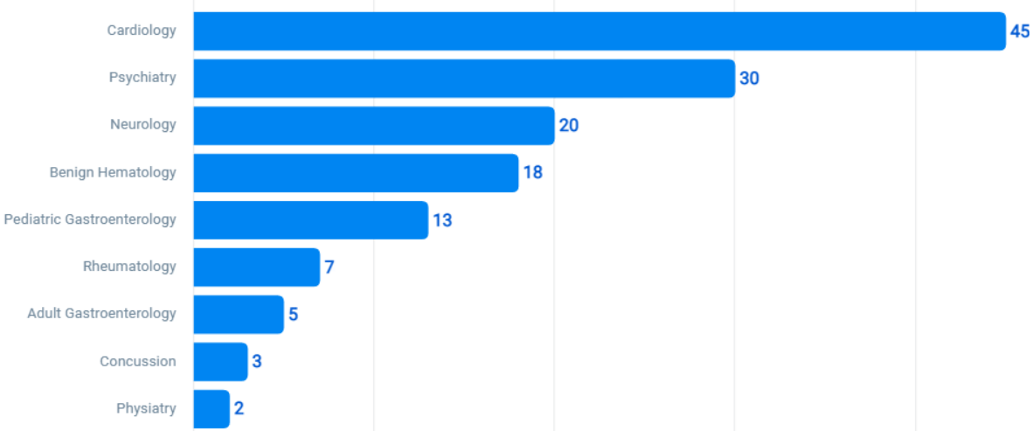
Completed eConsults by specialists increase slowly following department Go-Live

Slide 34
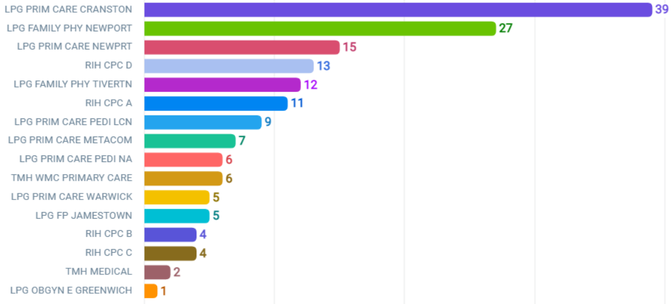
eConsult placement volume varies by practice

Slide 35
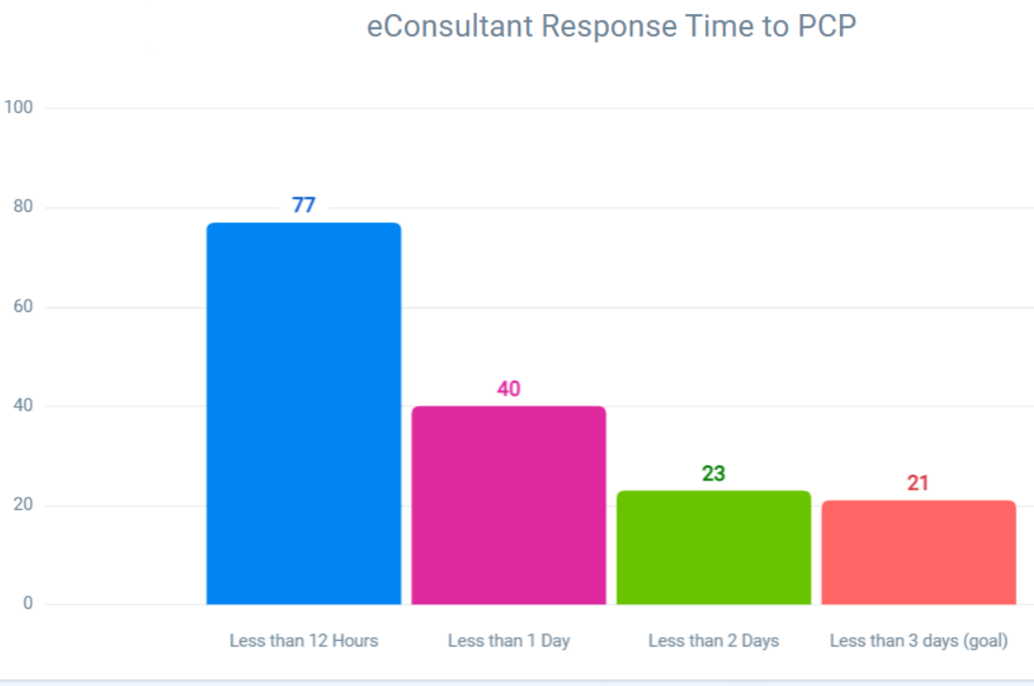
eConsultant is responding in less than 3 days and frequently same day

Slide 36
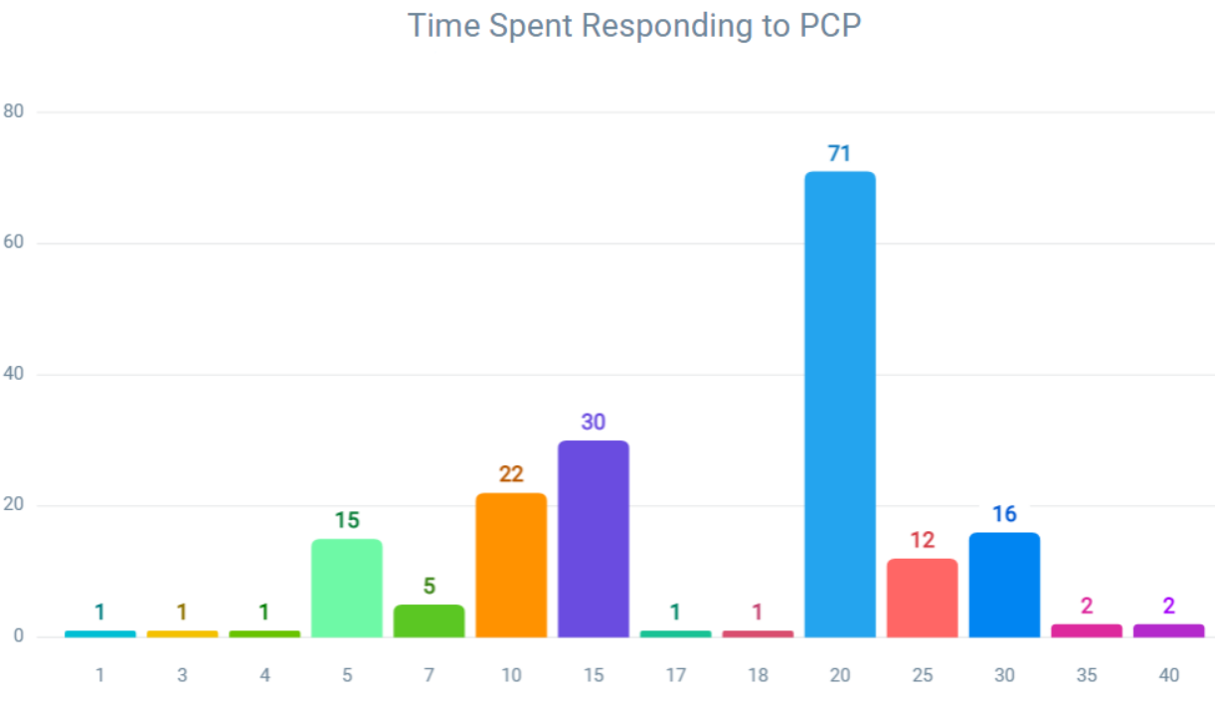
eConsultant spends 20 min completing reply

Slide 37
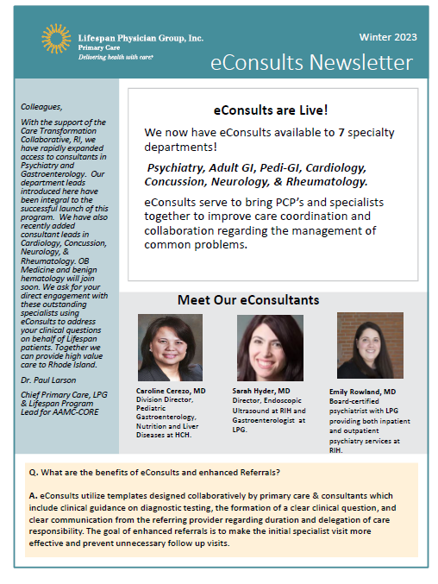
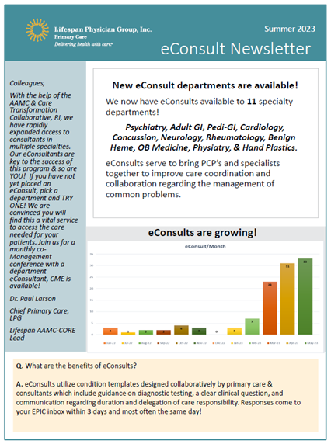
PCP Engagement
Co-Management Conferences
Scheduled Monthly – March – November 2023
Completed: CVI, Psych, Rheum, Concussion/PM&R, Neuro
Planned: GI, Heme.
CME Available: March, April, May, June, Aug
eConsult Newsletter
Winter 2022 - 2023
Summer 2023

Slide 38
Enhanced Referrals
Referring PCPs:
LPG Primary Care (7 practices)
LPG OB/GYN
LPG Pediatrics
CVI – System-wide
June 6, 2022
Pediatric GI
Adult GI
Psychiatry
December 1, 2022
Cardiology
In Development
Psychiatry/BH
LCI Oncology
Enhanced Referral development is now integrated with the Lifespan Referral Management Initiative.

Slide 39
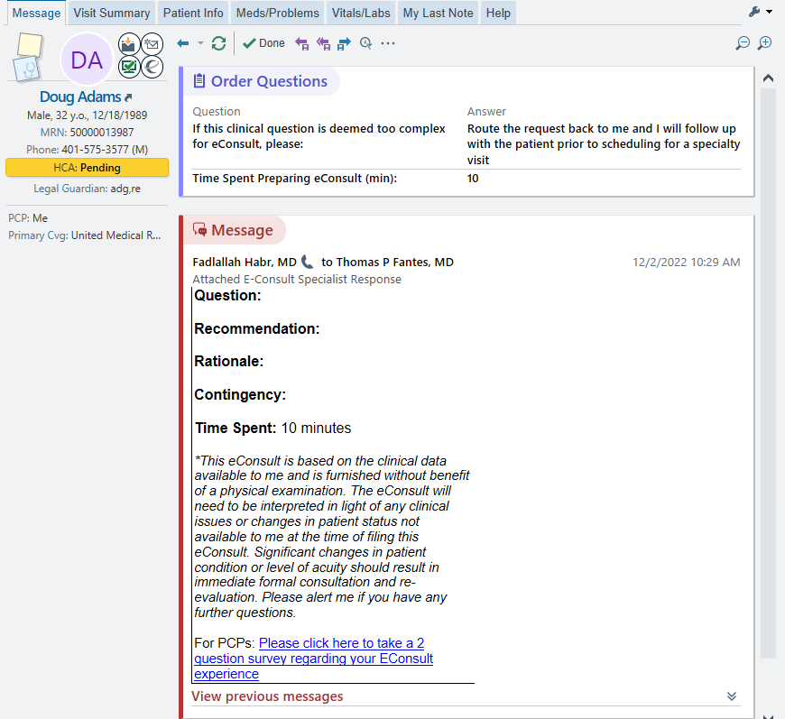
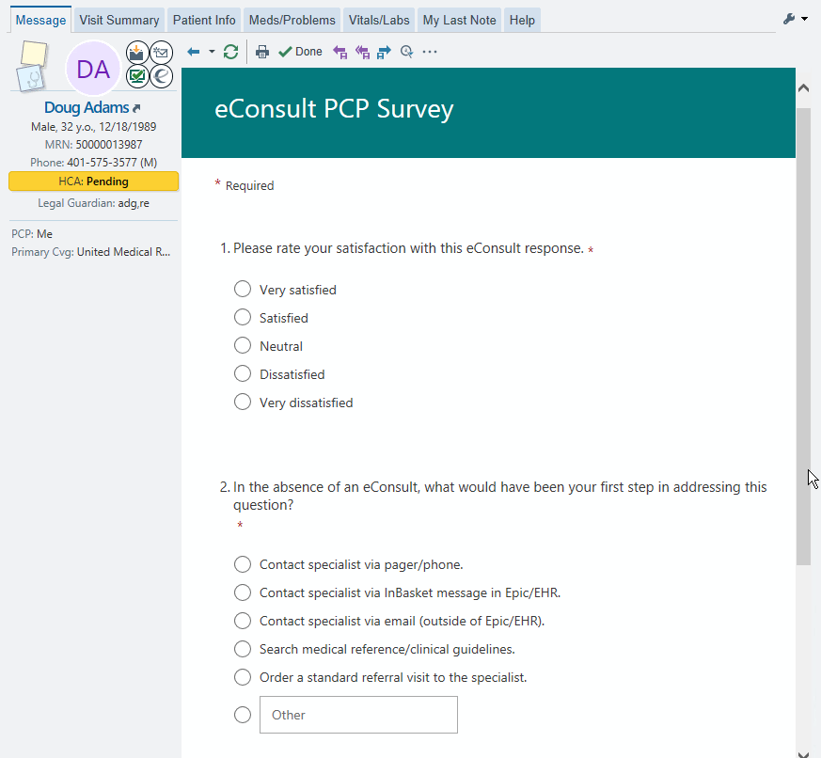
PCP Feedback Process (https://forms.office.com)

Slide 40
Feedback-PCP’s
100% of PCP very satisfied/satisfied with eConsult response.
Survey Feedback
67% of eConsults would have been referrals.

Slide 41
Feedback - PCPs
Overall very positive feedback from PCPs
“I have found the Econsult very helpful to my practice!... I find patients have been very satisfied with this type of consult as it helps them to avoid unneeded visits, especially for those patients who have limitations like lack of transportation to appointments.”
“All the specialists I’ve communicated with have been prompt and knowledgeable and I’m excited to continue to use this program to improve patient care and gain quicker access to specialist input.”
“I also see it being able to reduce some of my office based clinical referrals if I am able to quickly get an answer to a clinical question.”
“I have found e-consults to be very helpful... Responses from specialists have been fast. Lack of timely access to see specialists in person is frustrating so this helps some (though of course does not fill all the gaps). Would love to see more specialties with e-consults.”

Slide 42
Feedback - Specialists
“very good experience”
“steady (volume) but not overworked”
“could use it more” – many patients that could easily be e-consults
“straightforward”
‘Would be helpful for someone to triage consults’ and provide e-consult option

Slide 43
CORE Implementation Experience
Wins:
High specialty engagement in development
Outstanding IT support in Epic build
Implementation coordination and support from CTC RI
Challenges:
Primary care referral base is small at Lifespan
Fewer Integra specialists available on EPIC
Priorities 2023:
External pivot strategy for community PCP
Engagement with payors for equitable access

Slide 44
Future Development
Payer engagement ongoing: BCBS, UHP, Tufts, & NHP.
External pivot for community PCPs in discovery with RI Quality Institute and the state Health Information Exchange.
Patient Experience Survey
Patient education and aligned communication strategies
Optimizing primary care and specialist communication in new payment models

