Slide 1

George Mason District
Roundtable
January 11, 2024

Slide 2

Pledge

Slide 3
Agenda
Welcome and Pledge
Questions about Read-ahead
Award(s)
General Announcements
Breakout Sessions:
  Cub Scouts – Program Changes
  Scouts BSA – OA Elections
Cracker Barrel/Networking (Optional; NLT 9pm)
Next Meeting: February 8, 2024 (7:30pm)

Slide 4
Welcome
New to Roundtable?
Please introduce yourself!

Slide 5
Questions/Clarification about Read-ahead?

Slide 6
Award(s)

Slide 7
General Announcements

Slide 8

Current 2023 George Mason Calendar
February 03, 2024 – Life to Eagle Seminar, Virtual
February 24, 2024 – University of Scouting, Alexandria, VA
March 09, 2024 – GMD Merit Badge Day, Fairfax, VA
April 13, 2024 – GMD Pinewood Derby, Fairfax, VA
May 27, 2024 – Memorial Day Flags In, Falls Church, VA

Slide 9
STEM
02/03/24 - Akela Chess Classic Cub Scout Tournament, MSSC, Bethesda, MD
02/10/24 - Akela Chess Classic Scouts BSA Tournament, MSSC, Bethesda, MD
03/23/24 – Maryland Science Center Camp-In, Baltimore, MD
Ancient Earth: Birth of the Sky (on PBS) - link
Anytime – DC STEM Trek- Showcases 24 government agencies, private organizations and monuments related to the tenets upon which STEM is based. Two hikes - 10.57 miles, or 4.75 miles

Slide 10

2024 GM District Merit Badge Day
March 9th, 2024, at Fairfax Presbyterian Church in Fairfax.
There are currently 110 Scouts registered today. There are still openings, but they are going fast. Please check out at the Registration site to see what is open:
https://site.corsizio.com/a/5bf2f8e8e6dfc6f1ca7cbd64
Still need the Unit’s Merit Badge Day Coordinator names and contact details or the Registration reports will be going to the Key 3 of the Units participating. Send info to : gmasonmeritbadgeday@gmail.com
Scouts should be utilizing the merit badge books and read requirements and start tackling the “pre-work” now.
Note: The “pre-work” is not the same as a “prerequisite.” The “pre-work” consists of tasks/activities that the Scout is advised to do in advance of the Merit Badge Day. A Scout can still participate in the Merit Badge Day class if he hasn’t completed the pre-work but failure to complete the pre-work may mean the Scout leaves the Merit Badge Day with a partial badge. A prerequisite is something that must be done in order to qualify to take the class. The only prerequisite we are aware of for the George Mason Merit Badge Day is that the Scout must be a registered member of the Boy Scouts in a participating unit.
Feedback to John Drisco at gmasonmeritbadgeday@gmail.com

Slide 11
Big Rock
Breakout Sessions –
  Cubs – Program Changes
  Scouts BSA – OA Elections

Slide 12

PROGRAM UPDATES
2024-25 Program Year
Effective:
June 1, 2024
Notes:
The following is based on information I brought back from the Cub Scout Program Updates conference at Sea Base last month.
My goal over the next ten minutes is to help you understand the 2024-25 Program Updates as well as anticipate likely questions you might run into. I’m NOT trying to make you an expert on every detail of the program update. The key thing to remember is the updates are Fun, Simple and Easy!

Slide 13
Why Change the Cub Program?
Average Cub tenure is short!
Parents are influential – keeping parents is key to keeping Cubs
More effective to retain the Cubs we have than recruit, lose and repeat
Program quality is one key to retention
1.6
Fun, Simple And Easy For Cubs, Parents and Leaders!
Notes:
On average, a typical Cub spends 1.6 years in the program. An updated program that is fun for the Cubs, simple for the parents to understand, and easy for the leaders to implement will help keep Cubs longer. A simpler program that is easy to deliver will benefit Cub parents and leaders.
Engaged Cubs and parents, through word-of-mouth, can be effective recruiters. So, the program our units deliver makes a major contribution to Cub retention, therefore, improving the transition to Scouts BSA, benefits our Troops, Crews and Ships.

Slide 14

Feedback From over 23,000
Cub Scout Leaders and Parents
95% Confidence
Notes:
The BSA used a Data-Driven Design to develop these updates based on feedback from multiple surveys over four years from over 23,000 Cub Scout Leaders and parents.
The response rates to each survey exceeded industry averages and had a 95% confidence level, meaning, if we ran the survey again, we would get similar results.
They received open-ended responses on what den leaders and parents like and don’t like about the program.
The updates were then tested with Cubs and parents. Any that didn’t result in high approval were reworked until they did.

Slide 15




4 Major areas of focus:
BOBCAT
ADVENTURES
WEBELOS (4TH/5TH GRADE)
AWARDS
Notes:
The Cub Scout parent and leader feedback identified four main opportunities for improvement: [click]
Bobcat is how we introduce a Cub to the values of Scouting.
When I was a Cub Scout, you had to be 8 to be in a Cub Scout Den, and 10 to be in a Webelos Den. Between then and now, we have expanded the membership and added Scouts as young as 5, but there are still only One set of requirements for Lion through AOL, which proved frustrating. It should be different based on the grade of the Cub to remain age appropriate. Plus, den leaders are challenged if they have Cubs who already earned Bobcat and have one that hasn’t. [click]
Cub Scout Adventures were disjointed with some adventures covering different topics. It also wasn’t clear why some were required, and others were elective. [click]
The Webelos program, currently for 4th AND 5th graders, caused confusion because it didn’t follow the single grade level pattern and raised a question about how long it really took to prepare a Cub for Scouts BSA [click] and
The feedback revealed that leaders didn’t focus on awards. They aren’t in the direct line of sight of den leaders, so they don’t drive behavior. Even if they knew about them, many felt they weren’t important since they weren’t part of the advancement program. So, on average only 1.5% of youth earn an award.
Now, let’s look at how the BSA has addressed each of these areas. [click]

Slide 16

Bobcat’s New Look
Notes:
Going forward, instead of a once & done Badge, Bobcat will be the first required Adventure for each rank. This allows the requirements to be age appropriate, be reinforced each year. I recommend this not be started until after the Pack’s Join Scouting Events to include any new Scouts. During the summer months, there are plenty of fun Elective Adventures can be earned.

Slide 17
Reimagined Adventures
6 + 2
Simple structure
  6 required adventures at each rank
  2 elective adventures
Dens can do more than two electives if they want
Notes:
Going forward, 6 and 2 are the numbers to remember for each rank. They stand for 6 required Adventures, and 2 elective Adventures.
The simple structure, and the consistency across ranks, makes it easier for Cub parents to understand and for Cub leaders to deliver. The updated program also allows den leaders the flexibility to do additional electives if their Cubs have the time and interest.

Slide 18




























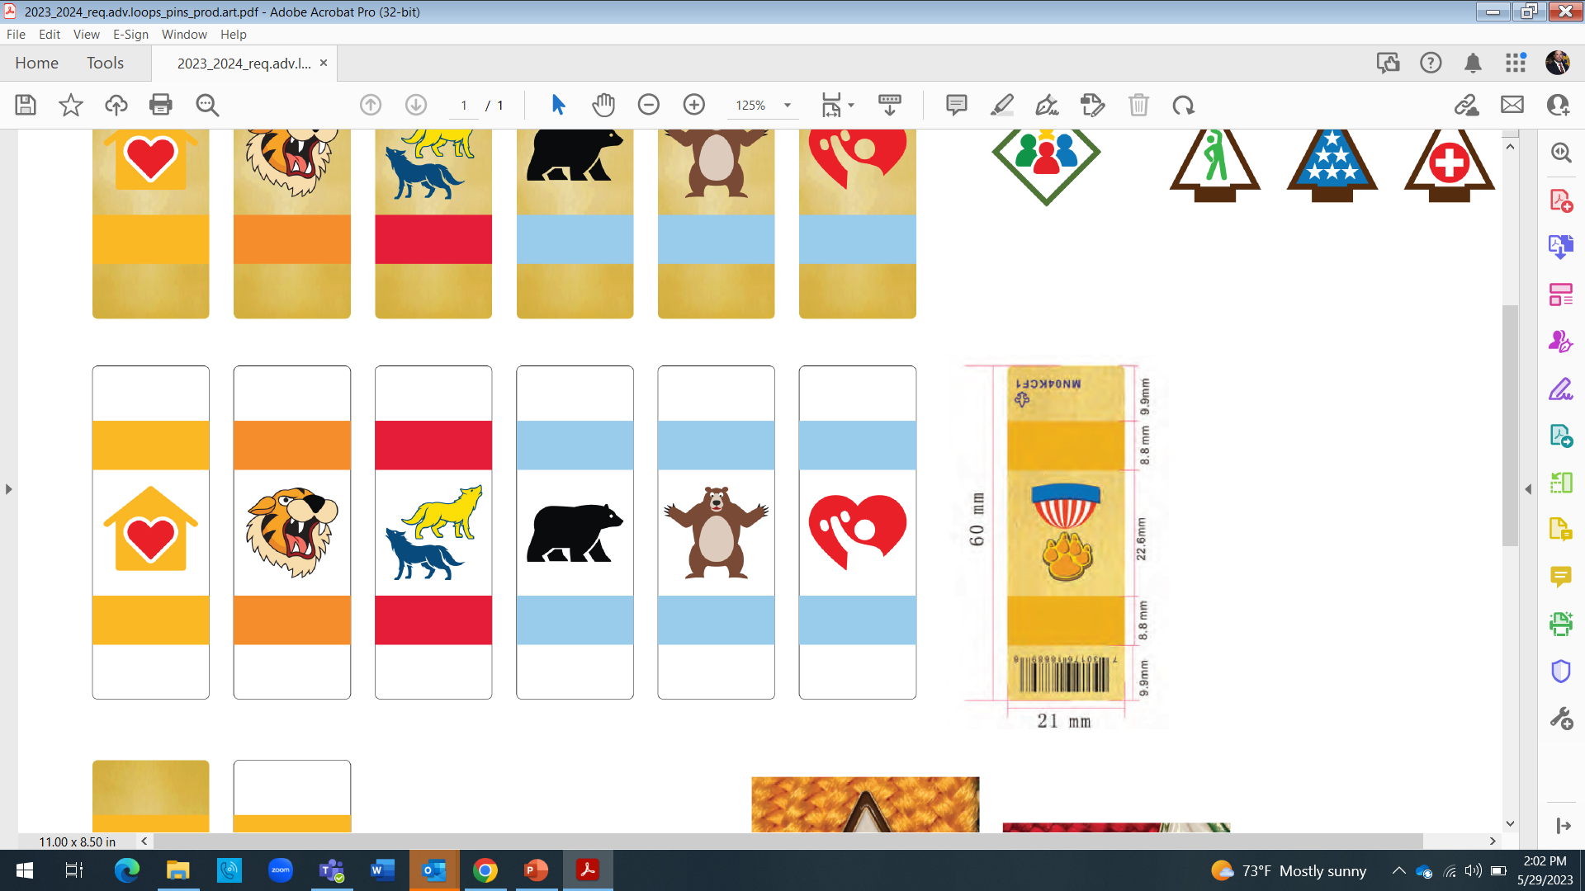
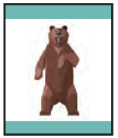







2024-2025
Cub Scout Badges of Rank
6 Required Adventures per rank
2 Elective Adventures per rank
Requirements
LION
Kindergarten
TIGER
1st Grade
WOLF
2ND Grade
BEAR
3RD Grade
WEBELOS
4TH Grade
®
ARROW OF LIGHT
®
®
®
®
®
5TH Grade
BOBCAT
Character/Leadership
BOBCAT
Character/Leadership
BOBCAT
Character/Leadership
BOBCAT
Character/Leadership
BOBCAT
Character/Leadership
BOBCAT
Character/Leadership
MOUNTAIN LION
Outdoors
TIGERS IN THE WILD
Outdoors
PAWS ON THE PATH
Outdoors
BEAR HABITAT
Outdoors
WEBELOS WALKABOUT
Outdoors
OUTDOOR ADVENTURER
Outdoors
FUN ON THE RUN
Personal Fitness
TIGER BITES
Personal Fitness
RUNNING WITH THE PACK Personal Fitness
BEAR STRONG Personal Fitness
STRONGER, FASTER, HIGHER
Personal Fitness
PERSONAL FITNESS
Personal Fitness
KING OF THE JUNGLE
Citizenship
TEAM TIGER
Citizenship
COUNCIL FIRE
Citizenship
PAWS FOR ACTION
Citizenship
MY COMMUNITY Citizenship
CITIZENSHIP
Citizenship
LION ROAR
Personal Safety
TIGER ROAR
Personal Safety
SAFETY IN NUMBERS
Personal Safety
STANDING TALL
Personal Safety
MY SAFETY
Safety/First Aid
FIRST AID
Safety/First Aid
LION’S PRIDE
Family/Reverence
TIGER CIRCLES
Family/Reverence
FOOTSTEPS
Family/Reverence
FELLOWSHIP
Family/Reverence
MY FAMILY
Family/Reverence
DUTY TO GOD
Family/Reverence
2 Elective Adventures
2 Elective Adventures
2 Elective Adventures
2 Elective Adventures
2 Elective Adventures
2 Elective Adventures
11/9/23
Notes:
For the 6 required Adventures, the BSA refocused them on key BSA aims and methods – Character & Leadership (Bobcat), Outdoors, Personal Fitness, Citizenship, Personal Safety, and Family & Reverence.
Leaders have a simpler format that includes common activities. Outdoors, for example, is based on Cubs getting outside and taking a walk. The walk for Lions is short and adapted to their ability level while for Webelos it involves taking a 2-mile walk with their den incorporating the buddy system. Plus, because each required adventure has similar requirements, it makes it easier to plan and execute activities for multi-rank dens in smaller packs or for units that want to conduct an activity at the pack level.

Slide 19



CUB SCOUT ELECTIVE ADVENTURES
Kindergarten
1st Grade
2nd Grade
3rd Grade
4th Grade
5th Grade
16 Electives
20 Electives
20 Electives
20 Electives
20 Electives
16 Electives
Build It Up, Knock It Down
Gizmos and Gadgets
I'll Do It Myself
On Your Mark
Pick My Path
Ready, Set, Grow
Count On Me
Everyday Tech
Go Fish
Let’s Camp
On a Roll
Race Time
Time to Swim
World Conservation
Archery
Slingshot
Curiosity, etc.
Floats and Boats
Good Knights
Rolling Tigers
Safe and Smart
Sky Is the Limit
Stories in Shapes
Tiger Tag
Tiger-iffic!
Designed by Tiger
Fish On
Let’s Camp
Race Time
Summertime Fun
Tech All Around
Tigers in the Water
World Conservation
Archery
BB Guns
Slingshot
Adventures in Coins
Air of the Wolf
Code of the Wolf
Cubs Who Care
Digging in the Past
Finding Your Way
Germs Alive!
Paws of Skill
Spirit of the Water
A Wolf Goes Fishing
Computing Wolves
Let’s Camp
Paws for Water
Pedal with the Pack
Race Time
Summertime Fun
World Conservation
Archery
BB Guns
Slingshot
A Bear Goes Fishing
Baloo the Builder
Critter Care
Forensics
Marble Madness
Roaring Laughter
Salmon Run
Super Science
Bears Afloat
Bears on Bikes
Balancing Bears
Let’s Camp
Race Time
Summertime Fun
Top Chef Tech
Whittling
World Conservation
Archery
BB Guns
Slingshot
Aquanaut
Art Explosion
Aware and Care
Build It
Earth Rocks!
Catch the Big One
Let’s Camp
Math on the Trail
Modular Design
Paddle Onward
Pedal Away
Race Time
Chef’s Knife
Summertime Fun
Tech on the Trail
World Conservation
Yoyo
Archery
BB Guns
Slingshot
Engineer
Into the Wild
Into the Woods
Cycling
Estimations
Fishing
High Tech Outdoors
Knife Safety
Paddle Craft
Race Time
Summertime Fun
Swimming
World Conservation
Archery
BB Guns
Slingshot
Notes:
Elective Adventures
There are more elective Adventures available at each rank.
Since the Lions and Arrow of Light are 9-month programs, they will each have 16 elective Adventures.
Tigers, Wolf, Bears, and Webelos, being 12-month programs, will each have 20 elective Adventures.
Elective Adventures feature activities like fishing, cycling, and aquatics – things that youth of that age like to do. Electives also include traditional Cub events like Pinewood Derby or Rain Gutter Regatta.
All adventures were updated in some way. The light-colored ones are existing adventures that were reimagined. The dark colored ones are new. Range and Target Shooting adventures, at the bottom, can only be done as District or Council-level events with appropriate, trained supervision.

Slide 20


Webelos and Arrow of Light are separate ranks
Changes to AOL were in collaboration with the National Scouts BSA Committee
The Arrow of Light rank is designed to prepare for Scouts BSA
Scouts BSA units need to “be prepared” for earlier Cub contacts.
Arrow of Light
to
Scouts BSA
Notes:
Webelos will be a one-year program for 4th graders in 2024-2025 and will continue to function like any other Cub Scout Den, and will continue to wear the blue Cub uniform.
5th graders will be in the new Arrow of Light program and wear the tan Scouts BSA uniform as preparation for crossing over. When creating the new program, the development group worked with the National Scouts BSA Committee to include requirements designed to prepare the Scouts to join a Troop.
Like the other ranks, Bobcat is the first required AOL adventure. One Bobcat requirement is to visit a Scouts BSA troop with your patrol or parent/legal guardian. That means that many AOL dens may be looking to visit a Troop in August or September rather than late Fall or Winter. Scouts BSA leaders need to be prepared that Cub contacts will come earlier than in the past.

Slide 21

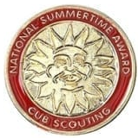

Reimagined Awards
OLD NAME | Sunset |  | NEW NAME
Outdoor Activity Award |  |  | Let’s Camp
World Conservation Award |  |  | Champions for Nature
Summertime Pack Award |  |  | Summertime Fun
Whittling Chip |  |  | Whittling
Notes:
Awards
Awards were either designed to introduce a topic that is not already an Adventure to Cub Scouts or to get Cub Scouts to do something that they normally wouldn’t do. They are not designed to be exclusive and only accessible to a few.
So, the Cub Scouts awards have been reimagined into Cub Scout elective Adventures. By putting the awards up front with the other electives, they are both more noticeable to Scouts, parent, and leaders, and rise to the same level of importance as the other elective Adventures.

Slide 22
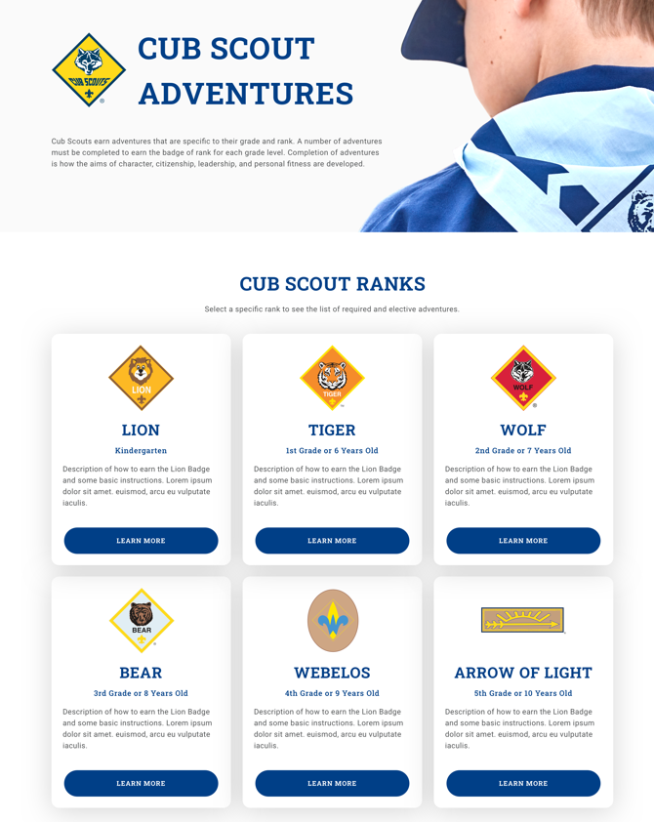
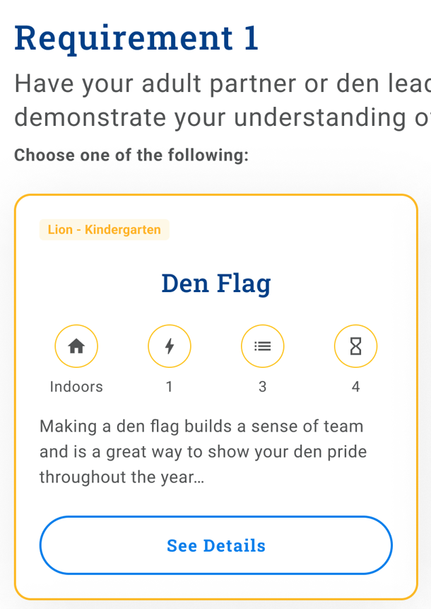
Reimagined Leader Resources
Online Leader “pages” – Desktop, mobile or printable
Cards tell leaders at a glance about level of effort, supplies, etc.
Activity card makes planning easier
Giving a card to another adult makes delegation easier too
Simpler Delivery Leads to Positive Leader Experience!
Notes:
Now that we have talked about the changes to the advancement program and awards, let’s take a look at how we are supporting our leaders going forward.
Along with new handbooks for every Cub, there are updated (digital) resources for Cub leaders. Each Cub rank has its own landing page where leaders can access simple and easy-to-follow guides. Each adventure will also have its own landing page, making it easy to bookmark. On the Adventure page there will be a snapshot describing the Adventure, safety items and the requirements. The page also will have links to one, two or three activity cards. The one pictured here is for Lions making a den flag. The cards suggest activities a den leader could use to complete the adventure. Den leaders can use activities of their own design to complete the requirement. But the card provides a “quick-start” for a den leader who is pressed for time.
Each card provides leaders insights on the level of effort involved in executing the activity. The scale is one to five with one being minimal effort and five being a lot of effort.
Location – indoor our outside
Energy Level – ranges from sitting quietly to a major calorie-burn
Supplies – level one involves materials available in most homes while five might involve multiple trips to Home Depot
Prep Time ranges from just a few minutes to a major time commitment
The cards also make it easier for a busy den leader to enlist the help of another parent. Cards are designed so that an adult doesn’t need a lot of training or experience to deliver the activity. That promotes getting other parents engaged while lightening the den leader’s burden.

Slide 23
How will we get out the word to Cub leaders and others?
National #CubChatLive podcasts used to deliver 1 hour session on each topic, along with some Q&A sessions
Program Updates at scouting.org
University of Scouting Period #1
Unique Situations or Exceptions? – Do Your Best
Notes:
Communication of these changes will be key. 9 years ago there was a clear difference between the Packs that were informed, and those who hide under a rock.
Encourage leaders to watch the Friday Cub Chat Live sessions, and keep an eye on the Program Updates pages, to get the latest information.
Push for EVERY Pack to have at least 1 representative at the University of Scouting. The Cub Scout College will focus Period #1 on the CS Program Updates.
As we move through the roll-out, there will inevitably arise questions about specific situations. All of our Cubs are unique. So are their parents. No program could cover all of the myriad of situations they will present. So, when they arise, we recommend using the Cub Scout motto “Do Your Best.” If a Scout hits a growth spurt and the family wants to buy a tan uniform now, will a different colored shirt for a few months really matter in the long run? We need to implement the program as designed but be empathetic to parents and leaders as we do that.

Slide 24

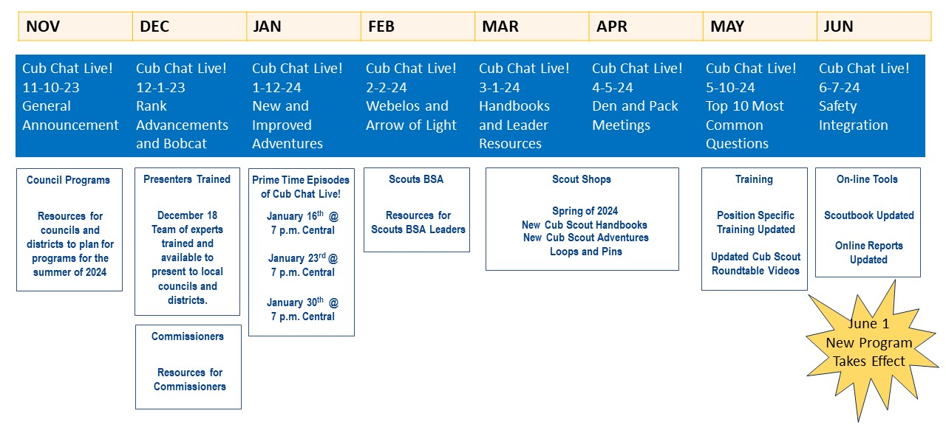
CUB SCOUT PROGRAM UPDATES ROLLOUT
Promote Cub Chat Live!
Notes:
Cub Chat Live is a podcast that talks about the Cub program on a regular basis. Leaders and parents that participate in the podcast can ask questions and get answers. Cub Chat Live has links from Aaron on Scouting as well as Facebook and Youtube.
The National Cub Program team is leveraging Cub Chat Live, which has a substantial following among Cub parents and leaders, to communicate the 2024-25 program updates. Promoting Cub Chat live is one way to get out the word about the program update. And for anyone that misses a Cub Chat Live presentation, one can catch up by watching earlier podcasts posted on Facebook or Youtube.

Slide 25

Program Announcement: https://bit.ly/CS_June2024_announce
Program FAQ: https://www.scouting.org/program-updates/cub-scout-program-updates-faq-11-16-23/
Cub Chat Live: https://bit.ly/CubChatLive
Notes:
These are a few of the resources that are available to council, district and unit leaders.
Scout Shops have access to contacts at National supply who can update them on when to expect deliveries of handbooks, belt loops and other impacted products.

Slide 26
Questions?
Contact:
Matt Burns, NCAC Advancement:
2024 Cub Program Update Questions
All changes go into effect on June 1, 2024

Slide 27
Time for Cracker Barrell
Minutes and slides available on the GMD web site (District Resources, Roundtable). Password is “GMDRT”
Next meeting – Feburary 8, 2024, at Thoreau MS

Slide 28
Backup Slides

Slide 29


Merit Badges
The online Merit Badge Counselor registration works for all Scouters who do not already hold another District position.
New Merit Badge Counselors must complete online merit badge counselor training, in addition to YPT. Be sure the counselor uses his/her legal name – no nicknames.
Merit Badge Counselors, or the unit Dean/Leader, also need to scan and send Margee the Merit Badge application form listing the badges the counselor is applying to teach and providing a justification of his/her qualifications.
Youth Protection Training is the essential first step. Don’t hit “send” on the application without it!
Contact Margee if you have questions at GM.MB.Dean@hotmail.com.
Did you know:
The National Council does not limit the number of merit badges a youth may earn from one counselor, though a unit leader is permitted to do so, as long as the same limit applies to all Scouts in the unit. Ideally, Scouts should work with a variety of adults. (GTA 7.0.0.3)
Partial Merit Badges have no expiration except the Scout’s 18th birthday. (GTA 7.0.3.3)
Due to the BSA policies related to Youth Protection and two-deep leadership, a merit badge counselor must have another adult present during all merit badge counseling sessions. However, the parent or legal guardian of the Scout may serve as the second adult. This parent or legal guardian does not have to be a registered leader.
If the requirements for a merit badge differ between the merit badge pamphlet and the current edition of Scouts BSA Requirements, the requirements in the Scouts BSA Requirements book supersede all others.

Slide 30
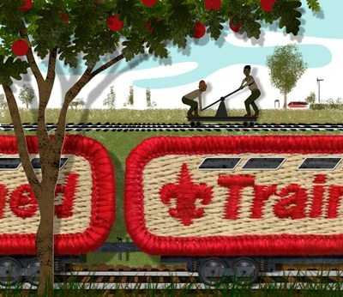
Training (https://www.ncacbsa.org/george-mason/training/)
Back Country Outdoor Leadership Skills (BCOLS)
03/23/24 & 04/27/24-04/28/24
10/05/24 & 11/02/24-11/03/24
Climbing Level 1 Instructor
April 20-21 at Great Falls Park, 7:30 AM to 5:00 PM. Logistics memo
April 27-28 at Carderock Rec Area, 8:00 AM to 5:00 PM. Logistics memo
June 15-16 at Great Falls Park, 7:30 AM to 5:00 PM. Logistics memo
Sept 7-8 at Great Falls Park, 7:30 AM to 5:00 PM. Logistics memo
Sept 21-22 at Sugarloaf Mountain, 8:15 AM to 5:00 PM. Logistics memo
Mental Health First Aid https://www.fairfaxcounty.gov/hscode/ereg/Registration.aspx?groupID=47
NYLT
24-1: 01/12/24 -01/15/24 & 01/27/24-01/28/24
24.2: 06/16/24-06/21/24
24.3: 06/23/24-06/28/24
24.4: 07/28/24-08/02/24
24.5: 07/28/24-08/02/24
Registration will open in the Fall and will be announced via email and on Facebook
Trainer’s Edge
09/10/24
12/07/24
Wilderness First Aid (N02) https://scoutingevent.com/082-WFASpring2024
01/27/24 0 01/28/24 – Camp Snyder
02/24/24 – 02/25/24 – Camp Snyder
03/23/24 – 03/24/24 – Camp Snyder
04/27/24 – 04/28/24 – Camp Snyder
Wood Badge (A90) https://www.ncacbsa.org/wood-badge/
04/12/24 – 04/14/24 & 05/04/24 – 05/05/24
10/14/24 – 10/15/24 & 10/05/24 – 10/06/24

Slide 31

GM High
Adventure
Members of the High Adventure Committee are available to assist units in planning and training for their upcoming high adventure trips – Contact Brian Heath for more information
Important notes for this month
  Registration dates for 2025 trips
    NORTHERN TIER & OPIK: Reservations open Jan 18, 2024
    SEA BASE: Reservations open Jan 18, 2024
    SUMMIT: Reservations open Jan 18, 2024
    Philmont: Lottery registration has closed, but treks are still available
  2024 National High Adventure Base Scholarships
    NORTHERN TIER: Submit by Jan 31st, 2024. Go here for the application.
    PHILMONT: Up to $400. Submit by Feb 1st, 2024. Go here for the application.
    SUMMIT: Submit by Mar 31st, 2024. Go here for the application.
    SEA BASE: The deadline has already passed
  Most BSA High Adventure bases still have availability for summer 2024 trips – See the URL below for more information
    https://www.scouting.org/outdooradventures/open4adventure/
NCAC-Organized High Adventure Trips - 2024
  Lenhok’sin – James River Canoeing Trek - July 7-13, 2024
    Crew of 6-12 - $475 per participant – 6 slots remaining
    Registration: https://scoutingevent.com/082-75664
    For more information, e-mail highadventure@ncacbsa.org
  Wind River Range, WY: 06/22 to 06/30/24
    Registration: https://scoutingevent.com/082-77027
    Booking up fast! - $1,430 per participant – 2 slots remaining
    Mandatory Practice/Training for Everyone
      HAC Philmont Training Sessions
  NCAC-sponsored trips for Philmont, Northern Tier & Sea Base are already full
Jan 2024
Notes:
Sea Base Trip on Jul 29-Aug 3, 2024 - FULL

Slide 32
GM High
Adventure
High Adventure Preparation Training - Open to all NCAC Scouts & adults that are participating in HA trips in the next few years
  Philmont 2024 Sessions: I – passed; II – 01/07/24; IIIa – 03/24/24; IIIb – 04/06/24
  Philmont Advisor Hikes: 8:00am, Sat 3/09 & Sun 3/17/24, 8:00am Catoctin Mt Park, Thurmont, MD
  Northern Tier: Sat, 04/06/24 (in-person); Sat, 04/20/24 (virtual)
  Sea Base Session: TBD
Other Training
  BCOLS: Maryland session, Spring 2024: 03/02/24 (classroom), 04/27 & 28 (overnight), https://scoutingevent.com/082-79025-191979
  Paddle Craft Safety Training Sessions (2024): May 18-19, June 1-2, August 24-25, September 7-8
Council Plans for More Big High Adventure Trips
  Backpacking in Wyoming – Summer of 2024
  Climbing Trip to Zion National Park – Planning Underway
  Looking for more ideas and volunteers to plan the trips
National High Adventure Base Quick Links
  Philmont: https://www.philmontscoutranch.org/register/
  Northern Tier: https://www.ntier.org/provisional-scout-connections/
  Sea Base: https://www.bsaseabase.org/scouts/scout-connections/
  Summit: https://www.summitbsa.org/registration/scoutconnections/
Other High Adventure Bases
  Adirondack High Adventure Area: https://public.3.basecamp.com/p/hLgsVbk7Suju6cuDzQQJaEn4
  Maine High Adventure Area: https://www.mainehighadventure.org/
  Montana Outdoor High Adventure Base: https://montanabsa.org/camps/high-adventure/
Other useful links for high adventure information and opportunities
  NCAC High Adventure website - https://www.ncacbsa.org/high-adventure/
  List of units with available slots in their upcoming high adventure trips - https://public.3.basecamp.com/p/xWpkdrKHKAA9pCzwmHMNdbWb
Jan 2024 (cont)

Slide 33
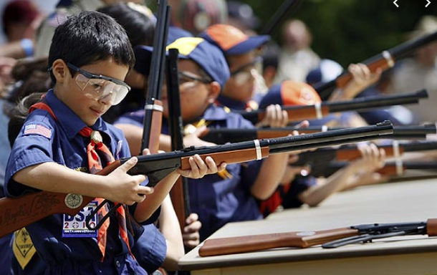
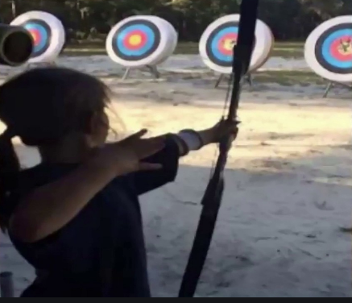
Shooting Sports
Requests for Shooting Events – Lead Time!
  50+ scouts - 6mos
  Less than 50 scouts - 3mos
Shooting on private land:
  Requirements
  Permissions/protocols
Shooting Sports web page
Shooting Sports Instructor Classes:
  Rifle/Shotgun - 02/24/24, 04/27/24, 07/20/24, 08/24/24
  Archery – 02/24/24, 03/18/24

Slide 34
Order of the Arrow
  Mary Neuse has accepted the Scoutmaster position at T1978G. Brian Fleck will be the new Chapter Advisor.
  2024 Dues can be paid online: https://wipit470.org/dues.html
  The Amangamek-Wipit Lodge will be sending a contingent to the one-and-only National Order of the Arrow Conference (NOAC) next summer and we want you to join us! Registration is now open! Follow the directions below to register for the one and only 2024 National Order of the Arrow Conference (NOAC) at the University of Colorado at Boulder. Here are the steps to register for this once-in-a-lifetime opportunity!
Step 1: Click the registration link here!
Step 2: Fill out all information for the registration form.
Step 3: Congrats! You have reserved your spot for the 2024 NOAC! Look out for other emails in regard to both national registration AND further payments you may need to make! Can’t wait to see you there!!
If you have any questions regarding the National Order of the Arrow Conference email noac2024@wipit470.org
  * Registrations open online https://wipit470.org/index.html under “Events”

