Slide 1
Better Together Family Café:
Building HOPE and Resilience Together
Notes:
Trainer Note: Introduce yourself and welcome participants to the café.

Slide 2
Let's get ready!
Rename yourself if your screen does NOT say your name.
Move the mouse over your picture until you see 3 little dots in the top right corner.
Click on the dots and then click on “Rename” and type your first and last name.
Please be actively engaged during our time together :
Participating in the chat box, discussing topics, contributing to the conversation.
1
4
Type the following information in the chat box:
First and last name
Tell us the name of the ECE Program your child attends
Please stay muted unless you have a question or comment.
2
5
If you get kicked off during the training due to a technology issue, please log back in using the same link in your confirmation email.
3
Please turn on your video at this time.
6
Notes:
Trainer Note: Omit this slide if you are hosting the cafe in person.

Slide 3
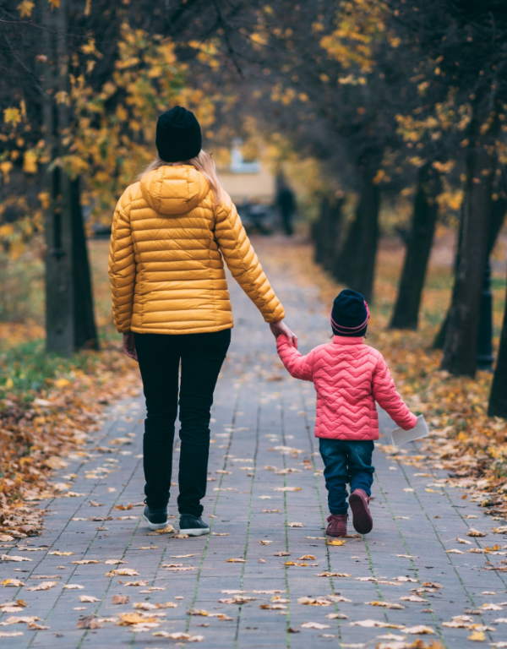
Welcome!
Share something you enjoy doing or wish you could do more of.
Notes:
Share something you enjoy doing or wish you could do more of. For example- an activity, tradition, a hobby. Or, something you wish you were able to do more of - baking, reading, walking, family nights, etc.
Trainer Note: Share your own response to start the conversation.
Thank you all for sharing! Now let’s find out a little more about what we’re going to be discussing.

Slide 4
Objectives
Understand the Four Building Blocks of HOPE (Healthy Outcomes from Positive Experiences).
Discuss the role that self-care and well-being plays in promoting the Building Blocks of HOPE.
Explore resiliency and growth that you and your family may have experienced in the recent past.
Notes:
Objectives for this Better Together Cafe:
Understand the Four Building Blocks of HOPE (Healthy Outcomes from Positive Experiences).
Discuss the role that self-care and well-being plays in promoting the Building Blocks of HOPE.
Explore resiliency and growth that you and your family may have experienced in the recent past.
We are going to start by learning more about the Building Blocks of HOPE.

Slide 5
The Four Building Blocks of HOPE
Sege and Browne. Responding to ACEs with HOPE: Health Outcomes from Positive Experiences. Academic Pediatrics 2017; 17:S79-S85
Notes:
Just as ACEs (Adverse Childhood Experiences) are organized into categories or domains, we see that PCEs (positive childhood experiences) can be organized into the Four Building Blocks. HOPE (Healthy Outcomes from Positive Experiences) centers around key Positive Childhood Experiences that buffer against the negative lifelong health effects caused by Adverse Childhood Experiences. These building blocks are essential for healthy development - even in the absence of ACES.
Research shows that positive experiences promote children’s long-term health and well-being. They allow children to form strong relationships and meaningful connections, cultivate positive self-image and self-worth, provide a sense of belonging, and build skills to cope with stress in healthy ways.
Now we will look deeper into each of the Four Building Blocks: Relationships, Environment, Engagement, and Emotional Growth
Background Information:
Information about HOPE & the Mission- Spreading-HOPE_FINAL_2.2.2021.pdf (positiveexperience.org)

Slide 6
The Four Building Blocks of HOPE: Relationships
Sege and Browne. Responding to ACEs with HOPE: Health Outcomes from Positive Experiences. Academic Pediatrics 2017; 17:S79-S85
Notes:
Being in nurturing, supportive relationships are critical for children to develop into healthy, resilient adults.
Having key foundational relationships: parents/caregivers who respond to a child’s needs and have warm, responsive interactions.
Having adults outside of the family that take a genuine interest in a child and support their growth and development.
Having healthy, close, and positive relationships with peers.
Let’s reflect on how we can create positive relationships for our family.

Slide 7
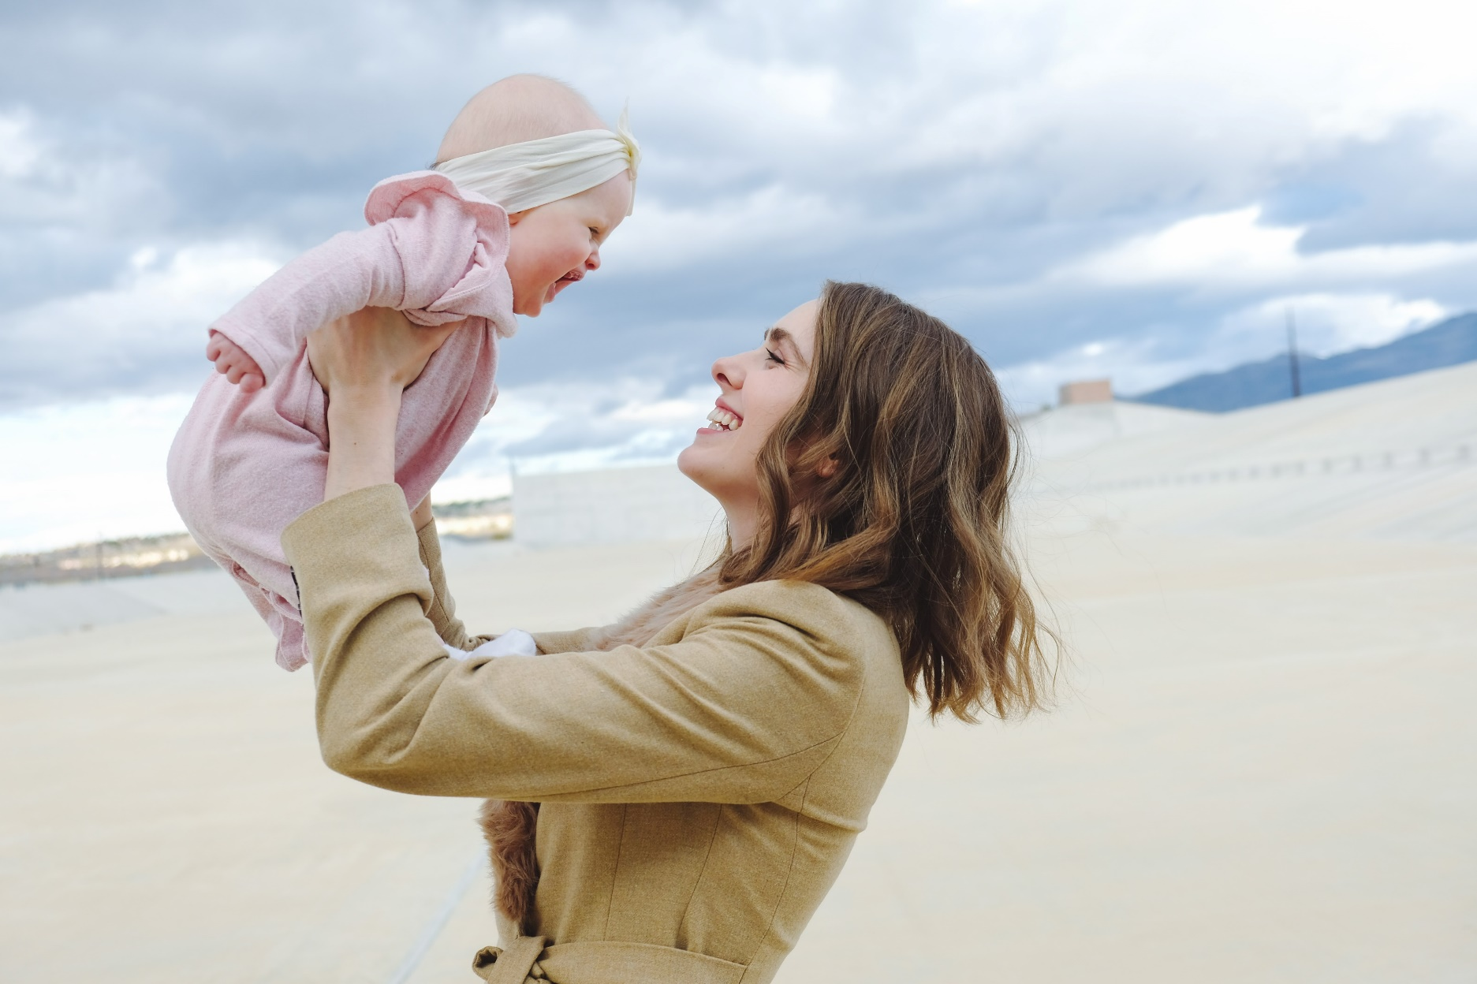
Photo by Wesley Tingey on Unsplash
Notes:
Trainer Note: Only read the suggested script that is most applicable for your training need. If it’s a blended session with both providers and families, just read the parent/family section.
For child care providers: Individuals that recall having these types of relationships during childhood experience significantly lower rates of depression and poor mental and physical health during adulthood. When working with families, especially vulnerable families affected by trauma, it is important to ask about the types of positive relationships a parent may recall from their childhood. This information can then be celebrated and used to help create opportunities for their children to experience the types of relationships encompassed by this Building Block of HOPE.
For parents/families: Individuals that recall having these types of relationships during childhood experience significantly lower rates of depression and poor mental and physical health during adulthood. We encourage you to think about these types of positive relationships from your own childhood. Reflecting on this yourself can then be used to help create opportunities for your own children to experience these types of relationships encompassed by this Building Block of HOPE.
Trainer Note: Ask for response- As you think about the positive relationships in your life - what characteristics have they had?
Maybe the relationships have been trusting, nurturing, supporting, etc.
The next Building Block we will discuss is Environment.

Slide 8
The Four Building Blocks of HOPE: Environment
Sege and Browne. Responding to ACEs with HOPE: Health Outcomes from Positive Experiences. Academic Pediatrics 2017; 17:S79-S85
Notes:
Children who live, learn, and play in safe and stable environments are less likely to experience poor mental and physical health as adults. A safe, stable environment is:
Secure in meeting a child’s basic needs, including adequate food, shelter, and healthcare.
A school or home where children feel emotionally safe
A nurturing home where a child is emotionally secure.
A stable school environment where children feel valued and receive high-quality education.
A community environment to play and interact with other children safely.
Let’s see how our environment can create positive experiences.

Slide 9
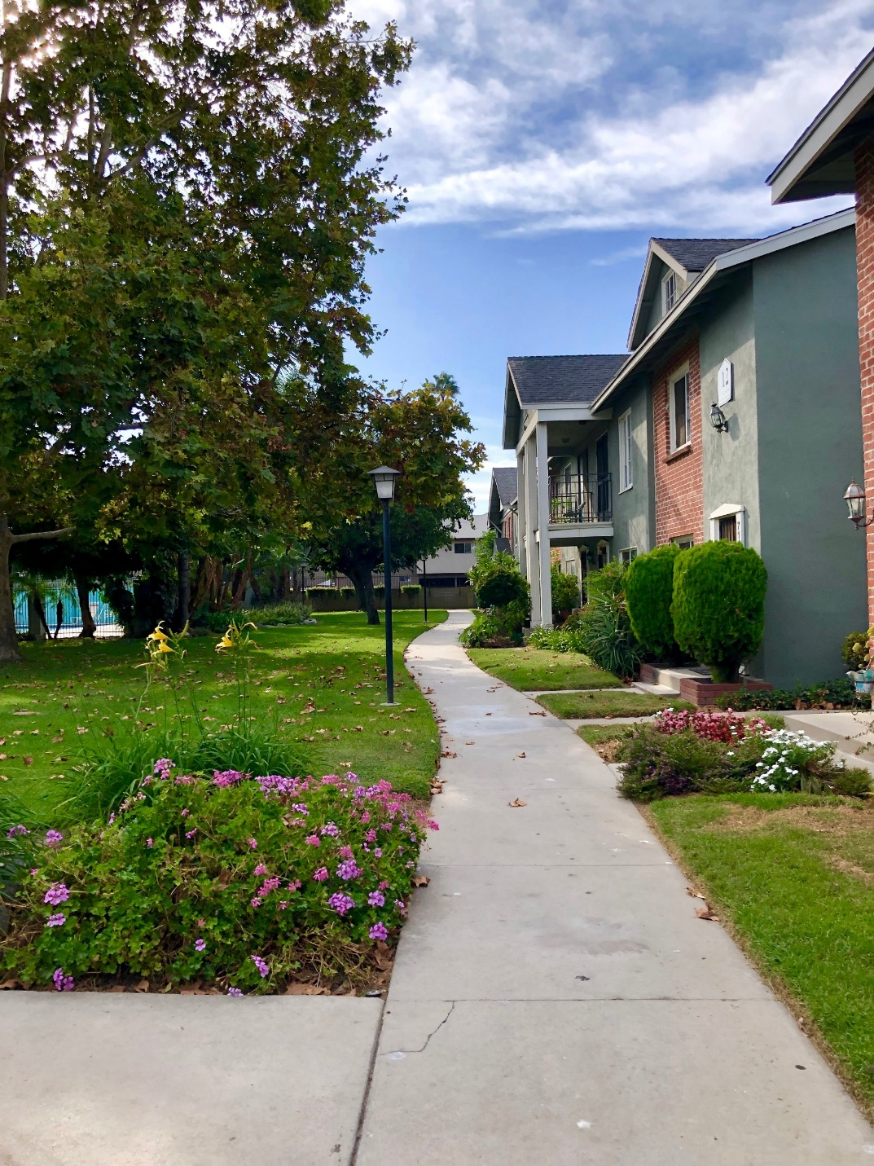
Photo by Shona Corsten on Unsplash
Notes:
Trainer Note: Only read the suggested script that is most applicable for your training need. If it’s a blended session with both providers and families, just read the parent/family section.
For providers: It is crucial to ask caregivers about the types of environments their children are experiencing. Celebrate the positive and work with families to help ensure their child has the opportunity to live, learn and play in safe and nurturing environments.
For parents/families: It’s important to think about the type of environment your children are experiencing. Celebrate the positive and work to ensure your child has the opportunity to live, learn, and play in safe and nurturing environments.
Think about your child's environment - what positive things does your child experience in their environments?
Do they have friends in their neighborhood they like to play with? Do you have a garden where they can enjoy learning outside?
We will now move on to discuss the Engagement Building Block.

Slide 10
The Four Building Blocks of HOPE: Engagement
Sege and Browne. Responding to ACEs with HOPE: Health Outcomes from Positive Experiences. Academic Pediatrics 2017; 17:S79-S85
Notes:
Children need opportunities for social engagement and to develop a sense of connectedness. Developing a connection to and sense of belonging in a community, as well as a sense that you matter to your community, describes the essence of the third of the Four Building Blocks of HOPE. This can include:
Being involved in projects, peer-mentoring, or community service through one’s school or religious organization.
Partaking in family cultural traditions.
Participating in organized music, art, or sports.
Now, we will reflect on how communities help support positive experiences.

Slide 11
Photo by tribesh kayastha on Unsplash
Notes:
Children need to feel connected to their communities, loved, and appreciated. Having this type of engagement (involvement in social institutions and environments, awareness of cultural customs and traditions, and a cultivated “sense of mattering” and belonging) helps children develop into secure and resilient adults.
Have any of you experienced positive benefits or had good experiences being part of a community group or friend group that you would be comfortable sharing?
Trainer Note: Add a personal story or experience here if participants don’t feel comfortable sharing.
Now let’s move on to discuss the last Building Block- Emotional Growth.

Slide 12
The Four Building Blocks of HOPE: Emotional Growth
Sege and Browne. Responding to ACEs with HOPE: Health Outcomes from Positive Experiences. Academic Pediatrics 2017; 17:S79-S85
Notes:
The final Building Block of HOPE Emotional Growth: through playing and interacting with peers for self-awareness and self-regulation. Children need opportunities for social and emotional development. Social-Emotional development is when children are:
Developing a sense of emotional and behavioral self-regulation
Having the ability to respond to challenges in a productive manner
Developing key socially and culturally appropriate communication and interpersonal skills
Children need to have ample opportunity to develop their sense of social and self-awareness, learn how to self-regulate emotions and behaviors, and acquire skills needed to respond functionally and productively to challenges.
Trainer Note: (emphasize this point) Many of these skills arise during child-centered play. Some children will naturally pick up these skills, others may need adults to help them name and understand their own feelings.
Examples of what play and social emotional development looks like-
Play pretend with baby dolls with your child. This helps develop empathy as young as 18 months. Narrate what you’re doing by responding to the baby “crying” and name their feelings. “Oh, the baby must be sad”. Then give the doll to your child and encourage them to do the same.
Practice taking turns. Grab a race car, and give a car to the child. Use cues such as “my turn, your turn, you’re being very patient while you are waiting for your turn”. You can even practice this skill with an infant by playing games such as peek a boo and cooing back and forth.
Playing dress up and imitating housework activities to help them develop a sense of independence.
Whether a child needs help developing these skills, or they naturally pick up on them, these skills are critical for children to be able to become resilient, emotionally healthy adults.

Slide 13
Why HOPE?
Positive experiences can alleviate toxic stress and help children grow into more resilient, healthier adults.
HOPE aims to evolve our understanding and support
of these key experiences.
Notes:
Positive experiences can alleviate toxic stress and help children grow into more resilient, healthier adults. By promoting The HOPE Building Blocks, we aim to support resiliency for our families.
We will now move into our partner activity.

Slide 14
Partner Activity
Think about a time in your life when things were going really well.
What made that so?
Notes:
Ten minute activity: Four minutes in groups or breakout rooms, six minutes to debrief upon return
Trainer Note:
Pose question to participants: Think about a time in your life when things were going really well. What made it so?
Send participants to groups or breakout rooms in groups of two-three. Allow four minutes total, approximately two minutes for each partner to share.
Debrief: We invite anyone to share your own thoughts or share something from your partner, whatever you are most comfortable with.
Trainer note:
If no one speaks up during debrief, trainer can share experience first.
Relate experiences that are being shared back to the Building Blocks (Relationships, Environment, Engagement, Emotional Growth) when everyone is done sharing. For example: I'm hearing a lot of ways these experiences are connecting to things like relationships, how your environment played a part or being connected with others or communities. Overall, when things are going well, it’s likely because we were actively involved in service, relationships, environment, emotionally strong, etc.

Slide 15
Self-Care
The practice of taking an active role in protecting one's own well-being and happiness, particularly during periods of stress.
Notes:
As we learn to love and take care of our own well-being, we are better able to provide positive childhood experiences to support children. Some examples of possible outcomes from adult well-being include:
provide trusting, nurturing and supportive environments for our children and families
a physically and mentally healthy parent
a safe and stable home with adequate nutrition and sleep
finds joy in activities and in relationships with others (through the modeling of the adults)
behavioral, emotional and cognitive self-regulation- we are more in tuned with ourselves when we are paying attention to our own well-being.
Trainer note: Trainer use personal examples or stories to show connection of how self-care impacts your day to day life.
We’re going to talk together about how we each experience self-care.

Slide 16
Self-Care
How do you currently take care of yourself?
Notes:
Trainer Note: Pose question and ask for participants to share. If virtual, ask them to put their answer in the chat or unmute to share.
How do you currently take care of yourself?
Trainer Note:
Give personal response of how you experience Self-Care. Some ideas: gratitude journal, taking daily walks, relaxing baths, exercise, proper nutrition, etc.

Slide 17
"
“Talk to yourself like you would to someone you love.”
-Brene Brown
Notes:
“Talk to yourself like you would to someone you love.” -Brene Brown
Brene’s wisdom embodies the concept of self-care. We, as caregivers, do so much for others, oftentimes at the expense of our needs. We say positive things to others and lift others up, and we need to match that for ourselves. To be our best, we have to take care of ourselves too, and that includes lifting ourselves up. This is the best way to start with self-care. If starting a gratitude journal or taking daily walks is too much, try tomorrow morning to use the first few thoughts of your day by lifting yourself up.
When we invest in our own emotional health & well-being, we show up better able to care for our families and others. We are then able to help build resiliency for ourselves and our families.
Trainer note: Use personal examples or stories to show connection.

Slide 18
Building Parental Resilience
The ability of families to get through difficult and challenging circumstances, recover, and even grow from the experience.
National Alliance of Children’s Trust & Prevention Funds
Notes:
The ability of families to get through difficult and challenging circumstances, recover, and even grow from the experience We bounce back BETTER!
ALL families are confronted by challenges. However, when we practice self-care and complete wellness, we are providing an environment for ourselves and our families to better be able to build resilience and be prepared for the challenges that come in life.
Through practicing these things, we model self-compassion, healthy relationships, providing boundaries, positivity and many more things which are key to a healthy and resilient life.
Background information:
Parental Resilience definition is taken from Strengthening Families (National Alliance of Children’s Trust & Prevention Funds).

Slide 19
8 Dimensions of Wellness
Emotional
Physical
Environmental
Professional
Financial
Social
Intellectual
Spiritual
Notes:
Many of us may think of self-care as health or physical wellness. There are eight areas of wellness that focus on the complete and holistic (looking at the whole self) self-care of an individual to ensure a balance for their well-being in every aspect of their lives. (citation: samsha.gov)
We need to recognize that health is not just the absence of illness.
Trainer Note: If you have enough time, you can share the next two hidden slides in place of the information/examples below. In our experience, there has not been enough time to dive into each examples slide in descriptive detail. Please use trainer discretion.
We’re going to introduce you to four of the dimensions of wellness that most clearly align and support the Building Blocks of HOPE. We’ll also share a few examples from these four dimensions on how the well-being of adults can help to nurture and build resilient children.
Emotional Wellness:
Naming your emotions- it’s important to put a name to our emotions and what we are feeling, and it also helps children put names to emotions as well.
Journaling or drawing- this is a great way to process and understand our feelings and what is happening on our lives.
Social Wellness:
Family game nights- laughter in your family goes a long way!
Belong to groups or communities outside of work- maybe its church or play groups or other groups in our community. Maybe we offer service in places around our community.
Professional Wellness:
Using vacation/sick days- that’s why you have those days and need to take them!
Setting clear boundaries to create a balance in your life
Environmental Wellness:
Spending more time outdoors- the sunshine and air does wonders for our mental state, for our family and our children.
Monitoring technology time- being aware of your screen time
Which Building Blocks can these connect to and how does it support positive childhood experiences? We are supporting the Relationship & Emotional Growth Building Blocks when we focus on Emotional & Social wellness. We are supporting the Engagement and Environment Building Blocks when we focus on our Professional & Environmental wellness.
(We are strengthening all of the HOPE Building Blocks, in more ways than one!) When we work to support wellness in our lives, we model the things we are developing and in turn will impact the child in positive ways.
Sources:
Self-care: https://www.lexico.com/en/definition/self-care
What is Self-Care? (habitsforwellbeing.com)

Slide 20
Emotional
Naming your emotions
Helping children name their emotions
Journaling or drawing
Practicing self-compassion
Social
Family game nights
Cooking together as a family
Lunch or coffee with a friend
Belong to groups or communities outside of work
Sege and Browne. Responding to ACEs with HOPE: Health Outcomes from Positive Experiences. Academic Pediatrics 2017; 17:S79-S85
Notes:
These are examples of how you can practice emotional and social wellness:
Emotional Wellness:
Naming your emotions- it’s important to put a name to our emotions and what we are feeling, and it also helps children put names to emotions as well.
Helping children name their emotions
Journaling or drawing- this is a great way to process and understand our feelings and what is happening on our lives.
Practicing self-compassion- practicing the way you speak to yourselves and practicing self-care
Social Wellness:
Family game nights- laughter in your family goes a long way!
Cooking together as a family- It’s a great way to bond together as well as fueling your body with great nutrition.
Lunch or coffee with a friend
Belong to groups or communities outside of work- maybe its church or play groups or other groups in our community. Maybe we offer service in places around our community.
When we work to build our own emotional and social wellness, we model the things we are developing and in turn will impact the child in positive ways.
Which Building Blocks can this connect to and how does it support positive childhood experiences?
By working on these areas of wellness, we are supporting the Relationships, Engagement, and Emotional Growth Building Blocks.
Trainer should relate personal experiences to these areas of self-care:

Slide 21
Professional
Setting professional goals
Belonging to a professional organization
Make sure to take breaks
Using vacation/sick days
Setting clear boundaries
Environmental
Keeping space clean and tidy
Spending more time outdoors
Monitoring technology time
Recycling
Sege and Browne. Responding to ACEs with HOPE: Health Outcomes from Positive Experiences. Academic Pediatrics 2017; 17:S79-S85
Notes:
Professional Wellness:
Setting professional goals- do we push ourselves to grow and learn more?
Belonging to a professional organization
Make sure to take breaks
Using vacation/sick days- that’s why you have those days and need to take them!
Setting clear boundaries
Environmental wellness:
Keeping space clean and tidy- a cluttered space= a cluttered mind
Spending more time outdoors- the sunshine and air does wonders for our mental state, for our family and our children.
Monitoring technology time- being aware of your screen time
Recycling- giving back to our environment
Again, when we work to build our professional and environmental wellness, we model the things we are developing and in turn will impact the child in positive ways.
Which Building Blocks can this connect to and how does it support positive childhood experiences?
When thinking of working on our professional wellness, we are strengthening the Relationship Building Block. When we are working on our environmental wellness, we are strengthening the Environmental Building Block.

Slide 22
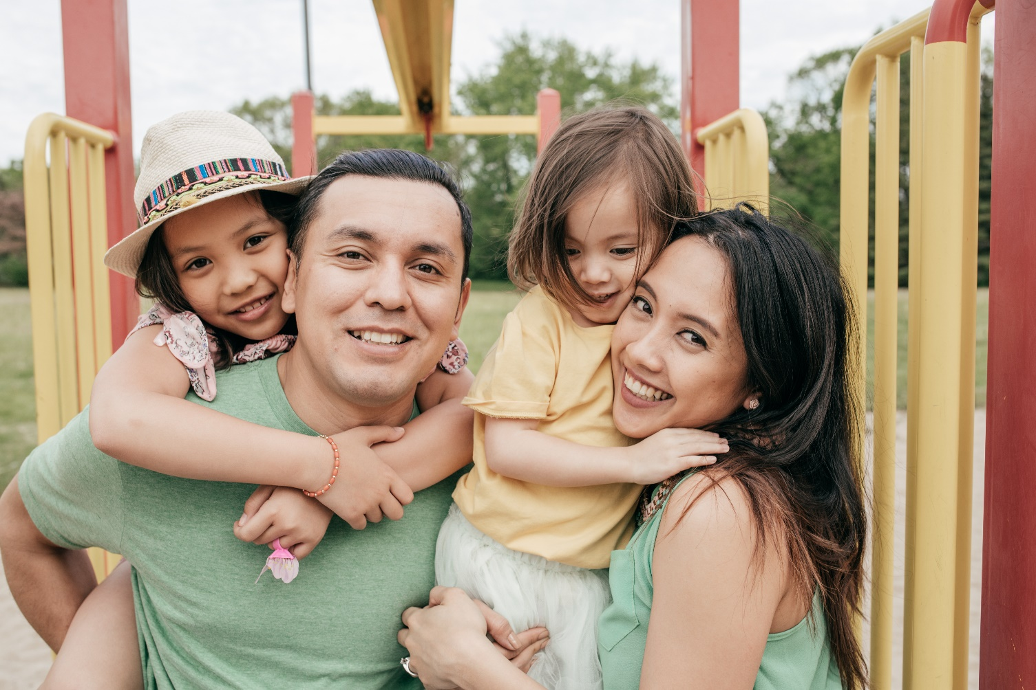
The ultimate goal
=
resilient families with resilient children
Notes:
The ultimate goal for all families is to build a resilient family to in turn build resilient children. By focusing on complete wellness, we are strengthening the foundation of the HOPE Building blocks, and we are helping to promote resiliency.
Now we will move into the heart of the cafe, our discussion questions.

Slide 23
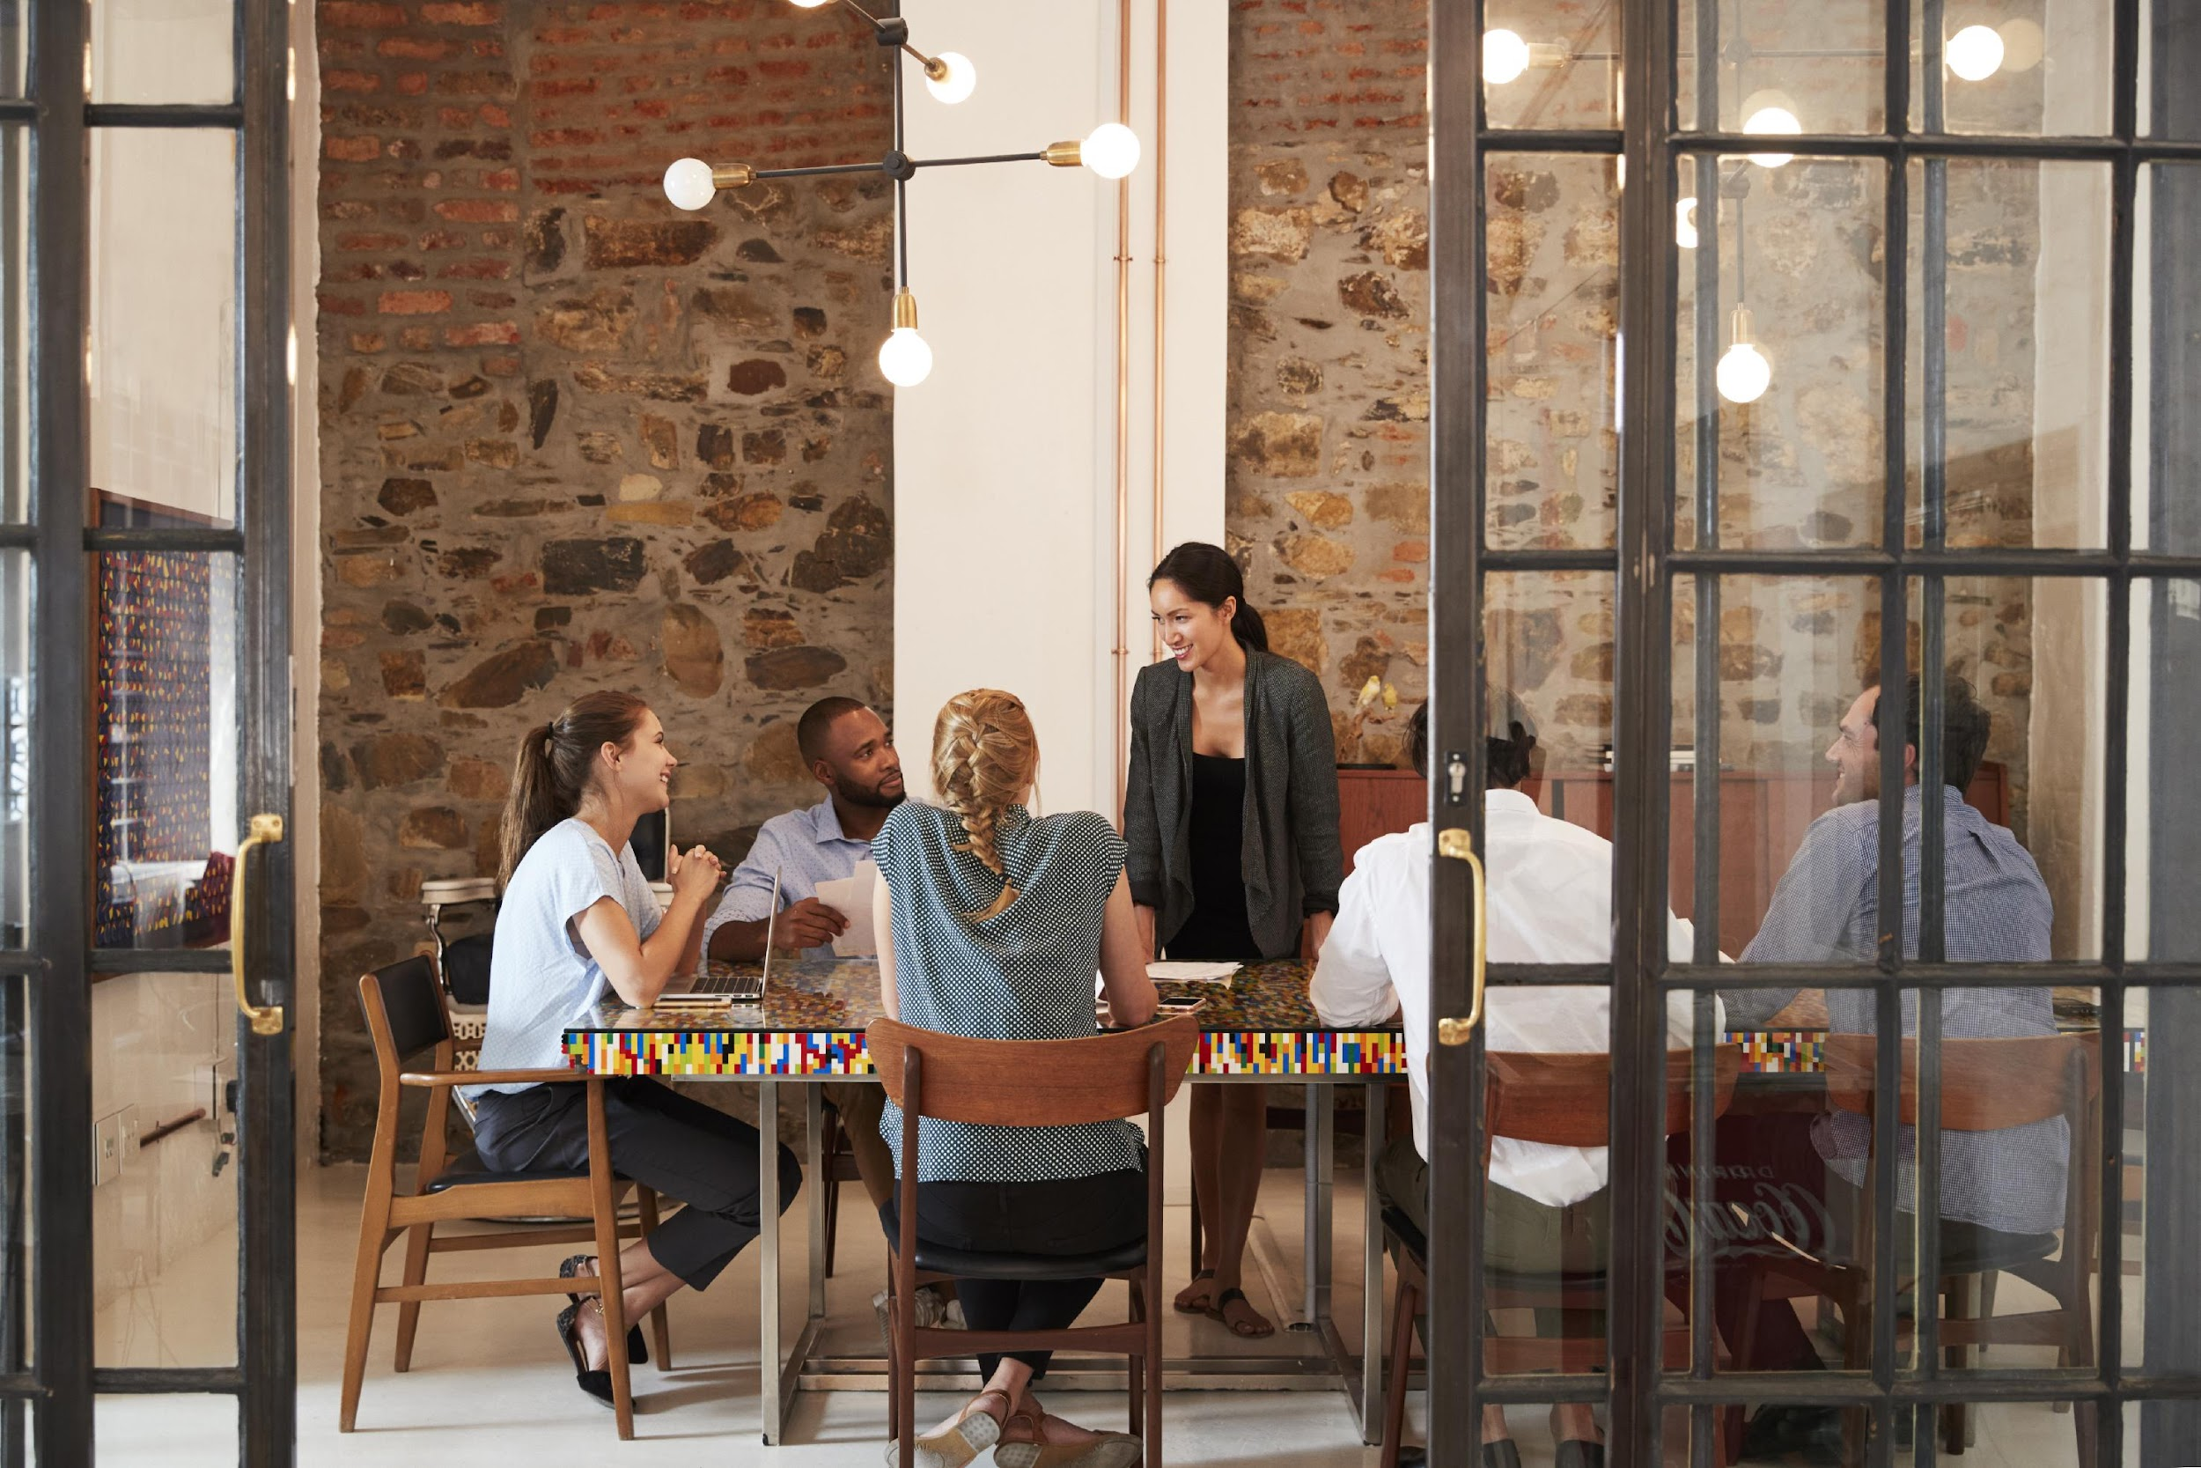
Creating an Emotionally Safe Environment
Active listening
Judgement free zone/safe place
Confidentiality
All responses welcome!
Notes:
Before we move into the discussion, we want to make sure we are setting a space for a positive environment and experience for all who are participating today. This will help set the stage for our conversations.
Active listening- truly listening to everyone sharing and being present
Judgement free zone/safe place- This is a judgement free zone in order to help create a safe place.
Confidentiality-What happens in the café, stays in the café!
All responses welcome! We encourage everyone to be open in sharing their thoughts and experiences. That's what makes a cafe so special!
Any questions? Alright, let’s dive into the Cafe questions.

Slide 24
Cafe Questions
Building HOPE and Resilience Together
Notes:
Trainer Note: Based on the number of participants, divide into groups of up to five people. Breakout rooms will be used for each of the cafe questions. Small group discussions should last for eight-ten minutes.
If the Cafe is in person, refer to the Better Together Family Cafe Toolkit for facilitation instructions.
At this time, give a brief explanation of how the cafe portion works to the participants.
Sample Script (This will vary based on several factors: in person/virtual, large group/small group, etc):
We are about to move into the cafe questions. During this time, you will have about eight minutes with your group to discuss the each question. This is an opportunity to connect and collaborate with each other. After each cafe question, we will come back together to debrief our discussion with the whole group.

Slide 25
Reflecting over the last couple of years, what is something that has changed for you as an individual or something that has changed for your family?
#1
Notes:
Trainer note: Let participants know that this can be a positive or a negative change.

Slide 26
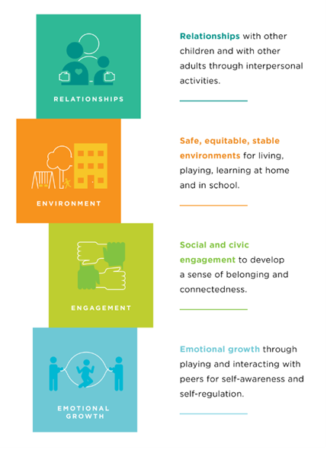
Thinking about the four Building Blocks of HOPE, which one(s) do you feel the strongest connection to as a family and why?
#2
Sege and Browne. Responding to ACEs with HOPE: Health Outcomes from Positive Experiences. Academic Pediatrics 2017; 17:S79-S85
Notes:
Trainer Note: Remind participants to refer to the HOPE Building Blocks handout.

Slide 27
Out of the dimensions of wellness discussed (Emotional, Professional, Social, Environment) was there one that you think you would want to grow or work on? What is one way you could do that?
#3

Slide 28
Reflection
How do you feel after listening to the responses from the other participants?
How did you feel sharing your own thoughts and experiences?
What is one thing you will take away from today?
Notes:
Trainer Note: It is important to ask each reflection question individually and allow wait time for responses.

Slide 29
Note to Self
Think of a small change you can make in order to strengthen a Building Block of HOPE to create a positive experience for your family.
Sege and Browne. Responding to ACEs with HOPE: Health Outcomes from Positive Experiences. Academic Pediatrics 2017; 17:S79-S85
Notes:
The purpose of the note to self is to leave you with an action plan in creating a positive experience for your family. We really encourage you to take the time to complete your Note to Self.
“Think of a small change you can make in order to strengthen a Building Block of HOPE to create a positive experience for your family.”
Trainer Note: Examples of opportunities- Engage child to help me make dinner-1x in the next two weeks. Eat together regularly at least 1x per week. Enjoy a family game night together at least 1x per month.

Slide 30
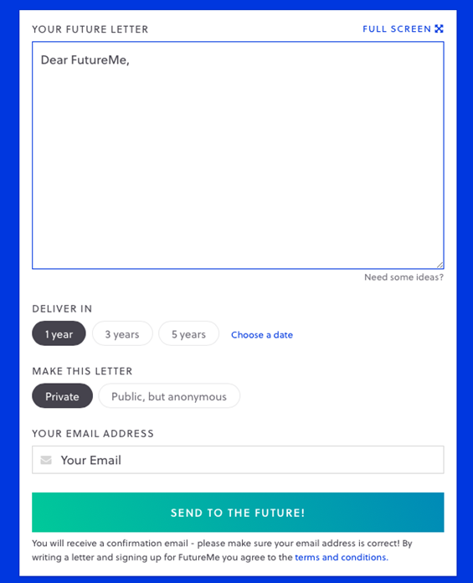
Futureme.org
Type response after reflecting on the
“Note to Self”
Click ‘Choose a Date”
Enter the date two weeks from today
Make this letter private
Type in your email address
Click “Send to the Future!”
Notes:
Trainer Note: Only use this slide if you are hosting the cafe virtually. If you are hosting in person, please refer to the Better Together Family Cafe Toolkit for more details.
Futureme.org is a website we suggest using for the Note to Self. Type in your response, click “Choose a Date” and enter the date two weeks from today. Keep the letter private. Type in your email address. Click “Send to the Future!” On your selected date, your note to self will arrive in your email to serve as a reminder of the positive experience you wanted to create for your family.
Background Information:
https://www.futureme.org is a website participants can use, especially virtually, to send the note to self. The link and information should be included in the follow up email if the cafe is done virtually.

Slide 31
Questions?
Notes:
Trainer Note: This slide can be used to discuss any questions, evaluations, next steps, etc.

Slide 32
THANK YOU!
Notes:
Type your notes

