Slide 1
Yvonne Kester
Semester Calendar Maintenance in Alma
December 16, 2021
www.suny.edu

Slide 2
Calendar Maintenance: A Quick Review
Roles needed to manage calendars
General System Administrator (allows editing of institution and libraries)
Fulfillment Administrator (library only)
In addition, Ex Libris can enable the following roles to edit calendar information for a library (contact Ex Libris support to enable this).
Circulation Desk Manager
Circulation Desk Operator
Circulation Desk Operator Limited
Requests Operator
www.suny.edu

Slide 3
Three Types of Hours in Alma
Standard opening hours – regular hours during terms; set in individual libraries’ configuration
Events – used to force the end of a loan period on a specific date, such as end of term; set in institution configuration
Exceptions – change the standard opening hours temporarily; set in either institution configuration or individual libraries’ configuration
Libraries inherit events and exceptions from the institution. However, libraries do not inherit institution opening hours; opening hours must be defined for each library.
www.suny.edu

Slide 4
Important to Remember
The below areas in Alma (among others) may be influenced by the open hours (depending on the policies configured):
Due dates
Fines calculations
Overdue blocks
Booking times
Overdue and Lost Loan Profiles
www.suny.edu

Slide 5
Editing at Institution Level
Adding the End of Semester Event
Only one End of Semester event may exist at a time
Event must be set on an Open day, and if you set a time, it must fall within Open Hours
www.suny.edu

Slide 6
Editing at Institution Level
Adding the End of Semester Event
www.suny.edu

Slide 7
Editing at Institution Level
Adding the End of Semester Event
www.suny.edu

Slide 8
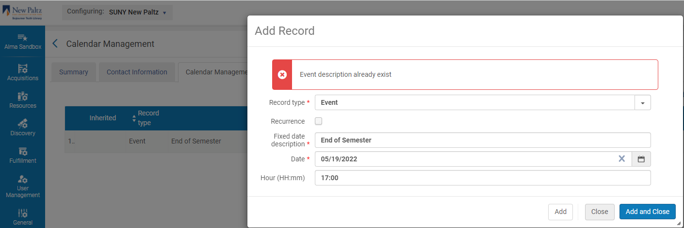
Editing at Institution Level
Adding the End of Semester Event
www.suny.edu

Slide 9
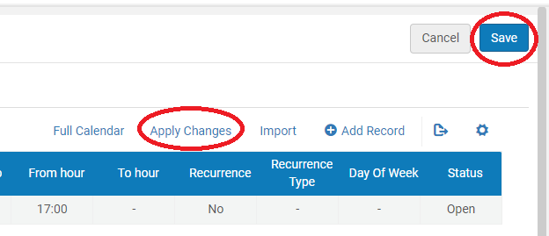
Editing at Institution Level
Adding the End of Semester Event
www.suny.edu

Slide 10
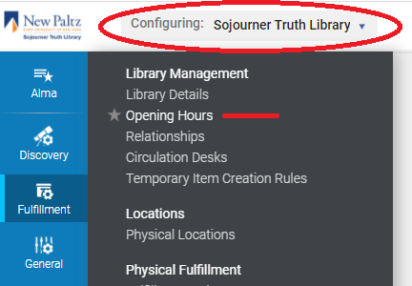
Editing at the Library Level
In Alma Configuration, at top left, change “Configuring” to the library you wish to edit
Click on Fulfillment, Opening Hours
www.suny.edu

Slide 11
Editing at the Library Level
Extending the Valid to date for Standard Opening Hours (SOHs)
Click on the ellipsis and choose Edit
Click Save
The Standard Opening Hours instance will move to the bottom of your SOHs and Exceptions (if you have any), and the Valid to date will now be three years in the future
www.suny.edu

Slide 12
Editing at the Library Level
Extending the Valid to date for Standard Opening Hours
www.suny.edu

Slide 13
Editing at the Library Level
Extending the Valid to date for Standard Opening Hours
www.suny.edu

Slide 14
Editing at the Library Level
Cleaning up old exceptions: optional but nice on the eyes
It makes things easier to have a clean slate, so go on through each old exception, click the ellipsis, and select Remove
www.suny.edu

Slide 15
Editing at the Library Level
Adding New Exceptions
If possible, have a calendar of your regular hours open for reference
Click Add Record at the top of the table
Change Record type to Exception
Status should be Closed (unless you are opening outside of SOHs)
Valid from date and Valid to date are the only other required fields
www.suny.edu

Slide 16
Editing at the Library Level
Adding New Exceptions
If you leave the From hour and To hour fields blank, the exception will cover the full 24 hour period of that date
Remember that these are exceptions to SOHs, which can be tricky to get your head around at first, so a couple of examples:
SOHs for Fridays are 8am to 7pm and you want to close at 5pm: your exception is the 2-hour time that you normally would be open
SOHs are Sundays 12pm to 12:30 am, and you want to close Sunday: you will have two exceptions. The first exception closes all day Sunday. Your second exception closes Monday from 00:00 to 00:30
www.suny.edu

Slide 17
Editing at the Library Level
Adding New Exceptions
If you are adding many exceptions at once, just click Add and the window will stay open, keeping all the information in the fields
When finished adding exceptions, click Add and Close
Click on Apply Changes
Click Save
www.suny.edu

Slide 18
Editing at the Library Level
Adding New Exceptions: Some Examples
SOHs Thursday are 8am to 12:30am Friday, and you are closing at 9pm Thursday
Add an exception with Valid from and Valid to date of December 16
The From hour will be 9pm, because that is where the exception to normal hours begins. The To hour will be 23:59
Click Add, then change the Valid to and Valid from date to December 17, and change the hours to 00:00 and 00:30
Click Add or Add and Close to save your changes
www.suny.edu

Slide 19
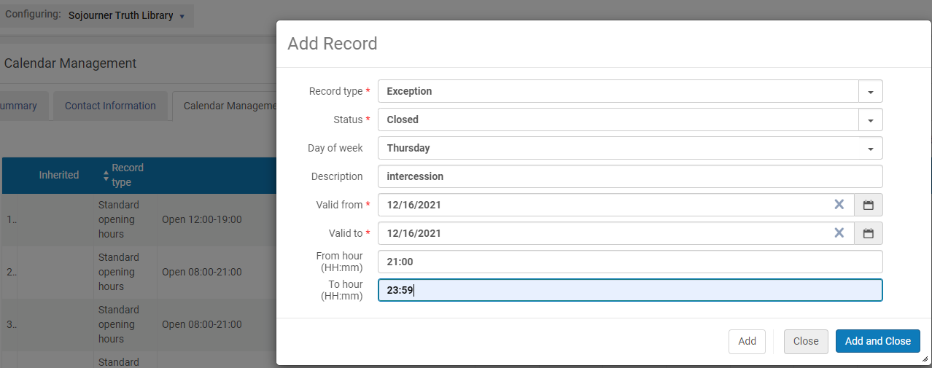
Editing at the Library Level
Adding New Exceptions: Some Examples
www.suny.edu

Slide 20
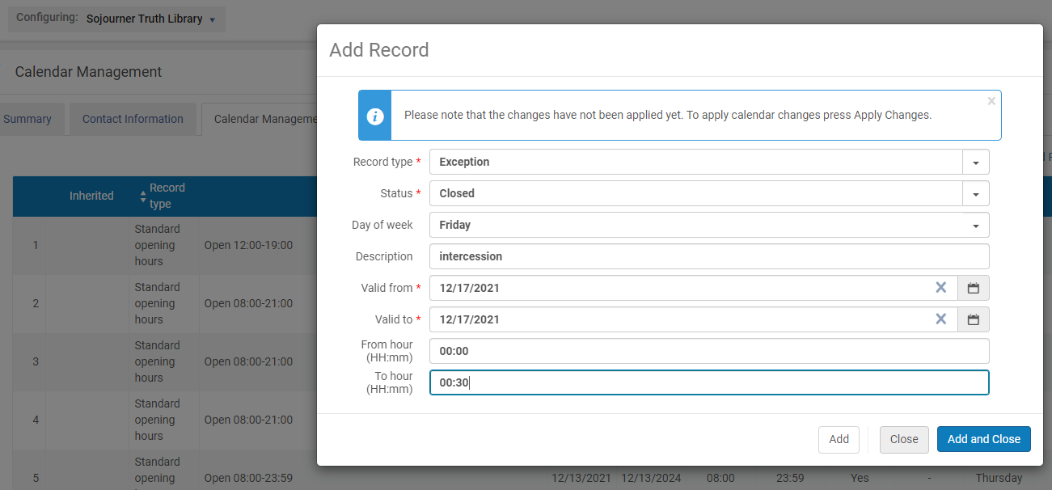
Editing at the Library Level
Adding New Exceptions: Some Examples
www.suny.edu

Slide 21
Editing at the Library Level
Adding New Exceptions: Some Examples
SOHs include Saturday and Sunday hours, and the library is closing for the weekend
Add Record, Exception, Closed. Leave Day of week blank
Valid from date is Saturday’s date
Valid to date is Sunday’s date
You can leave From hour and To hour blank, and it will do the same as if you put 00:00 and 23:59
Increase the span between dates to close for longer periods
www.suny.edu

Slide 22
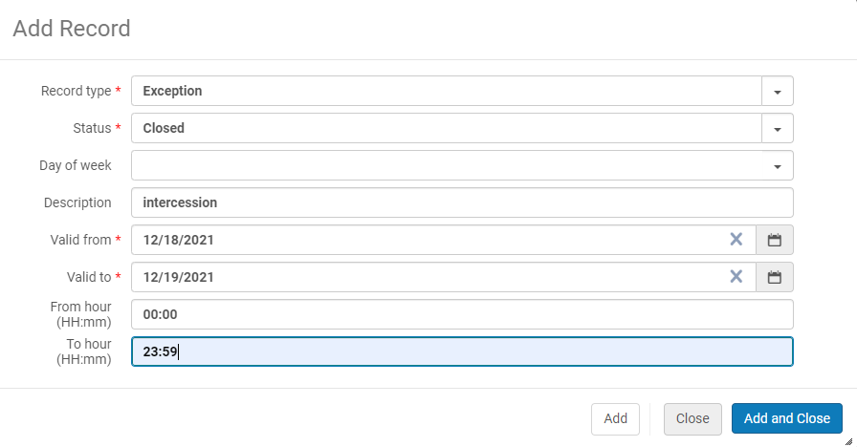
Editing at the Library Level
Adding New Exceptions: Some Examples
www.suny.edu

Slide 23
Editing at the Library Level
Adding New Exceptions: Some Examples
www.suny.edu

Slide 24
Editing at the Library Level
Adding New Exceptions: Some Examples
We have intercession hours spanning 4 days, Monday through Thursday, and every day is open 8am to 5pm
If your Monday to Thursday SOHs are all the same, your exception can span all four days
If Thursday’s SOHs are like the previous example, open until 12:30 Friday morning, you would make one exception spanning Monday through Wednesday, one exception for Thursday, and one exception for the first half hour of Friday.
www.suny.edu

Slide 25
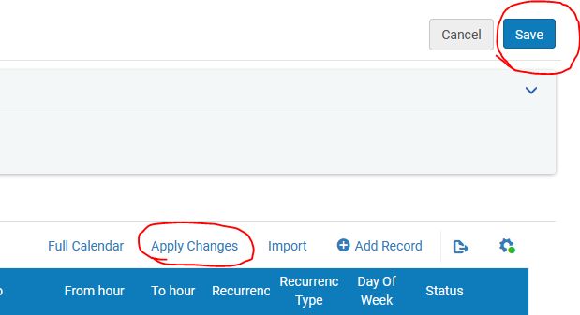
Don't forget to Apply Changes and Save
www.suny.edu

Slide 26
Helpful Links
ExLibris Knowledge Article: How do you extend a library's Standard Opening Hours to the future?
ExLibris Documentation: Configuring Institution/Library Open Hours
SUNY SLS FAQ: How Do I Perform Semester Calendar Maintenance in Alma?
Yvonne Kester yvonne.kester@suny.edu
www.suny.edu

